Slide 1
Asymmetric Catalysis for Fine Chemicals Synthesis
Monday, 8h15 – 10h00, GR A3 30
http://moodle.epfl.ch/
https://www.epfl.ch/labs/lcso/Teaching/
https://epfl.zoom.us/j/83387556644?pwd=Sy9JRCtlSFdGNzc1YTRnc0kwcFVuUT09
https://mediaspace.epfl.ch/channel/CH-435+Catalytic+asymmetric+reactions+in+organic+chemistry/29624
Prof. Jérôme Waser
Laboratory of Catalysis and Organic Synthesis
BCH 4306 - jerome.waser@epfl.ch

Slide 2
Organic Chemistry at EPFL
Bachelor
Chimie générale avancée I et II (Jerome Waser)
Principles, acids and bases, green chemistry, structures, addition, elimination and substitution reactions
Introduction Lab (2 days)
BA1-2
OBL
Fonctions/Réactions Organiques I (Jieping Zhu)
Thermodynamic, Kinetics, Carbonyls, Rearrangements
OC Lab I (7 days)
Organic Fonction/Reactions II (Nicolai Cramer)
Aromatic Compounds, Heterocycles, Cycloadditions
OC Lab II ( 7 days)
BA3
BA5
OBL CHEM
OBL CHEM/ING
Asymmetric Synthesis and Retrosynthesis
(Stefano Nicolai, Sandrine Gerber)
Stereoselective methods and synthesis of building blocks
Preparative Chemistry II
(Hu, Severin)
Advanced Synthesis Lab
BA6
BLO
BA6
BLO
Master
Physical/Computational
Org. Chemistry (C. Corminboeuf)
Mechanisms and Calculations
Structure and Reactivity
(Nicolai Cramer)
Rearrangement, cycloadditions, metals
Natural Product Synthesis
(Jieping Zhu)
Complex synthesis
BLO
BLO
BLO
Asymmetric Catalysis
(Jerome Waser)
Recent research, primary literature.
Research Projects (10, 28, 70 days), Catalysis Design for Synthesis, Chemistry of Small Biological Molecules, Pharmacological Chemistry, Supramolecular Chemistry, Organic Materials, Polymer Chemistry, Food Chemistry
OPT
OPT

Slide 3
Lecture Structure
Power point presentation
First hour: 10+5 min presentation of recent publication
Second hour: 10 min mechanism exercise
Content: principles for catalysis in organic chemistry, reactions and ligands introduced on the way
Classical examples and new developments
Bridging gap between classics and current research

Slide 4
Lecture Structure: The Presentation
Power point presentation by 2-3 students (10 min) Answering the exam questions on a recent publication:
  Which reaction?
  Reactivity analysis (nucleophile-electrophile)
  Principle of catalysis
  The complete catalytic cycle
  Specifics of the publication: scope, conditions, applications
  Critical analysis of novelty, practicability and sustainability
Questions are given by me to the class before presentation
Discussion in the class after presentation

Slide 5
Lecture Structure: Mechanism exercise
On the spot catalytic cycle analysis
Critical analysis

Slide 6
Exam and Grading
Grading system: 20% on presentation, 80% oral exam
Oral exam on a recent publication with 20 min reading time
Answering the same questions as asked for presentations

Slide 7
Didactic Goal: Learning to Deal with Information Overflow
Information
Me
Bachelor, 1. Master Lecture
Needed
Information
Me
Advanced Master Lecture
Needed
Information
Me
Real Life
Needed

Slide 8
Didactic Goal: Getting the Maximum from Oral Presentations
Information content on one slide very low
Learn to identify the key information
Nearly no text on the slides: learn to take notes!
Learn to summarize a topic

Slide 9
Scientific Goals
Key concepts in organic, coordination and stereo chemistry
Catalysis and Sustainability (9th Principle of Green Chemistry)¹
In direct contact with current research
Principles of catalysis (activation, whole catalytic cycle)
Principles of asymmetric induction
Reading and analyzing scientific primary literature
Important research groups in the World and Switzerland
(1) Anastas, P. T.; Eghbali, N. Green Chemistry: Principles and Practice. Chem. Soc. Rev. 2010, 39, 301.

Slide 10
Why care about asymmetric catalysis?
Pharmaceutical industry want to escape “flatland”^{1,2}
Enantiomers have different bioactivity
In 2020, 20 out of 35 new small molecule pharmaceuticals accepted by FDA were chiral³
Drug complexity is constantly increasing⁴
In theory, asymmetric catalysis is “the sustainable solution”: a small amount of chiral element leads to nearly enantiopure products
However, the impact of asymmetric catalysis in chemical production is still low compared to investment in research: why?
(1) Lovering, F.; Bikker, J.; Humblet, C. J. Med. Chem. 2009, 52, 6752. (2) Lovering, F. MedChemComm 2013, 4, 515. (3) Jarvis, L.M. Chem. Eng. News 2021, 99. (4) https://sites.arizona.edu/njardarson-lab/top200-posters/

Slide 11
NCCR Catalysis: Towards Sustainable Chemical Processes
UniBas
PSI
Empa
ETHZ
UZH
IBM
Transforming carbon dioxide into fuels and chemicals
ZHAW
UniBe
UniFr
HES-SO
13 institutions
50 principal investigators (PIs)
> 200 researchers
Computational design of new catalysts
EPFL
UniGe
From nature to drugs using catalysis and sun light
From nitrogen in the air to fertilizers directly on the field
Planetary (plant-to-planet) assesment of chemicals
https://nccr-catalysis.ch

Slide 12
Bibliography
Catalytic Asymmetric Synthesis; Ojima, I. ed.; Wiley-VCH, 2000. – A good book on the classical developments in the 90’s
New Frontiers in Asymmetric Catalysis; Mikami, K., Lautens, M., Eds.; Wiley: 2007. – Collection of reviews on specific reactions
Enantioselective Chemical Synthesis: Methods, Logic and Practice; Corey, E. J.; Kurti, L.; Direct Book Publishing, LLC, Harvard, 2010.
No really good overview book
Changing every week and exponentially
Primary literature is best source: each year the literature list is updated (for future eventual use, not meant to be read!)
Organic seminars at EPFL: https://www.epfl.ch/schools/sb/research/isic/news-events/organic_chemistry_seminars/

Slide 13
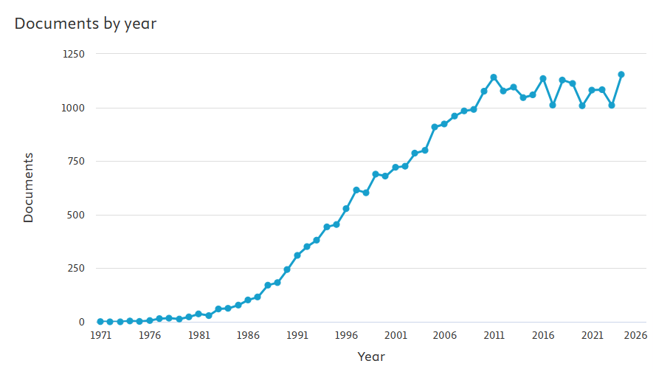
Bibliography: Statistics
Lecture start
Scopus search on 1.02.2025 for articles with «enantioselective» in title

Slide 14
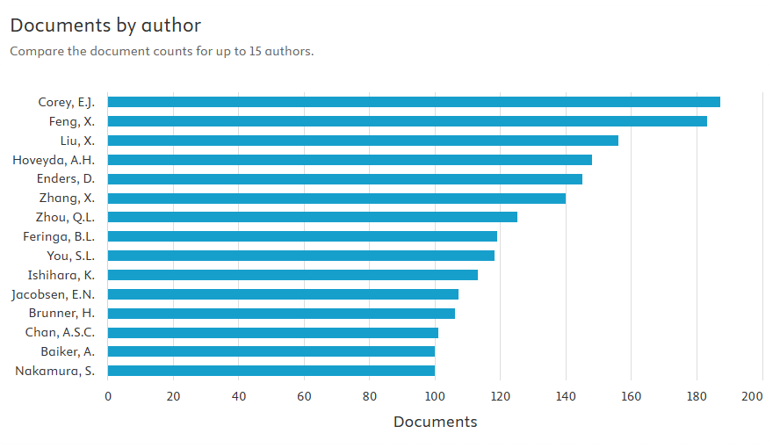
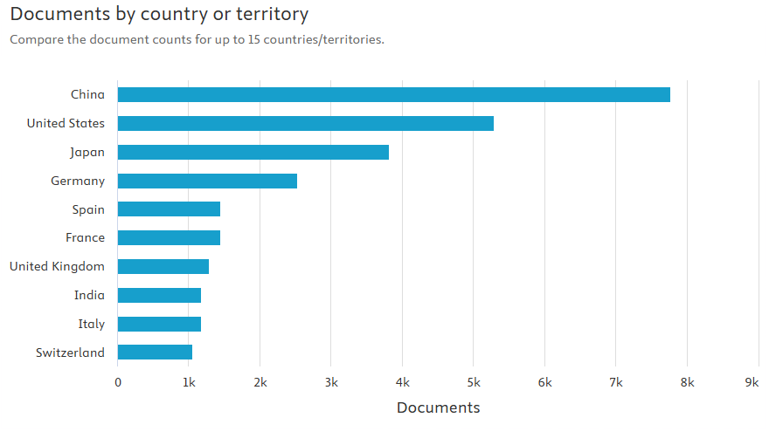
Bibliography: Statistics
In Switzerland:
Cramer (EPFL, 70)
Zhu (EPFL, 69)
Alexakis (Geneva, 68)
4. Carreira (ETHZ, 67)

Slide 15
Table of Content
1. Introduction
  - Vocabulary and concepts in asymmetric catalysis
  - Classification problem: ligands, metals, reactions or principles?
2. LUMO Activation
  2.1. Lewis and BrØnsted acids activation of carbonyl and imines
  2.2. Lewis and BrØnsted acids activation of extended π- systems of carbonyl and imines
  2.3. Catalysis via iminium formation
  2.4. Activation of electrophiles other than carbonyl/imines
  2.5. Activation of allylic systems
  2.6. Direct activation of C-C double bond
  2.7. Chiral acylation

Slide 16
Table of Content
3. HOMO Activation
  3.1 Chiral enolate generation
  3.2 Enamine catalysis
  3.3 Phase-transfer catalysis
  3.4 Chiral ylides generation
4. Dual Activation
  4.1 BrØnsted acid / base dual activation
  4.2 Enamine Acid dual activation
  4.3 Metal-ligand dual activation
  4.4 Dual activation on two metal centers
  4.5 Dual activation on a single metal center: activated systems
  4.6 Dual activation on a single metal center: non-activated systems

Slide 17
Table of Content
5. Umpolung of Reactivity
  5.1 Carbene and phosphite catalysis
  5.2 Somo activation
6. Conclusion

Slide 18
1. Introduction

Slide 19
Key Parameters for Catalysis
Catalysis is the acceleration of a chemical reaction by means of a substance called a catalyst, which is itself not consumed by the overall reaction.¹
Parameters for Efficiency in Catalysis
  Turnover number (TON): number of catalytic cycles (until deactivation)
  Turnover frequency (TOF): number of catalytic cycles in one time unit
  Catalyst Loading (usually in mol%)
Typical digits in academia: 5 mol% catalyst, TON = 20, TOF = 5/h
Desired in industry: < 0.01 mol% catalyst, TON = 10⁵-10⁶, TOF = 10⁵ !
(1) Definition from Wikipedia

Slide 20
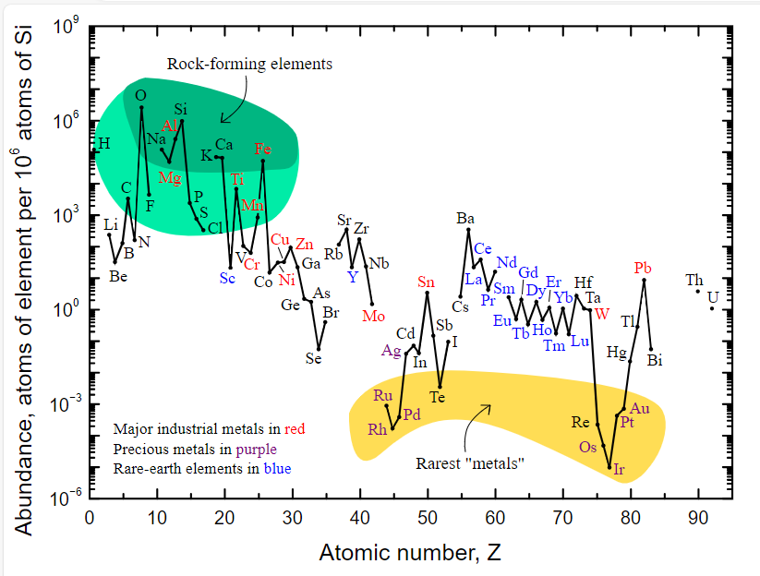
Which elements are abundant?
(1) Picture from Wikipedia

Slide 21
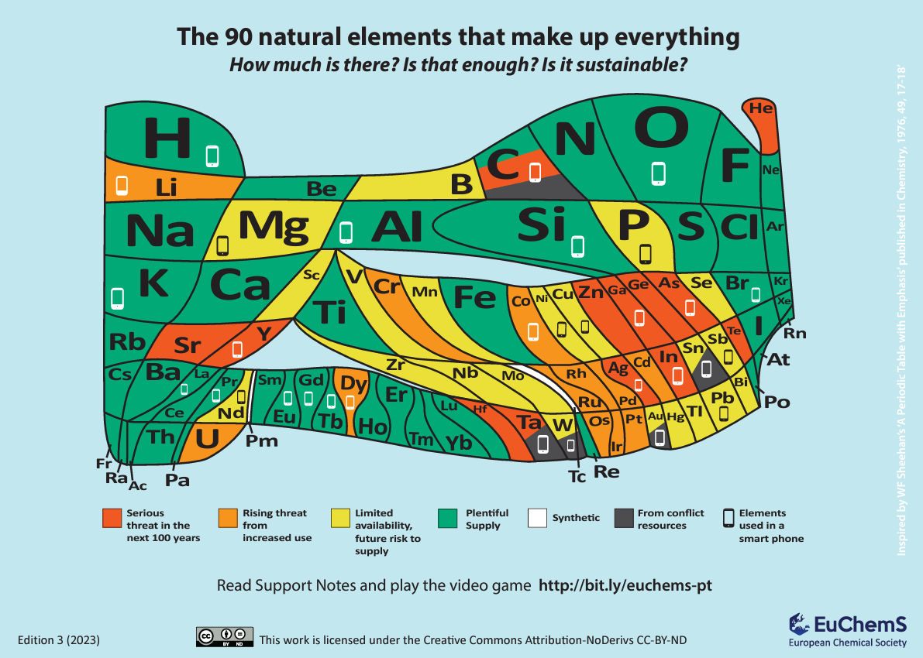
Which elements are sustainable?
(1) https://www.euchems.eu/euchems-periodic-table/

Slide 22
Key Parameters for Asymmetric Catalysis
In asymmetric catalysis, a chiral catalyst is able to induce chirality in the product.
  Special Parameters for Asymmetric Catalysis
  - Enantiomeric / Diastereomeric Ratio (er, dr)
  - Enantiomeric/ Diastereomeric Excess (ee, de)
  Difference in % between major and minor enantiomer/diastereomer
What is a good ee?
Dependent of reaction and physical state of product, often > 90%

Slide 23
Key Parameters for Asymmetric Catalysis
The Gold Standard for Asymmetric Catalysis in Industry
Ciba-Geigy Synthesis of (S)-Metolachlor

Slide 24
Key Parameters for Asymmetric Catalysis
The Gold Standard for Asymmetric Catalysis in Industry
Ciba-Geigy Synthesis of (S)-Metolachlor
Imine hydrogenation/reduction: good way to make chiral amine.
Hydrogenation=most atom economical reduction.
Herbicid, agrochemical: synthesis has to be cheap!
Exceptionally low loading: 0.1 ppm
Late metal catalysts for hydrogenation (Ru, Rh, Pd, Ir)
Moderate ee: often less important for industry
Chiral bisphosphine based on Ferrocene: exceptional ligands for catalysis (A. Togni, Ciba, ETHZ)
Be active, take notes! Now your script should look somewhat like that!

Slide 25
Modes of Asymmetric Induction
1. Creation of a New Chirality Element During Reaction
General Scheme
  Key Elements:
    Activation via catalyst (no background, direct reaction)
    Chirality of catalyst directs stereoselective bond formation
    Catalyst easily released by product: turnover possible

Slide 26
Modes of Asymmetric Induction
Example of Activation: Addition to Carbonyl
  Possible activation modes:
    Lowering LUMO: more electrophilic
    Hightening HOMO: more nucleophilic
    Dual activation: towards best selectivities

Slide 27
Modes of Asymmetric Induction
2. Kinetic Resolution of Chiral Compounds
General Scheme
Resolution of Secondary Alcohols
Dynamic Kinetic Resolution
  Kinetic resolution: max. 50% enantiopure product and 50% enantiopure starting material.
  Dynamic kinetic resolution: max. 100% enantiopure product.

Slide 28
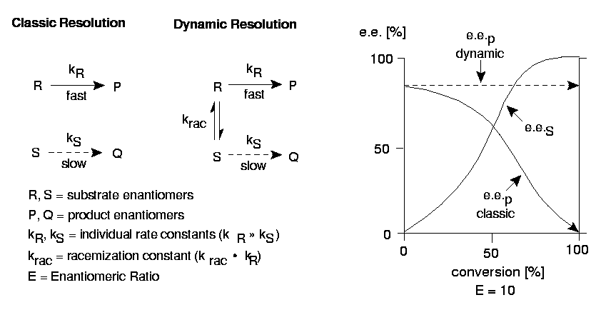
Modes of Asymmetric Induction
Parameters for Kinetic Resolution¹
  ee is dependent of the yield if the selectivity is not perfect!
  The best parameter to describe the selectivity is E, called S factor, S = k_{R}/k_{S.}
(1) ecsoc2.hcc.ru/ecsoc-2/al001/al001.htm

Slide 29
Modes of Asymmetric Induction
3. Desymmetrization
General Scheme
Desymmetrization of Diols
  No chirality element introduced in bond forming event
  Symmetric non-chiral substrates usually easy to prepare

Slide 30
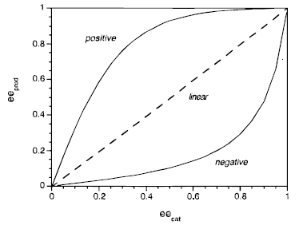
Relationship ee Catalyst ee Product
Non Linear Effect¹
  Intuitively expected: linear relationship
  How can we explain negative or positive non-linear effects?
(1) Blackmond, D. G. Acc. Chem. Res. 2000, 33, 402-411.

Slide 31
Relationship ee Catalyst ee Product
Linear relationship: no interaction between enantiomers of catalyst
Dimerization of Catalyst: NLE possible
  Simplest case: dimers are inactive:
    K_{RS} > 1, K_{SS} = K_{RR} < 1: positive NLE (reservoir effect)
    K_{RS} < 1, K_{SS} = K_{RR} > 1: negative NLE
  ₋ Reality is more complex (no ideal reaction, dimer are active, trimer possible…)
(1) Blackmond, D. G. Acc. Chem. Res. 2000, 33, 402-411.

Slide 32
Relationship ee Catalyst ee Product
Autocatalysis: The formed product is able to catalyse the reaction.
Special Case: Autocatalysis with strong positive NLE
Soai’s system:¹
Are similar phenomenes responsible for homochirality in nature?
(1) Sato, I.; Urabe, H.; Ishiguro, S.; Shibata, T.; Soai, K. Angew. Chem., Int. Ed. 2003, 42, 315.

Slide 33
Classification of Catalytic Asymmetric Reactions
1. Classification via Catalyst
Easy systematic, but not easy for understanding/using
2. Classification via Reaction
Good for the laboratory, user
3. Classification via Chiral Element (Ligand)
Good for understanding stereoselectivity and ligand design
4. Classification via Catalytic Principles
Good for understanding and studying catalysis and enhance creativity
Understanding principles allows to understand current research and design the research of the future!

