Slide 1
Protein domains mediating interactions
W_03 • Protein - Protein interactions domains
Scaffolds and co-incidence
PPI’s and networks
W_04 • Protein - Membrane
Lipid-binding domains
Manipulation of location
Activation
“the right molecules at the right place at the right time”
05 - Protein domains p

Slide 2
Localising proteins to and within membranes
Part 1
Membrane binding domains
• PIPx interacting domains
• PIPx imaging
• Polybasic sequences
5 - Membrane binding domains p

Slide 3
Membrane architecture
Depth probability profile of lipid functional groups
White & Heijne , Ann Rev Biophys 2008
5 - Membrane binding domains p

Slide 4
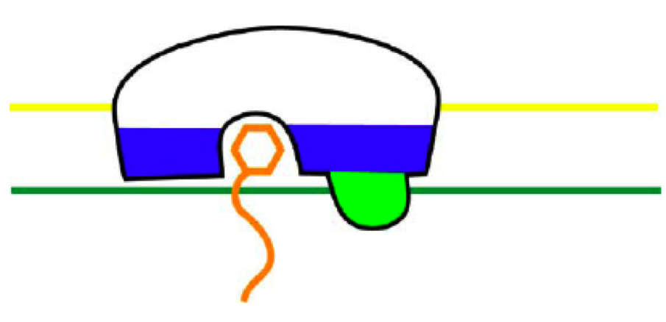
Membrane binding domains
Schematic representation:
Membrane-water interface
Start hydrophobic core
Three interactions are generally observed:
- Polar stereo-selective binding site for a lipid head group
- Hydrophobic loop inserting in membrane core (green)
- Electrostatic interaction with polar head groups (blue)
Hurley, BBA 2007
5 - Membrane binding domains p

Slide 5
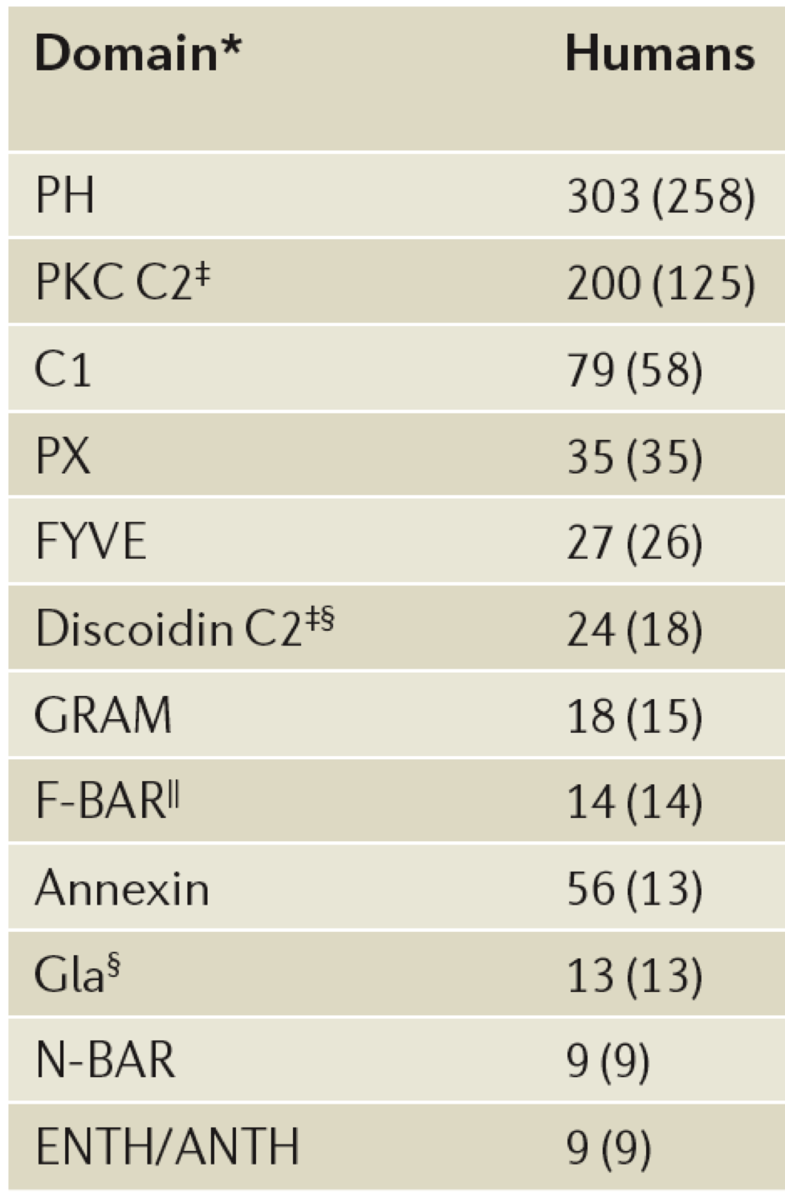
Membrane binding domains
In human genome many such domains have been identified:
=> PIPx
=> Ca²⁺-dependent to phospholipids
=> diacylglycerol
=> PI(3)P
=> PI(3)P
(#) : number of proteins
Lemmon, 2008
5 - Membrane binding domains p

Slide 6
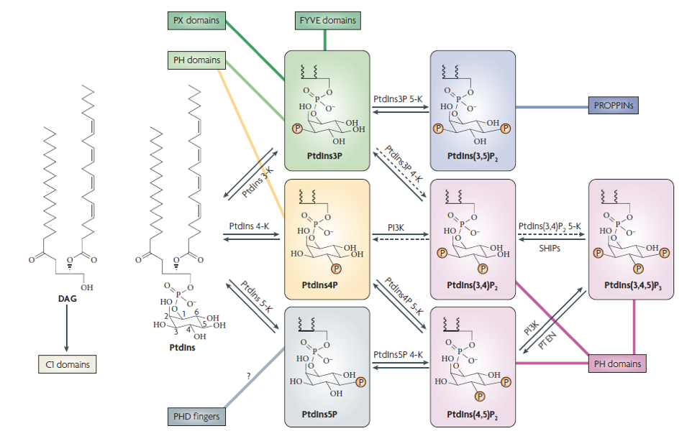
Domains recognising different PIPx species
10 - Membrane domains p
Lemmon, 2008

Slide 7
PIPx: Specific locations
Antonietta, Nat Cell Biol 2004
5 - Membrane binding domains • PIPx p

Slide 8
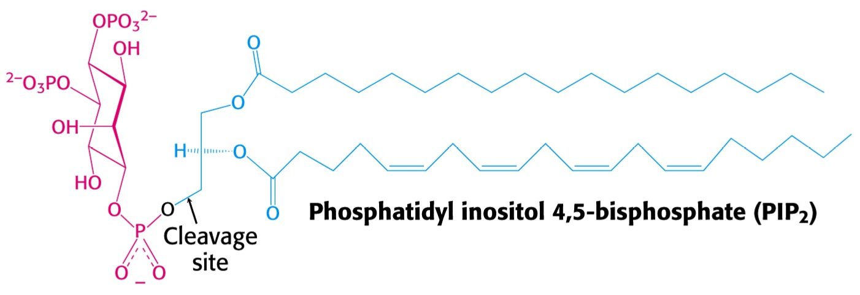
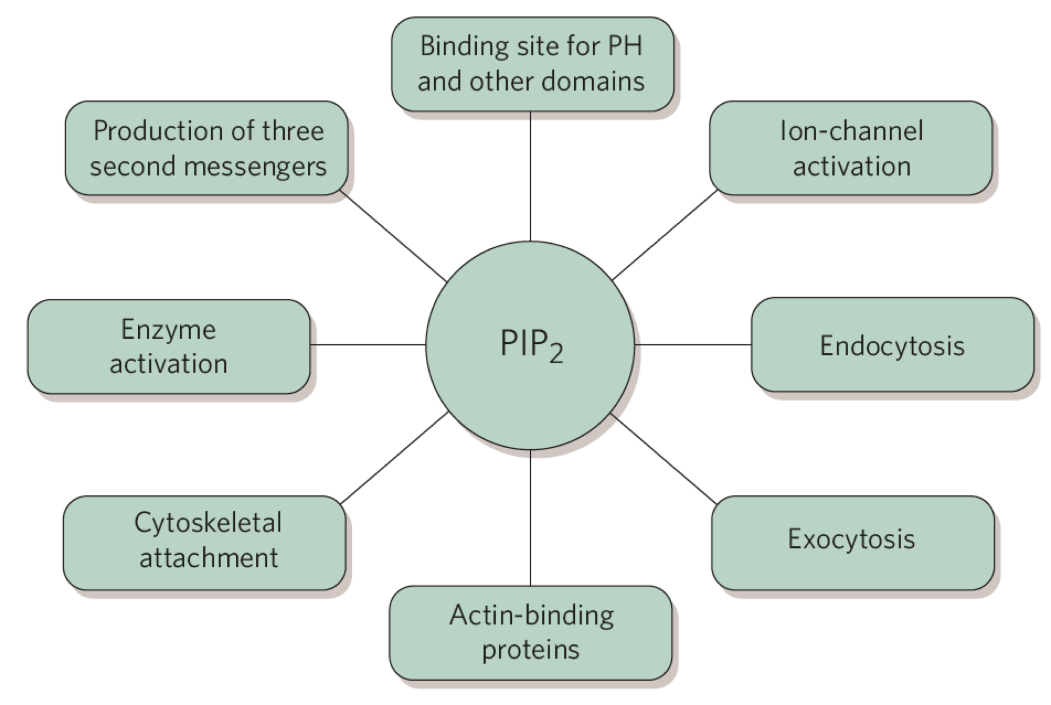
Phosphatidylinositol-(4,5)-bisphosphate (PIP2)
• About 1% of PM lipids (about 1-10 μM); the most abundant of the PIPx
• Involved in many, many processes
McLaughlin, Nature 2005
5 - Membrane binding domains • PIPx p

Slide 9
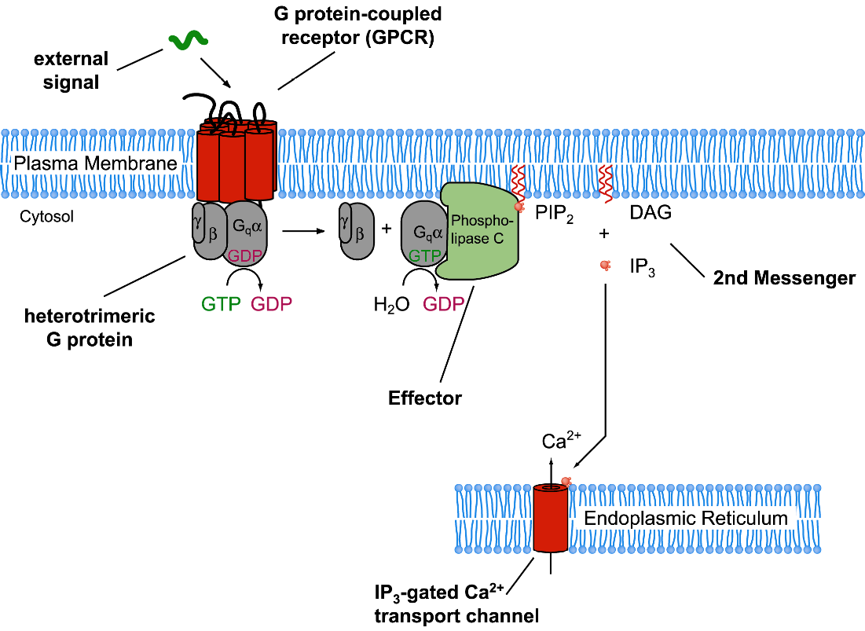
PIPx undergo signal-dependent turnover; e.g. PI(4,5)P2
GPCR signalling via Gαq:
=> PLC activation PI(4,5)P2 => DAG + IP3
IP3 = Inositol(1,4,5) triphosphate
DAG = Diacylglycerol
PLC = Phospholipase C
Another example:
Receptor tyrosine kinases:
=> PI(3)kinase activation
PI(4,5)P2 => PI(3,4,5)P3
5 - Membrane binding domains • PIPx p
Notes:
DAG => C1
Ca-dependent => C2
PIP2 => PH et al
IP3 => Ca

Slide 10
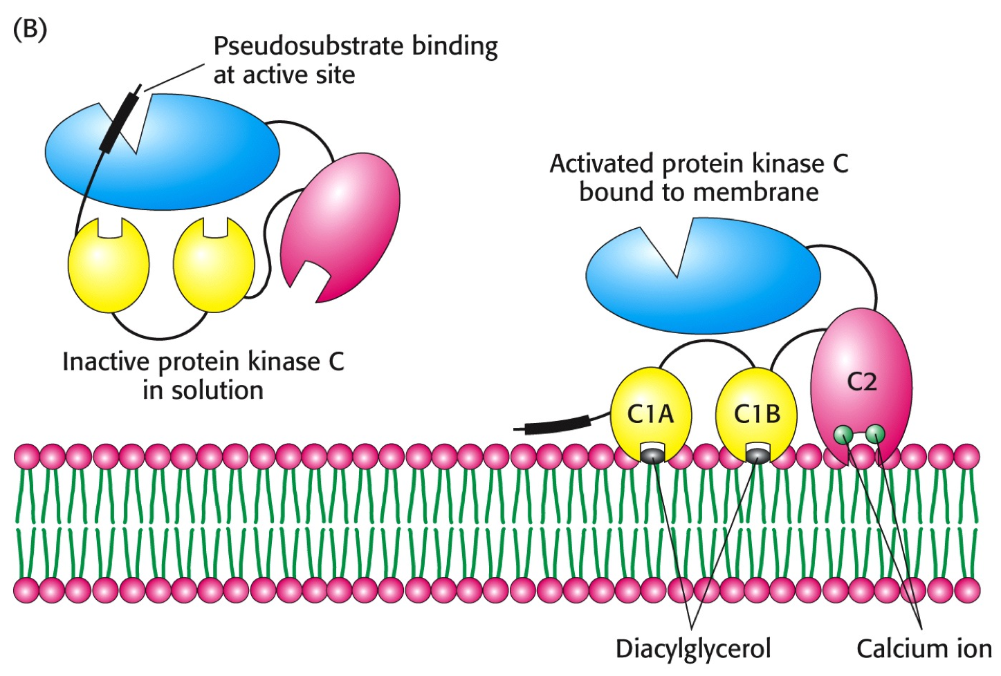
Reversible membrane location and activation
Protein kinase C combines the 2 mechanisms, both for localisation & activation:
5 - Membrane binding domains p

Slide 11
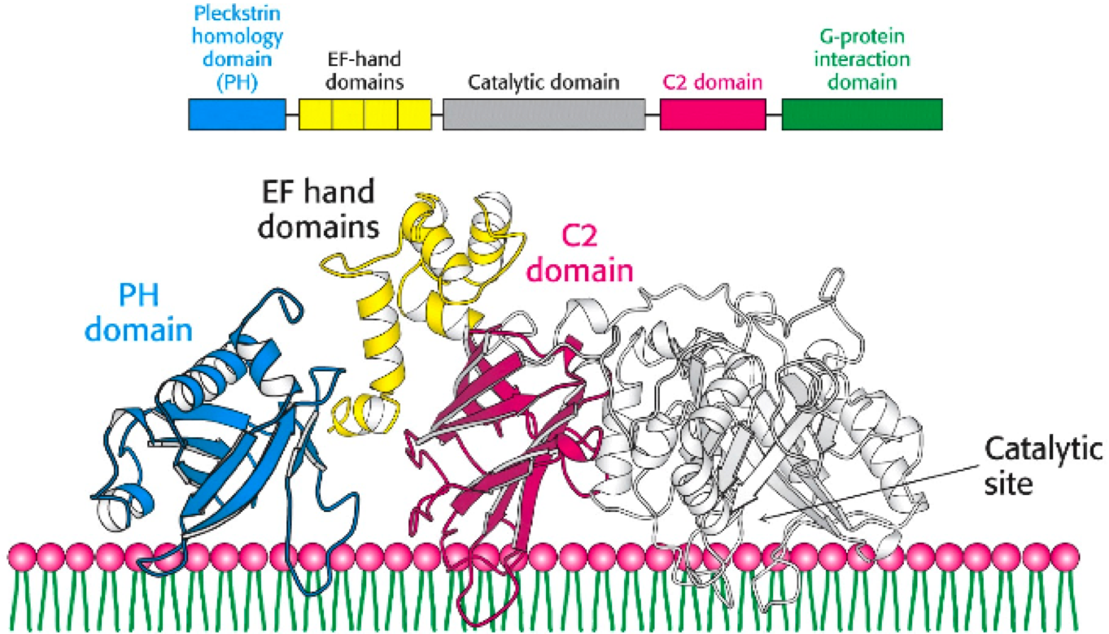
Reversible membrane location and activation
Phospholipase Cβ combines the 2 mechanisms, both for localisation & activation:
but also for it’s in-activation!!
PIPx lipids Ca²⁺-dependent
lipid binding
5 - Membrane-binding domains p

Slide 12
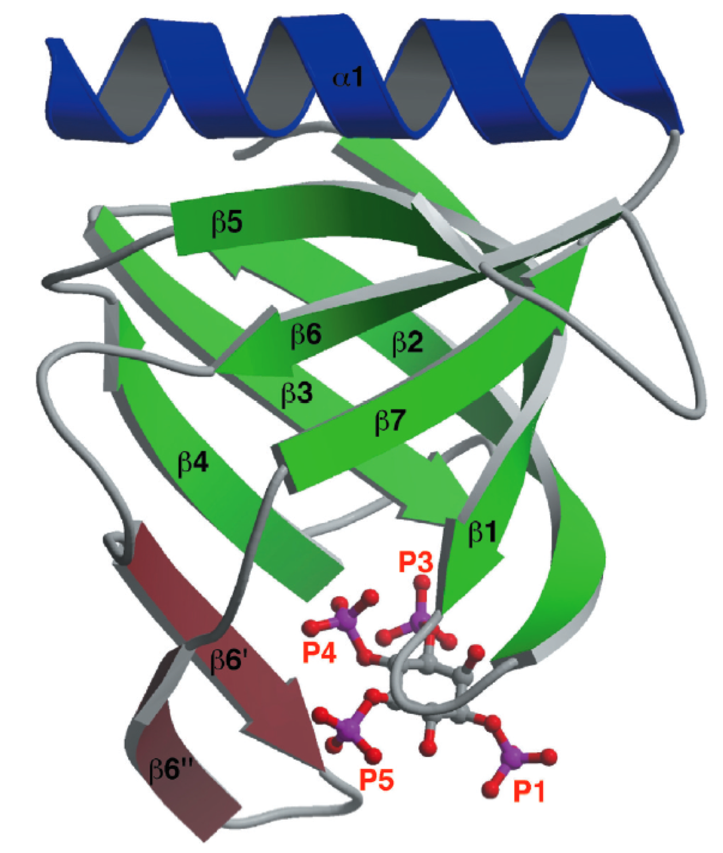
PH domains recognising PI(3,4,5)P3
• PI(3,4,5)P3 has a very low abundance in resting cells
• upon activation 40-fold increase due to
phosphorylation of PI(4,5)P2 by PI-3-kinase
=> see : 1fgy.pdb
Important regions for interactions:
• β 1-β2 loop is a basic region
• 17-19 H-bonds
• Large hydrophobic loop absent
• Kd = 27 nM => strong enough for firm
membrane attachment
• I(1,3,4,5)P4 binds with same affinity
5 - Membrane binding domains • PIPx binders p

Slide 13
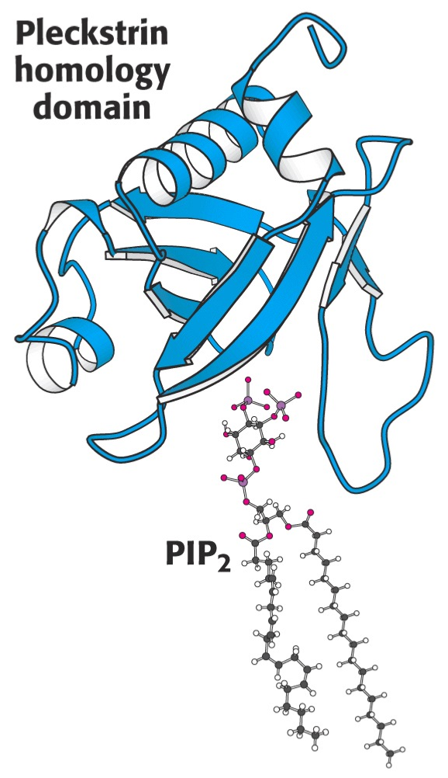
Domains recognising PI(4,5)P2
• PI(4,5)P2
- most abundant PIPx
about 1% of plasma membrane PL’s
5 to 100-fold more abundant than other PIPx’s
- most domains bind with low affinity
=> see : 1mai.pdb
An exception:
• PH domain of phospholipase-Cδ1 binds
with high affinity, however:
affinity for I(1,4,5)P3 is 10-fold higher
=> The enzyme is removed from the membrane by it’s own product.
5 - Membrane binding domains • PIPx binders p

Slide 14
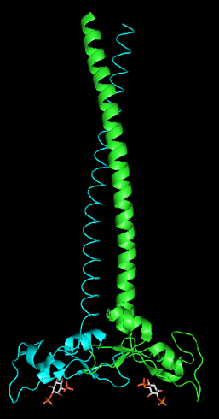
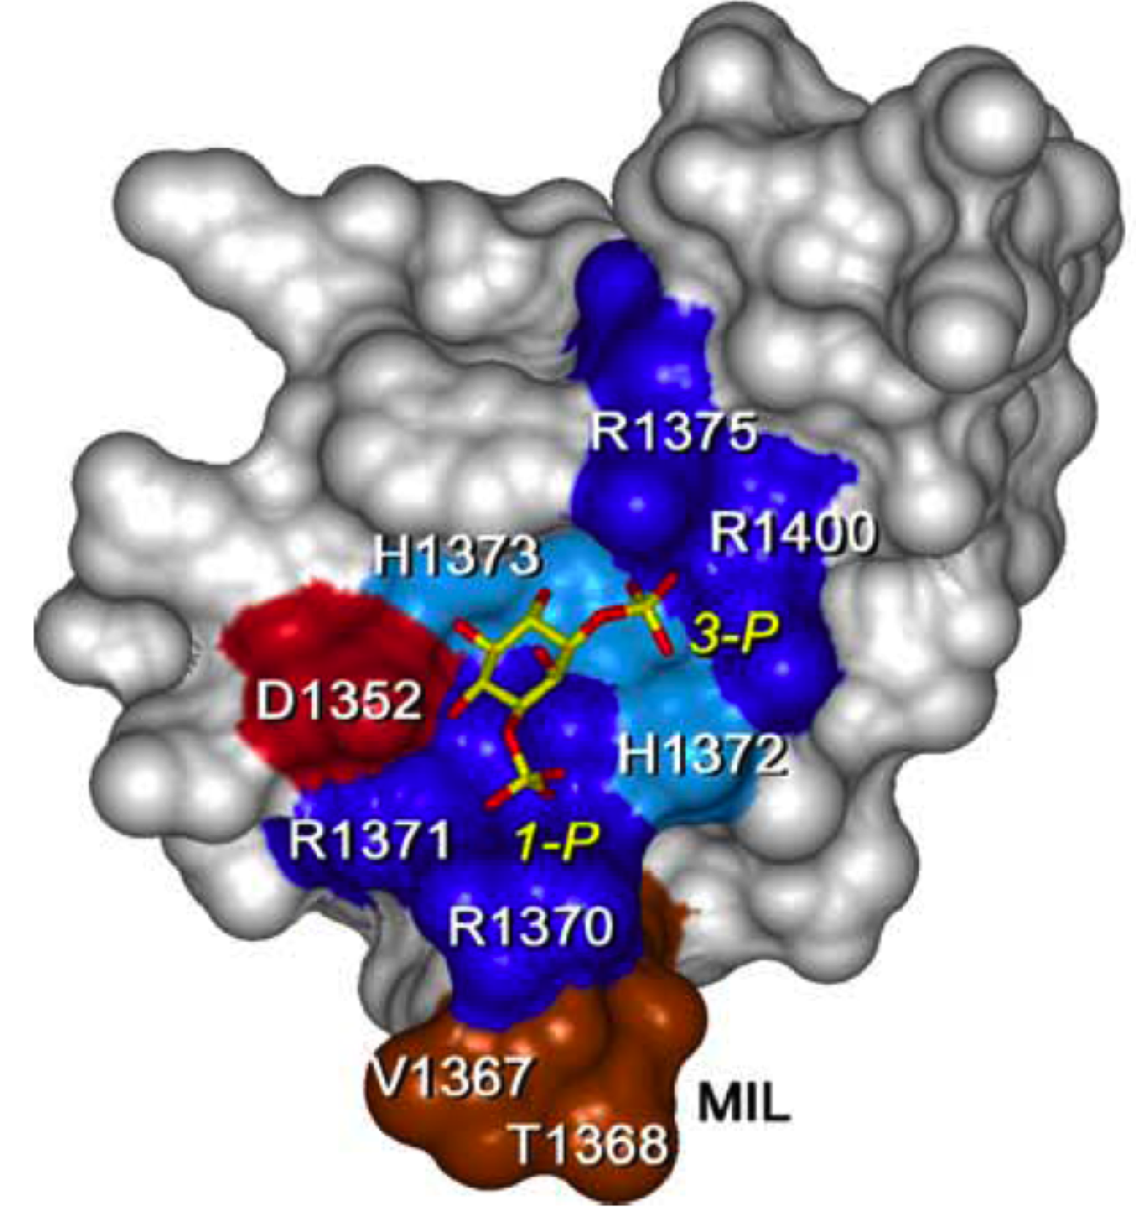
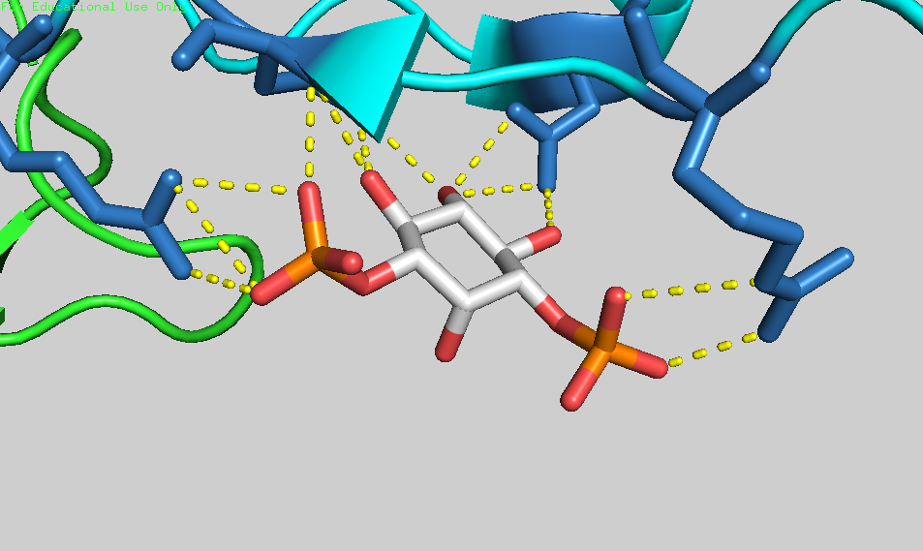
FYVE domains recognising PI(3)P1
• PI(3)P1 present in endosomes, 0.25 % of cellular lipid, or 200 μM
• important in regulating trafficking in endosomal pathway
and Golgi-lysosome sorting
◊ FYVE domains : Important for interaction with PI(3)P:
• basic (R/K)(R/K)HHCR in 1st β-strand
• 12 H-bonds with Pi and OH groups
• Monomer too weak for membrane attachment
=> dimers do !!
e.g. PI(3)P1 binding site of EEA1
}
=> selectivity
5 - Membrane binding domains • PIPx binders p

Slide 15
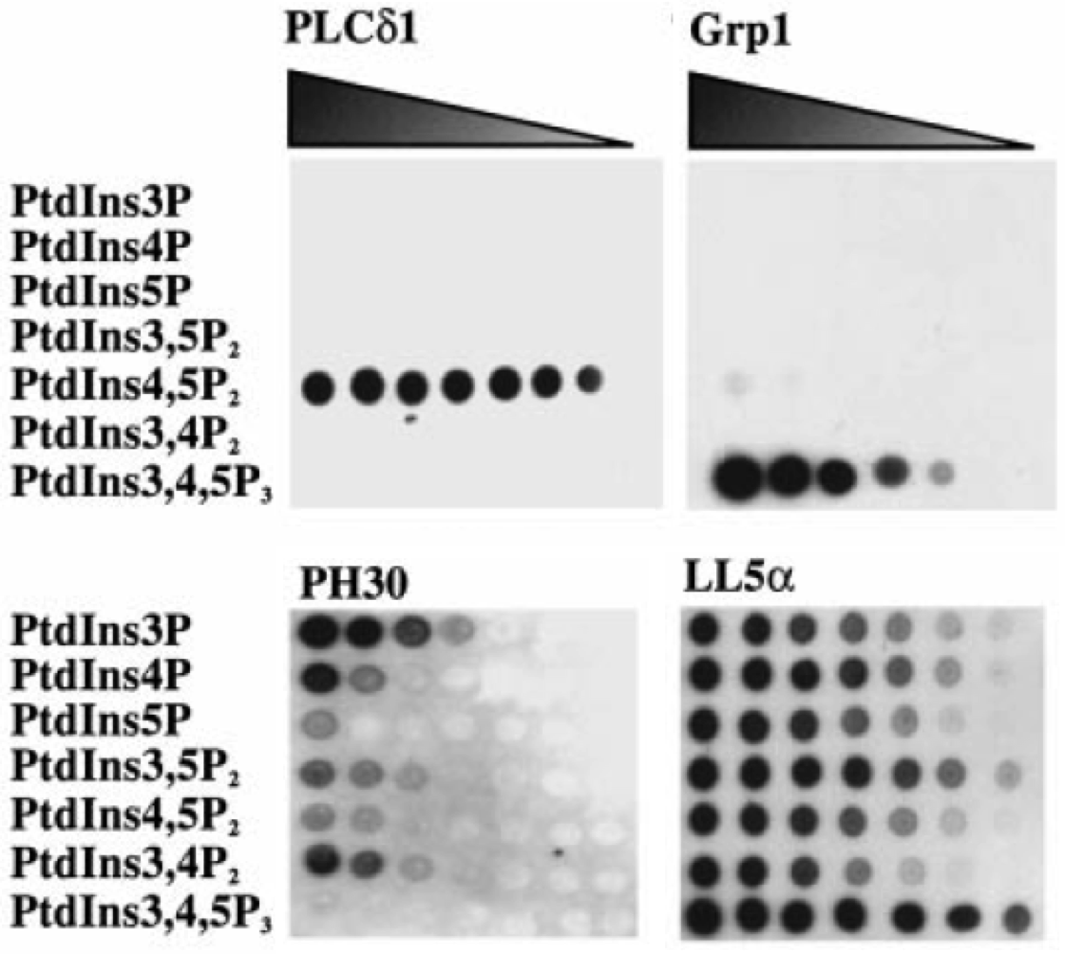
Testing specificity and affinity of PIPx domains
“Dot blot assay”
• Spot the different lipids in decreasing amounts on nitrocellulose
• Overlay with PH-domain-GST fusion proteins
• Detect bound fusion with an anti-GST antibody
Dowler, Biochem J 2000
GST = Glutathion-S-
Transferase
is an affinity tag
for protein purification
5 - Membrane binding domains • PIPx - Omics p

Slide 16
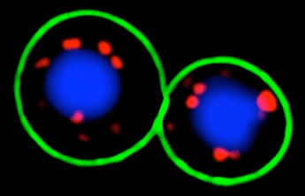
Imaging PIPx in vivo using domain-GFP chimeras
In yeast cells:
Green: PH-domain - GFP fusion => PI(4,5)P2 in plasma membrane
Red: FYVE-domain - DsRed fusion => PI(3)P in endosomes
Blue: Vacuoles
5- Membrane binding domains • PIPx - Omics p

Slide 17
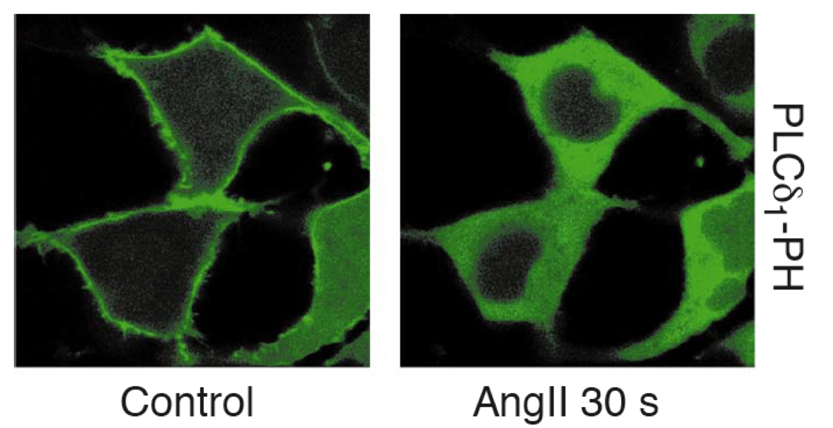
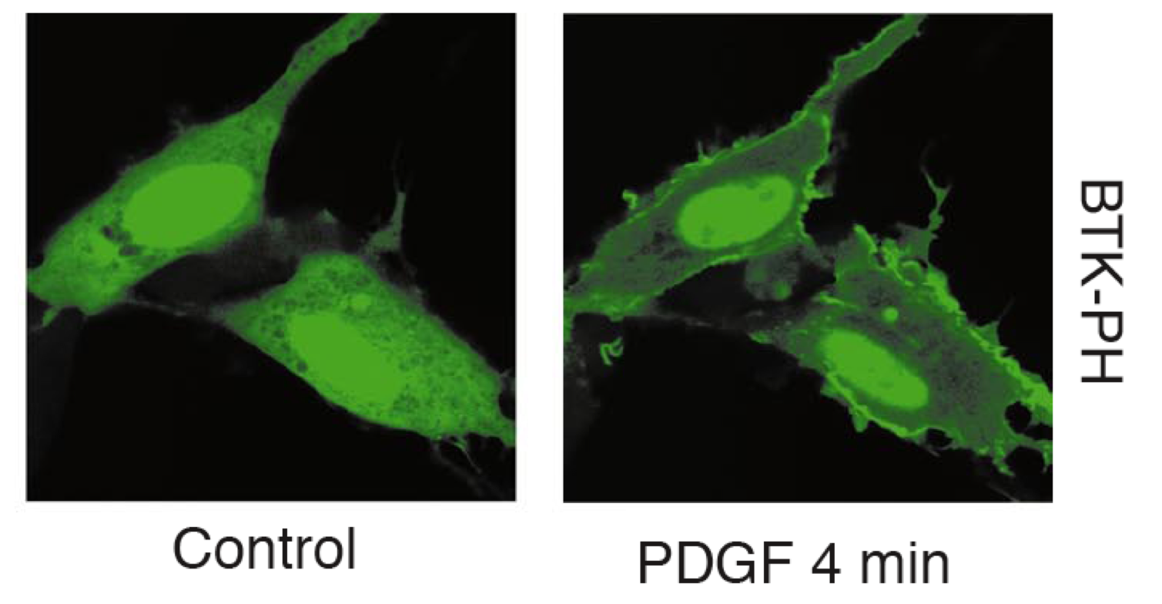
Imaging PIPx metabolism in vivo using PH-GFP chimeras
In mammalian cells: • If target lipid is present => PH-GFP probe on membrane
• If not: => probe in cytosol
A: PI(4,5)P2-specific probe
Control: PI(4,5)P2 in plasma membrane
+ Angiotensin II (AngII) promotes breakdown via PLase-C
B: PI(3,4,5)P3-specific probe
Control: little PI(3,4,5)P3 in plasma membrane
+ PDGF stimulate synthesis by
activation of PI-3-Kinase
Balla, TiPS 2000.
5 - Membrane binding domains • PIPx - Omics p

Slide 18
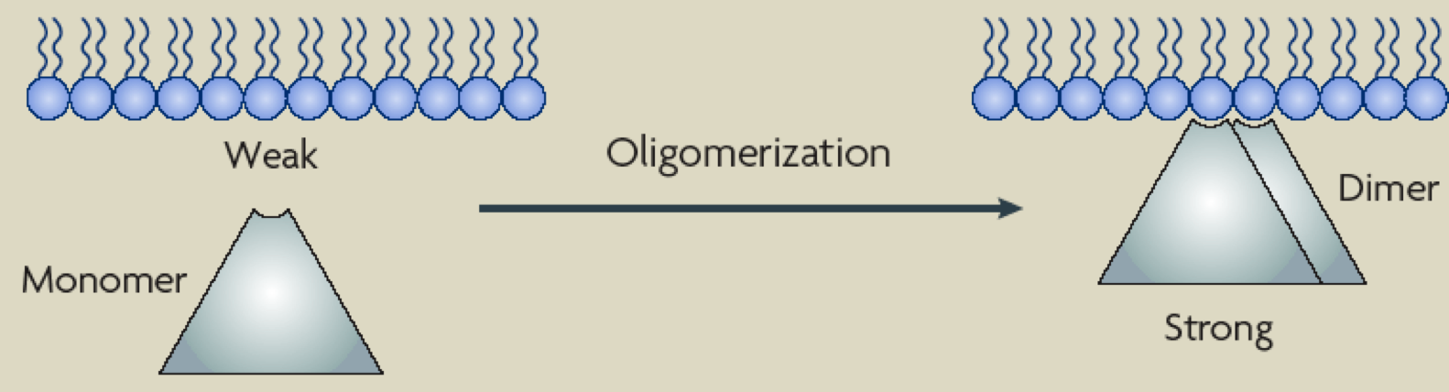
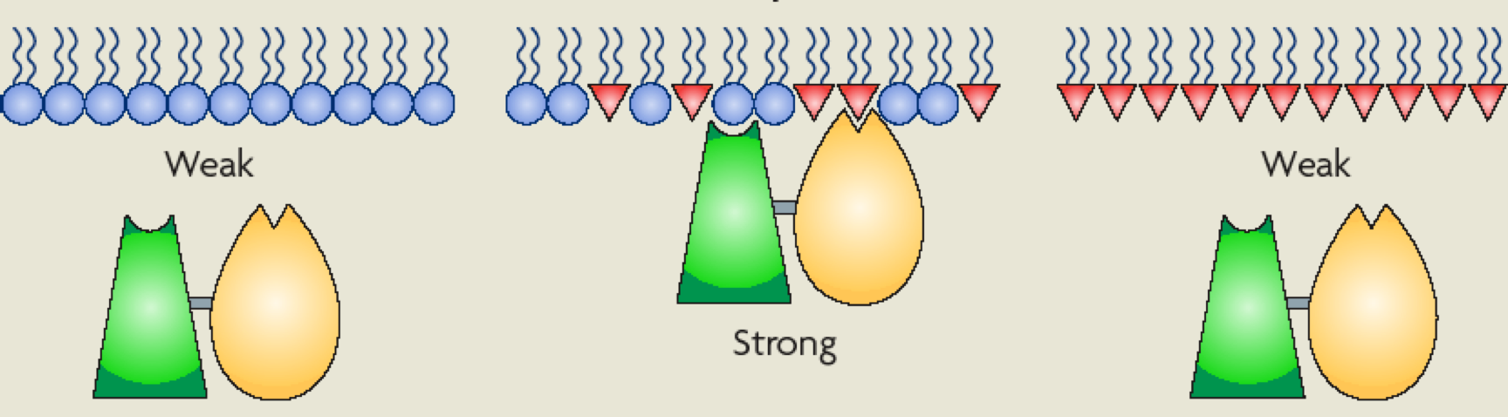
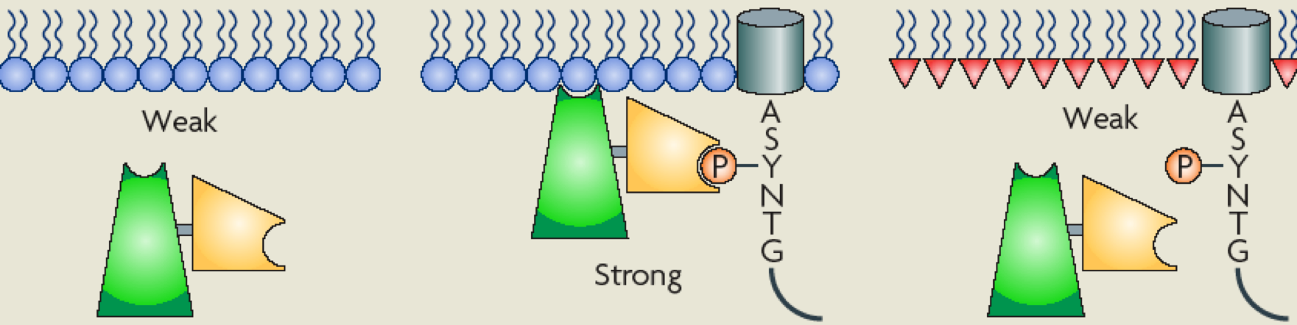
Membrane binding : Combination of domains
=> Stronger by more of the same
=> => Stronger & more selective/specific through co-incidence
Lemmon, 2008
5 - Protein domains p

Slide 19
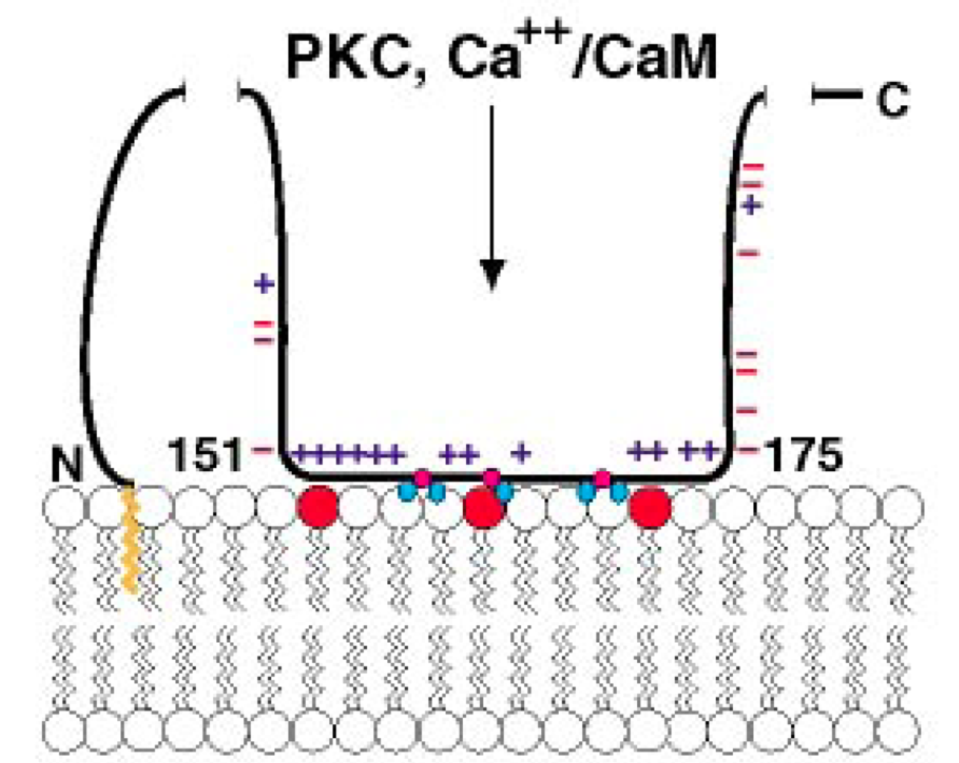
Poly-basic sequence: Membranes, PIP2 and Ca²⁺²⁺²⁺²
Poly-basic sequence: A short stretch of amino acids with many K and/or R
• Bind strongly to negatively charged membranes
• Sequester PIP2
E.g. MARCKS
• “ Myristoylated Alanine-Rich C-Kinase Substrate”
• Present in the cell at μM concentrations
• Polybasic domain …KKKKKRFSFKKSFKLSGFSFKKNKK
• N-terminal myristoyl
red dot = PIP2
McLaughlin, Nature 2005.
5 - Membrane binding domains • Polybasic p

Slide 20
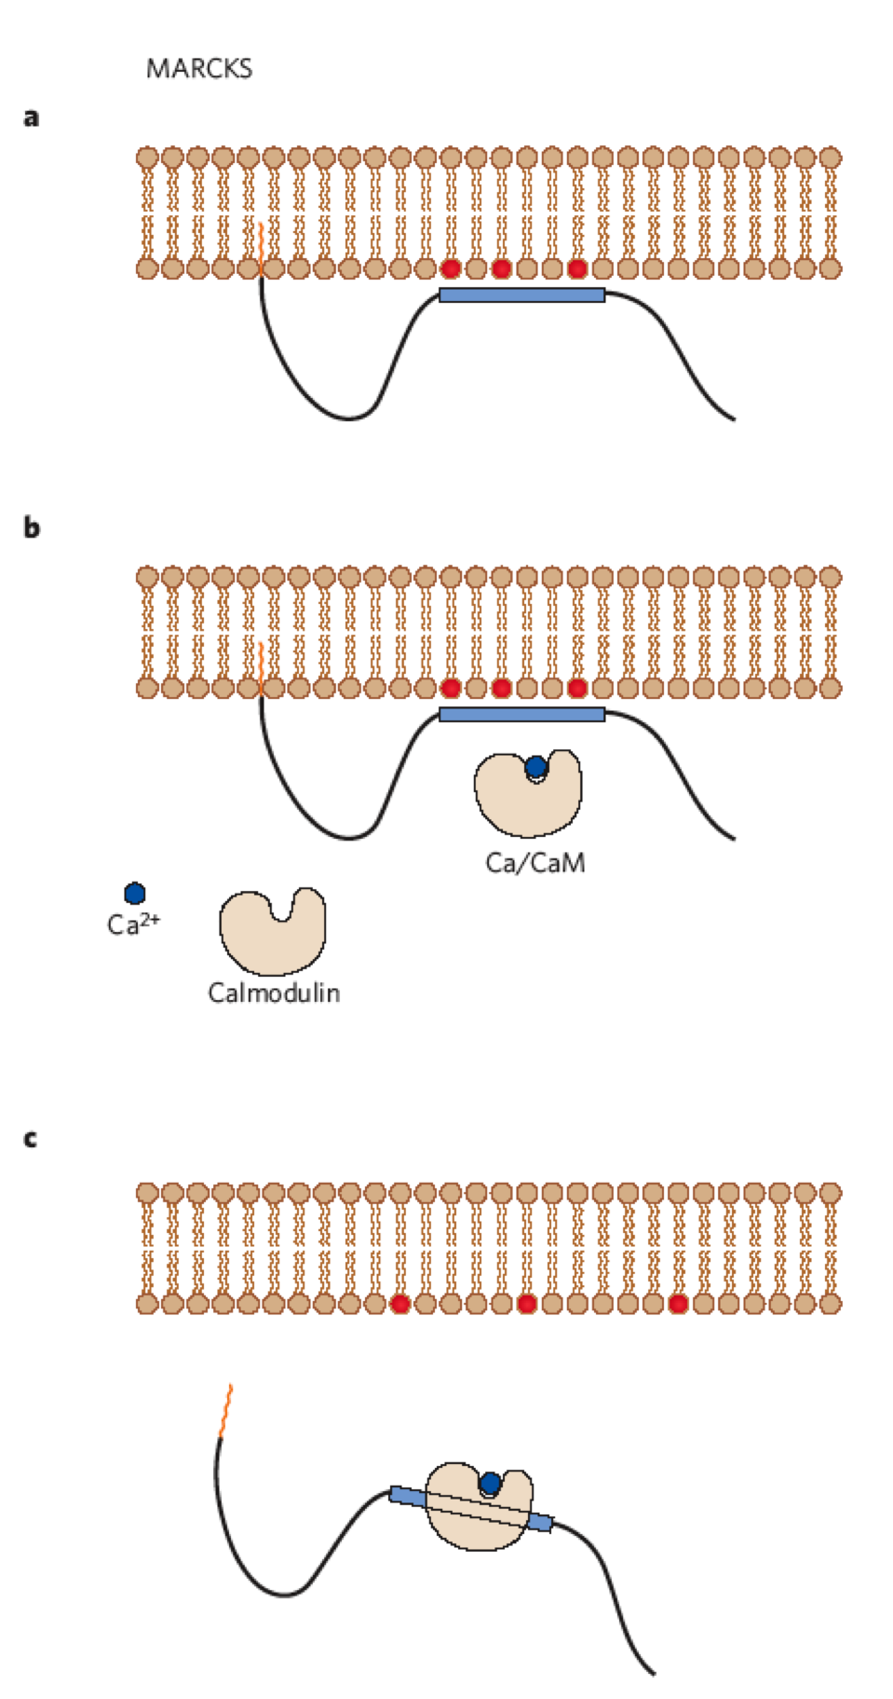
Poly-basic sequence: Release from membrane
Reduction of MARCKS binding to membranes:
i) Hydrolysis of PIP2
ii) Phosphorylation of serine S residues by
protein kinase C (PK-C)
iii) Binding of calmodulin-Ca²⁺
KKKKKRFSFKKSFKLSGFSFKKNKK
McLaughlin, Nature 2005.
5 - Membrane binding domains • Polybasic p

Slide 21
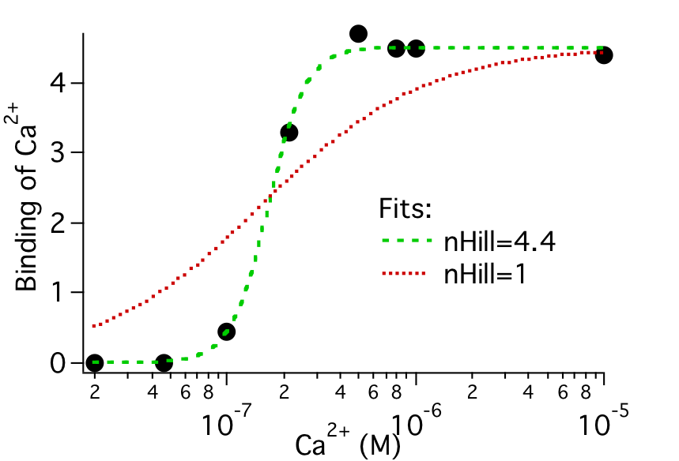
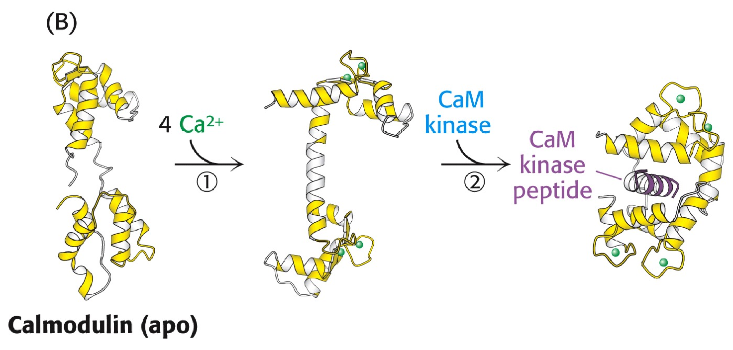
Calcium, a ubiquitous messenger
iii) Through a mediator, e.g. calmodulin:
[Ca²⁺] > 500 nM => steep cooperative binding
=> dramatic structural change
==> binding to calmodulin targets
===> modulation of target’s activity
5 - Membrane binding domains • Polybasic p

Slide 22
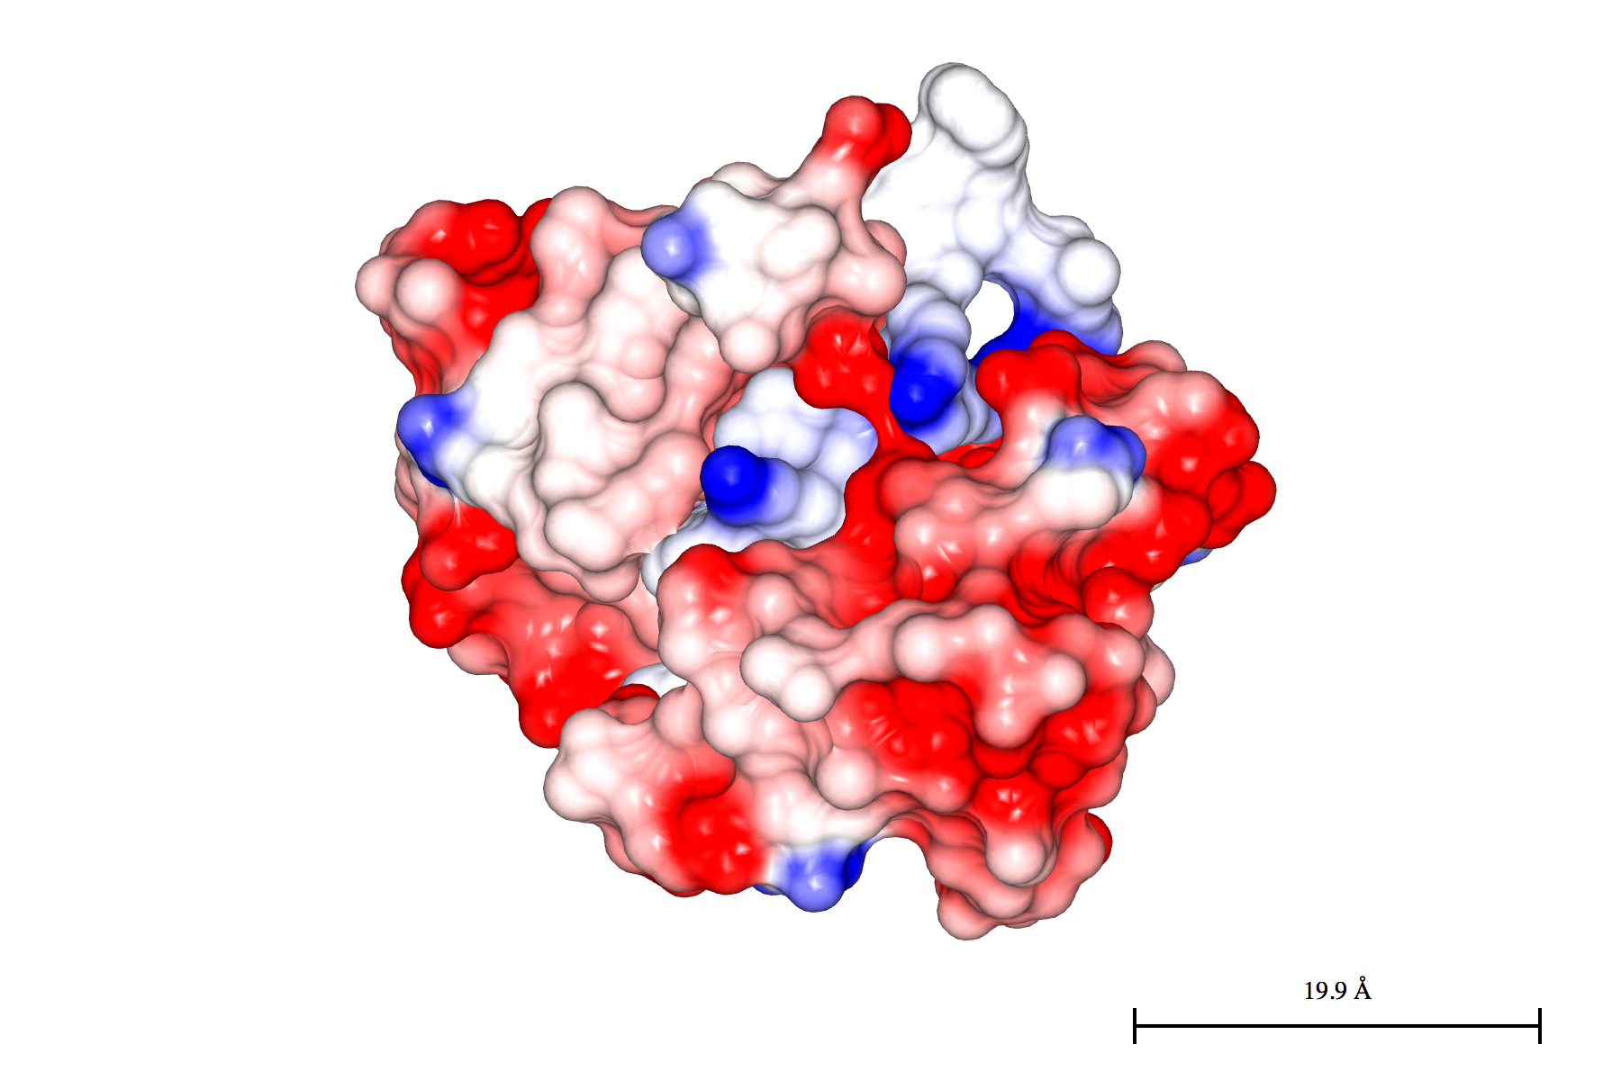
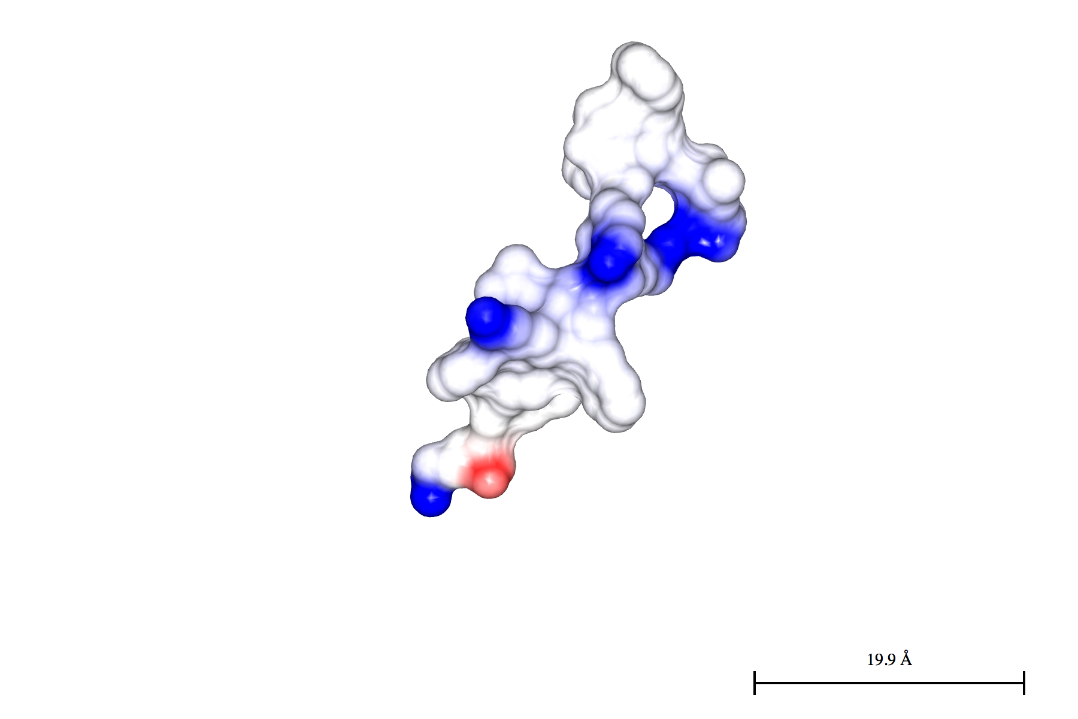
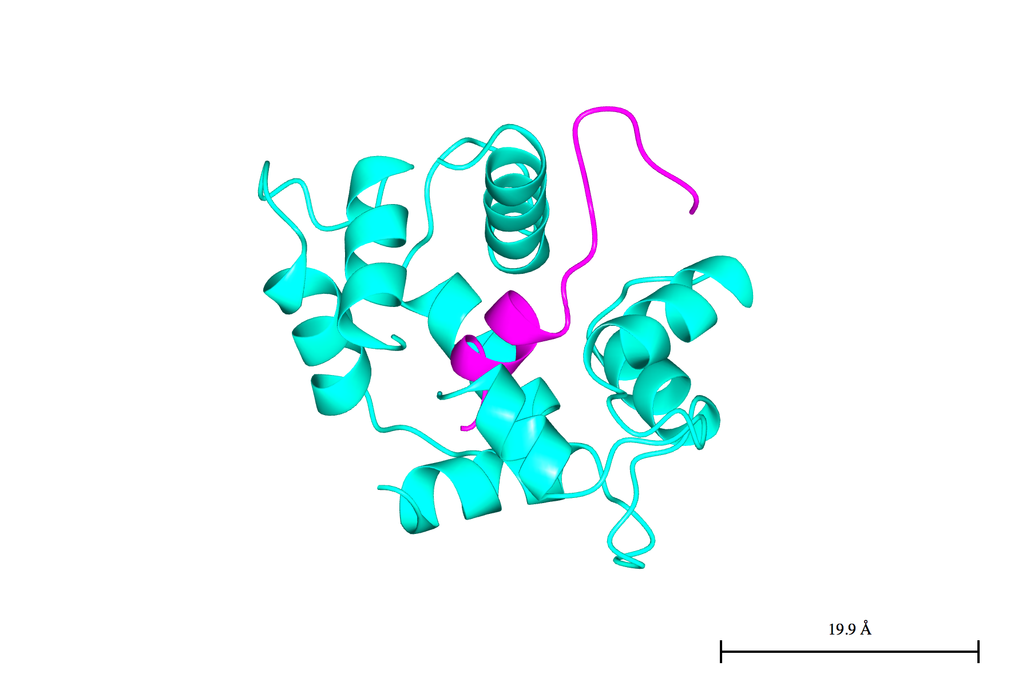
Poly-basic sequence: Release from membrane
Regulation of MARCKS binding to membranes:
- Hydrolysis of PIP2
- Phosphorylation of Ser
- Binding of calmodulin-Ca²⁺
Crystal structure of complex of
calmodulin-MARCKS
cartoon:
- cyan: calmodulin
- purple: MARCKS
Iso-potential surface:
- red -25 mV
- blue + 25 mV
=> see 1iwq.pdb
McLaughlin, Nature 2005.
5 - Membrane binding domains • Polybasic p

Slide 23
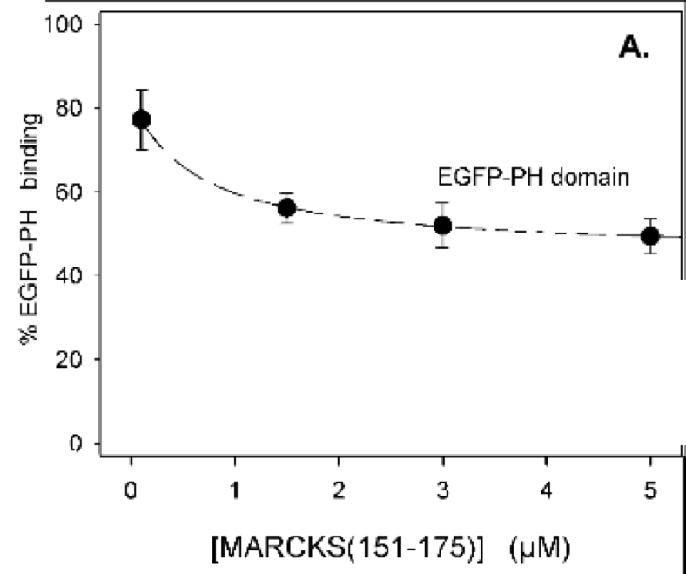
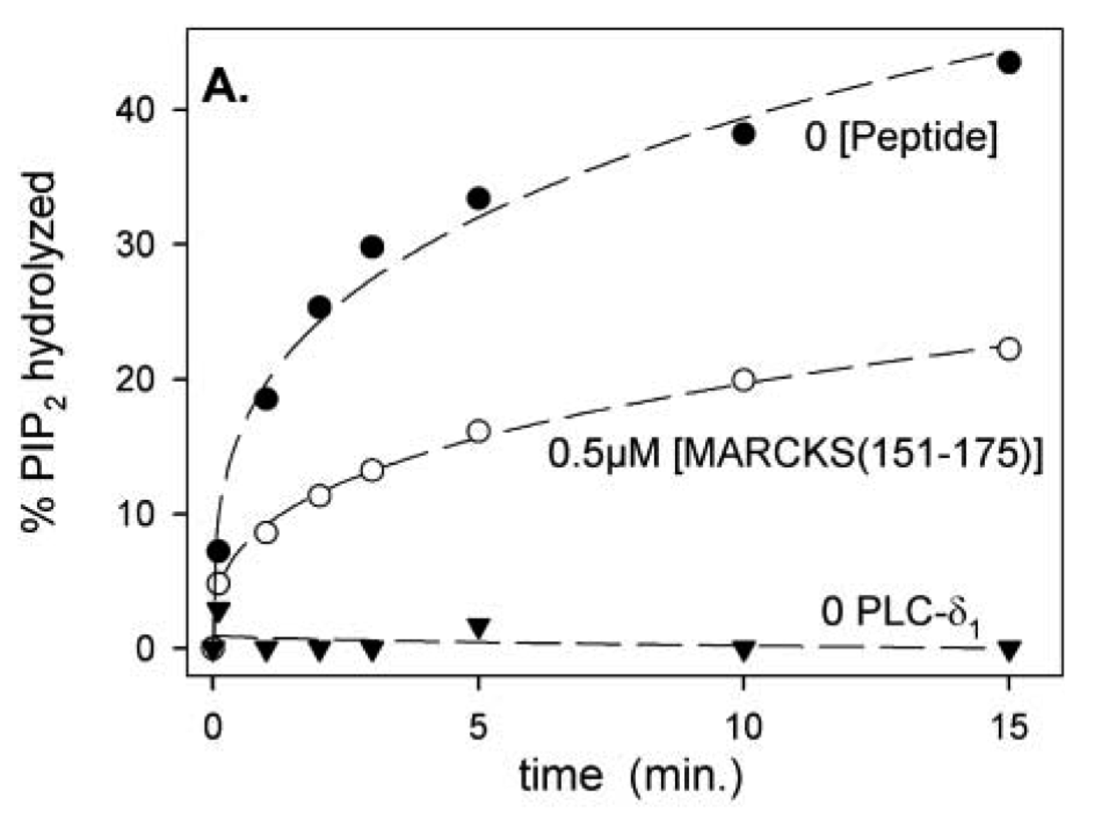
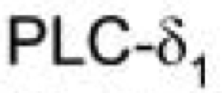
Poly-basic sequence - Effect on other PIP2 binding proteins
• Inhibition of PH-domain binding • Inhibition of PIP2-hydrolysis
to PIP2 by MARCKS by MARCKS
Lipid vesicles containing 1% PIP2 Lipid vesicles containing 0.15 % [³H]-PIP2
10 nM PIP2 binders Hydrolysis by phospholipase Cδ1
=> MARCKS decreasing PLC binding and activity by reducing PIP2-availability
Gambhir, Bp J 2004
5 - Membrane binding domains • Polybasic p

Slide 24
Poly-basic sequence - Effect on other PIP2 binding proteins
• Inhibition of PH-domain binding • Inhibition of PIP2-hydrolysis
to PIP2 by MARCKS by MARCKS
Lipid vesicles containing 1% PIP2 Lipid vesicles containing 0.15 % [³H]-PIP2
10 nM PIP2 binders Hydrolysis by phospholipase Cδ1
=> MARCKS decreases PLC binding and activity by reducing PIP2-availability
Gambhir, Bp J 2004
5 - Membrane binding domains • Polybasic p

Slide 25
Localising proteins to and within membranes
Cytosolic proteins can bind in a spatio-temporally regulated manner
to the membrane surface through
- lipid binding domains
- poly-basic sequences
Reversible membrane attachment depends
- on type and number of interactions
- cofactors like Ca²⁺
- composition and concentration of lipids recognized
- co-incidence of different conditions and
- co-operation between domains
÷ This is regulated by signalling processes
5 - Membrane binding domains p

Slide 26
Further reading:
Balla: “How accurately can we image inositol lipids in living cells?”
TiPS 2000
McLaughlin:”Plasma membrane phosphoinositide organization by protein electrostatics” Nature 2005
Lemmon: “Membrane recognition by phospholipid-binding domains”
Nature Reviews Molecular Cell Biology, 2008
Next week:
Part 2: Lipidation & transmembrane domains
5 - Membrane binding domains p

