Slide 1
Protein domains mediating interactions
W_03 • Protein - Protein interactions domains
Scaffolds and co-incidence
PPI’s and networks
W_04 • Protein - Membrane
Lipid-binding domains
Manipulation of location
Activation
“the right molecules at the right place at the right time”
03 - Protein domains p

Slide 2
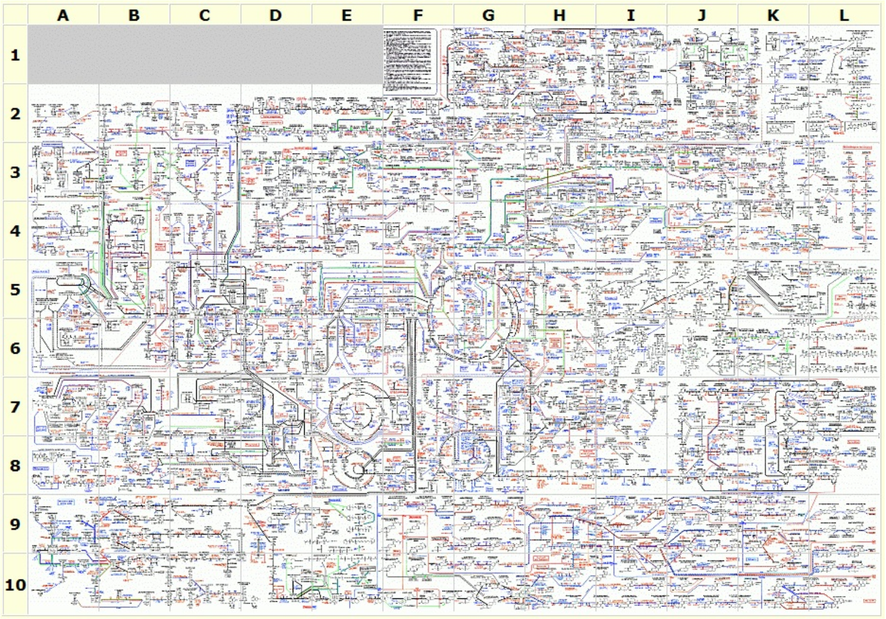
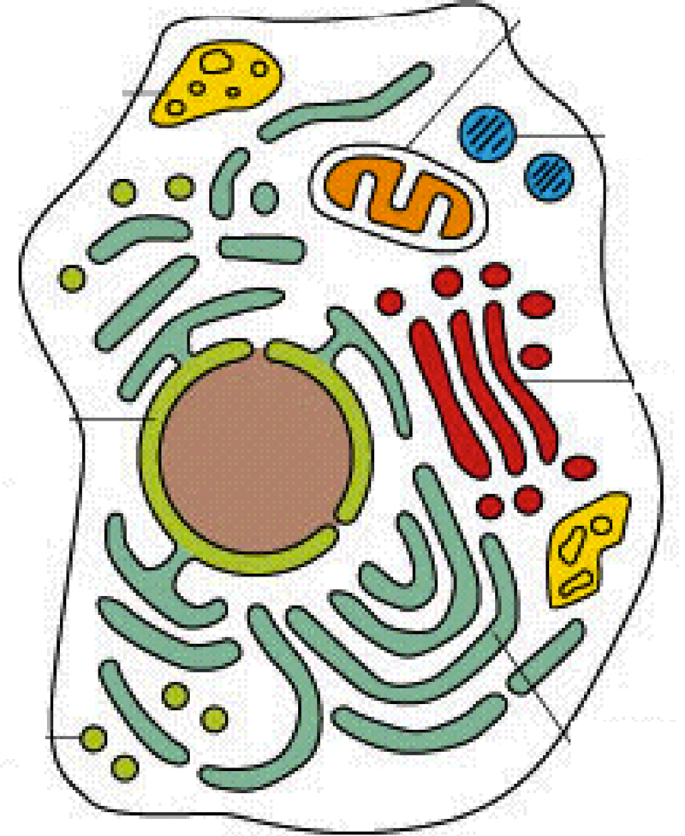
Metabolic pathways: The early days of Biochemistry
•http://www.expasy.org/cgi-bin/show_thumbnails.pl
However, reactions
are localized in specific specialized subcellular
compartments
3 - Introduction p.
Networks
Notes:
Classical : Reaction _> gene
Modern: Gene ->? or ligand ->? orphan receptor or orphan ligands

Slide 3
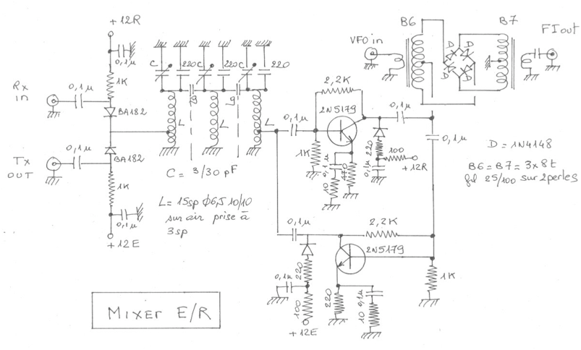
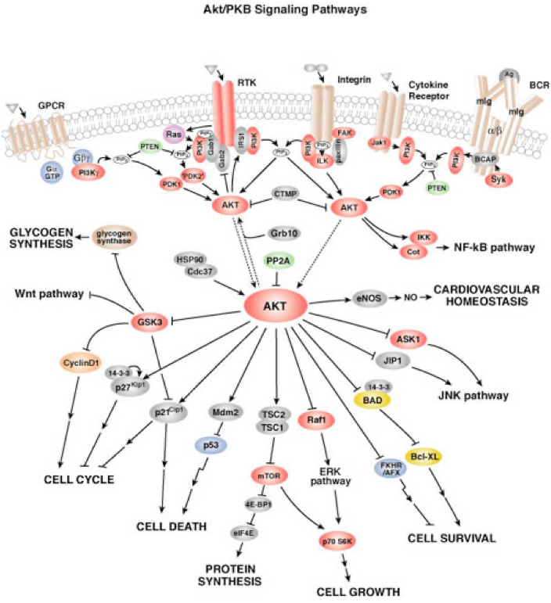
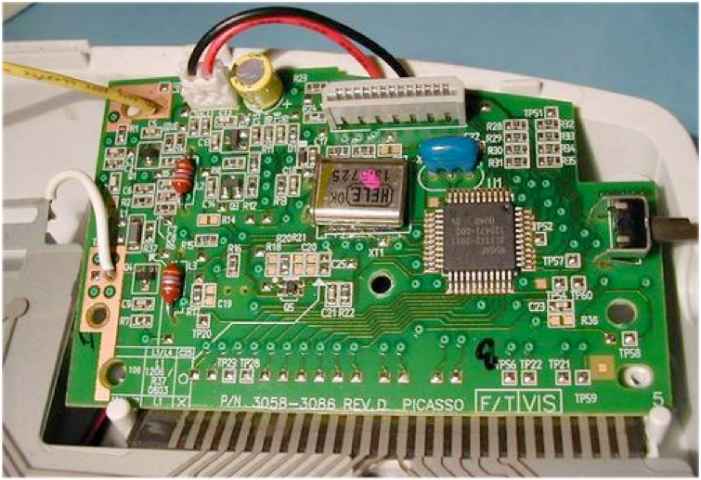
Cellular signalling - Biological networks
• The cell is extremely complex
- many intertwined multi-dimensional networks of signalling and metabolism
- a strong spatial & temporal organisation of molecular interactions
3 - Introduction p.
Networks

Slide 4
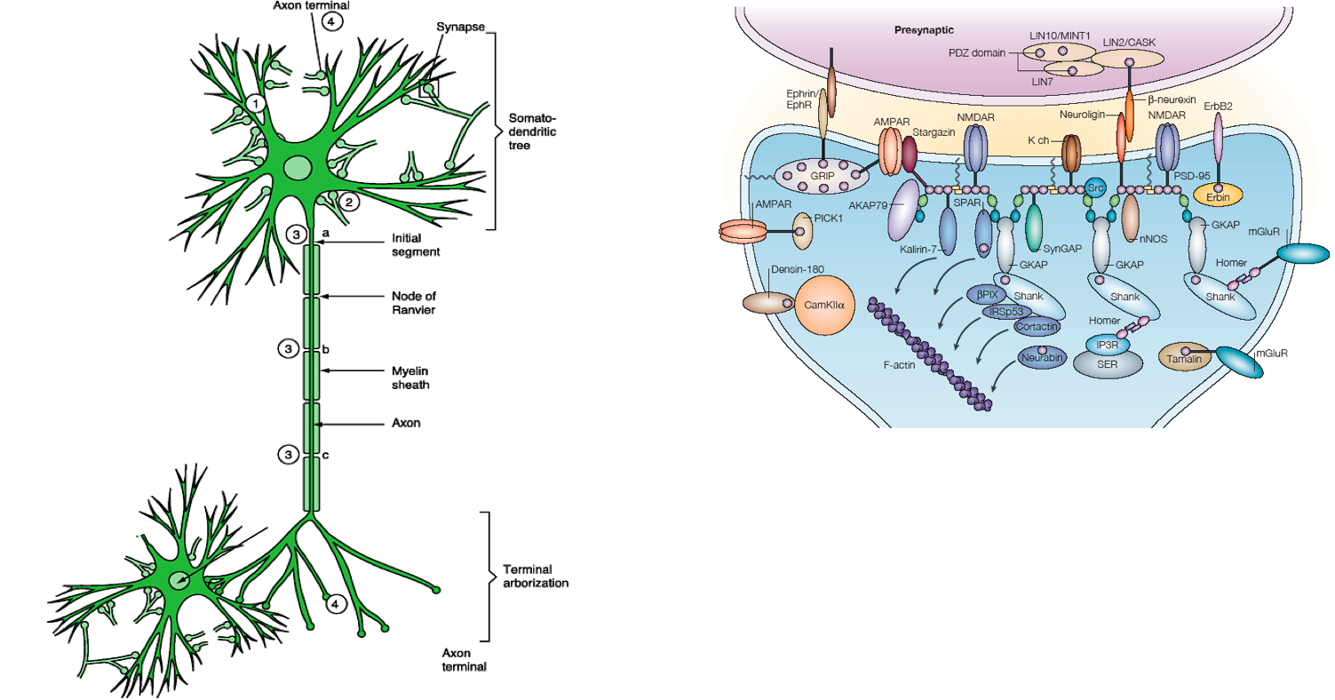
Cellular signalling - Molecular organisation
• Interacting neurons • Synaptic organisation
Signalling events within a cell
- Right place
- Right time
- Proper arrangement
- Specificity & right partners
through reversible and adjustable
localised molecular interactions.
Hammond “Cell & Mol Neurobiology”
Kim, Nat Rev Neurosci 5 (2004) 772
3 - Introduction p.
Networks
Notes:
Classical : Reaction _> gene
Modern: Gene ->? or ligand ->? orphan receptor or orphan ligands

Slide 5
Space & time in signalling: A theoretical example
E.g. for the phosphorylation state of protein M (purple hue indicate [M-Pi].
- the phosphatase Phos is homogeneously distributed in the cytosol, but
- the kinase Kin is bound to
a central structure or the plasma membrane
Kholodenko, Nat Rev Mol Cell Biol 2006
3 - Protein domains p

Slide 6
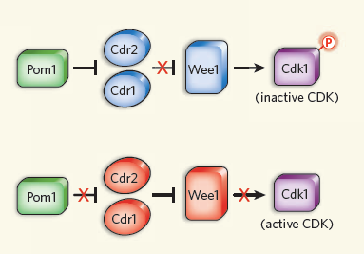
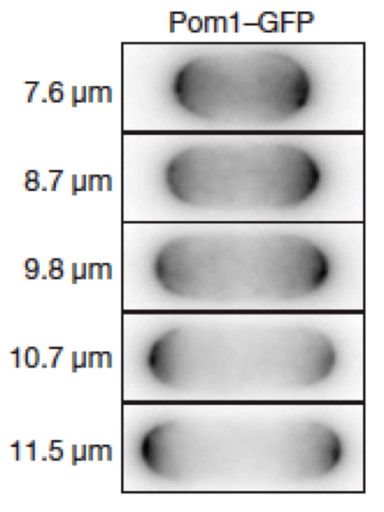
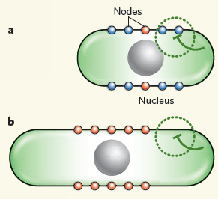
Space & time in signalling: A cellular mechanism
Regulation of cell division of yeast.
Observations: - Only big cells divide
- All components involved seem to be present continuously
- When nuclear Cdk1 is active => cell division
- Pom1 (green) inhibits Cdk1 via a cascade
Moseley, Nature 2009
3 - Protein domains p
Notes:
Some how Pom_1 is bound/retained at the tip of the cells
=> molecular interactions => proteins play a big role !!

Slide 7
Proteins : Modular assembly of functional domains
• Domains: - 50-150 residues that fold autonomously
- specific functionalities
- > 1’000 types of domains in genome
• Eukaryotic proteins comprise often several domains
- a combinatorial approach yields shear infinite possibilities
An example: Protein Kinase C
3 - Protein domains p
Notes:
Draw globular protein on the black board
Different domains : e.g. enzyme ; catalytic & binding & allosteric regulation
Draw structure when not on the membrane: pseeudo substrate blocks catalytic domain

Slide 8
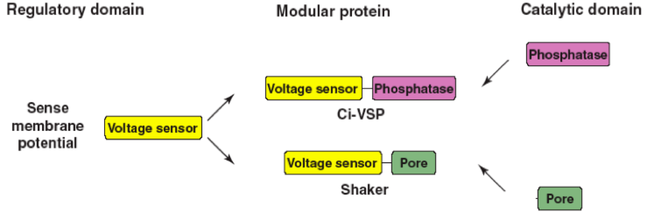
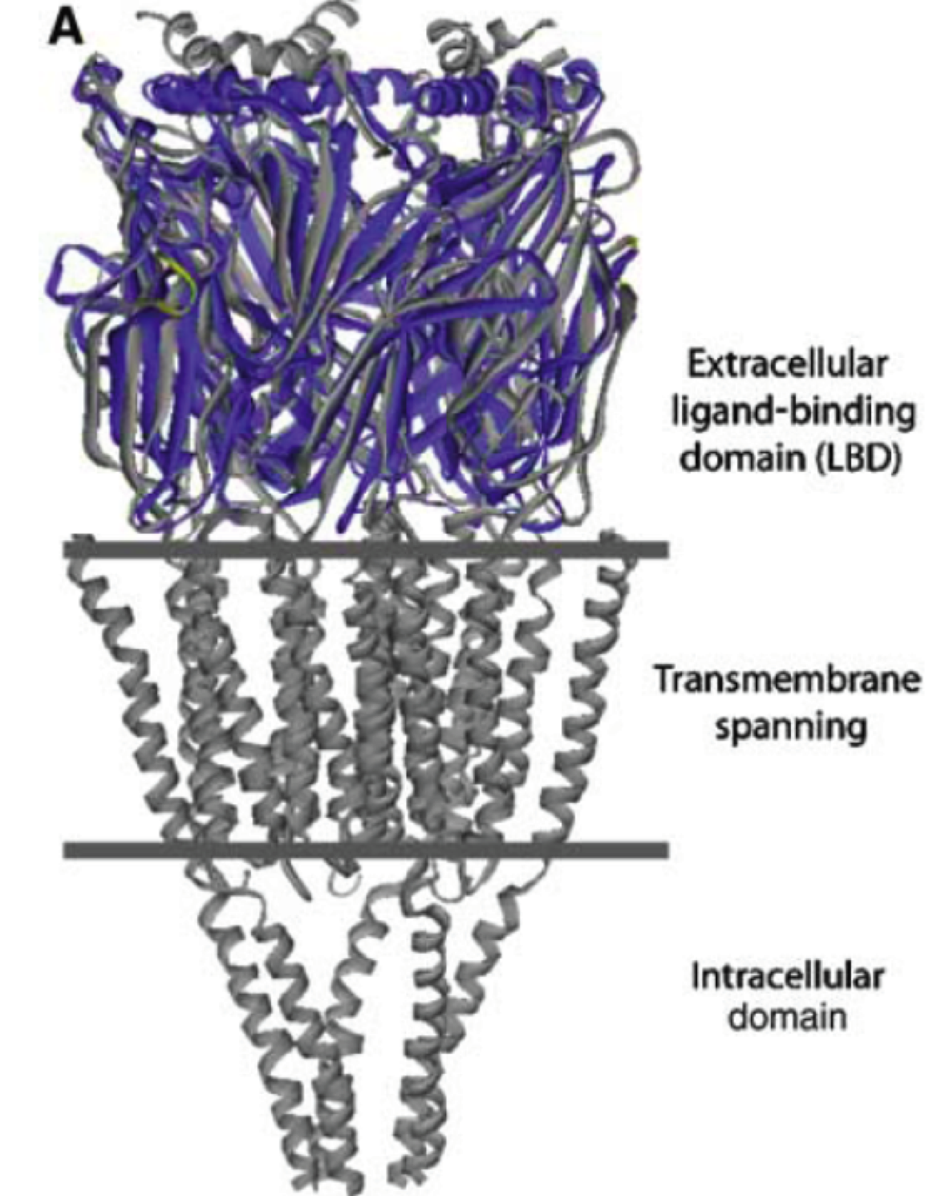
Combination of domains with different functions
Ligand-gated ion channels:
binding domain ->
channel domain ->
intracellular domain ->
Bhattacharyya Ann Rev Bc 2006
3 - Protein domains p
Notes:
Voltage sensor : membrane potentail depenedent structural changes
Phosphatase : cleaves Pi groups
Pore : transmembrane protein which allows ions to flow over the membrane

Slide 9
Many domains have been identified
Examples of protein domains involved in molecular recognition:
Domain Generally recognised Abundance in
sequence human genome
SH2 -pY-x-x-hydrophobic- 352
PTB -hydrophobic-x-N-P-x-pY- 141
SH3 -P-x-x-P-x 894
WW -P-P-x-Y- 307
14-3-3 -R-S-x-pS-x-P- 19
PDZ -E-S/T-D/V- C-terminus 918
PH phospholipids ±250
C2 phospholipids 641
NB: human genome encodes approximately 3.10⁴ proteins
M-M Zhou, Bhattacharyya Ann Rev Bc 2006
3 - Protein domains p

Slide 10
Phosphorylation : A common signalling motif
Writers:
- Kinases :
activity is
context-dependent
Erasers:
- Phosphatases :
activity is often
constitutive
Readers :
- Proteins with
specific domains
Lin (2010) Cell 142, 661
• Intro
3 - Protein domains p

Slide 11
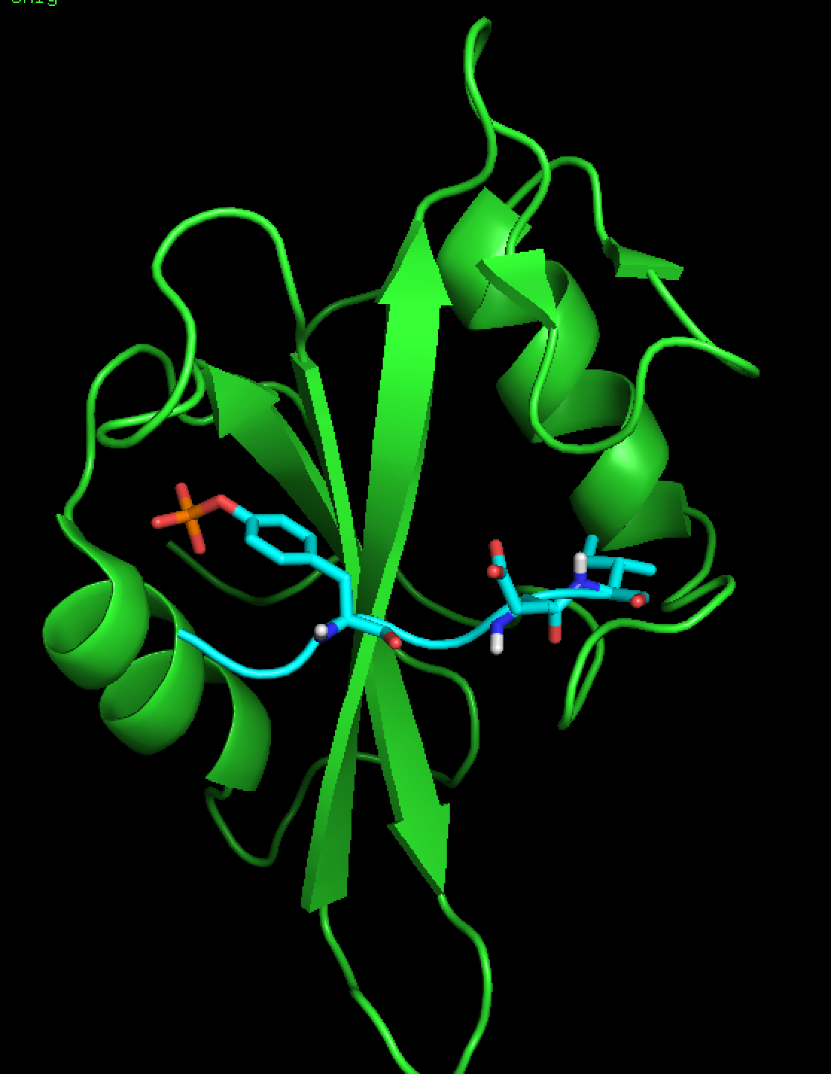
Example: SH2 domains recognising pTyr
Recognized sequence:
-Y^{P}-x-(x)-hydrophobic-
• Deep binding site for Y^{P}
containing 1 or 2 R’s
+
multiple H-bonds
• Binding “site” for
subsequent residues
==> Affinity of SH2-domains for pTyr ranges from 10⁶ to 10⁹ M⁻¹
==> Affinity of non-phosphorylated is ~1’000-fold lower
3 - Protein domains p
Notes:
the MET : hydrophobic contacts with a side chain of Arg & a Phe

Slide 12
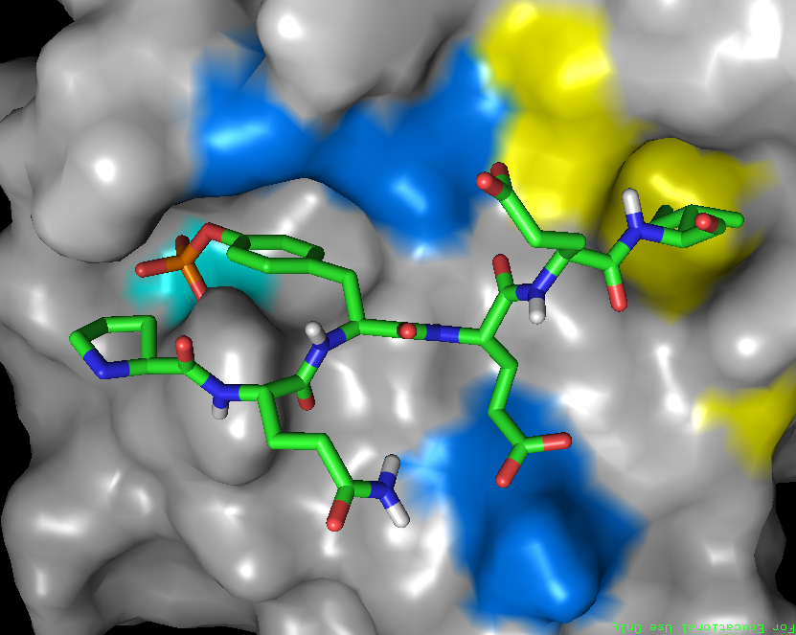
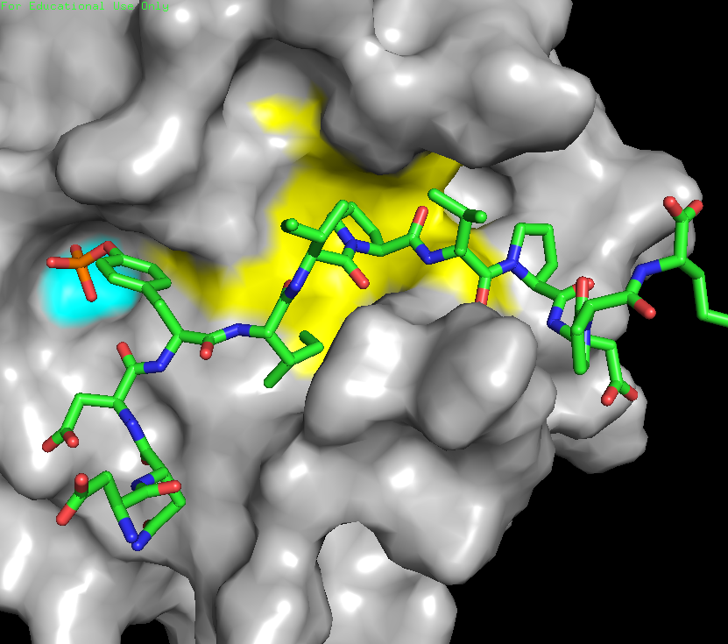
Example: SH2 domains recognising pTyr
Recognized sequence:
-Y^{P}-x-(x)-hydrophobic-
• Conserved overall structure
• Peptides positioned
similarly
• Interactions
Y^{P—-}R
polar
hydrophobic
top:
Src SH2 domain 1SPS.pdb :
PQY^{P}EEI
bottom:
PLCγ SH2 domain 2PLD.pdb :
DNY^{P}IIPLPDPK
3 - Protein domains p
Notes:
the MET : hydrophobic contacts with a side chain of Arg & a Phe

Slide 13


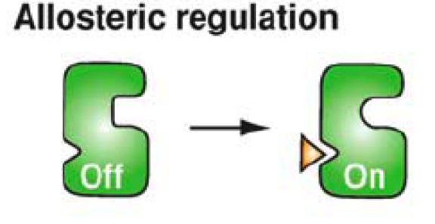
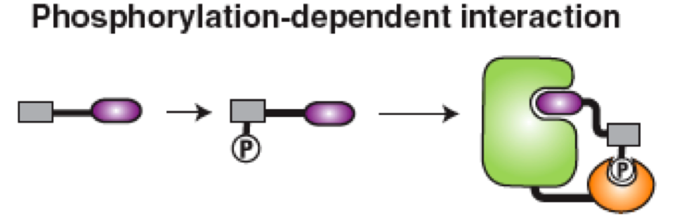
Domains and protein architecture and function
How to modulate enzyme activity ?
Enzyme
catalytic
site
•Regulation of activity - Only activity under certain conditions
M-M Zhou, Bhattacharyya Ann Rev Bc 2006
3 - Protein domains p
Notes:
Let’s imaging what one could do using domains that can eatables molecular interactions :
Enzyme substrate : how to increase the affinity , or how to make it conditional ?

Slide 14
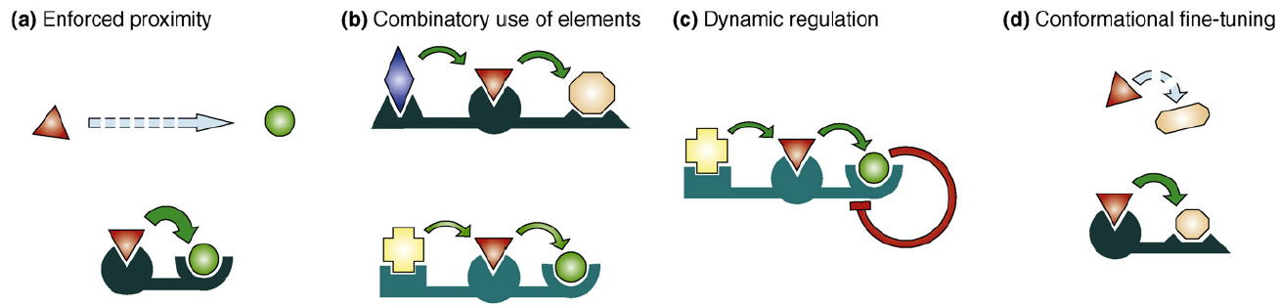
Scaffolds - regulation and integration
Adaptors & scaffolds: allow certain proteins to get together in a specific orientation and order at a specific site in the cell
Co-incidence : Only when all conditions are met,
a productive event can take place
=> modifications of scaffold or of proteins that bind affect output
Adaptor
Scaffold
“biological integrated circuit”
M-M Zhou, Zeke TiCB 2009
3 - Protein domains p
Notes:
Other way using proteins that are able to bring others to gather together:
Q: which molecule is a scaffold per excellence ?? => DNA
TF binds to its reconnition sequence: other protein from the initialtion complex bind and finally the RNA polymerase binds to the promotor site and transcription to mRNA can start

Slide 15
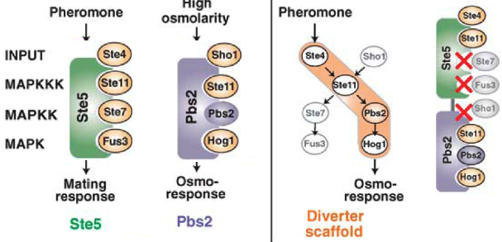
Scaffolds - regulation and integration
Comparison of pheromone and osmo-sensing in yeast
- organisation by different scaffolds
- different cellular response
Modified scaffold
M-M Zhou, Bhattacharyya Ann Rev Bc 2006
3 - Scaffolds p
Notes:
diploid yeast become haploid, either a or alpha; a & alpha can fuse and become diploid
coincidence : only when all are there things can happen !!!
Osmo : upregulation of glycerol-uptake & up regulation of glycerol production from glycolysis ::di-hydroxy acetone-Pi via dehydrogenase & phosphatase

Slide 16
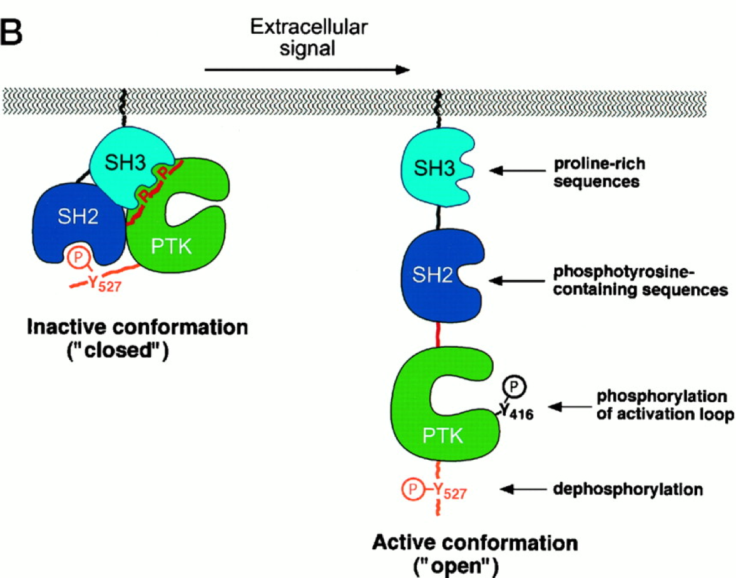
Intra-molecular co-incidence : Regulation of Src kinase
Src: Involved in cell differentiation;
- activity is tightly regulated,
- 4-component activation
4-binding P-rich
sequences
2-binding p-Y
sequences
3-Phosphorylation
1-Dephosphorylation
Domain Target
SH3 Pro-rich
SH2 pY
PTK pY-kinase
domain
P-P
v-Src: protein encoded by the Rous sarcoma virus
identical to Src, but missing the C-terminal Tyr
=> Active => cancer
M-M Zhou
3 - Protein domains p
Notes:
one of the 1st discovered domains with very tight internal regulation and negative feedback
which has a very compact folded-up inactive state
need competition of the internal interactions : SH” & SH3 as all as specific phosphorilytion & dephosphorilytion

Slide 17
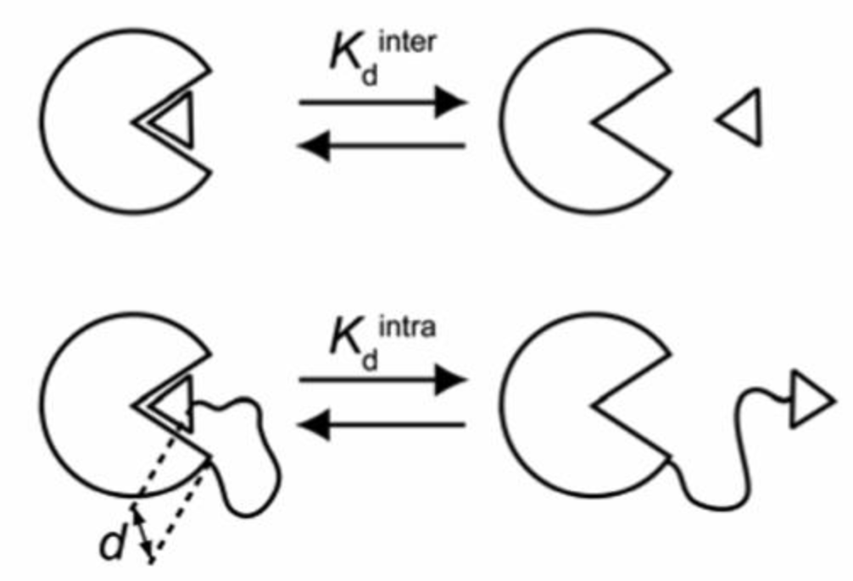
Effective molarity
A protein has a binding site to interact with ligand ◁ with Kd^{inter}.
How would tethering the ligand to the protein affect binding to Kd^{intra} ?
Or, what is the effective concentration Meff of the intermolecular ligand ?
Effect of linker length
3 - Protein domains p
Zeke TiCB 2009
Notes:
imaging 10x10x10 nm => 1 mM as effective concentration !!!!!!
Independent of the concentration !!!!
George Whitesides : the most cited chemists : most influencial chemist !
here local concentration enhancement through binding

Slide 18
Effective molarity - Enabling scaffolds
Scaffold: allows certain proteins to get together in a specific place
• Freely diffusing
1’000 molecules of Ste_11 and Ste_7 in a yeast cell of 40 μm³
=> Bulk concentration = 42 nM
• Bound to scaffolds
Introduce 1’000 scaffolds Ste_5
Each scaffold binds 1 pair of Ste_11 and Ste_7
Assume the diameter of the scaffold to be 100 Å
=> Total Scaffold Volume is 0.014 μm³
=> Local concentration = 120 μM
3 - Scaffolds p
Zeke TiCB 2009
Notes:
domains : higher local concentrations :
=> accelerated chemical kinetics
v = kx AxB => 3000 X 3000 fold increase !!!

Slide 19
Protein-protein interaction networks
3 - Networks p

Slide 20
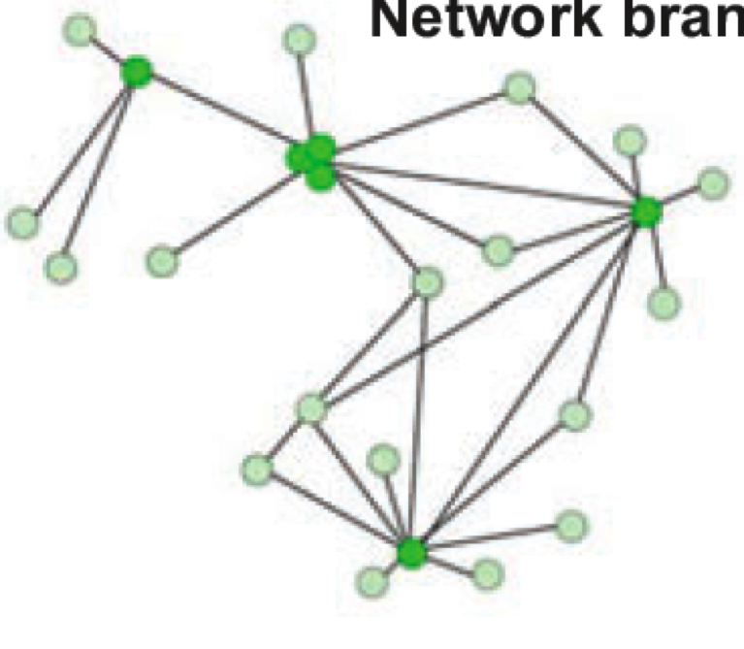
Protein-protein interactions : Genome-wide approaches
• Classical biochemical methods to determine protein-protein interactions:
2-hybrid, GST-pull down, phage display....
=> protein interaction maps, where dots represent proteins
lines indicate interactions
=> Very “simplistic” view of proteins
3 - Networks p

Slide 21
Protein-protein interactions : Genome-wide approaches
• Domains: - ~1’000 types of domains in genome
÷ for > 750, one or more structures are known
- ~10’000 types of domain - domain interactions are predicted
÷ 20% have been structurally characterised
=> Use structural information to predict
- interactions between domains & between proteins
- identify interactions that
÷ can happen simultaneously
÷ are sterically overlapping
- estimate by modelling
÷ affinities
÷ rate constants
3 - Networks p
Notes:
overlap : mutually excludeing

Slide 22
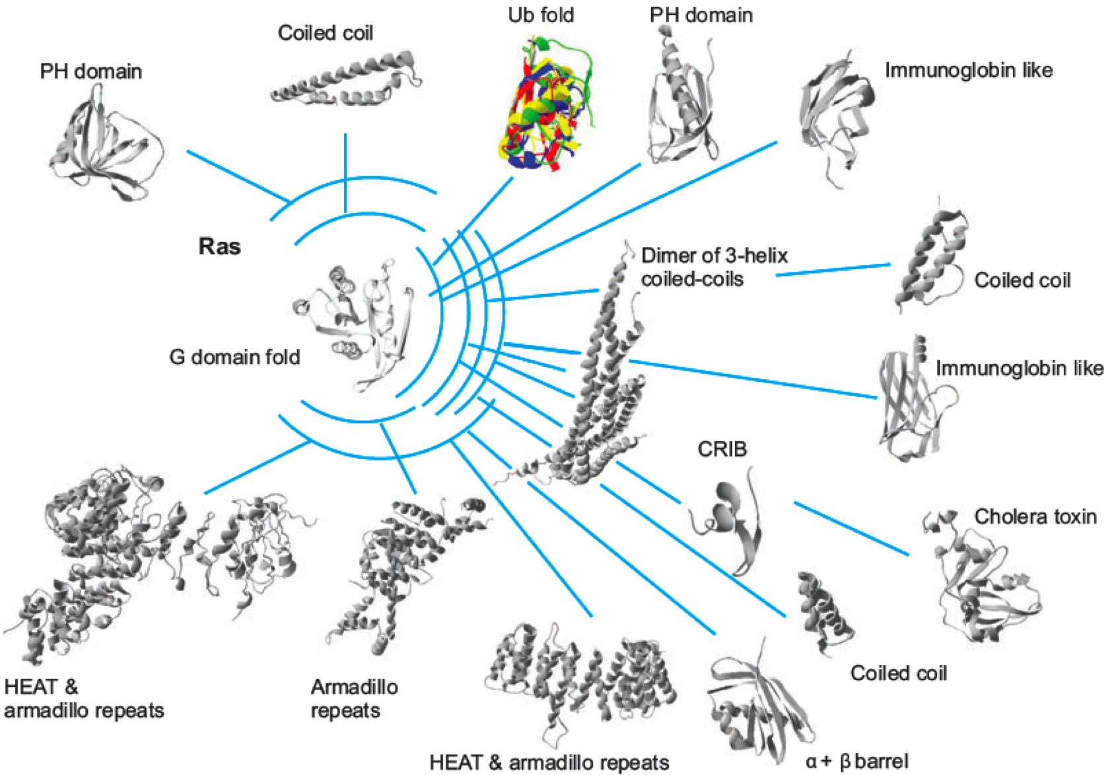
Protein-protein interactions : Genome-wide approaches
• An example for the Ras-protein:
3 - Protein domains p
Notes:
need to know which proteins are present where & when and how much !! and in which state
=> expression atlas

Slide 23
Linear medication:Disaese => Gene => Pill
”A linear concept” in pharmacy and medicine:
1 disease <=> 1 gene <=> 1 medication
• Identification of a disease:
i• Symptoms Diagnosis or effect
ii• Pharmacology Well-defined ligand
iii• Signal transduction
or Precisely described mechanism
Metabolic route
iv• Gene Ultimate identification
3 p
Networks
Notes:
Classical : Reaction _> gene
Modern: Gene ->? or ligand ->? orphan receptor or orphan ligands

Slide 24
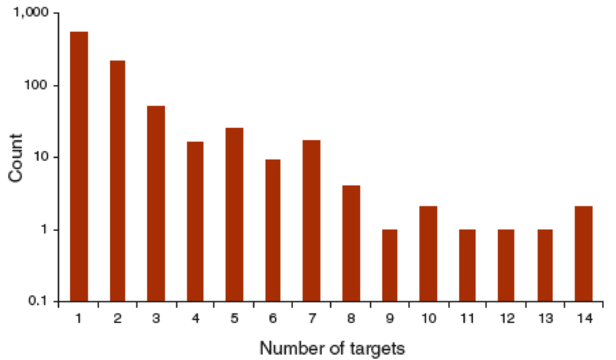
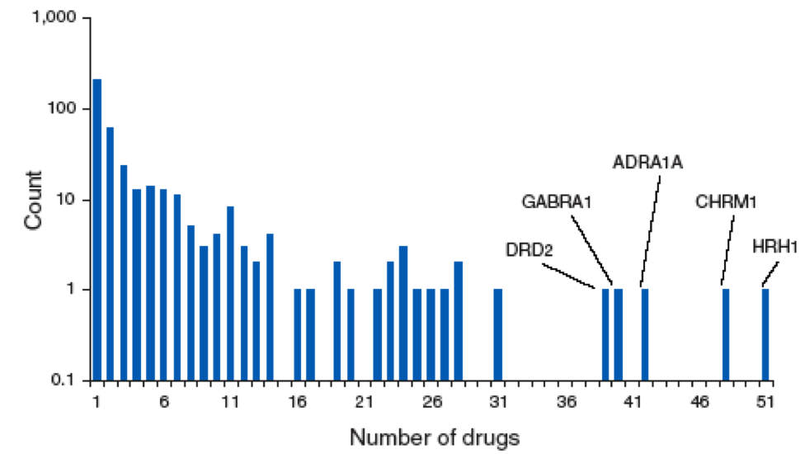
1 Disease - 1 Gene - 1 Medication ?
• What does statistics say?
Network analysis of all FDA-approved drugs (890)
and their known targets (394)
How many targets per drug? How many drugs per target?
M.A.. Yildirim, Nat Biotech 25 (2007) p.1119
3 p.
Networks
Notes:
Classical : Reaction _> gene
Modern: Gene ->? or ligand ->? orphan receptor or orphan ligands
majority of drugs 1 target or few only
majority of targets only 1 drug

Slide 25

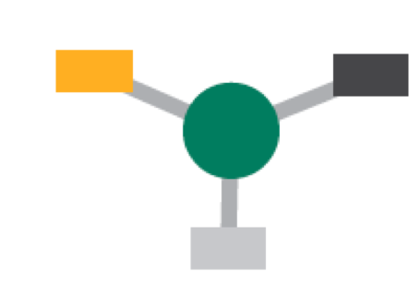
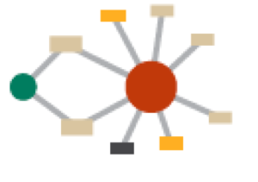
1 Disease - 1 Gene - 1 Medication ?
Next step:
- integration of drug-target relations into a network
- size of symbol corresponds to number of interactions
890 drugs in total:
- 102 are linked to only one target: 1 drug 1 target
- 788 are linked to multiple targets, e.g.: 1 drug 3 targets or small networks
- the biggest network contains 476 drugs !!
M.A.. Yildirim, Nat Biotech 25 (2007) p.1119
3 - p.
Networks
Notes:
circle : drug
square is protein/target
Classical : Reaction _> gene
Modern: Gene ->? or ligand ->? orphan receptor or orphan ligands

Slide 26
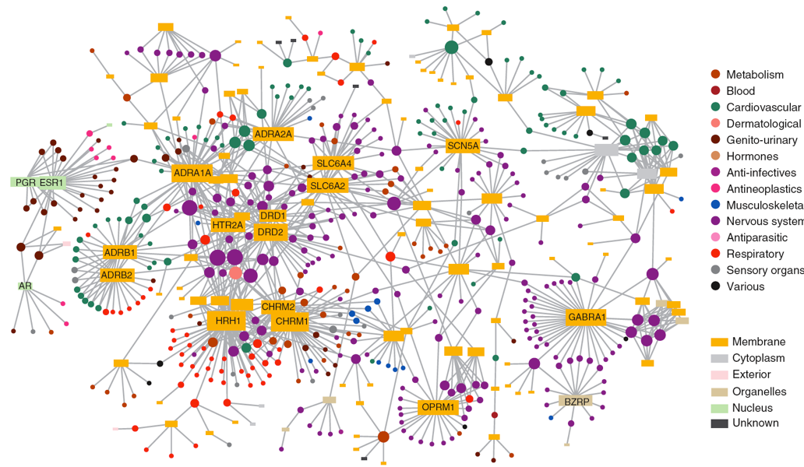
Drug - target network
Circle: drug
Box: target
3 p.
Networks
M.A.. Yildirim, Nat Biotech 25 (2007) p.1119
Notes:
it is like a spider web all is connected which ever strips you pull all is moving more or less.
Classical : Reaction _> gene
Modern: Gene ->? or ligand ->? orphan receptor or orphan ligands
DRUG <=> protein & disease class PROTEOME

Slide 27
Drug - target network
The linear concept was:
1 disease <=> 1 gene <=> 1 medication
==> search for selective compounds to avoid unwanted targets and side effects.
However,
- many of the “selective drugs” do act in a network on several targets & diseases
- many effective drugs interact with multiple targets
=> “poly-pharmacology”
Indications for this from biology:
- gene knock-out does not always have effects
- “random” accumulation of mutations in multiple genes cause disease
Prediction from systems biology:
- components that act on > 1 target are more effective than those acting on 1 only
- combining compounds acting on different targets is more effective
3 p.
Networks
A. L. Hopkins, Nat Biotech 25 (2007) p.1110
Notes:
Classical : Reaction _> gene
Modern: Gene ->? or ligand ->? orphan receptor or orphan ligands

Slide 28
Protein - protein interactions & signalling
÷ Reversible interactions with a limited life-time
÷ Domains with specificity for certain sequences
÷ Combination of domains to create a specific function
÷ Interactions affected by signalling
÷ Scaffolds and adaptors dictate order of events
÷ Signalling cascades localised in space and time
÷ Co-incidence and integration
3- Protein domains p

Slide 29
Specific, reversible and adjustable interactions
=> organisation
=> localisation
=> integration
=> enabling
Further reading:
=> Good:”Scaffold Proteins: ”Hubs for controlling the flow of cellular information Science 2011
=> Seet: “Reading protein modifications with interaction domains”
Nat Rev Cell Biol 2006
=> Zeke: “Scaffolds: interaction platforms for cellular signalling circuits”
TiCB 2009
=> Kiel: ”Analyzing protein interaction networks using structural information” Ann Rev Biochem 2008
3 p

