Slide 1
Receptor - ligand interactions :
- Equilibrium
- Thermo & kinetics
- Methods to determine
- Efficacy
“Receptor” can also be “enzyme” or more general “protein”
2 p.
Notes:
P

Slide 2
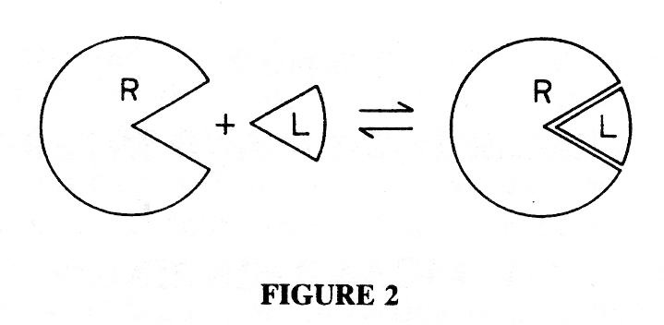
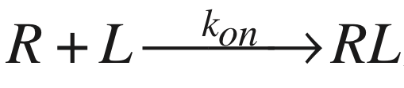
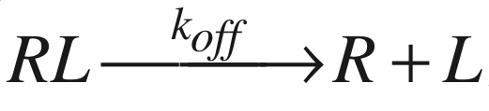
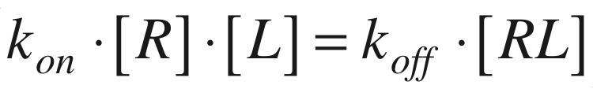
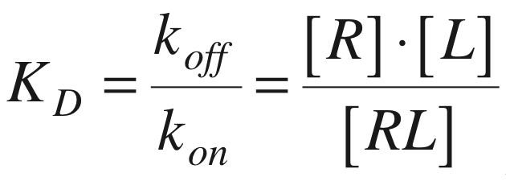
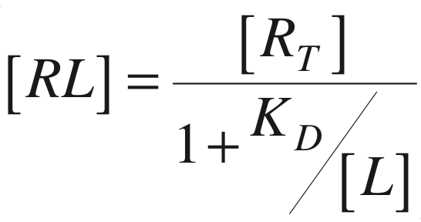
Receptor - Ligand interaction
1-to-1 stoichiometry: Association Dissociation
At equilibrium:
Dissociation constant: (unit: M)
=> Langmuir isotherm:
Langmuir: The absorption of gases on plane surfaces of glass, mica and platinum. JACS. 40, 1918, p.1361.
2 - p.
• Equilibrium binding
Notes:
k_on often (close to be) diffusion limited
asymptotic behaviour, similar to M&M
Often what you would like to know are Kd & R_tot

Slide 3
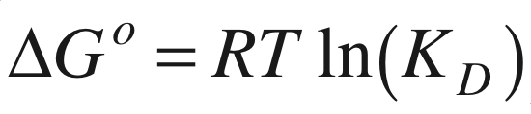

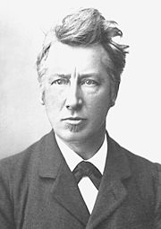
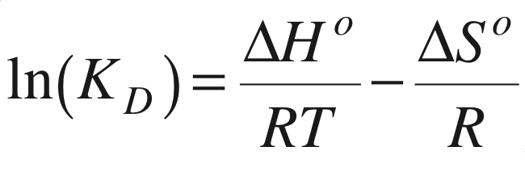
Receptor - Ligand interaction: How strong?
Gibbs free energy at equilibrium:
◊ 10-fold lower KD decreases ΔG by -5.7 kJ/mol
(or ~1.4kcal/mol)
◊ Instead of KD one often prefers:
From the T-dependence of KD one can estimate ΔH° and ΔS°:
Van ‘t Hoff
2 - p.
• Thermodynamics
Notes:
d(lnKd)/dT = DH/RT^2 if DS and DH not T dependent if DS & DH are not too dependent
Van ‘t Hoff plot : ln Kd vs 1/T
Why pKd ?

Slide 4
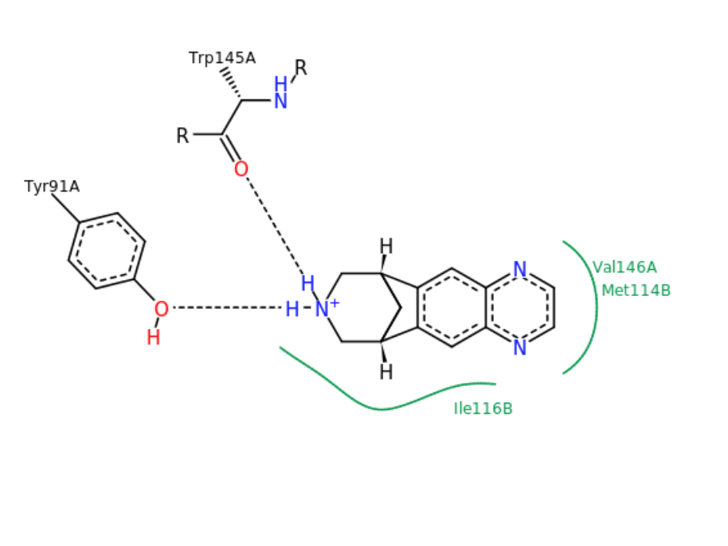
Receptor - Ligand interaction
Scaling interactions looking at the energy:
Covalent bonds 200 - 400 kJ/mole
Ion - dipole 50 - 200
Anion-cation 6 at 3Å in water
Dipole-dipole 5 - 50
H-bond 4 - 13
Ion - π 5 - 80
π - π 0 - 50
Van der Waals 2 - 4 per atom pair
kT 2.48
Varenicline bound
to acetylcholine
binding protein
2 - p.
• Thermodynamics
Notes:
5.7 kJoule = 10 -fold change in Kd
kT = ~2,4 kJ
60 nM VARENICLINE to acetylcholine receptor

Slide 5
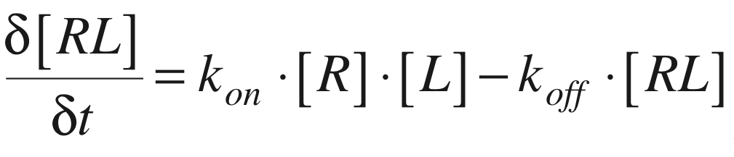
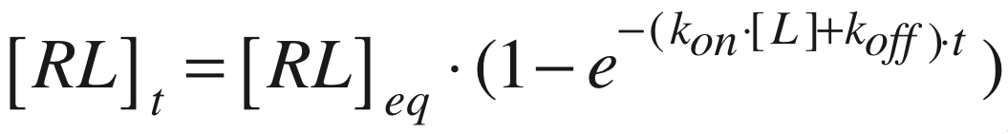
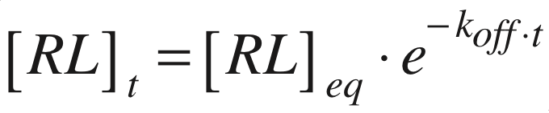
Receptor - Ligand interaction: Who long?
Association:
Assuming [LT] >> [RT]:
Dissociation
upon removal of L:
◊ The mean lifetime <𝜏> of RL equals 1/koff
• Kinetics
2 - p.
Notes:
Dissociation:mono-exponential decay
1/k = <t> mean or time constant
half.live = ln(2)/k = 0.7/k

Slide 6
k_{off}, residence time and target potency
k_{off vs} k_{on for 3 examples}
=> Affinity (=1/Kd) seems to be governed by koff
streptavidin
mutants
vs
biotin
HIV protease
mutants
vs
saquinavir
Methyl transferase
vs
several
inhibitors
2 - p.
• Kinetics
Copeland, Nat Rev Drug Disc (2016)15, p87
Notes:
strep mutants

Slide 7
k_{off}, residence time and efficacy
=> Affinity (=1/Kd) seems to be governed by koff
Copeland, Nat Rev Drug Disc (2016)15, p87
2 p.
• Kinetics
Notes:
target occupation
survival upon bacterial infection & then treated with different inhibitors

Slide 8
- Methods to determine binding
2 p.
Notes:
P

Slide 9
Localising receptors in tissues
Hi: hipocampus
La: lateral layer
Pir : pyramidal layer
Cb : cerebellum
Sol : solaris nucleus tractus
DH : dorsal horn
See also:
www.proteinatlas.org
visible human project
2 - p.
Notes:
what other methods : mRNA, Ab’s, ..
PIR Pyramidal layer sol: Solaris nucleus tractus
Hi:: hypocampus
DH Dorsal horn in the spinal cord
the protein atlas https://www.proteinatlas.org/ENSG00000166736-HTR3A/tissue
Visible Human Project

Slide 10
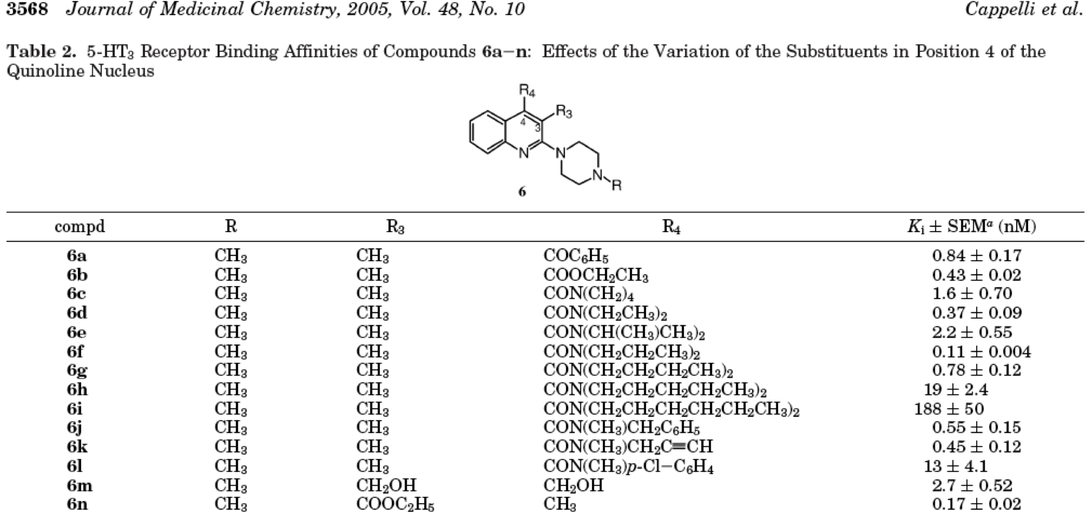
Quantifying receptor - ligand interaction
=> Understanding receptor ligand interaction, e.g. for medical chemistry
2 - p.
Notes:
draw quipazin
till 2 n-butyl

Slide 11
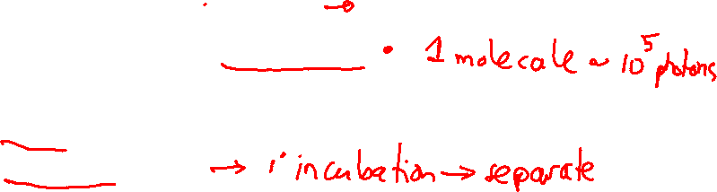
Quantifying and localising receptor - ligand interactions
Receptor Organism
Tissue
Homogenate
Cell culture
Membrane preparation
Purified
Ligand Label-free
Labelled Isotope
Fluorophore
Assay format Homogeneous
Heterogeneous
2 - p.
Notes:
the protein atlas https://www.proteinatlas.org/ENSG00000166736-HTR3A/tissue

Slide 12
Heterogeneous methods : Separation needed
How to determine RL without affecting the equilibrium?
=> be fast, with separation times < 1/koff
Compare 2 standard separation methods:
- Rapid filtration separation in ∼ 1 sec
- Gel filtration ∼10-300 sec
kon ∼ 10⁶ M⁻¹ s⁻¹ Kd = 10 μM koff = 10 s⁻¹
  1 μM koff = 1 s⁻¹
                10 nM koff = 0.01 s⁻¹
                1 nM koff = 0.001 s⁻¹
  => Only applicable in case high-affinity or very slow ligands
2 - Quantifying RL p.

Slide 13
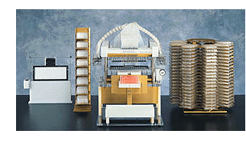
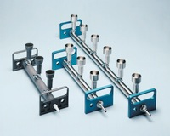
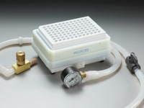
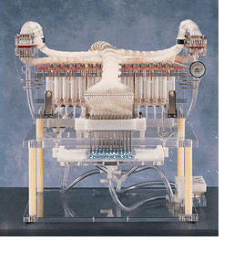
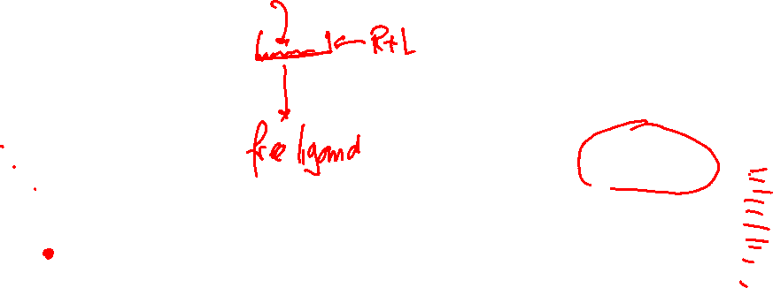
Quantifying receptor - ligand interaction
Rapid filtration:
- incubation mixture is sucked through a filter by vacuum
- receptor proteins are retained by the filter
Manual filtering Automatic filtering
- radioactivity on filter is quantified by scintillation counting
2 - Quantifying RL p.
Notes:
like a Büchner
robot like the stacker in

Slide 14
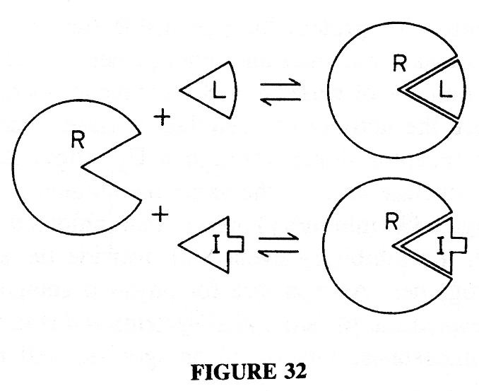
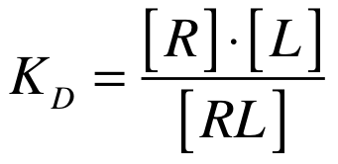
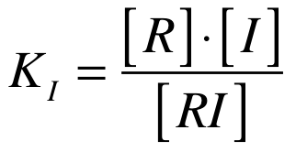

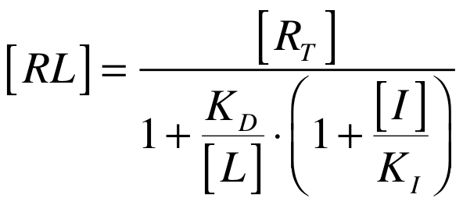
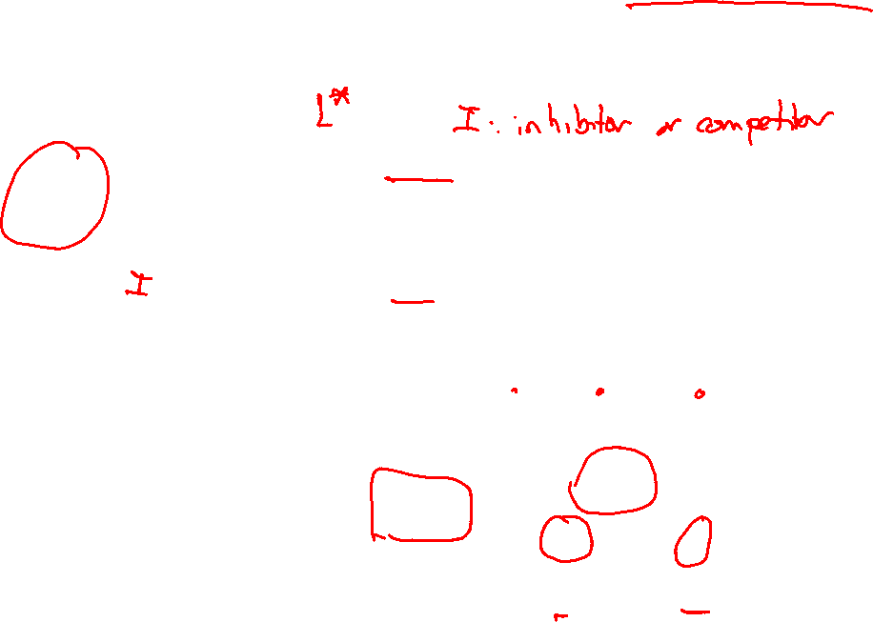
Ligand-binding assays with competition
Reversible inhibitor I competing for the same binding site:
2 - p.
• Equilibrium binding
Notes:
when I gets large => RL goes to ZERO
when Ki gets small => RL goes to ZERO
When L get big => RL get RT

Slide 15
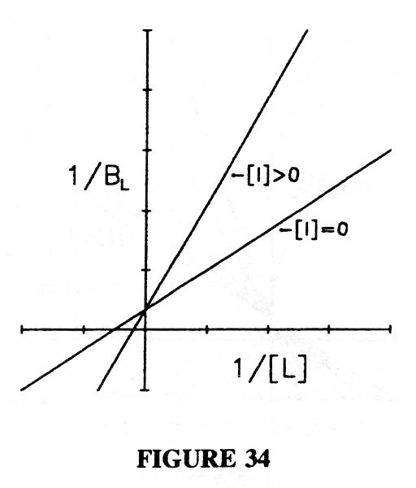
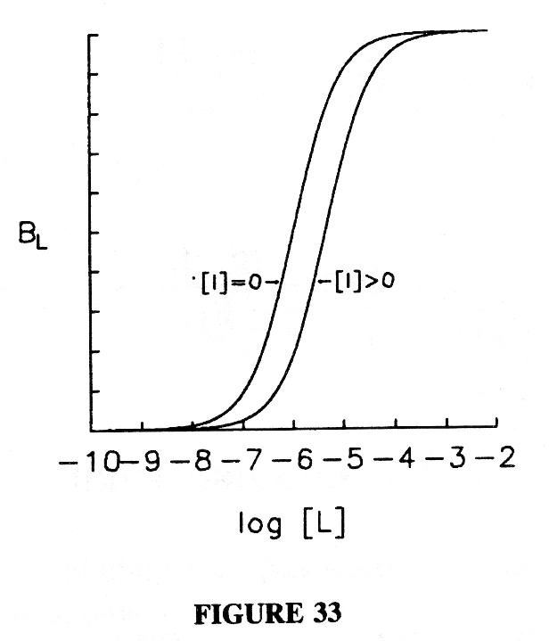
Receptor - Ligand interaction: Competition
Reversible inhibitor I competing for the same binding site:
- Binding isotherm of L shifts to higher concentrations
=> apparent higher KD
- Maximal binding is unaffected
Semi-logarithmic plot Double-reciprocal plot
1/[RL]
[RL]
2 - p.
• Equilibrium binding
Notes:
slope Kd/RT (1 +I/Ki)

Slide 16
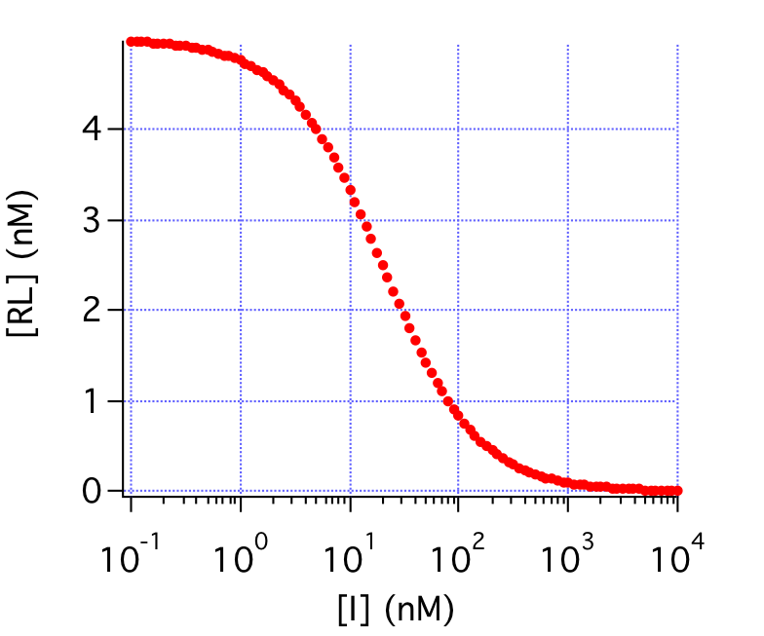
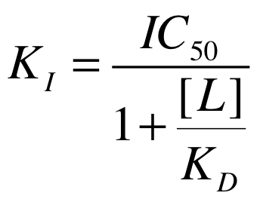
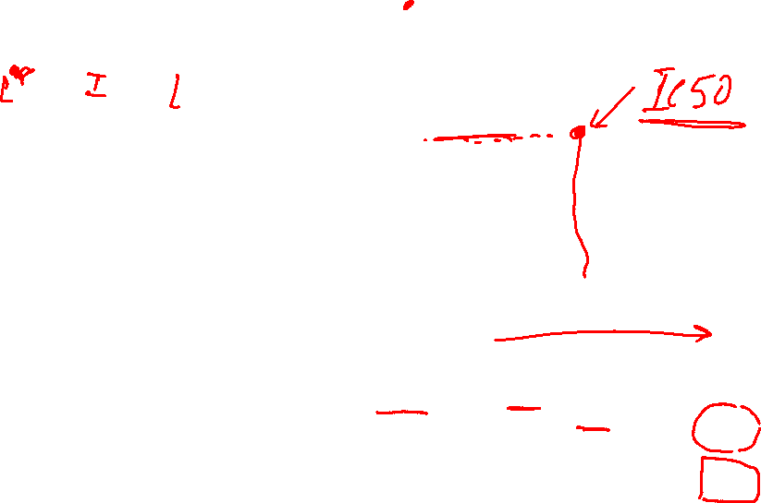
Receptor - Ligand interaction : Competition
Increasing concentrations of [I] will compete out L for binding to receptor
e.g. [RT]=[KD]=[KI]=[L]= 10 nM
IC50: [I] of half-maximal inhibition
of binding of L to R
Cheng-Prusoff equation (1973) relates IC50 and KI:
5
//
//
0
2 - p.
• Equilibrium binding

Slide 17
Quantifying receptor - ligand interaction
=> Understanding receptor ligand interaction, e.g. for medical chemistry
2 - p.
Notes:
draw quipazin
till 2 n-butyl

Slide 18
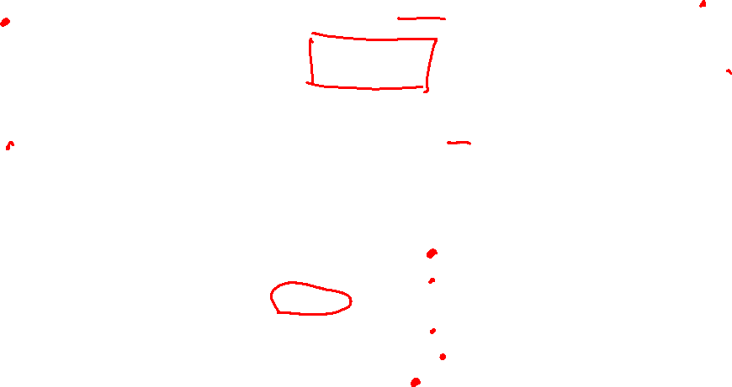
Methods to quantify receptor - ligand interactions
NMR
CETSA
2 - p.
Notes:
homo VS hetero label-free vs label
no or yes separation need to make or not

Slide 19
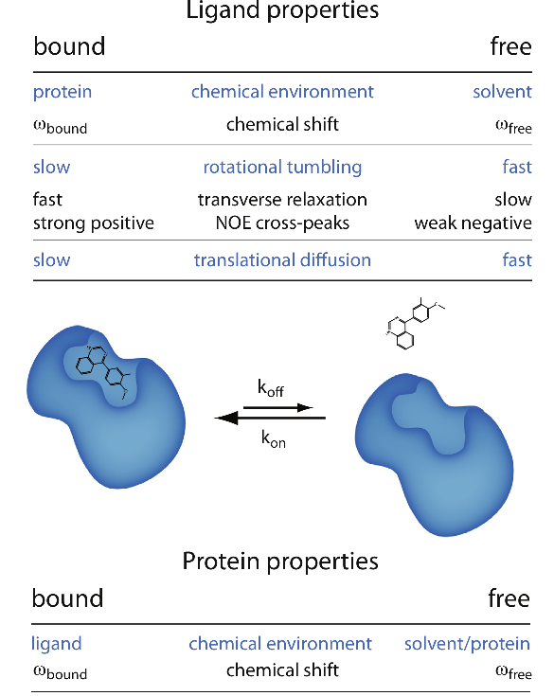
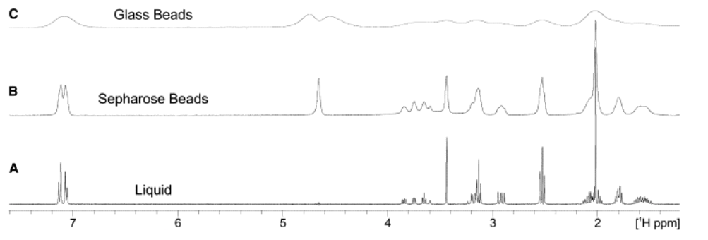
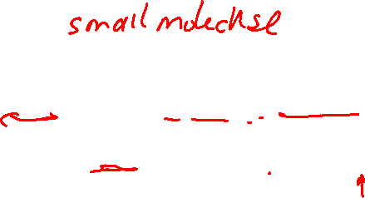
NMR for drug screening
TINS : Target Immobilized NMR Screening
What change upon binding ?
Small molecules in solution
in liquid
with sepharose
with glass beads
2 - Quantifying RL p.
Siegal, Chem & Biol, 12 (2007)207
Gossert, Prog NMR Spec, 97 (2016) 82
Notes:
Bound fast transversal relaxation => T2 small => R2 large => broad resonance

Slide 20
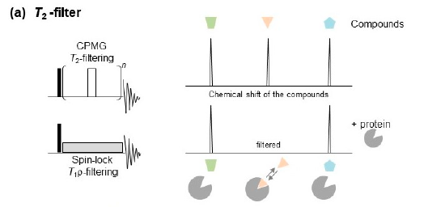
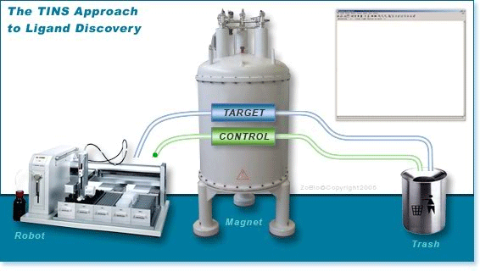
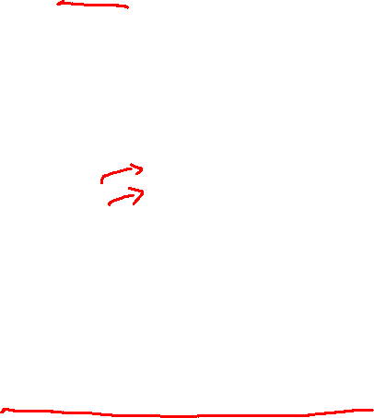
NMR for drug screening
How to screen efficiently ? Industrial platform
Mix & measure www.zobio.com
Up to 100 compounds per run
Sugiki, Molecules 2018, 23,148
2 - Quantifying RL p.

Slide 21
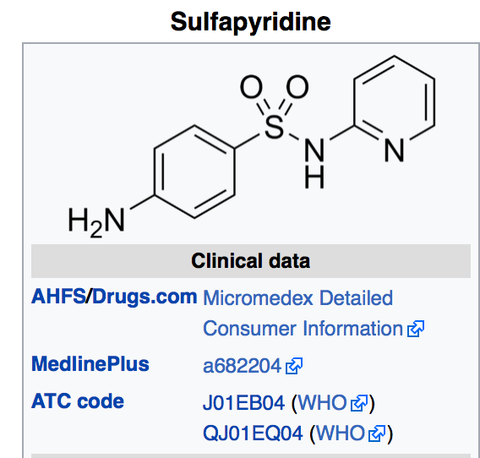
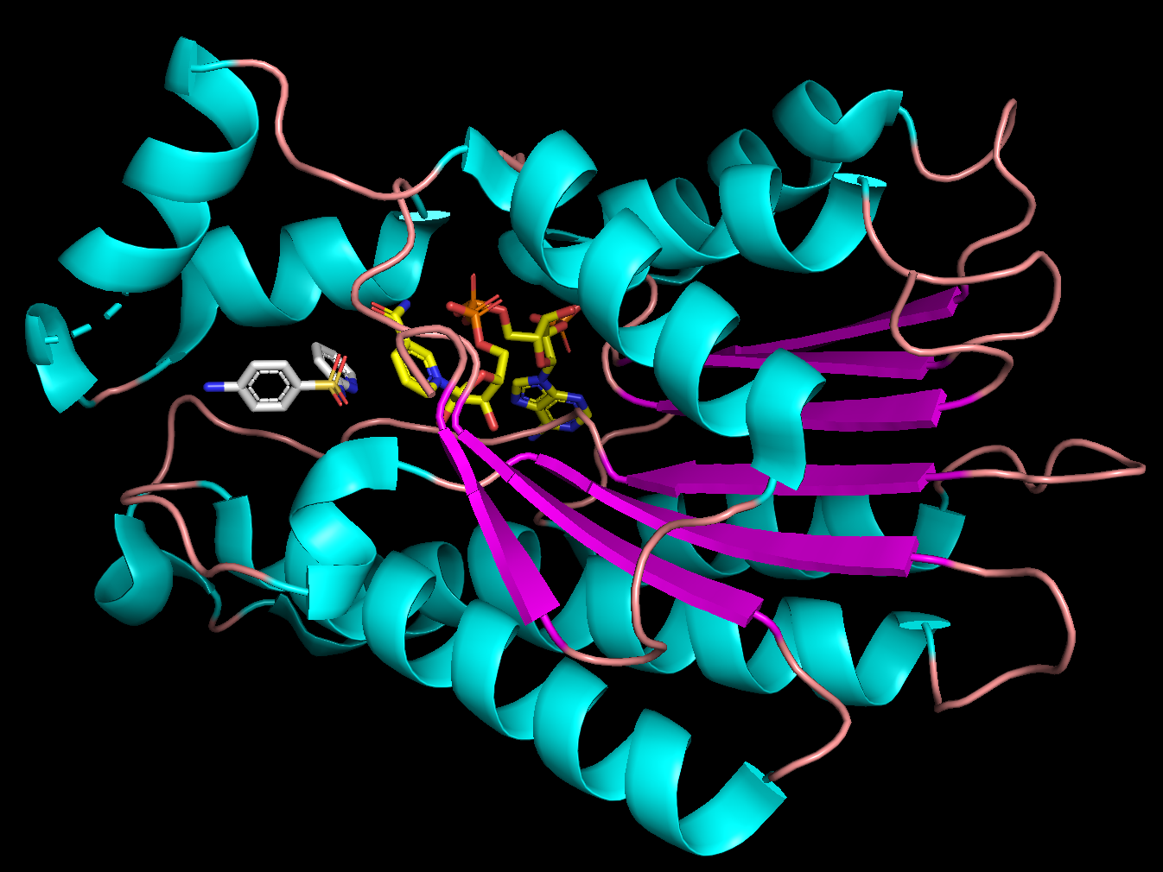
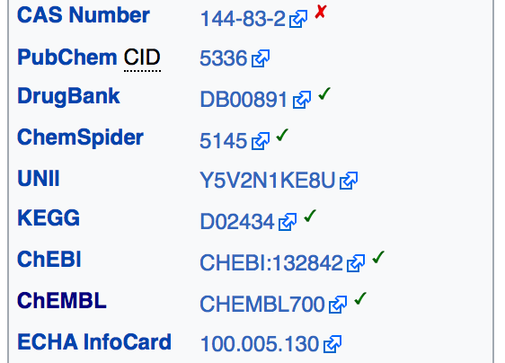
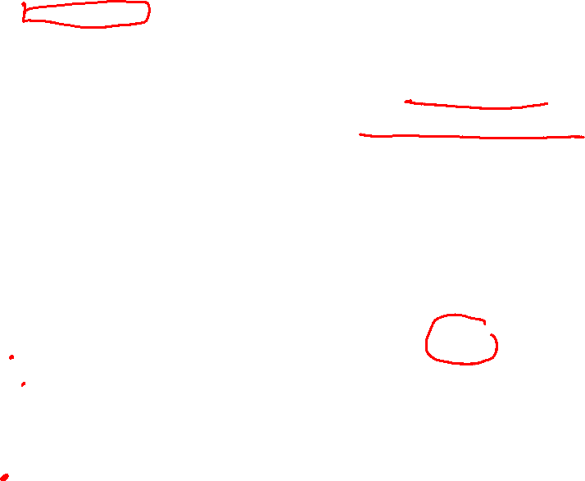
Ligand - Protein interactions :: Information data bases
Knowledge-based :
Protein structure-based :
PDB at http://www.rcsb.org
e.g. sulfapyridine bound to
sepiapterin reductase
4HWK.pdb
2 Databases p.

Slide 22
- Efficacy
2 p.
Notes:
P

Slide 23

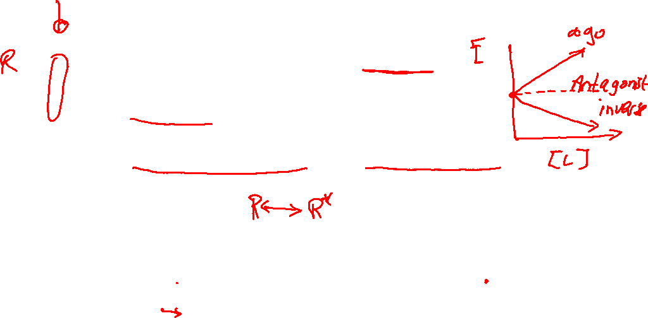
Ligand effect on receptor activity & cellular response
Ligand nomenclature :
- Activation of effect =>Agonist
- No effect =>Antagonist
- Inhibition of effect =>Inverse agonist
effect
Manner of ligand action :
  Reversible or irreversible
  Competitive or noncompetitive
3 - Introduction Ligand character p.
Notes:
explain on the black board : dose response

Slide 24
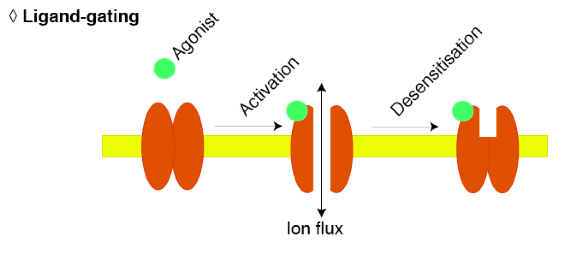
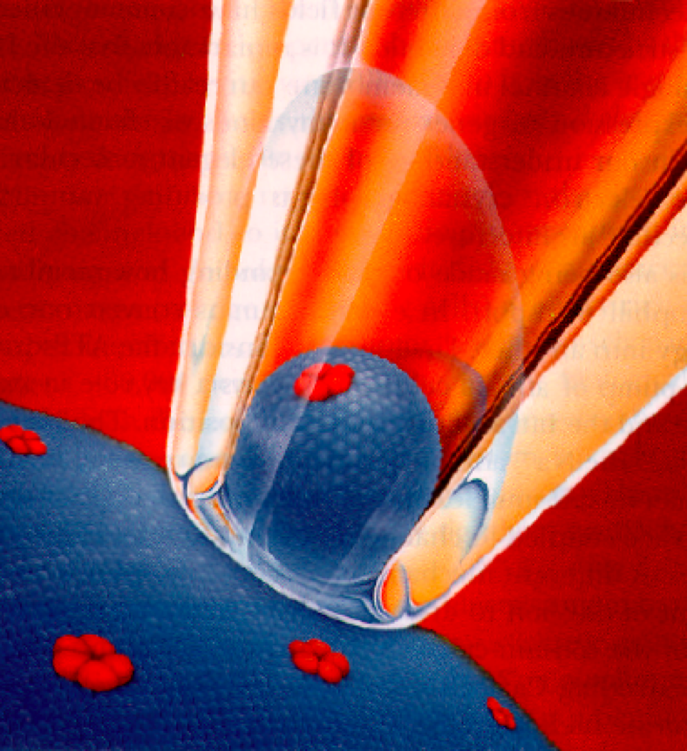
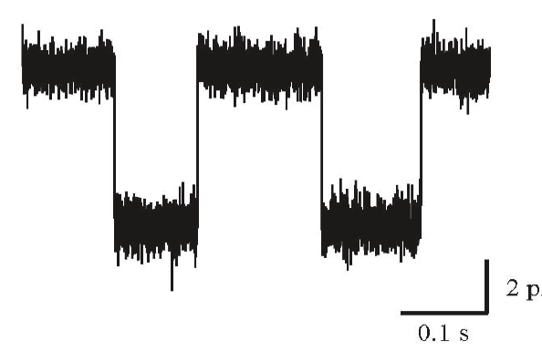
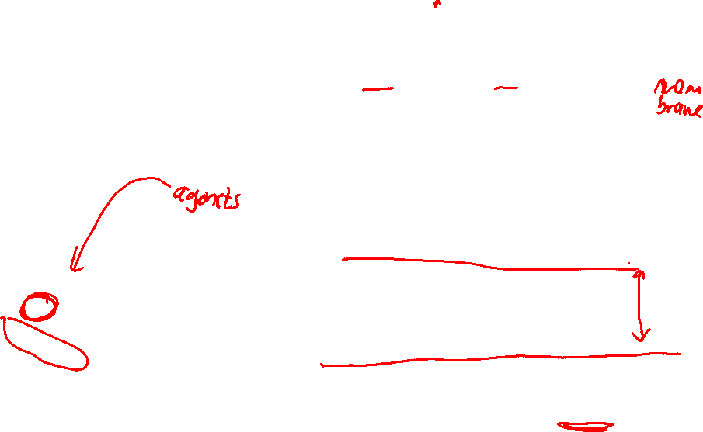
Receptor activation : The most simple case
Agonist-binding induced activation
e.g. ligand-gated ion channel
ligand binding channel opening
    Single-channel patch clamp
    electrophysiology
closed
open
A
2 Receptor activation p.

Slide 25
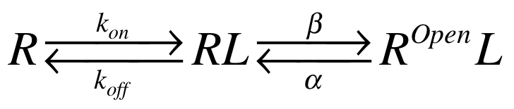

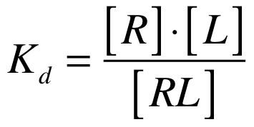
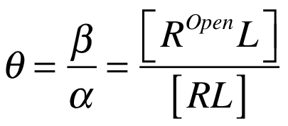
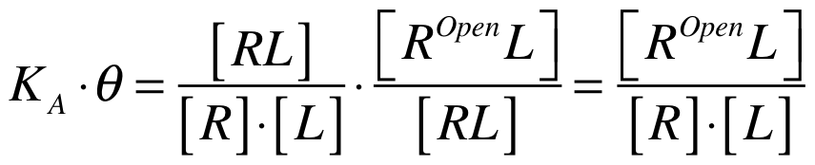

Receptor activation
Ligand binding is followed by a structural change that leads to opening of an internal channel
Del Castillo-Katz equation (1957):
Dissociation constant Gating constant
Effect ~ Binding x Gating =
2 Receptor activation p.

Slide 26




Receptor activation
Only binding Binding & activation
50 % of RT as RL when
Half-maximal receptor activation, when
This [L] concentration is called EC50:
Concentration giving half-maximal effect
2 Receptor activation p.

Slide 27



Receptor activation - Effect of mutations
The ligand-concentration dependency of binding and activation can be affected by mutations, below a hypothetical example:
Q: What is affected by the mutation?
2 Receptor activation p.

Slide 28


Ligand-gated ion channels : The power of θ
E.g. KD = 10⁻⁵ M & θ ranges from 0.125 to 1000
θ=1
θ => affects both potency (EC50) & efficacy
2 Receptor activation p.

Slide 29




Receptor activation - Effect of mutations
  Labarca & Lester,
  Nature 1995
  Labarca & Lester,
  Nature 1995
2 Receptor activation p.

Slide 30
Relating ligand binding and cellular effect : Disproportionality
2 Receptor activation p.

Slide 31



Relating ligand binding and cellular effect : Disproportionality
2 Receptor activation p.

Slide 32

  Further reading:
  Stryer
  Colquhoun 1998 : Receptor - ligand interactions
  Colquhoun 2006 : Historical perspective
  Copeland 2016 : Drug-target residence time
  Next week:
  Molecular interactions
https://www.proteinatlas.org
2 - Introduction p.

