Slide 1
Papers presentation
Biochemistry - Ruud Hovius
Benard Arthur
Bongini Arthur
Cerutti Louma
Lang Victoire

Slide 2
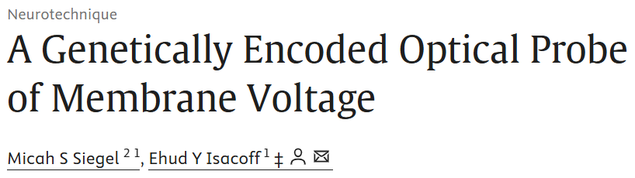
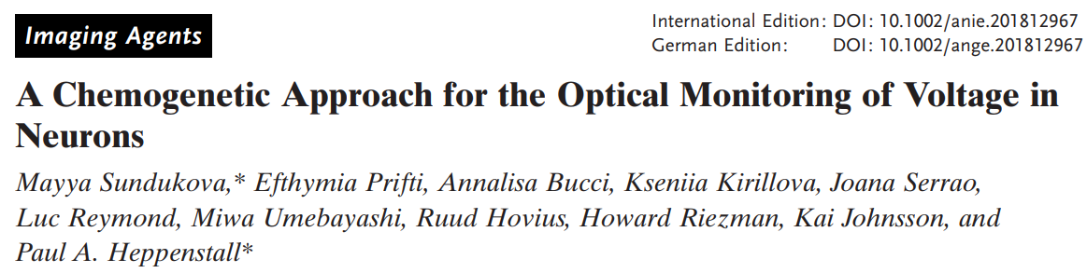
Two papers

Slide 3
Introduction

Slide 4
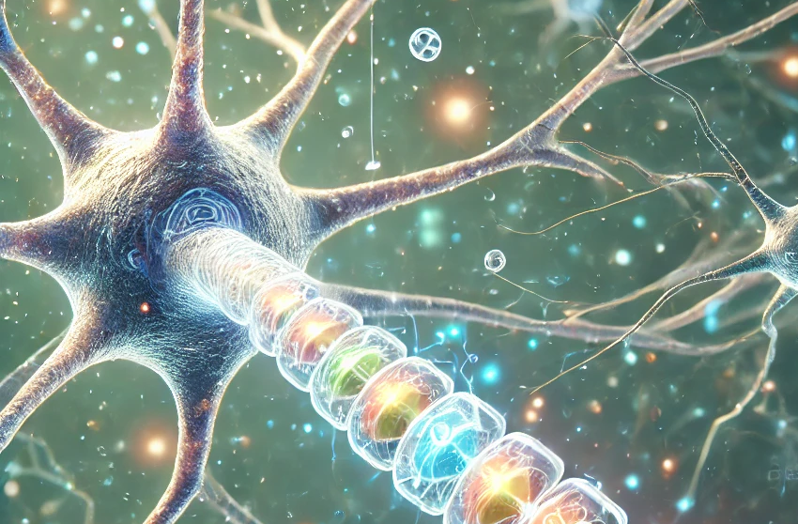
Why study membrane potential nowadays ?
Better understanding the electrical dynamics of neuronal membranes
Fundamental communication between neurons
traditional electrode-based method:
effective
BUT
lack of spatial or temporal resolution
invasive

Slide 5
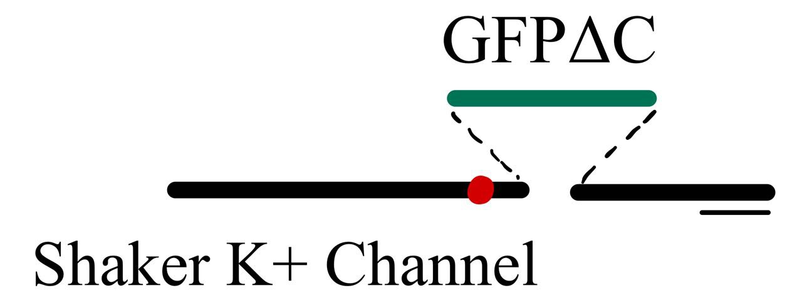
Two innovative approaches
Genetically encoded optical probe
responds rapidly and sensitively to voltage variations
powerful and non-invasive
good temporal resolution
allows us to study action potentials
more subtle phenomena such as inhibitory activity, often overlooked by conventional techniques.

Slide 6
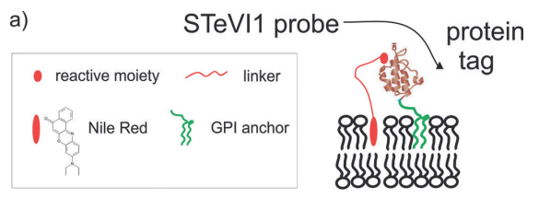
Two innovative approaches
Chemogenetic Approach
STeVI1 probe
combine Nile Red and targeted proteins
target neuronal membranes precisely
enhancing sensitivity and minimizing interference

Slide 7

Broader Implications
push back boundaries of neurobiology with tools from biotechnology and chemistry
potential application in the developments of treatments for neurogical diseases

Slide 8
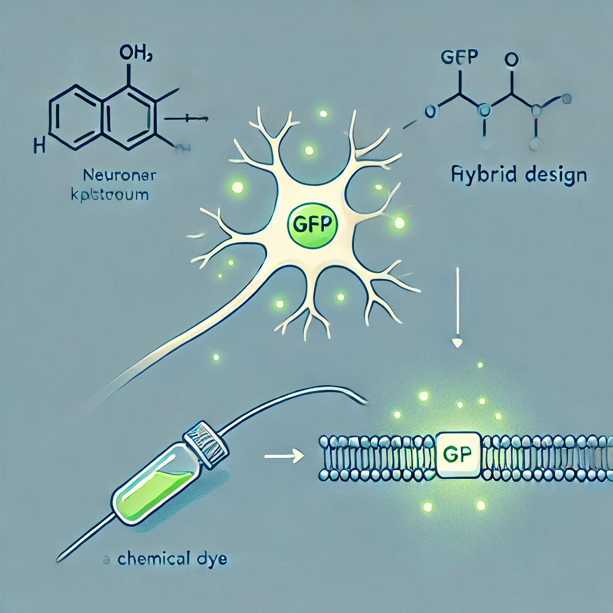
Aim of the study

Slide 9
First paper (1997): Genetically encoded optical probe
Objective : Design and validate a genetically encoded optical sensor for monitoring membrane voltage.
Key Innovation : GFP fused with the Shaker potassium channel to detect voltage changes.
How it works : Leverages voltage-dependent structural rearrangements to produce measurable fluorescence.
Advantages over traditional tools :
a. Higher specificity.
b. Non-invasive and stable.
c. Cell-specific targeting with high temporal resolution
Applications : Enables precise monitoring of fast action potentials and slower electrical events.

Slide 10
Second paper (2018) : Chemogenetic approach
Objective : Develop and validate a hybrid chemogenetic indicator (STeVI1) for voltage imaging.
Key Innovation : Combines Nile Red fluorogenic dye with genetic targeting via tags.
How it works : Enables precise and rapid imaging of neuronal membrane potential by targeting membranes genetically.
Advantages over traditional tools :
a. Overcomes limitations of VSDs (fast but lack specificity) and GEVIs (precise but with photostability issues).
b. Non-invasive, rapid, and sensitive for sub-threshold and high-frequency activity.
Applications : Real-time imaging of neuronal activity and exploration of complex neural circuits.

Slide 11
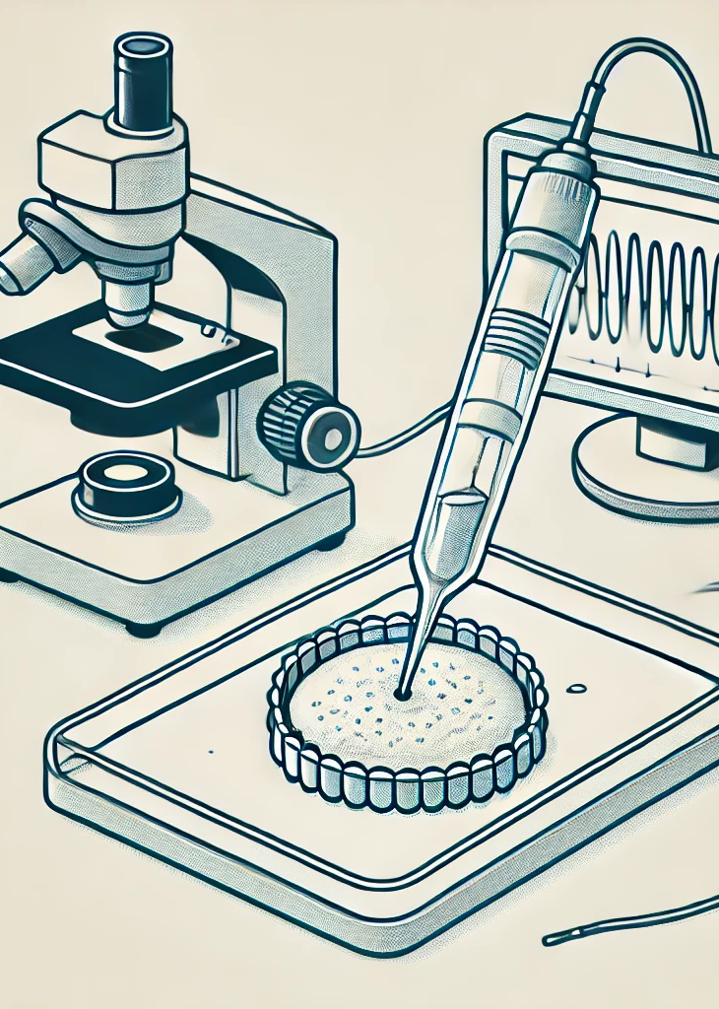
Methods
Genetic engineering: FlaSh protein
Chemogenetic approach: STeVI1

Slide 12
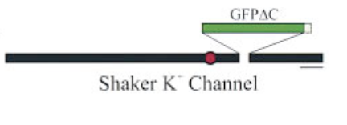
Genetic
Engineering
FlaSh Protein:
Green Fluorescent Protein (GFP)
voltage sensitive ion channel (K+)
Point mutation (W434F)
tryptophan (W) at position 434 is replaced by phenylalanine (F), prevents added ion conduction

Slide 13
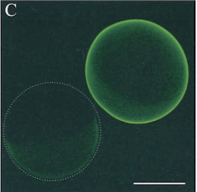
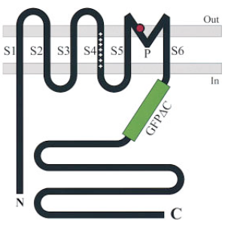
Genetic
Engineering
Right: frog egg cell injected with FlaSh (14 days later)
Left: same cell, uninjected
FlaSh protein in cellular membrane, GFP is intracellular

Slide 14
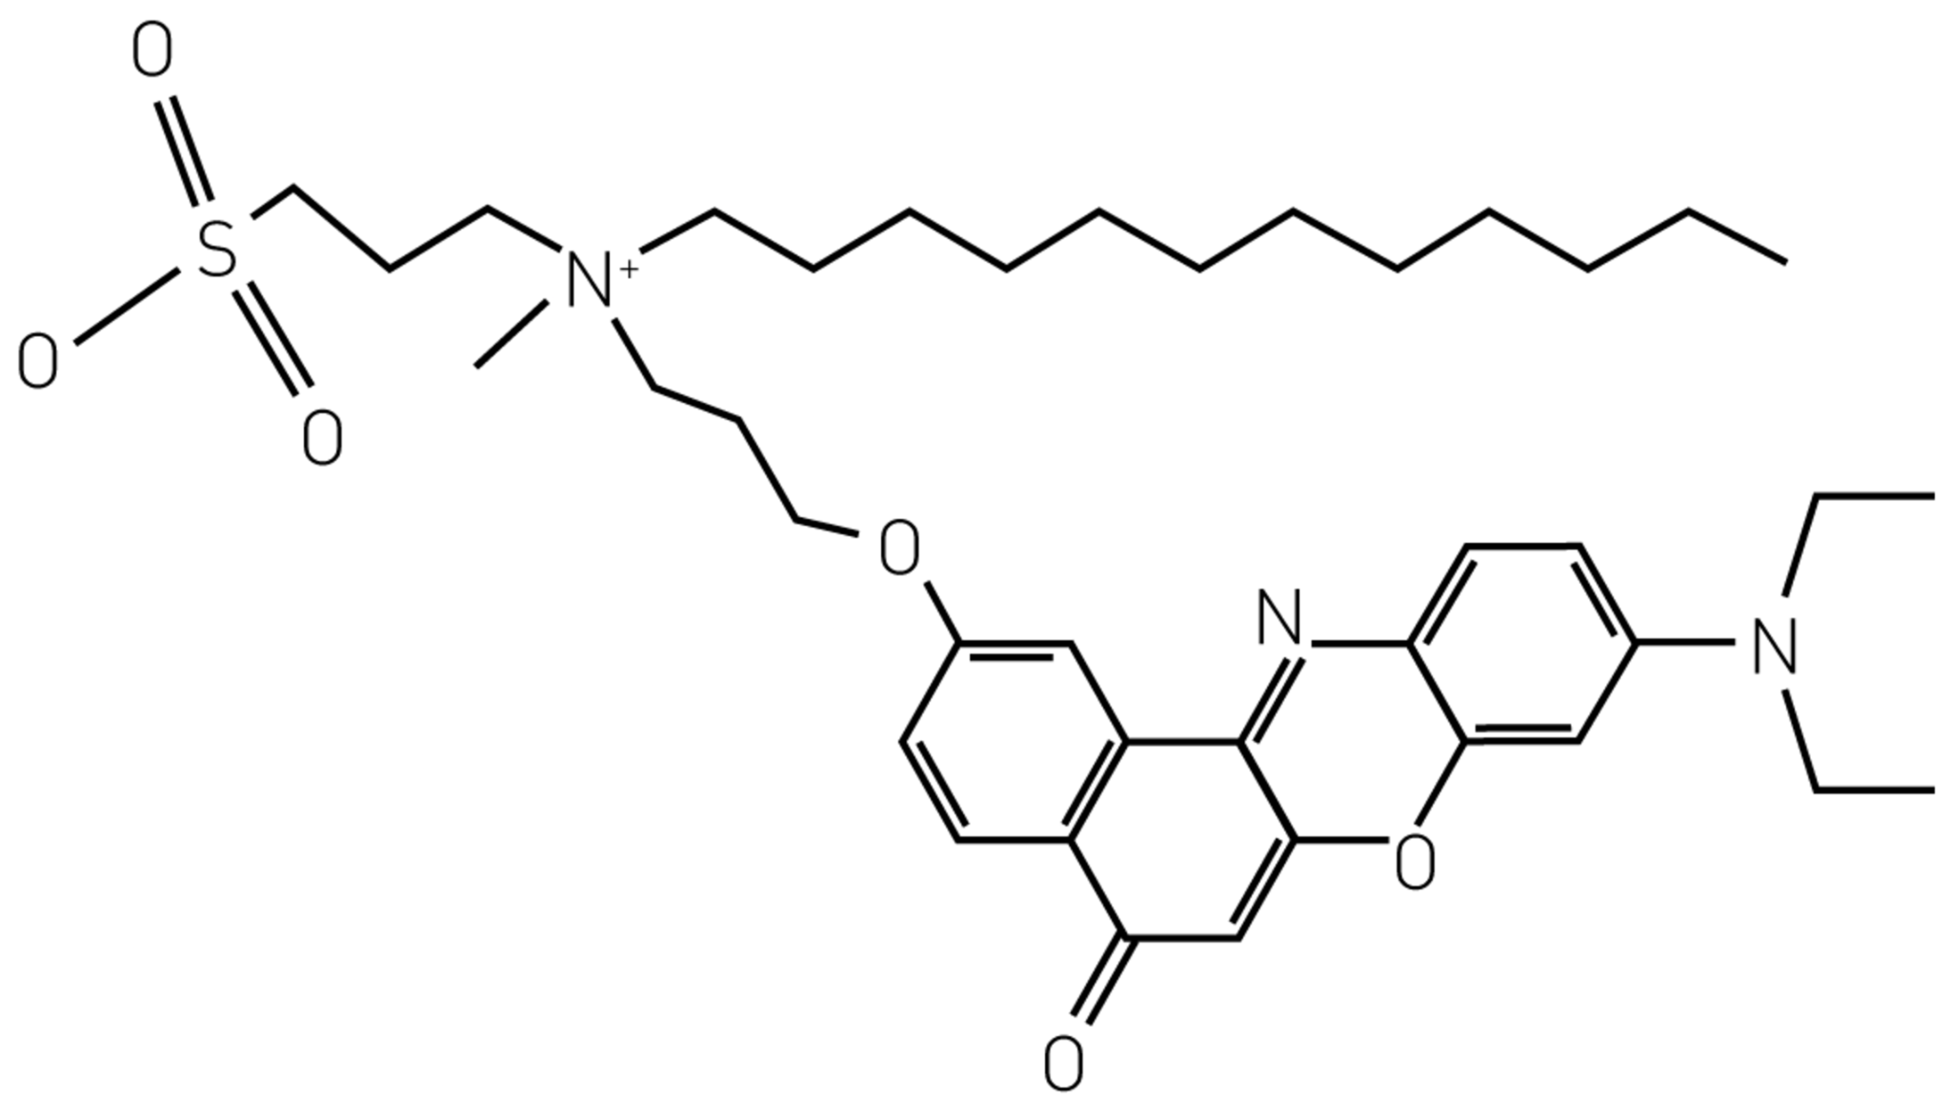
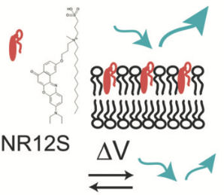
Chemogenetic
Approach
NR12S probe in membrane
NR12S
Nile red derivative
12C-alkyl chain
sulfonate group

Slide 15
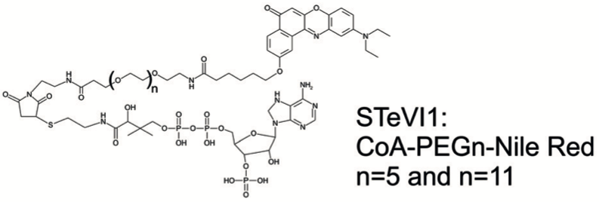
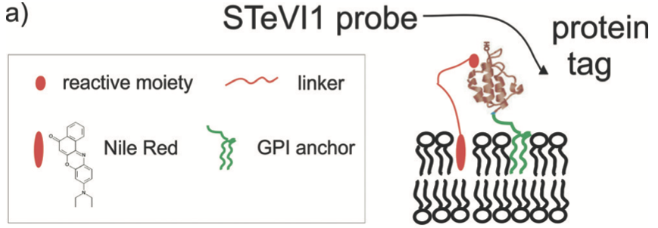
Chemogenetic
Approach
(variants)
GPI anchors outer leaflet of the membrane
Additional tag? (ACP, biotin)

Slide 16
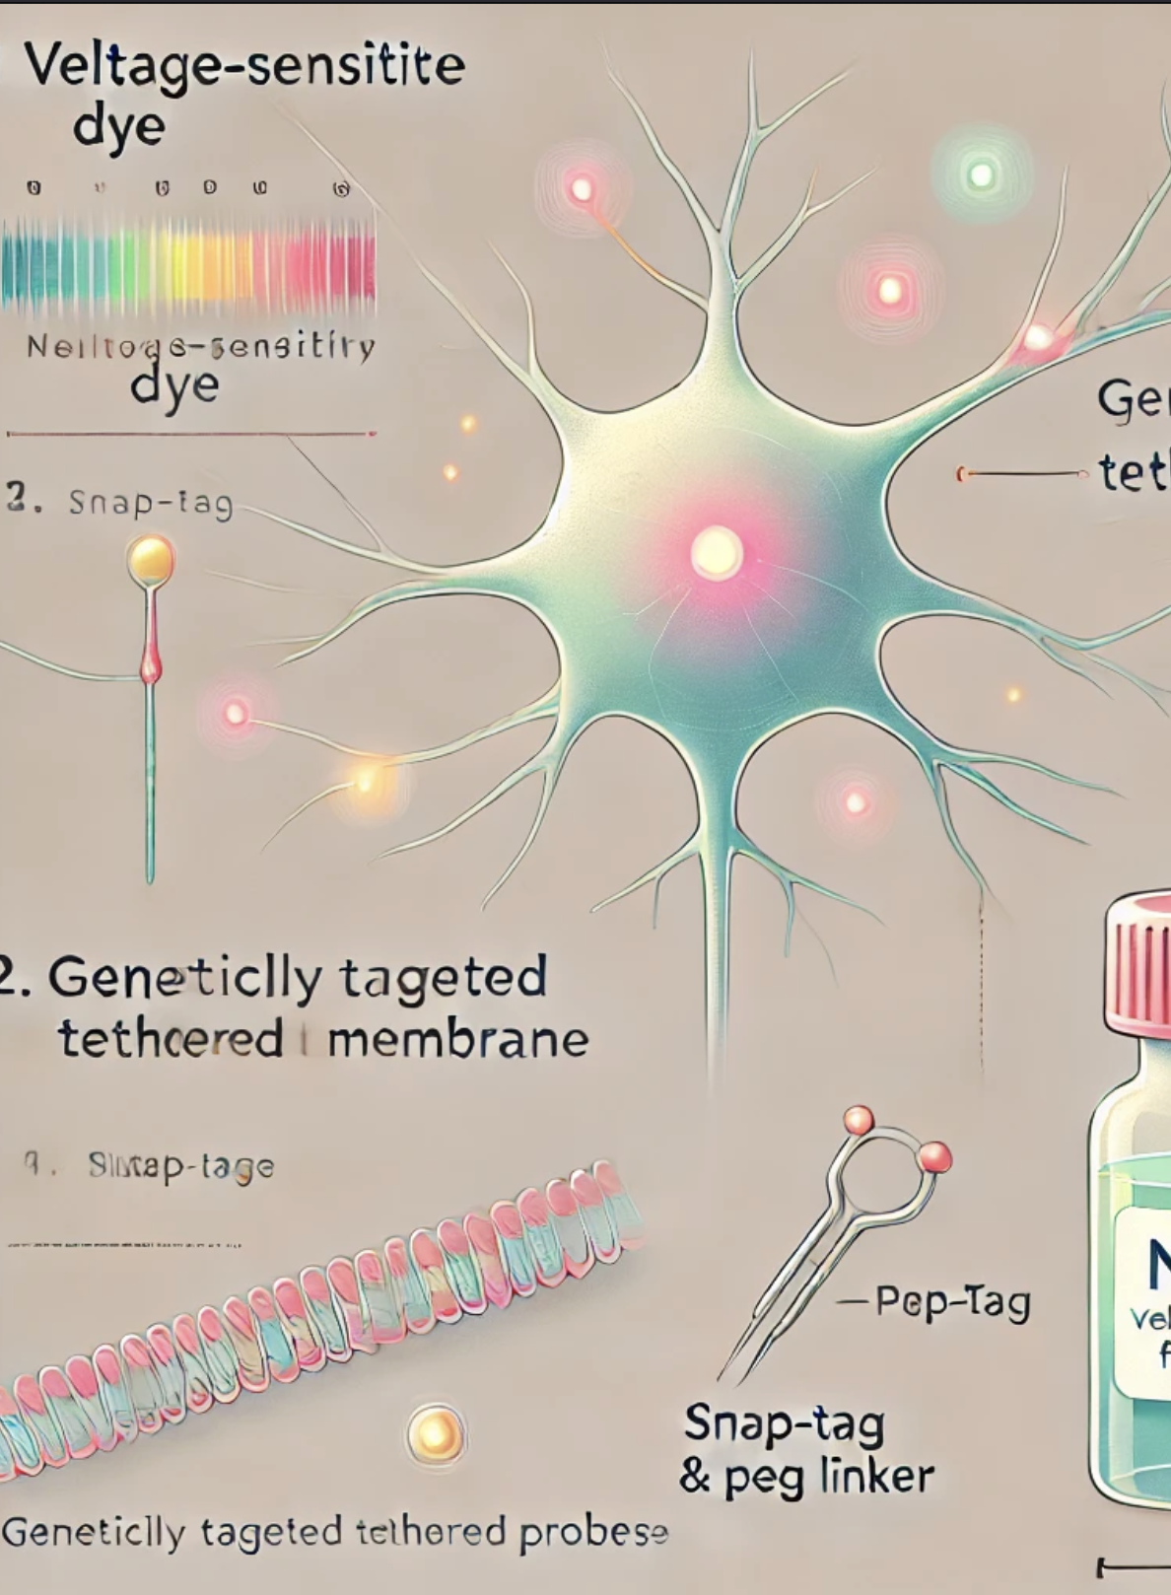
Results
Genetic engineering: FlaSh protein
Chemogenetic approach: STeVI1

Slide 17
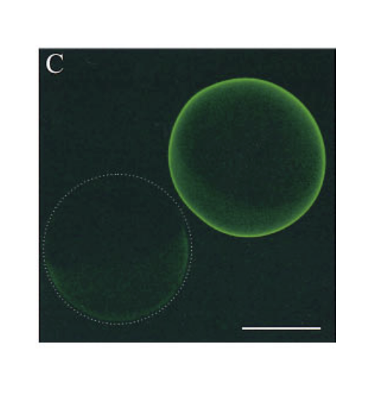
Genetically encoded optical probe
Construct Design
Shaker K⁺ channel
Fluorescence changes purely reflective of voltage-induced structural changes
FlaSh localizes to membranes and retains voltage sensitivity without disrupting physiology.

Slide 18
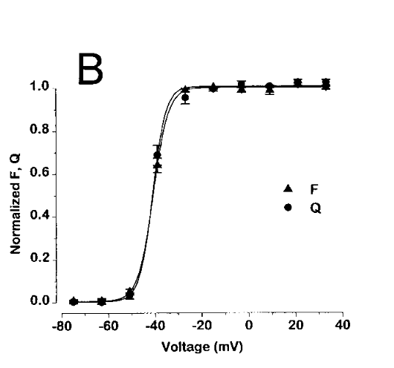
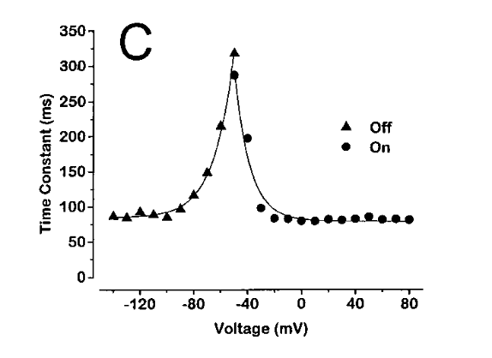
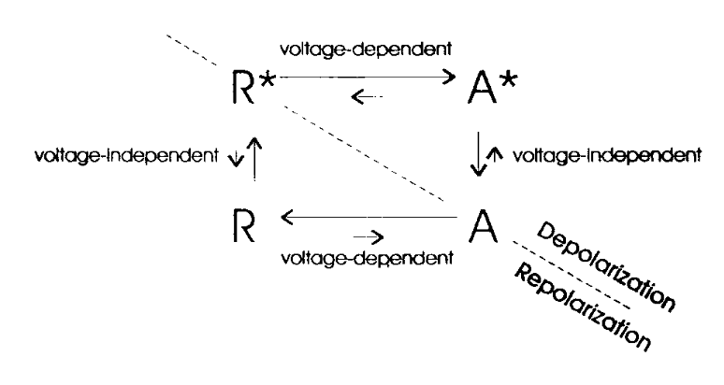
Genetically encoded optical probe
Voltage Dependence of Fluorescence Changes:
Fractional fluorescence change: ~5.1% per depolarization.
Fluorescence is tightly coupled to channel movement
FlaSh accurately reports membrane voltage.
Kinetics of Fluorescence Changes:
Onset time constant 23 ms;
Recovery time const 105 ms.
Secondary conformational changes.
FlaSh resolves both fast and slow voltage-dependent dynamics, making it suitable for diverse neuronal processes.

Slide 19
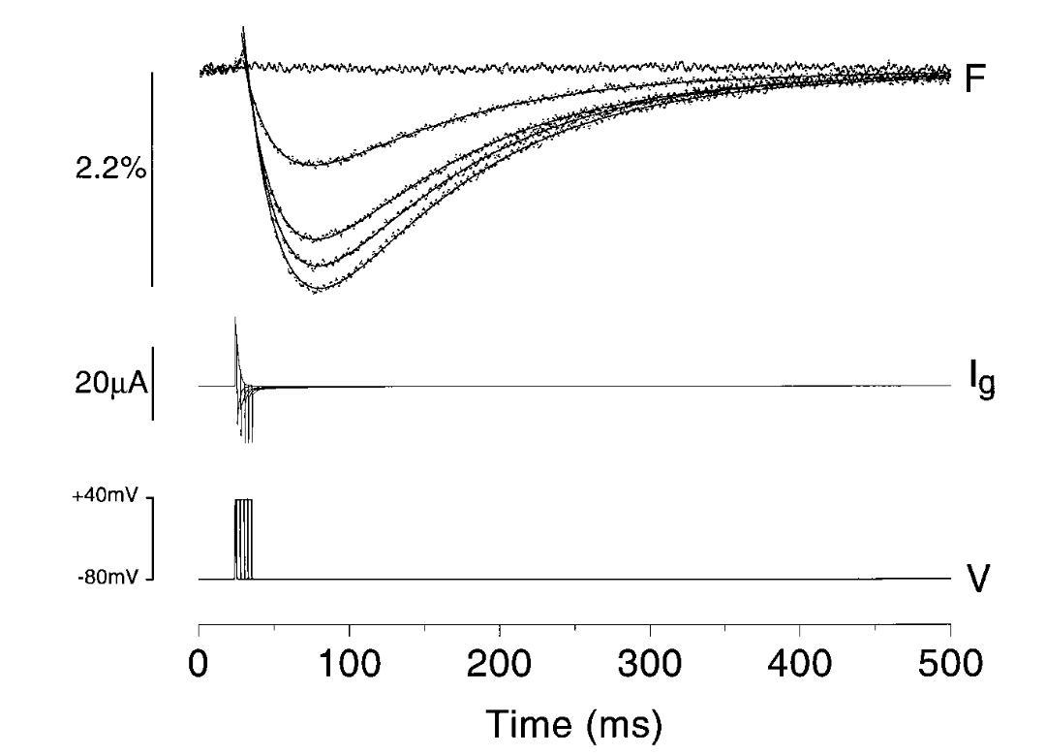
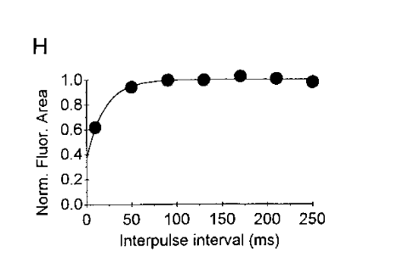
Genetically encoded optical probe
Responses to Brief Depolarizations
FlaSh detects voltage changes as short as 3 ms
Fluorescence recovery occurs on a slower timescale
FlaSh is sensitive enough to resolve rapid voltage changes -> powerful tool for studying neuronal signaling dynamics.
Behavior During Repetitive Activity:
At low frequencies (<20 Hz), cumulative gating charge movements.
At higher frequencies (>100 Hz),responses plateaued
FlaSh reliably tracks both single action potentials and repetitive neuronal firing -> suitable for studying neural circuit activity

Slide 20
Genetically encoded optical probe
Stability and Photobleaching
FlaSh exhibited minimal photobleaching, maintaining stable fluorescence over long imaging sessions (e.g., >5 minutes).
The fluorescence signal remained consistent across multiple trials.
FlaSh : for long-term experiments tracking changes in neuronal activity or developmental processes (no requirement of frequent recalibration).
Its photostability is an advantage for extended studies
Physiological Impact
Fluorescence signals only reflect conformational rearrangements.
Cells expressing FlaSh showed no disruption of normal physiological behavior.
FlaSh : non-invasive, physiologically safe tool for studying voltage dynamics.

Slide 21
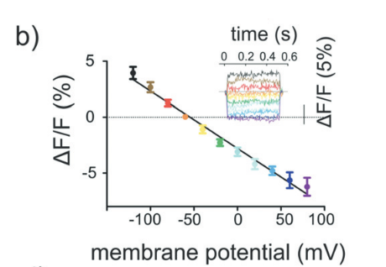
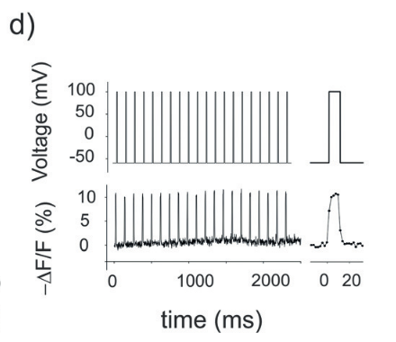
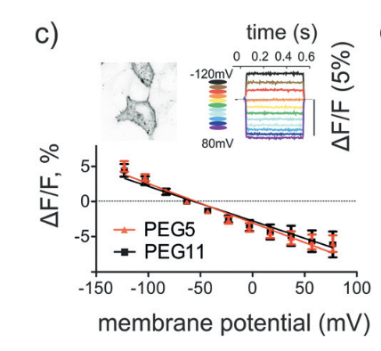
Chemogenetic Approach
Performance of Free Nile Red-Based Dye (NR12S)
Linear sensitivity to changes in membrane potential, with a fluorescence change of −5.1%±0.4 per 100 mV.
Fast kinetics, with a decay time constant of 1.9±0.2ms
NR12S can resolve both sub-threshold and supra-threshold voltage events with high temporal accuracy, outperforming traditional calcium indicators.
Genetic Targeting of Voltage Indicators
voltage sensitivity: (−5.5% (PEG5 linker) and −4.9% (PEG11) per 100 mV
The decay time constant slightly slower (2.6 ± 0.1 ms) for tethered probes
specific labeling of neuronal populations via SNAP- or ACP-tag systems.
Selective labeling of neuronal populations in complex tissues

Slide 22
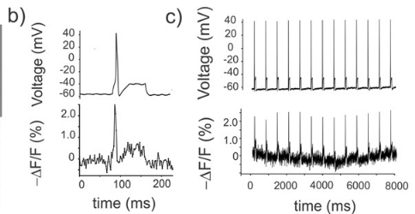
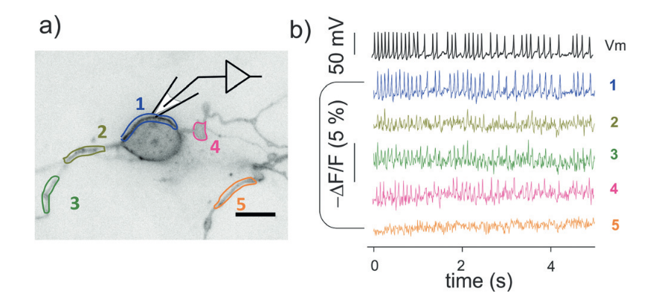
Chemogenetic Approach
Detecting Sub-Threshold and Supra-Threshold Activity
Sub-threshold depolarizations with high signal-to-noise ratios (SNRs).
Tethered probes accurately tracked fast action potentials
Detecting sub-threshold allows researchers to study neuronal inputs, excitability, and network dynamics beyond the capabilities of traditional calcium imaging.
Imaging Spontaneous Neuronal Activity
Spontaneous action potentials and sub-threshold depolarizations.
Tethered probes achieved an SNR of ~7.6 during single-trial recordings.
STeVI1 opens the door to real-time monitoring of spontaneous neuronal activity in living systems.

Slide 23
COMPARAISON
Voltage Sensitivity
Both systems showed excellent sensitivity ( 5%~5\% 5% fluorescence change) BUT:
  FlaSh linked fluorescence directly to gating charge movements
  STeVI1 emphasized sensitivity to sub-threshold events in neurons.
Kinetics of Fluorescence Response
FlaSh provides insights into slower conformational rearrangements.
STeVI1 is significantly faster, -> more suitable for resolving fast events (ex: action potentials.)
Detection of Action Potentials
FlaSh provided biophysical insights into channel dynamics during brief depolarizations.
STeVI1 demonstrated real-time imaging of neural activity
Behavior During Repetitive Activity
FlaSh was limited at high frequencies (>100 Hz).
STeVI1 maintained linearity across a broader range of neuronal events
Stability and Photobleaching
Both systems demonstrated excellent photostability BUT:
  STeVI1’s wash-free design makes it more practical for long-term in vivo studies.

Slide 24
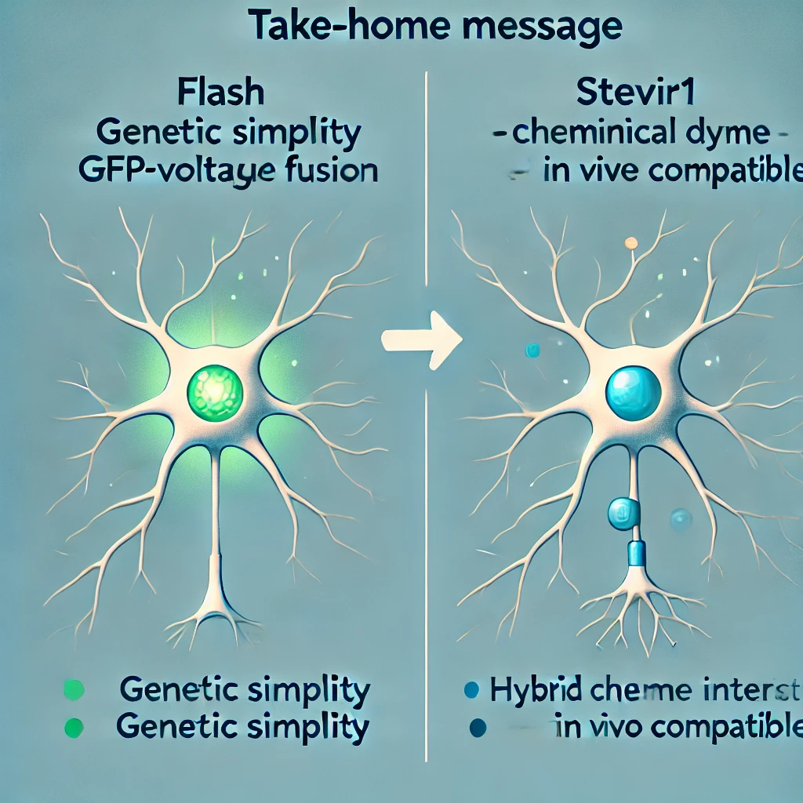
Conclusion

Slide 25
Shared goal:
Advance tools for monitoring neuronal membrane potential.
Address sensitivity, specificity, and invasiveness challenges.
Old Study: FlaSh
Purely genetic sensor using GFP-Shaker fusion.
Simple, robust, and cell-specific.
Detects rapid and sub-threshold signals.
New Study: STeVI1
Hybrid sensor combining Nile Red and ACP tags.
Versatile, in vivo compatible, sub-threshold detection.
Complementary Advances:
FlaSh: Simplicity and genetic precision.
STeVI1: Versatility with chemical-genetic integration.

Slide 26
Take home message

Slide 27
What should we remember?
FlaSh = valuable asset for biophysical research
WHILE
STeVI1 = dynamic tool for real-time functional imaging in living systems
BUT:
Both represent significant advancements in our ability to explore the intricate electrical landscapes of the brain
Both pave the way for novel applications in studying neurological diseases, aiding in the development of innovative therapies targeting electrical dysfunctionment in the nervous system

Slide 28

Finally…
Convergence of biotechnology and chemistry can transform neuroscience
Ask - and answer - more complex question about brain’s electrical communication
Thank you for listening :)

