Slide 1
Extra exercises
Coordination chemistry – Chapter 1
2025

Slide 2
1- Names and formulas
Complete the table below:
Formula | Full name
[Cr(OH₂)(NH₃)₅]³⁺
 | trichlorohydroxogallate (III)
cis-[PtBrCl(NO₂)₂]²⁻
 | trans-chlorobis(ethylenediamine)hydroxo cobalt (III)
[Mn(CO)₃(H₂O)]⁺
 | tetracarbonylnickel (0)
NH₄[AuCl₄]

Slide 3
2- Isomers
Write the formula and draw all isomers of the following complex: diamminebis(oxalato)manganate (III).
What is the electronic configuration of the metal? What then is the charge of the complex?

Slide 4
3- More isomers
Draw fac and mer isomers of the following compounds.
a) RhCl₃py₃ (py is a six-membered ring with five carbons and a nitrogen)
b) Mo(CO)₃(NH₃)₃
c) Co(NH₃)₃(NO₂)₃

Slide 5
4- Even more isomers
Draw all possible linkage isomers and stereoisomers for the following complex: [Co(NH₃)₃(H₂O)Cl(NO₂)]ClO₄

Slide 6
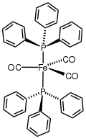
5- The triphenylphosphine ligand
What is the denticity of the PPh₃ ligand?
What is the oxidation state of the metal in the centre of this complex?
Name this complex (which is neutral) and give its formula. The ligand you see here is called triphenylphosphine and can be abbreviated as PPh₃.
What is the geometry of this complex?

Slide 7
6- Wilkinson’s catalyst
Named after chemist and Nobel laureate Sir Geoffrey Wilkinson, who first popularized its use, it has been historically used to catalyze the hydrogenation of olefins with H₂. It is a square planar complex, with the formula [RhCl(PPh₃)₃].
- Name it, then draw it (you may abbreviate the ligand formula with PPh₃ in the drawing)
- Does this compound have any isomers? If so, draw them and name them.
[RhCl(PPh₃)₃] reacts with carbon monoxide to give [RhCl(CO)(PPh₃)₂].
- Name this new compound and draw it also.
- Does this compound have any isomers? If so, draw them and name them.

Slide 8
1- Names and formulas
Complete the table below:
Formula | Full name
[Cr(OH₂)(NH₃)₅]³⁺ | pentaammineaquachromium (III)
[Ga(OH)Cl₃]⁻ | trichlorohydroxogallate (III)
cis-[PtBrCl(NO₂)₂]²⁻ | cis-bromochlorodinitroplatinate (II)
trans-[Co(OH)Cl(en)₂]⁺ | trans-chlorobis(ethylenediamine)hydroxo cobalt (III)
[Mn(CO)₃(H₂O)]⁺ | aquatricarbonylmanganese (I)
[Ni(CO)₄] | tetracarbonylnickel (0)
NH₄[AuCl₄] | ammonium tetrachloroaurate (III)

Slide 9
2- Isomers
Write the formula and draw all isomers of the following complex: diamminebis(oxalato)manganate (III).
What is the electronic configuration of the metal? What then is the charge of the complex?
Trans-[Mn(NH₃)₂(ox)₂]⁻
Mn(III) : [Ar]3d⁴
Mn has a charge of +3
NH₃ ligands are neutral
Oxalate ligands each have a charge of -2
→ Overall charge is -1
Δ-cis-[Mn(NH₃)₂(ox)₂]⁻
Λ-cis-[Mn(NH₃)₂(ox)₂]⁻

Slide 10
3- More isomers
Draw fac and mer isomers of the following compounds.
a) RhCl₃py₃ (py is a six-membered ring with five carbons and a nitrogen)
b) Mo(CO)₃(NH₃)₃
c) Co(NH₃)₃(NO₂)₃
fac
mer

Slide 11
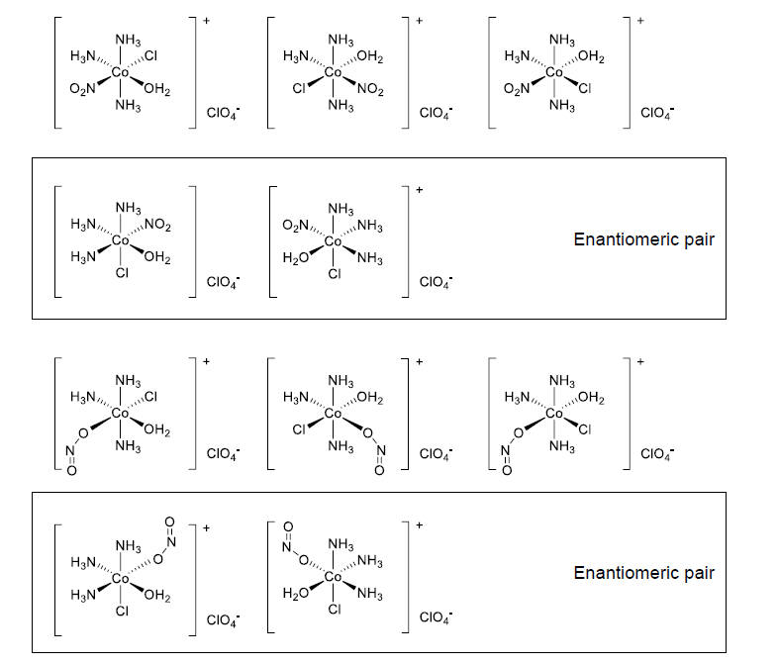
4- Even more isomers
Draw all possible linkage isomers and stereoisomers for the following complex: [Co(NH₃)₃(H₂O)Cl(NO₂)]ClO₄
NH₃ groups are mer
N₂O is linked through N
NH₃ groups are fac
N₂O is linked through N
NH₃ groups are mer
N₂O is linked through O
NH₃ groups are fac
N₂O is linked through O

Slide 12
5- The triphenylphosphine ligand
What is the denticity of the PPh₃ ligand?
What is the oxidation state of the metal in the centre of this complex?
Name this complex (which is neutral) and give its formula. The ligand you see here is called triphenylphosphine and can be abbreviated as PPh₃.
What is the geometry of this complex?
Each PPh₃ ligand has only one coordination bond to the metal, so the denticity is 1. The ligand is called monodentate.
CO and PPh₃ are all neutral ligands, and the coordination complex is neutral, so the metal has to be neutral also (i.e. oxidation state is 0)
Tricarbonylbis(triphenylphosphine) iron (0) Fe(CO)₃(PPh₃)₂
This geometry is called trigonal bipyramidal.

Slide 13
6- Wilkinson’s catalyst
Named after chemist and Nobel laureate Sir Geoffrey Wilkinson, who first popularized its use, it has been historically used to catalyze the hydrogenation of olefins with H₂. It is a square planar complex, with the formula [RhCl(PPh₃)₃].
- Name it, then draw it (you may abbreviate the ligand formula with PPh₃ in the drawing)
- Does this compound have any isomers? If so, draw them and name them.
[RhCl(PPh₃)₃] reacts with carbon monoxide to give [RhCl(CO)(PPh₃)₂].
- Name this new compound and draw it also.
- Does this compound have any isomers? If so, draw them and name them.
PPh₃
Chloro­tris(triphenylphosphine)­rhodium(I)
No isomer (only one possibility)
Carbonylchloro­bis(triphenylphosphine)­rhodium(I)
Ph₃P
Rh
PPh₃
CO
PPh₃
Cl
Ph₃P
Rh
PPh₃
Ph₃P
Rh
CO
Cl
Cl
Trans-
Cis-

