Slide 1
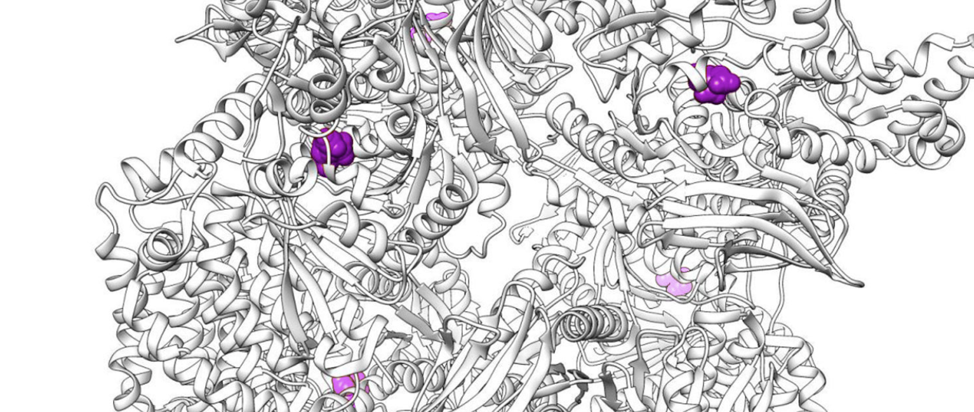
Design, Production and Purification of recombinant proteins
BIOENG-519: Methods: omics in biomedical research
Dr. MER Florence Pojer
Dr Kelvin Lau & Dr. Yoan Duhoo (practicals)
Protein Production and Structure Core Facility (PTPSP)
Fall 2024

Slide 2
Objectives of this part of the course:
Overview of state of the art technologies for production, purification and quality control of recombinant proteins – Strategies
Hands-on practical at the facility on purification and quality controls of proteins

Slide 3
What are proteins? And what are their roles?
Why producing recombinant proteins as revolutionized our life?

Slide 4
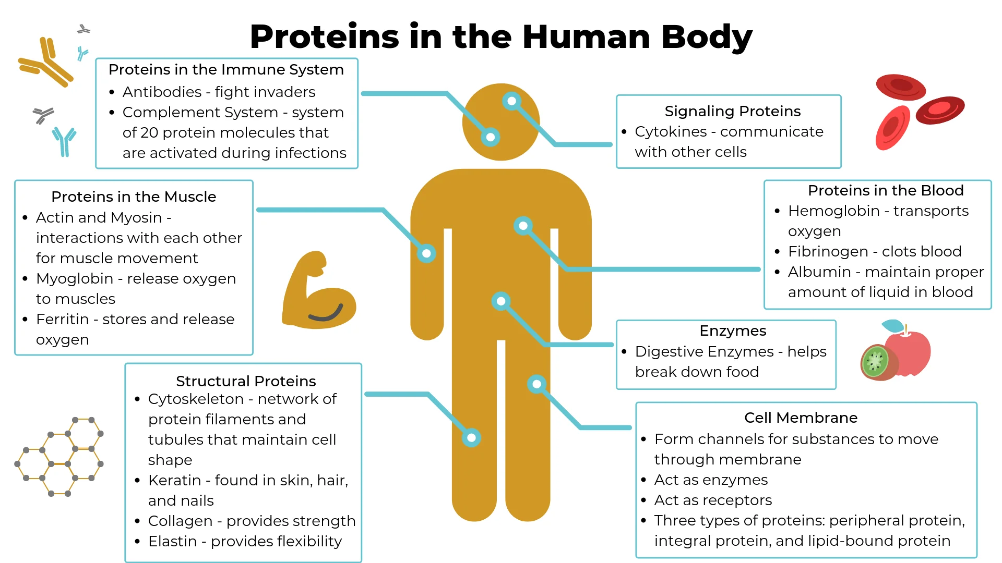
https://nusep.us/blogs/news/proteins-in-the-body-infographic

Slide 5
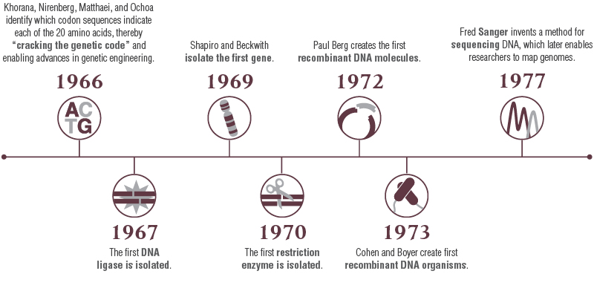
History
The advances in DNA manipulation were essential for expression of recombinant proteins
https://www.neb.com/

Slide 6
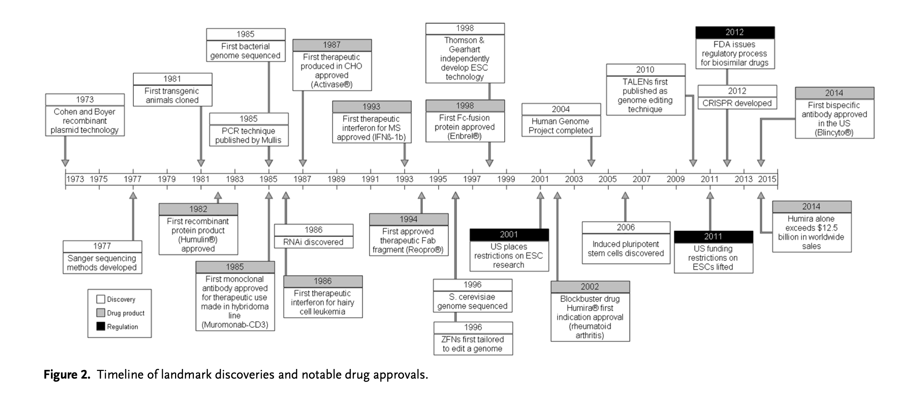
Timeline of notable biologic/drug
approvals
https://onlinelibrary.wiley.com/doi/pdf/10.1002/biot.201600105

Slide 7
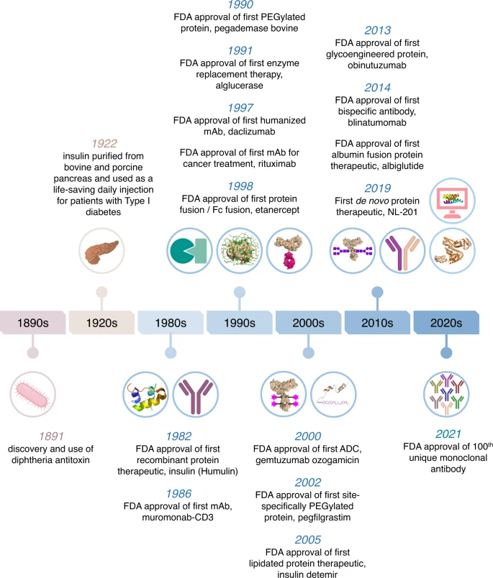
https://www.nature.com/articles/s41467-023-38039-x

Slide 8
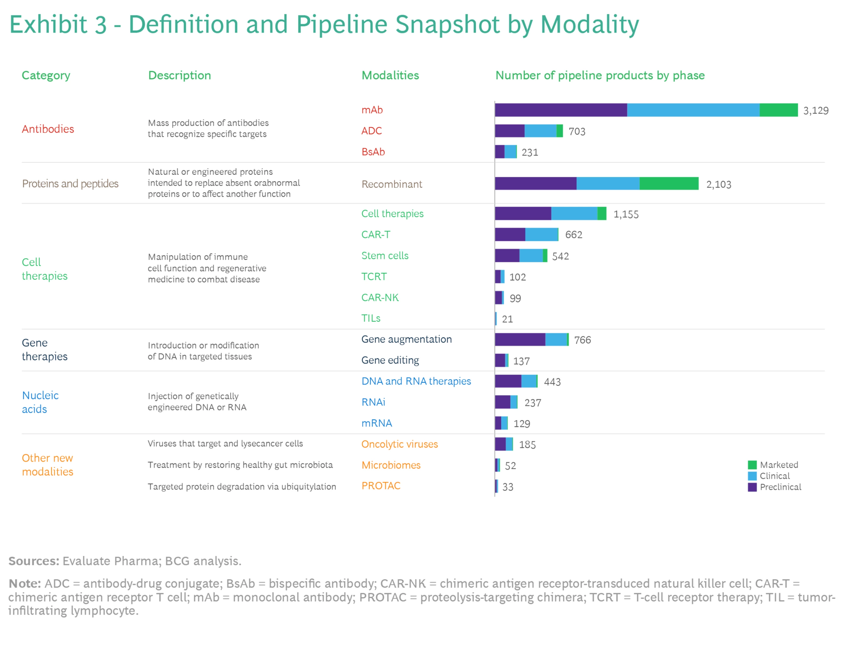
New drug modalities
https://www.bcg.com/publications/2023/latest-industry-report-on-new-drug-modalities

Slide 9
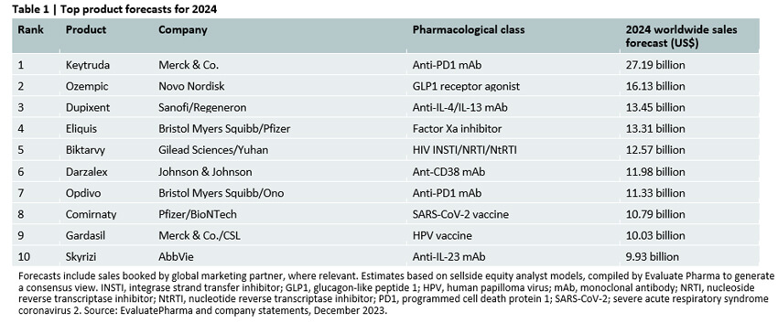
Top 10 Projected Best-Selling Drugs in 2024: Sales forecast
https://www.senieer.com/the-latest-top10-prediction-of-best-selling-drugs-in-2022/

Slide 10
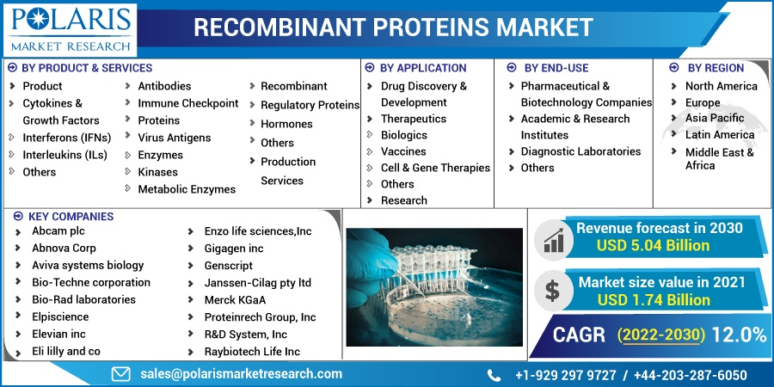
Applications of recombinant proteins
https://www.polarismarketresearch.com/industry-analysis/recombinant-proteins-market

Slide 11
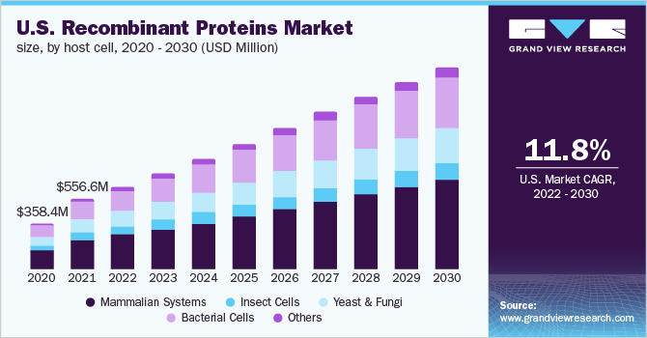
https://www.grandviewresearch.com/industry-analysis/recombinant-proteins-market-report

Slide 12
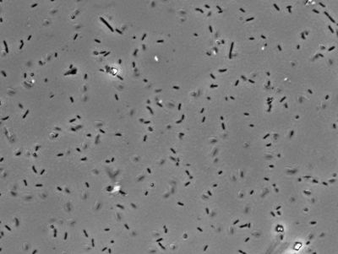
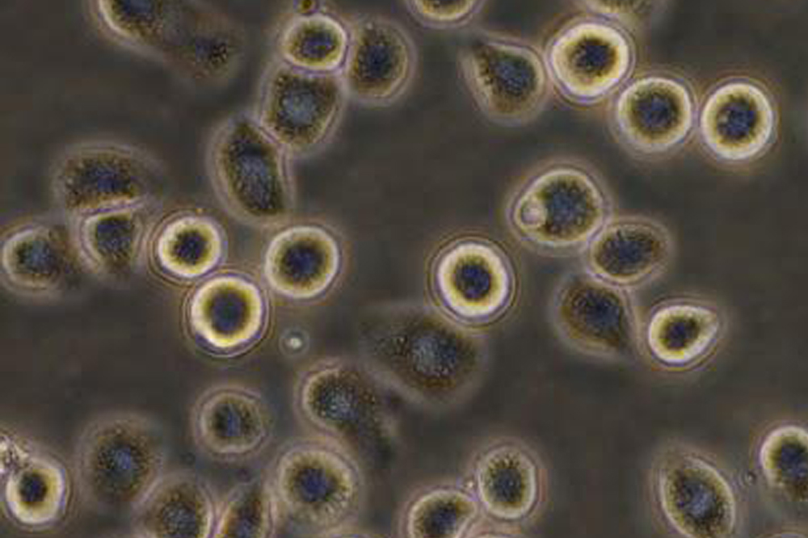
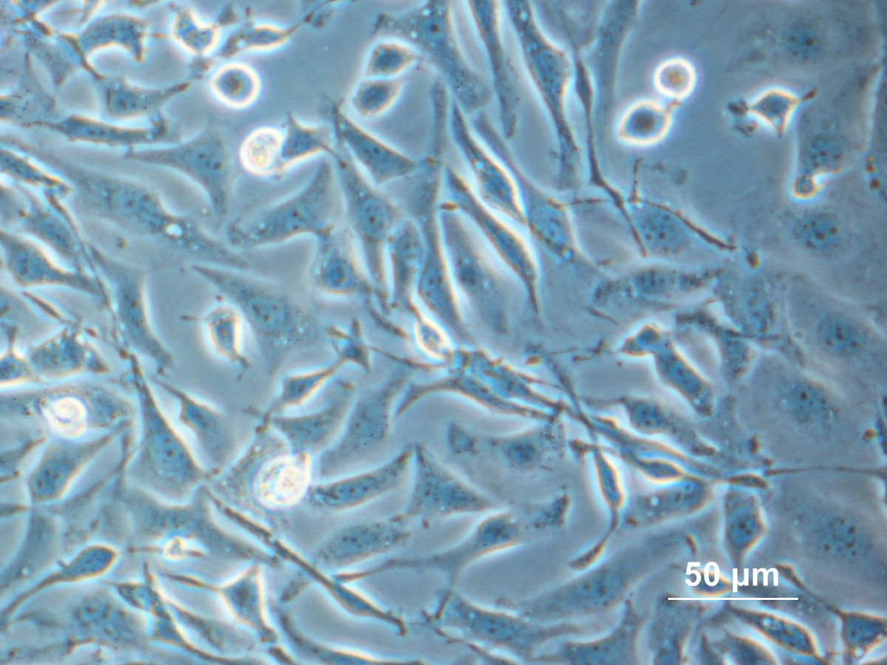
1
Clone the POI gene into a chosen expression vector
2
Transform/Transfect/Transduce the expression vector into chosen host
3
Expression test to check protein size and level
4
Protein purification
5
Protein quality control

Slide 13
1
Clone the POI gene into a chosen expression vector
TWO CRITICAL points to consider before starting designing your construct:
(to avoid spending months/years producing wrong/inactive Protein of Interest)
1. The type of experiments you plan to do with your purified protein/complex
What do you need the protein for?
Enzymatic assays, Elisa, serological tests
Structural biology
Reagent for cell culture, PCRs,..
Microscopy, histology
Animal studies
Design a strategy - with the help of database/ literature
Suitable expression host
amount required
Cofactor, partners, DNA needed
Purification process: tags vs no tag, cleavable tag,…
Expertise at your university, cost,…

Slide 14
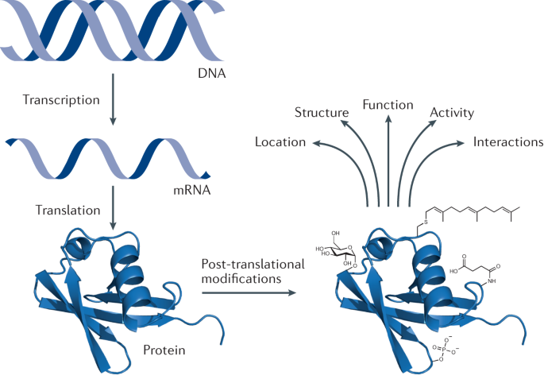
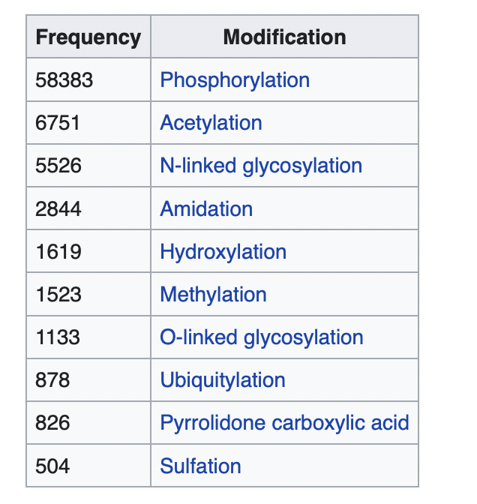
1
Clone the POI gene into a chosen expression vector
TWO CRITICAL points to consider before starting:
(to avoid spending months/years producing wrong/inactive Protein of Interest)
1. The type of experiments you plan to do with it
2. Know very well your Protein/complex and its context
Many database and software are available on internet
https://www.nature.com/articles/s41570-020-00223-8
Common PTMS by Frequency
https://en.wikipedia.org/wiki/Post-translational_modification

Slide 15
Useful resources in protein sciences
UniProt
Very informative and up to date: Function, Names & Taxonomy, Subcellular location, Pathology & Biotech, Interaction, Structure, Family & Domains, Sequence, …
AlphafoldDB included now in UniProt – models are to take with caution
Protparam
Essential for biophysical parameters: Number of amino acids, Molecular weight, Theoretical PI, Amino acid composition, Atomic composition, Extinction coefficients.
https://web.expasy.org/protparam/
Alphafold2(3), SWISSMODEL and I-TASSER
Useful for quick 3D modelling of any proteins based on their AA sequence
https://colab.research.google.com/github/sokrypton/ColabFold/blob/main/AlphaFold2.ipynb
https://swissmodel.expasy.org
https://zhanglab.ccmb.med.umich.edu/I-TASSER/
HHPRED:
Useful for unknown function. It is a sequence database searching and structure prediction: https://toolkit.tuebingen.mpg.de/tools/hhpred
3

Slide 16
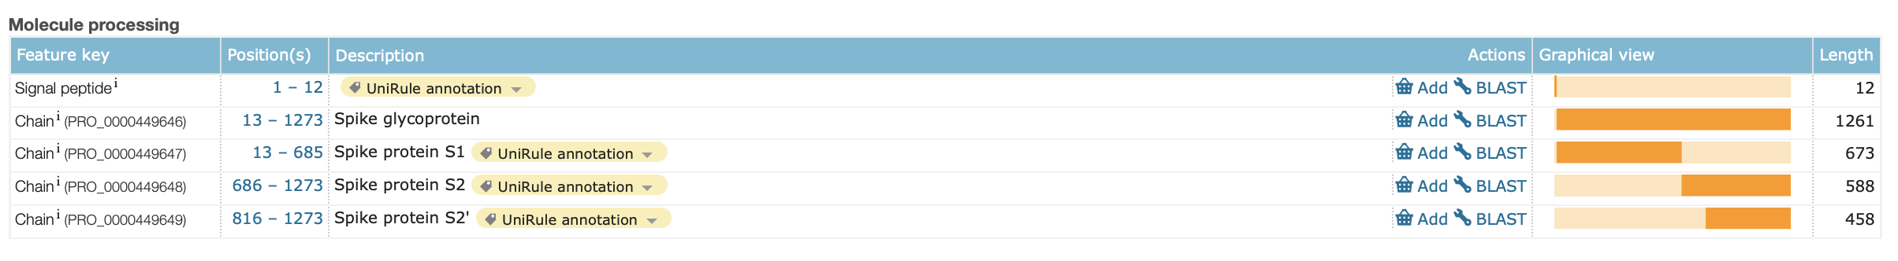
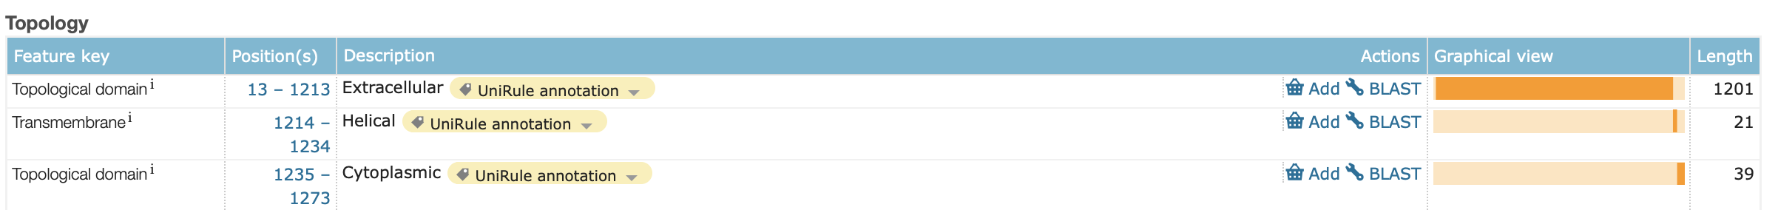
Example of design of Spike SARS-Cov-2 construct
Uniprot essential info:

Slide 17
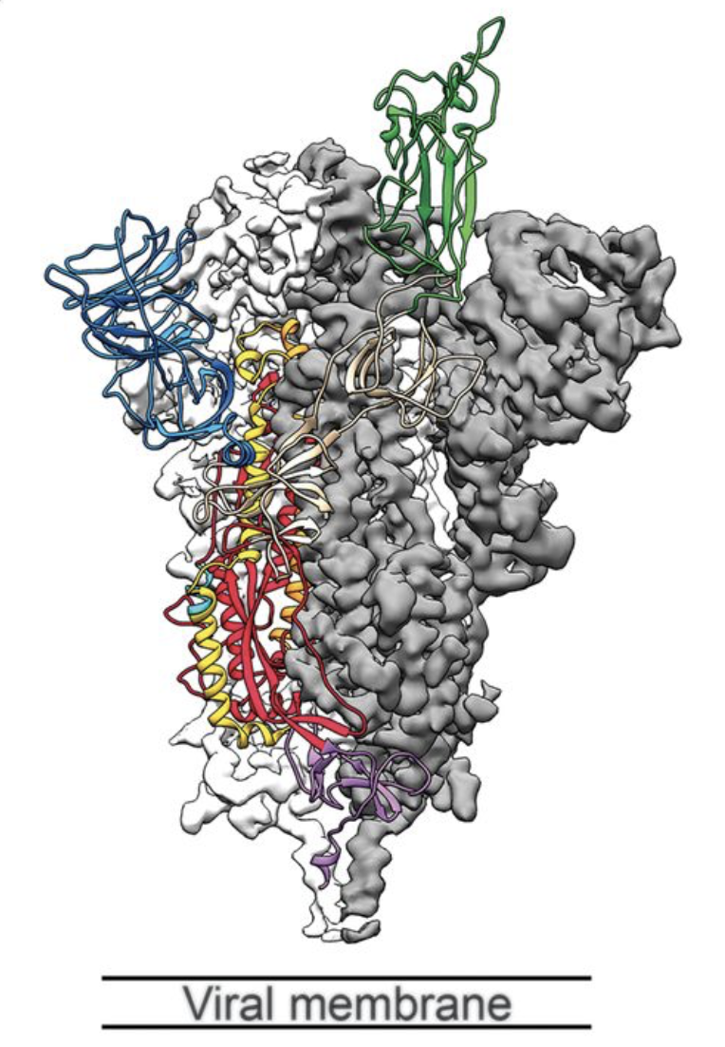
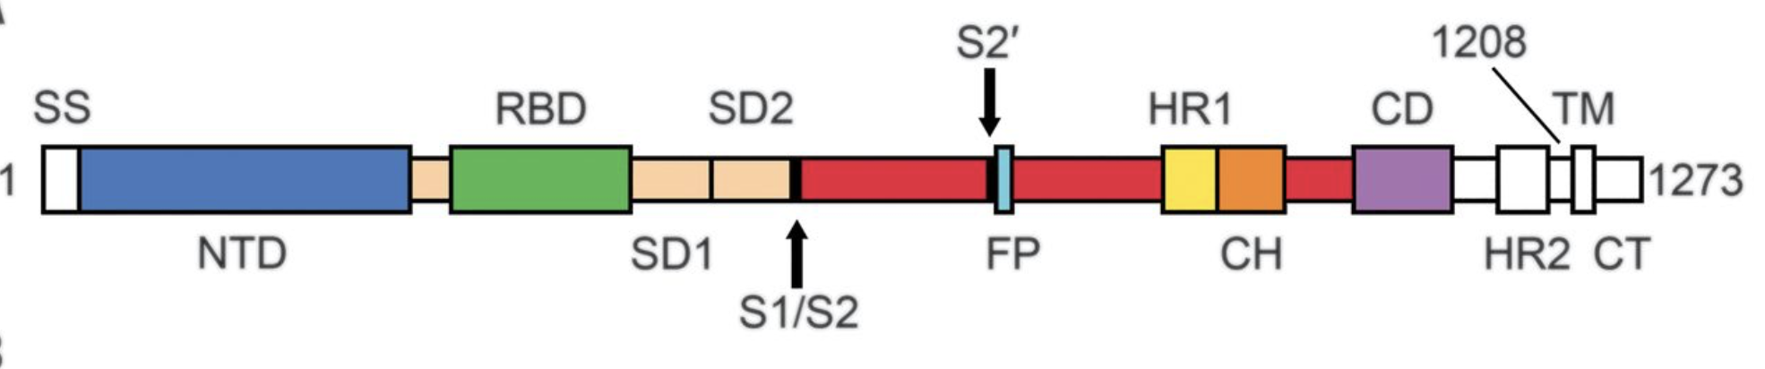
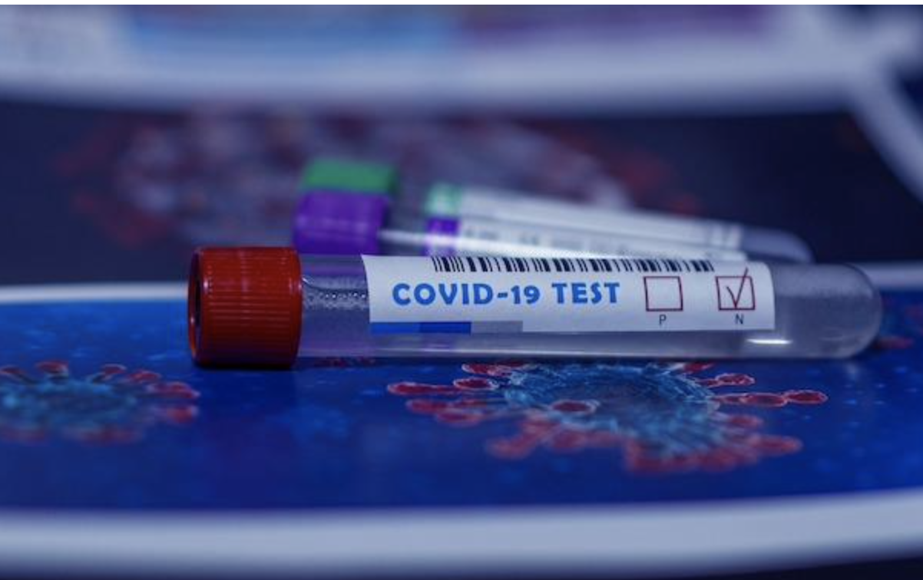
Construct was designed for cryo-EM experiments,
but is also very well suitable for serological assays
Good thinking
Vector Designed
Great Results
Signal sequence removed
Transmembrane domain removed
Furin cleavage-site mutated
Two stabilizing proline mutations added
T4 trimerization domain added
Purification tags added at C-term
(twin-strep and His tags)
Structure of Spike by CryoEM
Production in CHO cells
Purification by affinity tags
Serological tests (CHUV)
Wrapp et al., 2020

Slide 18
1
Clone the POI gene into a chosen expression vector
2
Transform/Transfect/Transduce the expression vector into chosen host
3
Expression test to check protein size and level
4
Protein purification
5
Protein quality control

Slide 19
Hosts for recombinant protein production
Prokaryotic system
Escherichia coli (various strains)
Cell-free transcription/translation system
Bacillus subtilis
Pseudomonas fluorescens
Lactococcus lactis
Eukaryotic system
Cultivated mammalian cells
Cultivated insect cells
Cell-free transcription/translation system (wheat germ, rabbit retic and CHO lysates)
Saccharomyces cerevisiae
Pichia pastoris
Leishmania tarentolae
Physcomitrella patens
Cultivated tobacco cells and Transgenic plants
Transgenic animals

Slide 20
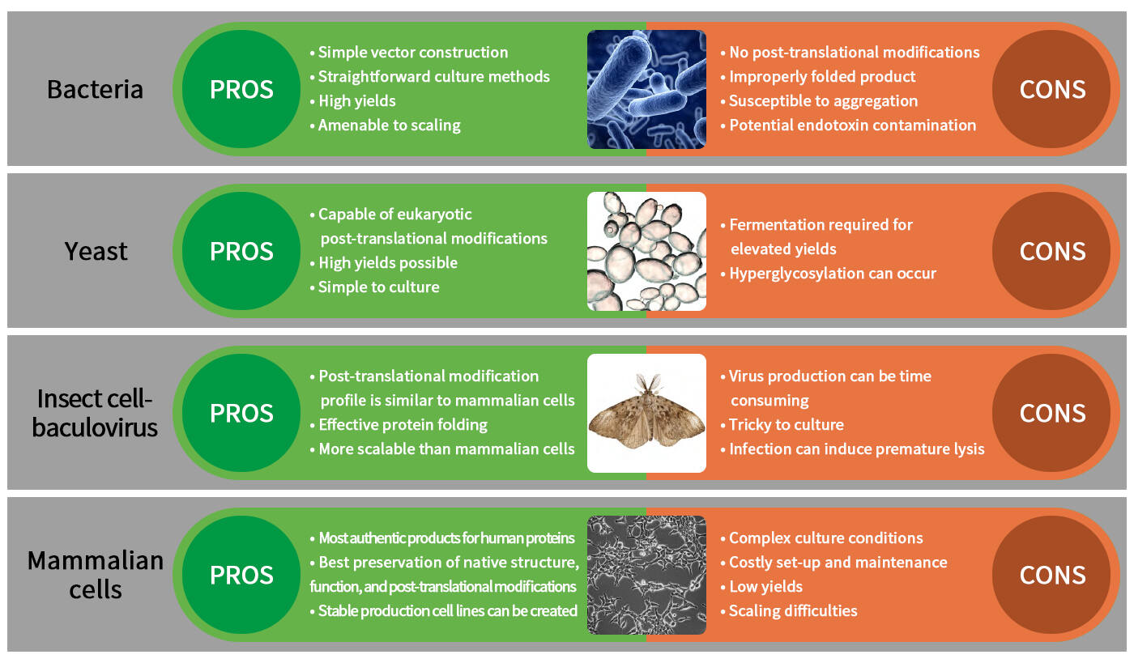
Summary production hosts: Pros and Cons
https://www.origene.com/

Slide 21
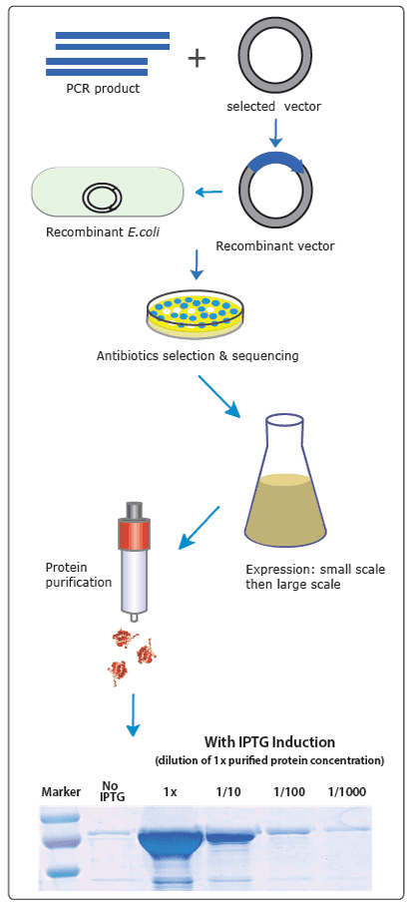
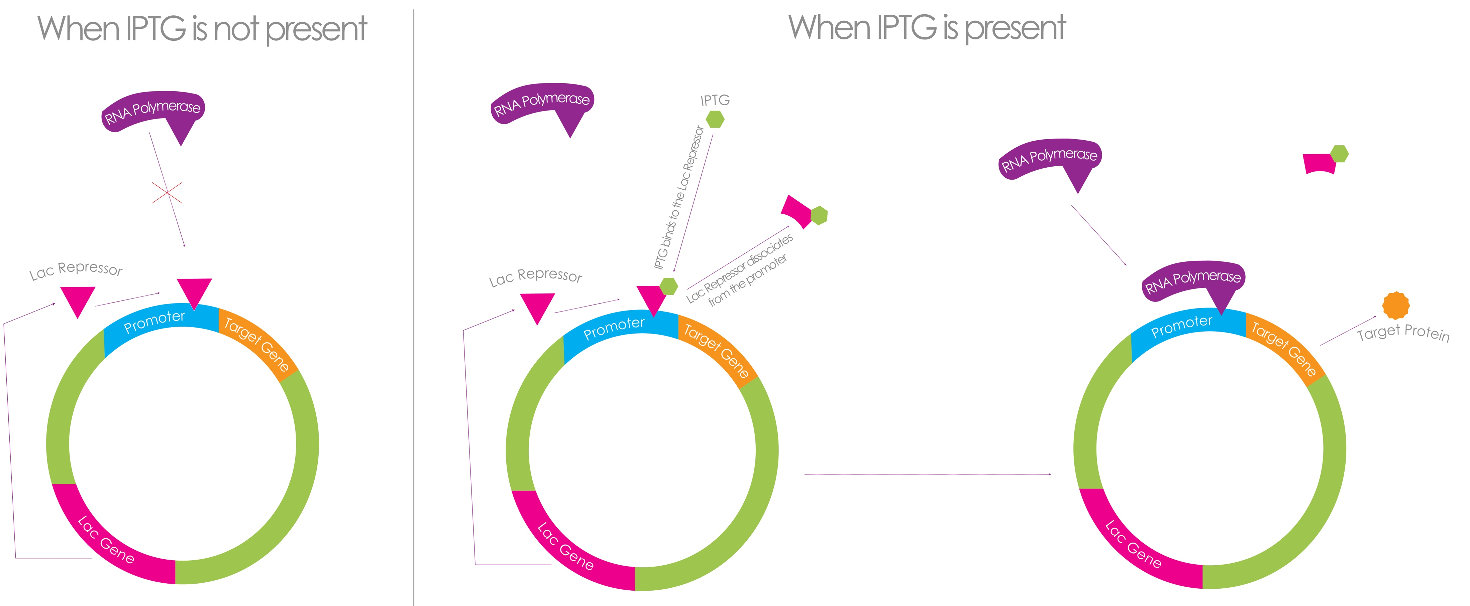
Production in Bacterial cells
Steps (total of 3 days and cheap)
Cloning in plasmid with antibiotic selection marker and tags for purification (lab or outsouce)
Transform in bacteria and select on plate with antibiotic
Amplification/culture from single clone
Induction of expression (often IPTG)
Lysis of the cells before purification
IPTG induction system (https://zellbio.eu/product/iptg/)
https://www.promab.com/e-coli-expression

Slide 22
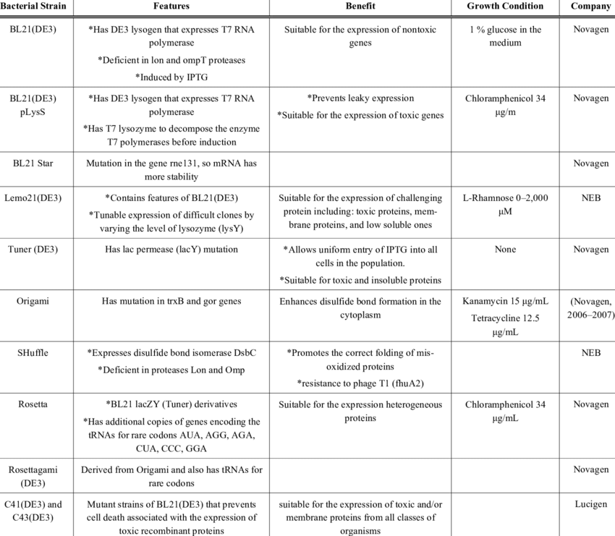
Production in Bacterial cells:
Many different strains available

Slide 23
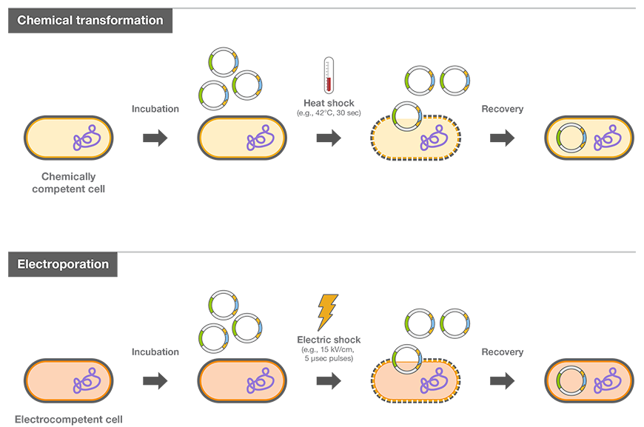
How to introduce DNA into the cells?
https://www.thermofisher.com/

Slide 24
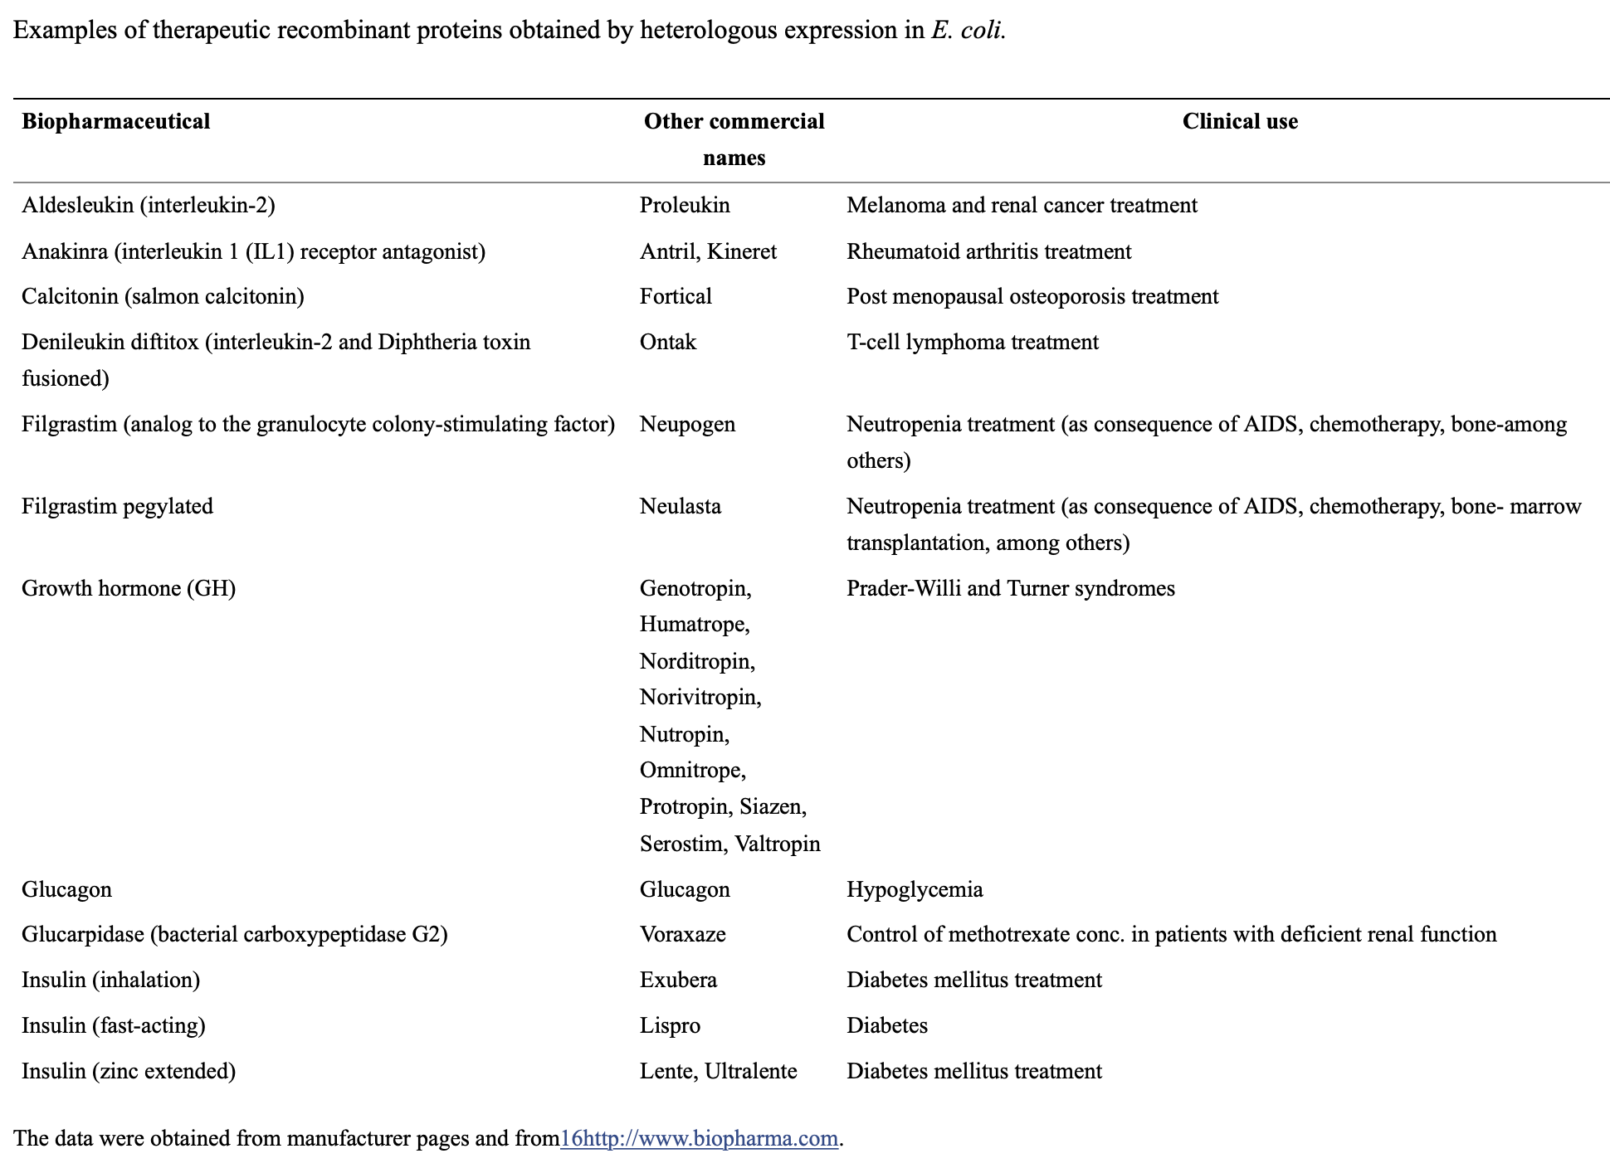
Applications of Production in Bacterial cell

Slide 25
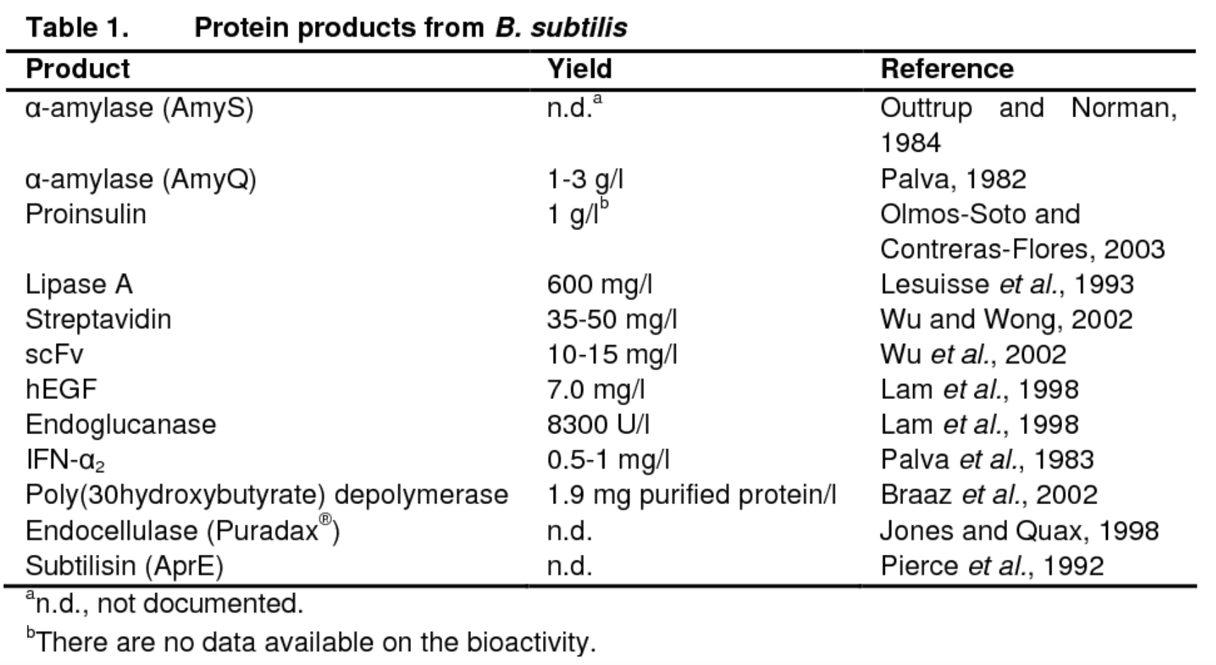
Applications of Production in Bacterial cell

Slide 26
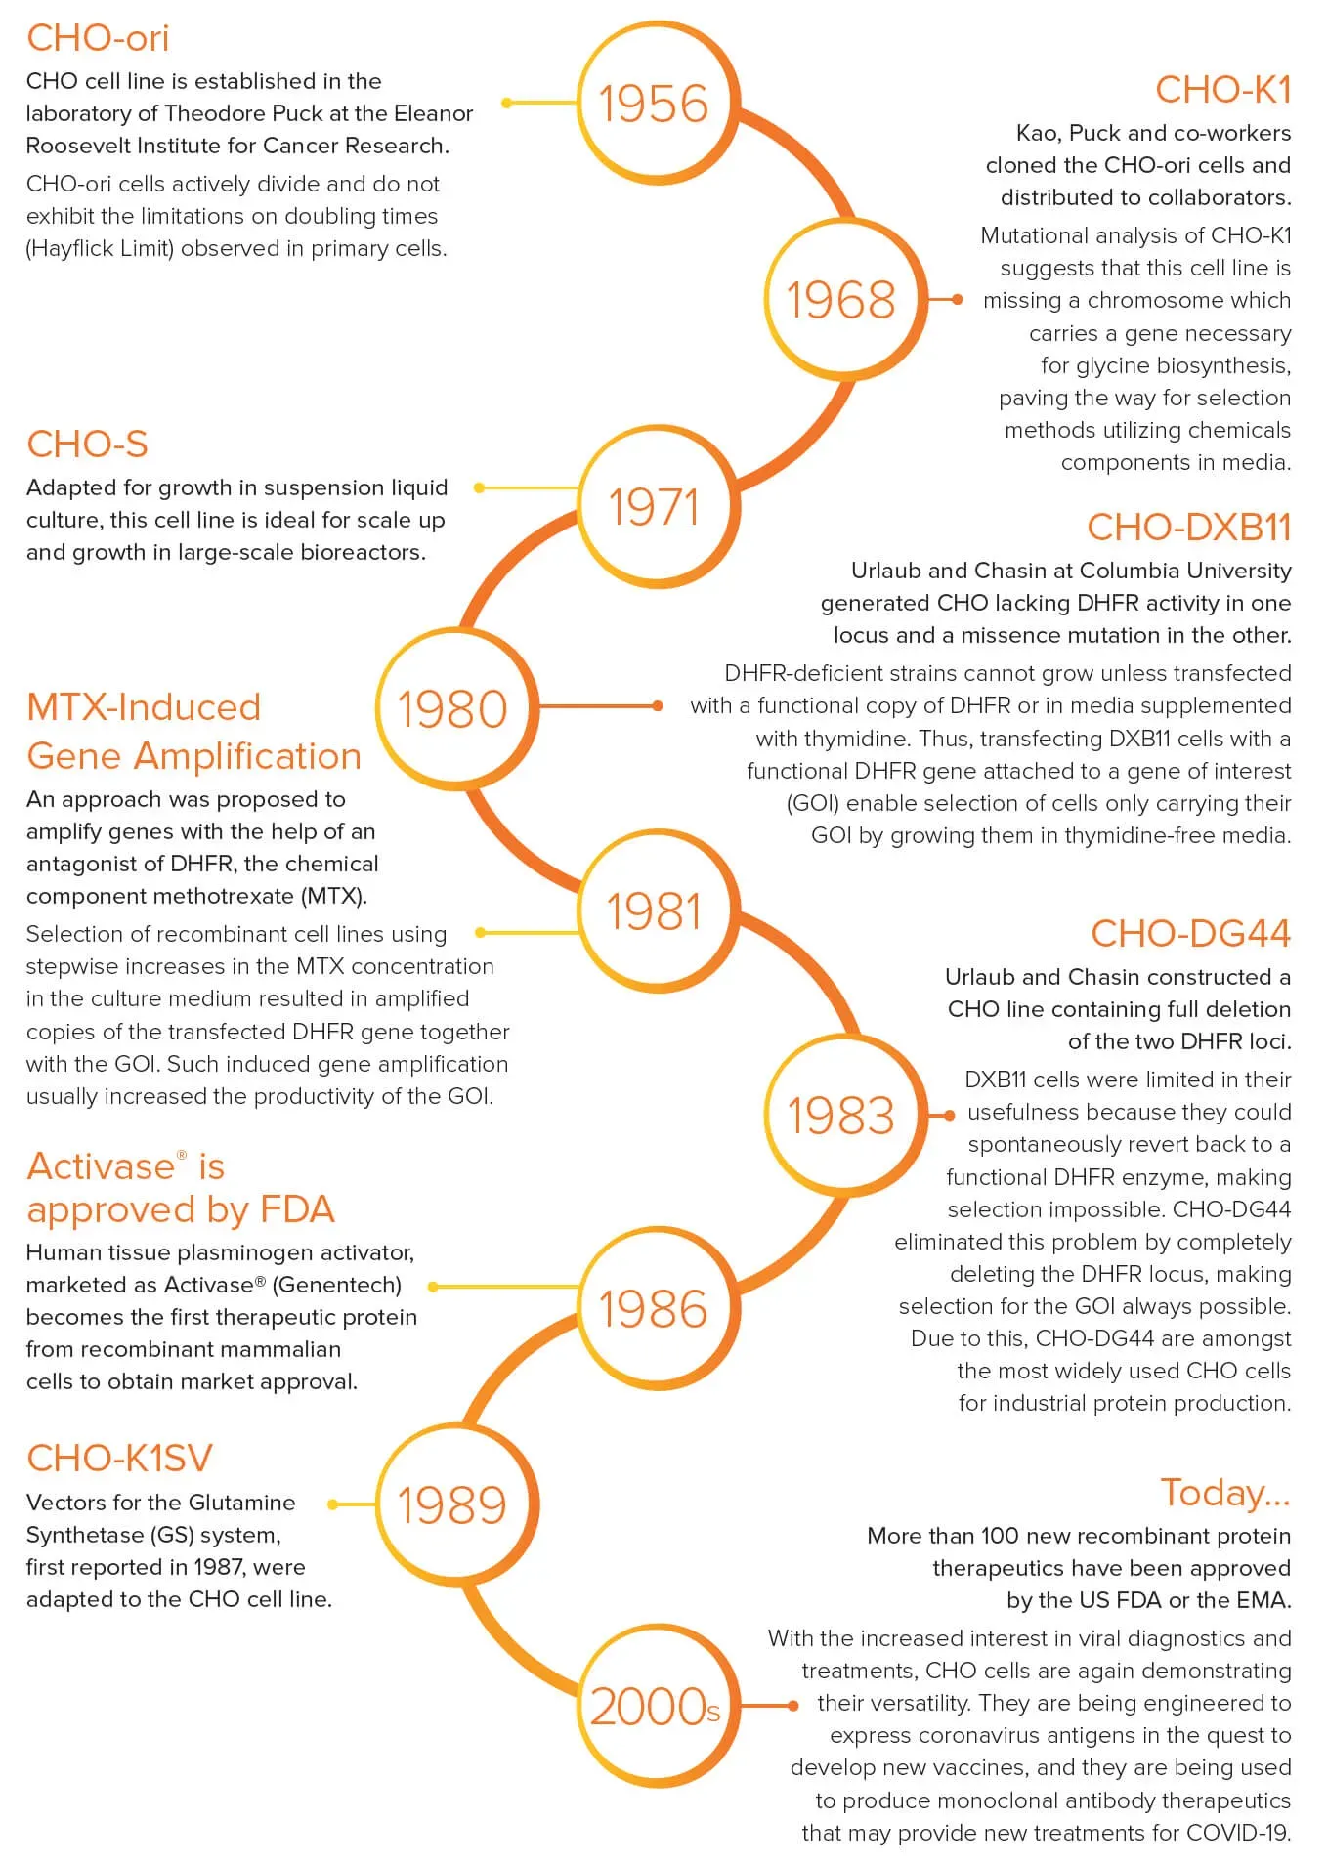
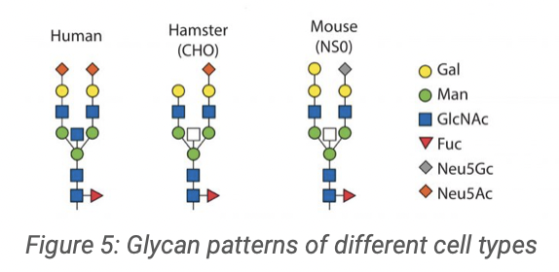
Production in mammalian cells: Two main cells used
HEK293 cells | CHO cells
Human Embryonic Kidney The most commonly used line for transient production, not as frequently used for therapeutic protein production Easy to transfect Adaptable for suspension culture Transient expression | Chinese Hamster Ovary Predominant cell line for therapeutic protein production due to preferred post-translational modifications Adaptable for suspension culture Transient and stable expressions
https://www.creativebiomart.net

Slide 27
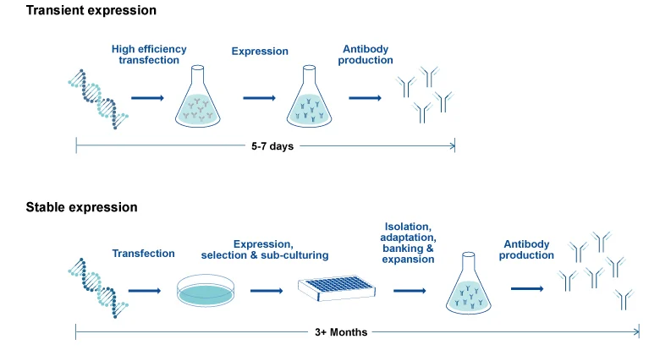
Transient versus stable mammalian expression
No integration in genome, Expression limited in time, Fast
https://www.genscript.com/protein-news/why-are-cho-cells-critical-in-bioprocessing.html

Slide 28
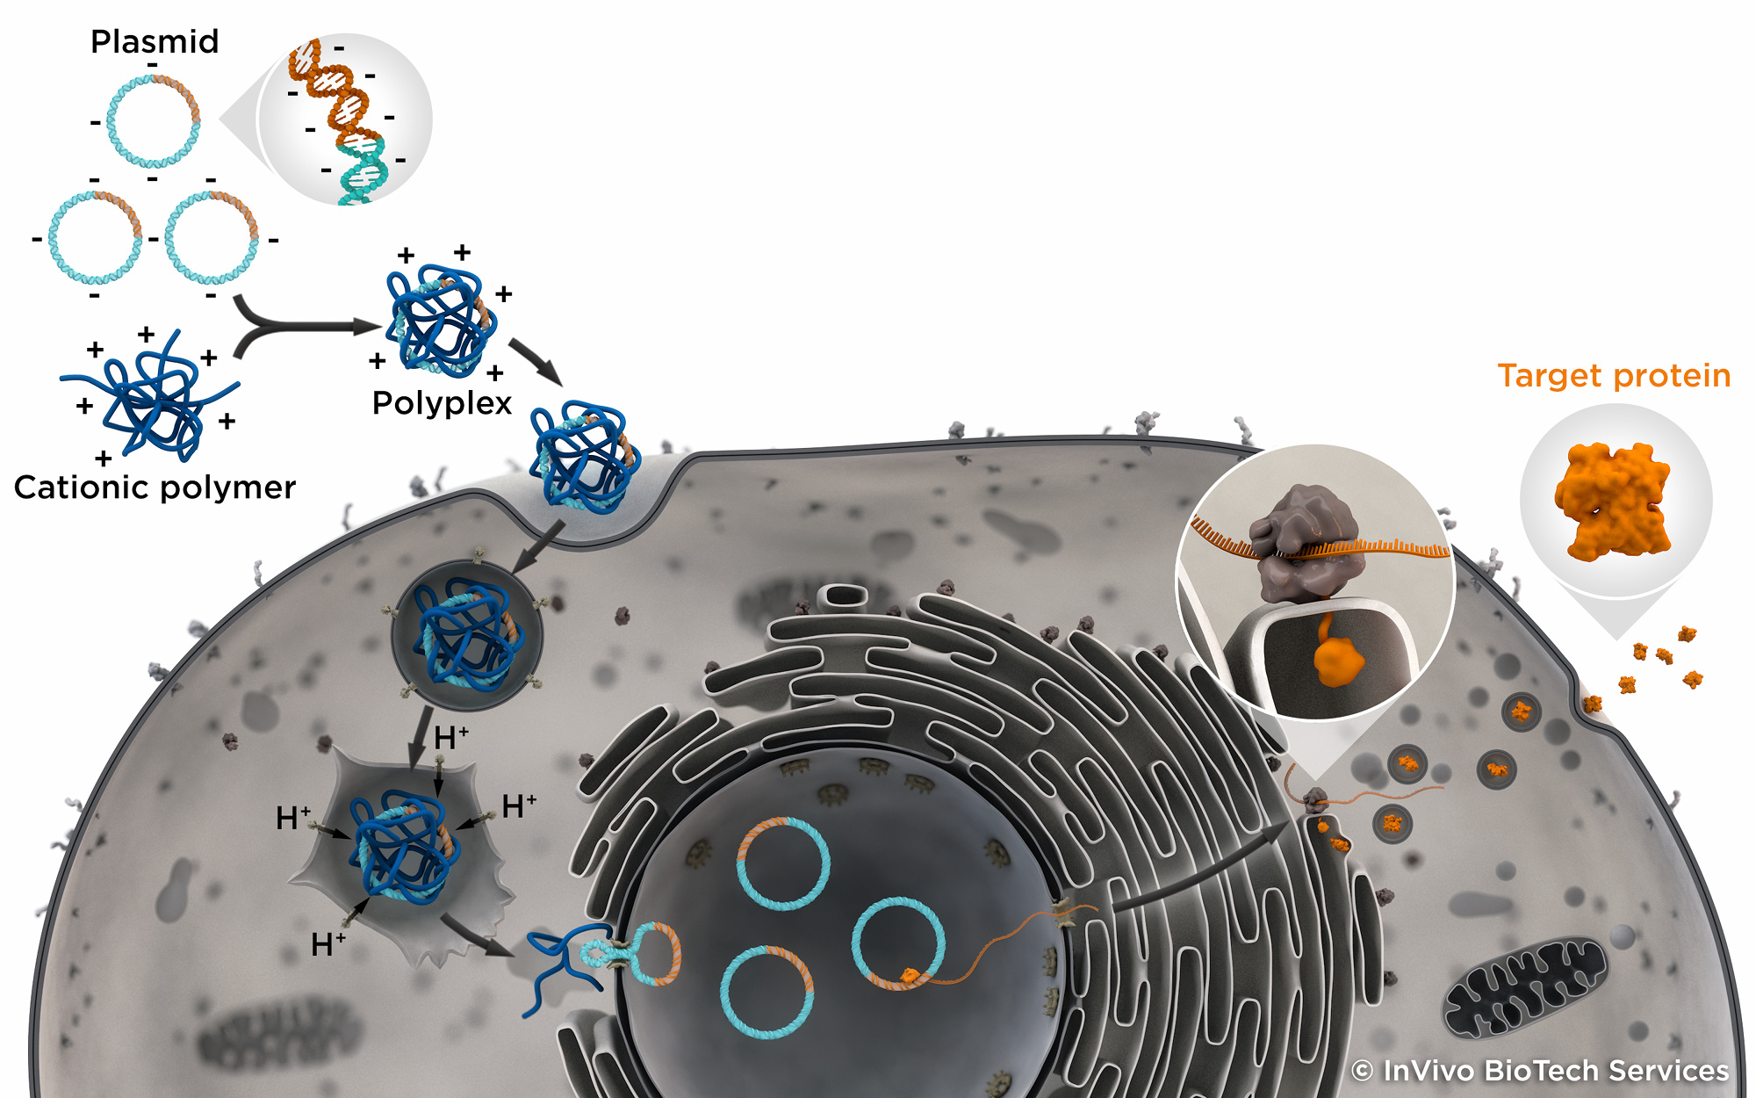
Transient transfection in mammalian cells
https://www.transient-transfection.com

Slide 29
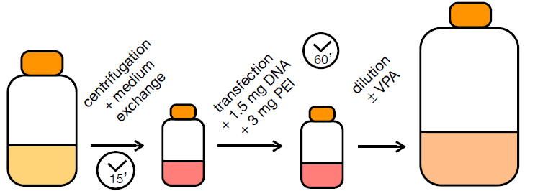
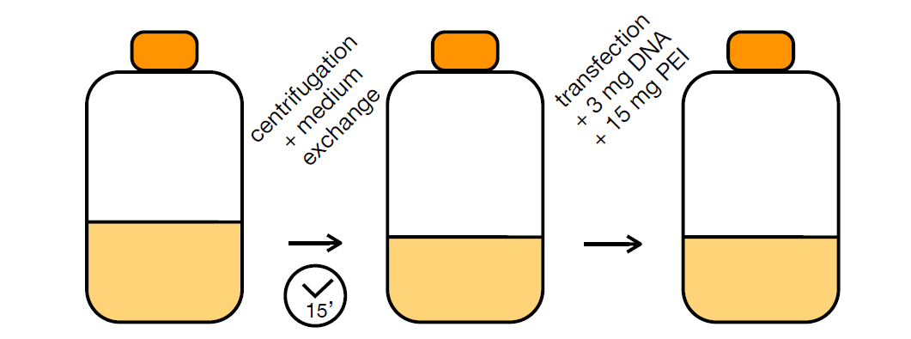
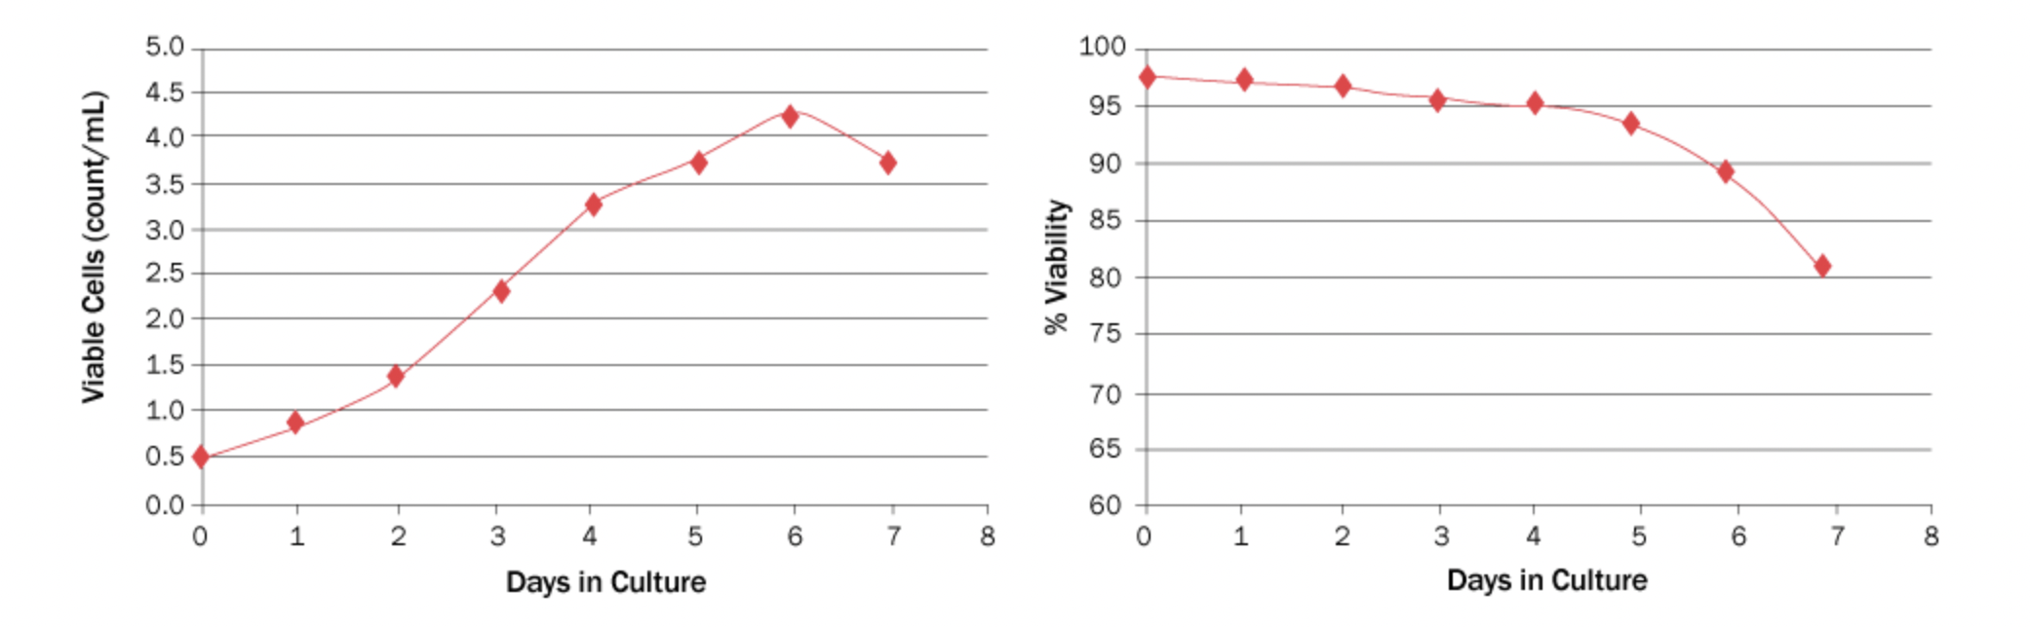
Transient transfection of HEK293E cells
Transient transfection of CHO cells
50 ml culture
20 million cells/ml
1 liter culture
1 million cells/ml
31°C
4 – 6 million cells/ml
37°C
+/- VPA: Valproic acid is a histone deacetylase inhibitor that blocks the cell cycle
+/- 2% DMSO
Typical growth and viability curves for HEK and CHO cells

Slide 30
Summary Transient vs Stable gene Expression
Transient gene expression
Rapid production of small quantities of protein
Production of multiple variants of one protein
Production of cytotoxic proteins
Technically difficult at volumes beyond 10 L
Stable gene expression – pools and clonal cell lines
Multiple productions of single protein or multi-protein complex
Inducible production of cytotoxic proteins
Requires a selection step (7 – 14 days for pools and 4 months for single cell clone)
Easy to scale up (100s -1000s of liters)

Slide 31
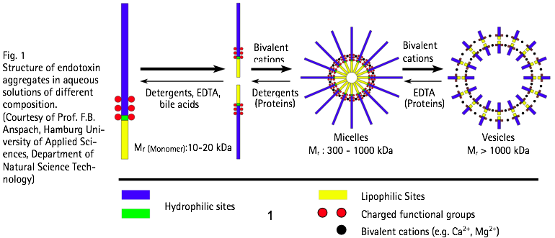
Avoid comtamination with Endotoxin
Heat-stable lipopolysaccharide (LPS) from gram-negative bacteria
Standard of measurement is Endotoxin Unit (EU): 1 EU = 100 pg LPS
Maximum dose for injected drugs is 5 EU per kg of body weight per hour

Slide 32
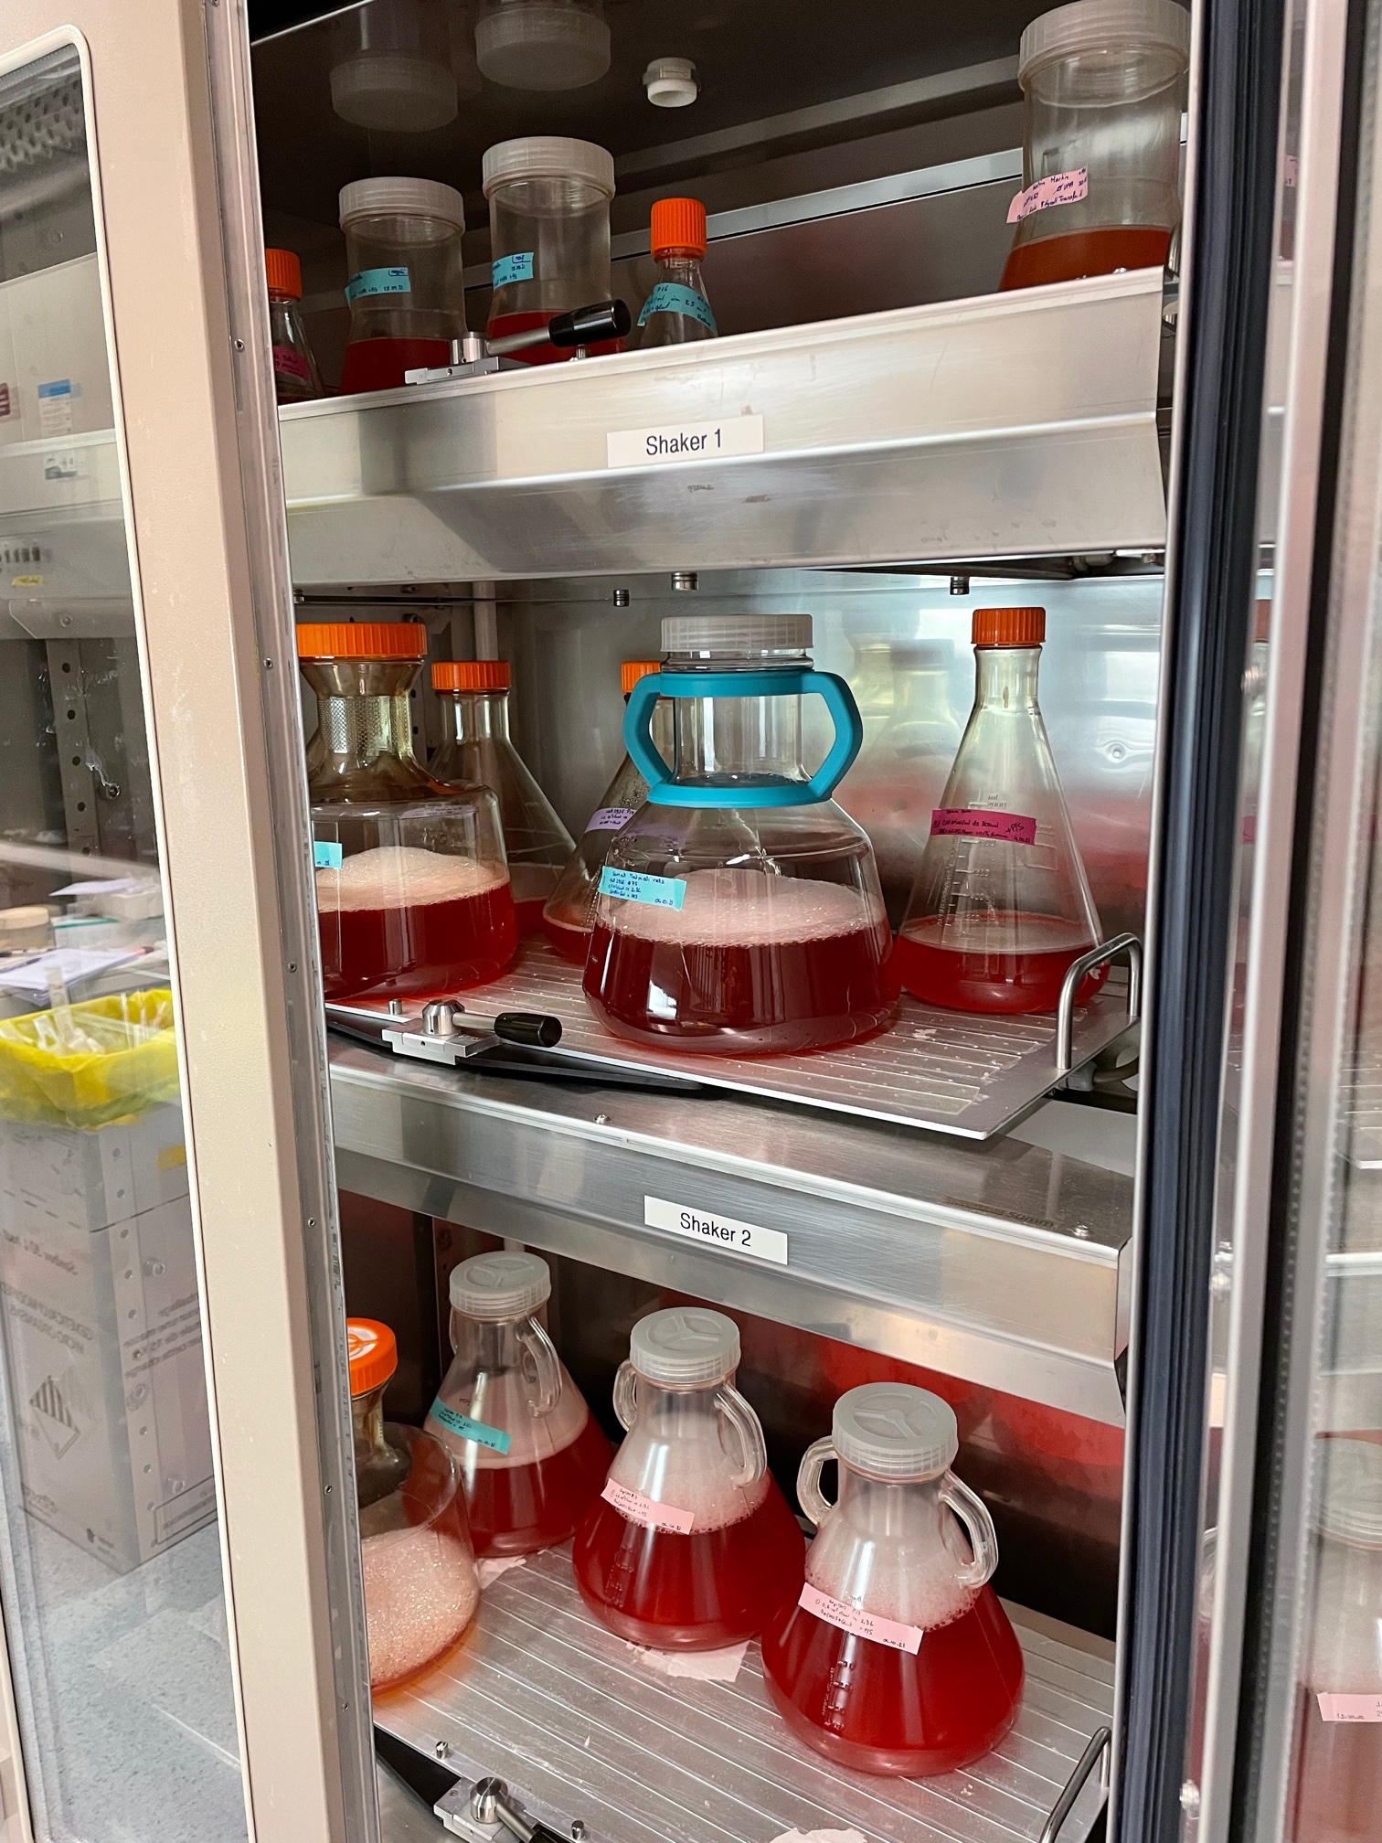
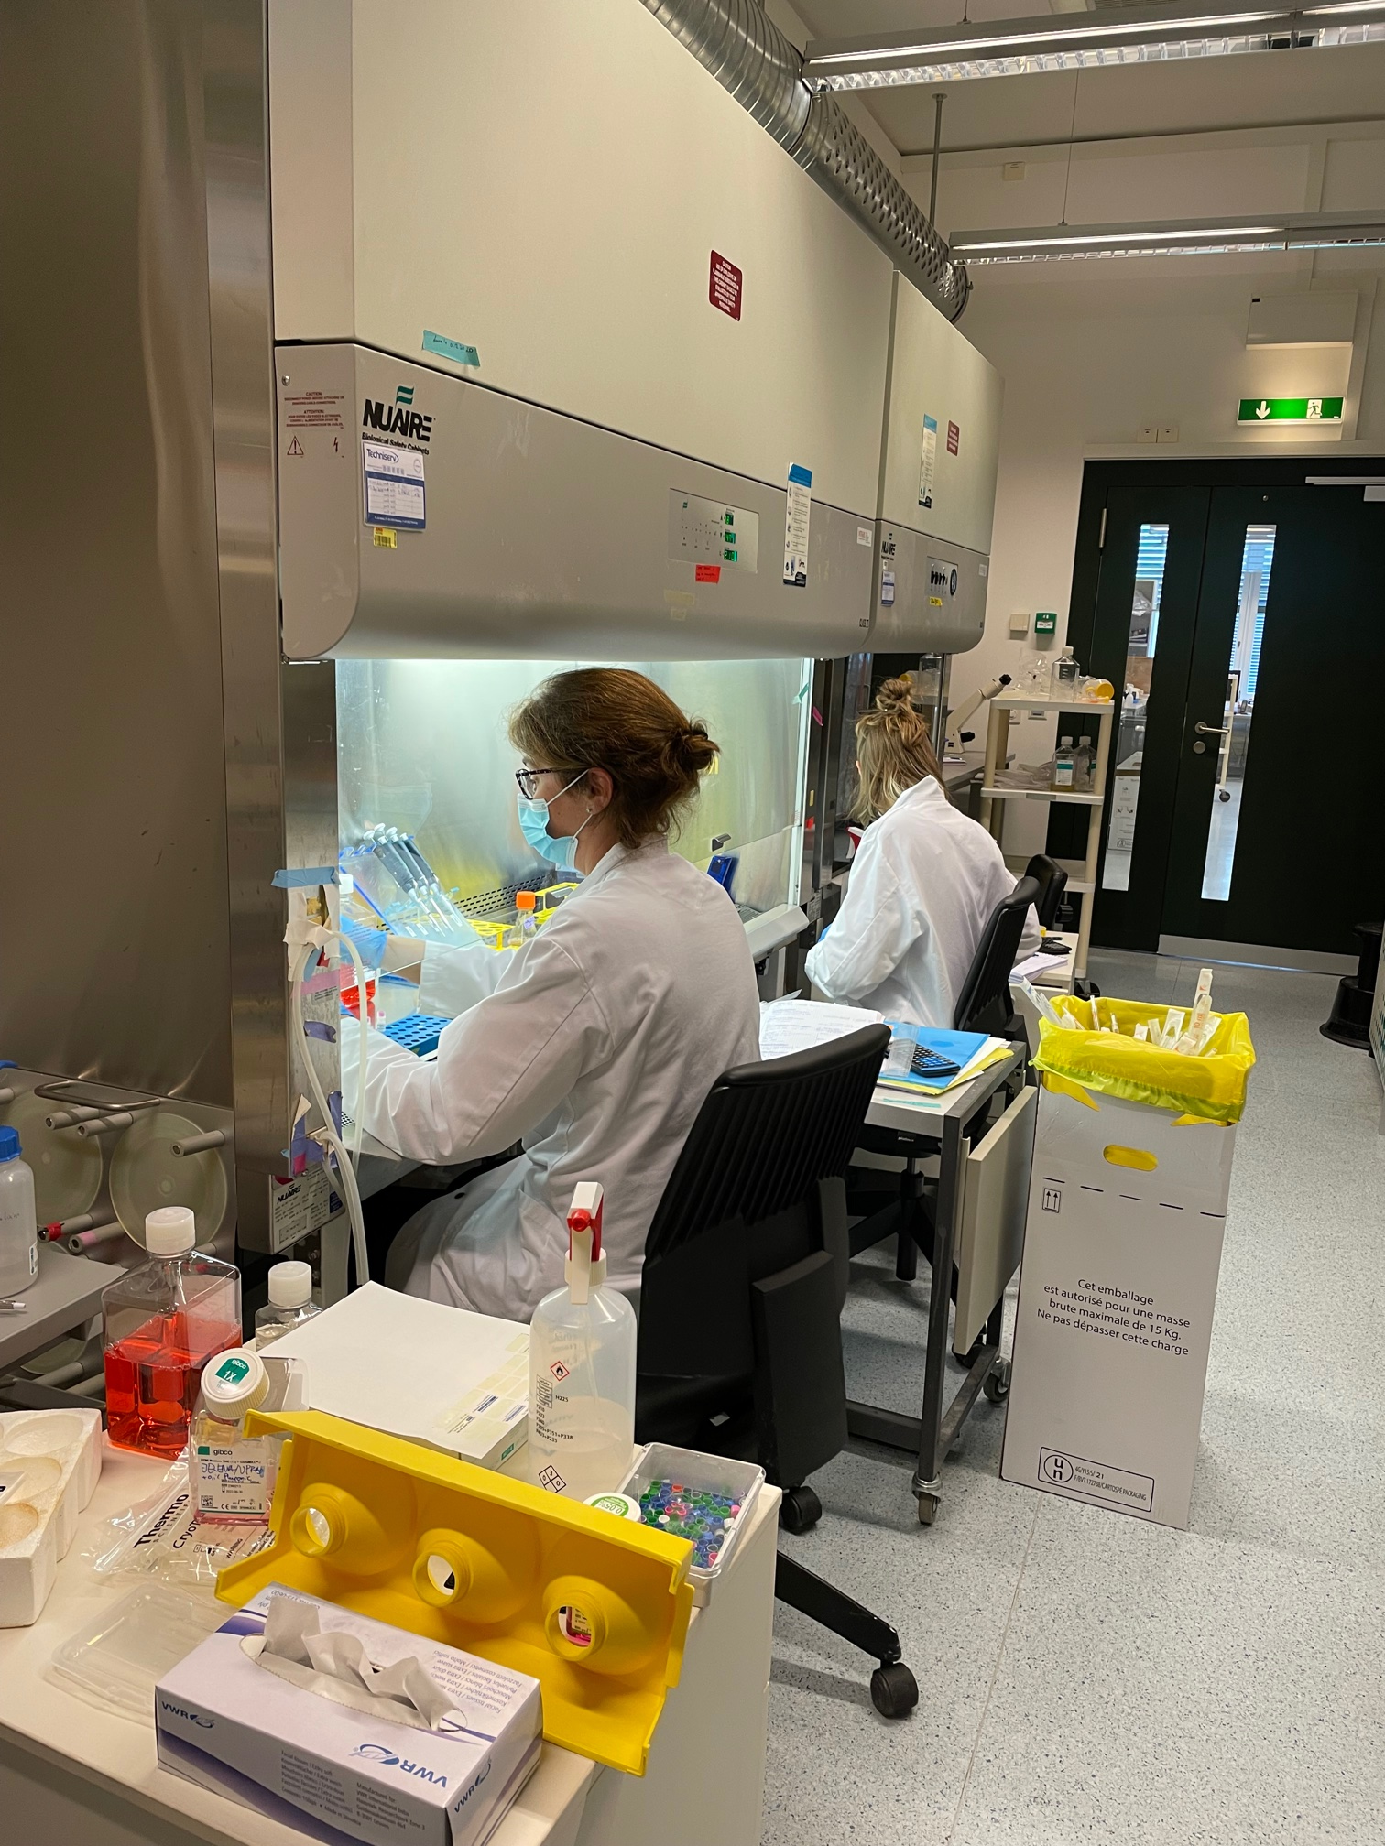
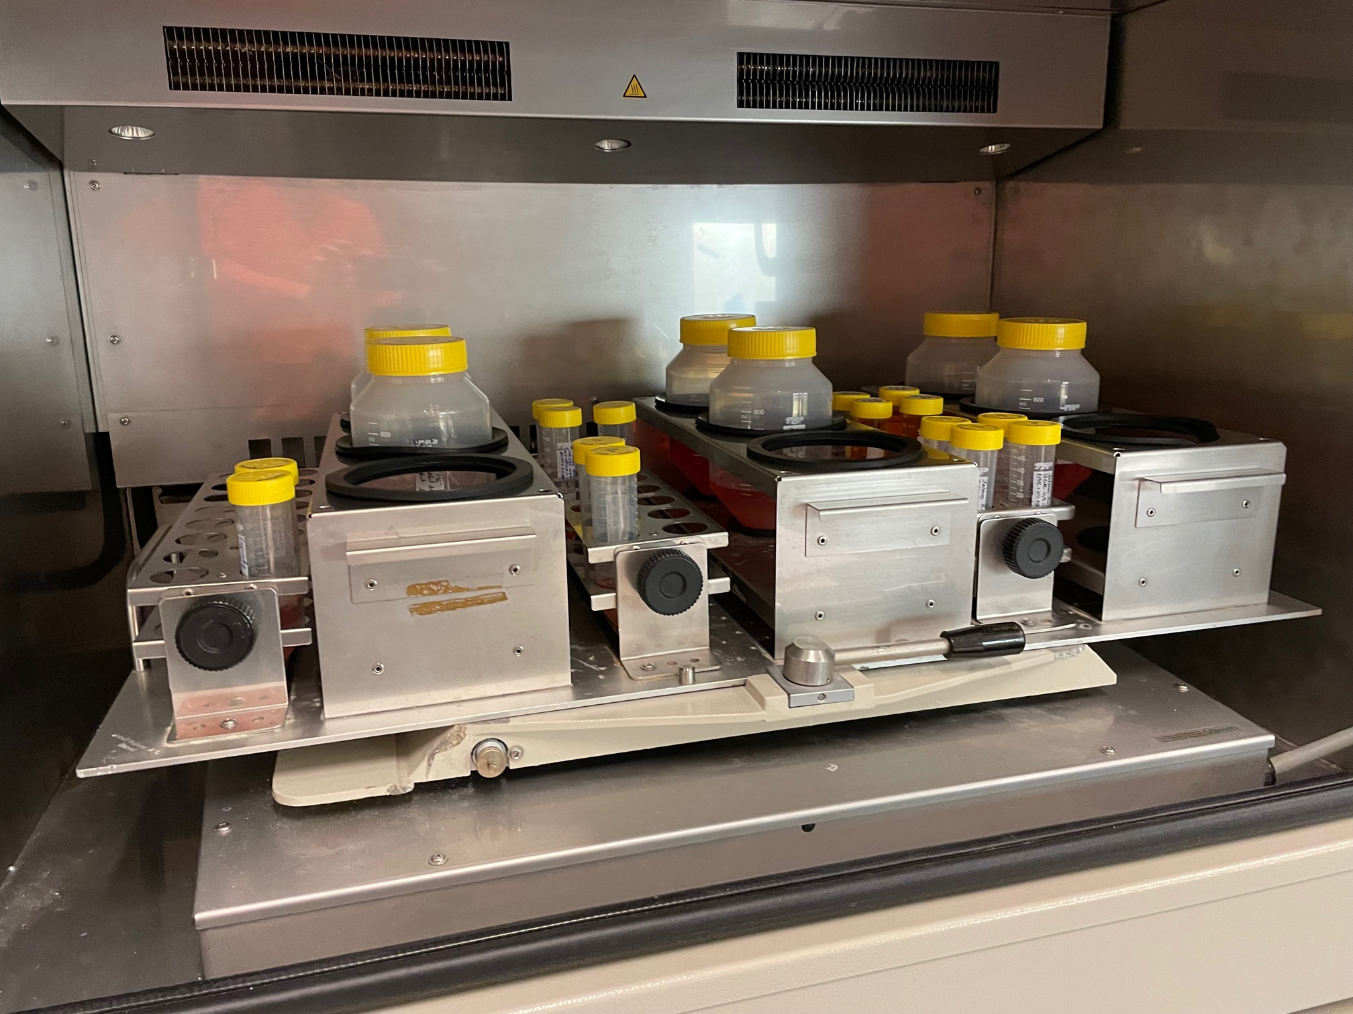
Academic setup for production
@ PTPSP- EPFL

Slide 33
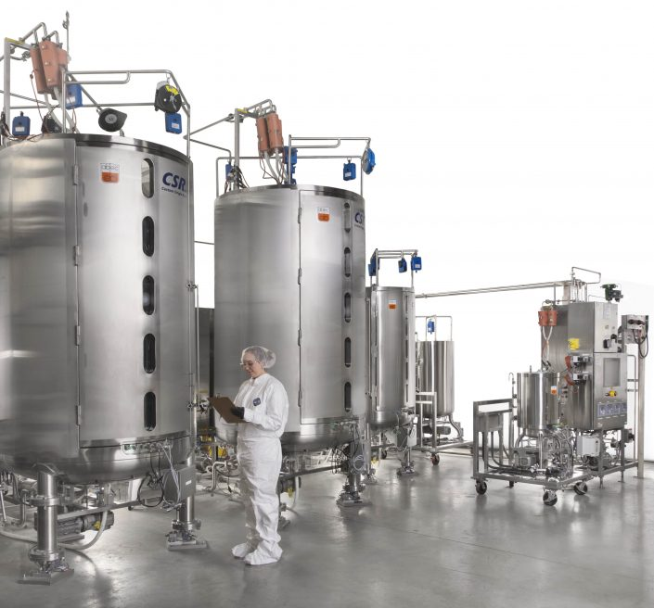
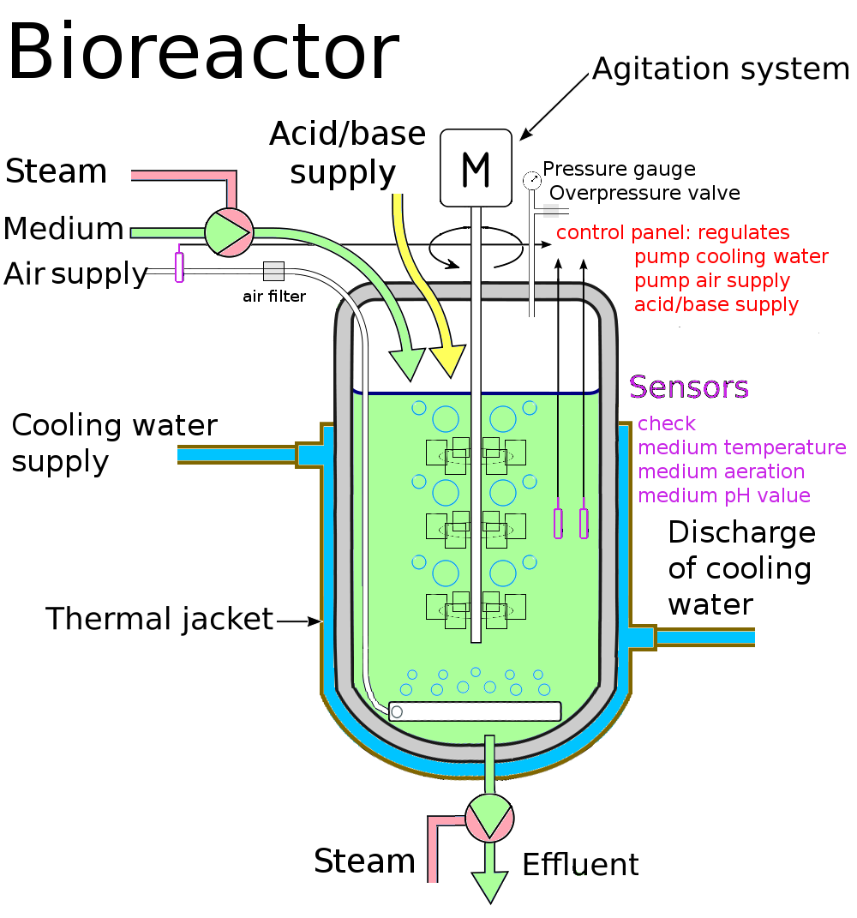
Industry setup for production
http://cn.abec.com/single-use/

Slide 34
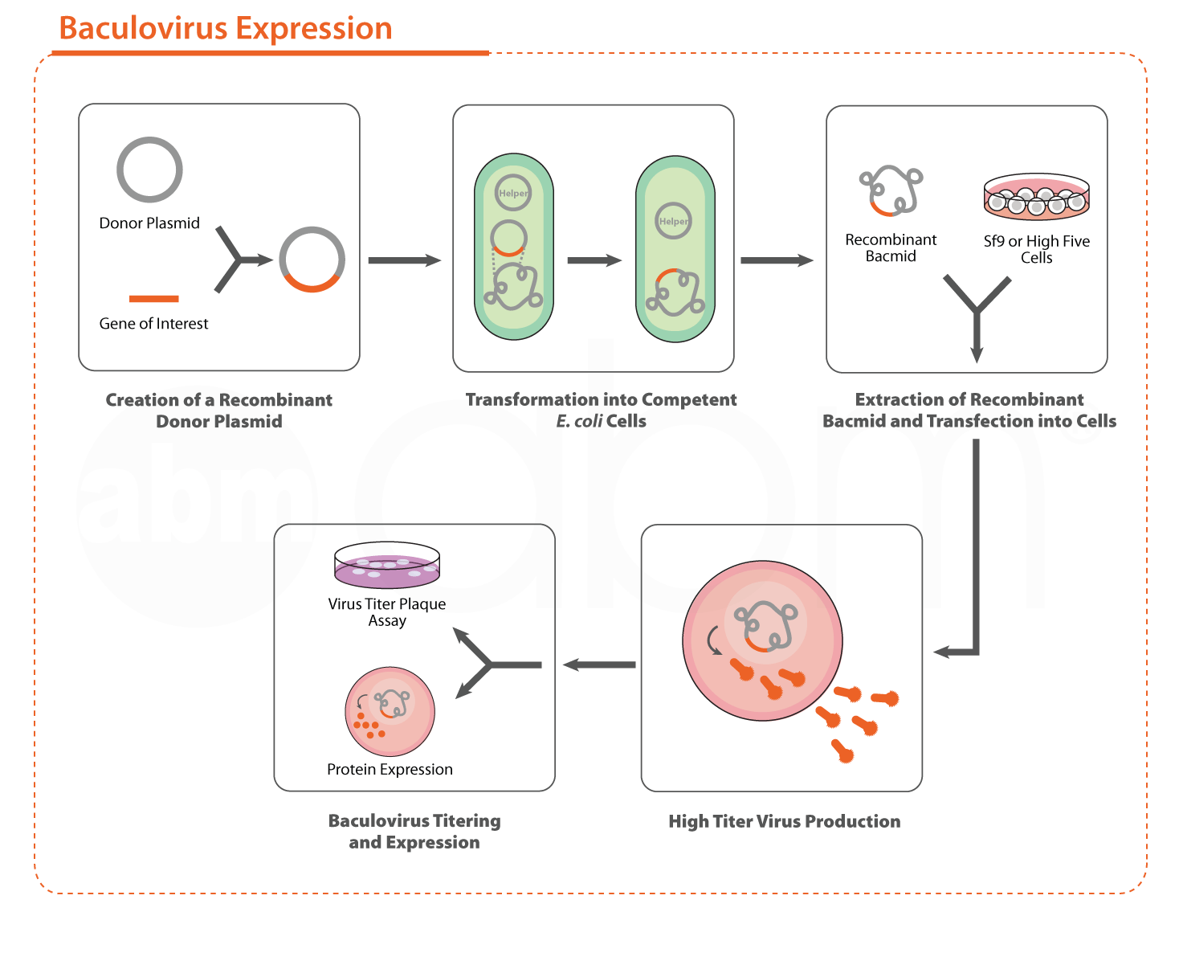
Production in insect cells via Baculovirus infection: a long process but very versatile
Simple to handle, Best practice : no antibiotics
Temperature : 21 – 28°C (very heat sensitive)
Full process: 4-5 weeks
https://www.abmgood.com/Custom-Baculovirus-Production-Services.html

Slide 35
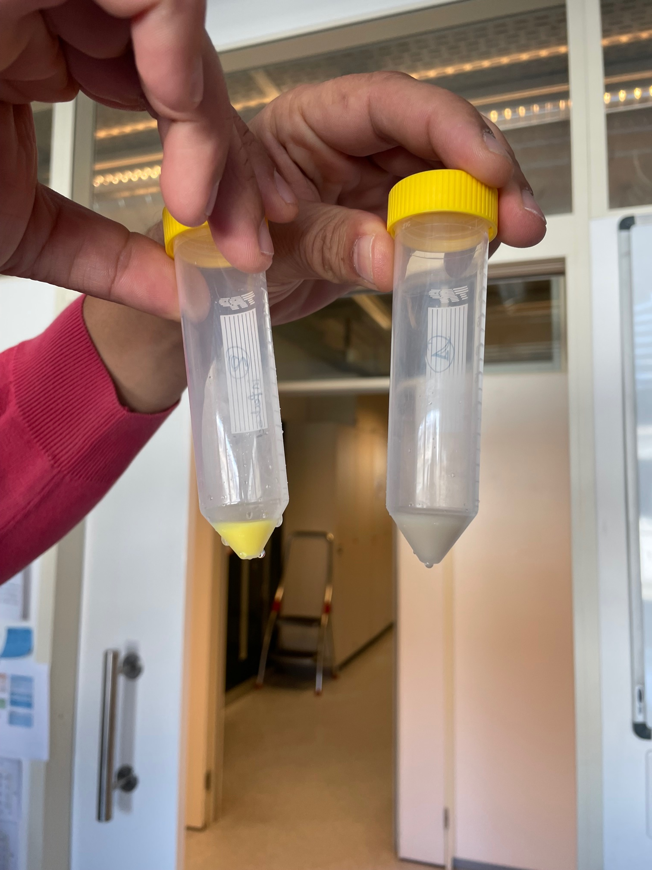
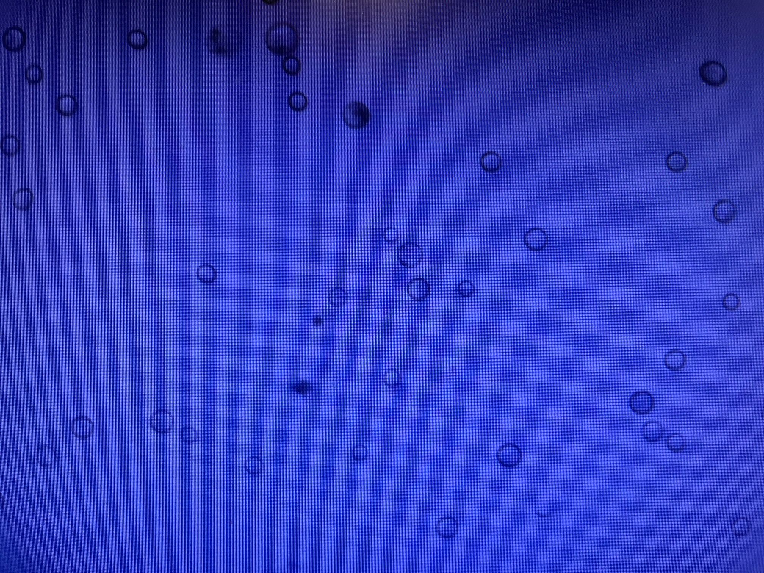

Different cell types for Production in insect cells
Sf9/Sf21 derived from Spodoptera frugiperda
most common cell lines, used mostly for virus production
Hi5/Tnao/Tni derived Trichoplusia ni
Fashion cell line, used for protein production
Sf9 cells 2 days post infection, YFP reporter

Slide 36
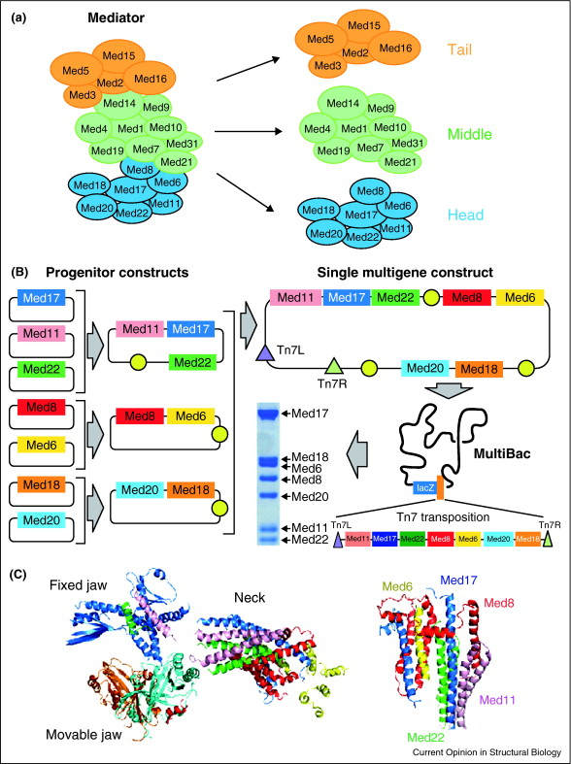
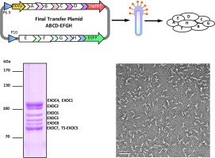
Production in insect cells: applications
Multibac system designed for high-order complexes via transposition
Can accommodate large insertions
https://doi.org/10.1016/j.yjsbx.2019.100003
DOI: 10.1016/j.sbi.2013.03.009

Slide 37

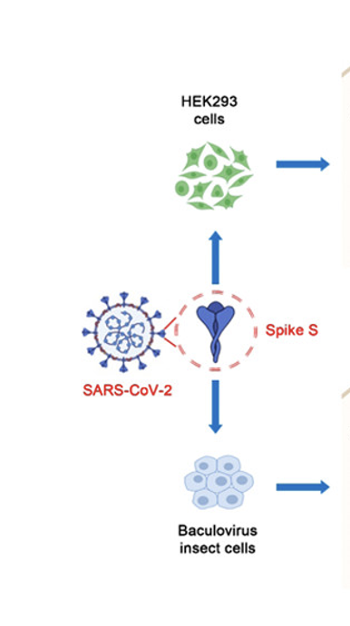
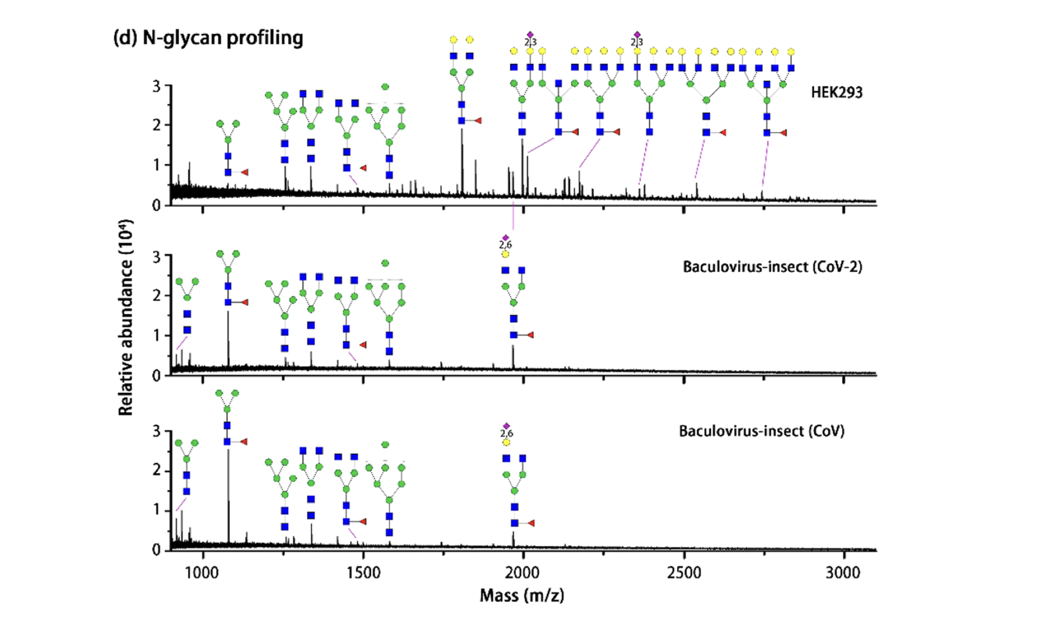



Slide 38
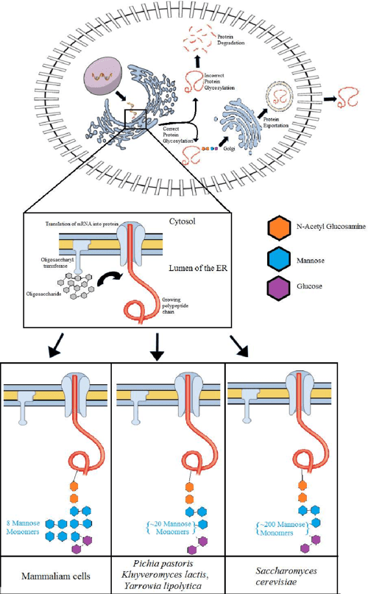
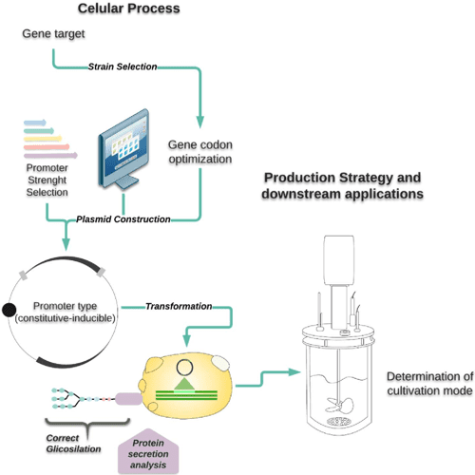
Production in yeast: easy process
Comparison of Yeasts as Hosts for Recombinant Protein Production, 2018

Slide 39
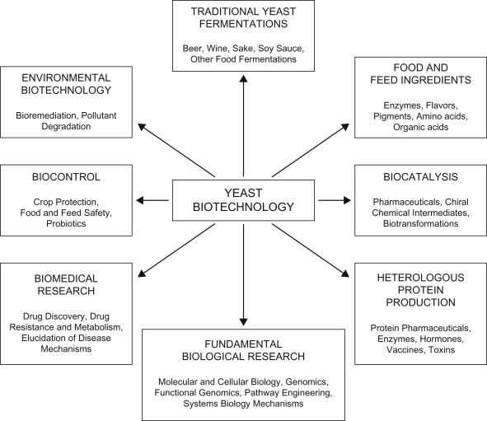
Production in yeast: applications
https://www.sciencedirect.com/science/article/pii/B9780444521491000033

Slide 40
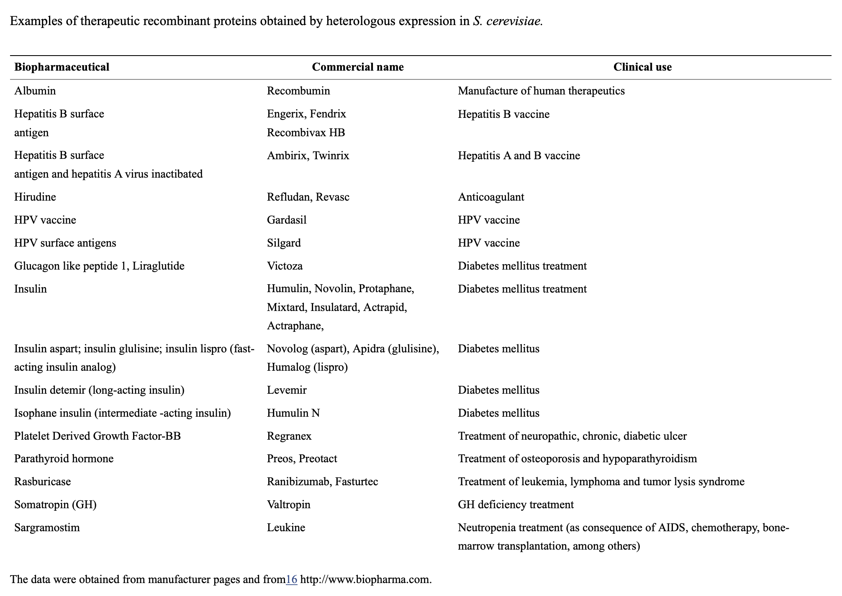
Production in yeast: applications

Slide 41

Market share comparison between biotherapeutic production hosts
Trends in Biotechnology 2022 40576-590DOI: (10.1016/j.tibtech.2021.10.003)

Slide 42
1
Clone the POI gene into a chosen expression vector
2
Transform/Transfect/Transduce the expression vector into chosen host
3
Expression test to check protein size and level
4
Protein purification
5
Protein quality control

Slide 43

Where is your protein overexpressed?

Slide 44


Slide 45




Academic setting
Culture before purification
Cells Lysis by homogenizer
Cells Lysis by sonicator
Removal of cells debris by centrifugation
During lysis, Protease inhibitors, DNase, lysozyme (bacterial cells) can be added

Slide 46



Protein purification is a multi-step process
Based on protein properties and applications, your need to choose the type and number of purification steps

Slide 47

Liquid chromatography is
the most common technique
A separation technique in which the mobile phase is a liquid

Slide 48






Batch versus automated purification
Batch purification | Automated purification
Little training required- no instrument | Automated- convenience
Easy to do parallel runs | Gradient elution- Higher resolution Reproducibility- easy reporting
Magnetic beads

Slide 49



Main Chromatography techniques

Slide 50

Affinity Chromatography (AC):
Separation by specific binding

Slide 51


Antibodies purification

Slide 52

Antibodies purification

Slide 53

https://resources.chromotek.com/blog/tags-for-affinity-purification

Slide 54

Example of tags for affinity purification
https://www.sinobiological.com/resource/protein-review/protein-tag

Slide 55

Example of tags for affinity purification
https://www.sinobiological.com/resource/protein-review/protein-tag

Slide 56

Simple Workflow for soluble protein
with His affinity tag

Slide 57


Zoom into His tag binding
Elution by competition with Histidine analog: Imidazole
https://www.researchgate.net/figure/Principle-of-protein-purification-through-histidine-affinity-tag_fig1_260950943

Slide 58




Anion exchange Chromatography (IEX): separation by charge for capture untagged proteins or intermediate step

Slide 59


Anion exchange Chromatography (IEX): separation by charge for capture untagged proteins or intermediate step

Slide 60


Size Exclusion Chromatography (SEC): separation by size/shape for polishing step after AC
Cytiva purification manual

Slide 61

Size Exclusion Chromatography (SEC): separation by size/shape for polishing step after AC
Superdex | Composite of cross-linked agarose and dextran. Versatile use in both preparative and analytical applications, especially with recombinant tagged proteins
Superose | Composite of cross-linked agarose. Wide fractionation range: optimized to purify large biomolecules, including membrane proteins, protein complexes, and DNA fragments
Sephacryl | Cross-linked copolymer of allyl dextran and N,N'-methylene bisacrylamide. Cost-efficient gel filtration resins providing high resolution with fast and easy operation.

Slide 62

Size Exclusion Chromatography (SEC): separation by size/shape for polishing step after AC

Slide 63


Hydrophobic Interaction Chromatography (HIC):
capture step of untagged proteins

Slide 64


Hydrophobic Interaction Chromatography (HIC):
capture step of untagged proteins

Slide 65


Reverse Phased Chromatography (RPC):
mostly for peptides, mobile phase is an organic solvent

Slide 66

Summary of main chromatography techniques

Slide 67

Other Tags to increase protein solubility
Costa et al (2014). Fusion tags for protein solubility, purification, and immunogenicity in Escherichia coli: the novel Fh8 system

Slide 68



Proteases to cleave the tags off

Slide 69

Purification of insoluble proteins
Some overexpressed proteins form aggregates, called inclusion bodies.
Solubilization by using denaturing agents (urea, guanidine hydrochloride)
Refolding by slowly removing the denaturing agents (e.g. by dialysis) or directly on affinity column
Lost of a lot of protein during the process, need to test if protein is functional after refolding

Slide 70

Purification of membrane proteins
Challenge: Extraction of transmembrane proteins from host cell membrane, while maintaining their integrity and function– limited material
Need to add detergents or membrane mimetic systems, such as nanodiscs and styrene malic acid lipid particles (SMALPs) – screening of conditions required
Further purifications can be performed by affinity chromatography as for soluble proteins (e.g. via His tag)– need to work fast (often not stable)
https://febs.onlinelibrary.wiley.com/doi/full/10.1111/febs.15676

Slide 71

Overview of purification strategy

Slide 72
1
Clone the POI gene into a chosen expression vector
2
Transform/Transfect/Transduce the expression vector into chosen host
3
Expression test to check protein size and level
4
Protein purification
5
Protein quality control

Slide 73

Protein Quality Control (QC)
https://www.nature.com/articles/s41467-021-23167-z

Slide 74
Example 1: Production of Spike
ExpiCHO + 2% DMSO
ExpiCHO cells
HEK + VPA
HEK cells
-Transient transfections in ExpiCHO or HEK cells to test expression
- 7 days culture
- Secreted into media
MW
240
Spike
140
80
62
50
31
27
Spike monomer
MW: 142.2 kDa
without glycans

Slide 75


Production in ExpiCHO for 7 days
Purification of Spike (His OR Strep affinity tags )
- Supernatant was loaded on StrepTrap XT OR Histrap columns
- Elution with 50mM Biotin OR 500mM imidazole gradient
- Dialysis overnight in PBS
- Concentration calculated on nanodrop at A280nm
Akta chromatography
with various columns
Quality assessment by SDS-PAGE

Slide 76



Example 2: A common antibody
Batch method
Protein A resin purification
Antibodies/Fc-Fusions
1) SN
2) FT
3) Wash
4) Elution
5) Pre-SEC
6) Fraction n°16
7) Fraction n°17
8) Fraction n°24
9) Fraction n°27
10) Fraction n°30
1 2 3 4 5 6 7 8 9 10
240
140
115
80
62
50
31
27
15
6.5
Size Exclusion chromatography

Slide 77



Example 3: Dual RT-Polymerase expressed in E. coli
1. Batch method – Ni-NTA via His-tag
2. Akta chromatography
Heparin affinity*: no tag needed
*Heparin (highly sulfated polysaccharide) Sepharose™ High Performance for purification of proteins such as DNA-binding proteins, coagulation factors, lipoproteins and protein synthesis factors.

