Slide 1


Goal
Precise control of fly movement
Neuroengineering Laboratory

Slide 2
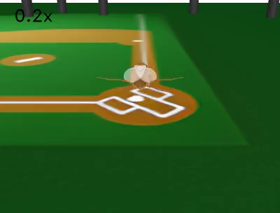
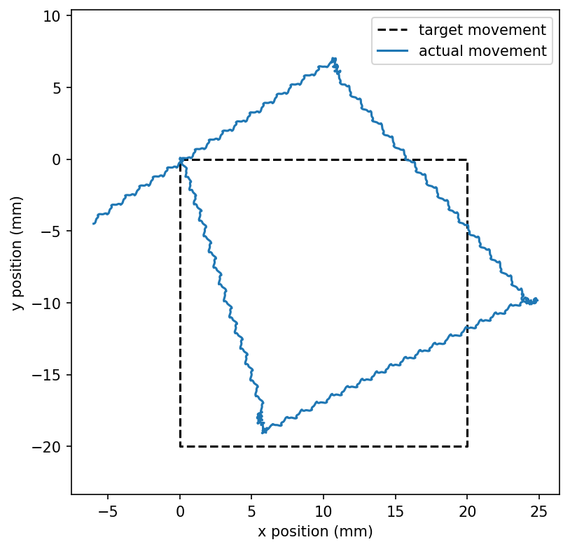
Open loop control
Neuroengineering Laboratory

Slide 3
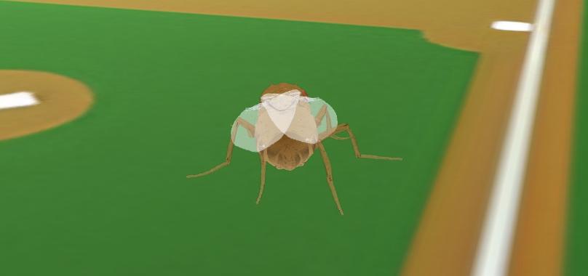
Odometry based path integration
Neuroengineering Laboratory

Slide 4
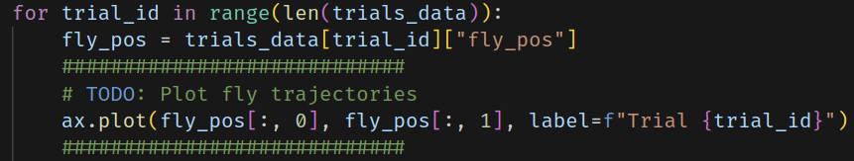
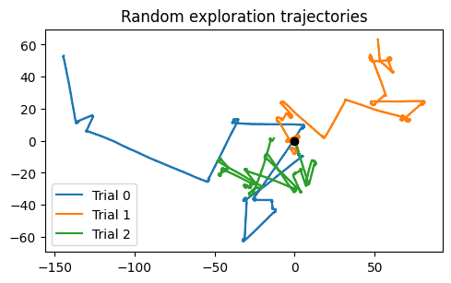
Plotting training data trajectories
Neuroengineering Laboratory

Slide 5
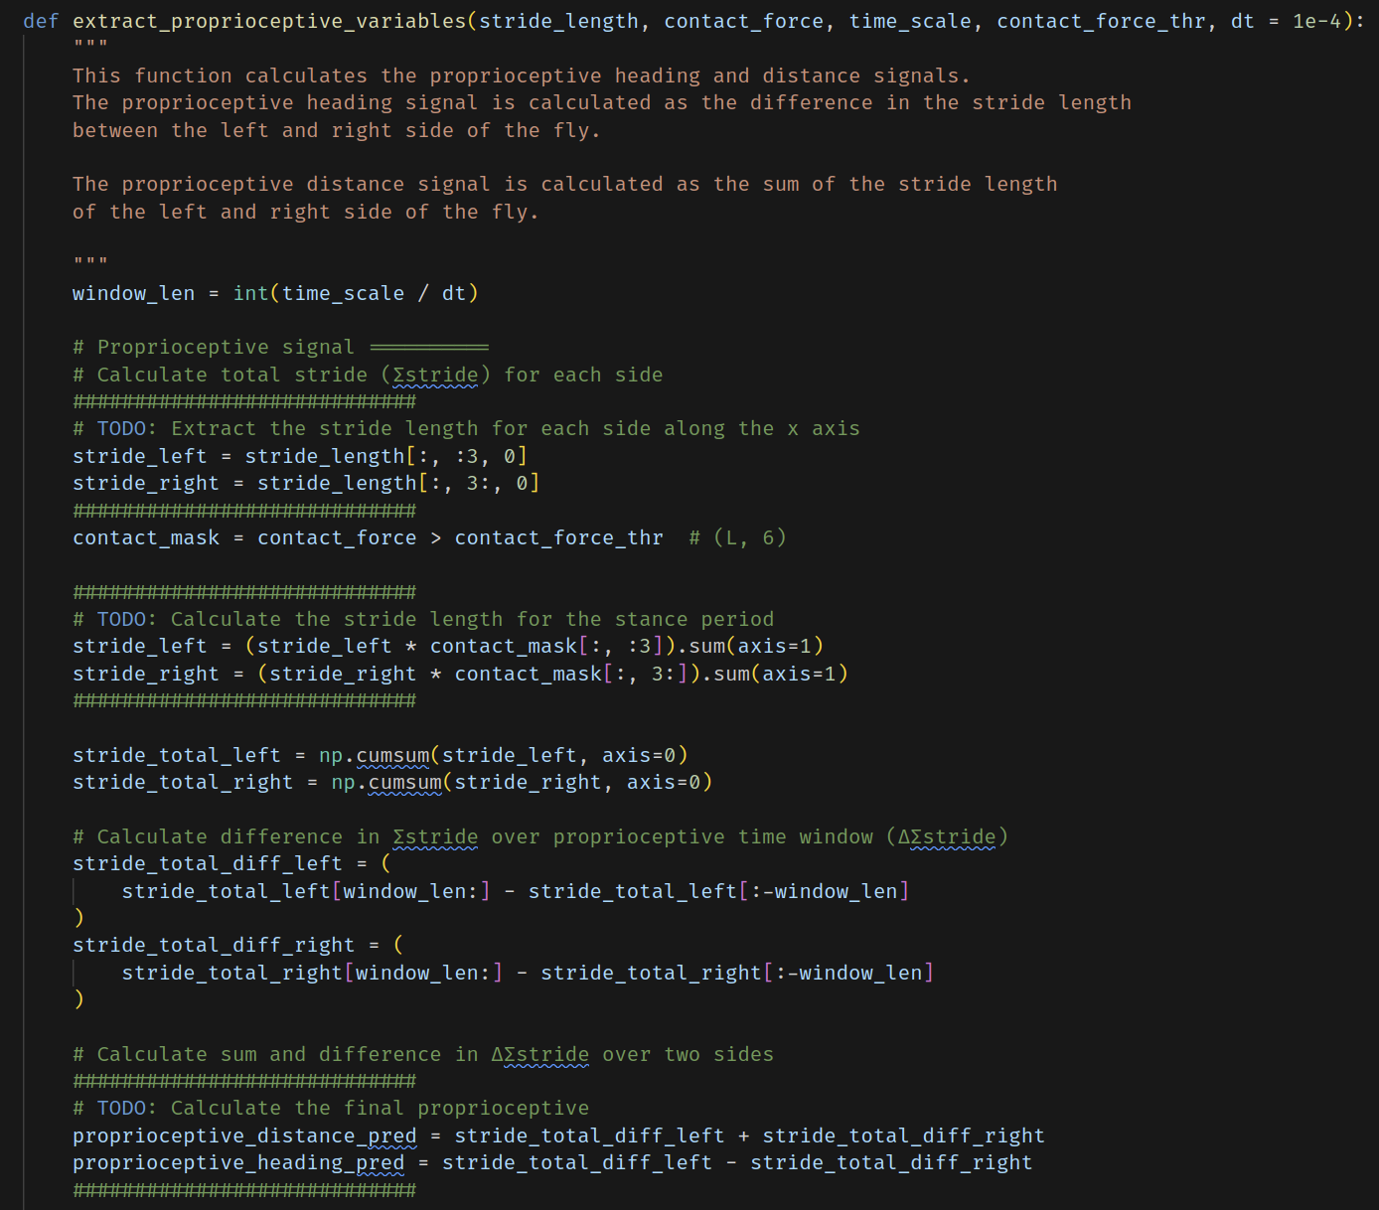
Calculating stride lengths
Neuroengineering Laboratory

Slide 6
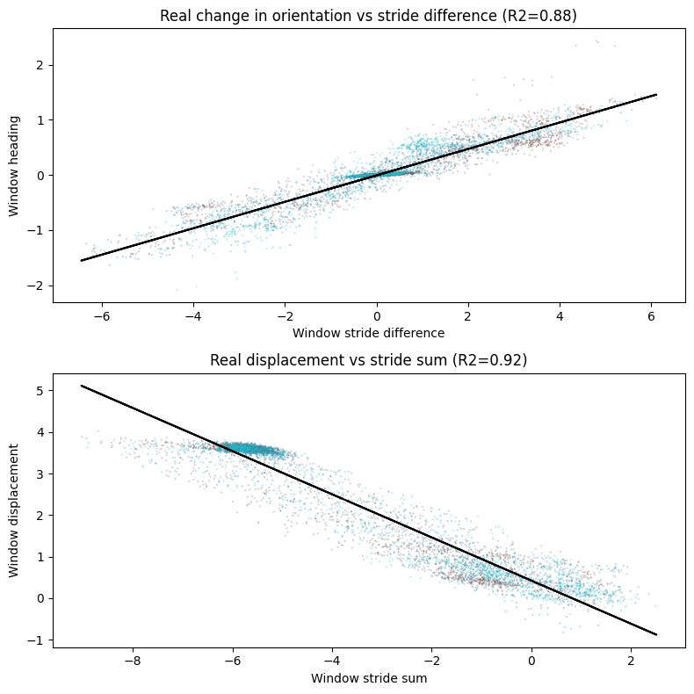
Calculating stride lengths
Neuroengineering Laboratory

Slide 7
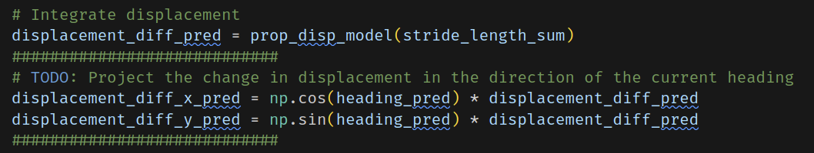
Integrating displacements
Neuroengineering Laboratory

Slide 8
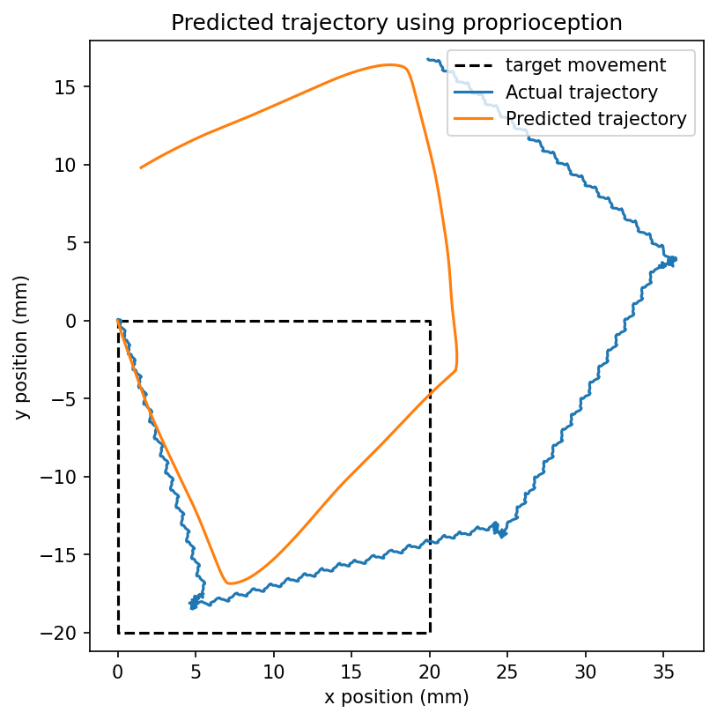
Path integration via step counting
Neuroengineering Laboratory

Slide 9
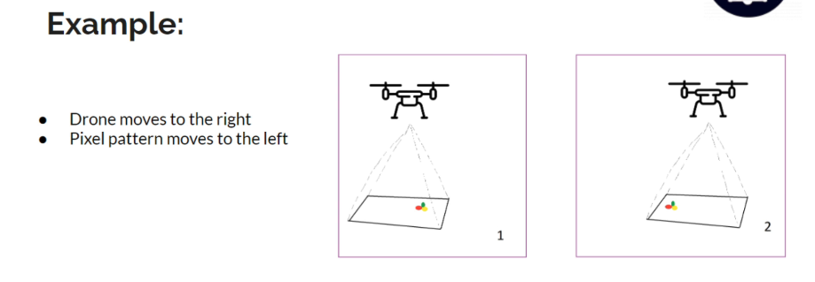
Path integration with optic flow
https://dojofordrones.com/diy-optical-flow-drone/
Neuroengineering Laboratory

Slide 10
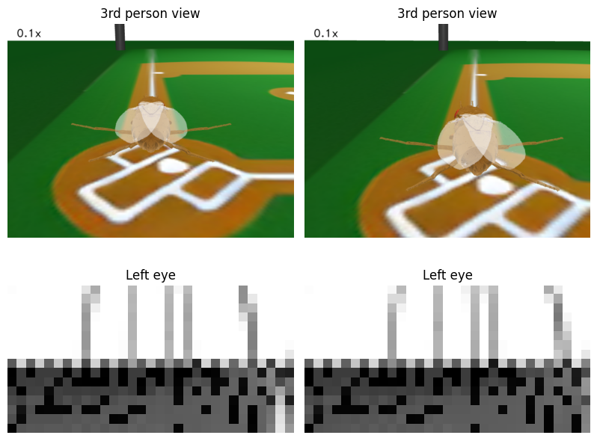
Path integration with optic flow
Neuroengineering Laboratory

Slide 11
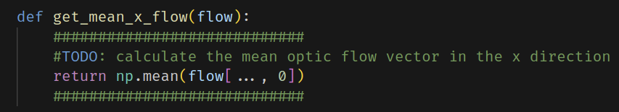
We only want horizontal optical flow
Neuroengineering Laboratory

Slide 12
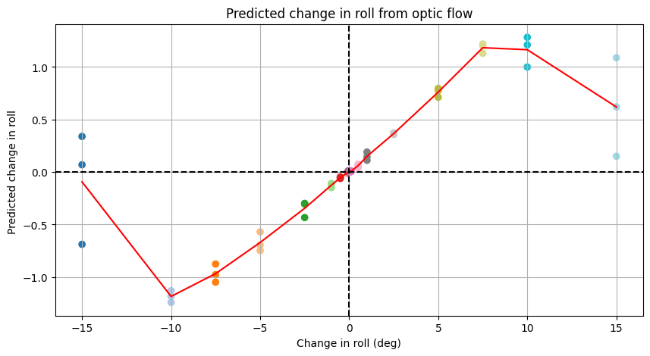
Optic flow vs true rotation
Images don’t look similar
Optic flow breaks
Neuroengineering Laboratory

Slide 13
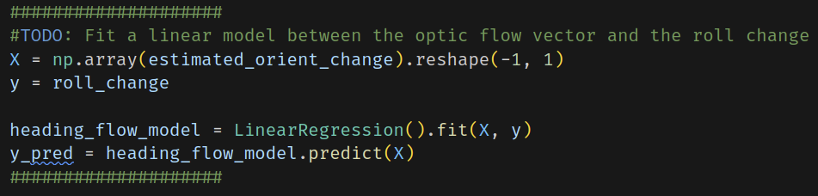
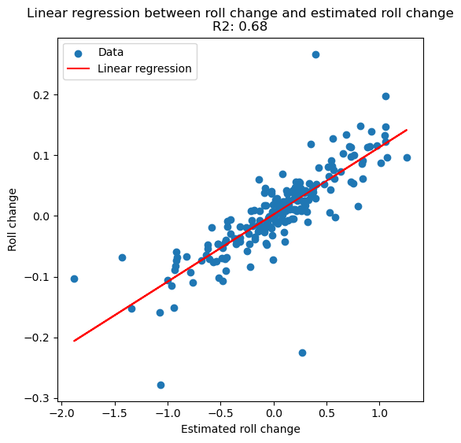
Regression model for optic flow
Neuroengineering Laboratory

Slide 14
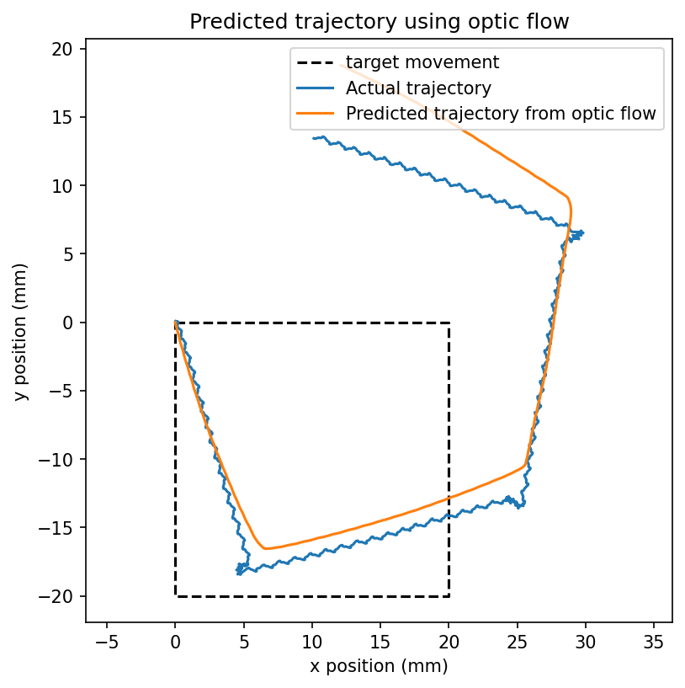
Path integration - step counting + optic flow
Neuroengineering Laboratory

Slide 15
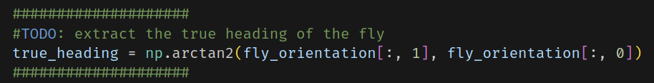
Polarised light as a compass
Neuroengineering Laboratory

Slide 16
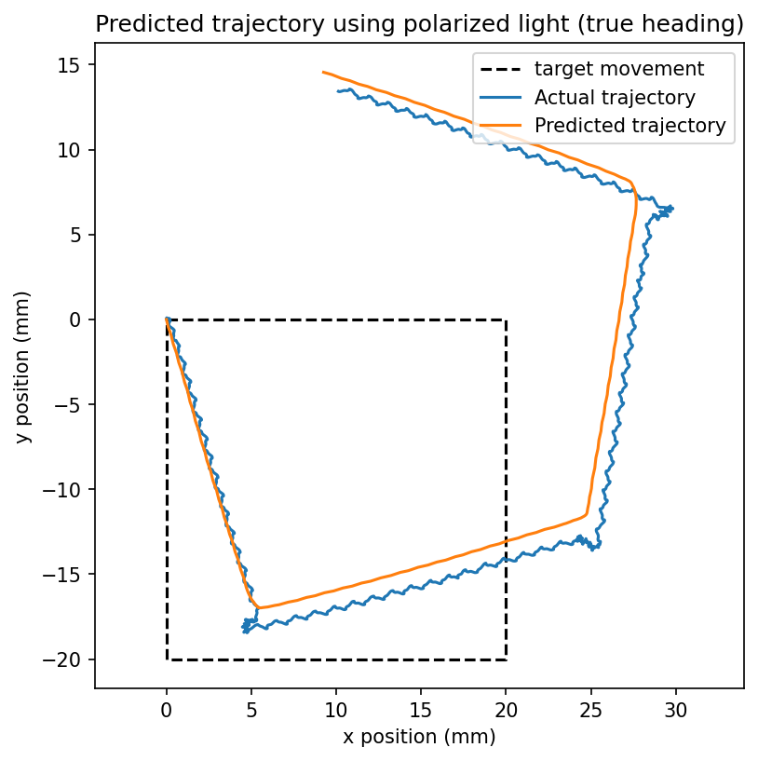
Step counting + polarised light
Neuroengineering Laboratory

Slide 17
Path integration comparison
Neuroengineering Laboratory

Slide 18

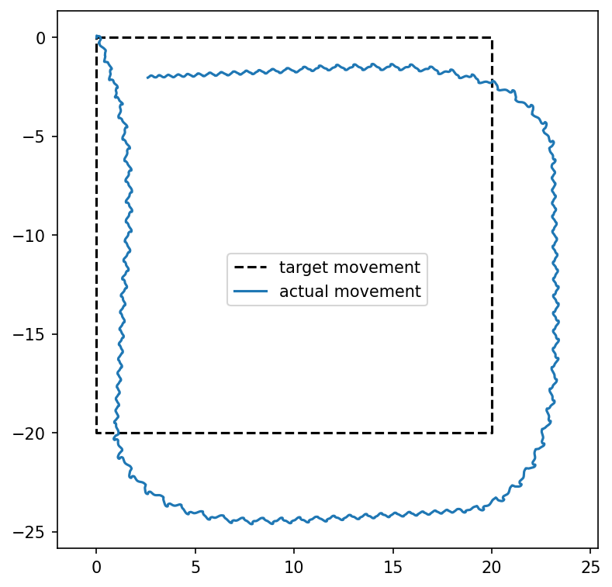
Closed loop control
vs open loop
Neuroengineering Laboratory

Slide 19
Possible improvements
Fusing multiple sensors instead of using only one
Step counting
Optic Flow
Polarised light
Tracking landmarks in the environment that don’t move
This provides global information about position (like how polarised light provided a globally accurate heading signal)
Instead of a local signal (change in position) like step counting and optic flow
Neuroengineering Laboratory

