Slide 1

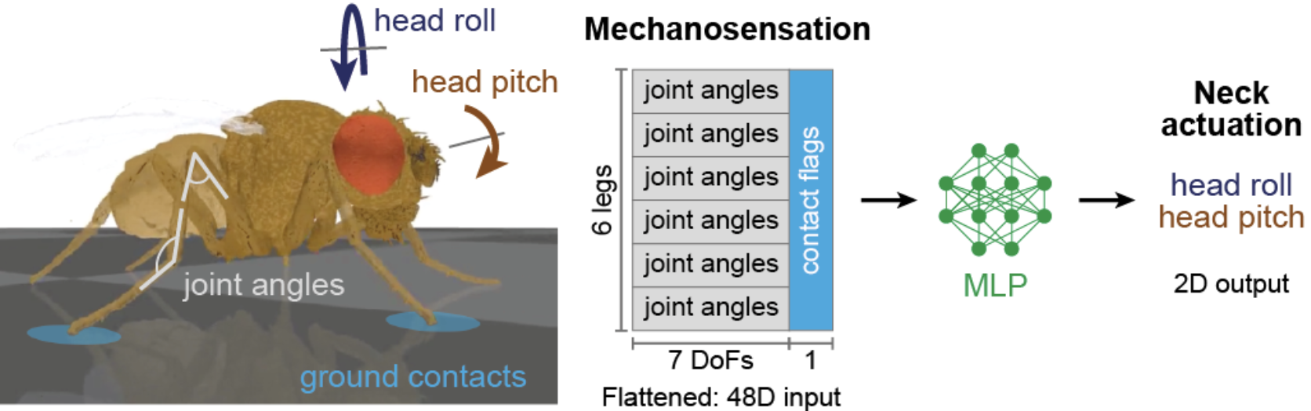
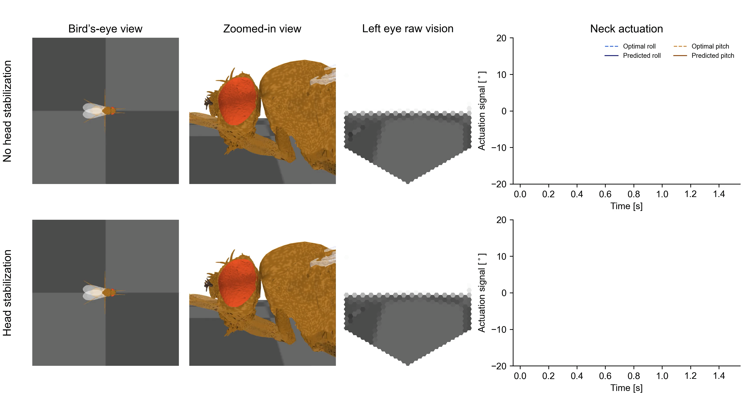
Head stabilization
Neuroengineering Laboratory

Slide 2
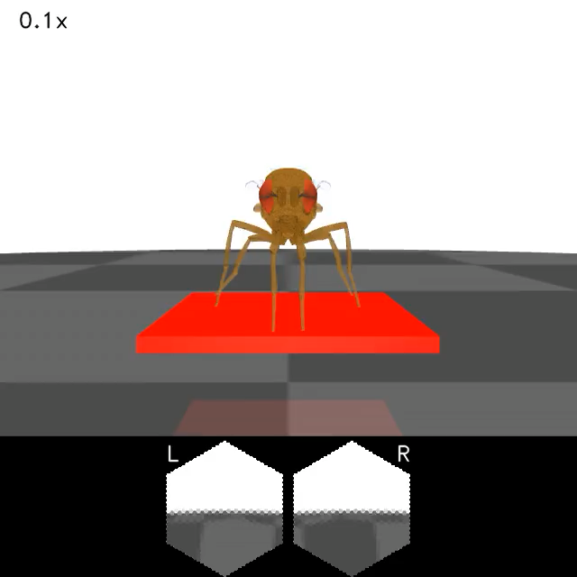
Implementing a rocking platform
Neuroengineering Laboratory

Slide 3


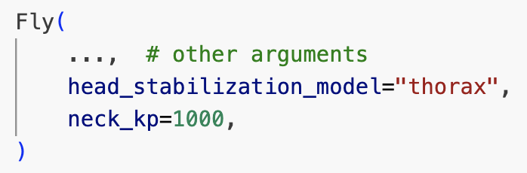
Joint-angles based
Optimal
Neuroengineering Laboratory

Slide 4
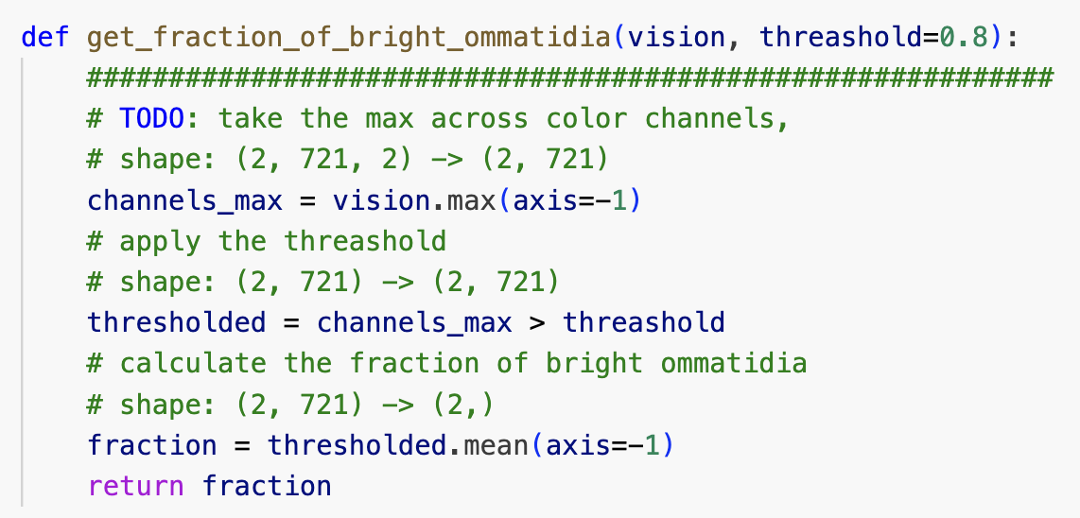
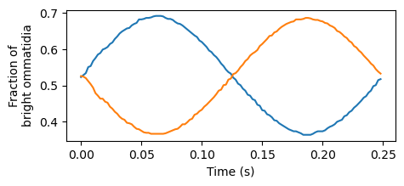
Visual cues for head stabilization
Neuroengineering Laboratory

Slide 5

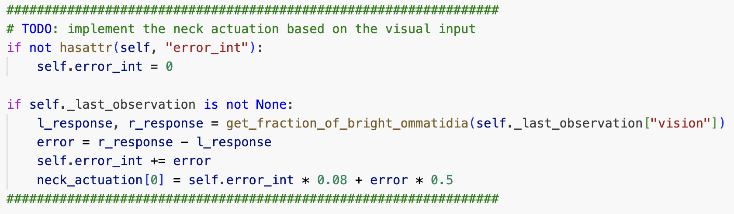
Head stabilization based on visual feedback
Neuroengineering Laboratory

