Slide 1

Vision
Neuroengineering Laboratory

Slide 2
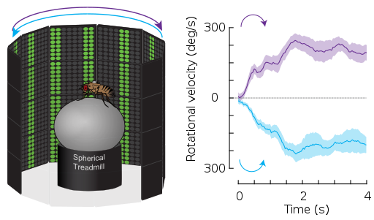
Exercise 1: optomotor response
https://en.wikipedia.org/wiki/Optomotor_response
Neuroengineering Laboratory

Slide 3
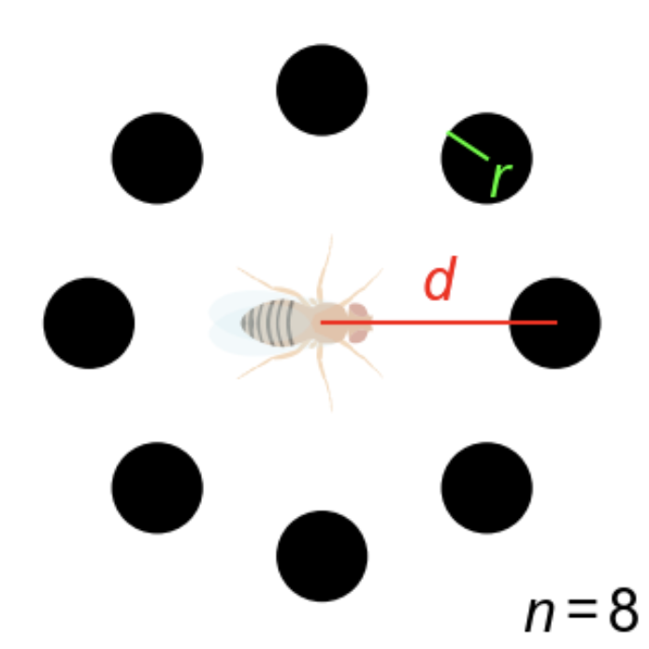

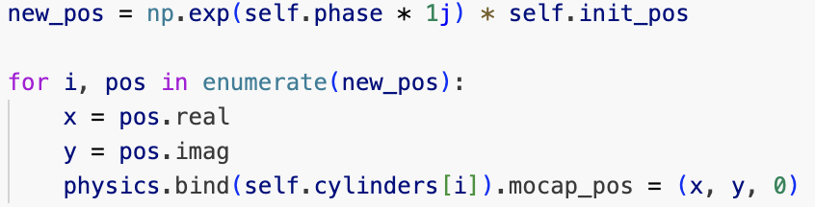
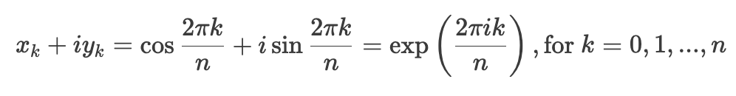
Grating pattern
Neuroengineering Laboratory

Slide 4
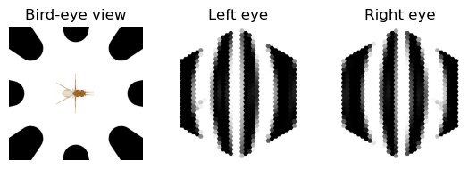
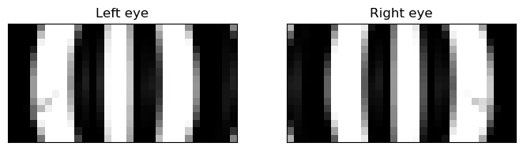
Grating pattern
Neuroengineering Laboratory

Slide 5
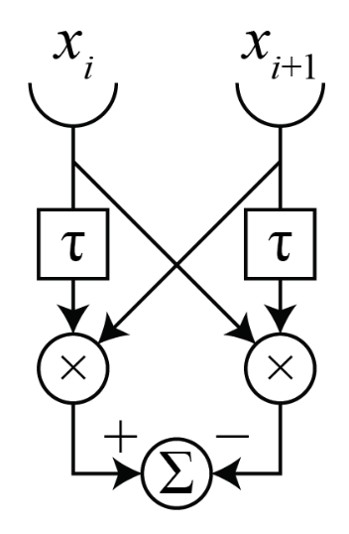
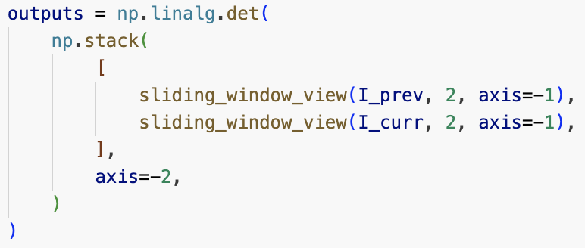
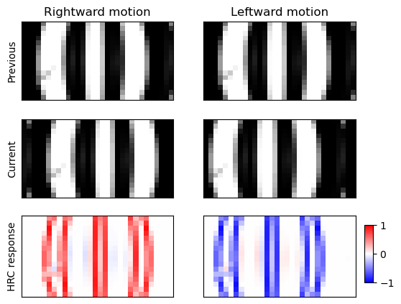
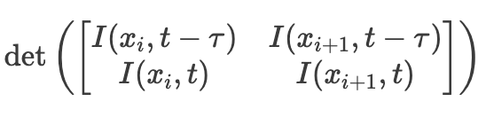
HRC model
Neuroengineering Laboratory

Slide 6
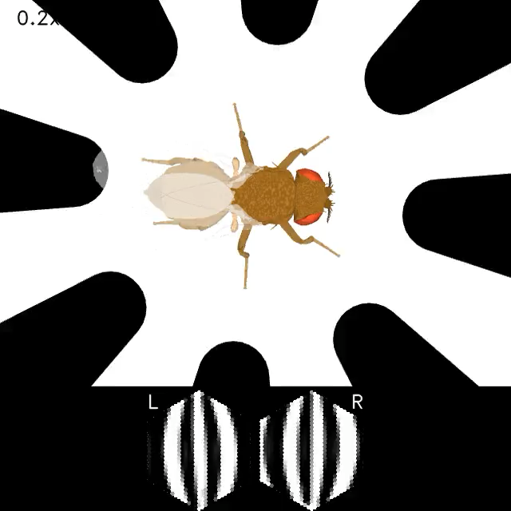
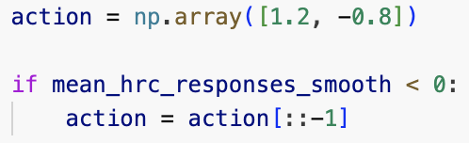
Modulate descending signal based on motion direction
Neuroengineering Laboratory

Slide 7
Neural network
Neuroengineering Laboratory

Slide 8
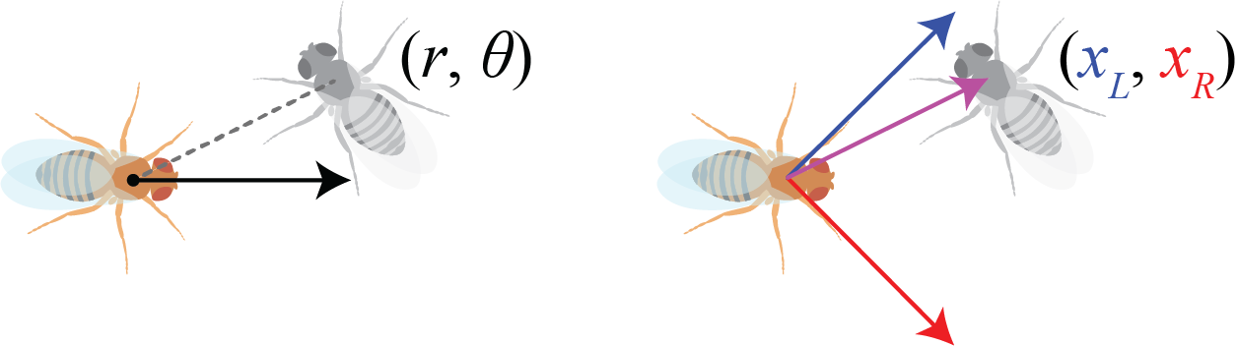
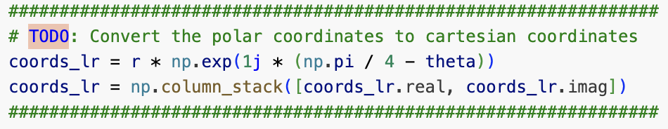
Coordinates transformation
Neuroengineering Laboratory

Slide 9
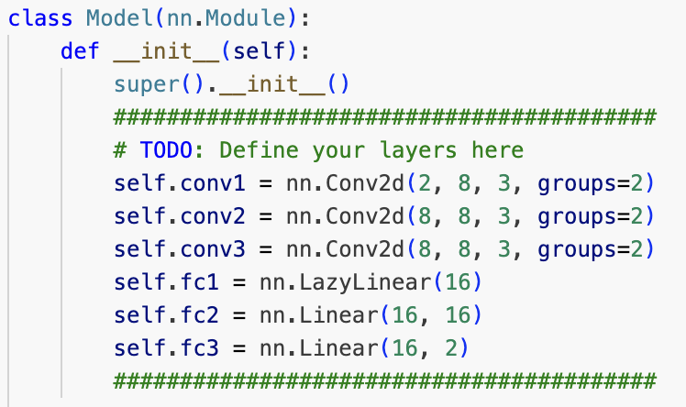
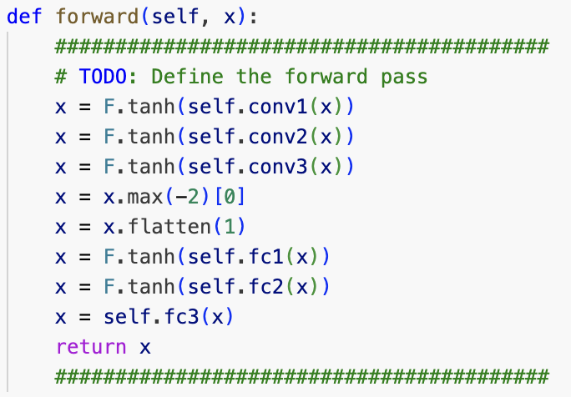
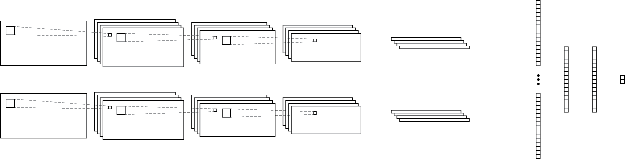
ConvNet to extract target position
Neuroengineering Laboratory

Slide 10
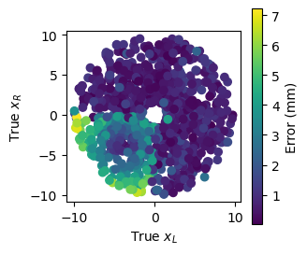
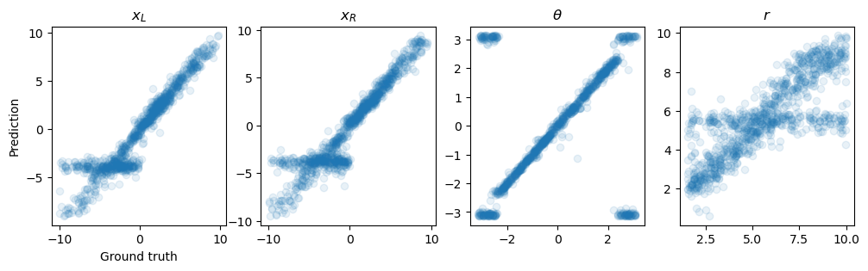
Evaluation
Neuroengineering Laboratory

