Slide 1

CPG controller
Neuroengineering Laboratory

Slide 2
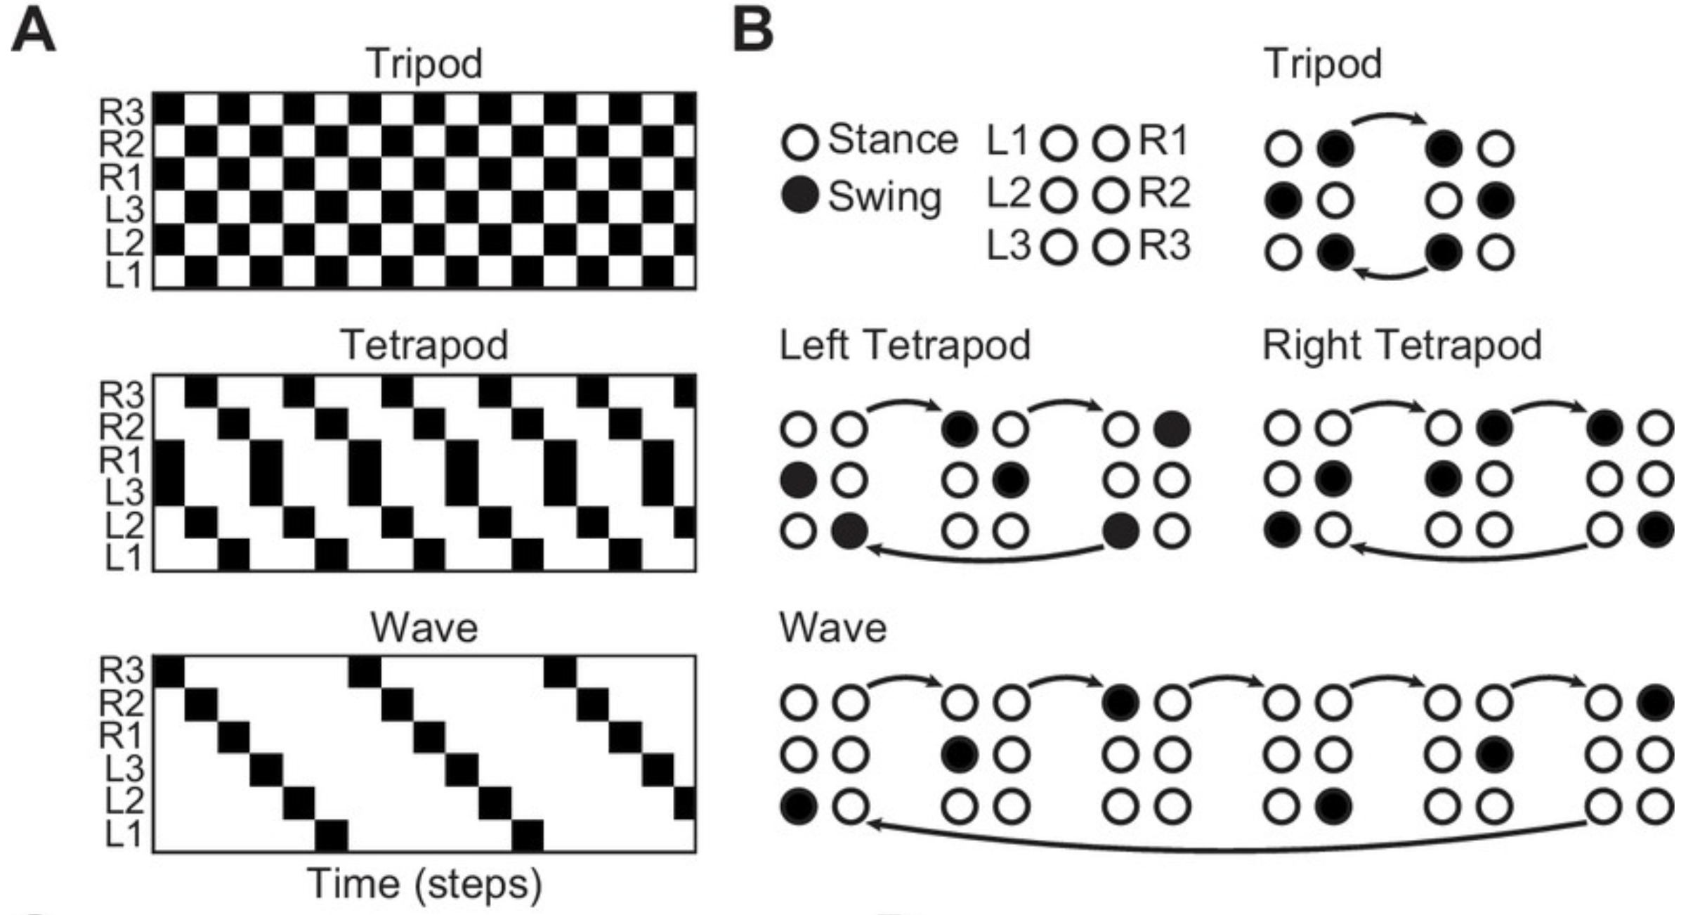
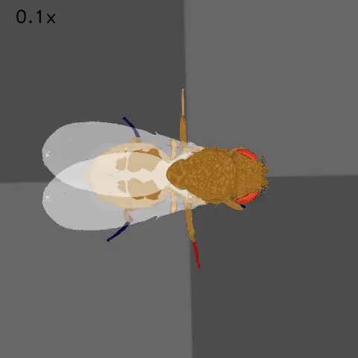
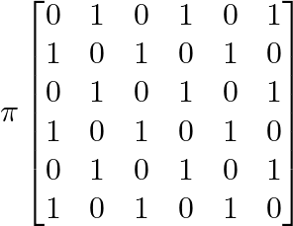
Exercise 2: Hexapod gaits
Tripod gait
Adapted from DeAngelis et al, 2019
LF
LM
LH
RF
RM
RH
Neuroengineering Laboratory

Slide 3
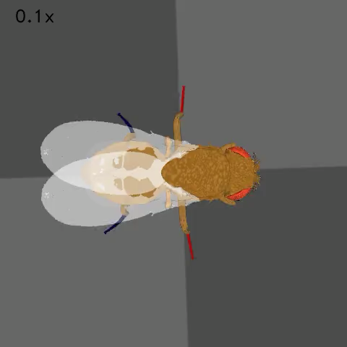
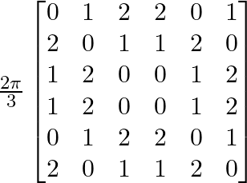
Tetrapod gait
Adapted from DeAngelis et al, 2019
LF
LM
LH
RF
RM
RH
Neuroengineering Laboratory

Slide 4
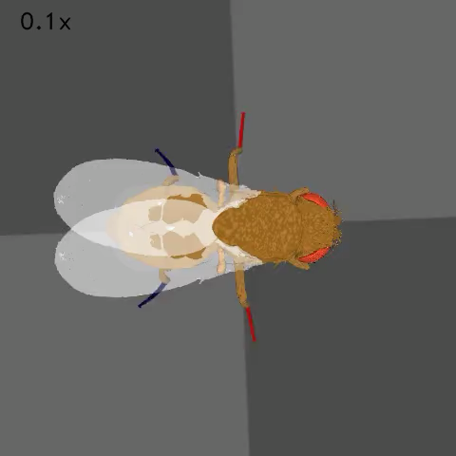
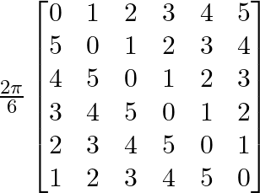
Wave gait
Adapted from DeAngelis et al, 2019
LF
LM
LH
RF
RM
RH
Neuroengineering Laboratory

Slide 5
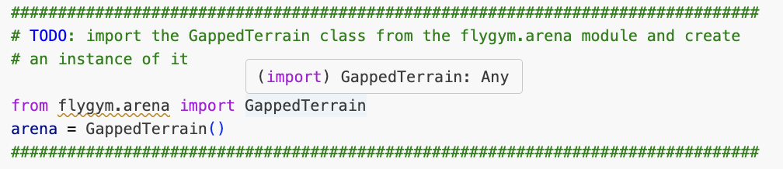
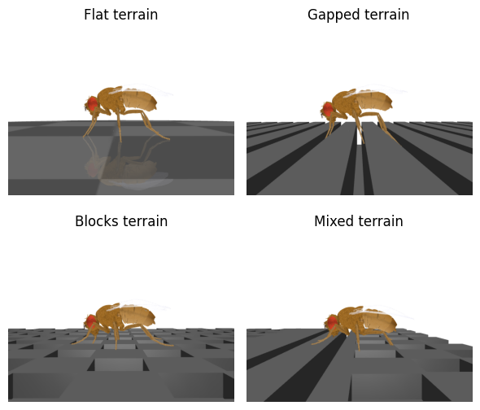
Exercise 3: Terrains
Note that flygym also provides BlocksTerrain and MixedTerrain.
See https://neuromechfly.org/api_ref/arena.html#preprogrammed-complex-terrain-arenas
Neuroengineering Laboratory

Slide 6
Exercise 3: Terrains
Does the CPG controller work well on the gapped terrain? If not, how can it be improved?
The CPG controller struggles with gapped terrain due to its limited adaptability to unexpected situations like legs getting stuck or stumbling. To improve performance, we can use a hybrid controller that utilizes sensory input to direct corrective actions, like retracting a leg if proprioception indicates it's stuck.
Refer to https://neuromechfly.org/tutorials/hybrid_controller.html for details.
Neuroengineering Laboratory

