Slide 1

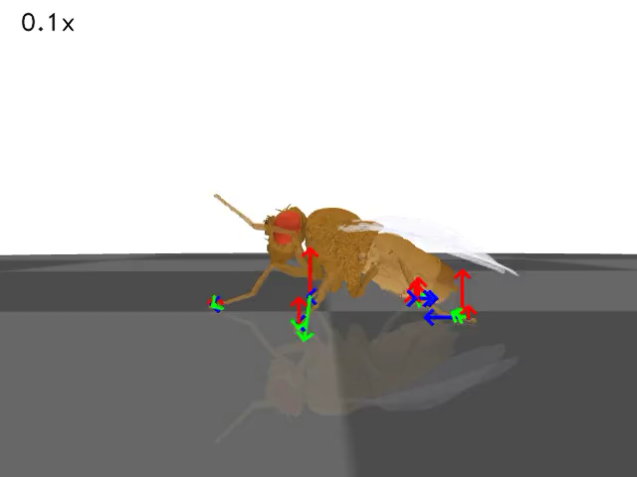
Kinematic replay
Neuroengineering Laboratory
1
Notes:
What is the value fo this approach

Slide 2
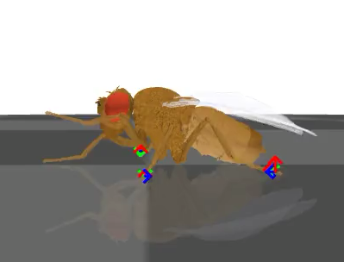
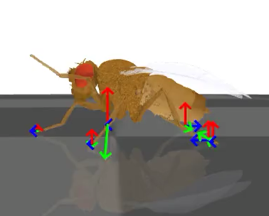
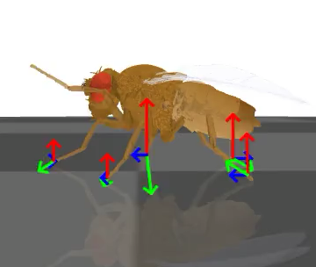
Exercise 1: effect of actuator gain
PhysicsError: Physics state is invalid. Warning(s) raised: mjWARN_BADQACC
10
45
90
9000
actuator_gain is the position feedback gain of the actuator
Higher actuator_gain → actuator will apply more force or torque to correct for the difference between desired and actual joint position.
Neuroengineering Laboratory
2

Slide 3
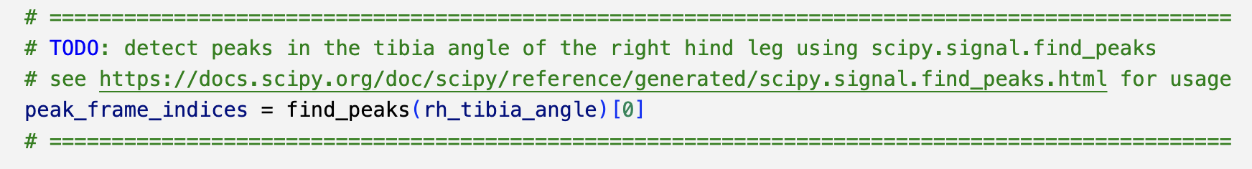
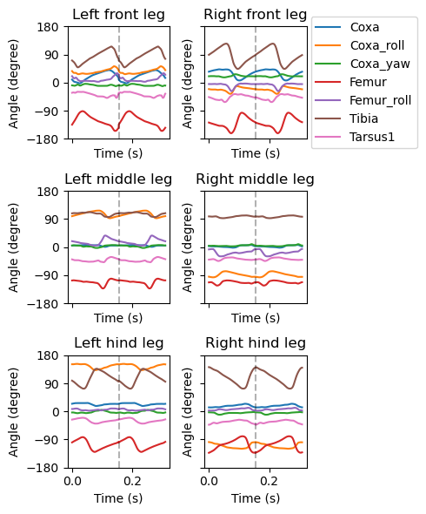
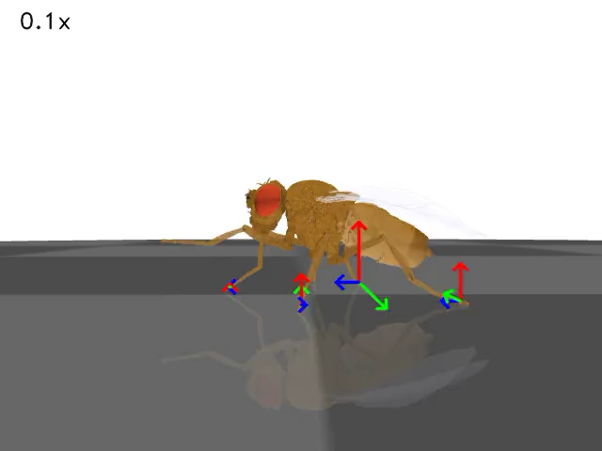
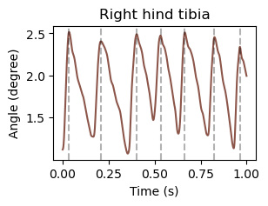
Exercise 2: extract kinematics for one step cycle
Neuroengineering Laboratory
3

Slide 4
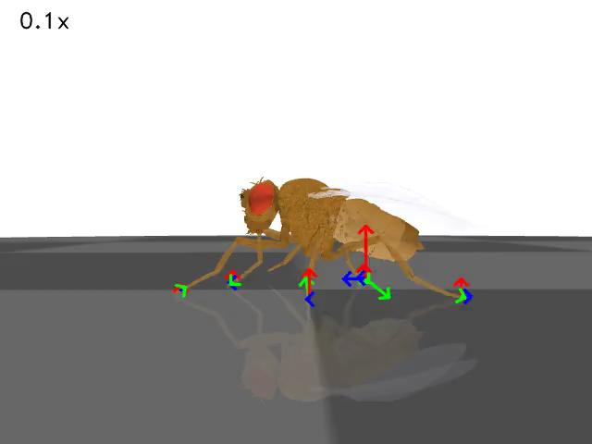
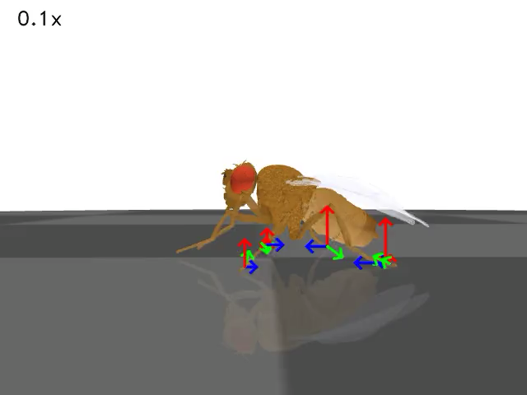
Exercise 3: alter locomotor kinematics
Neuroengineering Laboratory
4

Slide 5
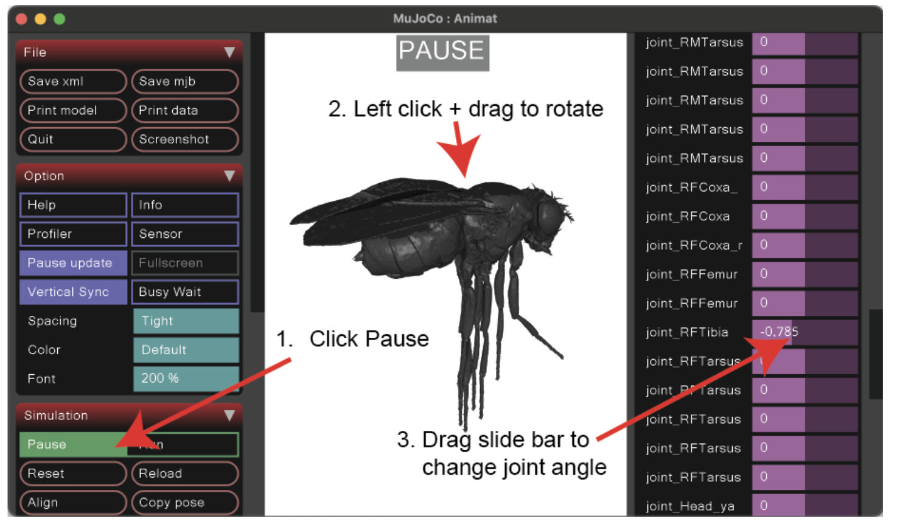
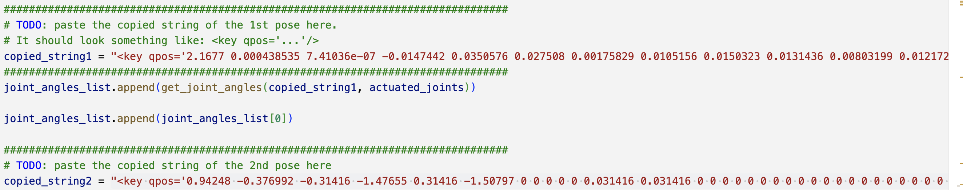
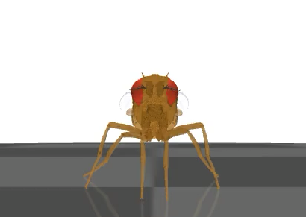
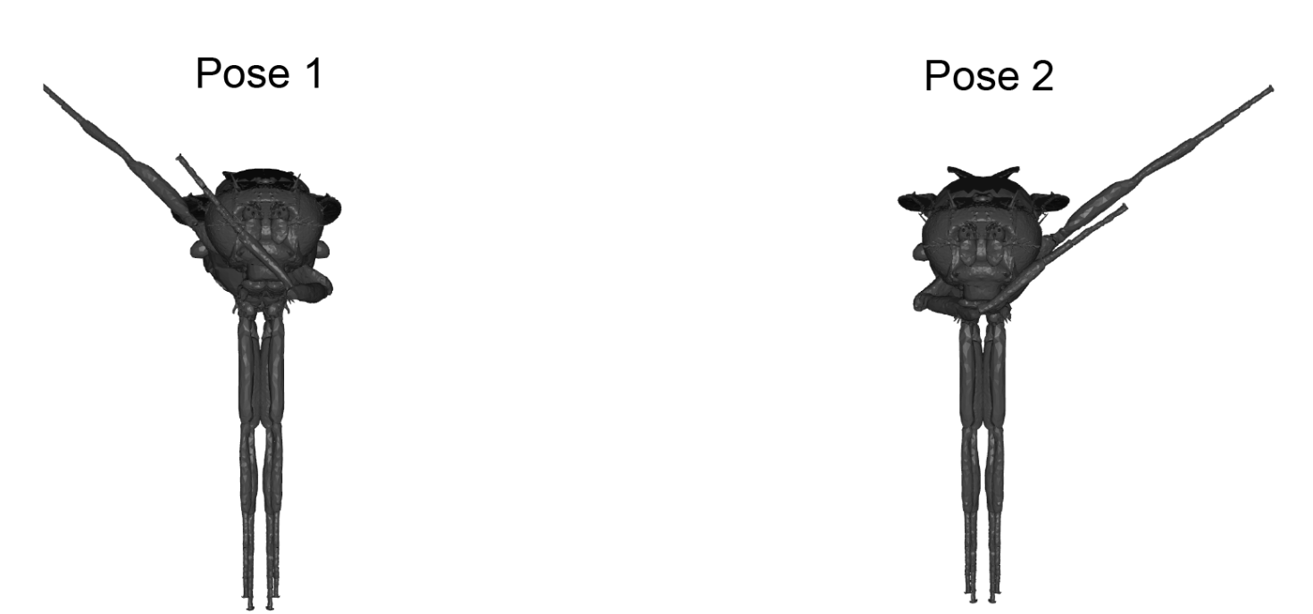
Exercise 4: engineering new behaviors
Neuroengineering Laboratory
5

