Slide 1
BIOENG-420 Single-cell biology
BIOENG420-Block1-Project | Project: Snapshot analysis of the Fly Cell Atlas
Vincent Gardeux
Deplancke’s Laboratory of Systems Biology and Genetics

Slide 2

«Block» overview
Week 2 | Week 3 | Week 4 | Week 5
L2. Introduction to single-cell transcriptomics | L3. Single-cell RNA-seq data analysis I | L4. Single-cell RNA-seq data analysis II | L5. Single-cell genomics applications
(P) Project description Installing environment Picking a group | (P) Group project work | (P) Group project work | (P) Group project work (hands on problems)
End of week 5
Project submission

Slide 3
Project summary
You are given a heterogenous mix of fly cells from different tissues (one tissue per group). You need to find out:
How many cell-types are in your dataset?
Which marker genes characterize the cell-types?
What cell-types are likely present?
Your tasks:
Split into groups of 2-3, get a group number from the TAs
Download & analyze the corresponding dataset using R (we suggest the Seurat toolkit) or Python (we suggest the Scanpy toolkit)
Filtering, Normalization, Dim. Reduction with t-SNE/UMAP, clustering
Perform differential expression analysis to identify marker genes
Identify cell-types using marker genes, FlyBase or any available resource
Prepare a short report (see next slide)

Slide 4
Prepare a report with your results
The report can be made in R markdown (Rmd) or Jupyter Notebook (ipynb) including code, plots and comments
Make sure to include
Dataset details (nb cells, nb detected genes, qc plots such as boxplot of avg. nb of genes expressed per cell, …)
Results (answering the main questions, include standard plots to visualize your results (t-SNE, UMAP, clustering, expression of marker genes, …)

Slide 5

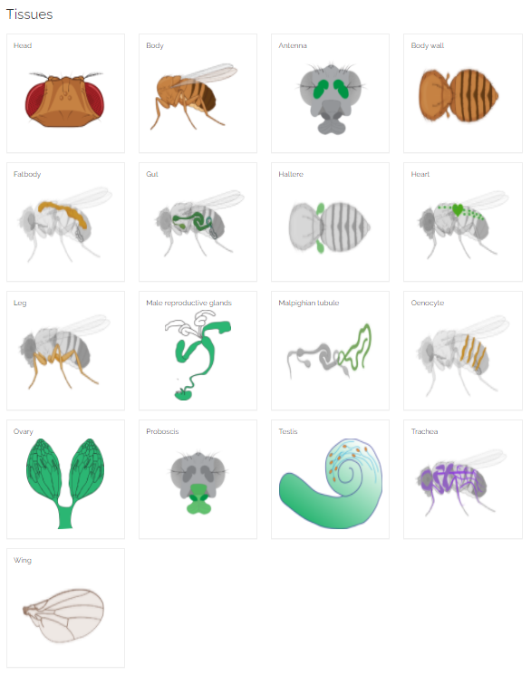
Overview of the dataset
63 10x runs
38B reads
570k cells
15 tissues
>40 fly labs
250 cell-type annotated and manually curated
https://flycellatlas.org/

Slide 6

Questions?
Vincent Gardeux

