Slide 1
BIOENG-420 Single-cell biology
BIOENG420-05 | Cell-type annotation Single-cell omics applications
Vincent Gardeux
Deplancke’s Laboratory of Systems Biology and Genetics

Slide 2
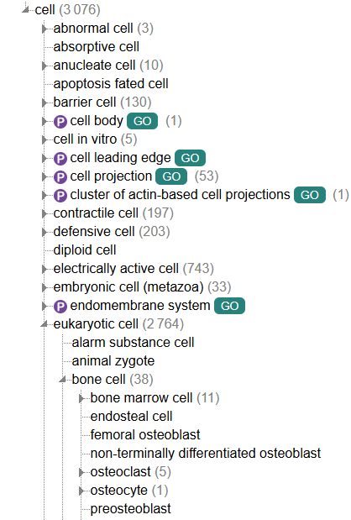
Cell type annotation
Usually the most labor-intensive task
Cell type depends on species / tissue / conditions / …
Cell types can be found in multiple tissues and may perform different roles in different tissues
Cell type (more stable) ≠ cell state (more transient), but it may be difficult to distinguish the two
Cell types can be broad (neuron) or more specialized (sensory neuron), so annotator/curator needs to set some annotation levels (broad or precise)
There are specific ontologies that describe tissues/cell-type as graphs or trees (UBERON, Cell Ontology, …)
https://www.ebi.ac.uk/ols4/ontologies/cl

Slide 3
Cell type annotation
Two main strategies:
Marker-based
Using databases of marker genes such as MSigDB, PanglaoDB, CellMarker
Manually from the literature
Reference-based
Transfer labels from a reference annotated dataset
Now a third option is to use LLMs (fine-tuned to this task, or not)
https://www.ebi.ac.uk/ols4/ontologies/cl

Slide 4
What methods to use?
There are a few options
Use marker genes and experts knowledge / litterature and manually curate all clusters
Use marker genes and cell-type databases (e.g. PanglaoDB) and perform functional enrichment analysis (Enrichr, topGO, …)
Using a prediction model trained on reference markers (e.g. Garnett)
Use a reference dataset/atlas to transfer annotations or integrate datasets together e.g.
Label transfer using Seurat
Supervised integration using scANVI
Cross-species integration and label transfer using SAMap or SATURN
Using cloud-based service such as cellranger annotate (cellranger v9 – Feb 6, 2025)
Using LLM-based prediction using AnnDictionary, GPTCelltype , …
Marker-based
Reference-based

Slide 5
How to select the best method?
Depends on your dataset
Is this a well-studied species (mouse, human) ?
Very detailed marker gene database exist
Marker-based methods
Lots of reference datasets exist
Reference-based methods
Is this a more "exotic" species?
Maybe not many markers are known
Use ortholog database
Maybe some atlases exist for close species
Use cross-species annotation transfer methods such as SAMap
Is this a very specific subpopulation of cells where only "broad annotations" exist
Probably automated methods will struggle to annotate subpopulations in details
Manual annotation

Slide 6
Limitations
Usually, even automated method will require some curation to ensure that the annotation is proper, often using some known marker genes
Sometimes, marker genes are not very clear for some clusters (low number of DE genes, or DE genes not very specific)
We can use a marker-specificity calculation: tau score/index to prioritize most specific markers
The τ index is an indicator of how specifically or broadly expressed a gene is, with a τ of 1 indicating expression specific to only one tissue, and a τ of 0 indicating equal expression across all tissues
https://biodatamining.biomedcentral.com/articles/10.1186/s13040-022-00315-9
https://www.aging-us.com/article/202648/text

Slide 7
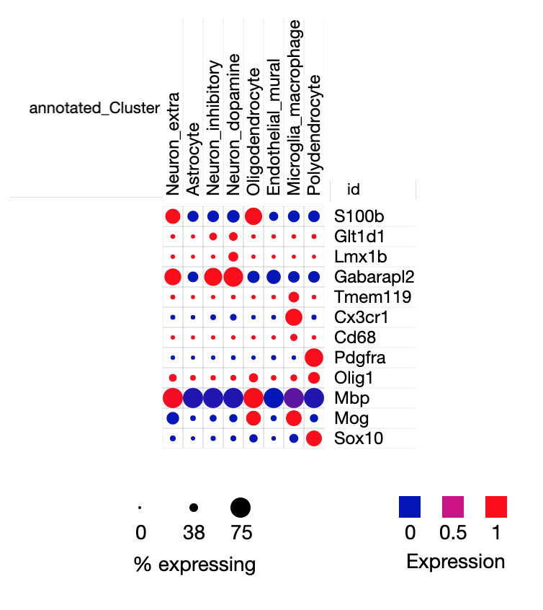
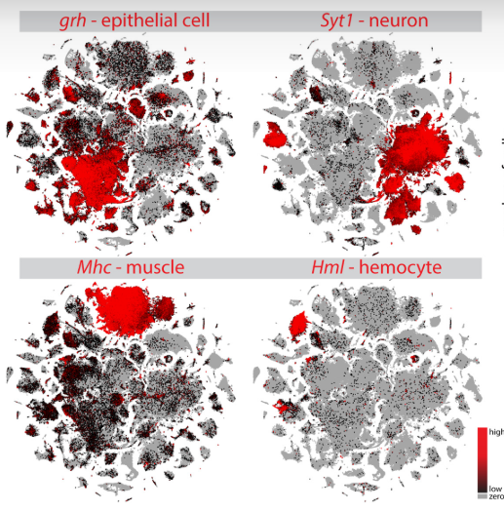
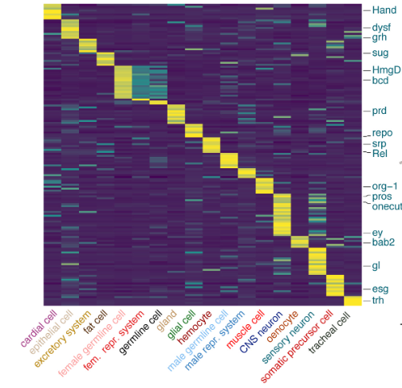
Visualization
Standard plots to know
Heatmap of top DE genes /
Marker genes
Dotplot
Marker gene expression

Slide 8
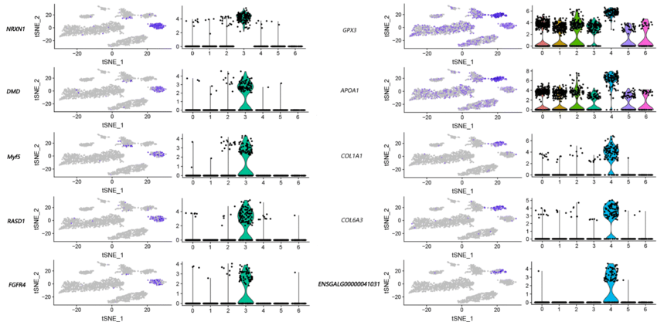
Visualization
Standard plots to know
Marker gene expression on UMAP/t-SNE + violin plots
Li et al, BMC Genomics, 2020

Slide 9
Conclusions
Usually very time-consuming step
Assess the best annotation method to choose based on your dataset (species, tissue, conditions, …) and desired outcome (broad or finer annotations)
Verify main cell-types from cross-tissues broad markers (neurons, muscle cells, …)
For more information on cell-type annotation:
https://bioconductor.org/books/3.13/OSCA.basic/cell-type-annotation.html
https://www.10xgenomics.com/analysis-guides/web-resources-for-cell-type-annotation

Slide 10
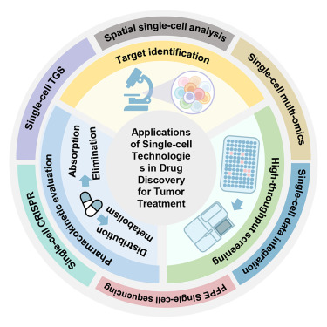
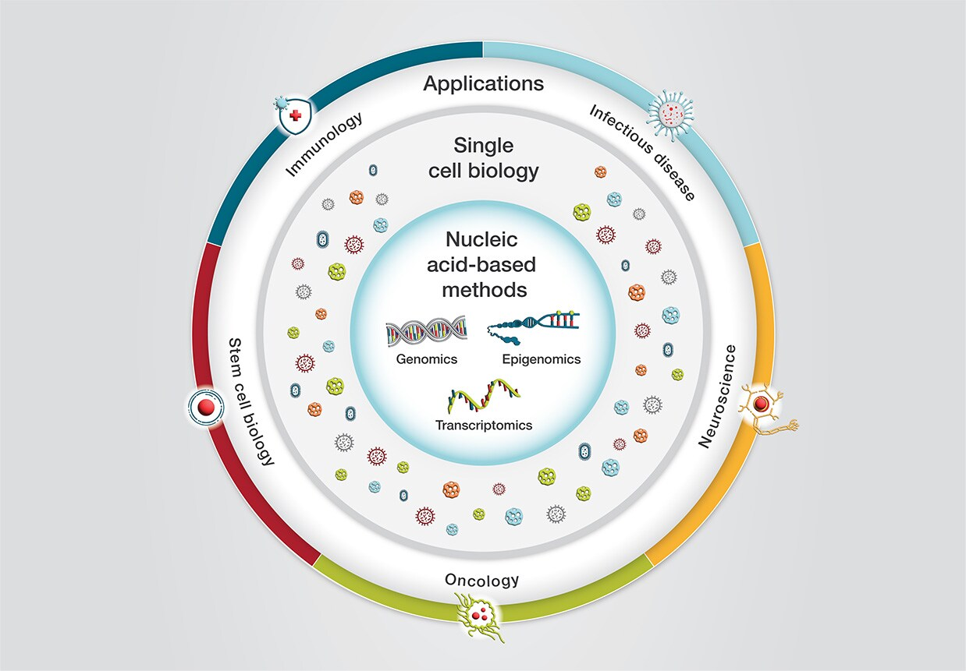
Single-cell omics, future and applications
Single-cell omics is more and more democratized
We saw single-cell RNA-seq, but there are many other technologies:
Spatial transcriptomics, metabolomics, proteomics
Single-cell epigenomics, proteomics, metabolomics
Single-cell multiomics
Cell atlas consortiums are generating very big datasets (e.g. Human Cell Atlas)
New technologies are appearing: Perturb-seq, Live-seq, …
It’s also applied in a wide variety of fields, and application
Liu et al, iScience, 2024
Thermofisher

Slide 11
Single-cell omics, future and applications
Single-cell omics is more and more democratized
We saw single-cell RNA-seq, but there are many other technologies:
Spatial transcriptomics, metabolomics, proteomics
Single-cell epigenomics, proteomics, metabolomics
Single-cell multiomics
Cell atlas consortiums are generating very big datasets (e.g. Human Cell Atlas)
New technologies are appearing: Perturb-seq, Live-seq, …
It’s also applied in a wide variety of fields, and application
Liu et al, iScience, 2024
Thermofisher

Slide 12
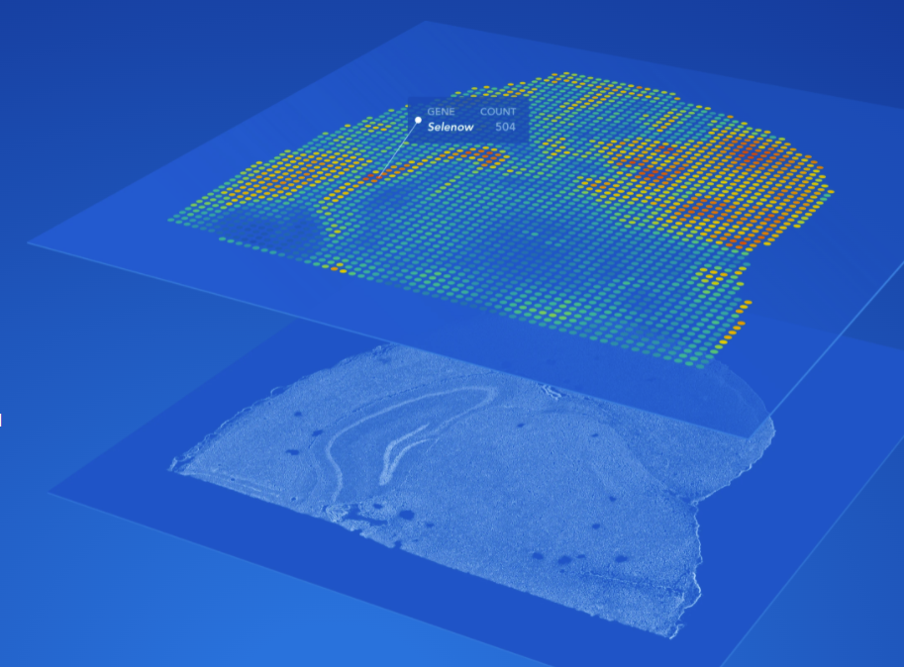
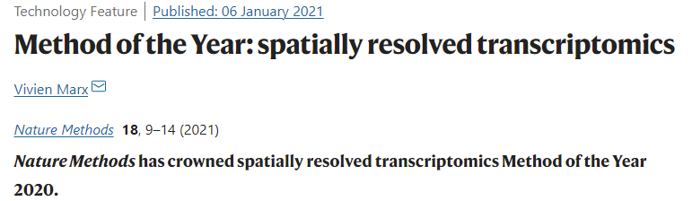
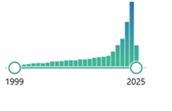

I. Spatial transcriptomics
Become more and more popular. Commercialized through 10x
Can combine transcriptomics and proteomics immunofluorescence detection (multiomics)
Transcriptomics is not always single-cell (using bins, i.e. multiple cells per bin depending on resolution)

Slide 13
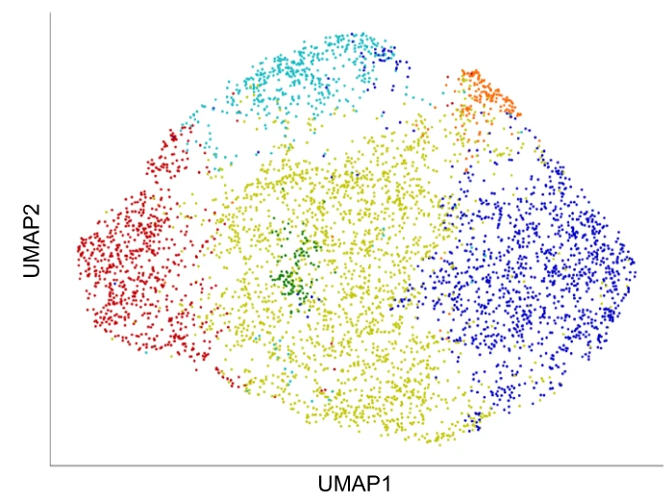
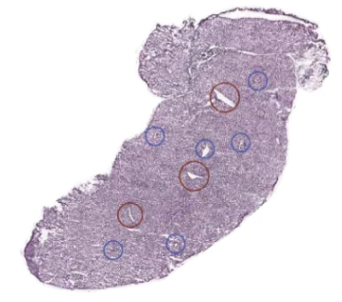
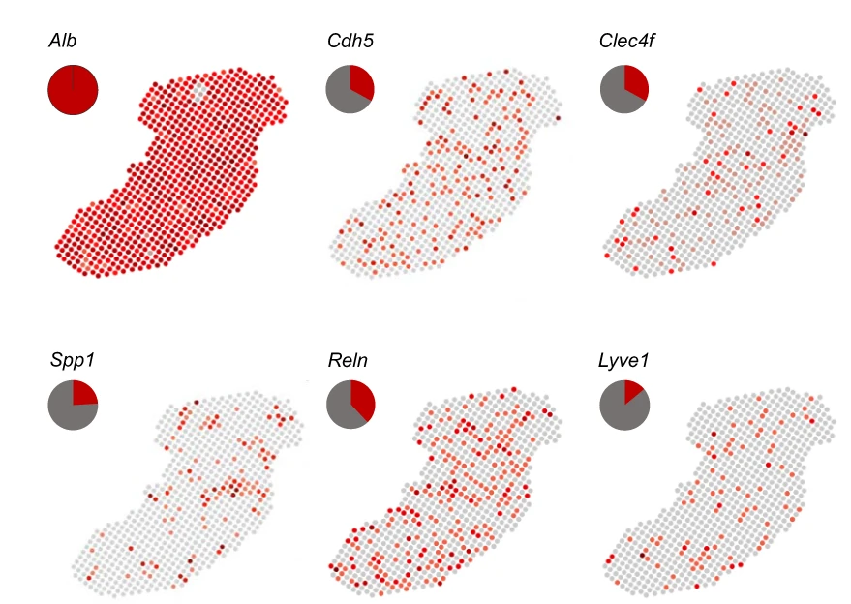
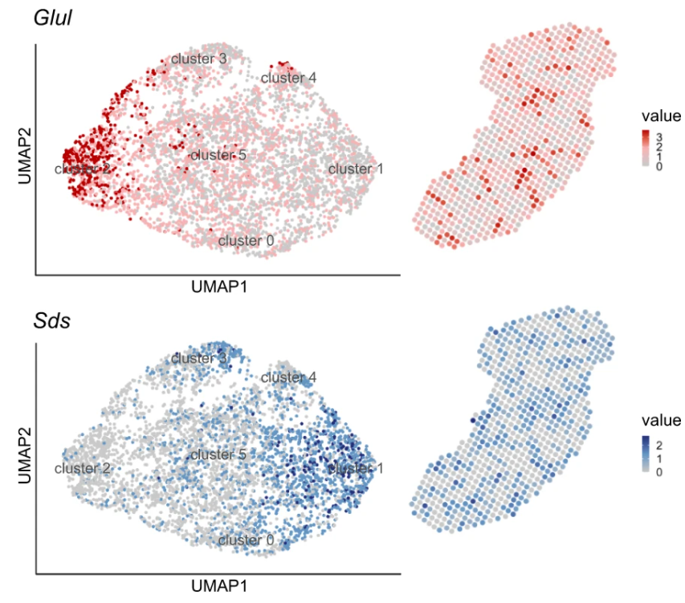
I. Spatial transcriptomics – Zonation in mouse liver
Hildebrandt et al, Nature Communications, 2021

Slide 14

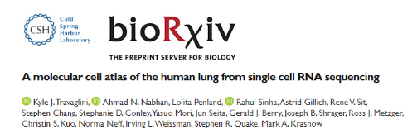
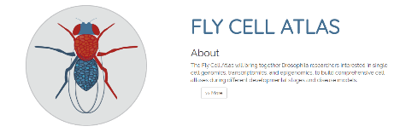
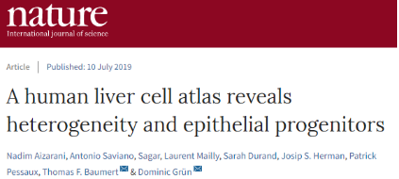
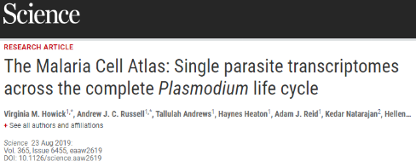
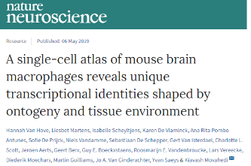
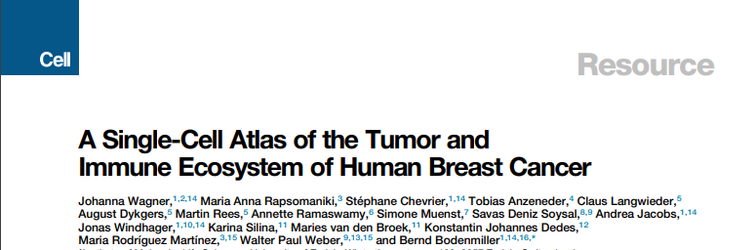
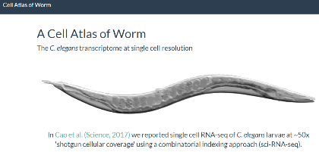
II. Creation of single-cell atlases

Slide 15


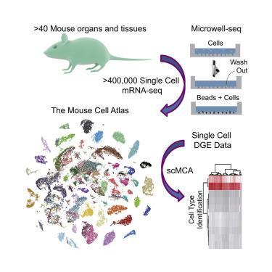
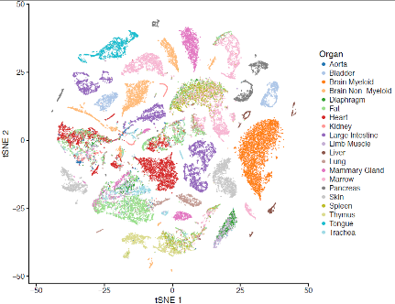
II. Mouse cell atlas
The two “first” single-cell atlases
(Quake, Darmanis et al., Nature, 2018)
Mouse Cell Atlas
(Han, Guo et al., Cell, 2018)
More challenging because of needs for reproducibility, data sharing, standardization of nomenclature, integration between technologies
~50’000 cells from 20 organs and tissues (SMART-Seq2)
~50’000 cells from 10x
bis.zju.edu.cn/MCA/
tabula-muris.ds.czbiohub.org

Slide 16

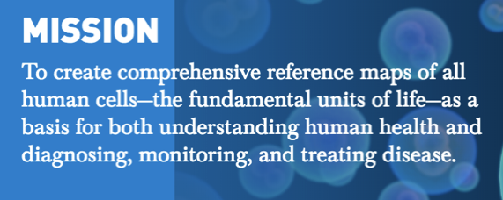

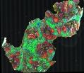
II. The Human Cell Atlas
HCA plans to sequence ~1-10 billion cells?
©Dana Pe’er
data.humancellatlas.org
Scope, Scale, Quality and Compatibility
Cell States and Types
Spatial location and architecture
Lineages and transitions
Chan Zuckerberg Biohub ($600 M Initiative)
https://www.humancellatlas.org/

Slide 17
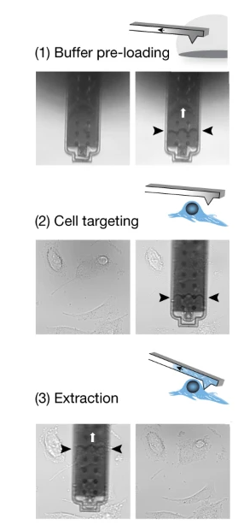
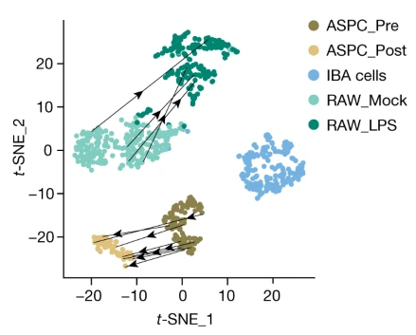
III. Live-seq
In our lab, we developed Live-seq
Biopsy of living cell
Does not kill the cell => Allow for temporal analysis
Chen et al, Nature, 2022
Notes:
macrophages before and after lipopolysaccharide (LPS) stimulation, and of adipose stromal cells pre- and post-differentiation
brown preadipocyte = IBA

Slide 18
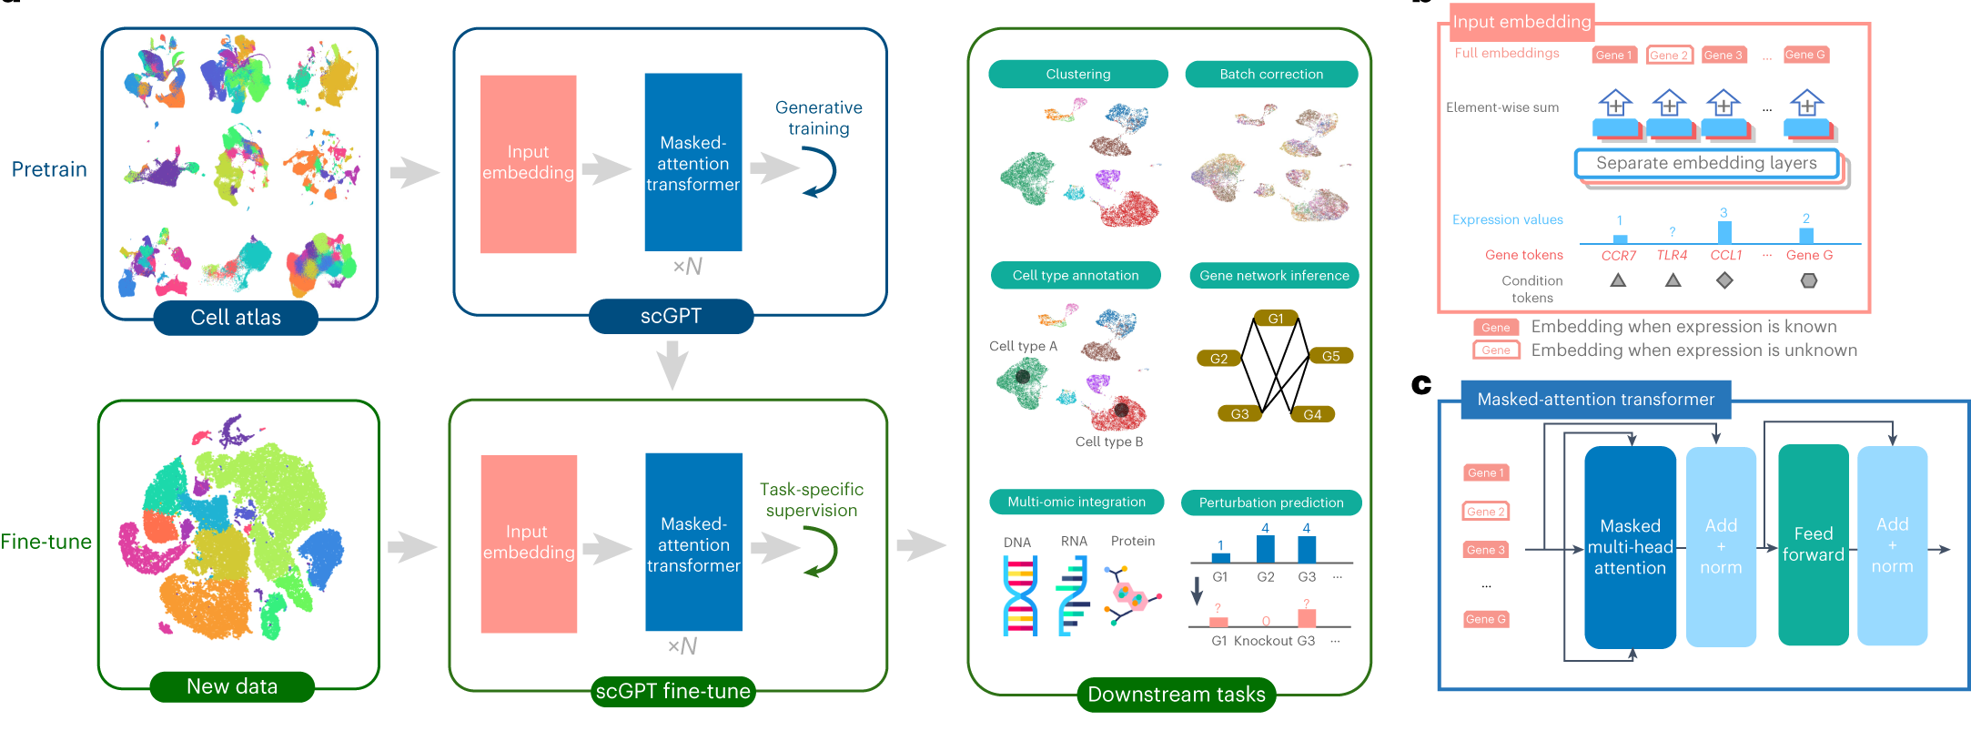
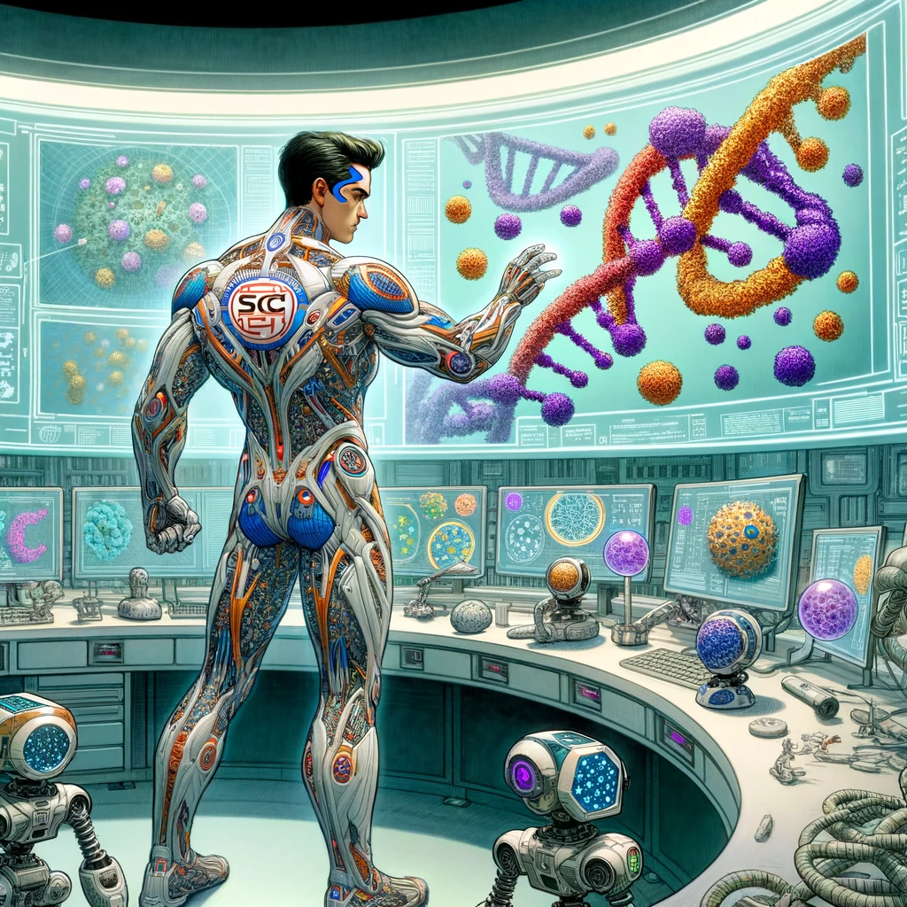
Future of single-cell genomics?
Create reference atlases (requires standardization, harmonization)
Applying single-cell technologies for medical purposes (drug screening, biomarker discovery, disease categorization, cancer, treatment response, …)
Still developing field: new technologies (spatial transcriptomics, perturb-seq, …) may overcome current single-cell RNA-seq limitations
Single-cell multiomics aggregating multiple omics layers from the same cell (e.g. ATAC-seq + RNA-seq) are developing as well
Methodology-wise: LLMs are now taking over to model different biological mechanisms based on these ever-growing datasets.
scGPT, a generative AI-based methods for clustering / cell annotation, etc..
Cui H., et al, scGPT: toward building a foundation model for single-cell multi-omics using generative AI, Nature methods (2024)
Ando, Y. et al. An era of single-cell genomics consortia. Exp Mol Med 52, 1409–1418 (2020)
Edsgärd, D et al, Identification of spatial expression trends in single-cell gene expression data. Nat Methods 15, 339–342 (2018)

Slide 19
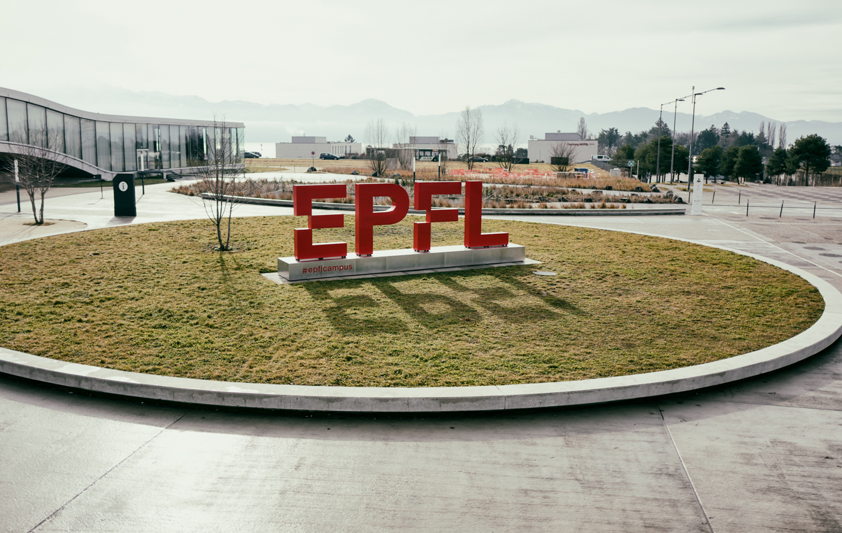
Questions?
Vincent Gardeux

