Slide 1
BIOENG-420 Single-cell biology
BIOENG420-04 | Single-cell RNA-seq analysis II
Vincent Gardeux
Deplancke’s Laboratory of Systems Biology and Genetics

Slide 2

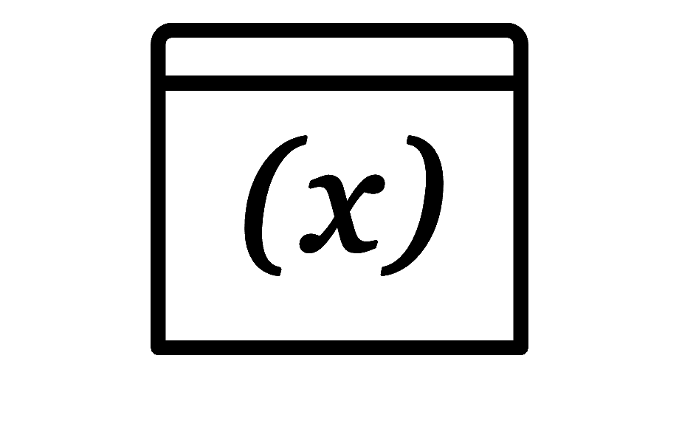
scRNA-seq analysis pipeline
.fastq
Mapping to reference genome
Single-cell specific:
Barcode demultiplexing
UMI counting
Filtering of cells (e.g. empty droplets, …)
Demultiplexing and
Quality Control (QC)
UNIX / Bash
.bam
PREPROCESSING
.txt / .csv
.h5 / .loom
Read / transcript matrix
(raw counts / UMI)
QC and filtering
Single-cell specific:
Filtering doublets, ambient RNA
Removing covariates (cell-cycle)
Integrating multiple datasets
Seurat or Scanpy objects
Normalization, noise removal
R / Python
DOWNSTREAM ANALYSIS
We stopped here
Study-specific downstream analysis

Slide 3
Quick recap
Matrix of n cells (called from ~800k barcodes, in case of 10x library) and 50-60k genes, pseudo-genes, miRNAs, …
Preprocessing
Downstream analyses
Gene/Cell filtering
Normalization
Highly variable genes
Of note: These numbers are only informative, mostly true for human data. But it depends largely on the species and the sequencing depth.
Matrix of n cells and ~10-20k detected genes
Marking (not removing) of ~2-3k HVG for PCA (next step)

Slide 4
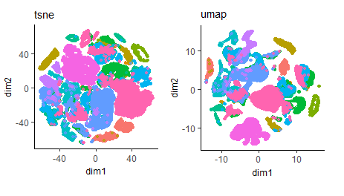


Dimensionality reduction
Goal: Find two axis (data projections) that maintain relations between cells as best as possible
In scRNA-seq, it is used to group cells by transcriptomic similarity, and display them in a two-dimensional space
 | Cell 1 | Cell 2 | …
Gene 1 | 25 | 918 | …
Gene 2 | 0 | 456 | …
… | … | … | …
Gene n | 103 | 180 | …
Single-cell gene expression matrix
PCA / t-SNE / UMAP / …
~10k-20k D
2D, 3D or 4D….

Slide 5
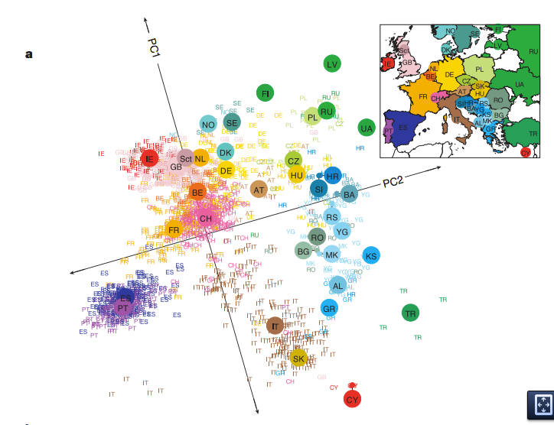
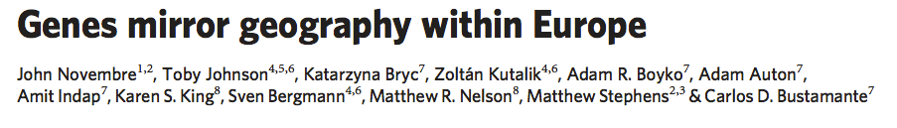
The magic of Principal Component Analysis (PCA)
PCA of Single Nucleotide Polymorphism (SNP) data reveals geographic location of individuals
3’000 EU individuals
0.5M SNPs
2 Principal Components (PCs)
North-South vs East-West

Slide 6
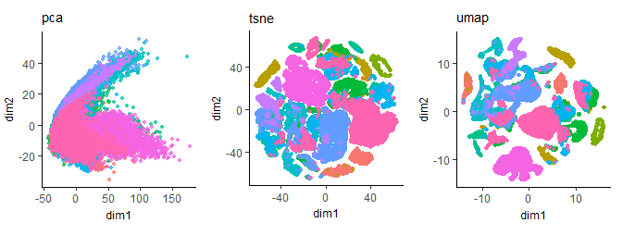
PCA with scRNA-seq
However, with single-cell data, PCA often struggles to resolve the heterogeneity of the data using only 2 dimensions

Slide 7
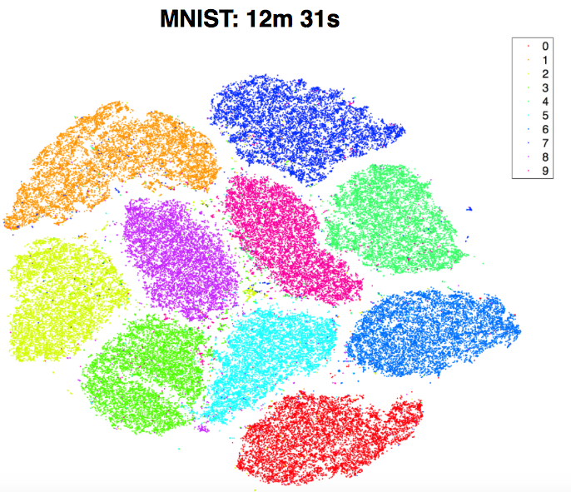
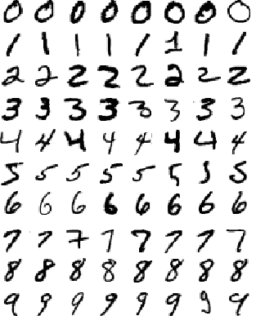
t-distributed stochastic neighbour embedding (t-SNE)
Non parametric multi-dimensional data is projected into 2-3 dimensions, accurately preserving the high dimensional relationships
Works well with large amounts of heterogenous data
Optimization-based method: no unique solution
Preserve intra-cluster distances but not inter-clusters distances
Example: Group all hand-written digits of the same type
MNIST handwritten digit database

Slide 8
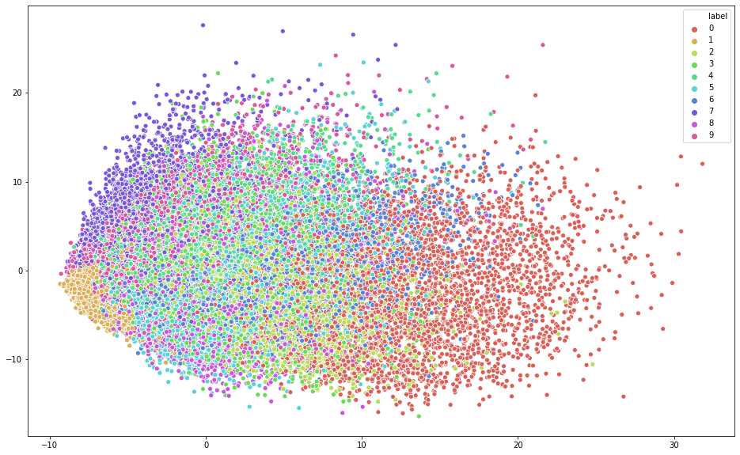
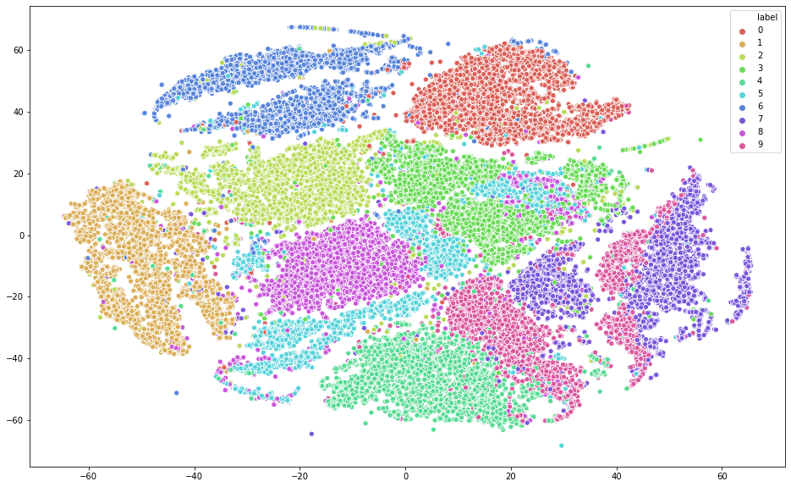
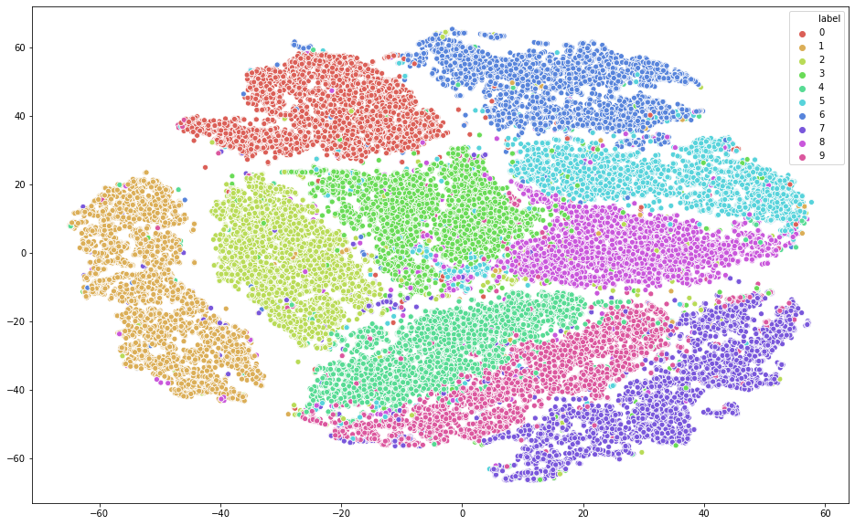
Comparing PCA vs t-SNE on the MNIST dataset
PCA
t-SNE
t-SNE on 50 top PCs
@Towards Data Science

Slide 9
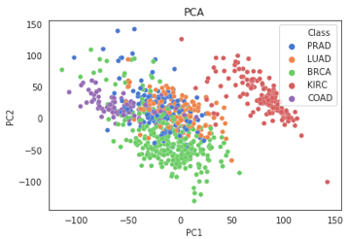
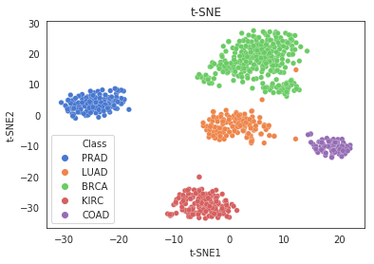
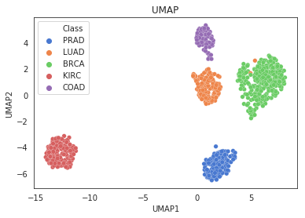
PCA, t-SNE and UMAP with single-cell RNA-seq datasets
UMAP
Equally good or perhaps better resolution compared to t-SNE
It also preserves better the global structure of the data (still not fully reliable) and runs faster than t-SNE
Usually the most-used dimension reduction method
@Towards Data Science

Slide 10
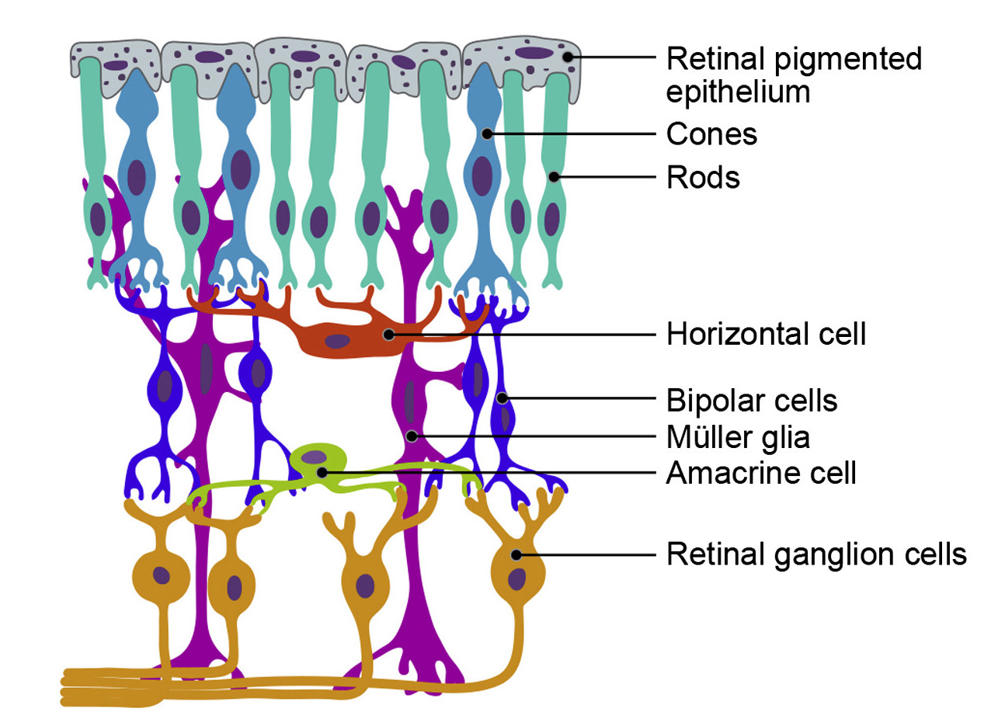
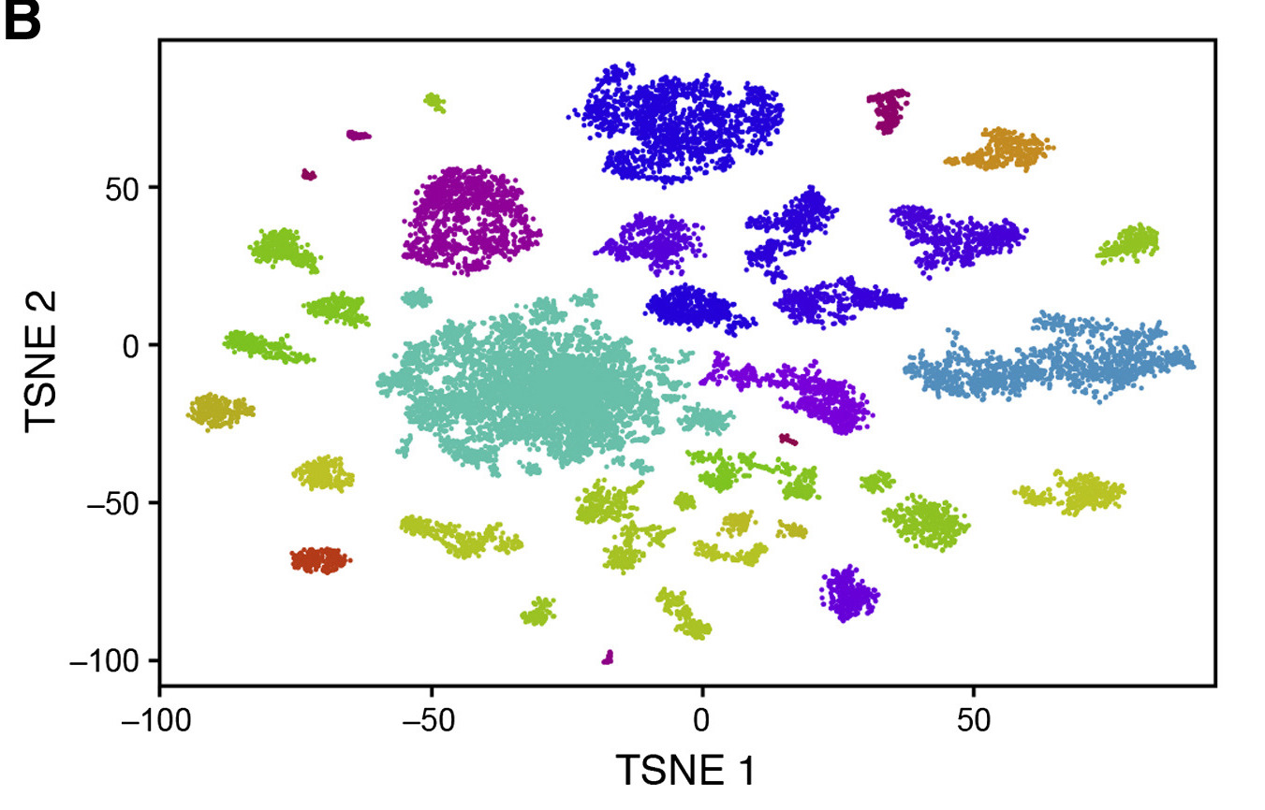
Single-cell RNA-seq case study
DROP-seq maps out retinal cell types
Microscopy | Single-cell
Knowledge: a priori ~10 different cell types
Drop-seq: 44,808 Mouse retinal cells
Cell frequencies estimated from single-cell RNA-seq correspond well to known cell frequencies (microscopy)
Q: What conclusion could we draw from the right plot?

Slide 11
scRNA-seq pipeline
Preprocessing
Downstream analyses I (preparing the data)
Gene/Cell filtering
Normalization – (Eventually imputation)
Highly variable genes
PCA for dimension reduction
t-SNE / UMAP for visualization
Clustering
Downstream analyses II (further analysis of the data)
STILL SOMEWHAT LINEAR
BACK AND FORTH RESEARCH
Differential expression
Functional enrichment
Trajectory / pseudo-time inference
And so on…

Slide 12

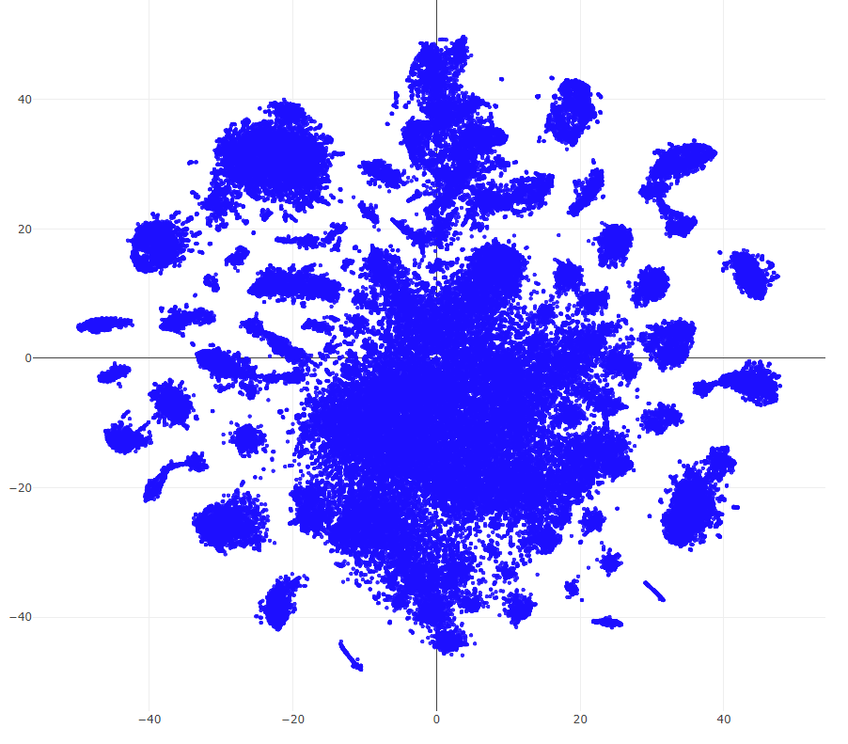
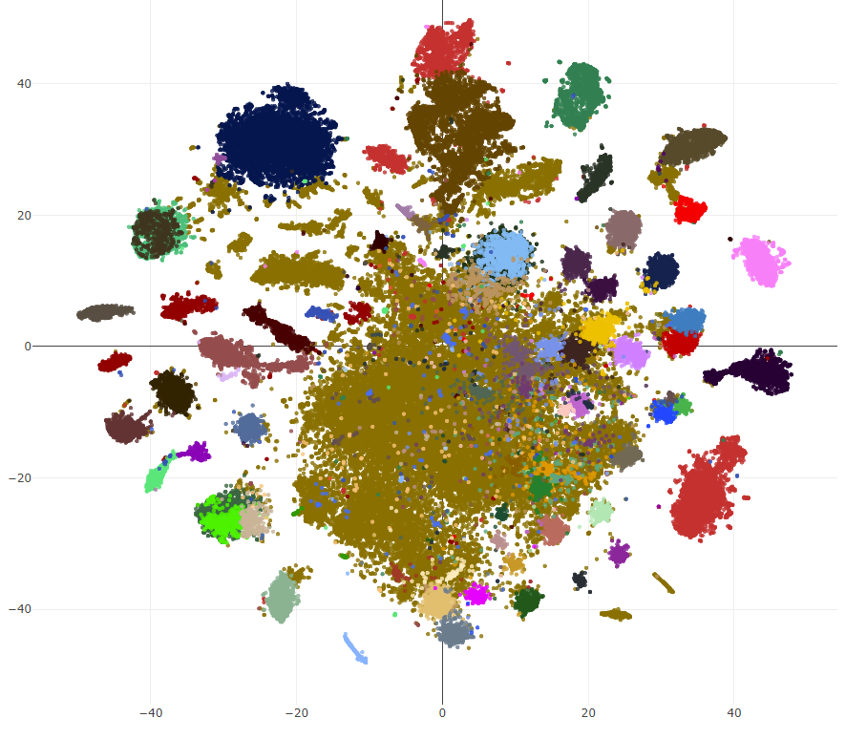
Clustering
Student λ: Why this step is mentioned again?
Question: Did we see clustering methods before?
UMAP / t-SNE are NOT clustering methods
≠
t-SNE
Clustering

Slide 13
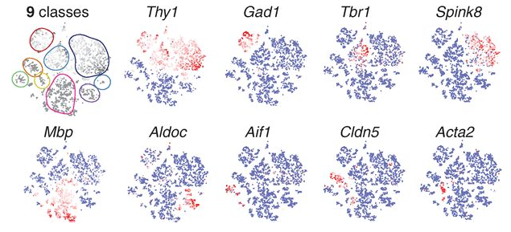
Clustering
Motivation: Dimension reduction allows to extract the most informative components and visualize cells, but how to automatically set boundaries between the individual cells? Systematic grouping into types?
Usage: Usually runs on the PCA components

Slide 14
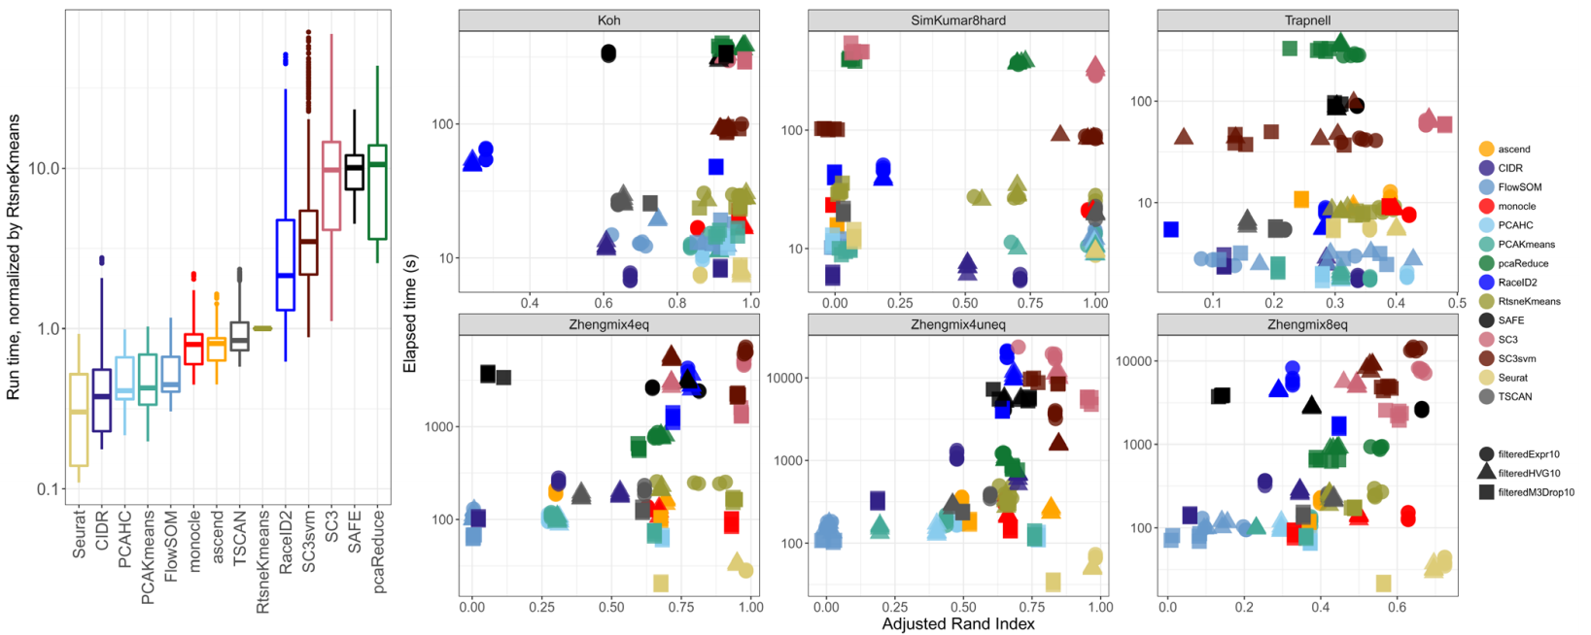
Comparison of clustering methods for scRNA-seq
Seurat = fastest + more accurate?
graph-based clustering (Louvain, Leiden)
Duò et al. 2018

Slide 15
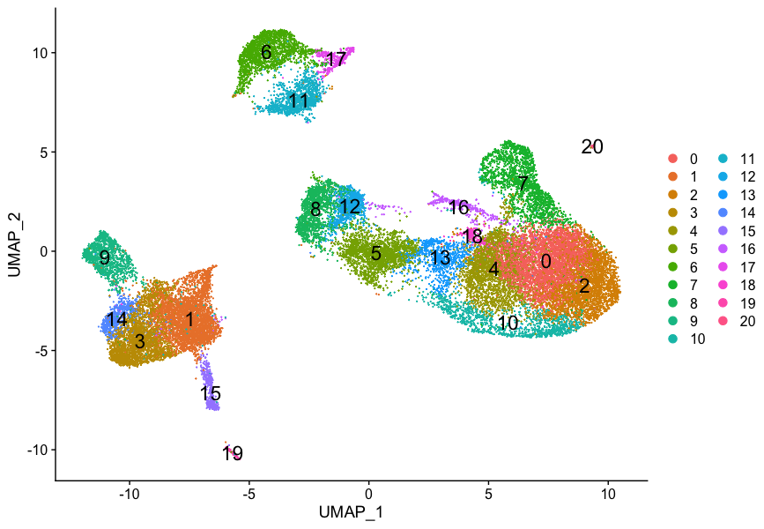
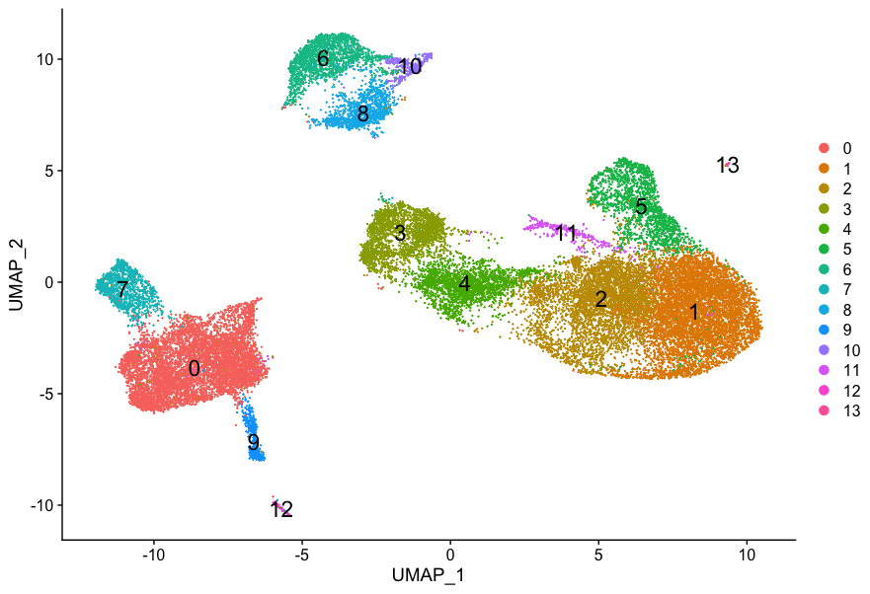
How to tune clustering method?
In a nutshell: It’s super arbitrary
Default Seurat resolution = 0.8
Seurat resolution = 0.4
https://hbctraining.github.io/scRNA-seq/lessons/07_SC_clustering_cells_SCT.html

Slide 16
scRNA-seq pipeline
Preprocessing
Downstream analyses I (preparing the data)
Gene/Cell filtering
Normalization – (Eventually imputation)
Highly variable genes
PCA for dimension reduction
t-SNE / UMAP for visualization
Clustering
Downstream analyses II (further analysis of the data)
STILL SOMEWHAT LINEAR
BACK AND FORTH RESEARCH
Differential expression
Functional enrichment
Trajectory / pseudo-time inference
And so on…

Slide 17
Finding marker genes of different clusters
Question:
I have 3 groups of cells (A,B,C)
I need to find marker genes for group B (i.e. genes that are more expressed in B, than A and C => cell-type specific expression)
What method do you know that I could use?

Slide 18
Differential Expression (DE) analysis
Goal: identification of genes (or transcripts, exons, …) that are expressed in significant different quantities in distinct groups
e.g. drug-treated vs control, disease vs healthy, cell-types, tissues, development stages, ...
What method to use for doing that?
Mostly statistical tests
Why not simply using fold-change (FC)?
Many FP or FN would be expected, because does not take into consideration:
Low expressed genes that will tend to have higher FC (vs High)
The distribution of the data (inherent variance of gene expression)

Slide 19
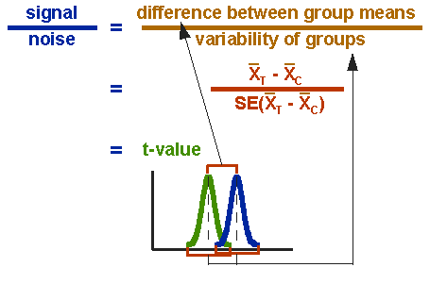


Example: Using t-test for DE calculation
Most of DE methods are univariate i.e. consider each gene independently (even though genes are not really independent)
Test is run for EACH gene
Usually we violate lots of hypotheses:
Genes are not independent
Data is not normal (scRNA-seq is Negative Binomial, or Zero-Inflated NB)
Gene A expression distribution in group 1
Gene A expression distribution in group 2
http://www.socialresearchmethods.net/kb/stat_t.php

Slide 20
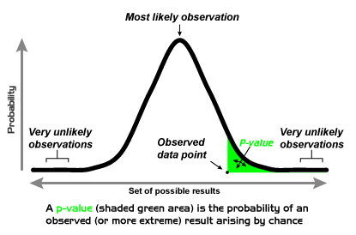
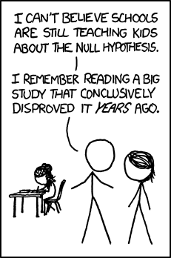
(Parenthesis) What is a p-value
DE methods output p-values and FC for each gene

Slide 21
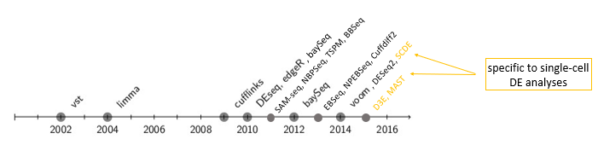
Different specific DE methods exist for scRNA-seq
SCDE¹ : observed abundance of a given transcript in each cell was modeled as a mixture of the droup-out (Poisson) and amplification (Negative Binomial) components
Fits individual error models and further compute DE with Bayesian model
D3E²: each group is fitted a “transcriptional bursting” model. Then comparison of distribution through non parametric Kolmogorov Smirnov or other statistics
Quantify average burst size, frequency and duty cycle
MAST³: estimation of the “cellular detection rate” (CDR) i.e. the faction of genes that are detectably expressed in each cell
CDR act as proxy for solving technical (drop-out, amplification efficiency) and biological (cell colume) factors
¹ Kharchenko, P. V., Silberstein, L., & Scadden, D. T. (2014). Bayesian approach to single-cell differential expression analysis. Nature methods, 11(7), 740-742.
² Delmans, M, Hemberg, M. (2015). Discrete Distributional Differential Expression (D3E) - A Tool for Gene Expression Analysis of Single-cell RNA-seq Data, BioRxiv preprint
³ Finak, G. et al. (2015). MAST: a flexible statistical framework for assessing transcriptional changes and characterizing heterogeneity in single-cell RNA sequencing data. Genome biology, 16(1), 1-13.

Slide 22
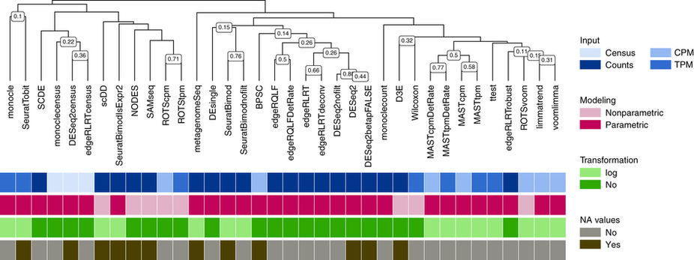
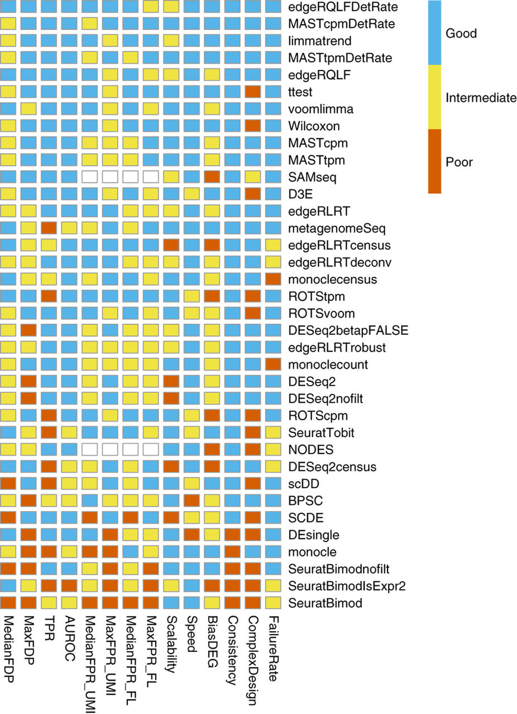
Ok but which one should I use?
Question: Do you see anything “unexpected” in this comparison?
Soneson & Robinson, Nature Methods, Feb 26 2018

Slide 23
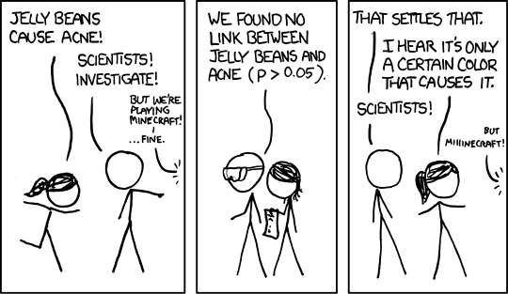
(Parenthesis II) Multiple testing correction
https://xkcd.com/882/

Slide 24
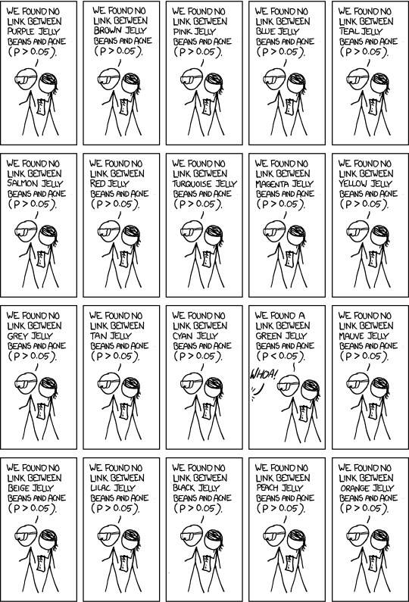
(Parenthesis II) Multiple testing correction
https://xkcd.com/882/

Slide 25
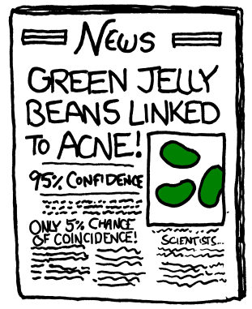
(Parenthesis II) Multiple testing correction
Question: Is this ok?
Answer: No
Need to adjust raw p-values according to number of tests
Many methods exist to adjust p-values
Bonferroni method (multiple p-value by the number of tests)
Benjamini and Hochberg FDR adjusted (False Discovery Rate)
…
https://xkcd.com/882/

Slide 26
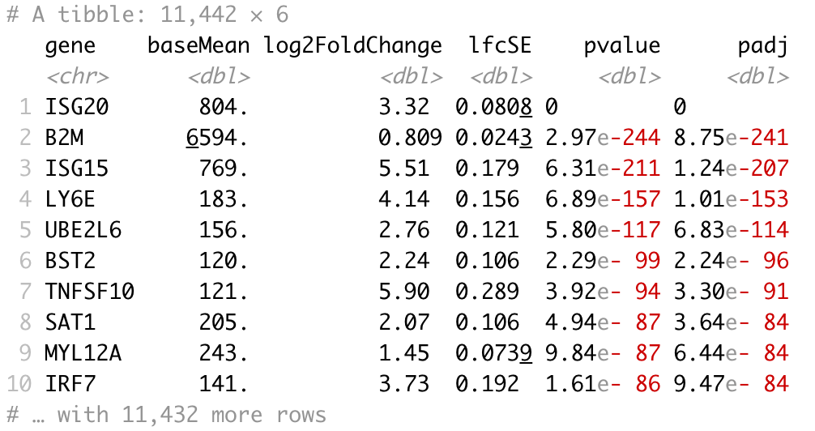
Typical output of DE method
Questions:
Do you understand all columns?
How is this sorted? Why?
Would you sort it differently?
Usually, in single-cell RNA-seq datasets, this is run for each cluster, to find its marker genes.
With Group1 = Cluster, and Group2 = All other cells.

Slide 27
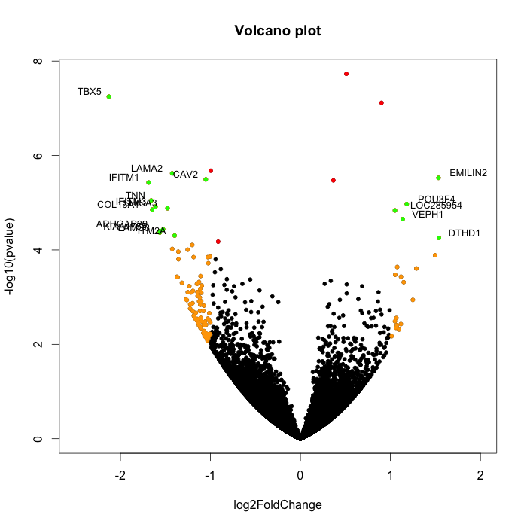
Volcano plots can show DE results and cutoffs
DE results can be shown in a Volcano plot
Question:
Can you find which thresholds were used for FC and p-value?
-log10(padj)

Slide 28
scRNA-seq pipeline
Preprocessing
Downstream analyses I (preparing the data)
Gene/Cell filtering
Normalization – (Eventually imputation)
Highly variable genes
PCA for dimension reduction
t-SNE / UMAP for visualization
Clustering
Downstream analyses II (further analysis of the data)
STILL SOMEWHAT LINEAR
BACK AND FORTH RESEARCH
Differential expression
Functional enrichment
Trajectory / pseudo-time inference
And so on…

Slide 29
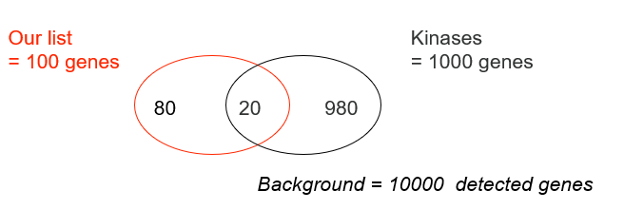
Functional enrichment
DE analysis output a ranked list of genes, DE between 2 groups
What is their functional role?
Are they majoritarily involved in a common biological pathway?
Are they enriched in a particular cell-type?
Functional enrichment analyses check if DE genes are over-represented (more than expected by chance) in pathways, characterized by set of genes.
Example: are our genes enriched in the kinase pathway?
Contingency table
 | ∈ kinase | ∉ kinase
∈ our list | 20 | 80
∉ our list | 980 | 8920
Fisher’s exact test (FET) p = 0.0022
Our genes are enriched in the kinase pathway

Slide 30
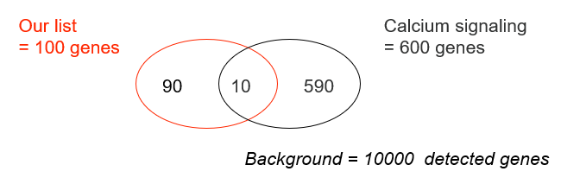
Functional enrichment
Are our genes enriched in the calcium signaling pathway?
To be repeated for every pathway or cell-type of interest
In this case, of course, perform multiple test correction (FDR)
Contingency table
 | ∈ calcium | ∉ calcium
∈ our list | 10 | 90
∉ our list | 590 | 9310
Fisher’s exact test (FET) p = 0.1401
Our genes are NOT enriched in the calcium pathway

Slide 31
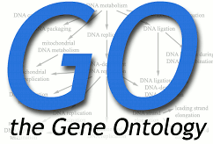


Functional enrichment
Many tools exist
Online: DAVID, GSEA, EnrichR, …
Statistical: χ², Fisher’s Exact test, hypergeometric, permutation, …
Packages: R (topGO)
Main issue: what database to use?
Gene ontology (GO): Structured controlled vocabularies that describe relationships between gene products and their associated biological roles
Pathways: KEGG, BioCarta
Disease association: OMIM
Drug targets: DrugBank
Cell-type: PanglaoDB, Gene Atlas, …
Now there are tools that exist to try predicting cell-types using deep-learning (Garnett, ScType, scPred, SCSA, scCATCH, SingleR, ….)

Slide 32
scRNA-seq pipeline
Preprocessing
Downstream analyses I (preparing the data)
Gene/Cell filtering
Normalization – (Eventually imputation)
Highly variable genes
PCA for dimension reduction
t-SNE / UMAP for visualization
Clustering
Downstream analyses II (further analysis of the data)
STILL SOMEWHAT LINEAR
BACK AND FORTH RESEARCH
Differential expression
Functional enrichment
Trajectory / pseudo-time inference
And so on…

Slide 33
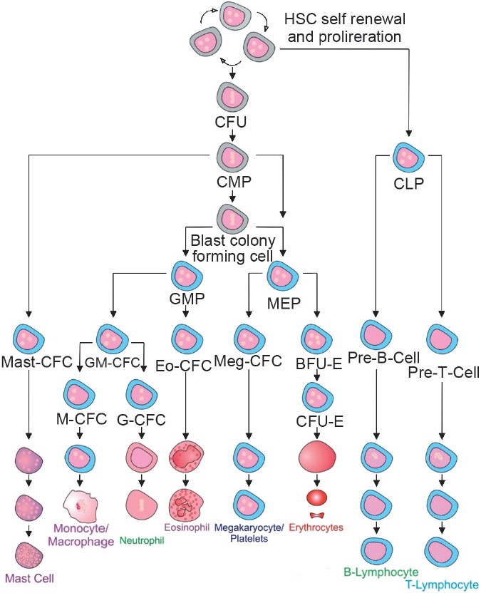
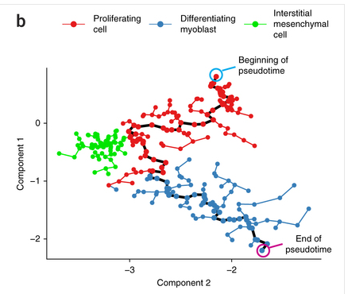
Trajectory / pseudo-time inference
Cell type/state hierarchy
Provide bioinformatics reconstruction of transcriptomics shift
Idea: automatize the building of these differentiation trees
Trajectory, pseudotime analysis (here Monocle)

Slide 34
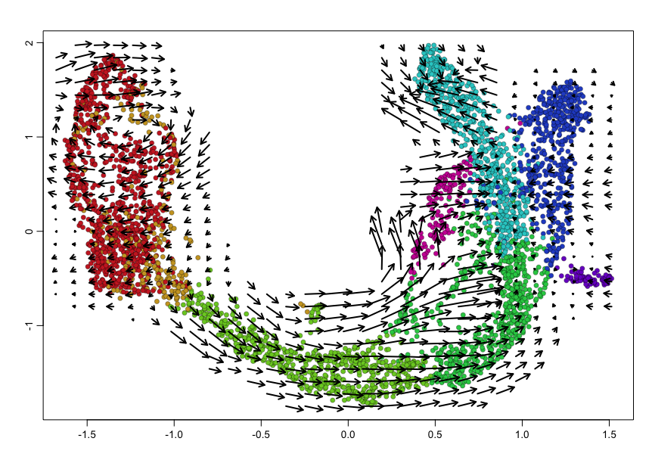
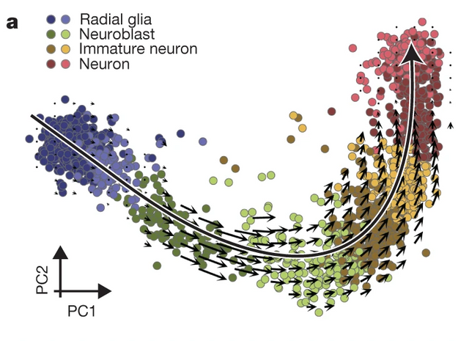
Velocyto
Based on pre-mRNA / mRNA ratio
La Manno et al., Nature, 2018

Slide 35
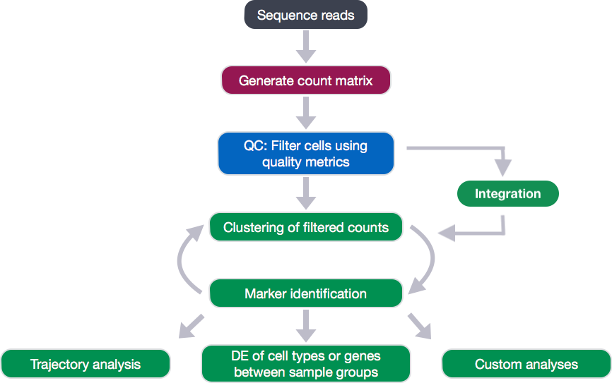
Final analysis pipeline looks more like this…
https://hbctraining.github.io/scRNA-seq/lessons/07_SC_clustering_cells_SCT.html

Slide 36
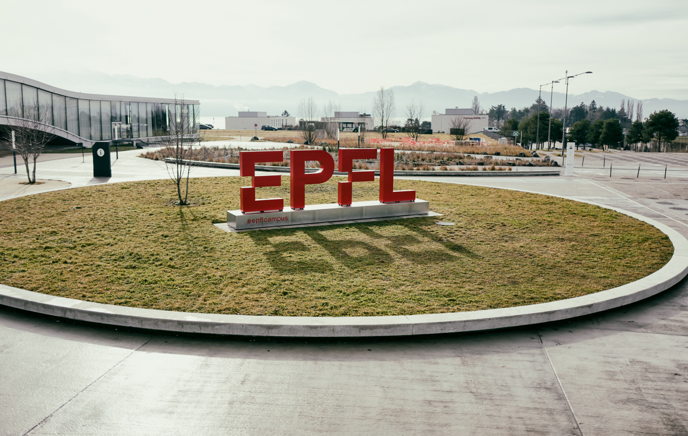
Questions?
Vincent Gardeux

