Slide 1
BIOENG-420 Single-cell biology
BIOENG420-03 | Single-cell RNA-seq analysis I
Vincent Gardeux
Deplancke’s Laboratory of Systems Biology and Genetics

Slide 2


Biologists: “I want to do single-cell”
I finally got good single-cell data!!

Slide 3
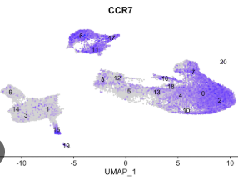


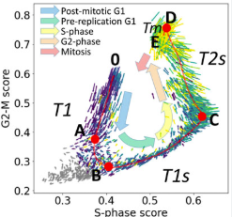
But how do I analyze single-cell data?
How to interpret my data?
What is UMI? How can I find doublets?
What is a PCA? UMAP?
Cell-cycle, ambient RNA, …
…
???

Slide 4



Single-cell RNA-seq vs bulk RNA-seq
There are fundamental differences between single-cell and bulk RNA-seq experiments that need to be considered in the analysis
Bulk RNA-seq
Single-cell RNA-seq
Typically < 100 samples
2-3 biological replicates
Starting material: millions of molecules
Stable across samples and time
Typically consistent measurements (average)
Expression of most genes is measured, and remains unchanged across conditions
100 – 10’000 cells (samples)
Use cells from same cell-types as “replicates” (each cell is unique though)
Starting material: <1M molecules
Highly variable measurements (physical stress, technical and/or biological variability, …)
Sparse data: many genes are not detected

Slide 5
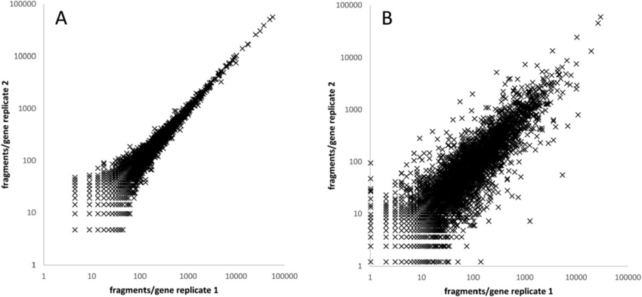
Bulk RNA-seq, technical vs biological variation
Technical replicates are usually very well correlated for bulk RNA-seq.
Biological reps a bit less, but it’s expected
Technical replicates Biological replicates
R²≃1
R²≃0.8
Landstorfer et al, BMC Genomics (2014)

Slide 6
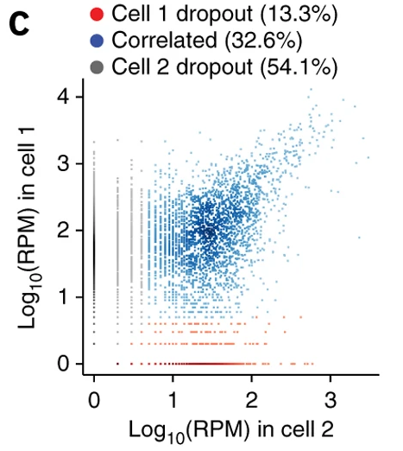
Single-cell RNA-seq – variation and dropouts
Cell 1 dropouts
Cell 2 dropouts
2 cells of the same cell-type:
Mouse Embryonic Fibroblast (MEF)
Kharchenko et al., Nature (2014)

Slide 7
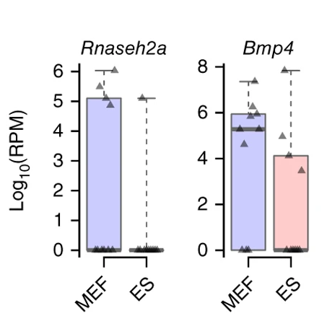
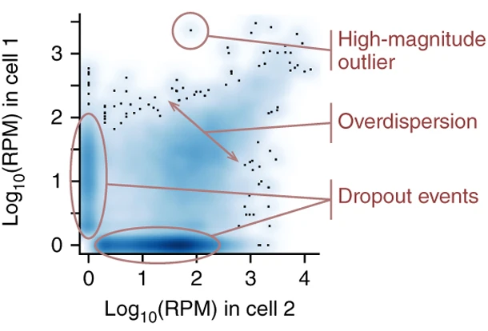
Single-cell RNA-seq – variation and dropouts
10 MEF vs 10 Mouse Embryonic Stem cells (ES)
  Is BMP4 differentially expressed?
Kharchenko et al., Nature (2014)

Slide 8
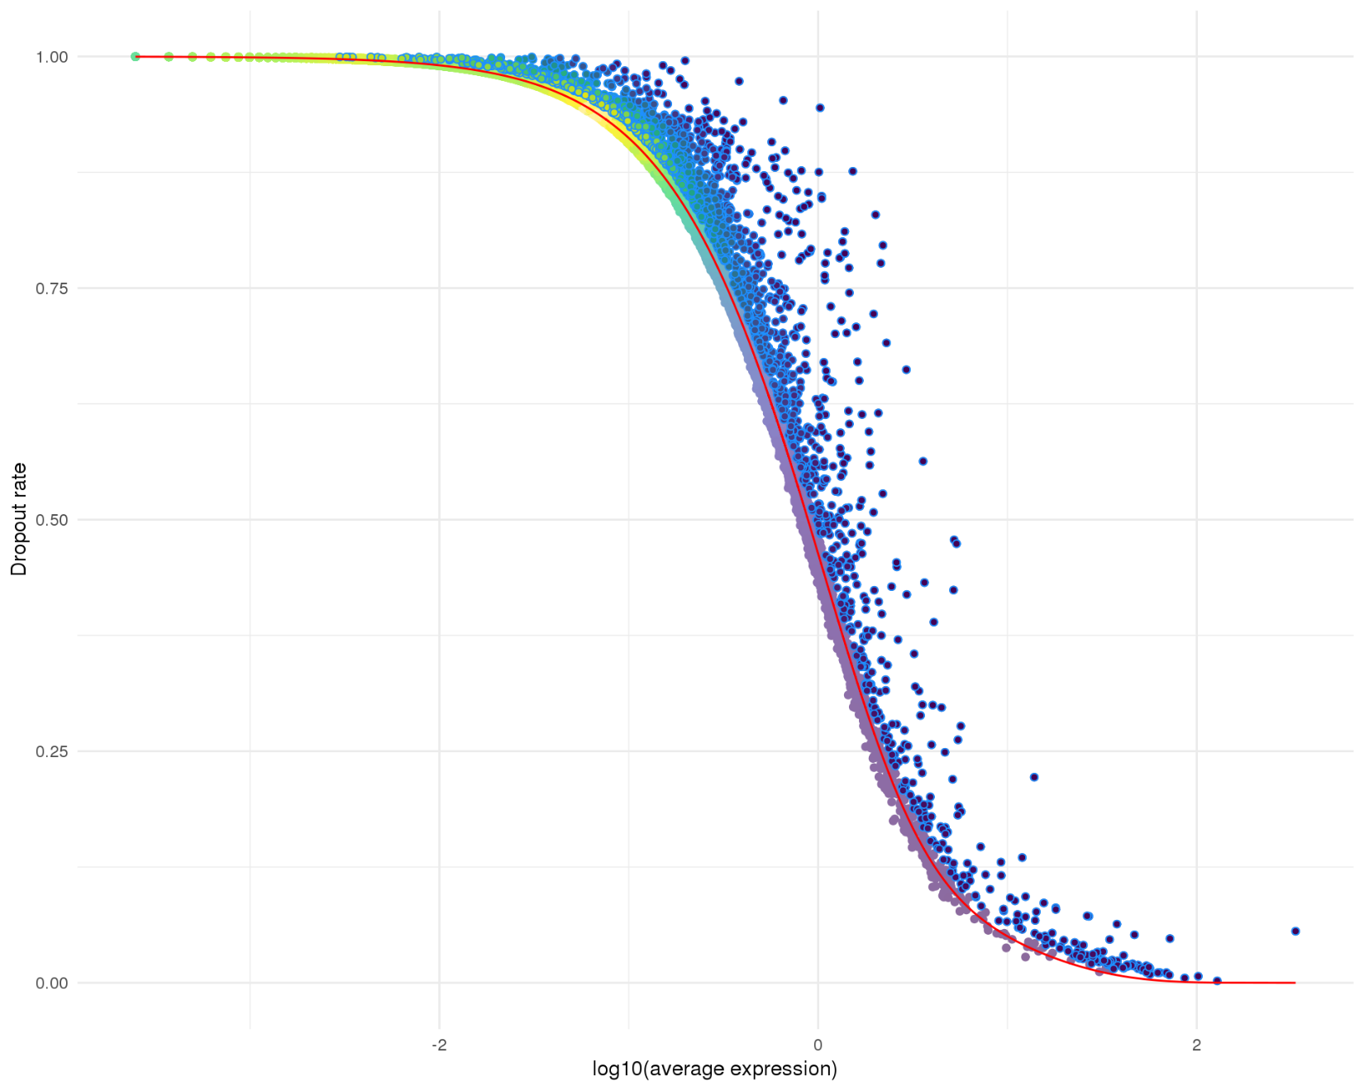

Why do we observe dropouts?
Technical artifacts
Statistical sampling
Biological factors / cell-types?
What to do?
  Tools like M3Drop try to model the dropout rate to find interesting genes
  Other methods use Zero-Inflated distribution to model the single-cell data (because of drop-outs)
  Other methods like scImpute, MAGIC, … try to impute the 0s
Technical artifacts vs Biological signal
T.S. Amdrews and M. Hemberg, Bioinformatics (2018)

Slide 9
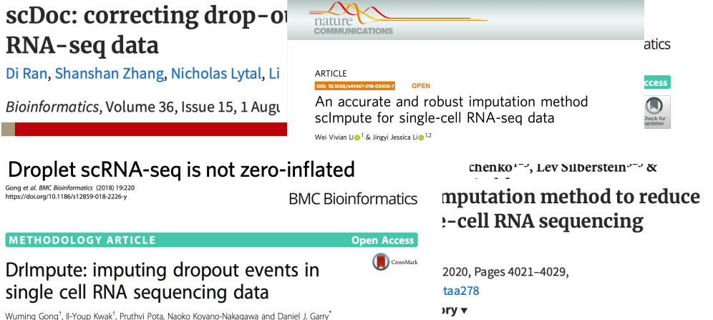
Dropouts, what to do?
There was a long debate about what is the best solution for dealing with drop-outs
Nowadays, apart from very specific analyses, we don’t do anything special about dropouts. We just keep in mind that they are present in the data

Slide 10
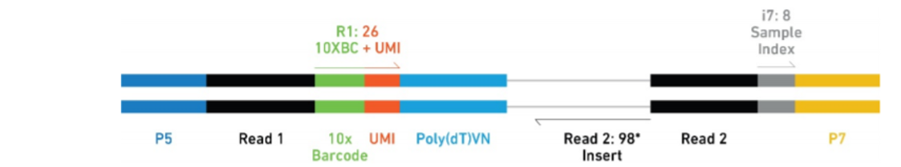
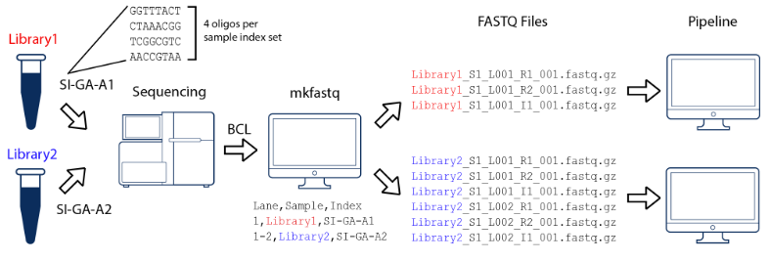
From a library to sequencing data
Final library structure (here example from 10X)
P5,P7: adapter seq. to allow library to bind and generate clusters on the flow cell
i7: index seq. Which allow multiplexing of multiple libraries in a single sequencing run
https://biocellgen-public.svi.edu.au/mig_2019_scrnaseq-workshop/processing-raw-scrna-seq-data.html

Slide 11

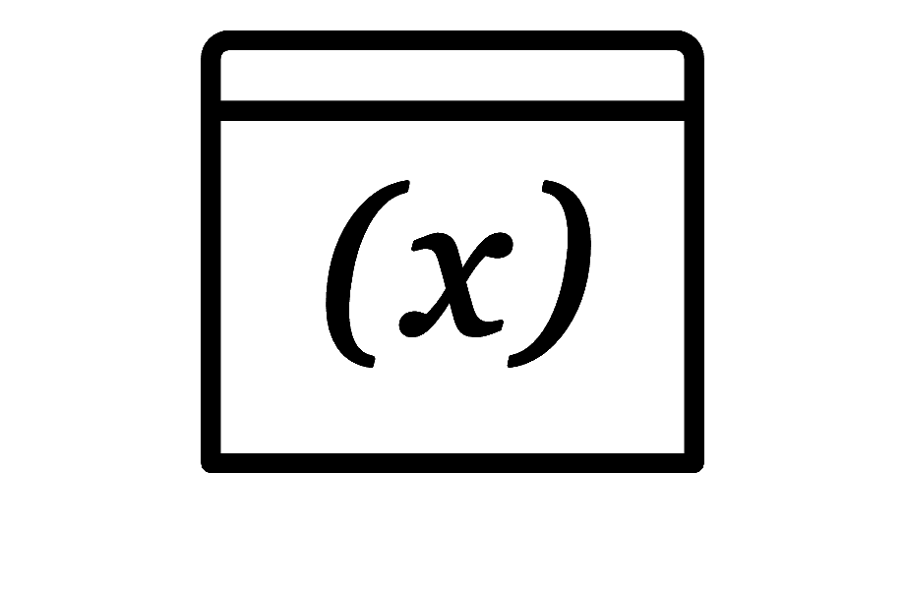
scRNA-seq analysis pipeline
.fastq
Mapping to reference genome
Single-cell specific:
Barcode demultiplexing
UMI counting
Filtering of cells (e.g. empty droplets, …)
Demultiplexing and
Quality Control (QC)
UNIX / Bash
.bam
PREPROCESSING
.txt / .csv
.h5 / .loom
Read / transcript matrix
(raw counts / UMI)
QC and filtering
Single-cell specific:
Filtering doublets, ambient RNA
Removing covariates (cell-cycle)
Integrating multiple datasets
Seurat or Scanpy objects
Normalization, noise removal, PCA
R / Python
DOWNSTREAM ANALYSIS
Study-specific downstream analysis

Slide 12
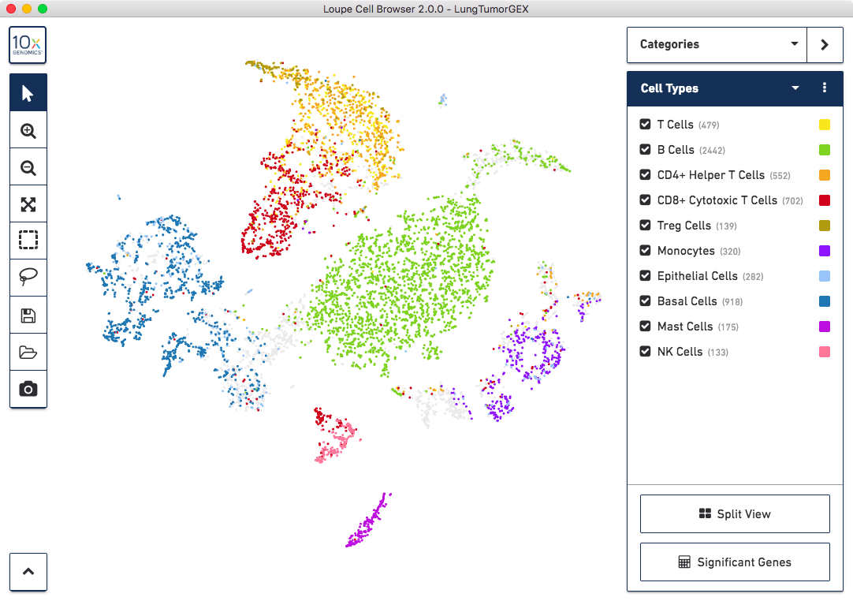
All-in-one analysis pipelines
Cell Ranger + Loupe visualization
Developed for customers of 10x
Black-box fixed pipeline

Slide 13

A scRNA-seq “blackbox” pipeline may not be applicable to all datasets
Preprocessing pipelines are now very standard but downstream analyses can require more hands-on experience
Solutions:
  Standardized but parametrizable downstream analysis pipelines (e.g. Seurat, Scanpy)
  Probably the best option for bioinformaticians
  User-friendly automated analysis and visualization portals (e.g. ASAP, Scope, FastGenomics, etc.)
  Good first glance at results for bioinformaticians
  Sufficient for non-bioinformaticians
https://satijalab.org/seurat/articles/get_started.html
https://scanpy.readthedocs.io/en/stable/
https://asap.epfl.ch
https://scope.aertslab.org

Slide 14
Preprocessing in short
.fastq
Mapping to reference genome
Single-cell specific:
Barcode demultiplexing
UMI counting
Filtering of cells (e.g. empty droplets, …)
Demultiplexing and
Quality Control (QC)
UNIX / Bash
.bam
PREPROCESSING
.txt / .csv
.h5 / .loom
Read / transcript matrix
(raw counts / UMI)
QC and filtering
Single-cell specific:
Filtering doublets, ambient RNA
Removing covariates (cell-cycle)
Integrating multiple datasets
Seurat or Scanpy objects
Normalization, noise removal, PCA
R / Python
DOWNSTREAM ANALYSIS
Study-specific downstream analysis

Slide 15
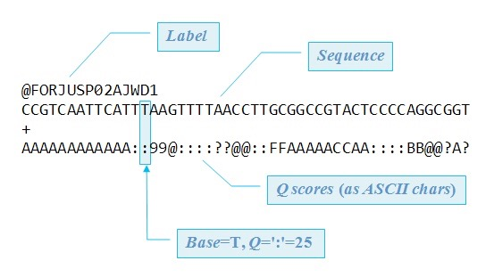
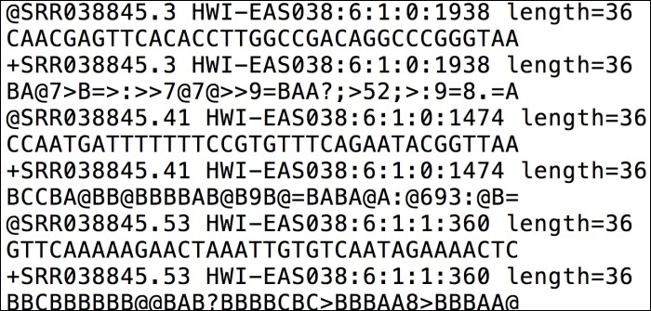
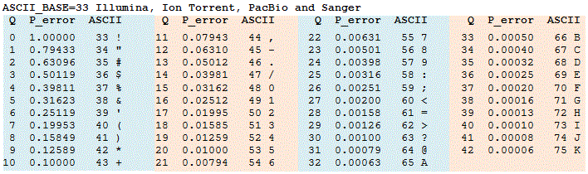
What is a .fastq file?
Text file containing (short) nucleotide sequences (reads)
First 12 lines of a .fastq file
4 lines
= 1 read
4 lines
= 1 read
4 lines
= 1 read
Label: info about the instrument name, flowcell lane, tile number, position, multiplexing index
Sequence: A, C, G, T or N
Quality:
  For each position in the sequence, an integer value representing the probability that the base call is incorrect [-log₁₀(p)]
  Mappped in ASCII (Character) encoding

Slide 16
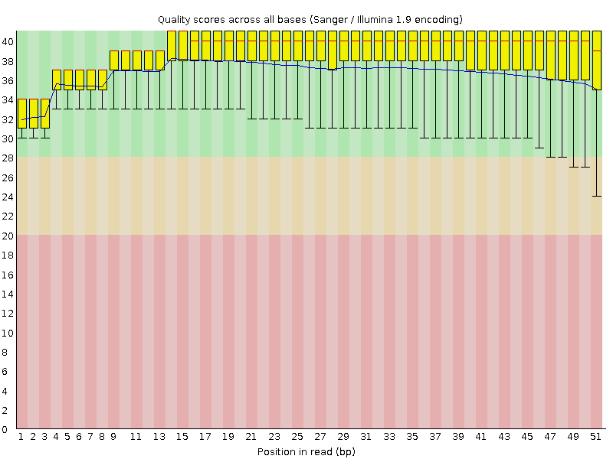
Preprocessing: Sequencing quality
The raw .fastq file is checked for:
  Number of reads
  Read length
  Base quality & distribution
  Duplication level
  Overrepresented sequences
  GC content
  etc.
2 example outputs from fastQC
(summary across all reads)
  Quality score
  Quality score
  Position in read (bp)
  Position in read (bp)
GOOD: Process without trimming
BAD: Trimming is necessary
Quality typically decreases towards the end of the read
  Remove or trim reads with low quality scores before alignment
https://www.bioinformatics.babraham.ac.uk/projects/fastqc/

Slide 17
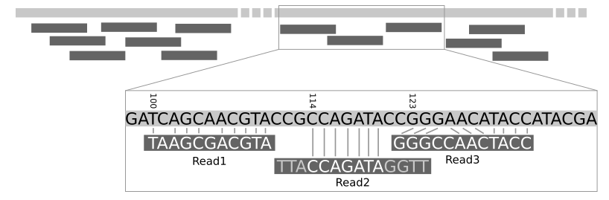

Preprocessing: Mapping to genome/transcriptome
Short reads are efficiently mapped to the genome or transcriptome using short read aligners and known genomic annotations (e.g. Ensembl or UCSC)
RNA-seq raw reads
Mapping to reference genome
Mapped reads
Galaxy tutorial
Efficient alignment with specialized tools
  Large number of aligners available
  (>70 on Wikipedia 20.02.2022)
  Considerations: accuracy, gap-aware, speed, memory, …
Tools:
BWA
Kallisto
STAR
  Now STARsolo is specifically designed for single-cell and multiplexed exp.

Slide 18
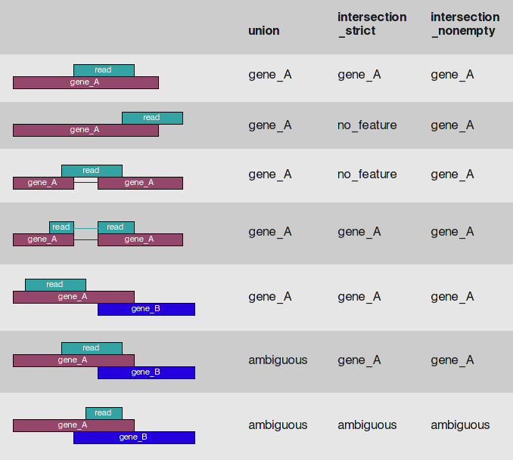
Preprocessing: Gene expression estimate – count matrix
Expression is summarized as read abundance per genomic feature (gene, transcript, exon)
Note: The assignment of reads to genes can be challenging due to overlapping annotation
  Arbitrary decisions need to be made for dealing with reads spanning multiple features
  Different tools, different results
 | Cell 1 | Cell 2
Gene A | 5 | …
Gene B | 2 | …
Gene C | 6 | …
Gene A
Gene B
Gene C
Read count
matrix
HTseq (AndersHuberBioinformatics2014)

Slide 19
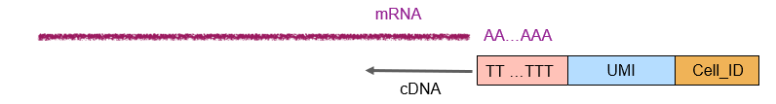
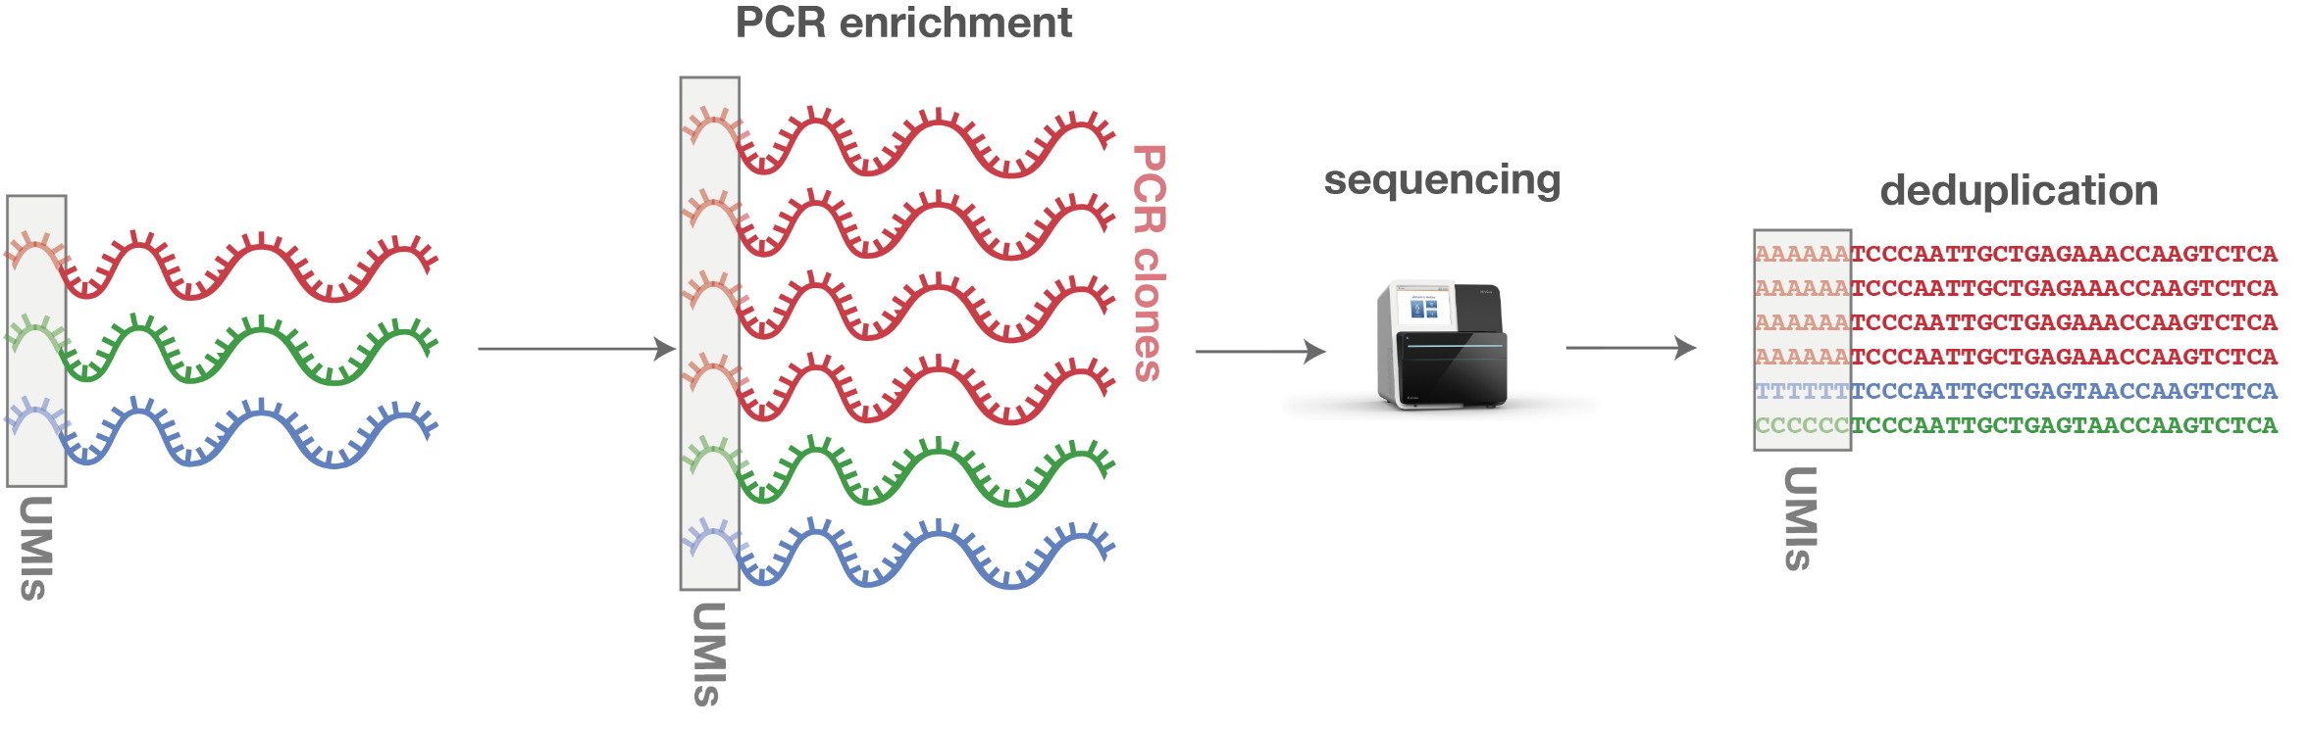
Unique Molecular Identifier (UMI) – Principle
UMIs are random sequences that are attached to the fragments prior amplifications
They are used to remove the amplification bias, after sequencing
“Original unique” transcripts can thus be detected in the final output by removing the duplicated UMI sequences
  Reduce the amplification bias
  Better approximation of duplicates as compared to standard Picard/Samtools tools estimation
6 identical sequences
3 unique input fragments
© ecSeq Bioinformatics

Slide 20
Unique Molecular Identifier (UMI) – Example
Same example than before. Now the reads are colored by unique UMI sequence
 | Cell 1 | Cell 2
Gene A | 5 | …
Gene B | 2 | …
Gene C | 6 | …
Gene A
Gene B
Gene C
Read count
matrix
 | Cell 1 | Cell 2
Gene A | ? | …
Gene B | ? | …
Gene C | ? | …
UMI count
matrix?

Slide 21
Unique Molecular Identifier (UMI) – Example
Same example than before. Now the reads are colored by unique UMI sequence
 | Cell 1 | Cell 2
Gene A | 5 | …
Gene B | 2 | …
Gene C | 6 | …
Gene A
Gene B
Gene C
Read count
matrix
 | Cell 1 | Cell 2
Gene A | 4 | …
Gene B | 2 | …
Gene C | 4 | …
UMI count
matrix
Also need to account for sequencing errors in the UMIs
  Allow mismatches
  Collapse barcodes with “similar enough” UMIs

Slide 22

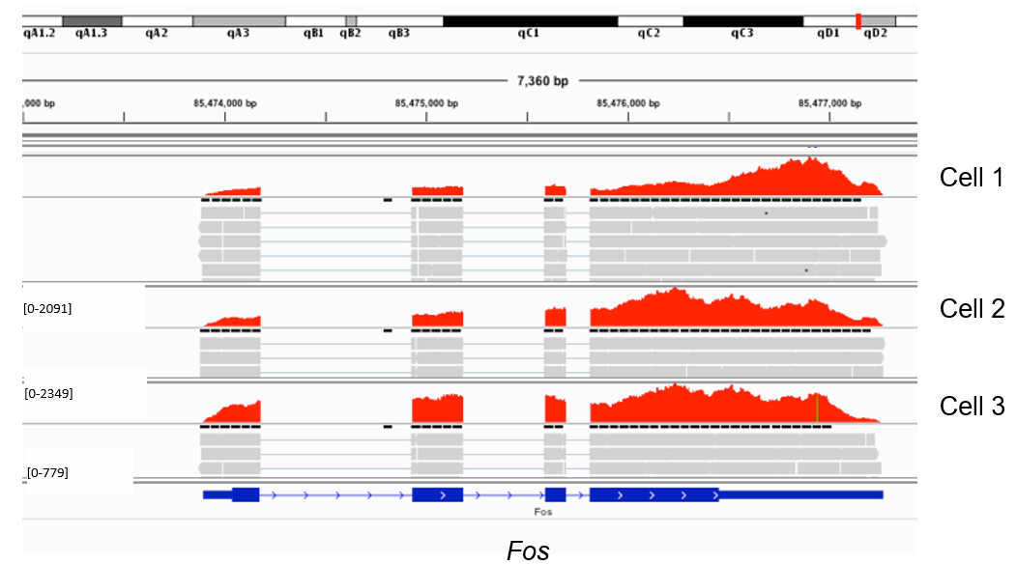
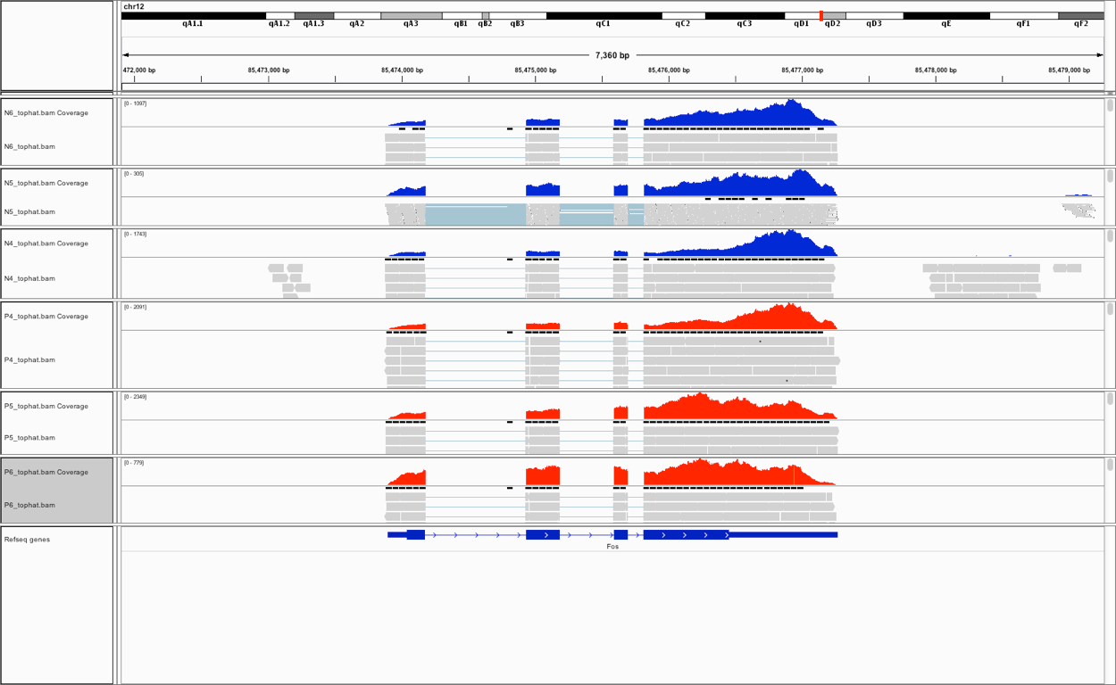
Visualizing coverage?
Expression can be summarized as coverage per genomic base position, and visualized in a genome browser
Tools:
IGV
UCSC Genome Browser
Coverage
IGV browser screenshot: scRNA-seq coverage of the Fos gene, for 3 cells
Cell 1
[0-2091]
Cell 2
[0-2349]
Cell 3
[0-779]
Fos

Slide 23
Downstream analysis pipeline
.fastq
Mapping to reference genome
Single-cell specific:
Barcode demultiplexing
UMI counting
Filtering of cells (e.g. empty droplets, …)
Demultiplexing and
Quality Control (QC)
UNIX / Bash
.bam
PREPROCESSING
.txt / .csv
.h5 / .loom
Read / transcript matrix
(raw counts / UMI)
QC and filtering
Single-cell specific:
Filtering doublets, ambient RNA
Removing covariates (cell-cycle)
Integrating multiple datasets
Seurat or Scanpy objects
Normalization, noise removal, PCA
R / Python
DOWNSTREAM ANALYSIS
Study-specific downstream analysis

Slide 24





Downstream analysis
At this stage, we have a count matrix (read counts or UMI)
  Let’s switch from UNIX to R/Python!
Many different file formats exist to store the single-cell RNA-seq projects
  Only count matrices
    CSV/TSV text file (dense Matrix)
    MTX text file (sparse Matrix)
    H5 format from cellranger (contains the sparse matrix in a similar format than the MTX format but in a single HDF5 file)
  Count matrix + metadata (nb detected genes, variable genes, …)
    SingleCellExperiment R object (sparse Matrix)
    Seurat R object (sparse Matrix)
    Scanpy Python object (sparse Matrix)
    Loom file (dense Matrix)
    .h5ad files (sparse and/or dense Matrix)
These are usually the output of the downstream analysis step

Slide 25
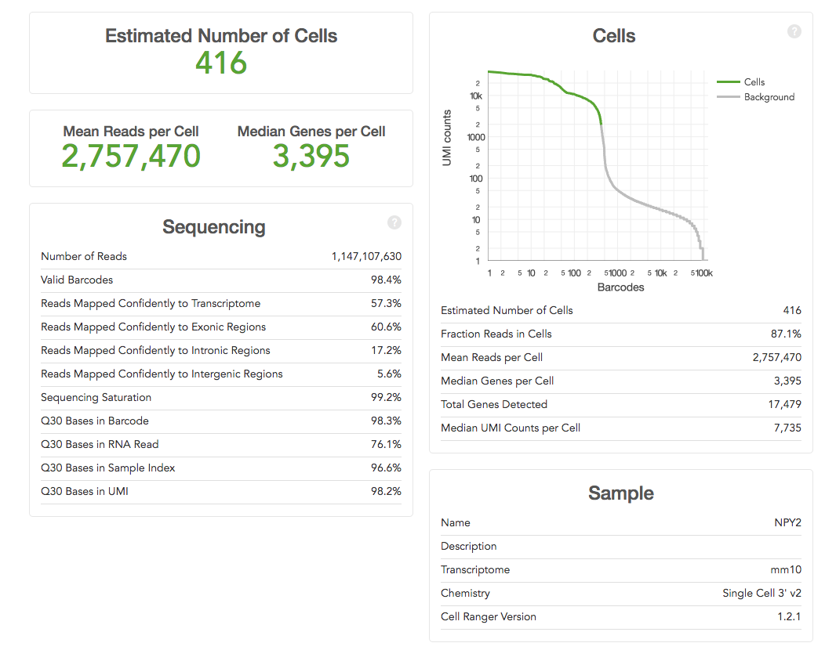
Downstream analysis: Quality control (post-alignment)
Number of Cells
  Removal of empty droplets
Alignment quality
  Number and fraction of mapped reads
Mapping to exonic regions (check for gDNA contamination)
  Number of detected genes/cell
  Where do the reads map? Introns/Exons/Intergenic
Check for stressed cells, dead cells, ribosomal/mitochondrial contamination
  Ratio Mitochondrial/Ribosomal/Protein-Coding
Goal: Hunt for aberrant low quality cells to filter out because they may bias the downstream results
Example 10x – CellRanger report

Slide 26
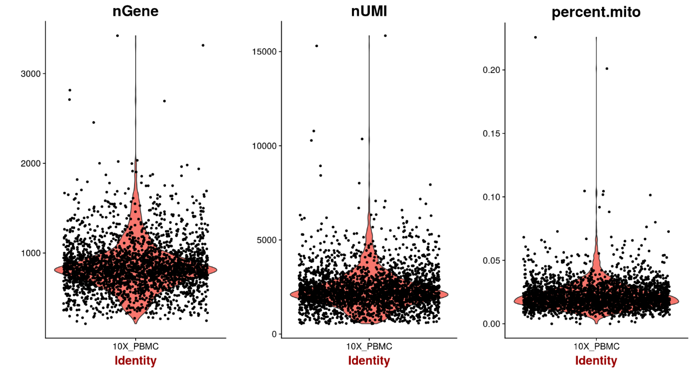
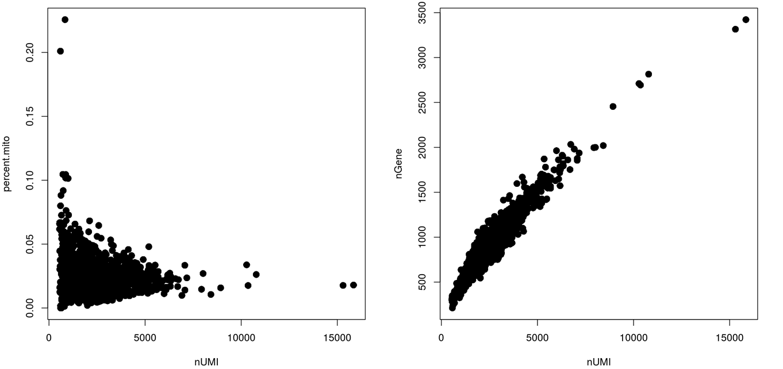
Downstream analysis: Cell Filtering
Low number of expressed genes / cell can indicate low quality cells (e.g. degraded RNA)
  Remove such cells
  “Low” is arbitrary, and depends on protocol and cell types
Low values can sometimes be biologically meaningful, so be careful when filtering
  Usually: Apply a very lenient filtering first, then check the UMAP (colored by tech. features)
VlnPlot() in Seurat
FeatureScatter() in Seurat

Slide 27
Downstream analysis: Gene filtering
Different thresholds can be applied, it’s often super arbitrary
  Usually, remove genes that are not expressed in any cell
  Can also remove genes that have less than k counts across all cells
  Or remove genes that are biasing results (like cell-cycling genes)
Most of the recent pipelines apply the first method
There is a more in-depth step called “highly variable genes” which occurs in later steps, but genes are not filtered out, just marked as “highly variable”

Slide 28
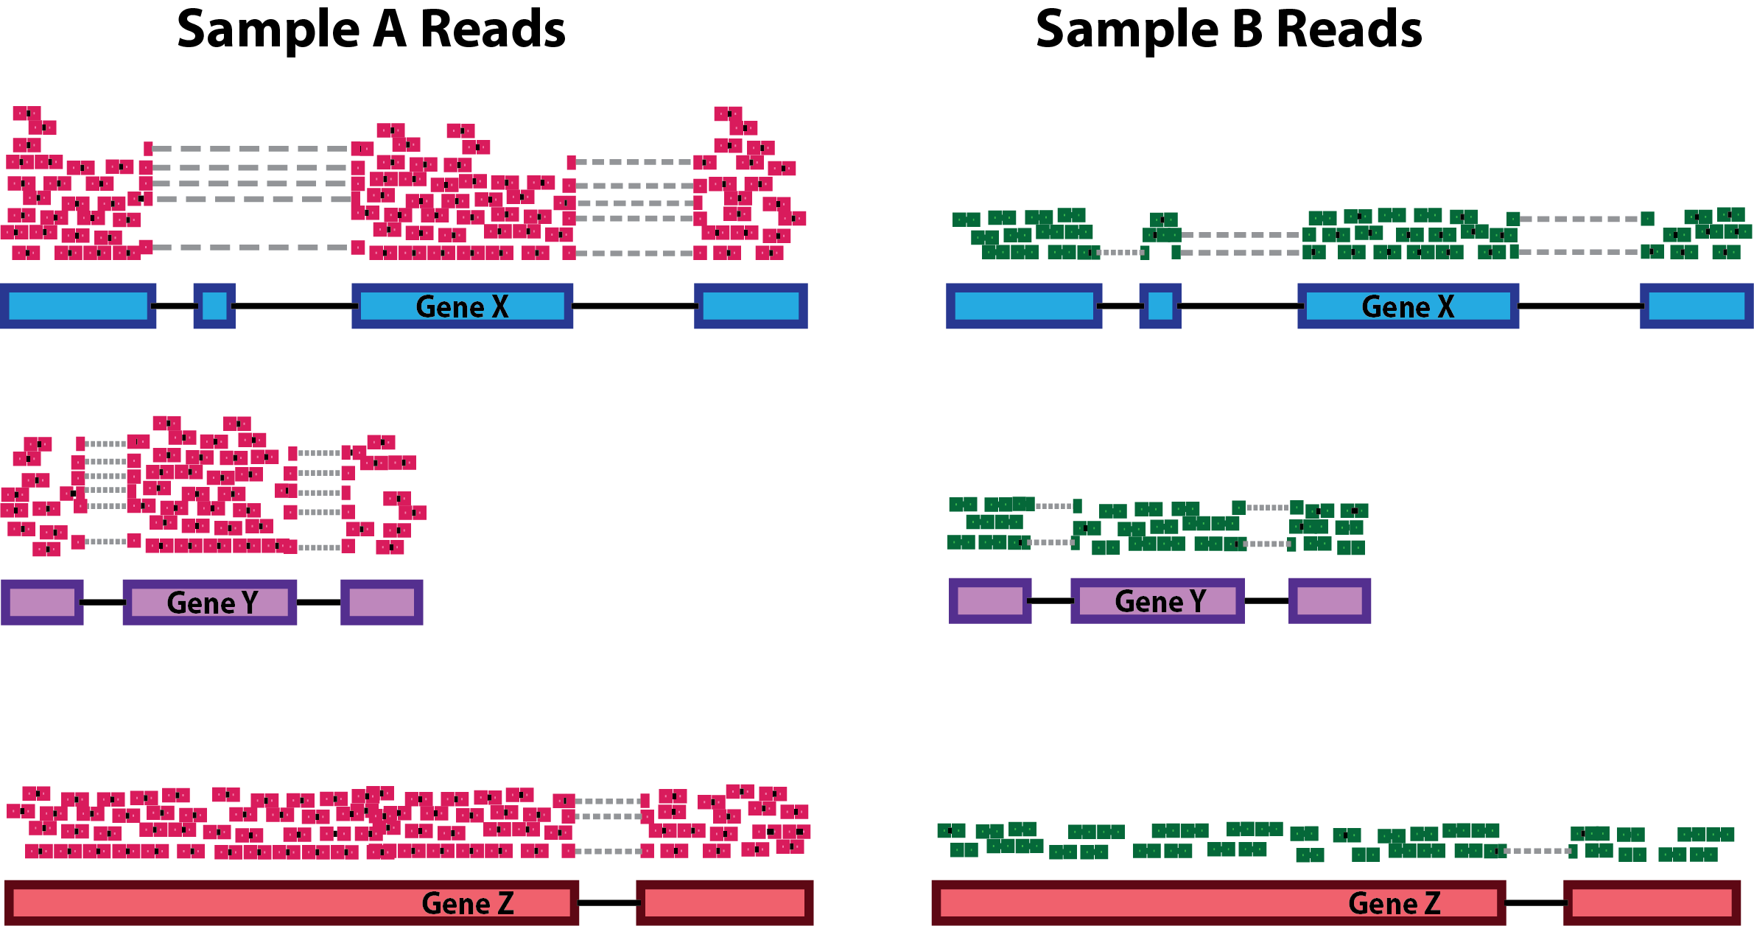
Downstream analysis: Normalization
Expression values typically need to be normalized to make samples comparable.
Why?
  Mainly to remove sequencing depth bias (total read count per cell)
  Gene length bias (if using a full transcript protocol instead of 3’ based protocol)
Which normalization to use?
  Usually, pipelines use a simple Count Per Million (CPM) normalization (or with different scaling factors (1E6 for CPM, sometimes 1E4)
  Then, the data is log₂(1 + x)transformed (or log / log₁₀) depending on the pipeline)
Sequencing depth bias: Gene Y is more expressed in Cell A than B?

Slide 29
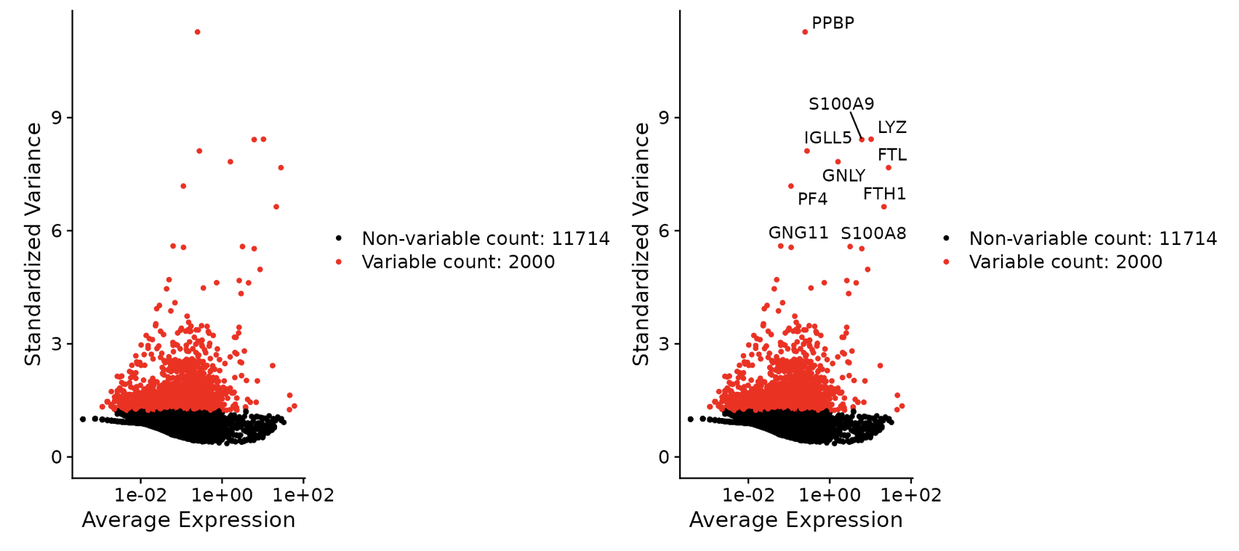
Downstream analysis: Highly Variable Genes
Identification of highly variable genes exhibiting high cell-to-cell variation in the dataset
  Focusing on these genes in downstream analysis helps to highlight biological signal in single-cell datasets
https://satijalab.org/seurat/articles/pbmc3k_tutorial.html

Slide 30
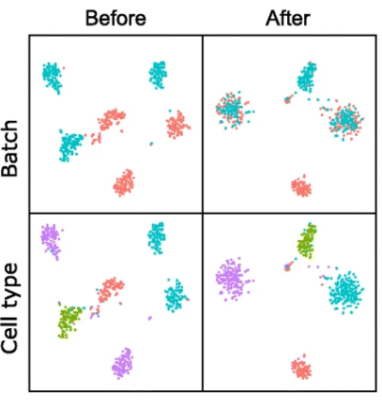
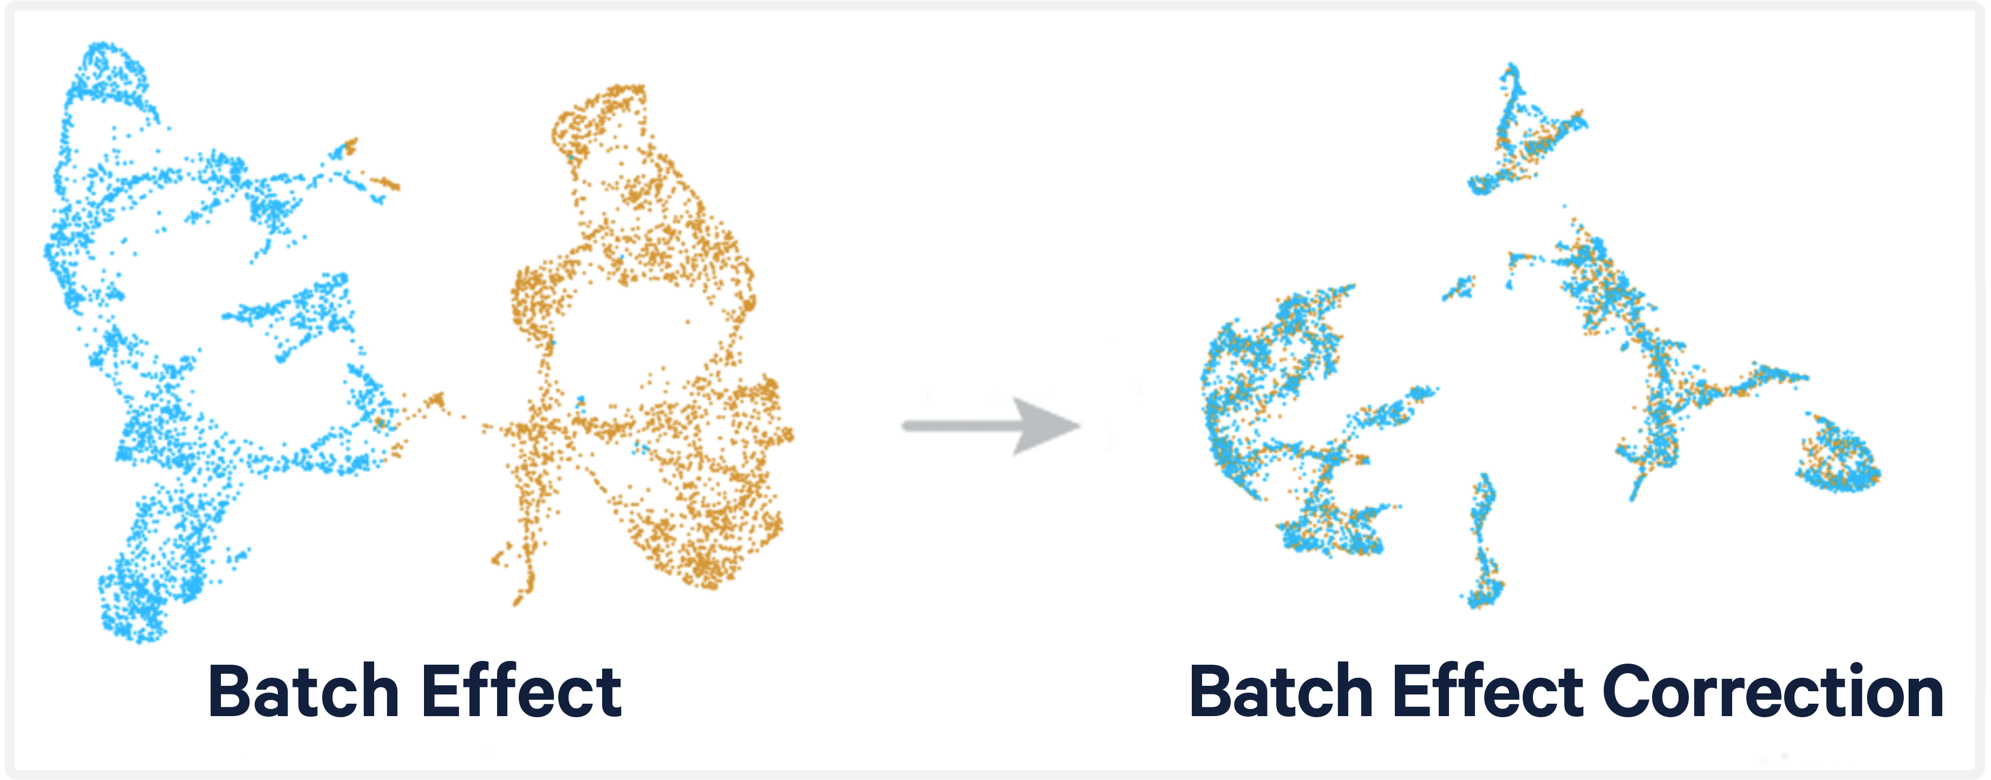
Removal of unwanted sources of variation
Batch effect is a non-biological signal in the data that comes from the experimental design
  It can be “regressed-out” as any other covariate (sex, cell-cycle, age, …)
  Many methods rather use “integration methods” to merge several scRNA-seq datasets together
Tools:
Harmony
FastMNN
Seurat
…
Luecken et al, Nature Methods, 2022

Slide 31
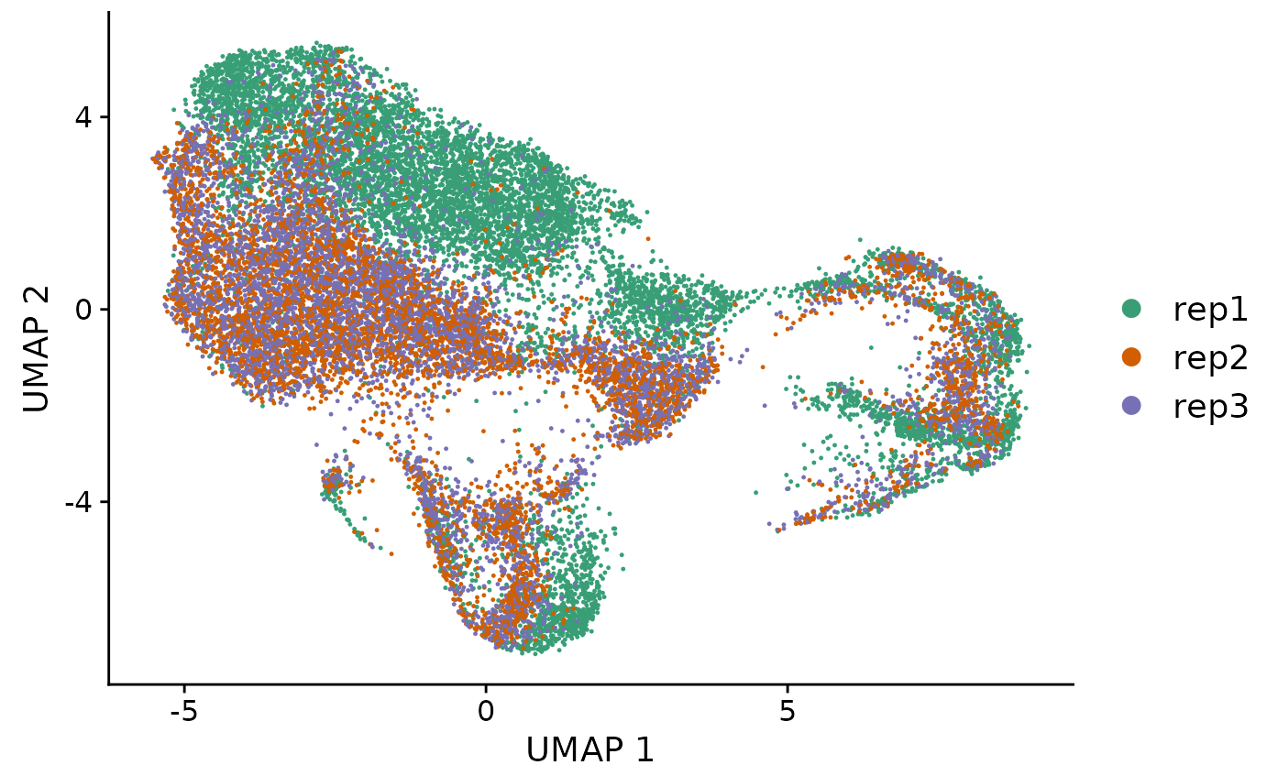
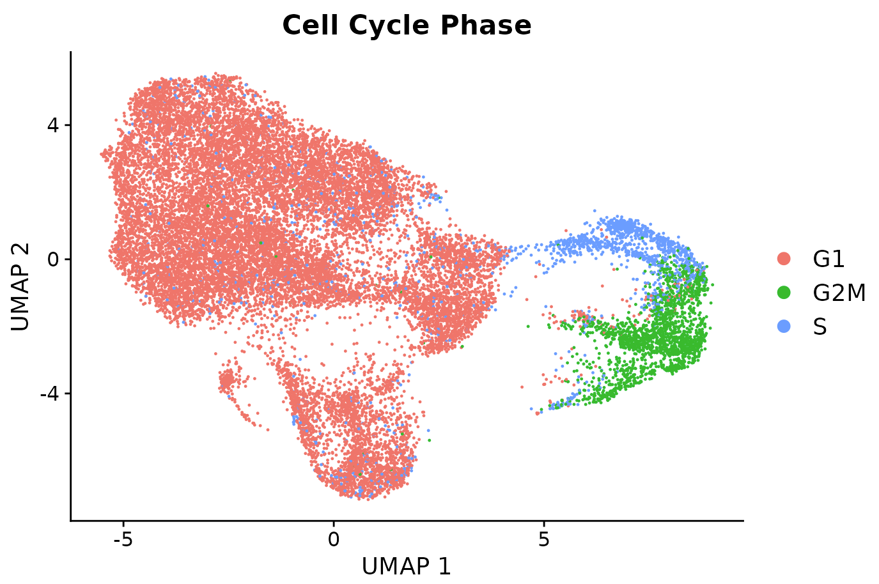
And other covariates?
Sex, Time, Individuals, …
  Usually these are “regressed out” from the data
  Sometimes they match with the experiments so they can be integrated together
  If an important biological signal overlaps with a batch/covariate, it can be tricky/impossible to correct it
“Biological noise” such as cell-cycle effect
  Biological factors unrelated to our process of interest
  Note: Seurat has its own method to score the cell-cycle state in which the cells are. This score can be regressed out to potentially remove cell-cycle effect.
Typical “cell-cycle cluster”

Slide 32
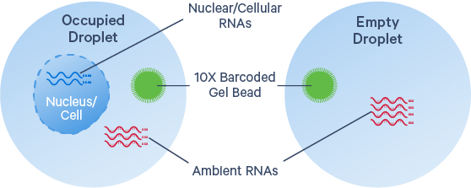
Other potential issues: ambient RNA
Sometime there is detectable « ambient RNA » in cells i.e. freely floating transcripts during the droplet-capture process
  Low level of background RNA counts
  Can contaminate the endogeneous gene expression profile
Solution:
  Methods like DecontX or CellBender remove these counts (using empty droplets for assessing background distribution)
https://www.10xgenomics.com/analysis-guides/introduction-to-ambient-rna-correction

Slide 33
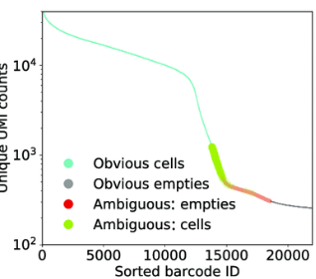
Other potential issues: empty droplets
It can be tricky to find which barcodes come from real cells or empty droplets, because of background noise or ambient RNA
Solution:
  Methods like EmptyDrops or CellBender try to find the optimal « cutoff » using expression profile distribution of empty droplets
https://www.10xgenomics.com/analysis-guides/introduction-to-ambient-rna-correction

Slide 34
Next week
Next step of the pipeline is dimensionality reduction, for visualization of our results
  PCA, UMAP, t-SNE
Then we will see about Clustering, Marker gene identification and other types of downstream analyses

Slide 35
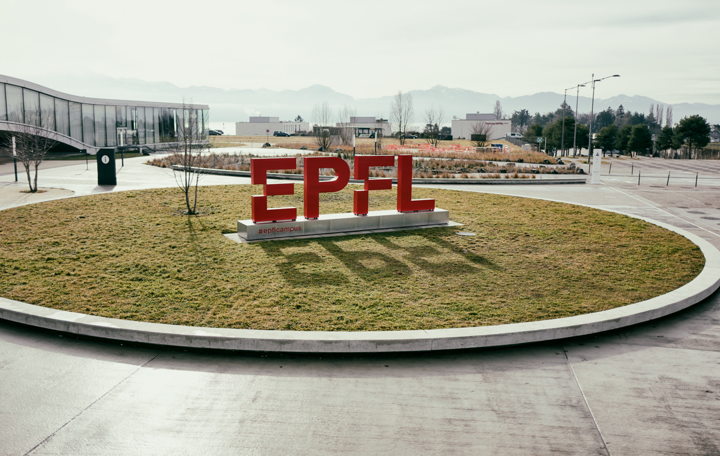
Questions?
Vincent Gardeux

