Slide 1
BIOENG-420 Single-cell biology
BIOENG420-02 | Introduction to single-cell transcriptomics
Vincent Gardeux
Deplancke’s Laboratory of Systems Biology and Genetics

Slide 2

«Block» overview
Week 2 | Week 3 | Week 4 | Week 5
L2. Introduction to single-cell transcriptomics | L3. Single-cell RNA-seq data analysis I | L4. Single-cell RNA-seq data analysis II | L5. Single-cell genomics applications
(P) Project description Installing environment Picking a group | (P) Group project work | (P) Group project work | (P) Group project work (hands on problems)
End of week 5
Project submission

Slide 3
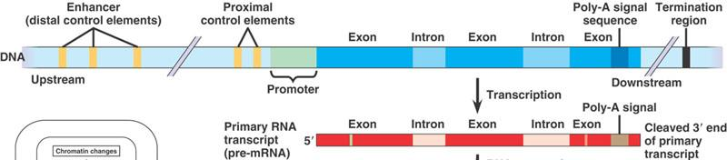
GenOMICs
The study of genes and their functions
ALL genes and their inter relationships in order to identify their combined influence on the growth and development of an organism
Genes consists of:
exons (protein-coding)
introns (non-translated)
Adjacent regulatory (control) elements
Transcription (RNA production) is controlled by proximal (promoter) and distal (enhancer) regulatory elements through the binding and action of transcription factors (TFs)
Transcription start site (TSS)

Slide 4

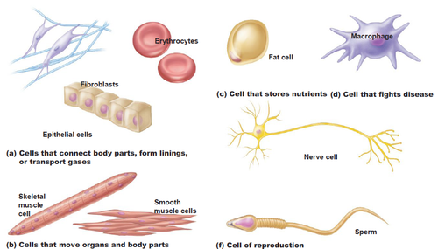
One genome: diverse functional outputs
One genome gives rise to a multitude of different cell types with highly distinct morphologies & functions
1 genome
Remarkable
cellular diversity
and specialisation
Blood cells
Immune cells
Fat cell
In human body there are:
~ 100 trillion cells
~ 200 types of cells
Tissue and organ functions are complex!
Skin
Nerve cell
Muscle
Sperm
anatomyandphysiology.com

Slide 5
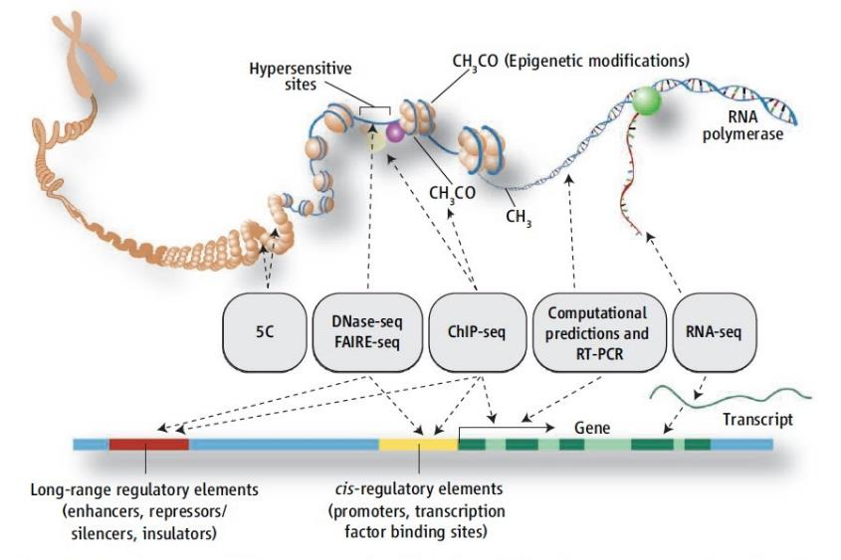

There are multiple genomic layers that can be measured
And
DNA Methylation
Nucleosome position
Chromatin etc.

Slide 6
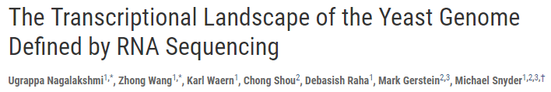
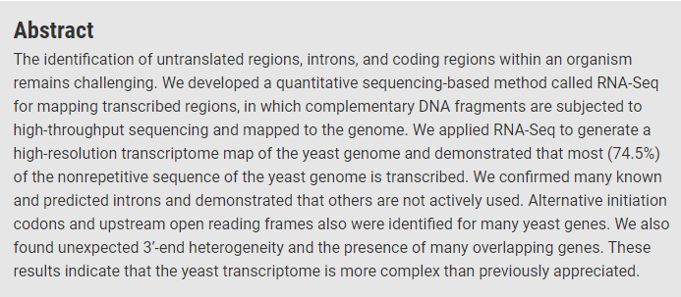
How to measure gene expression?
Bulk RNA-seq estimates expression of gene transcripts in a sample
A major breakthrough in the late 00’s (replaced microarrays)
Nagalakshmi et al, Science 2008

Slide 7
RNA-seq library preparation
There are multiple bulk RNA-seq protocols, but in short
Input RNA
Fragmentation
Fragmented RNA
Adapter ligation
Reverse transcription, PCR amplification
Sequencing Library
Sequencing
RNA-seq reads

Slide 8
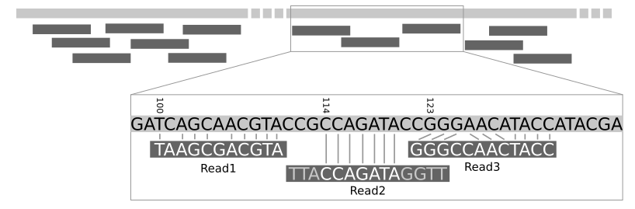
RNA-seq data analysis
Once the sequencing was performed, we get sequenced reads, that we need to align on a reference genome
RNA-seq raw reads
Mapping to reference genome
reference genome
Mapped reads
Galaxy tutorial
Quantify gene expression as read abundance, per gene
 | Sample 1
Gene A | 5
Gene B | 2
Gene C | 6
Gene A
Gene B
Gene C
Read count
matrix

Slide 9
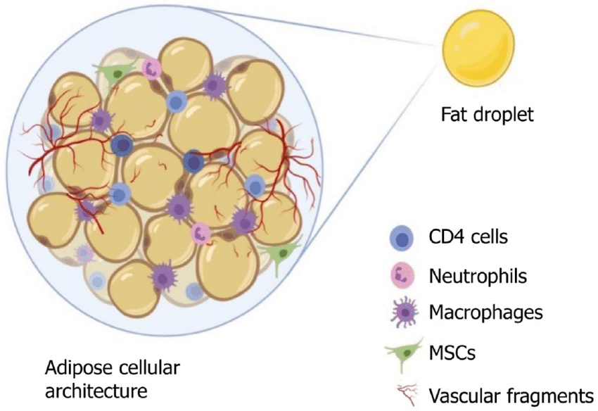
Limitations of bulk RNA-seq
Minimum starting material requirements: technique applied on millions of cells
Rare cell types and states cannot be analyzed
Tissues are generally heterogeneous
Tissue ≠ cell-type
Usually multiple cell-types in a tissue
e.g. of adipose tissue

Slide 10
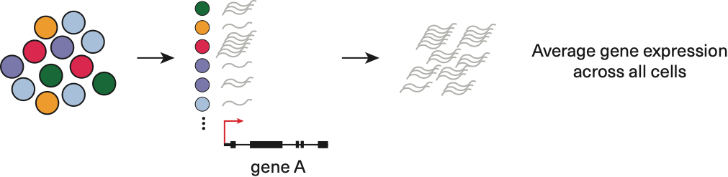
Limitations of bulk RNA-seq
Tissues are generally heterogeneous
Tissue ≠ cell-type
Usually multiple cell-types in a tissue
However, bulk RNA-seq works on large group of cells such as
tissues or cell lines which comprises different cell-types
Cell
Cell
Cell
Cell
Cell
Cell
Cell
Cell
Cell
Cell
Cell
Cell
Sample
Each bulk RNA-seq sample is an AVERAGE transcriptome of many cells
No idea of the distribution of expression levels for each cell, or of the heterogeneity of the sample

Slide 11
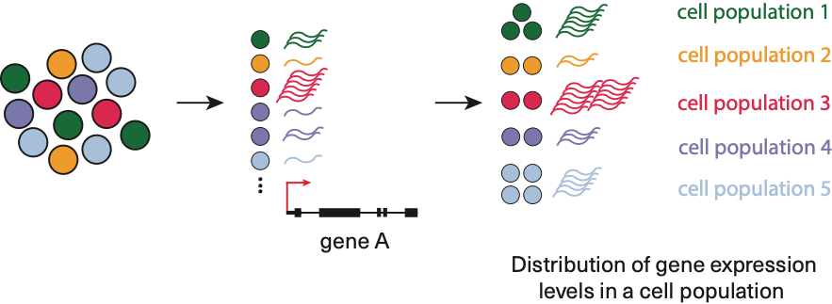
Single-cell RNA-seq (scRNA-seq)
scRNA-seq allows:
Identification of rare cell types (e.g. early development, stem cells, circulating tumor cells)
Studying heterogeneity (e.g. tissue composition, cancer, temporal processes)
Building gene regulatory networks (non-confounded correlations)
Exploring changes in expression while incorporating spatial, regulatory and/or protein information
Single cell phenomena* (gene expression stochasticity, mono-allelic expression)
Sample
*see review CoulonLarsonNatRevGenet2013

Slide 12
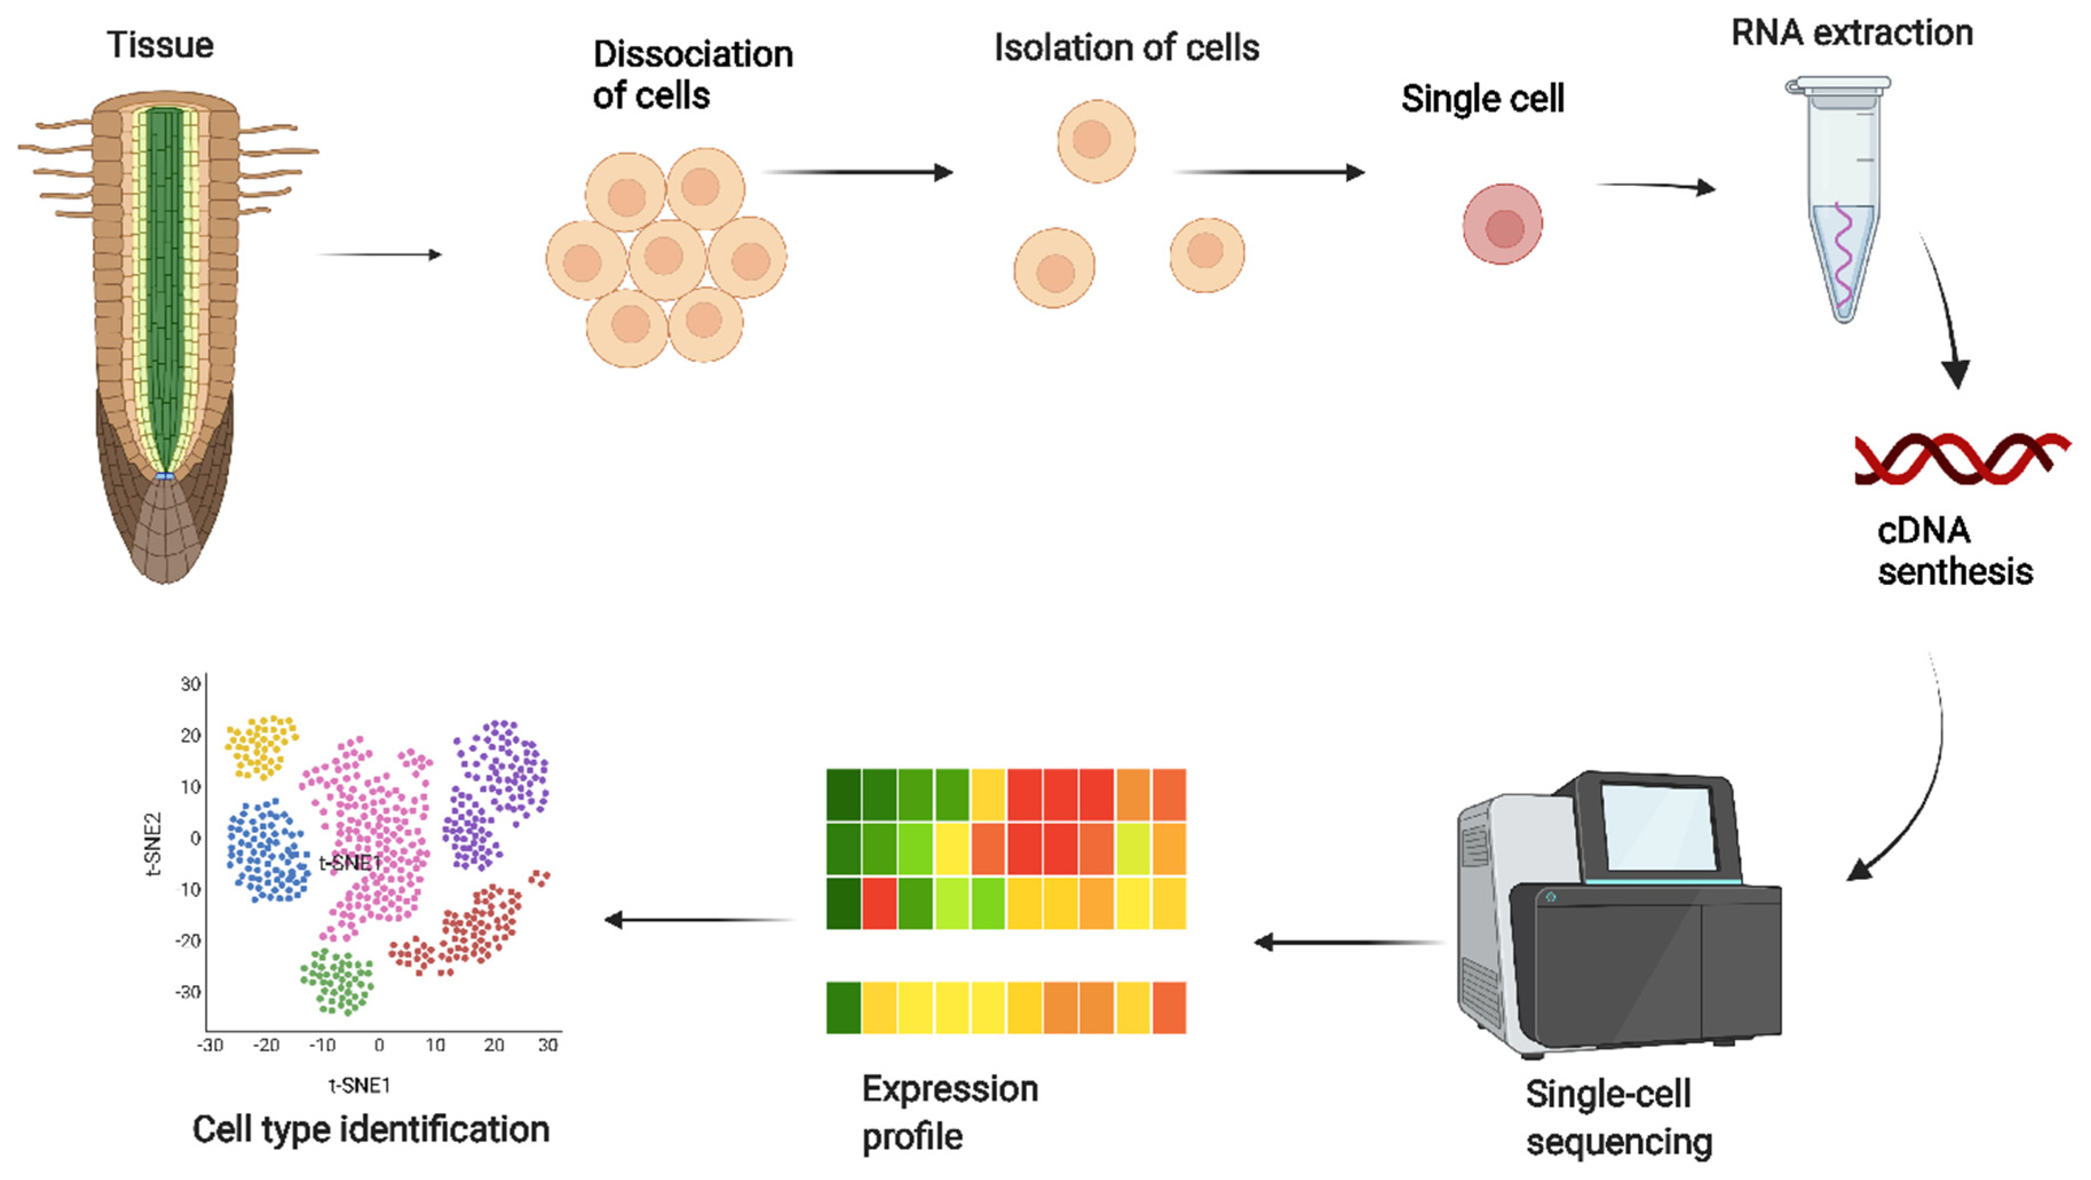
Single-cell RNA-seq experimental workflow
Similar than the bulk RNA-seq workflow, but including additional steps
Dissociation and isolation of cells (for e.g. cell encapsulation in droplets)
Library constructs include UMI and cell-specific barcodes for multiplexing
The data analysis pipeline is also different, as the goal is not only to compare samples together (differential expression), but to explore the sample heterogeneity (cell-type identification, trajectory inference, …)
Bawa et al, IJMS, 2022

Slide 13
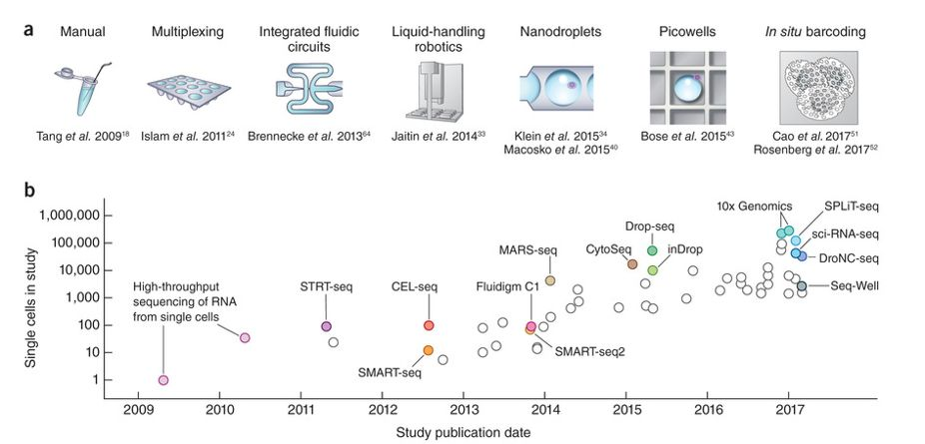
Single-cell RNA-seq, available protocols
Svensson …Teichman, Nature protocols, 2018

Slide 14
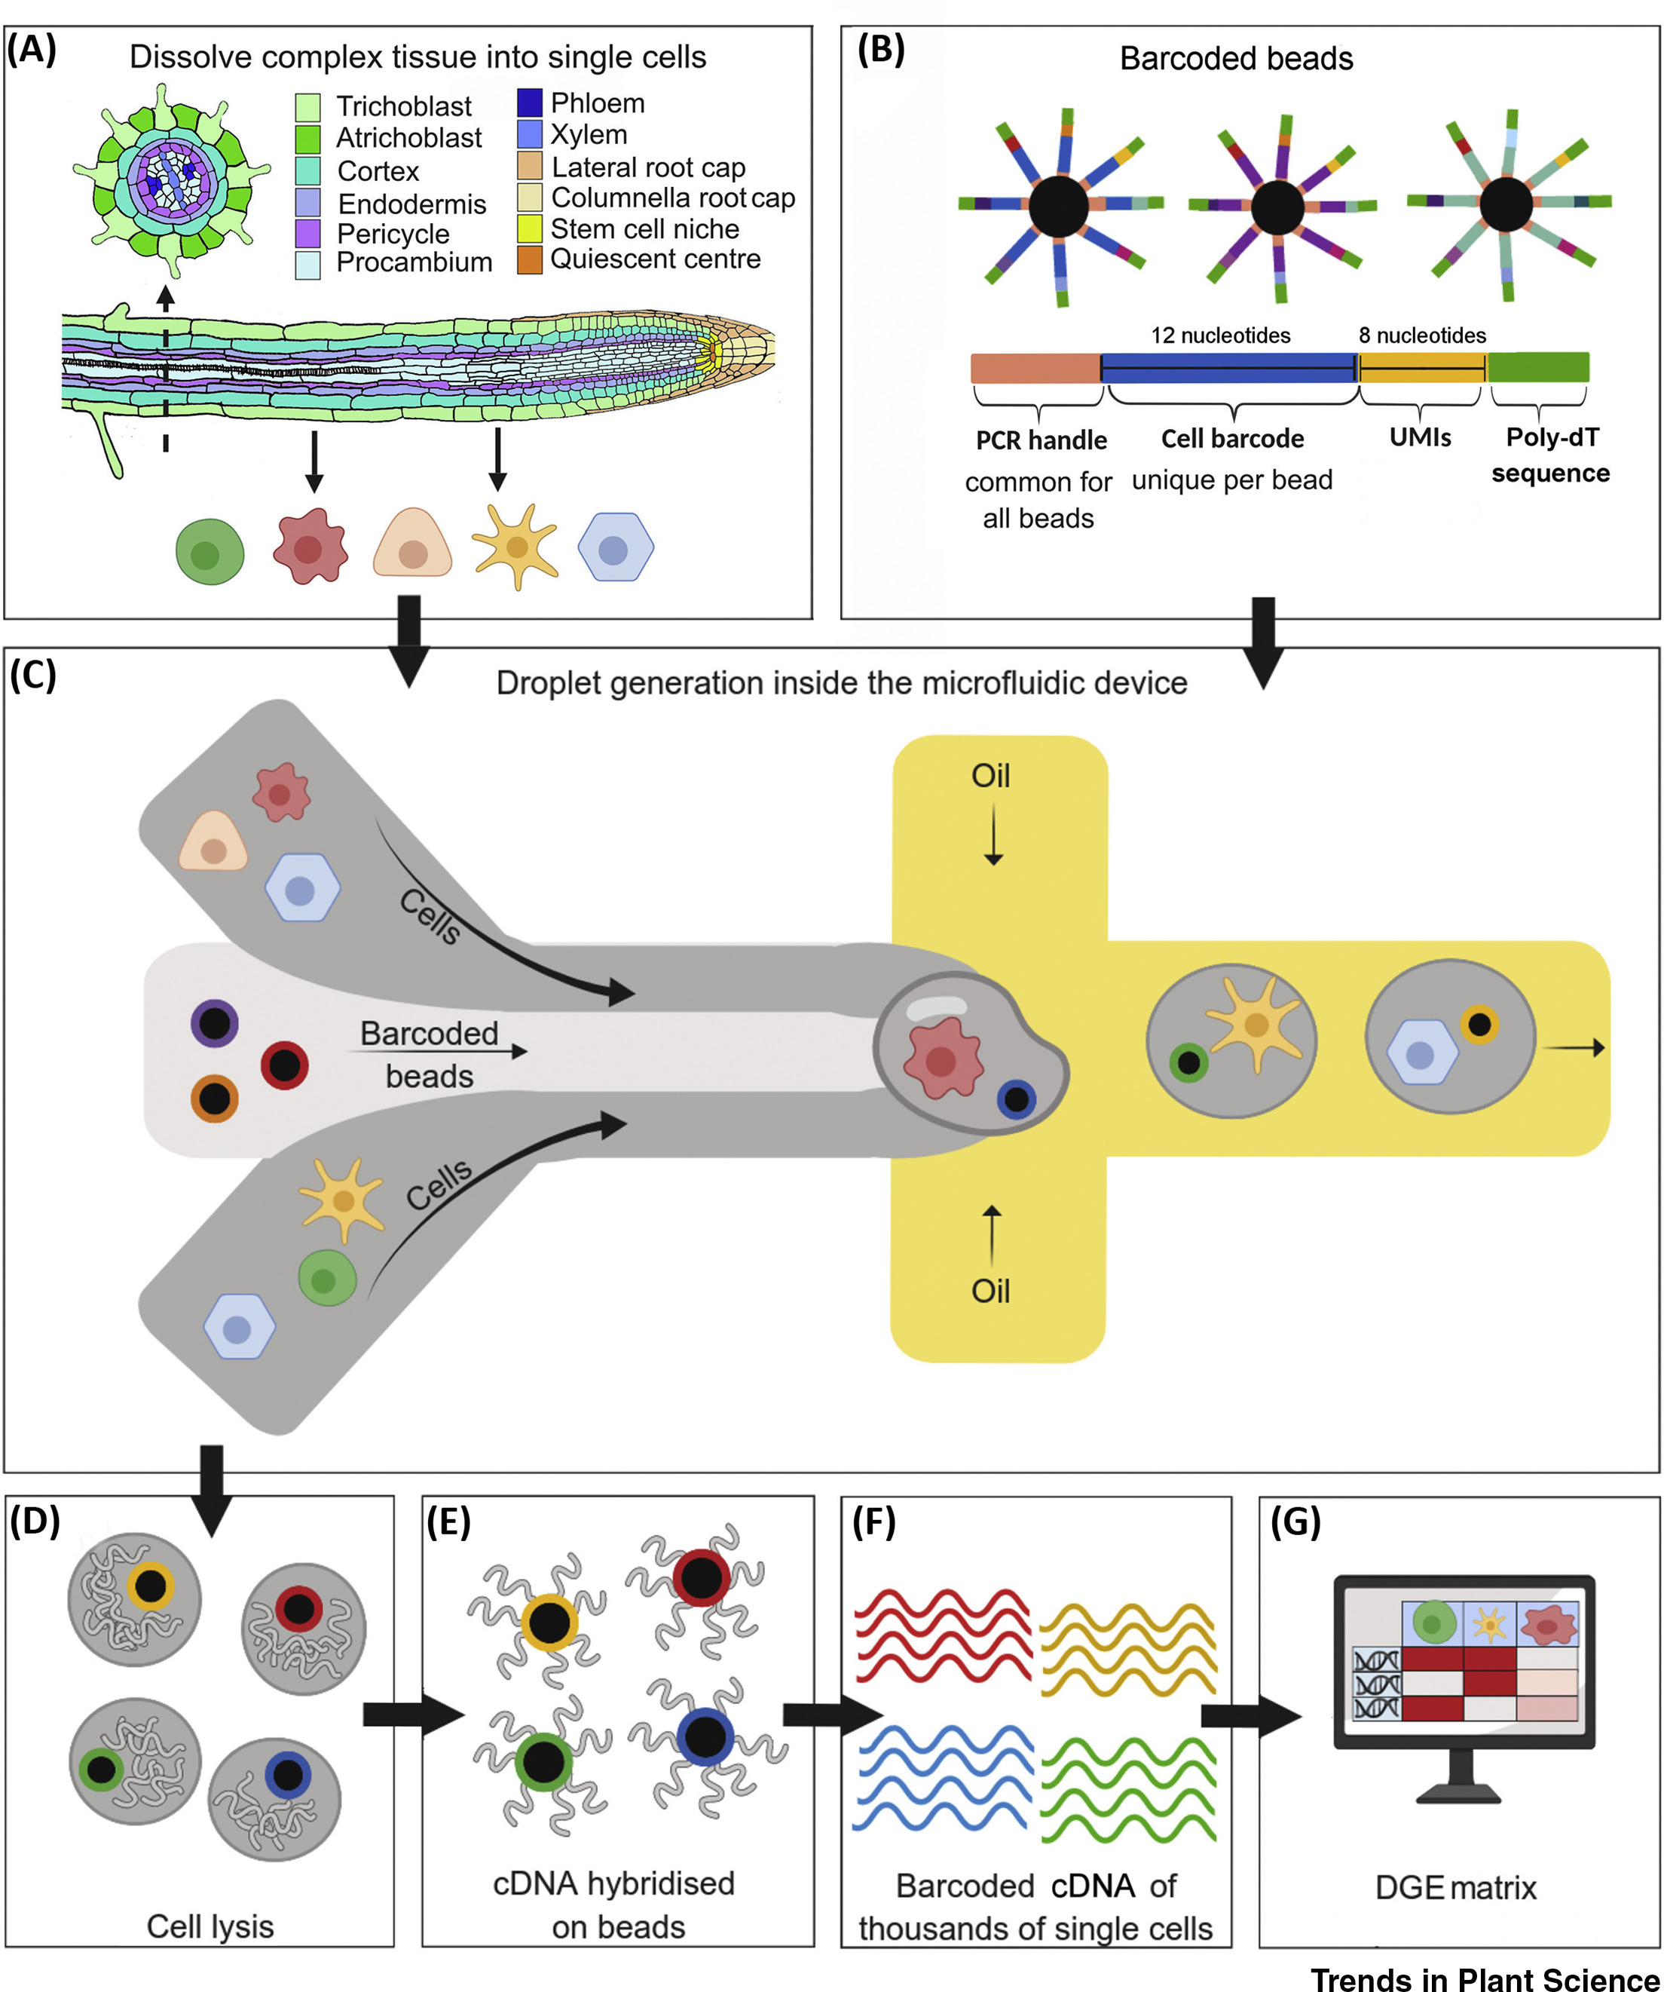

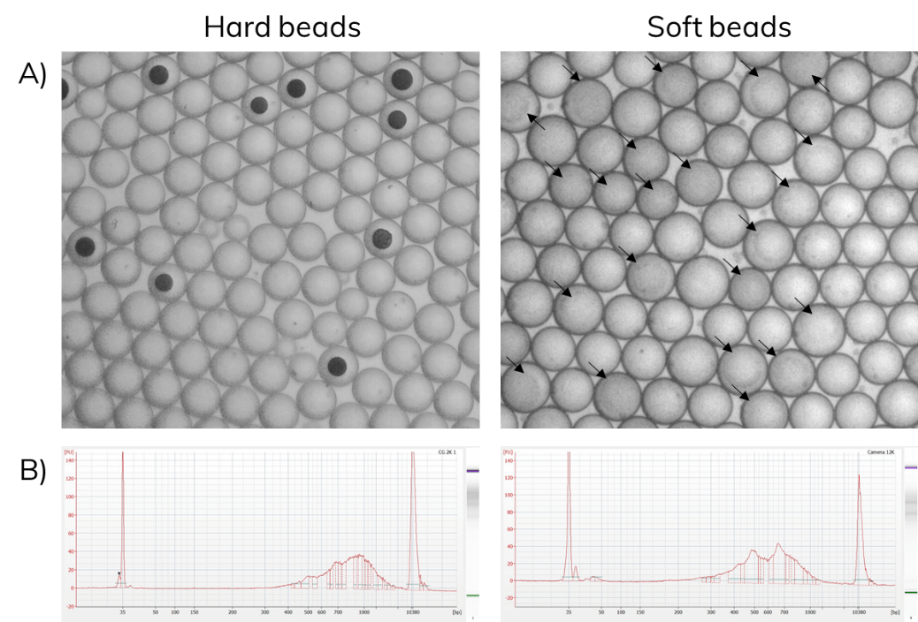
Droplet-based methods
Most commonly used current methods
10x genomics (commercial solution)
Hydrogel beads that dissolves in droplet for uniform distribution of oligos
Drop-seq
Much cheaper than 10x but more complicated to set up
Rich-Griffin et al, Trends in Plant Science, 2019

Slide 15
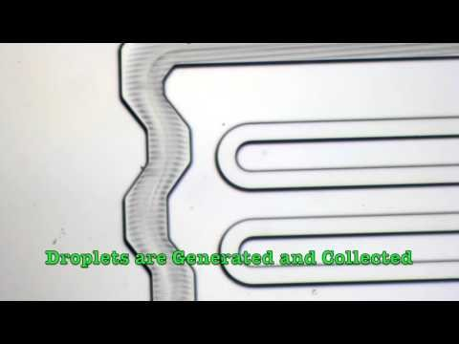
Droplet-based methods
Also, this video

Slide 16
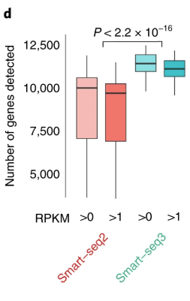
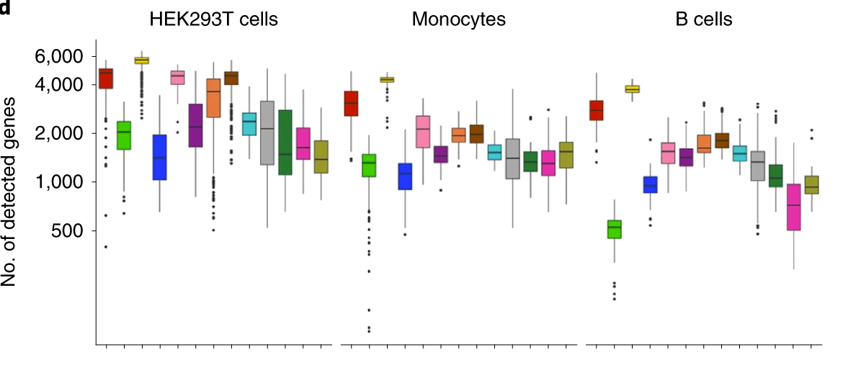
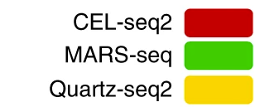
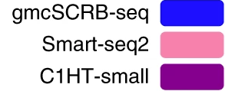

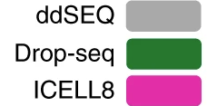


Which protocol to use?
***
***
**
**
***
***
***
***
**
**
*** Very sensitive methods
***
**
**
***
Mereu et al, Nat. Biotech, 2020

Slide 17
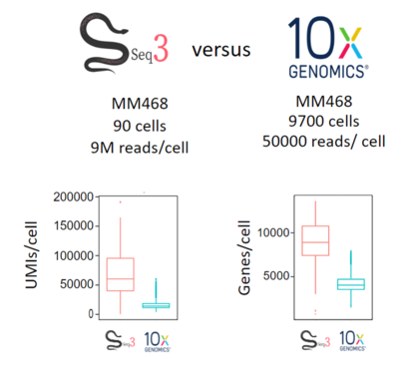
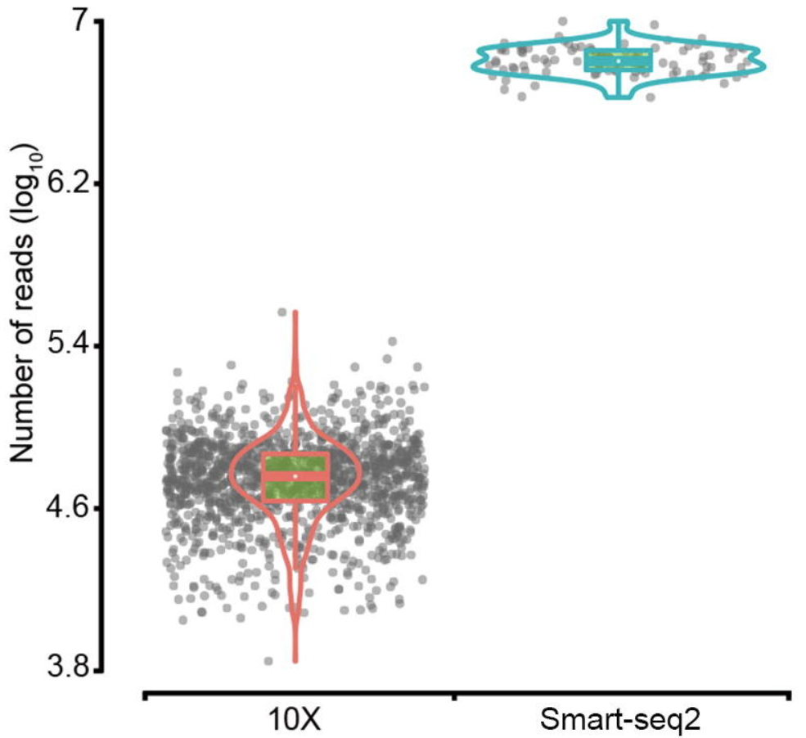
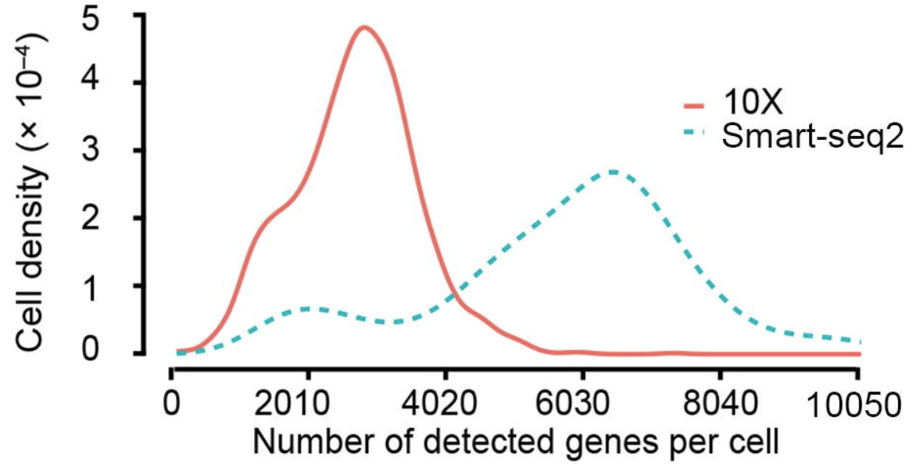
Which protocol to use?
Currently, there are two main protocols that are used:
10x
Smart-seq2 / Smart-seq3
Why using Smart-seq3?
Adapted for low cell numbers (from ~100)
More sensitive than 10x
X. Wang, Y. He, et al, Genomics, Proteomics & Bioinformatics, 2021

Slide 18
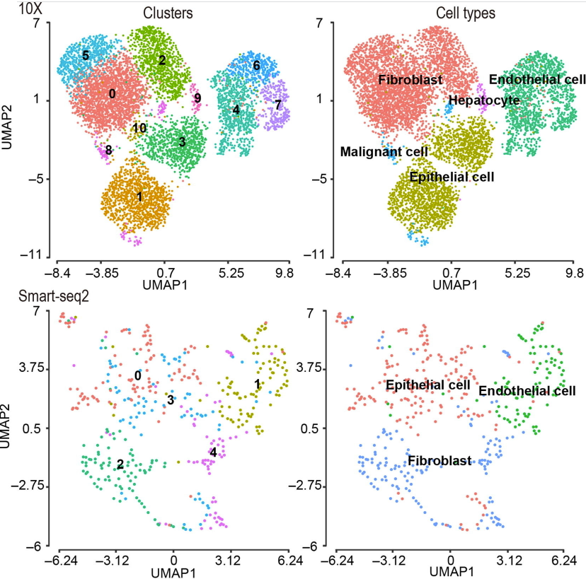
Which protocol to use?
Currently, the decision is a trade-off between sensitivity and number of cells
Smart-seq is the most sensitive and can process low RNA amounts and low cell numbers / 10x is more accessible & can process more cells
Pros of using Smart-seq3:
No limit on cell size
No need to keep fresh cells for transport
Full-length transcript information
Cheaper for small-sample sizes
Cons:
Limited number of cells (96- or 384-well plates)
Cell isolation through FACS sorting (or laser microdissection)
Labor-intensive sample prep.
The more cells you study, the better you are able to find and characterize sub populations
X. Wang, Y. He, et al, Genomics, Proteomics & Bioinformatics, 2021

Slide 19
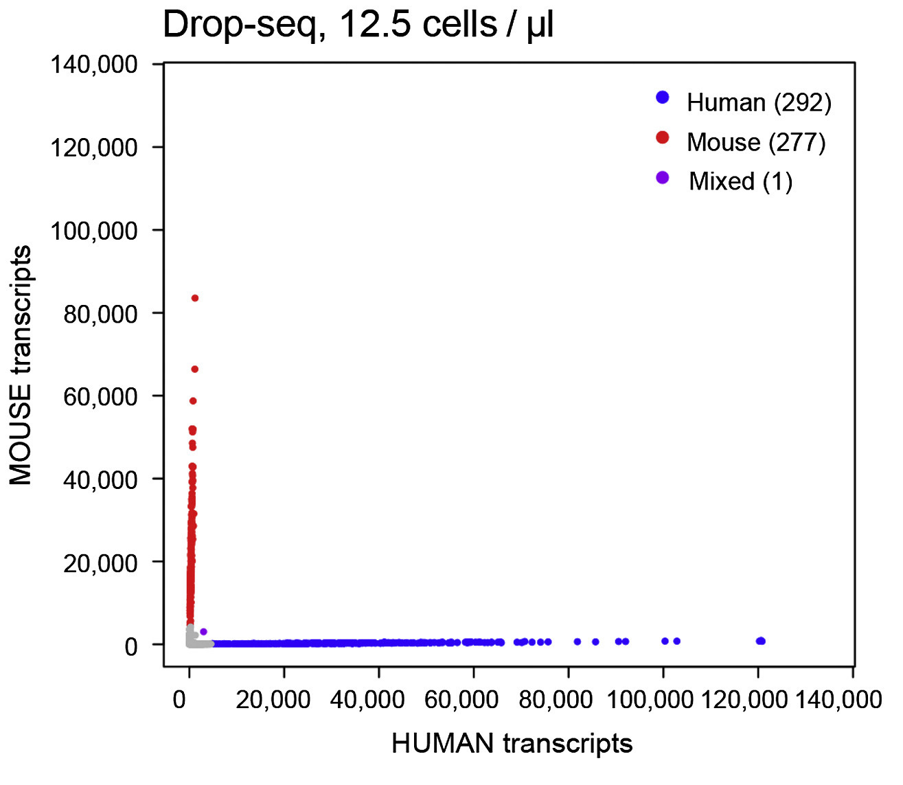
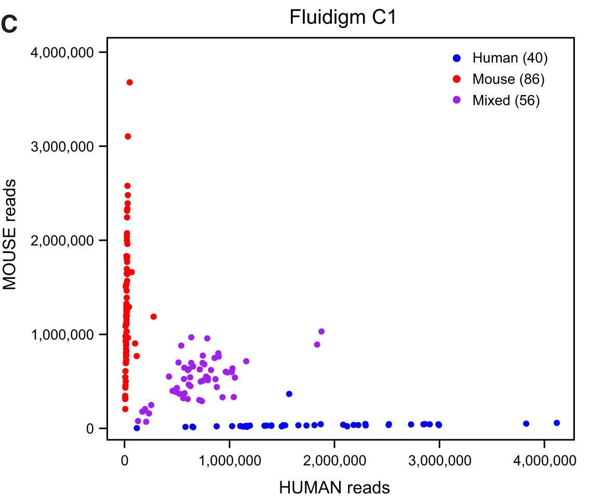
Single-cell RNA-seq, really single-cell?
Cell doublets can be assessed by species-mixing experiments
High rate (~ 40% of total) of duplicate cells in Fluidigm C1 experiments (medium chip)
sequences from both
mouse and human genome
in the same “cell”
Macosko … McCarroll Cell 2015

Slide 20
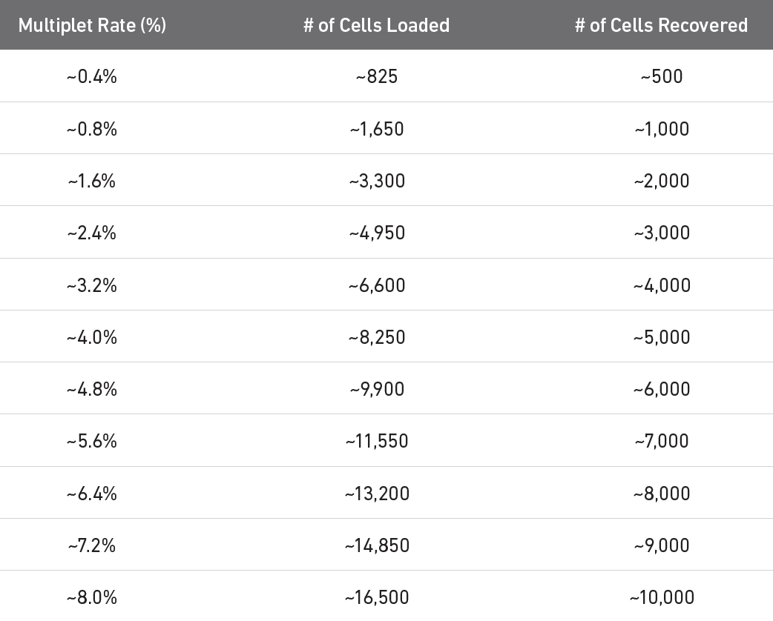
How many cells can be profiled? Doublet rate?
The multiplet rate depends on the number of loaded cells
The number of loaded cells needs to be adjusted towards the desired number of recovered cells
Usually, good range of action
https://kb.10xgenomics.com/hc/en-us/articles/360001378811-What-is-the-maximum-number-of-cells-that-can-be-profiled-

Slide 21
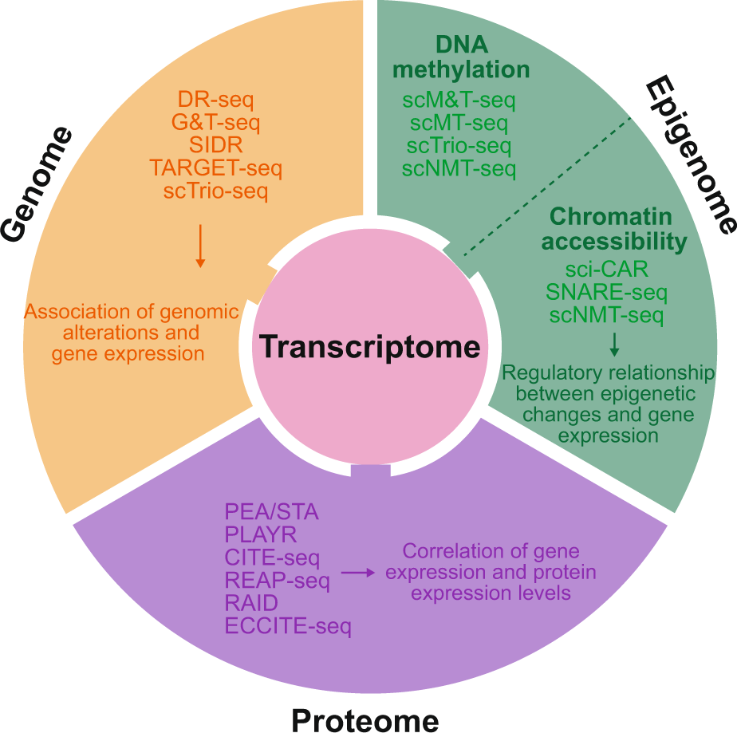
Single-cell multiomics
Single-cell protocols can now assess different genomic layers
DNA methylation
Chromatin accessibility
Proteome
Genome
Some can even be combined in the same cell (multiomics)
DNA & RNA: DR-seq and G&T-seq
Methylation & RNA: scM&T-seq
Chromium single-cell Multiome ATAC + RNA expression
Lee et al, EMM, 2020

Slide 22
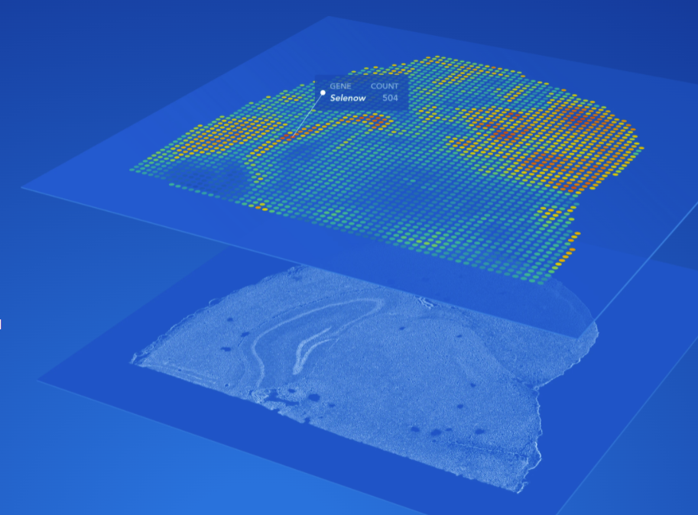
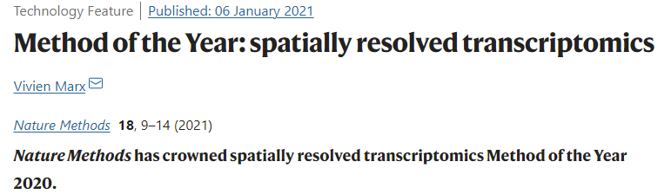

Spatial transcriptomics
Now becomes more and more accessible (commercialized through 10x)
This is not really single-cell anymore (using bins, i.e. multiple cells per bin)

Slide 23
Single-cell biology challenges
Cell Capture
Throughput, automation, cell stress, etc.
Technical variability across cells and samples
Small quantities
Obtain enough material for an accurate readout without introducing biases
Low depth of sequencing per cell (zero-inflated data)
Amplification requires many more cycles than bulk methods
Data analysis and interpretation
Sparseness, noise, high dimensionality, batch effect, doublets, ambient RNA contamination, etc.
Gene ‘dropouts’ in which a gene is observed at a moderate expression level in one cell but is not detected in another cell

Slide 24
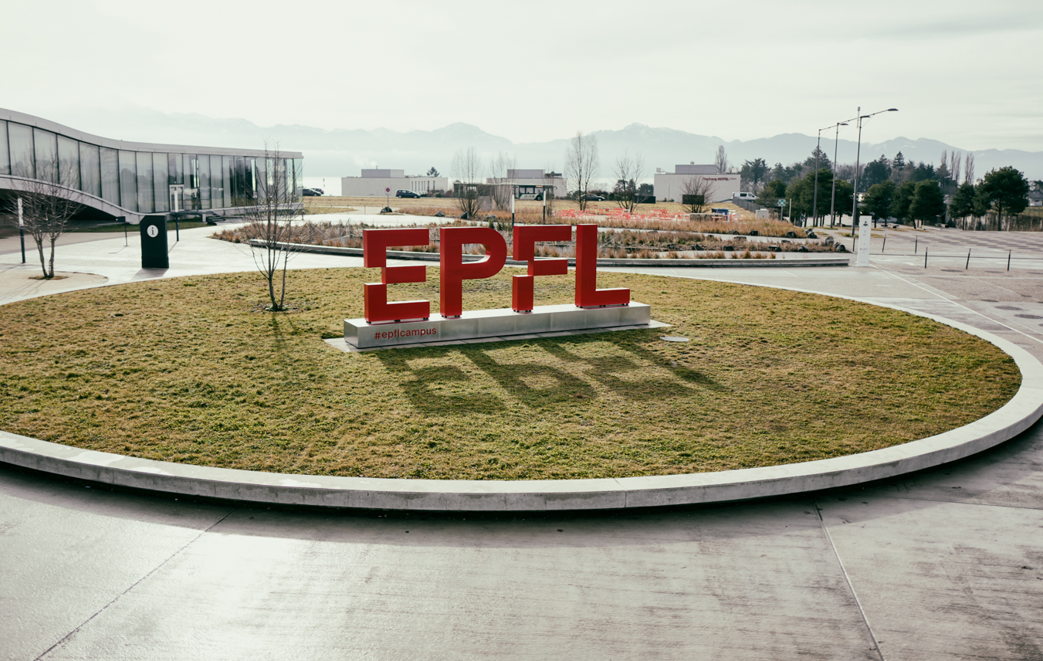
Questions?
Vincent Gardeux

