Slide 1
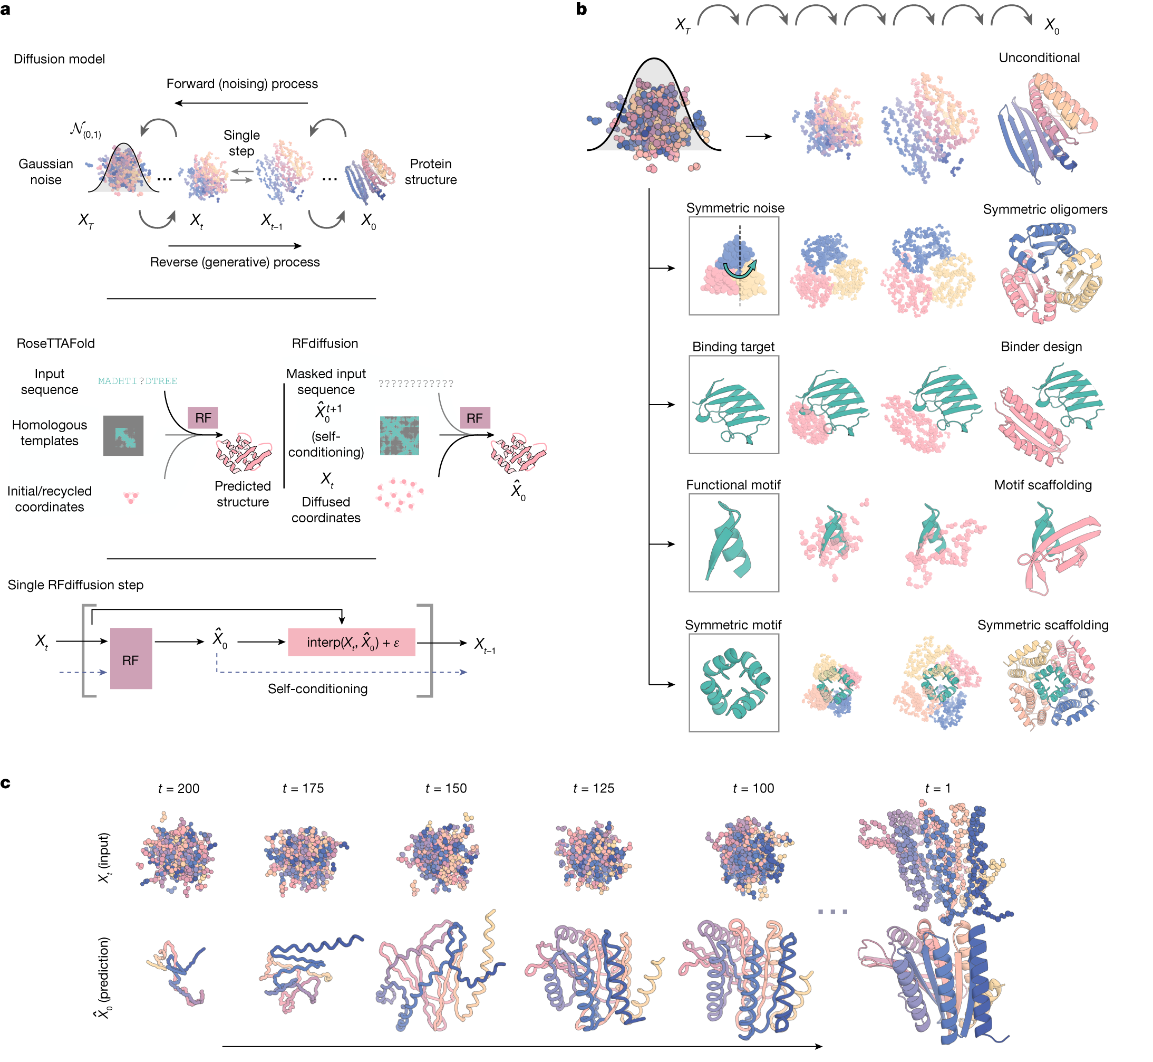
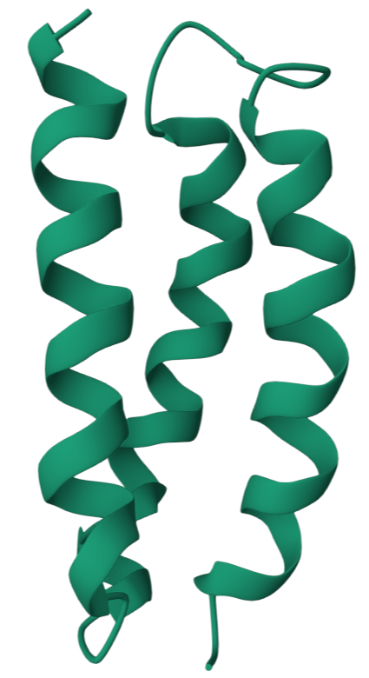
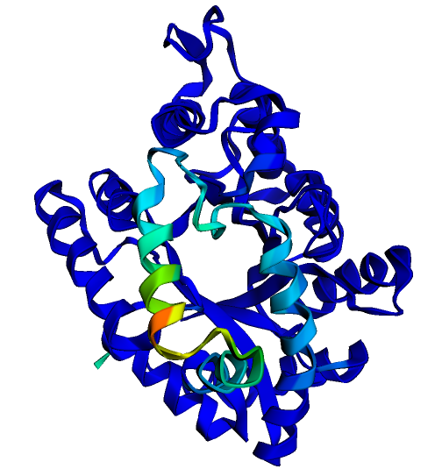
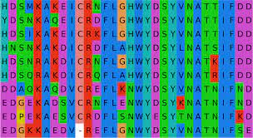
RFdiffusion
ESM
M P X K D R Y A X E
Protein Language Model
e
m
b
e
d
d
i
n
g
s
M P T K D R Y A G E
P(structure)
P(sequence)
P(sequence|structure)
P(structure|sequence)
HDSMKAKEI……TTFDD
MGSWAEFKQRLAAIKTRLQALGGSEAELAAFEKEIAAFESELQAYKGKGNPEVEALRKEAAAIRDELQAYRHN
MSA
ProteinMPNN
AlphaFold2&3
Notes:
These tools approach protein design problems from distinct angles. Diffusion-based protein generation frameworks excel at producing high-quality backbone structures, seeking to maximize the likelihood of a protein structure. ProteinMPNN focuses on maximizing the likelihood of a protein sequence given a structure. Protein language models, on the other hand, are instrumental in evaluating the quality of sequences, aiming to maximize the probability of a given protein sequence. AlphaFold2 excels in predicting protein structures from sequences, essentially maximizing the probability of a structure given a sequence. This diverse array of tools has given rise to a new paradigm in the protein design pipeline: We first use Diffusion-based tools to generate highly probable structures with desired properties. ProteinMPNN and other graph-based models for populating these structures with sequences. Optionally, protein language models can be employed to assess the quality of sequences. AlphaFold2 enters the pipeline for ultimate structure prediction validation. By cumulatively optimizing the probability from different angles, the success rate of design can be improved in silico.
1

Slide 2
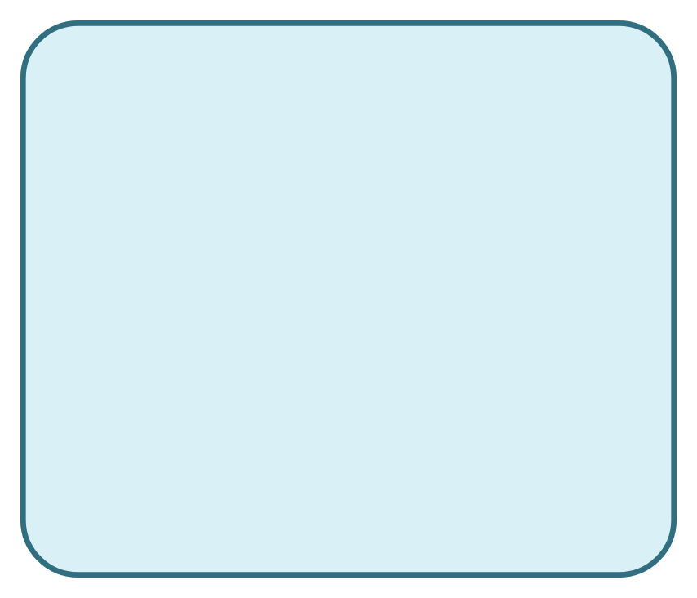
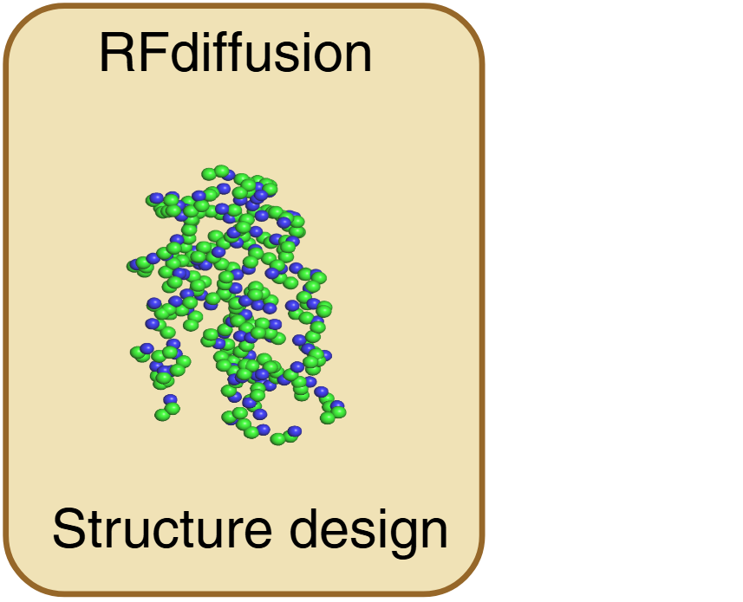


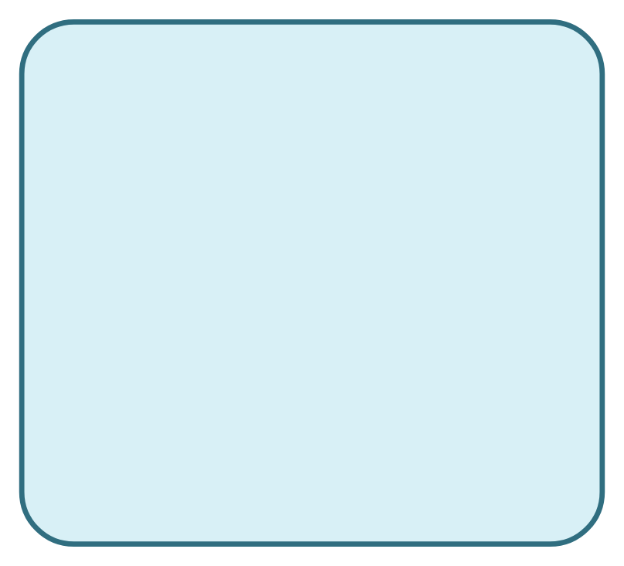
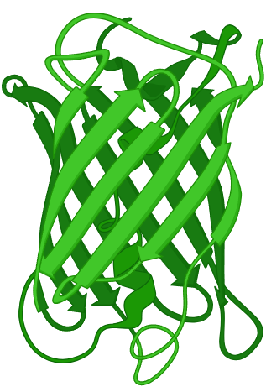

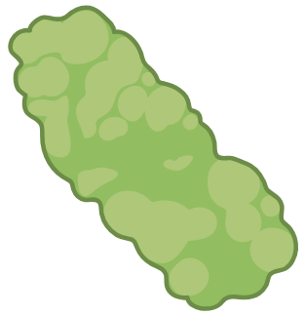


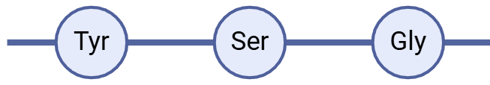


Input
ProteinMPNN
AlphaFold2
Output
Protein target
Sequence assignment
Structure prediction
Putative protein designs

Slide 3
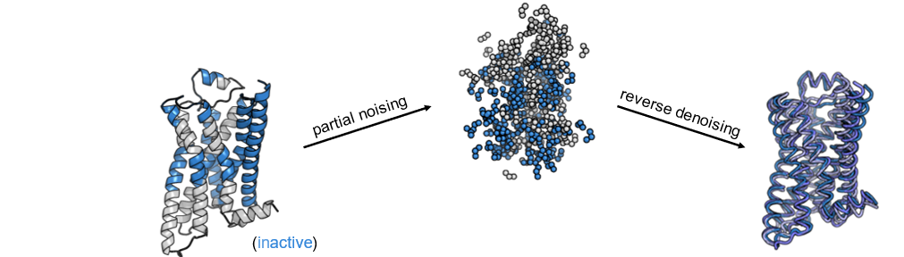
Binder design
Motif scaffolding
Partial diffusion

Slide 4
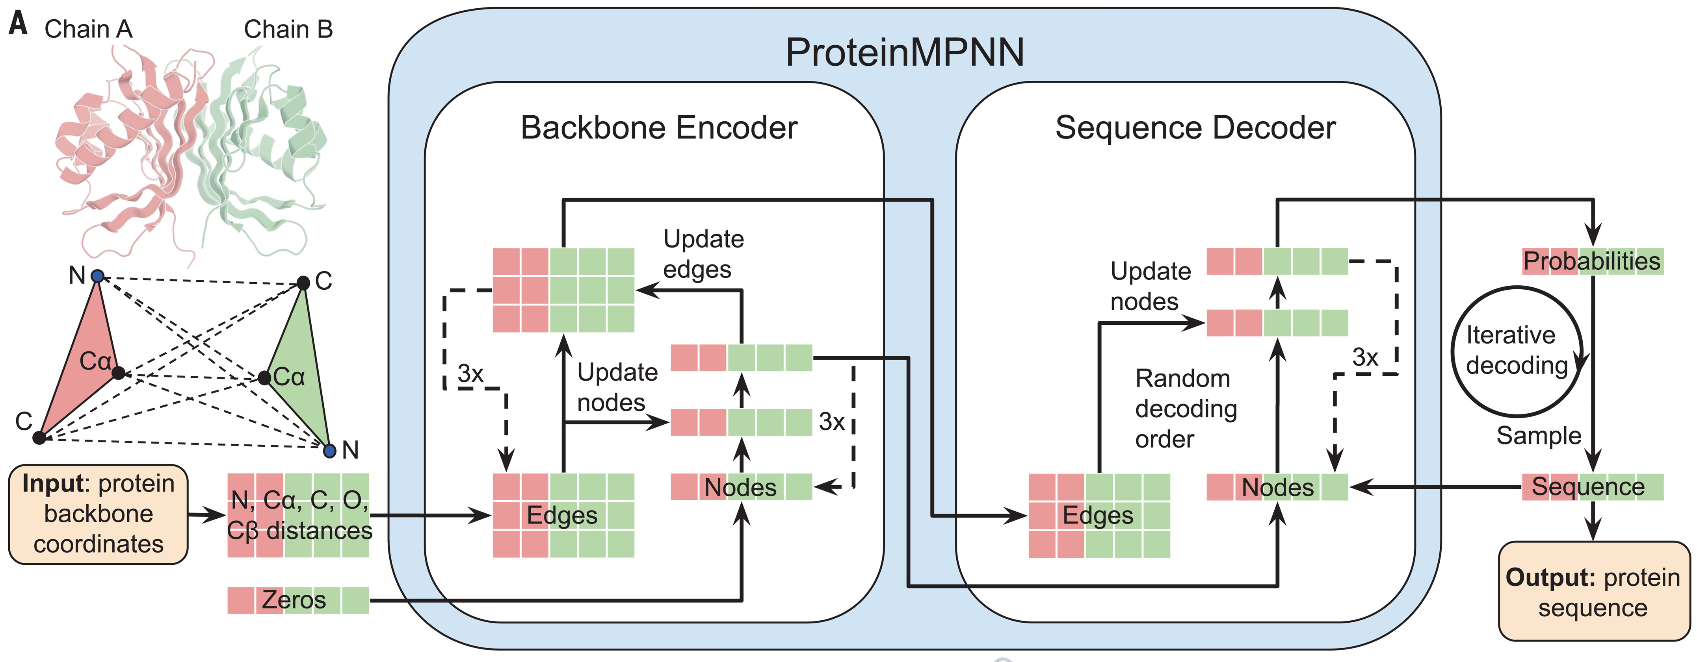

Slide 5
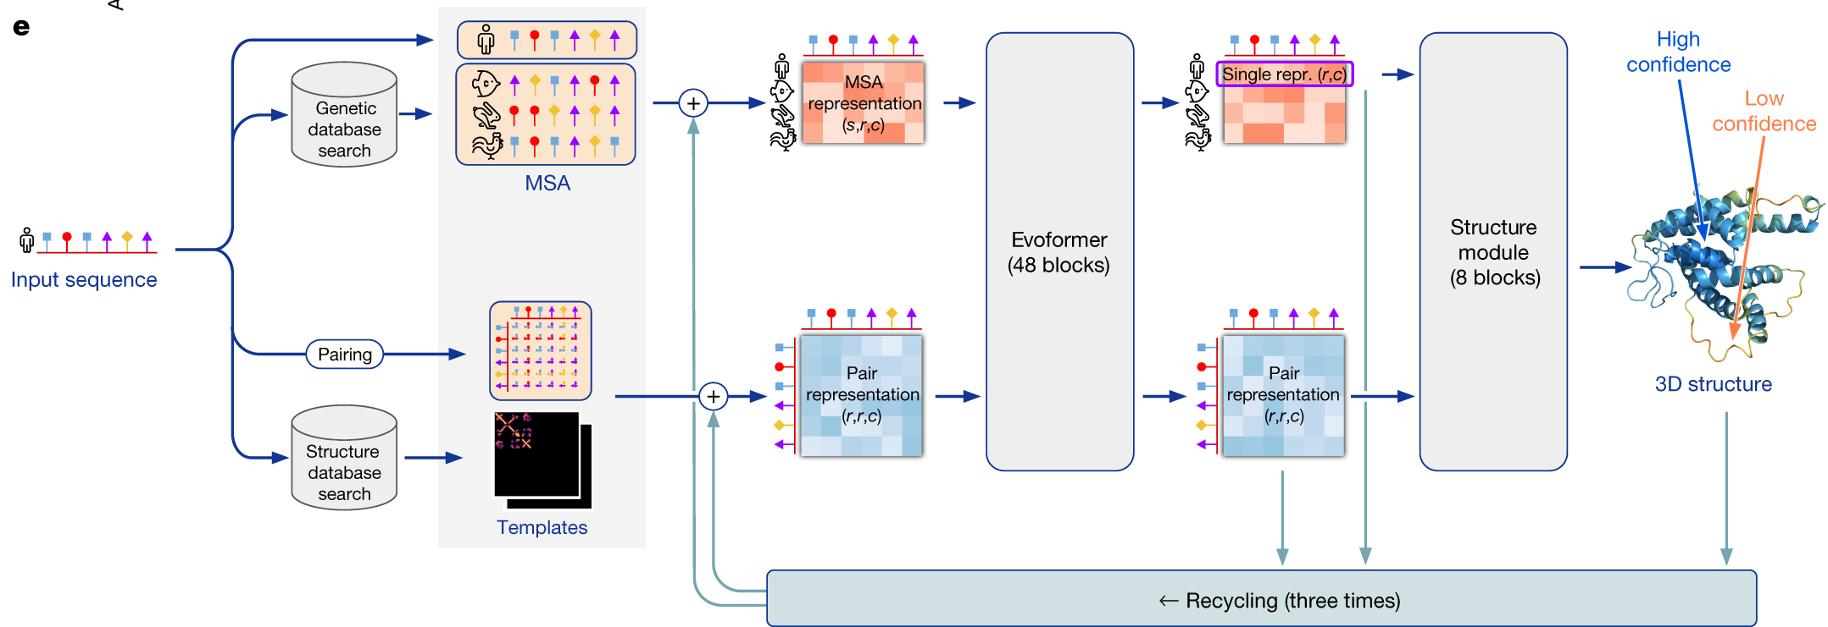
AlphaFold2&3

Slide 6
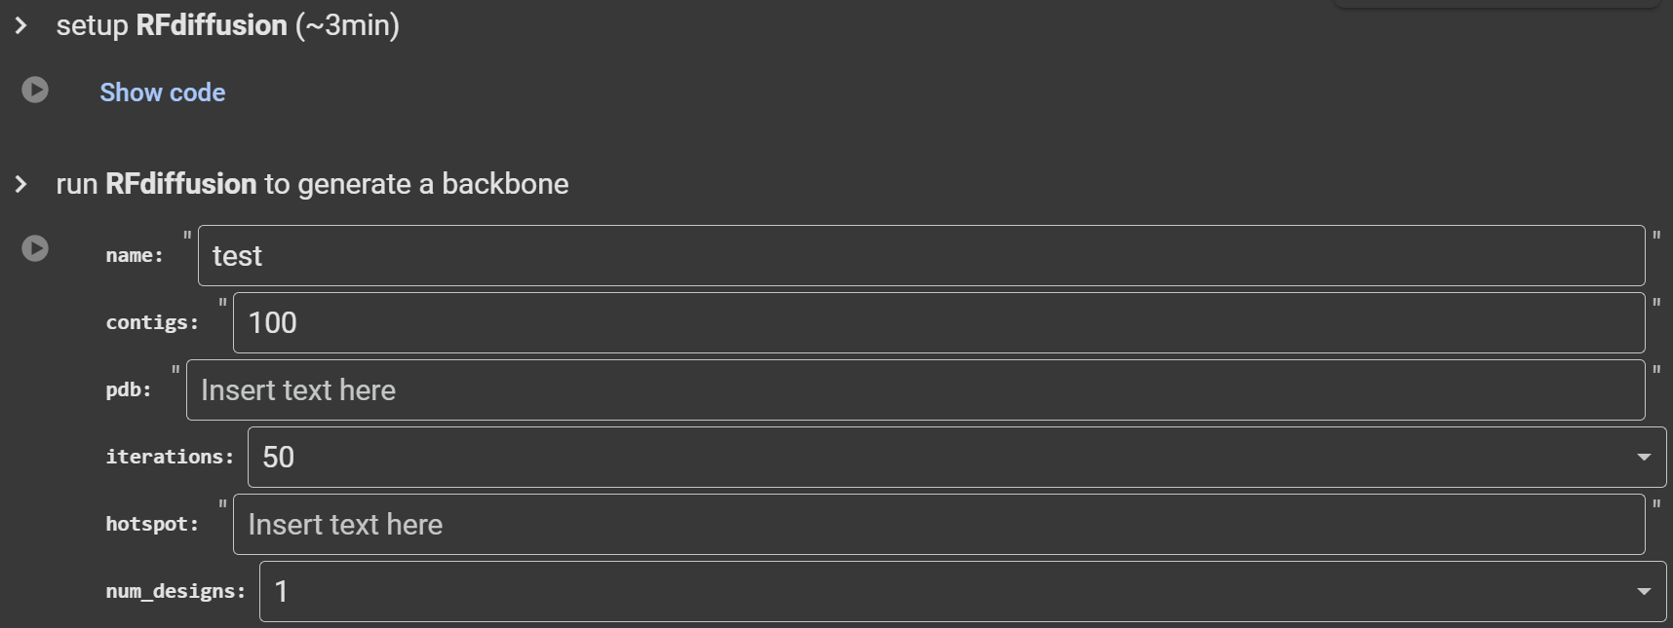
https://colab.research.google.com/github/sokrypton/ColabDesign/blob/v1.1.1/rf/examples/diffusion.ipynb
Google: ColabDesign RFdiffusion

Slide 7
Leave blank. You will be asked to provide a pdb file after running this cell.
If you do binder design
binder design
contigs='A:50' pdb='4N5T' - diffuse a binder of length 50 to chain A of defined PDB.
contigs='E6-155:70-100' pdb='5KQV' hotspot='E64,E88,E96' - diffuse a binder of length 70 to 100 (sampled randomly) to chain E and defined hotspot(s).
motif scaffolding
contigs='40/A163-181/40' pdb='5TPN'
contigs='A3-30/36/A33-68' pdb='6MRR' - diffuse a loop of length 36 between two segments of defined PDB ranges.
partial diffusion
contigs='' pdb='6MRR' - noise all coordinates
contigs='A1-10' pdb='6MRR' - keep first 10 positions fixed, noise the rest
contigs='A' pdb='1SSC' - fix chain A, noise the rest

Slide 8
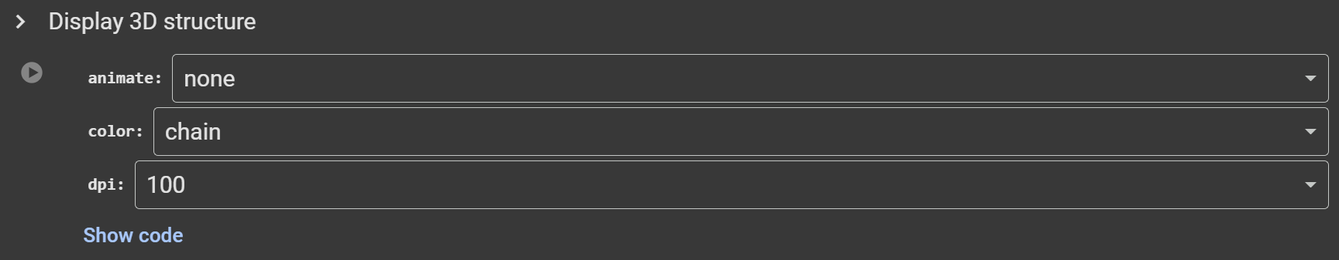

Slide 9
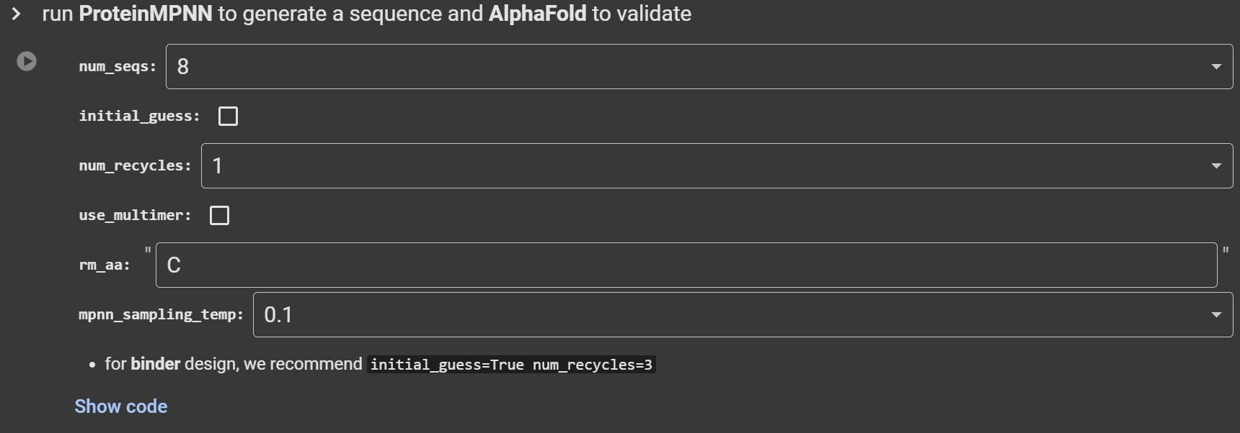
Higher: longer time to run & better chance to obtain good seq
Tick to use design template to help structure prediction
Higher: longer time to run & better folding of seq
Tick if your protein has two chains
Remove cystine in your design to avoid experimental issue
Higher: more randomness & diversity in your seq

Slide 10
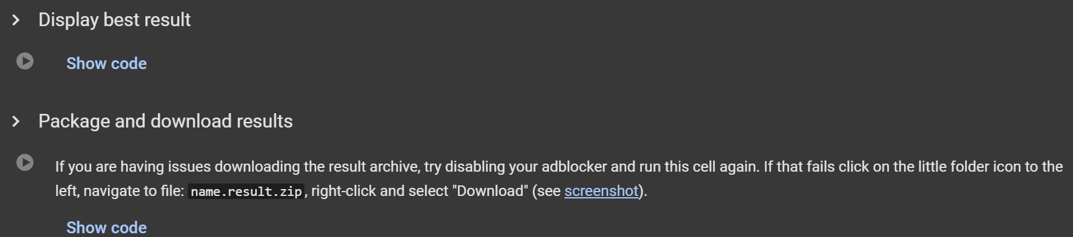

Slide 11
Example score output
design:0 n:0 mpnn:1.411 plddt:0.833 ptm:0.846 pae:5.731 rmsd:0.648
design:0 n:1 mpnn:1.394 plddt:0.844 ptm:0.851 pae:5.658 rmsd:0.663
design:0 n:2 mpnn:1.414 plddt:0.832 ptm:0.849 pae:5.575 rmsd:1.005
design:0 n:3 mpnn:1.427 plddt:0.849 ptm:0.854 pae:5.520 rmsd:0.556
design:1 n:0 mpnn:1.346 plddt:0.834 ptm:0.846 pae:5.653 rmsd:0.632
design:1 n:1 mpnn:1.298 plddt:0.832 ptm:0.845 pae:5.612 rmsd:0.656
design:1 n:2 mpnn:1.332 plddt:0.835 ptm:0.847 pae:5.553 rmsd:0.629
design:1 n:3 mpnn:1.276 plddt:0.834 ptm:0.846 pae:5.649 rmsd:0.646
plddt ↑ ptm ↑ pae ↓ rmsd ↓

