Slide 1

Synthetic Biology (BIOENG-320)
Session 1
PyMOL Tutorial

Slide 2
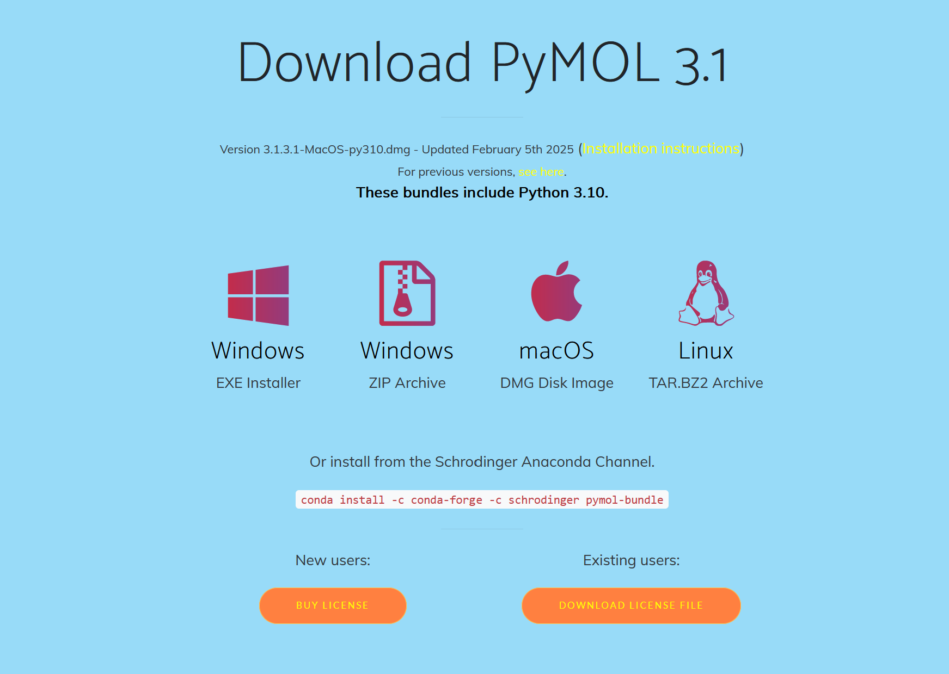
PyMOL – Biomolecule visualizer
https://www.pymol.org/

Slide 3
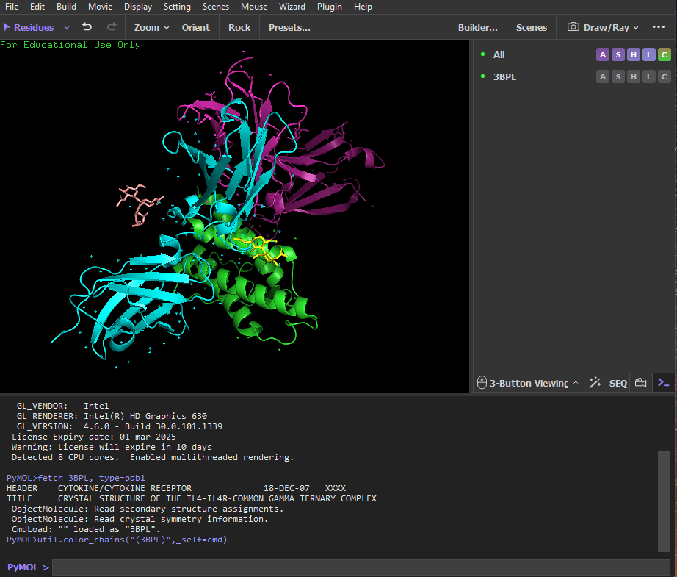
PyMOL – Biomolecule visualizer
Visualizer: Main Window
Object Panel
Command line

Slide 4
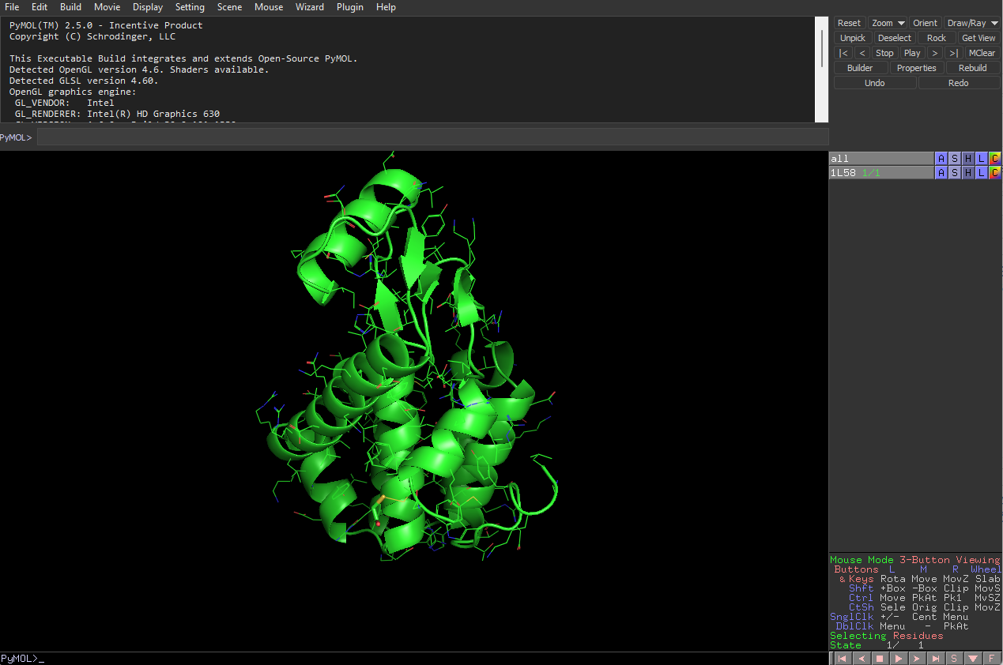
PyMOL – Biomolecule visualizer (PyMOL 2)
Object Panel
Command line
Visualizer: Main Window

Slide 5
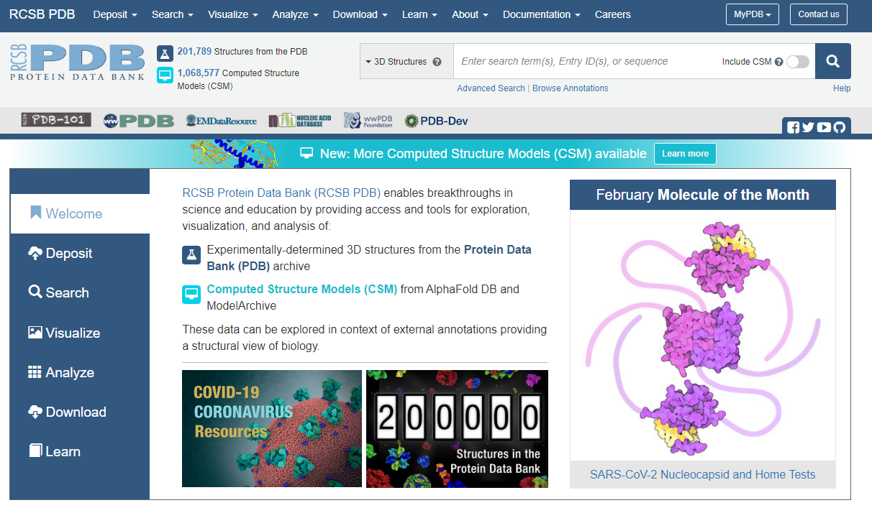
PDB: Protein Data Bank
PyMOL reads .pdb files downloaded from the Protein Data Bank website.
Structures obtained from:
X-ray crystallography
NMR
Cryo-EM
https://www.rcsb.org/

Slide 6
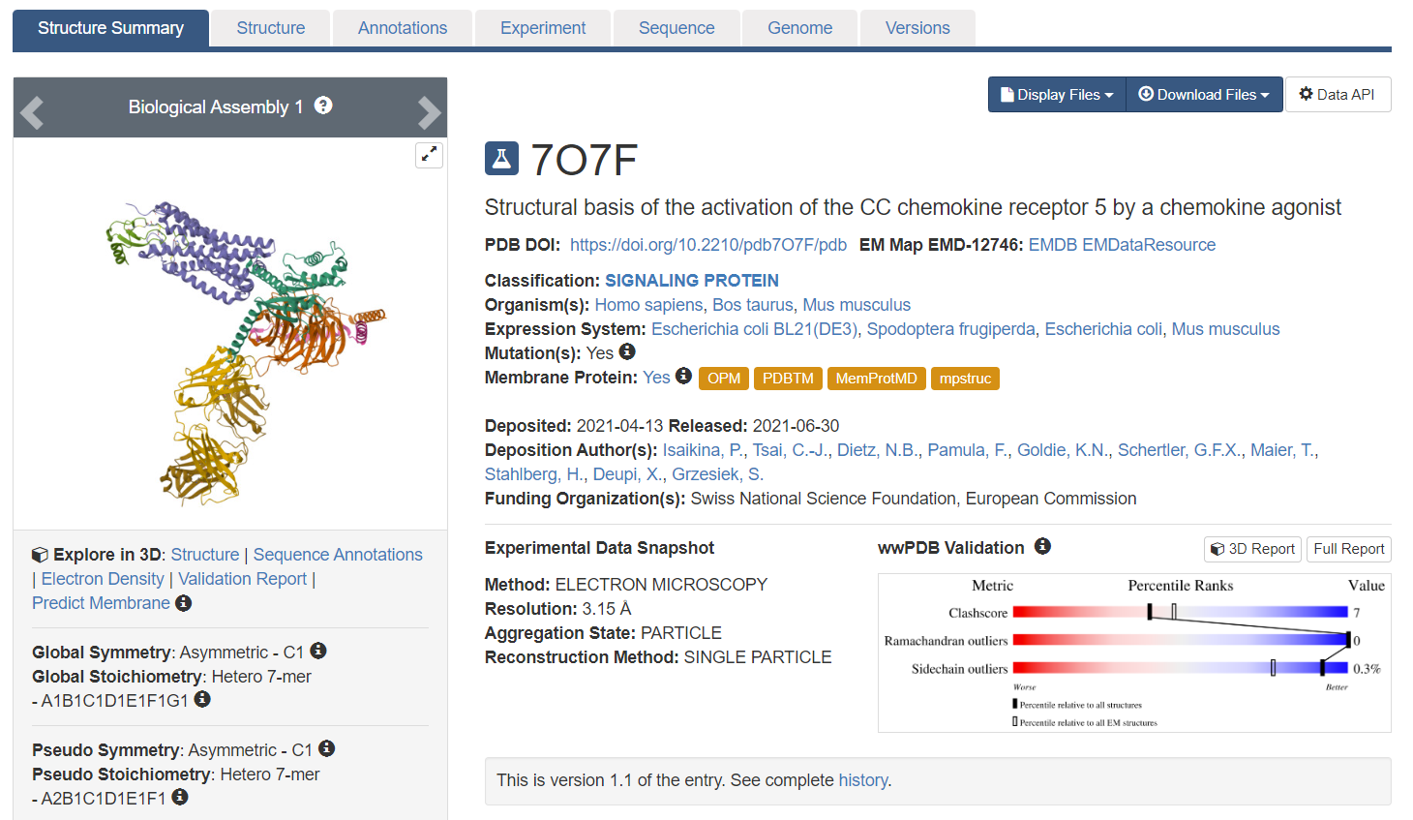
Download PDB to PyMOL
Two options:
Download the .pdb to your computer and open file from pymol
Use fetch on command line
fetch 7O7F

Slide 7
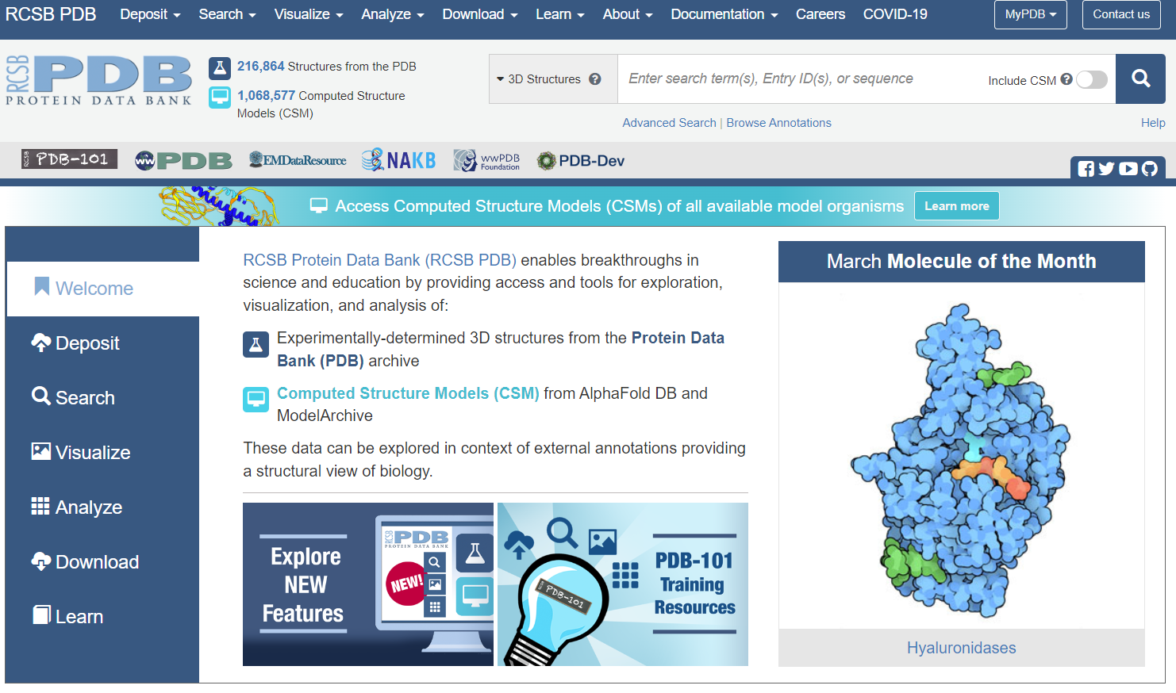
How to use PDB
Go to the protein data bank (https://www.rcsb.org/)
Search for your protein (complex) of interest with the search bar. You can either search by keywords (for example chemokine receptor CCR5), or by PDB-ID (for example 7O7F).

Slide 8
How to use PDB
Once you open the page for your structure of interest, click on the Sequence tab

Slide 9
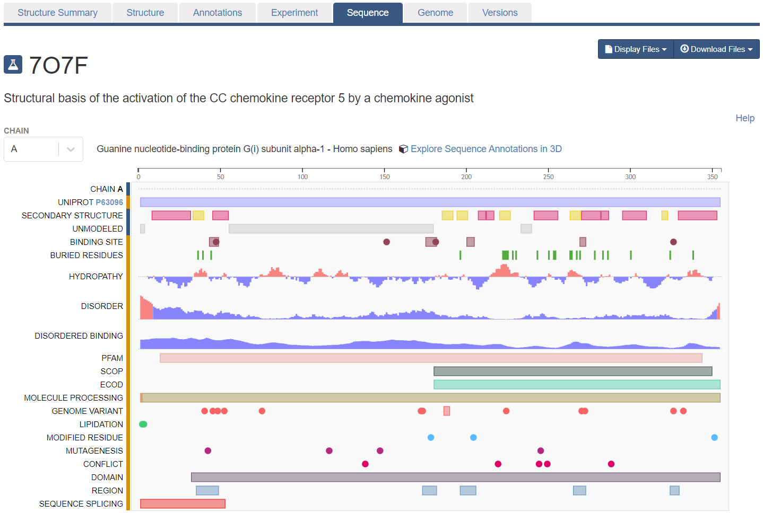
Finding chain in PDB
Click on the Chain button

Slide 10
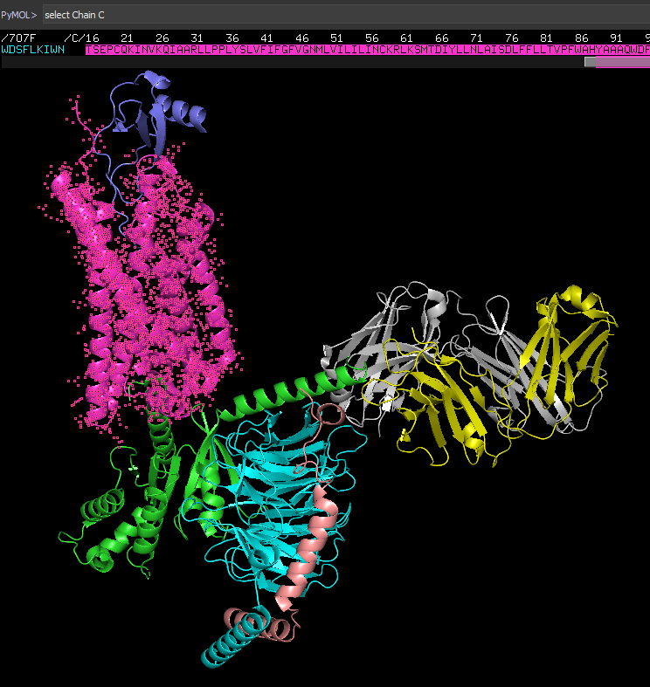
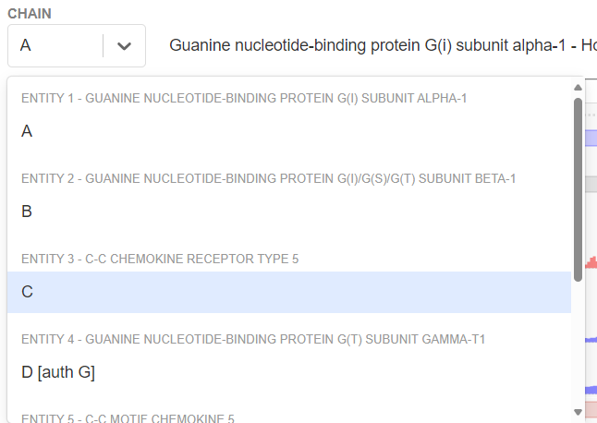
For each chain identity, you will find the corresponding entity (protein).
For example, our chemokine receptor CCR5 would correspond to chain C
Open the PDB in pymol 🡪 Display sequence 🡪 scroll through the sequence until you find chain C (or type select chain C in the command line)

Slide 11
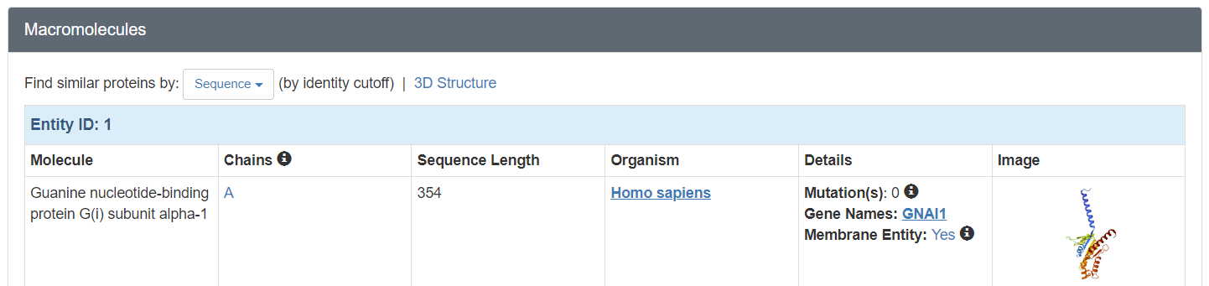
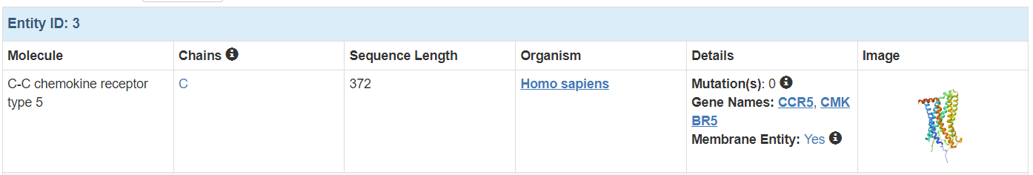
Alternative approach
Stay on the Structure Summary page
Scroll down to the Macromolecules section. For each Entity ID, you will find the description of the Molecule, as well as the corresponding chain

Slide 12
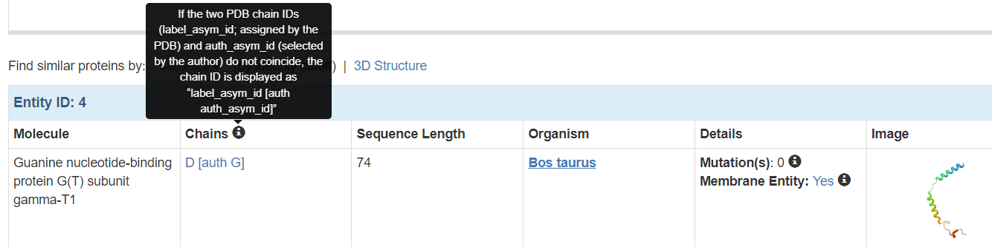
Some caveats with chain identities
The authors that deposit a structure define chain IDs… however, RCSB also automatically assigns a chain ID. Sometimes, the author and PDB chain ID differ. In that case, it is written in the format of /PDB_ID/author_ID, i.e. /D/G/. The “select chain” command will select the author ID. So in the case here, you would need to type select chain G (and not select chain D)

Slide 13
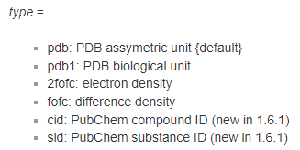
Some caveats with chain identities
Did you know: if you use fetch 7O7F, type=pdb1 instead of fetch 7O7F to load the structure, then you will only see the auth ID displayed in the pymol sequence
Documentation for the fetch command https://pymol.org/dokuwiki/doku.php?id=command:fetch
Asymmetric unit vs biological unit:
https://pdb101.rcsb.org/learn/guide-to-understanding-pdb-data/biological-assemblies

Slide 14
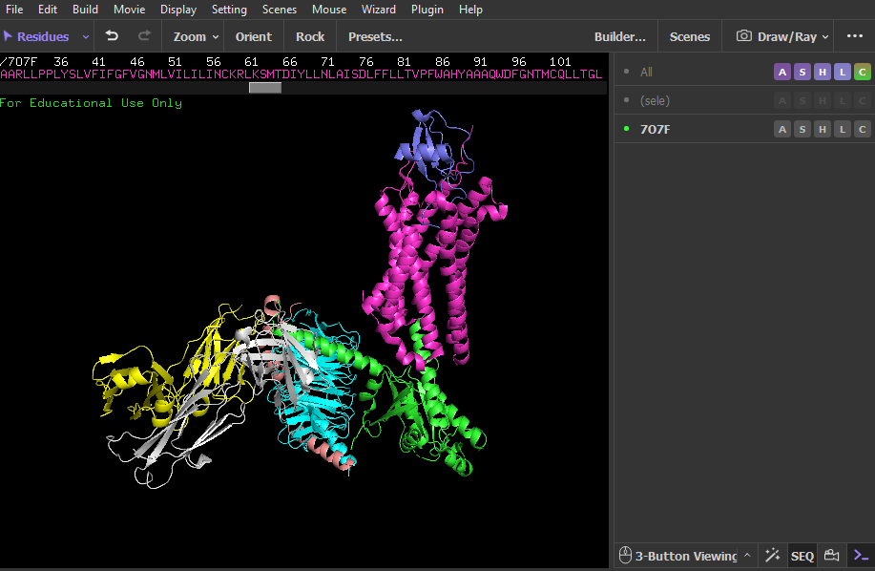
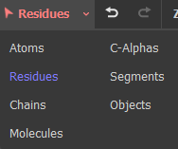
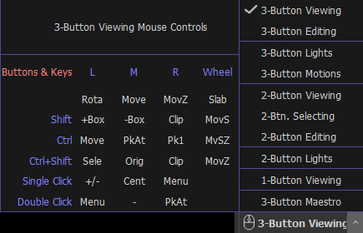
Protein visualization
Here you can change your “selection”, i.e. select individual atoms, residues, chains, molecules etc…
Make sure you stay in 3-Button Viewing mode (don’t go into “editing” mode)

Slide 15
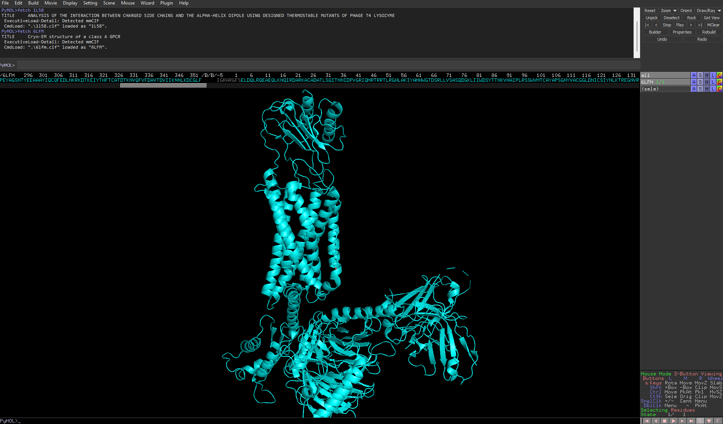
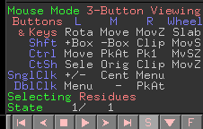
Protein visualization (PyMOL 2)

Slide 16
Protein visualization
Left click: Rotate protein
Right click: zoom in and out
Wheel: reduced opacity
Click with wheel: centers camera on clicked region
CRTL + left click or keeping wheel pressed: move whole protein in space

Slide 17
Protein visualization (PyMOL2)
Left click: Rotate protein
Right click: zoom in and out
Wheel: reduced opacity
Click with wheel: centers camera on clicked region
Ctrl + left click or keeping wheel pressed: move whole protein in space

Slide 18

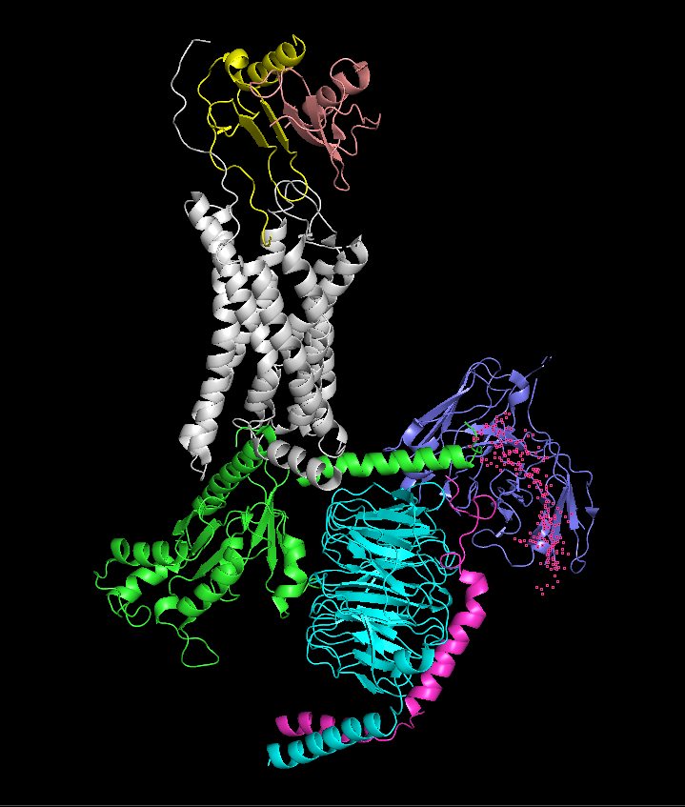
Protein visualization
A – Action. Allows you to perform various actions, analyses and calculations.
S – Show. Allows you to apply a particular graphical effect to a selection of residues/molecules. → show side-chains, backbone etc as stick, spheres, cartoon…
H – Hide. Same as S but hides the graphical effect.
L – Label. Allows you to add a label.
C – Color. Alters the color scheme of particular selection or object.
Let’s change the color of our proteins by chain.
C > by chain (elem C)
remove chain A (try removing all chains except the chemokine receptor and its chemokine ligand)

Slide 19

Protein visualization (PyMOL2)
A – Action. Allows you to perform various actions, analyses and calculations.
S – Show. Allows you to apply a particular graphical effect to a selection of residues/molecules.
H – Hide. Same as S but hides the graphical effect.
L – Label. Allows you to add a label.
C – Color. Alters the color scheme of particular selection or object.
Let’s change the color of our proteins by chain.
C > by chain (elem C)
remove chain A (try removing all chains except the receptor CXCR2 and ligand CXCL8)

Slide 20
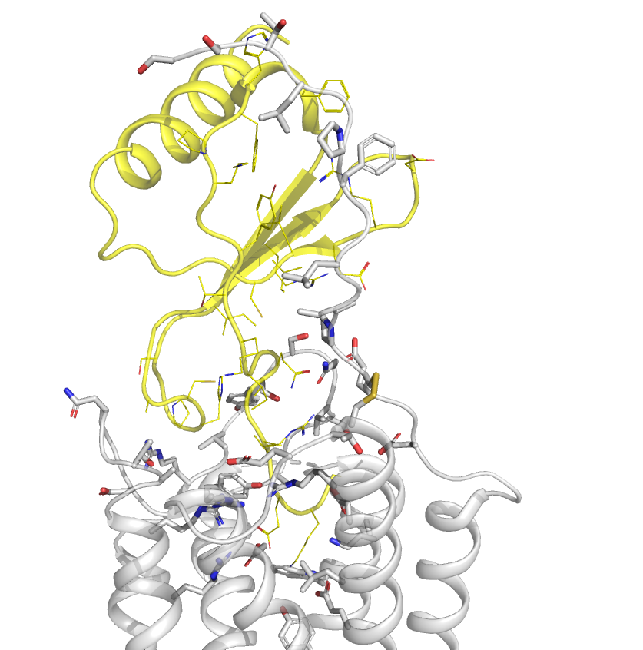
Useful commands
How to select different objects:
select chain A
select resn residuName i.e select resn Glu
select resi residueNumber i.e select resi 230-238
Visualize side chains with commands
show lines/sticks, chain/resn/resi [selection]
hide lines/sticks, chain/resn/resi [selection]
Visualize interacting residues between chains
select chain R within 5 of chain D (try the other way around)
You can save selection by going into Actions> rename selection
Editing the backbone appearance
Play with all available settings to get familiar and see what you like ☺
set cartoon_transparency, 0,3
set cartoon_oval length, 0.7

Slide 21
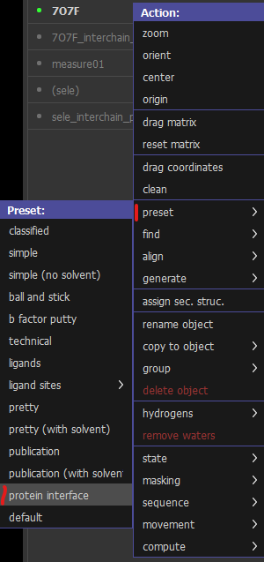
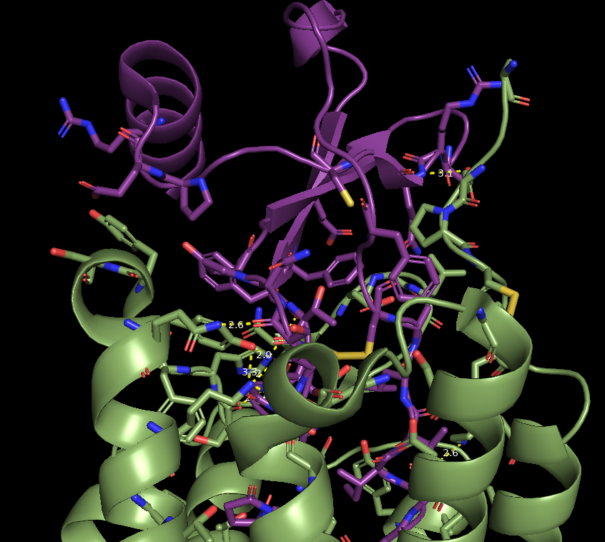
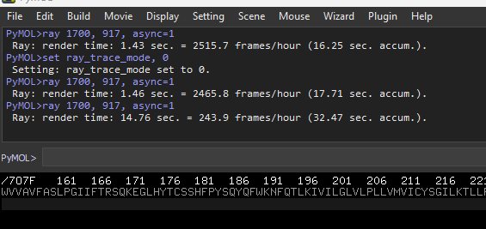
Find key contact in the protein interface
7O7F >Action: find > polar contacts > between chain
What types of interactions can you find?
Explore the find interaction action
it can be helpful to show the residues at the interface as sticks: Action → preset → protein interface
Note: the “Wizard 🡪 measurement” is also useful to measure distances between atoms
Save PDB session!
File>Save Session
Saves as a .pse file

Slide 22
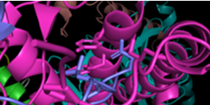
Turning your structure into a representative figure
How not to make figures
bad practice
Low resolution image
Too much irrelevant information in the background
Side-chains not colored by element
Positions not labeled with amino acid & residue number
No context provided (where in the structure are we?)
"…and here we see the interaction of Lys 55 on the receptor with with Asp 17 on the ligand, which is crucial for binding…"

Slide 23
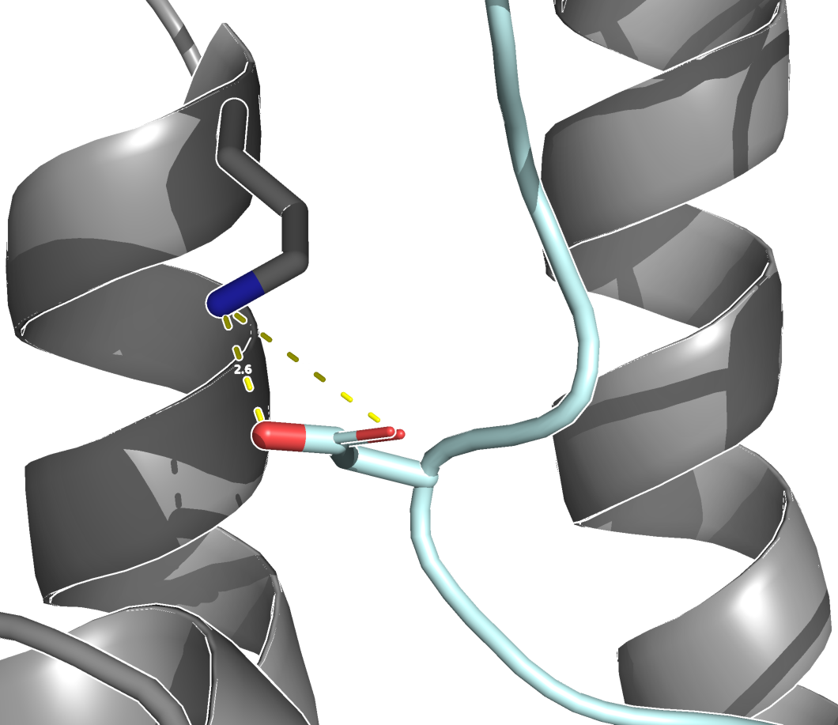
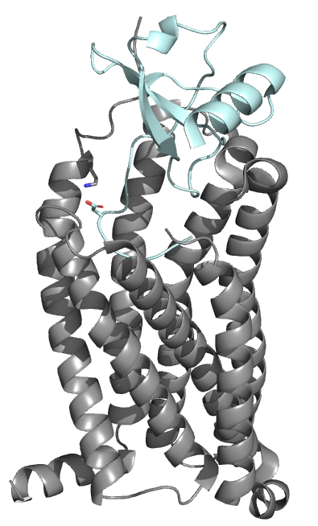
Turning your structure into a representative figure
Much better
Good practice
export high resolution image with transparent background (see next slide)
Exclude irrelevant structural elements from the background (side chains & backbone)
Color side chain by element to facilitate recognition of amino acids
Choose easily distinguishable colors for different protein chains (receptor/ligand)
Add labels (amino acid identity & residue numbering)
Provide context where in the structure we are
K55
Ligand
3.9 Å
D17
Receptor
"…and here we see the interaction of K55 on the receptor with with D17 on the ligand, which is crucial for binding…"

Slide 24
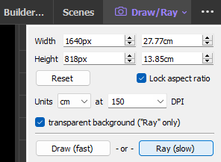
Turning your structure into a representative figure
Export your figure with transparent background: Draw/ray (top right of your screen) 🡪 transparent background 🡪 Ray (slow) 🡪 150 DPI usually gives good enough resolution
Adding labels: While it is possible to add residue number & amino acid identity directly in PyMol, they are usually hard to read. It is recommended to export the figure without labels, and then add the labels in a second step with powerpoint (or other tool where you can add text to images)

Slide 25
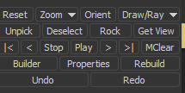
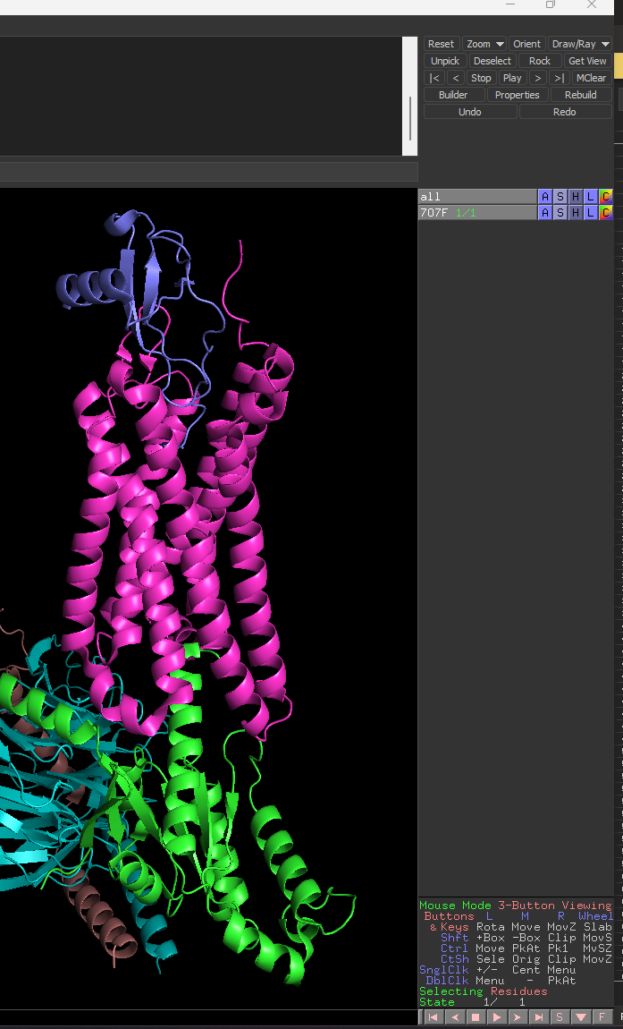
Turning your structure into a representative figure
Export your figure with transparent background: Draw/ray 🡪 transparent background 🡪 Ray (slow) 🡪 150 DPI usually gives good enough resolution
Adding labels: While it is possible to add residue number & amino acid identity directly in PyMol, they are usually hard to read. It is recommended to export the figure without labels, and then add the labels in a second step with powerpoint (or other tool where you can add text to images)

Slide 26
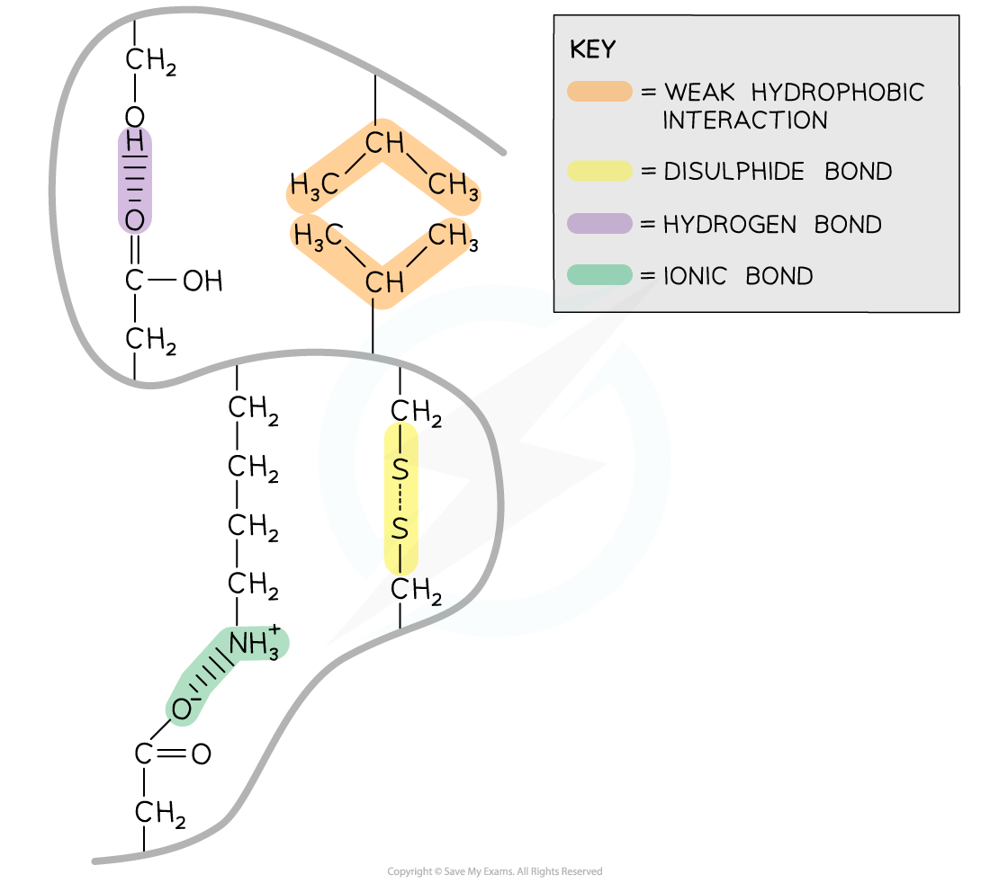
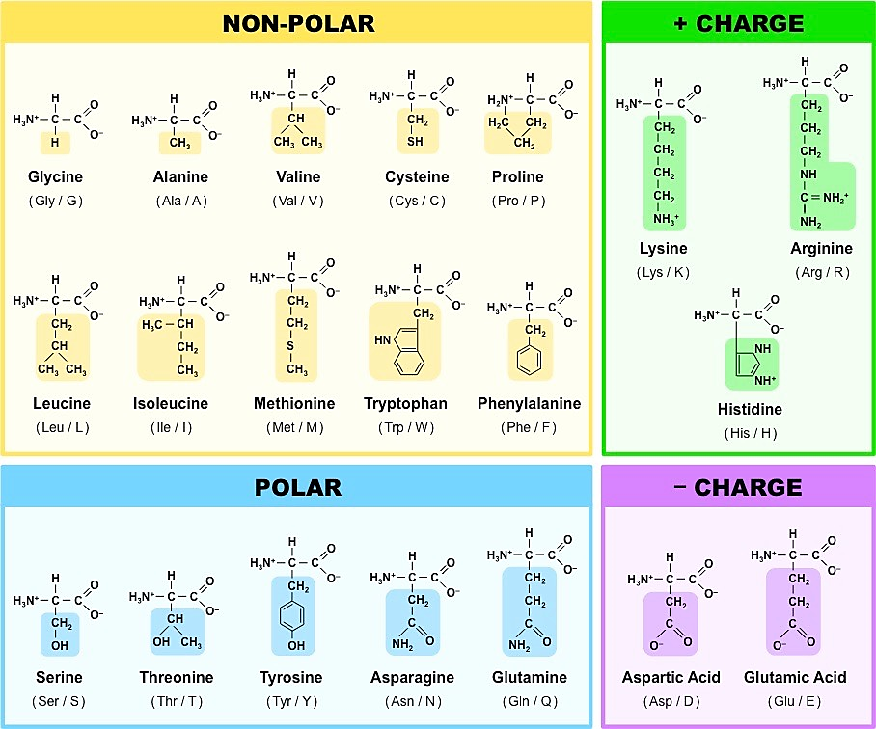
Nature of Amino Acids and Some Commonly Seen Interactions
Hydrogen Bond: Hydrogen bonds form between strongly polar R groups. These are the weakest bonds that form but the most common as they form between a wide variety of R groups
Weak Hydrophobic: Hydrophobic interactions form between the non-polar (hydrophobic) R groups within the interior of proteins
Disulphide Bond: Strongest bonds. These are covalent bonds that form between two cysteine R groups (as this is the only amino acid with an available sulphur atom in its R group)
Ionic Bond: Ionic bonds form between positively charged (amine group -NH3+) and negatively charged (carboxylic acid -COO-) R groups

