Slide 1
Cell Engineering Lecture 2:
Protein Circuit Design
Patrick Barth
BIOENG-320

Slide 2
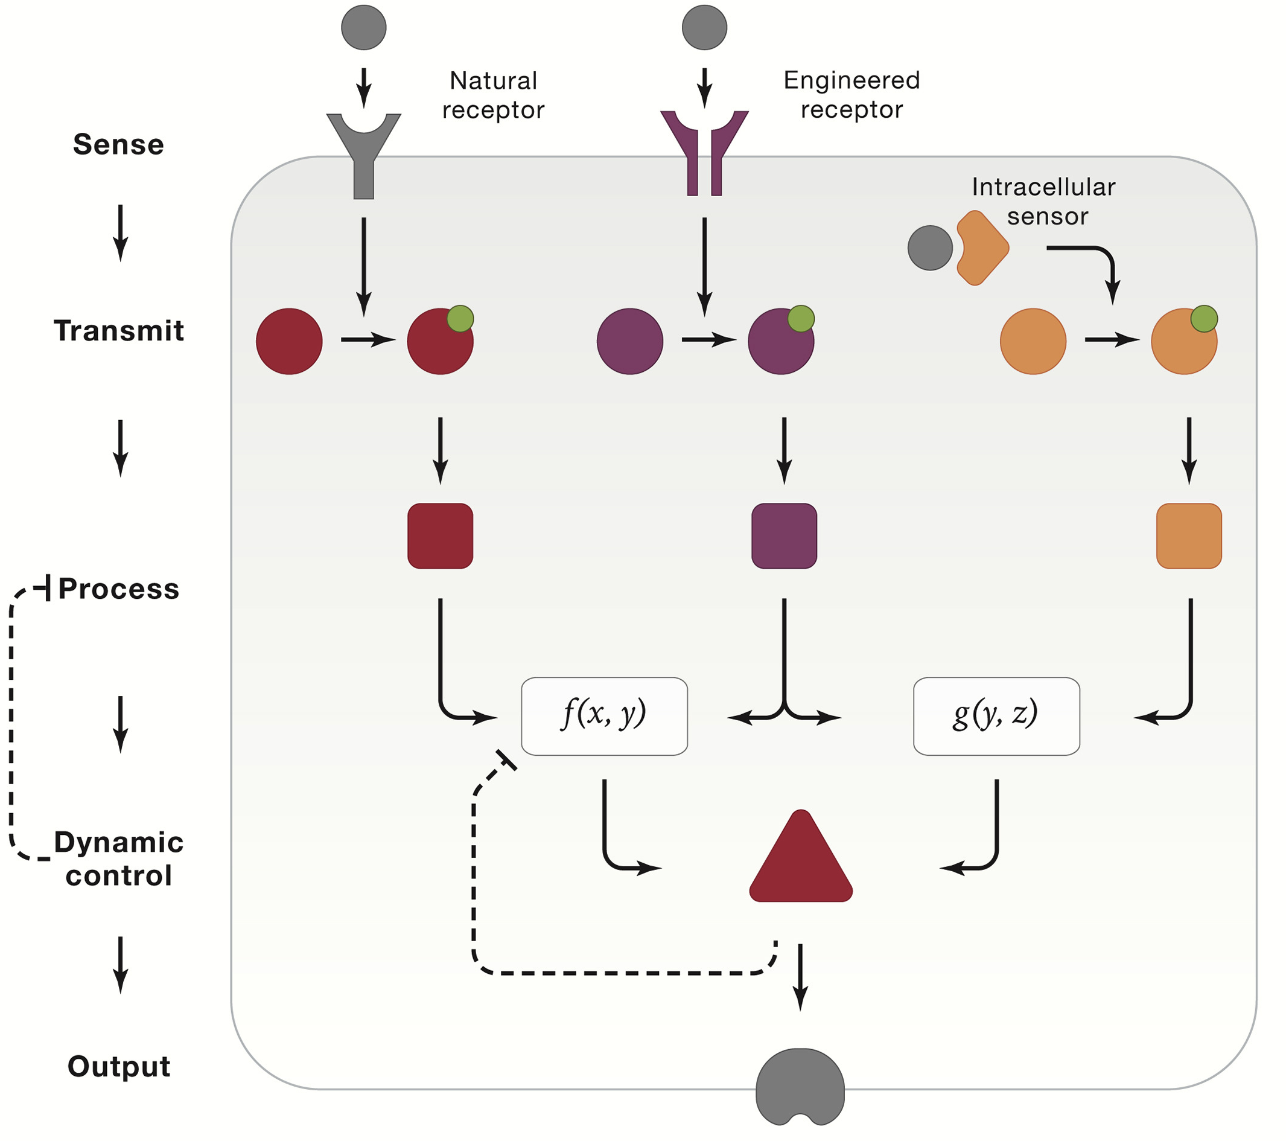
Generic protein circuit operational in a living cell
Notes:
Signal processing operations such as logic, amplification, and analog-to-digital conversion enable powerful computational capabilities.
Researchers have recently combined the principles of orthogonalizability and composability to implement these capabilities in different ways.

Slide 3
Generic protein circuit operational in a living cell
Signal processing operations enable powerful computational capabilities:
Logic
Amplification
Analog-to-digital conversion
through combination of orthogonalizability and composability principles
Notes:
Signal processing operations such as logic, amplification, and analog-to-digital conversion enable powerful computational capabilities.
Researchers have recently combined the principles of orthogonalizability and composability to implement these capabilities in different ways.

Slide 4
Protein-based processors can carry out
logic operations
Logic is ubiquitous in cell signaling, allowing cells to selectively respond only under certain input combinations
How to engineer LOGIC into protein circuits?

Slide 5
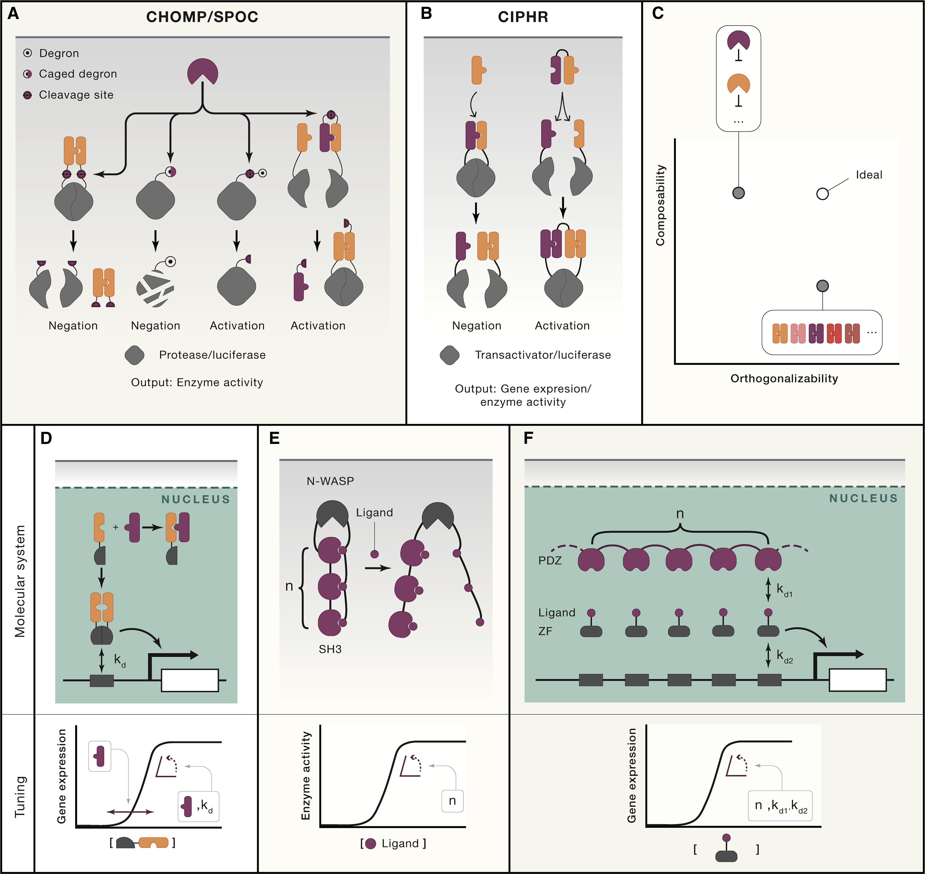
Principles for protease-based logic gates
and circuits
Need of circuits that:
allow proteases to directly inhibit and activate each other, offering composability.
use of potentially unlimited de-novo-designed protein heterodimers, enabling orthogonalizability.
A combination of these two schemes should result in an ideal system with full scalability.
Notes:
Need of circuits that:
allow proteases to directly inhibit and activate each other, offering composability.
use of potentially unlimited de-novo-designed protein heterodimers, enabling orthogonalizability.
A combination of these two schemes should result in an ideal system with full scalability.

Slide 6
Examples of protease-based logic gates
and circuits
Composability
CHOMP
circuits of hacked
orthogonal
modular proteases
SPOC
split-protease-
cleavable
orthogonal-
coiled coil-based
Notes:
Two logic circuits, circuits of hacked orthogonal modular proteases (CHOMP) and split-protease-cleavable orthogonal-coiled coil-based (SPOC) logic circuits allow proteases to directly inhibit and activate each other, offering composability.
In protease-based logic gates CHOMP and SPOC, proteases can carry out:
the negation operation by cleaving off the fused dimerization domains or revealing a caged degron on other proteases
activate each other by cleaving off a fused degron or an inhibition domain that prevents binding of dimerization domains for split protease or luciferase reconstitution.
demonstrated protease circuit design in mammalian cells

Slide 7
Examples of protease-based logic gates
and circuits
Orthogonalizability
CIPHR
(cooperatively
inducible protein
heterodimer)
Notes:
CIPHR: cooperatively inducible protein heterodimer
CIPHR makes use of potentially unlimited de-novo designed protein heterodimers, enabling orthogonalizability. The designed heterodimer-based logic gate CIPHR carries out:
the negation operation via competitive binding to separate a preformed dimer
the activation operation by bridging two otherwise non-interacting monomers and reconstituting fused split protein domains.

Slide 8
Protein-based processors carry out
analog-to-digital conversions
What is analog-to-digital conversion and
why is it important in living systems?
Notes:
In electronics, an analog-to-digital converter (ADC, A/D, or A-to-D) is a system that converts a continuous analog signal, such as a sound picked up by a microphone or light entering a digital camera, into a digital signal, discrete quantized value.

Slide 9
Protein-based processors carry out
analog-to-digital conversions
What is analog-to-digital conversion?
In electronics, an analog-to-digital converter (ADC, A/D, or A-to-D):
Conversion of a continuous analog signal (sound picked up by a microphone or light entering a digital camera) into a digital signal, discrete quantized value.
Notes:
In electronics, an analog-to-digital converter (ADC, A/D, or A-to-D) is a system that converts a continuous analog signal, such as a sound picked up by a microphone or light entering a digital camera, into a digital signal, discrete quantized value.
Ultrasensitivity: defined as the fold change in response for a given fold change in input
An ideal synthetic ultrasensitive protein module: independent tuning of response threshold and the level of ultrasensitivity.

Slide 10
Protein-based processors carry out
analog-to-digital conversions
Why is it important in living systems?
Ultrasensitive responses convert analog input signals to digital all-or-none outputs => background noise suppression, accurate detection of molecular targets, dynamic behaviors such as oscillation and multistability.
In natural circuits: ultrasensitivity through cooperativity, stoichiometric inhibitors etc…
High sensitivity
Low sensitivity
Output Signal
[Input]
Notes:
In electronics, an analog-to-digital converter (ADC, A/D, or A-to-D) is a system that converts a continuous analog signal, such as a sound picked up by a microphone or light entering a digital camera, into a digital signal, discrete quantized value.
Ultrasensitivity: defined as the fold change in response for a given fold change in input
An ideal synthetic ultrasensitive protein module: independent tuning of response threshold and the level of ultrasensitivity.

Slide 11
Protein-based processors carry out
analog-to-digital conversions
Molecular titration:
inhibitory molecule stoichiometrically
binds to and inhibits a target
An analog-to-digital converter
that makes use of intermolecular
sequestration
Response threshold: f([inhibitor])
Response slope: f(Kd_{inhibitor} & Kd_{DNA})
Notes:
A simple but powerful mechanism to achieve this is molecular titration, in which an inhibitory molecule stoichiometrically binds to and inhibits a target
An analog-to-digital converter that makes use of intermolecular sequestration
where a homodimer with fused DNA-binding domains can be separated by a higher affinity inhibitory-binding domain. The concentration of the inhibitor controls the threshold and the slope of response, with the latter being additionally tunable by the DNA-binding affinity of fused DNA-binding domains.

Slide 12
Protein-based processors carry out
analog-to-digital conversions
Intramolecular sequestration of the N-WASP domain by fused tandem repeats of SH3-ligand pairs results in ultrasensitivity
Response slope = f(the number of SH3-ligand interactions).
Notes:
Intramolecular sequestration can also lead to ultrasensitivity.
N-WASP output domain was caged by flanking repeats of Src Homology 3 (SH3) domains and their peptide ligands fused on either side. The degree of ultrasensitivity, and to a lesser extent the threshold, were shown to be tunable by the number of SH3 interaction modules.
Intramolecular sequestration of the N-WASP domain by fused tandem repeats of SH3-ligand pairs results in ultrasensitivity where the slope is controlled by the number of SH3-ligand interactions.

Slide 13
Quiz: synthetic versus natural signal
processing systems
 | natural | synthetic
orthogonal | bacteria | always
promiscuous | mammalian cells | never
signal outcome | can be multiple (more than one protein level change) | single (one protein concentration)
complex signal processing operations | often | not yet
Notes:
The signal processing schemes discussed above all assume that the relevant signal is encoded in the concentration of a particular protein species.
However, natural (especially mammalian) sensing systems appear to use promiscuous (many-to-many) interactions between sets of ligand and receptor variants to selectively respond to complex combinations of their inputs.
Computational approaches indicate that competition to form a variety of protein complexes with different activities can perform complex signal processing operations. It will be interesting to see whether these principles can be adapted to enable synthetic circuits with similar functions.

Slide 14
Quiz: synthetic versus natural signal
processing systems
Synthetic signal processing schemes so far: signal is encoded in the concentration of a particular protein species.
Natural (especially mammalian) sensing systems: use of promiscuous (many-to-many) interactions between sets of ligand and receptor variants to selectively respond to complex combinations of their inputs.
Computational approaches indicate that competition to form a variety of protein complexes with different activities can perform complex signal processing operations.
Can these principles be adapted to enable synthetic circuits with similar functions?
Notes:
The signal processing schemes discussed above all assume that the relevant signal is encoded in the concentration of a particular protein species.
However, natural (especially mammalian) sensing systems appear to use promiscuous (many-to-many) interactions between sets of ligand and receptor variants to selectively respond to complex combinations of their inputs.
Computational approaches indicate that competition to form a variety of protein complexes with different activities can perform complex signal processing operations. It will be interesting to see whether these principles can be adapted to enable synthetic circuits with similar functions.

Slide 15
Generic protein circuit operational in a living cell
Notes:
Dynamic control systems allow:
robust adaptation to the environment,
oscillations and time-based regulation,
the basis for cellular memory, etc…

Slide 16
Generic protein circuit operational in a living cell
Dynamic control systems allow:
1. robust adaptation to the environment
2. oscillations and time-based regulation
3. the basis for cellular memory, etc…
Notes:
Dynamic control systems allow:
robust adaptation to the environment,
oscillations and time-based regulation,
the basis for cellular memory, etc…

Slide 17
Dynamic control
Many biological circuits have the following dual properties:
1. maintain constant output level across a broad dynamic range of steady-state input concentrations,
2. while also responding transiently to input perturbations.
Can you define one key circuit mechanism
enabling such control?
Notes:
Many biological circuits have the following dual properties:
maintain constant output level across a broad dynamic range of steady-state input concentrations,
while also responding transiently to input perturbations.

Slide 18
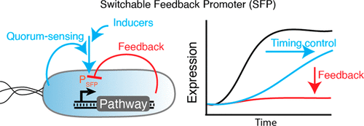
Dynamic control
Can you define one key circuit mechanism
enabling such control?
incorporation of feedback and feedforward loops
Notes:
By incorporating feedback and feedforward loops (Ma et al., 2009), researchers have begun to engineer protein circuits with similar adaptive capabilities.

Slide 19
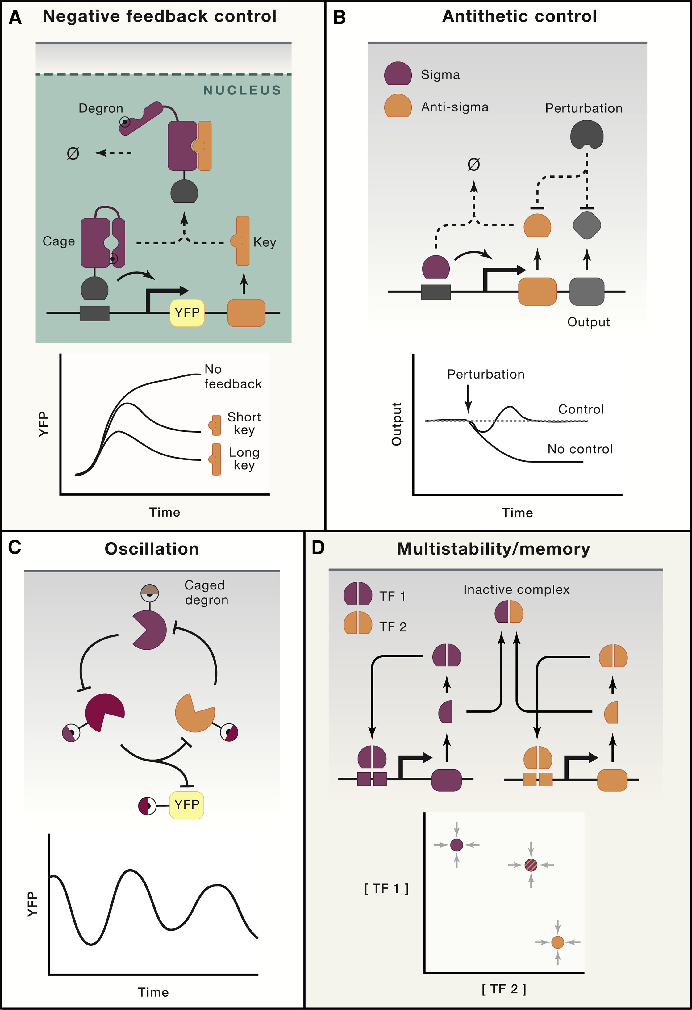
Protein-based dynamic control systems enable
negative feedback control
A negative-feedback system based on LOCKR
Transactivator fused to the cage activates expression of a YFP reporter and the key
Cage-key binding => degradation of the cage-transactivator fusion & reduced YFP expression
Negative feedback strength = f(key length) ~ binding affinity to the cage
Notes:
A negative-feedback system based on LOCKR.
The cage is fused to a transactivator, which activates expression of a yellow fluorescent protein (YFP) reporter and the key.
Binding between the cage and the key results in exposure of a sequestered degron and subsequent degradation of the cage-transactivator fusion, resulting in reduced expression level of the YFP reporter (top).
The strength of the negative feedback is tunable by the length of the key protein, which controls its binding affinity to the cage (bottom).

Slide 20
Dynamic control: Oscillation
Can you define two key periodic biological processes?
Notes:
Oscillation
Many biological processes, such as the cell cycle and circadian
clock, are periodic, sequentially advancing the cell from one stage or phase to the next before restarting again from the beginning.

Slide 21
Dynamic control: Oscillation
Can you define two key periodic biological processes?
the cell cycle and circadian clock
Periodic processes sequentially advancing the cell from one stage or phase to the next before restarting again from the beginning
Notes:
Oscillation
Many biological processes, such as the cell cycle and circadian clock, are periodic,
sequentially advancing the cell from one stage or phase to the next before restarting again from the beginning.

Slide 22
Protein-based dynamic control systems enable
oscillation
Three proteases that inhibit each other by exposing caged degrons lead to oscillatory behavior in bacteria
Notes:
Three proteases that inhibit each other by exposing caged degrons (top) lead to oscillatory behavior in bacteria (bottom).

Slide 23
Dynamic control: Memory
Memory allows cells to alter their behavior depending on their own individual history.
=> use protein-based circuits to store and read out information encoded in the states of proteins or DNA, providing a foundation for protein-based memory
Can you define one mechanism for information storage
in natural cells other than the DNA itself?
Notes:
Memory allows cells to alter their behavior depending on their own individual history.
Recent work has demonstrated different ways that protein-based circuits could be used to store and read out information encoded in the states of proteins or DNA, providing a foundation for protein-based memory.

Slide 24
Dynamic control: Memory
Can you define one mechanism for information storage
in natural cells other than the DNA itself?
chromatin-based epigenetic memory system:
The chromatin can store information in DNA or histone modifications
In natural epigenetic systems, chromatin regulators actively propagate these modifications, ensuring their stable mitotic inheritance
Notes:
The chromatin can store information in DNA or histone modifications.
In natural epigenetic systems, chromatin regulators actively propagate these modifications, ensuring their stable mitotic inheritance

Slide 25
Protein-based dynamic control systems enable
multistability and memory
Engineered transcription factors:
positively autoregulate their own expression as homodimers
inhibit one another’s activity through heterodimerization
=> multiple stable states with different levels of TF expression, e.g. 3 TFs => 7 distinct states stable for weeks
=> scalable architecture, exponentially increasing numbers of cell states with additional engineered TFs
Notes:
Engineered transcription factors positively autoregulate their own expression as homodimers and inhibit one another’s activity through heterodimerization
This circuit design can produce multiple stable states with different levels of expression of the transcription factors (bottom). 3 transcription factors could produce 7 distinct states, each stable for weeks of continuous culture.
Because it implements inhibition through engineered protein-level interaction domains, this architecture scales, generating exponentially increasing numbers of cell states as one introduces additional transcription factors.

Slide 26
Applications of synthetic protein circuits
Engineered cell-based therapies
Notes:
The abilities to sense, transmit, process, and dynamically respond to protein-level inputs, discussed above, together open up the possibility of engineering therapeutic devices that specifically target cells in disease states. Such therapeutic circuits could be designed and validated rapidly compared with conventional drugs. Here, we focus on therapeutically relevant protein circuits and assemblies that exemplify the promise of rational design.

Slide 27
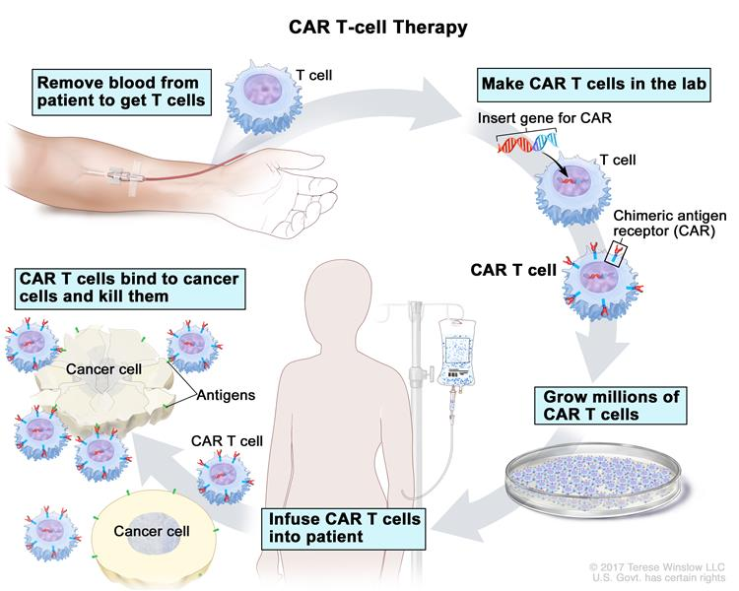
Adoptive CAR T cell therapy
Tumor associated
antigen
Tumor
associated
antigen
CAR
(NIH NCI)

Slide 28
Current limitations of adoptive
CAR T cell therapy
Tumor associated
antigen
1. Lack of tumor specificity (many tumor associated antigens are also found at the surface of normal cells)
2. Lack of sustained responses in immunosuppressive environment

Slide 29
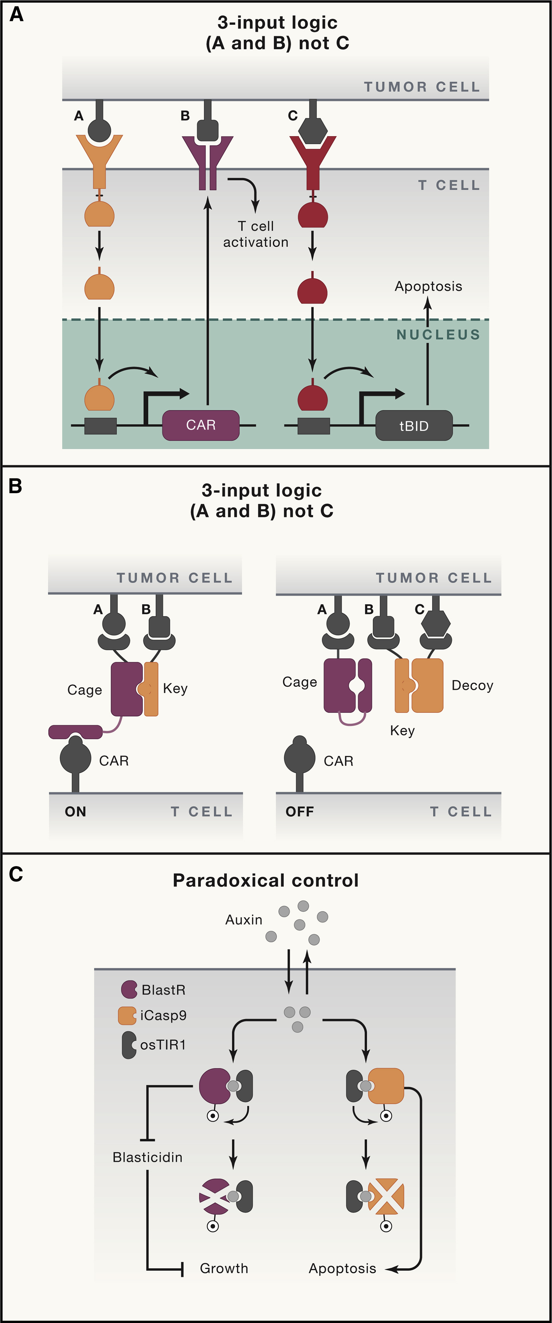
Protein circuits can provide useful capabilities
for cell-based therapeutics
2-input logic
(A and B)
Tumor cell
In the SynNotch “(A AND B)” logic gate, antigen A activates a SynNotch receptor, causing expression of a chimeric antigen receptor (CAR), which recognizes the second antigen B and triggers the T cell response.
T cell
Notes:
(A) In the SynNotch “(A AND B) NOT C” logic gate, antigen A activates a SynNotch receptor, causing expression of a chimeric antigen receptor (CAR), which recognizes the second antigen B and triggers the T cell response. Recognition of a third antigen, C, by an additional SynNotch, leads to expression of truncated BID (tBID) to trigger apoptosis.

Slide 30
Protein circuits can provide useful capabilities
for cell-based therapeutics
3-input logic
(A and B) not C
In the SynNotch “(A AND B) NOT C” logic gate, Recognition of a third antigen, C, by an additional SynNotch, leads to expression of truncated BID (tBID) to trigger apoptosis
Notes:
(A) In the SynNotch “(A AND B) NOT C” logic gate, antigen A activates a SynNotch receptor, causing expression of a chimeric antigen receptor (CAR), which recognizes the second antigen B and triggers the T cell response. Recognition of a third antigen, C, by an additional SynNotch, leads to expression of truncated BID (tBID) to trigger apoptosis.

Slide 31
Engineering advanced logic and distributed computing in human CAR immune cells
Cho, J.H., et al. Nat Commun 12, 792 (2021)

Slide 32
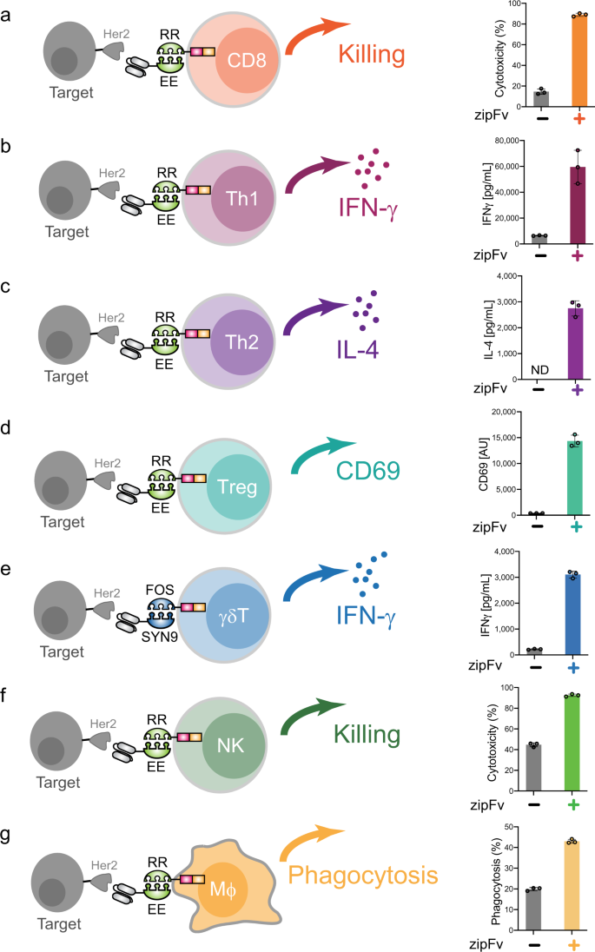
SUPRA CARs can activate diverse adaptive and innate immune cell types
Split, universal, and programmable (SUPRA) CAR system to improve specificity and controllability.
The SUPRA CAR system composition:
soluble antigen-binding portion, zipFv
universal signal transduction receptor, zipCAR, expressed on T cells
Notes:
Split, universal, and programmable (SUPRA) CAR system to improve specificity and controllability¹⁰. The SUPRA CAR system is composed of a soluble antigen-binding portion, zipFv, and a universal signal transduction receptor, zipCAR, expressed on T cells.
a Cytotoxicity by RR zipCAR-expressing CD8+ T cells. (Right) Nalm6 cells expressing Her2 were co-cultured in vitro with RR zipCAR-expressing CD8+ human primary T cells with and without α-Her2-EE zipFv (n = 3, data are represented as mean ± SD). b IFN-γ cytokine level from RR zipCAR expressing in vitro differentiated Th1 cells. (Right) Nalm6 cells expressing Her2 were co-cultured with RR zipCAR-expressing Th1 cells with and without α-Her2-EE zipFv (n = 3, data are represented as mean ± SD). c IL-4 cytokine level from RR zipCAR expressing in vitro differentiated Th2 cells. (Right) Nalm6 cells expressing Her2 were co-cultured with RR zipCAR-expressing Th2 cells with and without α-Her2-EE zipFv (n = 3, data are represented as mean ± SD). d CD69 expression level from RR zipCAR-FoxP3 expressing isolated Treg cells (CD4 + CD25hiCD127low). (Right) Nalm6 cells expressing Her2 were co-cultured with RR zipCAR-expressing Treg cells with and without α-Her2-EE zipFv (n = 3, data are represented as mean ± SD). e IFN-γ cytokine level from FOS zipCAR-expressing isolated γδ T cells. (Right) Nalm6 cells expressing Her2 were co-cultured with FOS zipCAR-expressing γδ T cells with and without α-Her2-SYN9 zipFv (n = 3, data are represented as mean ± SD). f Cytotoxicity by RR zipCAR-expressing NK-92MI cells. (Right) Nalm6 cells expressing Her2 were co-cultured in vitro with RR zipCAR-expressing NK cells with and without α-Her2-EE zipFv (n = 3, data are represented as mean ± SD). g Phagocytosis by RR zipCAR-expressing THP-1 macrophages. (Right) Nalm6 cells expressing Her2 were co-cultured in vitro with RR zipCAR-expressing THP-1 macrophages with and without α-Her2-EE zipFv (n = 3, data are represented as mean ± SD).

Slide 33
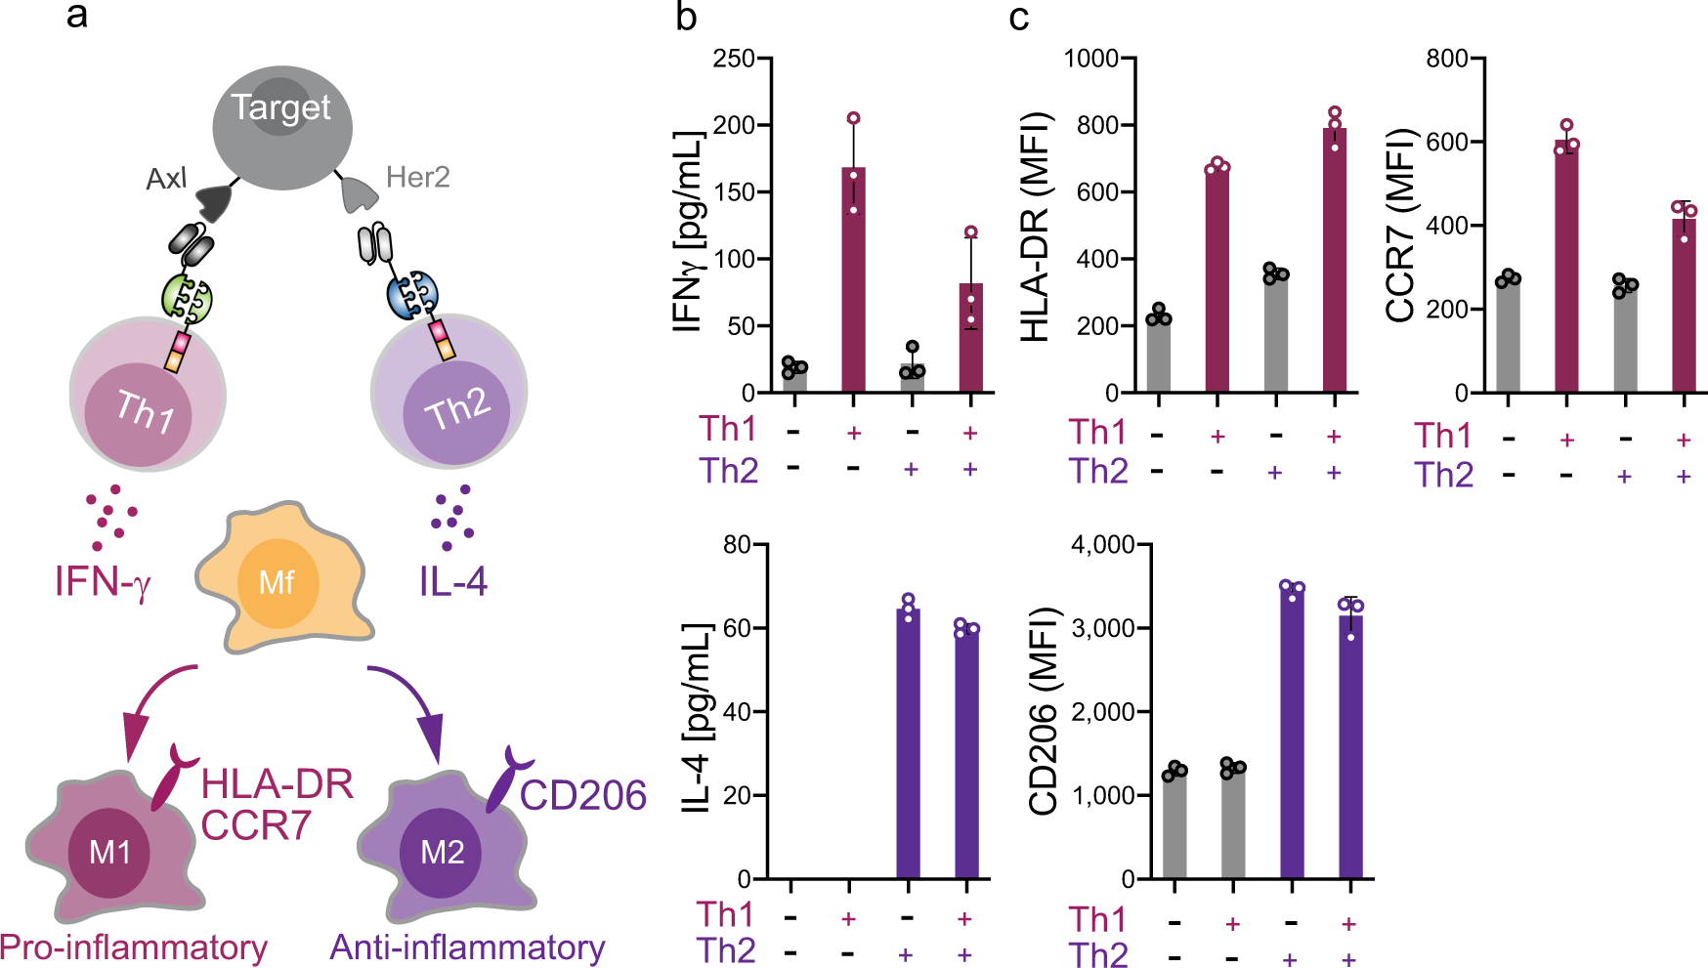
Engineering endogenous immune system with SUPRA CAR-expressing different T-cell subtypes
Controlling macrophage polarization by zipCAR-expressing Th1 and Th2 cells using RR zipCAR and FOS zipCAR
Notes:
a Schematic of controlling macrophage polarization by zipCAR-expressing Th1 and Th2 cells. The RR zipCAR and FOS zipCAR control activity of Th1 and Th2 cells, respectively.
α-Axl-EE zipFv binds to RR zipCAR and activates Th1 cells. α-Her2-SYN9 zipFv binds to the FOS zipCAR and activates Th2 cells. Activation of Th1 and Th2 CD4+ T cells leads to secretion of IFN-γ and IL-4, respectively. Macrophage polarizes to M1 (proinflammatory) when exposed to IFN-γ secreted by Th1 cell and it polarized to M2 (anti-inflammatory) when exposed to IL-4 secreted by Th2 cells. b IFN-γ (Top) and IL-4 (Bottom) production from RR zipCAR-expressing Th1 cells and FOS zipCAR-expressing Th2 cells with or without 5 nM α-Her2-SYN9 zipFv and 5 nM α-Axl-EE zipFv (n = 3, data are represented as the mean ± SD). c HLA-DR (Top left) and CCR7 (Top right) expression levels in THP-1 macrophages were measured by flow cytometer 24 h after staring co-culture. (Bottom) CD206 in THP-1 macrophages was also analyzed at the same time as detecting M2 marker (n = 3, data are represented as the mean ± SD).

Slide 34
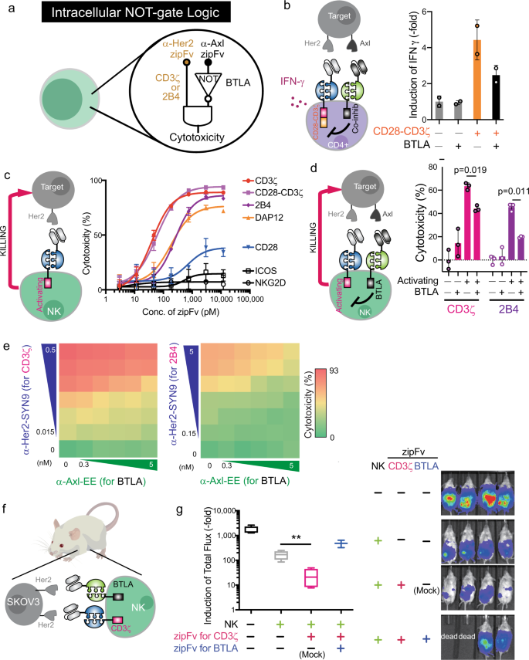
The intracellular NOT logic with BTLA in different cell types
T cells transduced with a FOS zipCAR that contains CD28 and CD3ζ signaling domains and a RR zipCAR with different inhibitory domains
Notes:
We generated a collection of zipCARs based on well-known co-inhibitory receptors (PD-1, LAG3, TIM3, BTLA, CTLA-4). CD4+ T cells and CD8+ T cells were transduced with a FOS zipCAR that contains CD28 and CD3ζ signaling domains and a RR zipCAR with different inhibitory domains
a Diagram of intracellular NOT logic with BTLA co-inhibitory signaling domain. b IFN-γ production from CD4+ T cells transduced with FOS-CD28-CD3ζ and RR zipCAR with BTLA co-inhibitory domain. (Right) Supernatants were collected 24 h after adding 1.2 nM α-Her2-SYN9 zipFv and/or 12 nM α-Axl-EE zipFv (n = 2; data are represented as the mean + SD). c Effect of concentration of α-Her2-SYN9 zipFv on cytotoxicity performed by FOS zipCAR-expressing NK-92MI cells with various activation domains (magenta, CD3ζ; light purple, CD28-CD3ζ; dark purple, 2B4; yellow, DAP12; blue, CD28; black with square, ICOS; black with circle, NKG2D; n = 3; data are represented as the mean ± SD). d Suppression of cytotoxicities by BTLA. NK-92MI cells expressing FOS zipCAR with activating domains (CD3ζ or 2B4) and RR zipCAR with BTLA co-inhibitory domain were co-cultured with Her2 and Axl-expressing Nalm6 target cells in the presence of different combinations of zipFvs (α-Axl-SYN9, α-Her2-EE). (Right) Live target cells were measured by flow cytometry 24 h after co-culture (magenta, CD3ζ; dark purple, 2B4; n = 3; data are represented as the mean + SD; the statistical significance was determined by two-tailed student’s t-test).

Slide 35
The intracellular NOT logic with BTLA in different cell types
Notes:
e Effect of concentration of α-Her2-SYN9 and/or α-Axl-EE zipFvs on cytotoxicity performed by NK-92MI cells. SUPRA CAR-NK cells express FOS zipCAR with BTLA co-inhibitory domain and RR zipCAR with CD3ζ domain (Left) and with 2B4 activation domain (Right) (n = 3, data are represented as the mean). f Schematic of the xenograft mouse model for verification of NOT gate NK cells. NK-92MI cells were expressing both FOS zipCAR with CD3ζ and RR zipCAR with BTLA. Target SKOV3-luc cells have high-level Her2 expression. We also administrated α-Her2-EE zipFv, α-Her2-SYN9 zipFv, and α-Her2 scFv (Mock) to specified groups in Fig. 4g. g (Left) Box and whiskers graph shows tumor burden in each group at 22 days after tumor injection; tumor only without NK cells (black), tumor and NK cells without zipFv (gray), tumor and NK cells with α-Her2-EE zipFv and α-Her2 scFv (magenta), and tumor and NK cells with α-Her2-EE zipFv and α-Her2-SYN9 zipFv (blue). Each zipFvs were injected intraperitoneally every day for 21 days. (Right) Representative bioluminescence images at day 22. Box plots indicate median (middle line), 25th, 75th percentile (box), and 5th and 95th percentile (whiskers). n = 4 (4th group is n = 2 because 2 mice died before imaging); mean ± SD; the statistical significance was determined by Multiple t-test; **p = 0.01.

Slide 36
Take home messages
Protein circuits can be used to engineer advanced logic operations in mammalian cells, including sensing, signal transmission, processing and dynamic control
Direct therapeutic applications

Slide 37
Questions?

