Slide 1
Synthetic Biology (BIOENG-320)
Conformational Dynamics and Flexibility in Protein Design

Slide 2
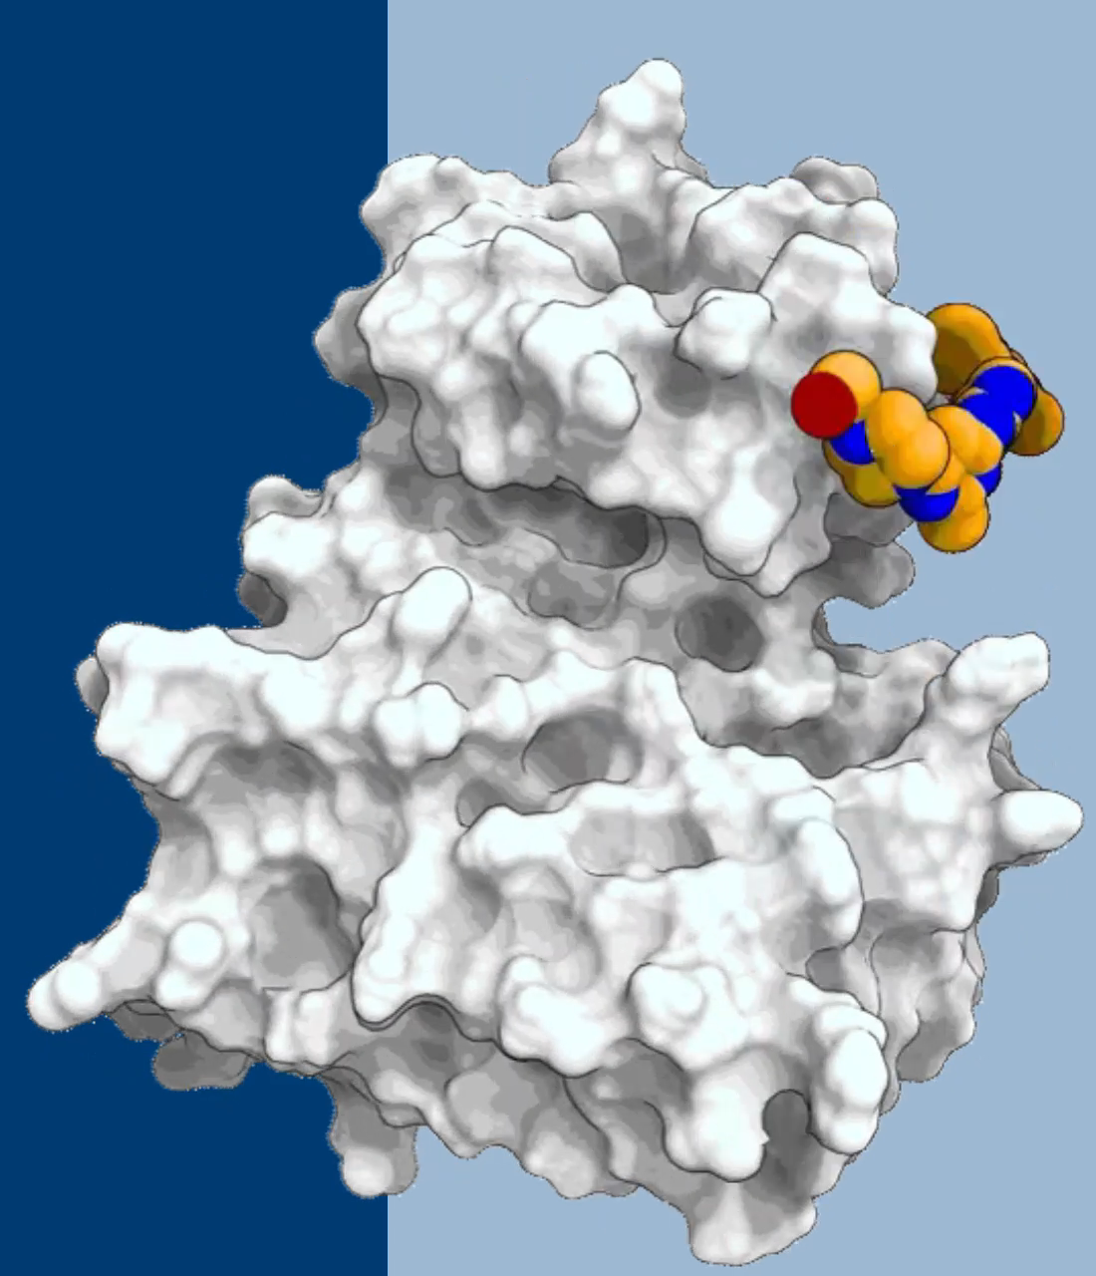
Molecules are conformationally dynamic
https://www.deshawresearch.com/index.html, 21.02.24.

Slide 3
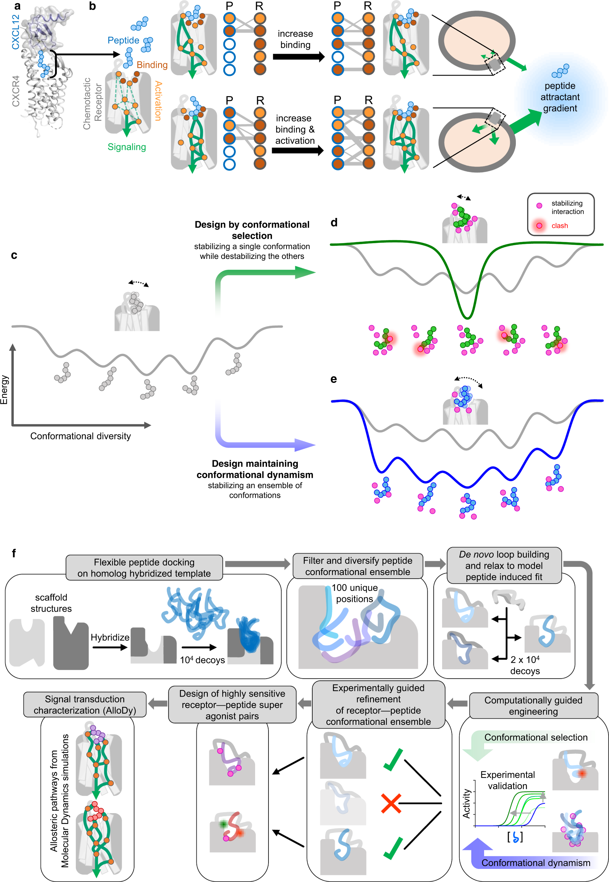
This week: The dynamic interaction between CXCR4 and a flexible peptide derived from the chemokine CXCL12
Jefferson, R. E., ... & Barth, P. (2023). Nat. Comm., 14(1), 2875.

Slide 4
This week: The dynamic interaction between CXCR4 and a flexible peptide derived from the chemokine CXCL12
Jefferson, R. E., ... & Barth, P. (2023). Nat. Comm., 14(1), 2875.

Slide 5
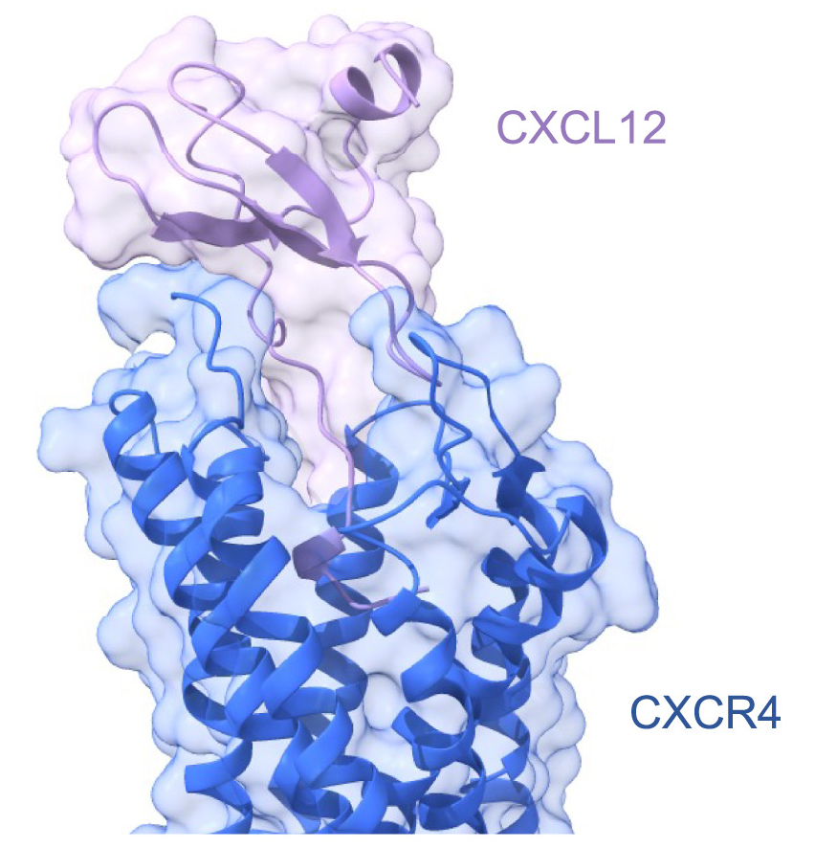
Your tasks for today ☺
Structural analysis of 5 conformationally different models for the CXCR4-peptide interaction, focusing on the various binding poses of the flexible peptide ligand within the receptor's pocket.
Discern the primary differences among the models
Explore the nature of stabilizing and destabilizing
amino acid interactions. Steric clashes?!

