Slide 1
Synthetic Biology (BIOENG-320)
Engineering Chemokine Receptors for Cancer Therapy

Slide 2
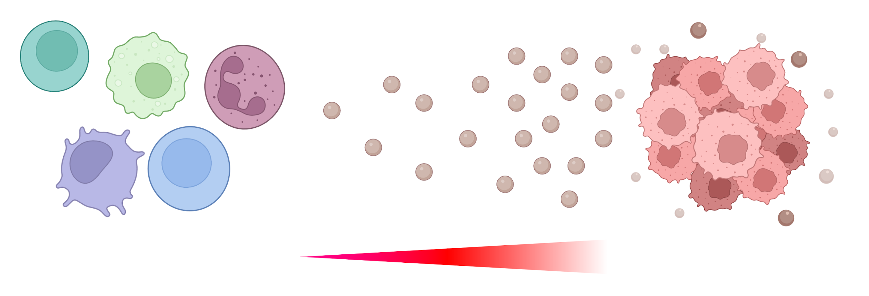
1.1 Chemokines and GPCRs
Directional movement of immune cells is caused by chemokine gradients
Chemokine receptors
Chemokine
Tumors and
Inflammation sites
Immune Cells
Cell movement
Chemokine gradient

Slide 3
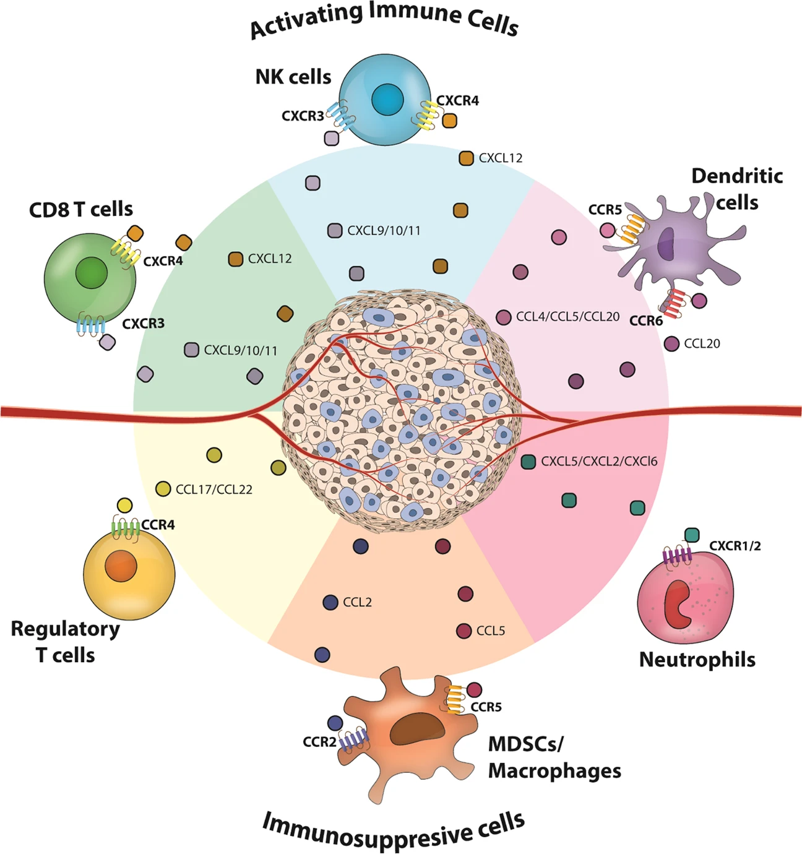
Chemokines are found to guide different types of immune cells into solid TME
Kohli, K. Cancer Gene Therapy. 2021

Slide 4
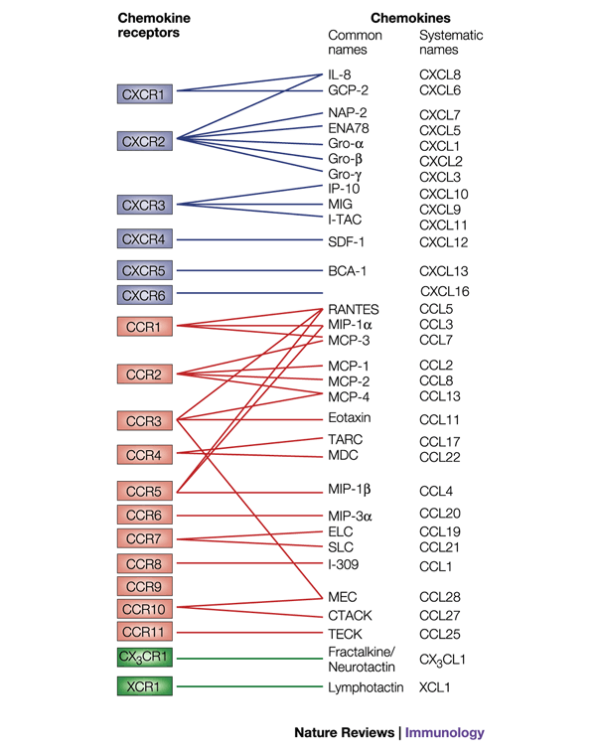
Chemokine receptors – Chemokines pairs
Chemokine receptors can bind several chemokines
Proudfoot, A. Nature Review Immunology. 2002

Slide 5
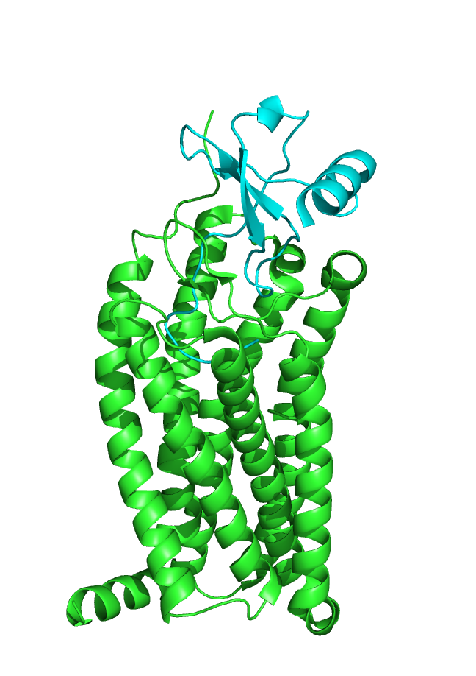
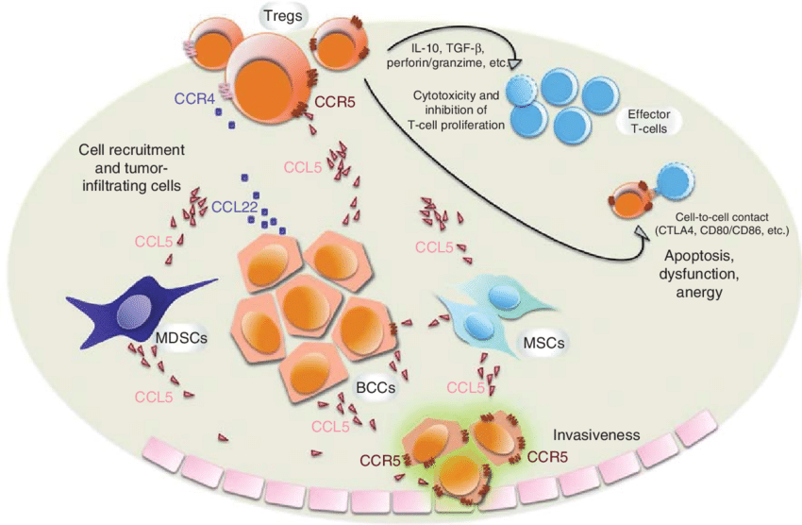
CCR5/CCL5 complex
CCR5 belongs to the inflammation chemokine family;
T cells presenting CCR5 recognize CCL5 and activate leukocyte recruitment;
Double edged sword in cancer progression:
  Immune cells are able to travel to the inflammation and tumor sites,
  However, immune cells recruitment stimulate angiogenesis, which helps tumor growth,
  On top of that, cancer cells are able to “hide” and not be attacked by immune cells
CCL5
CCR5
PDB 7O7F
Velázquez et al., Expert Opinion on Therapeutic Targets, 2014

Slide 6
Engineering strategies
Why would increasing or decreasing the affinity of the CCR5 receptor to its chemokine ligand CCL5 be beneficial, when trying to achieve a better response against cancer cells?
From a receptor re-engineering standpoint, how can you achieve an increased (or decreased) affinity to the chemokine?
Biochemically and biophysically, what are possible issues you can encounter when re-engineering a specific receptor?
You designed a perfect receptor that does exactly what you want. Now, from a therapeutic perspective, how can you make use of what you designed, in a clinical context?

Slide 7
Further reading
Roussos, E., Condeelis, J. & Patsialou, A. Chemotaxis in cancer. Nat Rev Cancer 11, 573–587 (2011). https://doi.org/10.1038/nrc3078
Proudfoot, A. Chemokine receptors: multifaceted therapeutic targets. Nat Rev Immunol 2, 106–115 (2002). https://doi.org/10.1038/nri722
Xuanmao Jiao, Omar Nawab, Tejal Patel, Andrew V. Kossenkov, Niels Halama, Dirk Jaeger, Richard G. Pestell; Recent Advances Targeting CCR5 for Cancer and Its Role in Immuno-Oncology. Cancer Res 1 October 2019; 79 (19): 4801–4807. https://doi.org/10.1158/0008-5472.CAN-19-1167
Myriam Labelle, Shahinoor Begum, and Richard O. Hynes, Platelets guide the formation of early metastatic niches, PNAS, 2014, https://doi.org/10.1073/pnas.1411082111
Graca, F.A., Stephan, A., Minden-Birkenmaier, B.A. et al. Platelet-derived chemokines promote skeletal muscle regeneration by guiding neutrophil recruitment to injured muscles. Nat Commun 14, 2900 (2023). https://doi.org/10.1038/s41467-023-38624-0
Geeta Ramesh, Andrew G. MacLean, and Mario T. Philipp, Cytokines and Chemokines at the Crossroads of Neuroinflammation, Neurodegeneration, and Neuropathic Pain, https://doi.org/10.1155/2013/480739

