Slide 1
Cell Engineering Lecture 3:
Multi cellular control
Patrick Barth
BIOENG-320

Slide 2
Synthetic Biology: Lecture series
From molecules to circuit to cell engineering
Protein circuits 1
Protein circuits 2
Cell engineering
Scale
Complexity

Slide 3
Cell Engineering is one of the ultimate goals in synthetic biology
Minimal self replicating living system / factory
Multicellular systems
Notes:
Living self replicating system / factory

Slide 4
Programming multi cellular systems
through intercellular communications

Slide 5
Principles of intercellular communications
Intercellular communication => coordinate the behavior of individual cells in multicellular communities
Impact of such communication in prokaryotes and eukaryotes?
Prokaryotes: consortia of prokaryotes control their behaviour based on the total population density through quorum sensing for example
Eukaryotes: Multicellular organisms use signalling to organize, synchronize and differentiate their specialized tissues
What kind of signals?
Electrical, mechanical, diffusible chemicals (secreted from the senders and recognized by the receivers through autocrine, paracrine or endocrine paths)

Slide 6
Lecture structure
Programming population control
Programming multicellular organization
Programming multicellular patterning

Slide 7
Population control by the environment
Common scenario in biology: Population control by the environment (e.g. nutrient supply):
=> bacterial population needs to maintain a cell density that is lower than the limits imposed by the environment
Notes:
The circuit programmes a bacterial population to maintain a cell density that is lower than the limits imposed by the environment (for example, by nutrient supply). The LuxI protein of the well-characterized LuxI/LuxR system synthesizes a small, diffusible acyl-homoserine lactone (AHL) signalling molecule. The AHL accumulates in the experimental medium and inside the cells as the cell density increases. At sufficiently high concentrations, it binds and activates the LuxR transcriptional regulator, which in turn induces the expression of a killer gene (E) under the control of a luxI promoter (pluxI). Sufficiently high levels of the killer protein cause cell death.

Slide 8
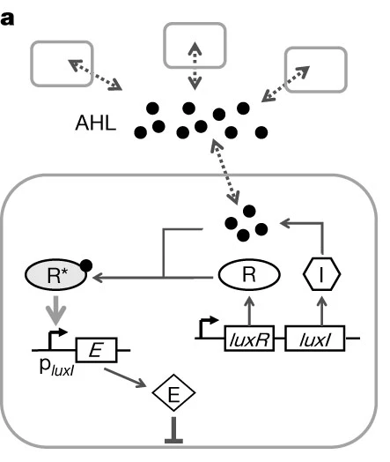
Synthetic circuit for programmed population control by cell–cell communication and regulated killing (model system: E Coli)
Population control circuit:
the circuit programmes a bacterial population to maintain a cell density that is lower than the limits imposed by the environment
by coupling gene expression to cell survival and death using cell–cell communication
(You Nature 2004)
Notes:
The circuit programmes a bacterial population to maintain a cell density that is lower than the limits imposed by the environment (for example, by nutrient supply). The LuxI protein of the well-characterized LuxI/LuxR system synthesizes a small, diffusible acyl-homoserine lactone (AHL) signalling molecule. The AHL accumulates in the experimental medium and inside the cells as the cell density increases. At sufficiently high concentrations, it binds and activates the LuxR transcriptional regulator, which in turn induces the expression of a killer gene (E) under the control of a luxI promoter (pluxI). Sufficiently high levels of the killer protein cause cell death.

Slide 9
Programmed population control by cell–cell communication and regulated killing (model system: E Coli)
LuxI (I) produces a small, diffusible AHL signalling molecule
AHL accumulates in the experimental medium and inside the cells as the cell density increases.
high [AHL] => LuxR (R) activation => killer gene (E) expression under the control of a luxI promoter (pluxI).
high [E] => cell death
Notes:
The circuit programmes a bacterial population to maintain a cell density that is lower than the limits imposed by the environment (for example, by nutrient supply). The LuxI protein of the well-characterized LuxI/LuxR system synthesizes a small, diffusible acyl-homoserine lactone (AHL) signalling molecule. The AHL accumulates in the experimental medium and inside the cells as the cell density increases. At sufficiently high concentrations, it binds and activates the LuxR transcriptional regulator, which in turn induces the expression of a killer gene (E) under the control of a luxI promoter (pluxI). Sufficiently high levels of the killer protein cause cell death.

Slide 10



Programmed population control by cell–cell communication and regulated killing: the model
Equations modeling the major kinetic events dictating the circuit function
Cell growth and death
(1)
Production and degradation of the killer protein
(2)
AHL signal
(3)
intracellular concentration of the killer protein (E)
AHL concentration (A); viable cell density (N)
Notes:
Assumptions: (1) without the circuit, changes in viable cell density (N, ml-1) follow logistic kinetics with an intrinsic per capita growth rate of k (h-1) and a carrying capacity of Nm (ml-1);
(2) for circuit-regulated growth, the cell death rate is proportional to the intracellular concentration of the killer protein (E, nM) with a rate constant of d (nM-1 h-1)
(3) the production rate of E is proportional to AHL concentration (A, nM, assumed to be the same inside and outside the cells) with a rate constant of kE (h-1);
(4) AHL production rate is proportional to N with a rate constant of νA (nM ml h-1)
(5) degradation of the killer protein and AHL follows first-order kinetics with rate constants of dE (h-1) and dA (h-1).

Slide 11
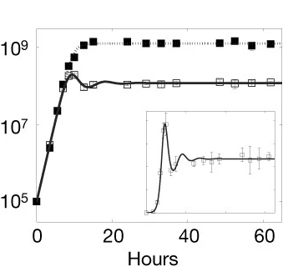
Tight & dynamic coupling between population dynamics and killer protein expression
Circuit
OFF ON
Cell density (ml⁻¹)
Data
Predictions
Why these Oscillation patterns?
At killer protein level < steady state => population growth
2. Then, killer protein level > steady state => decreases cell density
3. After some delay, cell density declines => decrease in [AHL] => reduced levels of the killer protein => cell population recovery
Notes:
Experimentally measured growth curves (a) and corresponding levels of LacZα–CcdB (b) of Top10F′ cells with the population-control circuit OFF (filled squares) and ON (open squares) for pH 7.0. Model predictions are shown in solid (ON) and dotted (OFF) lines, except for the OFF case of LacZ activity, where the killer protein concentration is always zero in the model. The simulated LacZ activity is obtained by multiplying the simulated killer protein concentration (in nM) by a constant factor so that the experiment and simulation are at the same scale. Insets show the growth curves and the LacZ activity in linear scale for the ON case. The similar growth of two cultures at low cell density is an intrinsic feature of the circuit and is not caused by a lag in circuit activation. When the ON culture at steady state was diluted into fresh medium with and without the inducer, the resulting cultures again grew similarly at low density but deviated at high density. B. Intracellular levels of LacZa–CcdB for the ON culture, measured in terms of LacZ activity, reached a steady state after an overshoot, again predicted by the simulation. The basal level of LacZa–CcdB expression in the OFF culture was negligible for all time points.

Slide 12
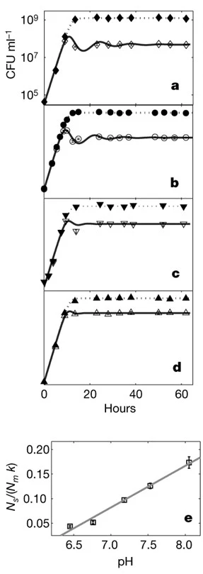
Prediction: steady-state cell density increases nearly proportionally with the AHL degradation rate constant
AHL serves as an
external ‘dial’ to operate the circuit
Degradation of AHL is facilitated by increasing pH
pH 6.2
pH 6.8
Cell density (ml⁻¹)
pH 7.6
pH 8.2
Notes:
Effects of pH on circuit behaviour. a–d, Cell growth with the circuit OFF (filled symbols) and ON (open symbols). e, Dependence of N_{s}/(N_{m} × k) on pH. f–i, Time courses of LacZ activity with the circuit ON. j, Dependence of LacZ activity/[k(1 - N_{s}/N_{m})] on pH. Panels a–d have the same scale in both x and y axes, as do the panels (f–i). Simulated growth curves (ON, solid line; OFF, dotted line) and killer protein time courses (ON, solid line) are shown in a–d and f–i. The killer protein concentration for the OFF cases is always zero in the model. Simulated LacZ activity in f–i is obtained by multiplying the simulated killer protein concentration by a constant factor so that the experiment and simulation are at the same scale in each panel. In e and j, steady-state pH values (Table 1) are used along the x axes. In e, N_{s} is normalized with respect to N_{m} and k to account for minor variations in these variables (Table 1). The dependence of N_{s}/(N_{m} × k) on pH is nearly linear (R² = 0.98).

Slide 13
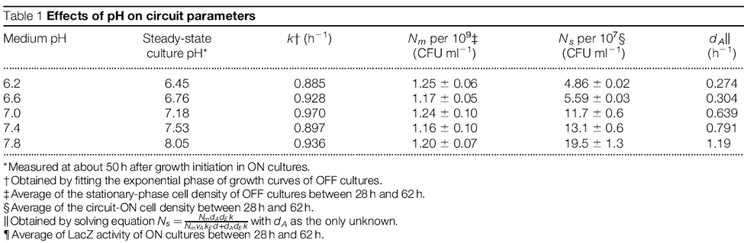
Effect of pH on circuit parameters
At steady state: E_{s} = k / d (1 – N_{s} / N_{m}) ~ k / d
k /d : the ratio of the growth and killing rate constants (assuming that the circuit-ON cell density is far below the carrying capacity; that is, N_{s} / N_{m} << 1).

Slide 14
Now, some thinking
By coupling gene expression with population dynamics, cell–cell communication integrates the entire population as an essential component of the population-control circuit.
This coupling => the circuit functions reliably at the population level by exploiting cell heterogeneity in terms of their size, age, plasmid copy number, gene expression and response to the killer protein.
Why are such phenotypic variations required for the circuit to function?
The outcome of circuit function is binary for any given cell: it lives or dies (judged by the ability to form a colony).
If all cells had the same phenotype, the circuit would fail to achieve a stable cell density because the population would become extinct once the killer protein concentration reached a critical threshold.

Slide 15
Now, some thinking
Because of the coupling between gene expression and population dynamics, the circuit can function only at the population level
Is this statement verified experimentally?
This is supported by experimental data: under each set of conditions, growth of the circuit-ON culture only deviated from that of the OFF culture when cell density was sufficiently high => cell-cell communication is key
What would happen if the circuit had functioned inside each cell autonomously and why?
growth of the ON and OFF cultures would have deviated from the beginning

Slide 16
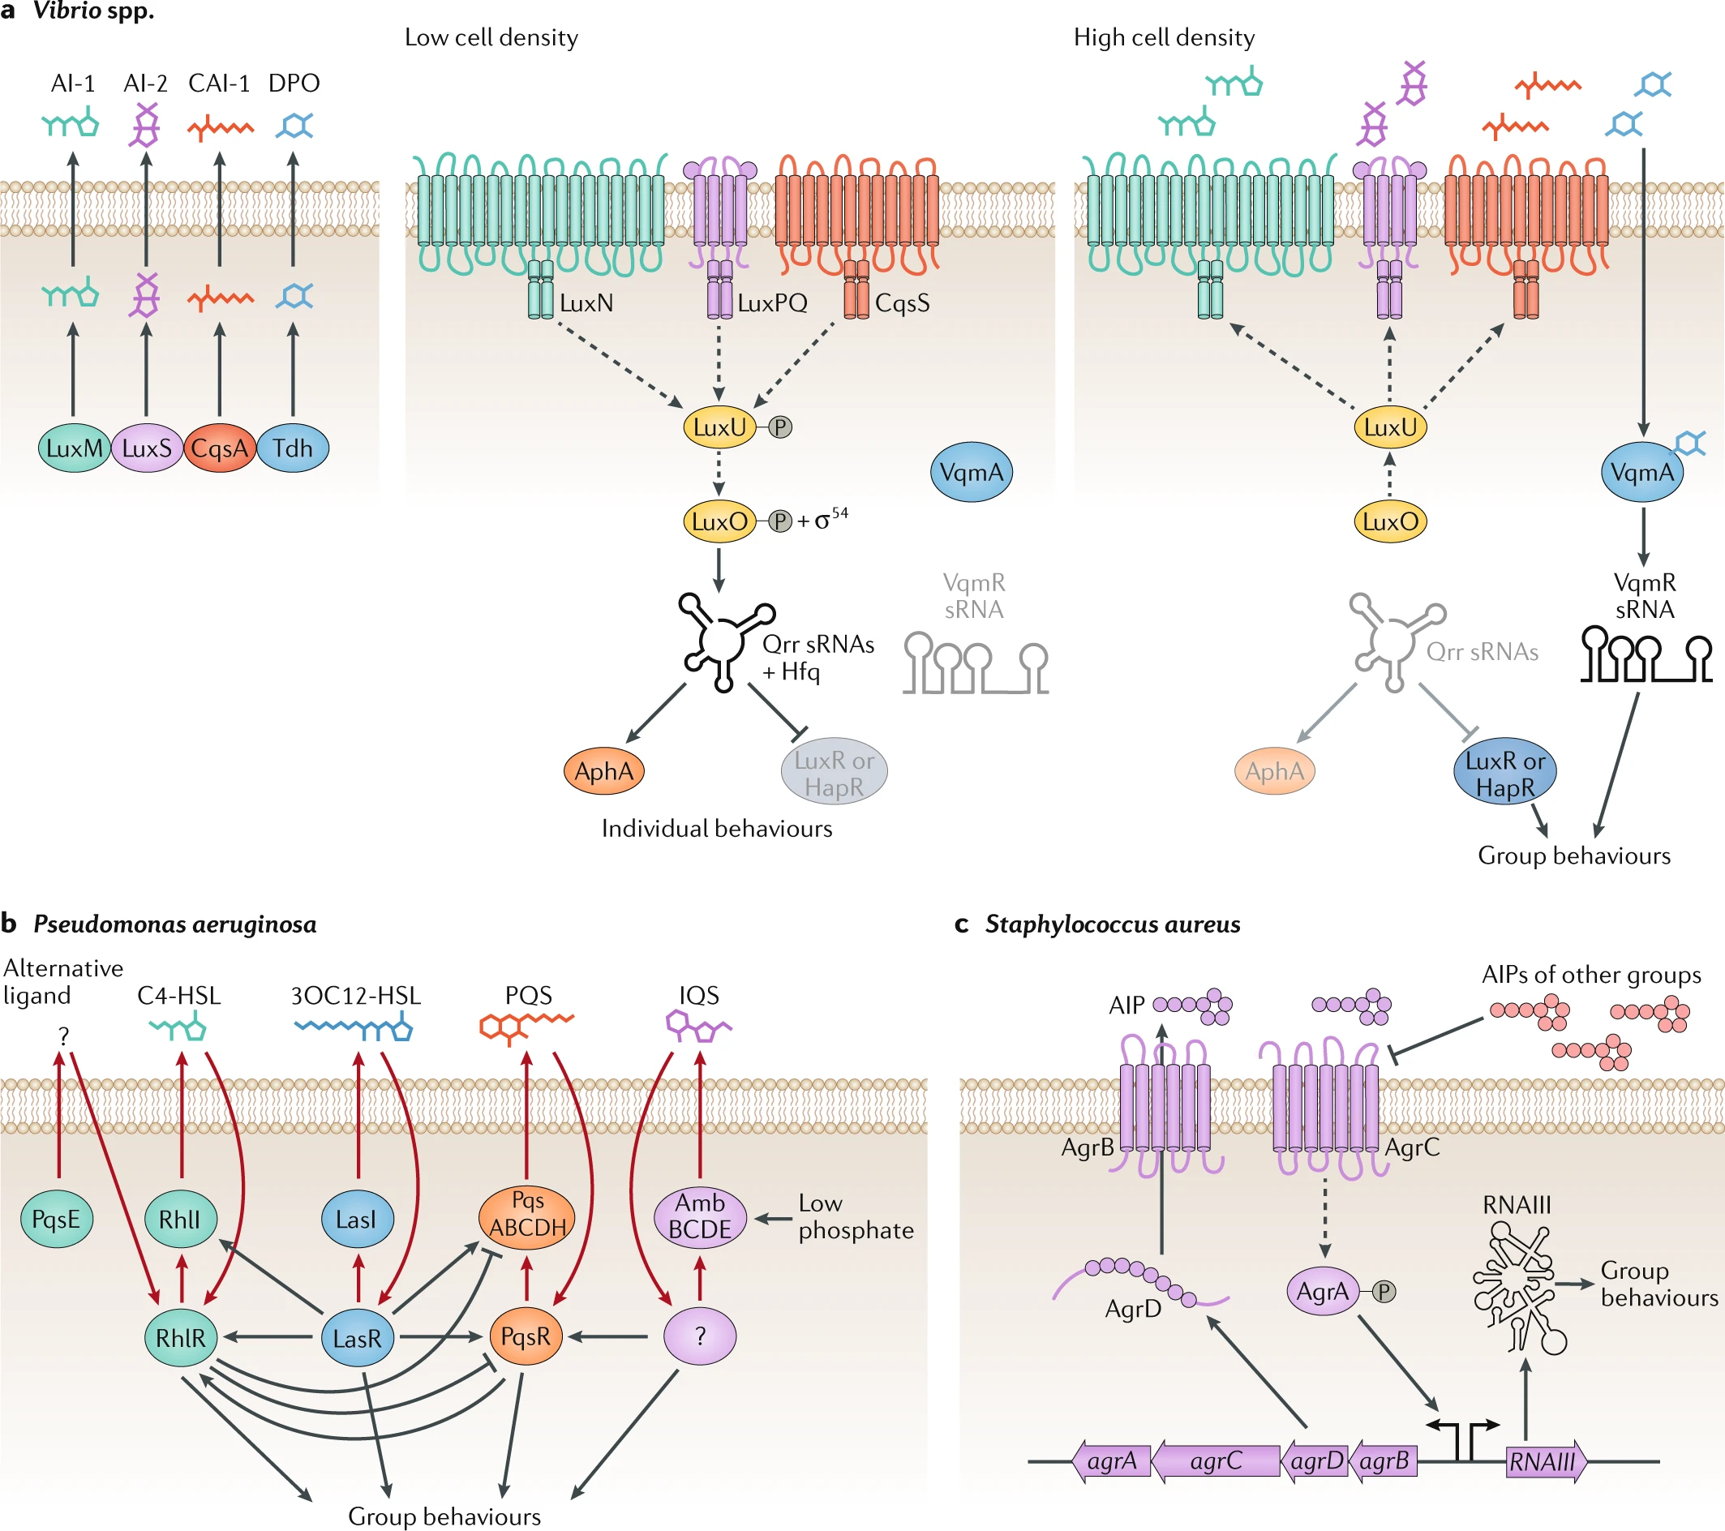
Native mechanisms for controlling cell population?
Similar mechanisms for controlling natural population through quorum sensing
Autoinducers
Low cell density
kinases
Individual behaviors
Notes:
Bacterial quorum sensing relies on networks of autoinducers, autoinducer synthases, partner autoinducer receptors and downstream signal transduction components that convert the information contained in autoinducers into changes in gene expression. a | When Vibrio spp. are at a low cell density, autoinducer levels are low, and their cognate receptors activate a phosphorylation cascade that ultimately results in the activation of the transcription factor AphA, which mediates individual behaviours. By contrast, at high cell density, the synthases LuxM, LuxS, CqsA and Tdh produce high levels of the autoinducers AI-1, AI-2, CAI-1 and DPO, respectively, and the corresponding receptors function as phosphatases. Instead of AphA, LuxR or HapR is produced, which mediates group behaviours.

Slide 17
Other mechanisms for controlling cell population?
Similar mechanisms for controlling natural population through quorum sensing
Autoinducers
Low cell density
High cell density
kinases
phosphatases
Individual behaviors
Group behaviors
Large diversity of quorum-sensing modules: multichannel feedback systems where population densities are coupled to communications
Notes:
Bacterial quorum sensing relies on networks of autoinducers, autoinducer synthases, partner autoinducer receptors and downstream signal transduction components that convert the information contained in autoinducers into changes in gene expression. a | When Vibrio spp. are at a low cell density, autoinducer levels are low, and their cognate receptors activate a phosphorylation cascade that ultimately results in the activation of the transcription factor AphA, which mediates individual behaviours. By contrast, at high cell density, the synthases LuxM, LuxS, CqsA and Tdh produce high levels of the autoinducers AI-1, AI-2, CAI-1 and DPO, respectively, and the corresponding receptors function as phosphatases. Instead of AphA, LuxR or HapR is produced, which mediates group behaviours.

Slide 18
Lecture structure
Programming population control
Programming multicellular organization
Programming multicellular patterning

Slide 19
Programming self-organizing multicellular structures with synthetic cell-cell signaling
Even with minimal external instructions, cells proliferate, diverge into distinct cell types, and spatially self-organize into complex structures and patterns.
How and why are these structures different from human-made ones?
They are not assembled from preexisting parts that are physically linked according to a defined Cartesian blueprint.
They emerge through a series of genetically programmed sequential events.

Slide 20
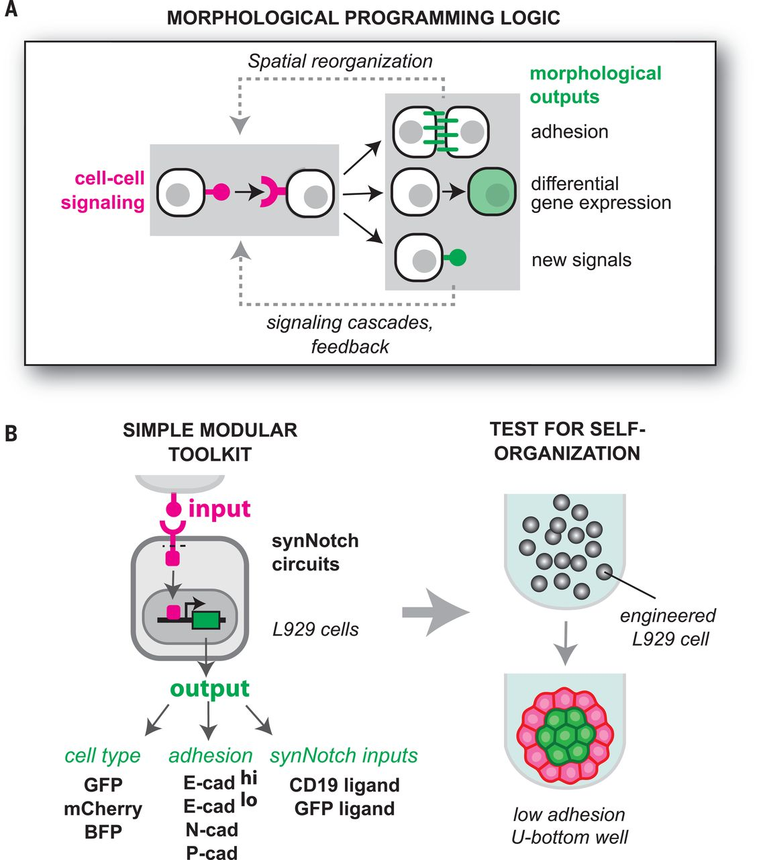
Can simple synthetic circuits in which morphological changes are driven by cell-cell signaling interactions generate self-organizing multicellular structures?
Toda Science 2018
Engineered cell-cell signaling is used to drive changes in cell adhesion, differentiation, and production of new cell-cell signals. These outputs can subsequently be propagated to generate new cell-cell signaling relationships.
Notes:
Design logic underlying our synthetic morphogenesis circuits. Engineered cell-cell signaling is used to drive changes in cell adhesion, differentiation, and production of new cell-cell signals. These outputs can subsequently be propagated to generate new cell-cell signaling relationships.

Slide 21
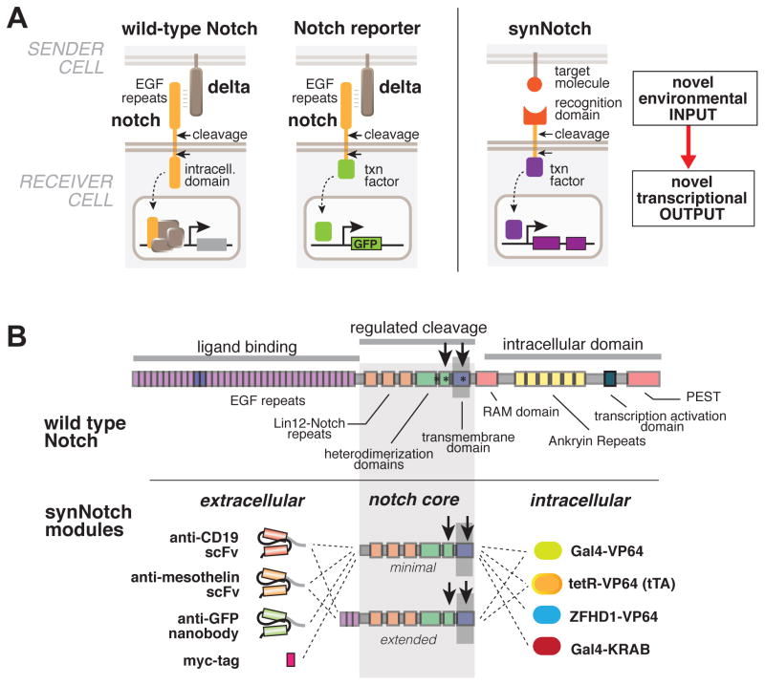
Coupling cell-cell communication with genetic programs
Morsut Cell 2016
Notes:
(A) Conceptual design of synNotch receptor systems. Left: wild-type Notch has a large extracellular domain that binds to its ligand, Delta, expressed on opposing partner cells, and an intracellular transcriptional regulatory domain that is released by ligand-induced cleavage. Arrows indicate the multiple proteolytic cleavage sites. Middle: Notch reporters have been built in which the intracellular domain is replaced by an orthogonal transcription factor. Right: in synNotch receptors, both the extracellular and intracellular domains have been completely replaced, leaving only the small central regulatory region of Notch. Both novel inputs and outputs can be defined by using the synNotch architecture.
(B) Modularity of the synNotch platform: the input and output domains from Notch can be swapped with diverse domains. On the extracellular side, diverse recognition domains can be used (antibody based, or peptide tags are shown), and on the intracellular side, diverse effector can be used (transcriptional activators with different DBDs are shown, as well as a transcriptional repressor).

Slide 22
Coupling cell-cell communication with genetic programs
Morsut Cell 2016
Notes:
(A) Conceptual design of synNotch receptor systems. Left: wild-type Notch has a large extracellular domain that binds to its ligand, Delta, expressed on opposing partner cells, and an intracellular transcriptional regulatory domain that is released by ligand-induced cleavage. Arrows indicate the multiple proteolytic cleavage sites. Middle: Notch reporters have been built in which the intracellular domain is replaced by an orthogonal transcription factor. Right: in synNotch receptors, both the extracellular and intracellular domains have been completely replaced, leaving only the small central regulatory region of Notch. Both novel inputs and outputs can be defined by using the synNotch architecture.
(B) Modularity of the synNotch platform: the input and output domains from Notch can be swapped with diverse domains. On the extracellular side, diverse recognition domains can be used (antibody based, or peptide tags are shown), and on the intracellular side, diverse effector can be used (transcriptional activators with different DBDs are shown, as well as a transcriptional repressor).

Slide 23
Coupling cell-cell communication with genetic programs
Morsut Cell 2016
Notes:
(A) Conceptual design of synNotch receptor systems. Left: wild-type Notch has a large extracellular domain that binds to its ligand, Delta, expressed on opposing partner cells, and an intracellular transcriptional regulatory domain that is released by ligand-induced cleavage. Arrows indicate the multiple proteolytic cleavage sites. Middle: Notch reporters have been built in which the intracellular domain is replaced by an orthogonal transcription factor. Right: in synNotch receptors, both the extracellular and intracellular domains have been completely replaced, leaving only the small central regulatory region of Notch. Both novel inputs and outputs can be defined by using the synNotch architecture.
(B) Modularity of the synNotch platform: the input and output domains from Notch can be swapped with diverse domains. On the extracellular side, diverse recognition domains can be used (antibody based, or peptide tags are shown), and on the intracellular side, diverse effector can be used (transcriptional activators with different DBDs are shown, as well as a transcriptional repressor).

Slide 24
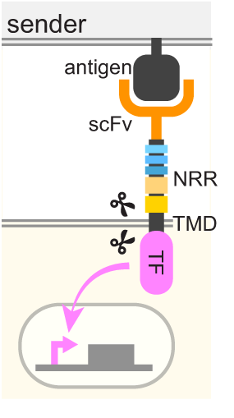
Simple morphological circuits
Notes:
Molecular components used for assembly of simple morphological circuits. We used two synNotch ligand-receptor pairs (surface ligands CD19 and GFP) for cell signaling, three fluorescent proteins as markers of “differentiation,” and several cadherin molecules (expressed at different levels) as morphological outputs. Engineered circuits are transduced into L929 fibroblast cells, placed in defined numbers in low-adhesion U-bottom wells, and screened by microscopy for spatial self-organization.

Slide 25
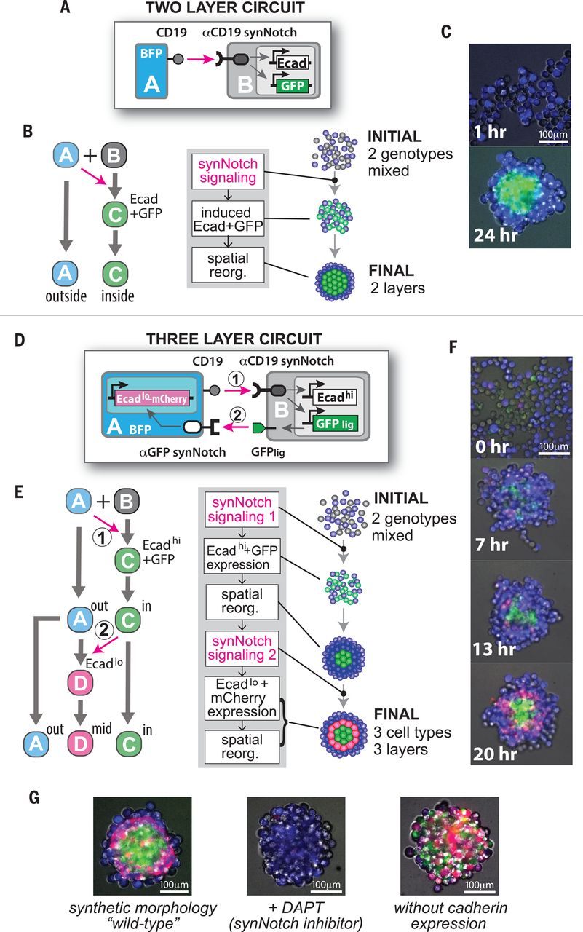
Engineering self-organizing multilayered spheroids
An A-type sender cell expressing CD19 ligand induces a B-type receiver cell to express E-cadherin and GFP
SynNotch cell-cell signals drive receiver cells to express E-cadherin (Ecad), which leads to their segregation into a central layer. The system starts with two disordered cell genotypes but organizes to form a structure with two distinct spatial compartments.
Toda Science 2018
Notes:
Two-layer circuit. (A) An A-type sender cell expressing CD19 ligand induces a B-type receiver cell to express E-cadherin and GFP. (B) SynNotch cell-cell signals drive receiver cells to express E-cadherin (Ecad), which leads to their segregation into a central layer. The system starts with two disordered cell genotypes but organizes to form a structure with two distinct spatial compartments. (C) Images of the spheroid at 1 and 24 hours.

Slide 26
Engineering self-organizing multilayered spheroids
2 genotypes
3 phenotypes
(1) An A-type cell can send signals to a B-type cell using CD19 ligand, which induces expression of E-cadherin (high expression) and GFP_{lig} (surface-expressed GFP).
(2) The induced B-type cell can then send reciprocal signals to the A-type cell; GFP_{lig} serves as ligand to stimulate anti-GFP synNotch receptor expressed in the A-type cell. This reciprocal interaction is programmed to drive a low level of E-cadherin and mCherry.
Toda Science 2018
Notes:
Three-layer circuit. (D) An A-type cell can send signals to a B-type cell using CD19 ligand, which induces expression of E-cadherin (high expression) and GFP_{lig} (surface-expressed GFP). The induced B-type cell can then send reciprocal signals to the A-type cell; GFP_{lig} serves as ligand to stimulate anti-GFP synNotch receptor expressed in the A-type cell. This reciprocal interaction is programmed to drive a low level of E-cadherin and mCherry. (E) Cell fate diagram showing how this program drives a two-step differentiation process in which the A→B synNotch signal first drives conversion of B-type cells to C-type cells that self-adhere and sort to the center of the structure. The sorted C-type cells then present the C→A synNotch signal (driven by GFP_{lig}) to convert spatially adjacent A-type cells into the middle-layer D-type cell (mCherry and low-level E-cadherin expression). A-type cells bifurcate into two phenotypes, depending on their spatial proximity to the C-type cells in the core of the structure. Here, the system starts with two disordered cell genotypes but self-organizes into three distinct cell phenotypes organized into three spatially distinct compartments. (F) Images from the development of the three-layer system from 0 to 20 hours. (G) Formation of the three-layer structure is disrupted if synNotch signaling is inhibited (using DAPT, a γ-secretase inhibitor) or if cadherins are not driven as outputs.

Slide 27
Engineering self-organizing multilayered spheroids
2 genotypes
3 phenotypes
Notes:
Three-layer circuit. (D) An A-type cell can send signals to a B-type cell using CD19 ligand, which induces expression of E-cadherin (high expression) and GFP_{lig} (surface-expressed GFP). The induced B-type cell can then send reciprocal signals to the A-type cell; GFP_{lig} serves as ligand to stimulate anti-GFP synNotch receptor expressed in the A-type cell. This reciprocal interaction is programmed to drive a low level of E-cadherin and mCherry. (E) Cell fate diagram showing how this program drives a two-step differentiation process in which the A→B synNotch signal first drives conversion of B-type cells to C-type cells that self-adhere and sort to the center of the structure. The sorted C-type cells then present the C→A synNotch signal (driven by GFP_{lig}) to convert spatially adjacent A-type cells into the middle-layer D-type cell (mCherry and low-level E-cadherin expression). A-type cells bifurcate into two phenotypes, depending on their spatial proximity to the C-type cells in the core of the structure. Here, the system starts with two disordered cell genotypes but self-organizes into three distinct cell phenotypes organized into three spatially distinct compartments. (F) Images from the development of the three-layer system from 0 to 20 hours. (G) Formation of the three-layer structure is disrupted if synNotch signaling is inhibited (using DAPT, a γ-secretase inhibitor) or if cadherins are not driven as outputs.

Slide 28
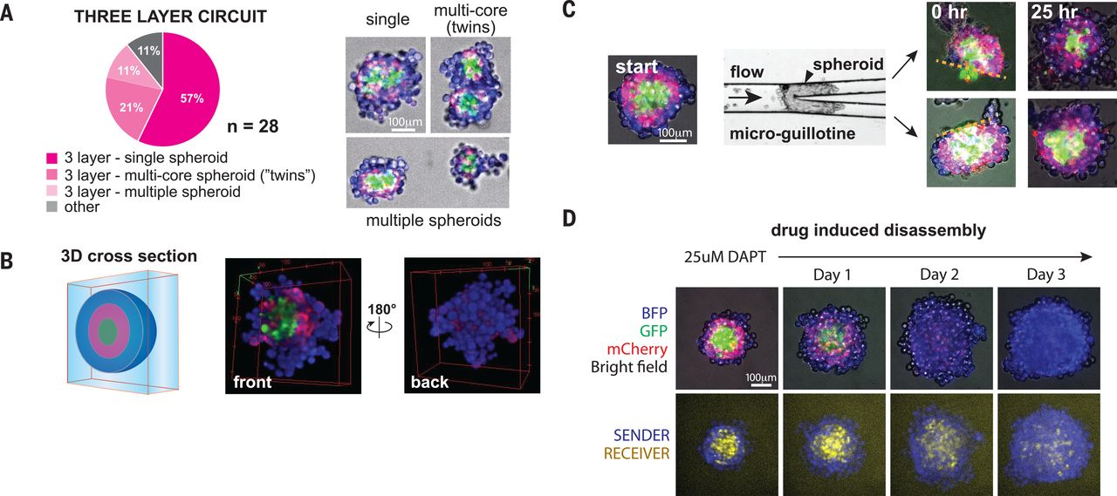
Three-layer self-organized structure is robust, reversible, and self-repairing
Notes:
(A) Distribution of structures generated in 28 independent wells (starting with 200 A-type cells and 40 B-type cells). About 90% of the wells showed formation of three-layer structures; the majority of these showed one spheroid per well, with the remainder showing either twinned spheroids or multiple independent three-layer spheroids. Example images of these structural subtypes are shown at the right. (B) Three-dimensional confocal reconstruction of a three-layer structure cross section, shown from two views. See movie S1 for full rotational view of the 3D structure. (C) Self-repair of a cleaved three-layer structure. The preformed spheroid was cleaved using a microfluidic guillotine, and the two resulting fragments were observed for 25 hours. The frames at 0 hours show the two fragments, with a dotted line indicating the cleavage plane that exposes the internal core of the spheroid. Images at 25 hours show self-repair of the spherical three-layer structure. (D) The structure is reversible if treated with the synNotch inhibitor DAPT. Within 3 days, the differentiation and spatial organization of cells disappeared. Original A- and B-type cells became randomly organized.

Slide 29
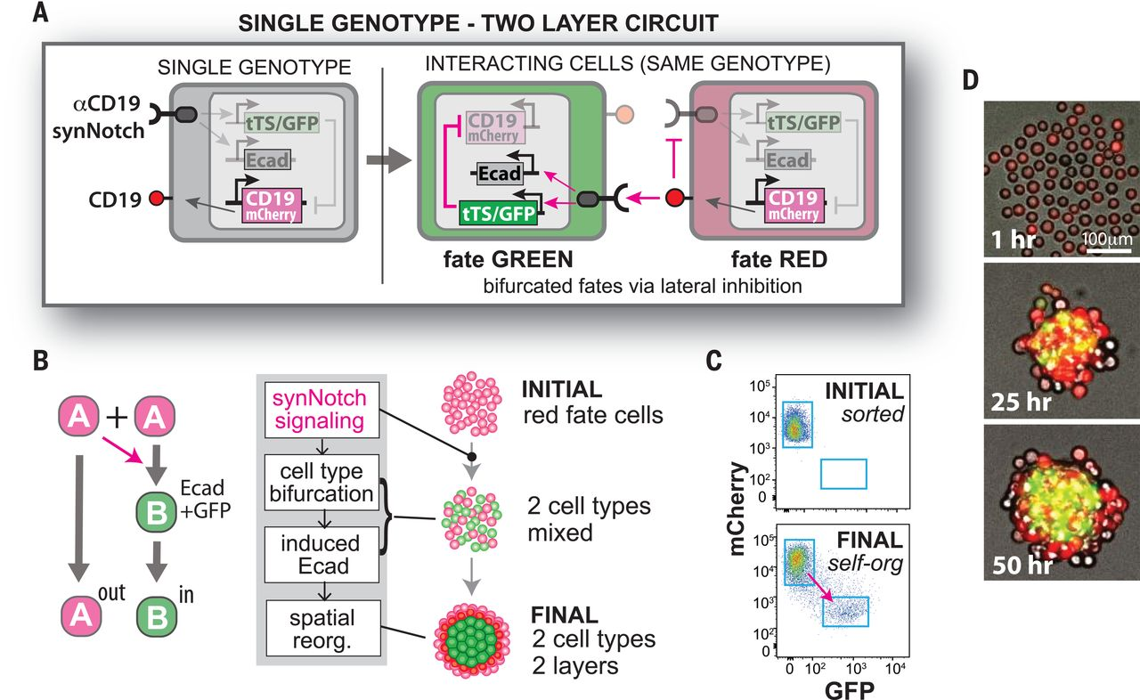
Single-genotype circuit that induces fate bifurcation and spatial ordering into a two-layer structure
Design of single-genotype circuit with lateral inhibition between sender (CD19⁺) and receiver (antiCD19-synNotch–activated) states.
The cell encodes both CD19 and anti-CD19 synNotch, but activated synNotch receptor drives expression of tet repressor (tTS), which inhibits CD19 expression.
Thus, neighboring cells will drive each other into opposite states indicated by red and green fluorescent markers (fate RED and GREEN).
Toda Science 2018
Notes:
(A) Design of single-genotype circuit with lateral inhibition between sender (CD19⁺) and receiver (antiCD19-synNotch–activated) states. The cell encodes both CD19 and anti-CD19 synNotch, but activated synNotch receptor drives expression of tet repressor (tTS), which inhibits CD19 expression. Thus, neighboring cells will drive each other into opposite states indicated by red and green fluorescent markers (fate RED and GREEN). (B) E-cadherin expression driven from the synNotch-activated promoter. An initially homogeneous population of red cells undergoes bifurcation into RED fate and Ecad-positive GREEN fate by lateral inhibition, and GREEN-fate cells are finally sorted inside to form an inner core. The system starts with a single-genotype population but is expected to organize into a two-layer structure. (C) Purification of a homogeneous population by sorting for mCherry^{high}/GFP^{low} cells. When allowed to communicate through lateral inhibition, the cells rebifurcate into two distinct fluorescently labeled populations (bottom). See fig. S4 and supplementary materials for more information on how the lateral inhibition circuit was constructed and executed. (D) Development of the single-genotype two-layer structure. Time frames are shown at 1, 25, and 50 hours, showing initial cell fate bifurcation followed by formation of a stable two-layer structure.

Slide 30
Single-genotype circuit that induces fate bifurcation and spatial ordering into a two-layer structure
Toda Science 2018
Notes:
(A) Design of single-genotype circuit with lateral inhibition between sender (CD19⁺) and receiver (antiCD19-synNotch–activated) states. The cell encodes both CD19 and anti-CD19 synNotch, but activated synNotch receptor drives expression of tet repressor (tTS), which inhibits CD19 expression. Thus, neighboring cells will drive each other into opposite states indicated by red and green fluorescent markers (fate RED and GREEN). (B) E-cadherin expression driven from the synNotch-activated promoter. An initially homogeneous population of red cells undergoes bifurcation into RED fate and Ecad-positive GREEN fate by lateral inhibition, and GREEN-fate cells are finally sorted inside to form an inner core. The system starts with a single-genotype population but is expected to organize into a two-layer structure. (C) Purification of a homogeneous population by sorting for mCherry^{high}/GFP^{low} cells. When allowed to communicate through lateral inhibition, the cells rebifurcate into two distinct fluorescently labeled populations (bottom). See fig. S4 and supplementary materials for more information on how the lateral inhibition circuit was constructed and executed. (D) Development of the single-genotype two-layer structure. Time frames are shown at 1, 25, and 50 hours, showing initial cell fate bifurcation followed by formation of a stable two-layer structure.

Slide 31
Lecture structure
Programming population control
Programming multicellular organization
Programming multicellular patterning

Slide 32
Engineering synthetic morphogen systems that can program multicellular patterning
Morphogens provide positional information during tissue development. For this behavior to occur, morphogens must spread out and form a concentration gradient
Can synthetic morphogens be used to program de novo multidomain tissue patterns independently from endogenous morphogen pathways?
Toda Science 2020

Slide 33
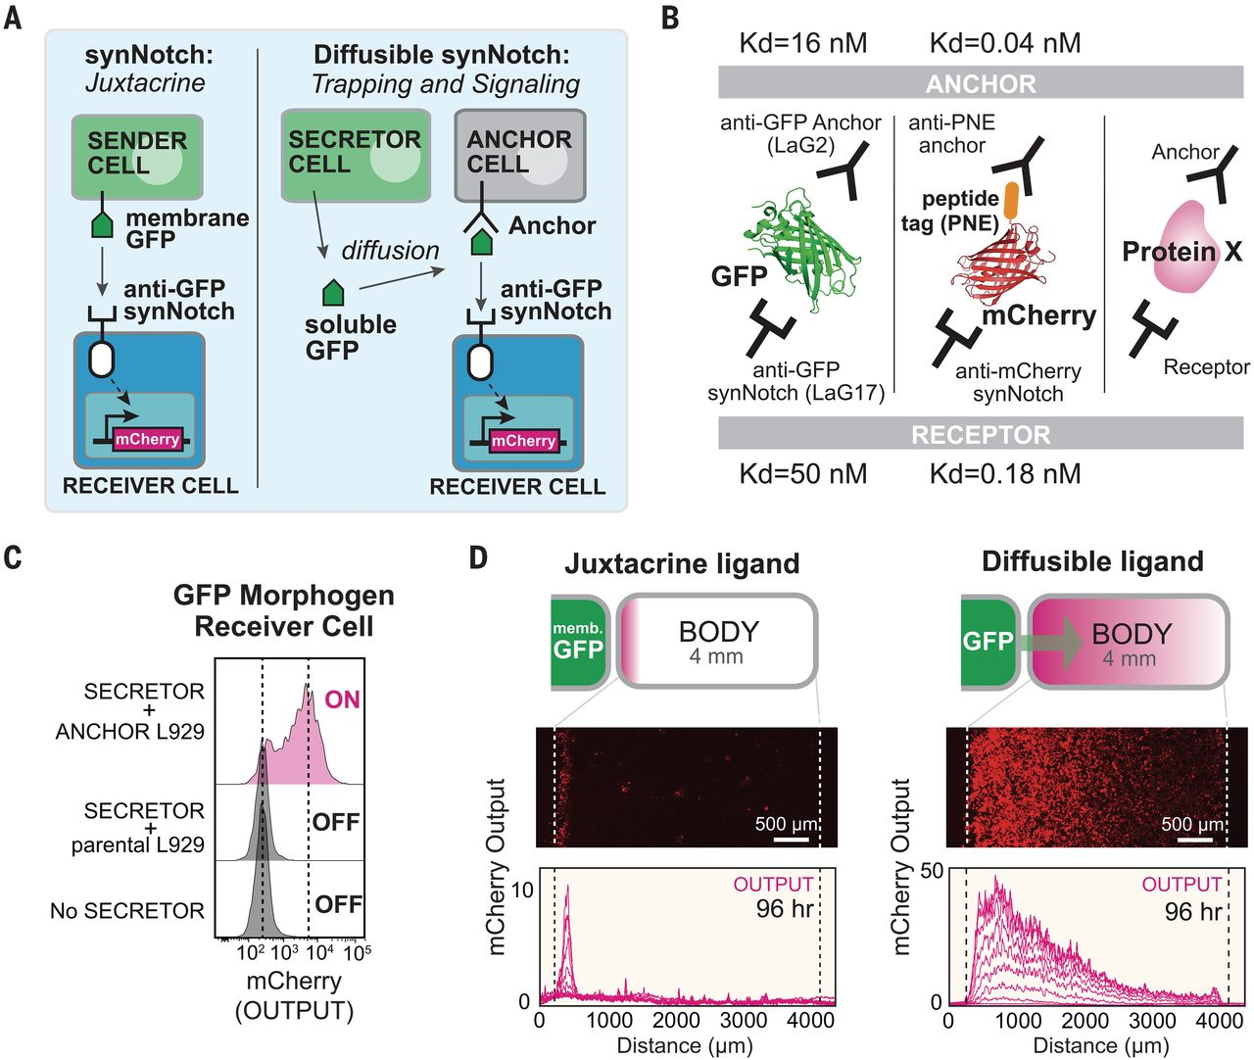
Turning arbitrary proteins into synthetic morphogens
Multiple arbitrary proteins with two recognition sites could be converted into synthetic morphogens
Toda Science 2020
Notes:
(A) SynNotch receptors detect juxtacrine signals (e.g., membrane-tethered GFP). In the diffusible synNotch system, soluble GFP is produced from a secretor cell, then trapped by anti-GFP anchor protein, and finally presented to anti-GFP synNotch on a receiver cell. (B) Multiple arbitrary proteins with two recognition sites could be converted into synthetic morphogens (see fig. S3 for construction of mCherry-PNE peptide morphogen). Kd, dissociation constant.

Slide 34
Engineering synthetic morphogen systems that can program multicellular patterning
Body contains:
Anchor + Receiver
cells
Sender
cells
Secretor
cells
Notes:
(C) Testing diffusible GFP synNotch system in L929 mouse fibroblasts. Anchor cell expresses anti-GFP LaG2 anchor protein. Receiver cell expresses anti-GFP LaG17 synNotch (induces mCherry reporter). 1 × 10⁴ GFP-secreting cells, 0.5 × 10⁴ anchor cells, and 0.5 × 10⁴ receiver cells were cultured overnight, and mCherry induction in receiver cells was measured by flow cytometry. (D) Juxtacrine versus diffusible GFP signaling gradient. Left pole has 3 × 10⁴ sender cells, and right body has 1.5 × 10⁴ cells (100% receiver cells for juxtacrine; 50:50 anchor:receiver cells for diffusible GFP; see fig. S2, A and B). Images were taken by incucyte system over 4 days when system reached steady state (movie S1). Individual lines show mCherry intensity every 12 hours. memb., membrane.

Slide 35
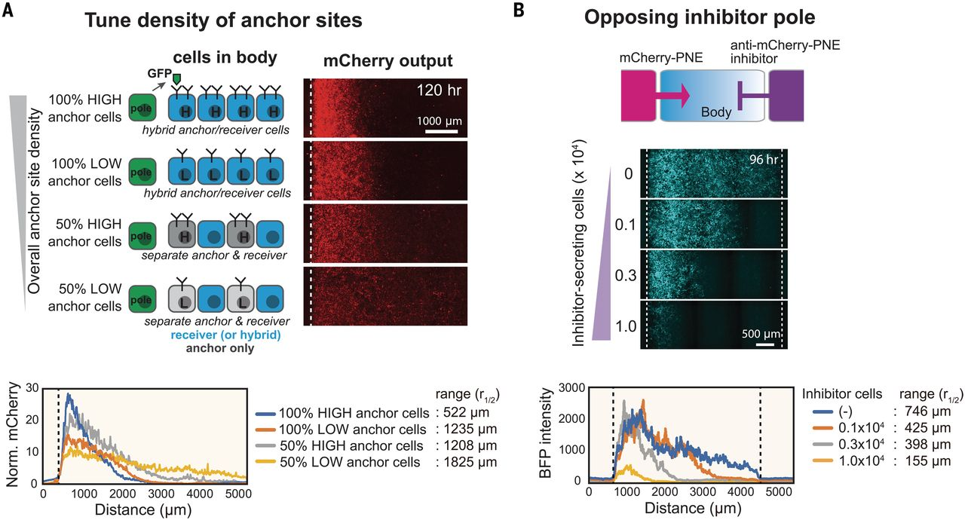
Systematic control over distance range of synthetic morphogen gradient
Toda Science 2020
Notes:
(A) Anchor density can tune synthetic GFP morphogen gradient shape and signaling range. We constructed bodies with four different densities of LaG2-anchor by using two types of variations: anchor expression level (high or low) and fraction of cells in the body that express anchor (100 or 50%).

Slide 36
Controlling signaling range of mCherry-PNE morphogen with inhibitor
Morphogen pole:
mCherry-PNE–secreting cells
Body:
anti-PNE anchor cells and
anti-mCherry synNotch receiver cells
Inhibitor pole :
cells expressing
anti–mCherry-PNE inhibitor
Toda Science 2020
Notes:
We used a three-well insert wall to build three regions: morphogen pole, body, and inhibitor pole. The morphogen pole has a mixture of 1 × 10⁴ mCherry-PNE–secreting cells and 2 × 10⁴ parental L929 cells. The body has a 1.5 × 10⁴ mixture of anti-PNE anchor cells and anti-mCherry synNotch receiver cells (50:50 ratio). The inhibitor pole has cells expressing anti–mCherry-PNE inhibitor (total cell number: 3 × 10⁴ of cells; varying number of inhibitor cells: 0, 0.1 × 10⁴, 0.3 × 10⁴, or 1.0 × 10⁴; remaining cells were parental L929). BFP output was quantified by In Cell Analyzer 6000 at day 4 (see fig. S6 for GFP inhibitor analysis).

Slide 37
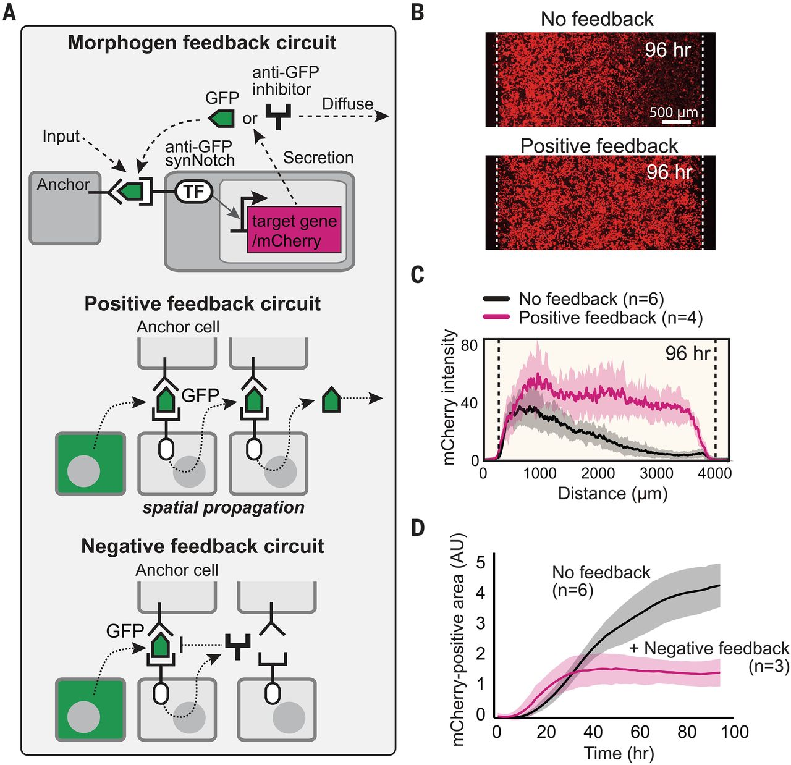
Reshaping morphogen interpretation with positive or negative feedback
In a positive feedback circuit, GFP morphogen activates receiver cells to induce the secretion of more GFP.
In a negative feedback circuit, GFP morphogen induces the expression of antimorphogen inhibitor by receiver cells.
TF, transcription factor
Toda Science 2020
Notes:
(A) In a positive feedback circuit, GFP morphogen activates receiver cells to induce the secretion of more GFP. In a negative feedback circuit, GFP morphogen induces the expression of antimorphogen inhibitor by receiver cells. TF, transcription factor. (B) Comparison of mCherry output in the body with and without positive feedback at 96 hours (see fig. S7C for time course). The pole has 3 × 10⁴ GFP-secreting cells; the body has a 1.5 × 10⁴ mixture of anchor cells and receiver cells engineered with a positive feedback circuit (50:50 ratio). Images were taken by incucyte system for 4 days (movie S1). (C) Activity gradient profiles at 96 hours, with and without positive feedback. Shaded area shows SD from multiple experiments. (D) The mCherry-positive area (integral of top plots) plotted over time shows that the body with negative feedback reaches steady state faster than it does without feedback. AU, arbitrary units.

Slide 38
Reshaping morphogen interpretation with positive or negative feedback
Notes:
(A) In a positive feedback circuit, GFP morphogen activates receiver cells to induce the secretion of more GFP. In a negative feedback circuit, GFP morphogen induces the expression of antimorphogen inhibitor by receiver cells. TF, transcription factor. (B) Comparison of mCherry output in the body with and without positive feedback at 96 hours (see fig. S7C for time course). The pole has 3 × 10⁴ GFP-secreting cells; the body has a 1.5 × 10⁴ mixture of anchor cells and receiver cells engineered with a positive feedback circuit (50:50 ratio). Images were taken by incucyte system for 4 days (movie S1). (C) Activity gradient profiles at 96 hours, with and without positive feedback. Shaded area shows SD from multiple experiments. (D) The mCherry-positive area (integral of top plots) plotted over time shows that the body with negative feedback reaches steady state faster than it does without feedback. AU, arbitrary units.

Slide 39
Take home message
Cell-cell communication through cell surface attached or diffusible ligands can control:
Cell population
Multicellular Morphology
Multicellular Patterning

Slide 40
Take home message
Open book exam with a large fraction inspired
from exercises and mini protein design project.
Mock exam to follow at the end of the lectures
(more info on Moodle soon)
No need to remember the precise details of circuits
Learn and understand the principles, concepts and goals underlying the different types of circuits

