Slide 1
For interactive questions
echo360poll.eu
Session ID:

Slide 2
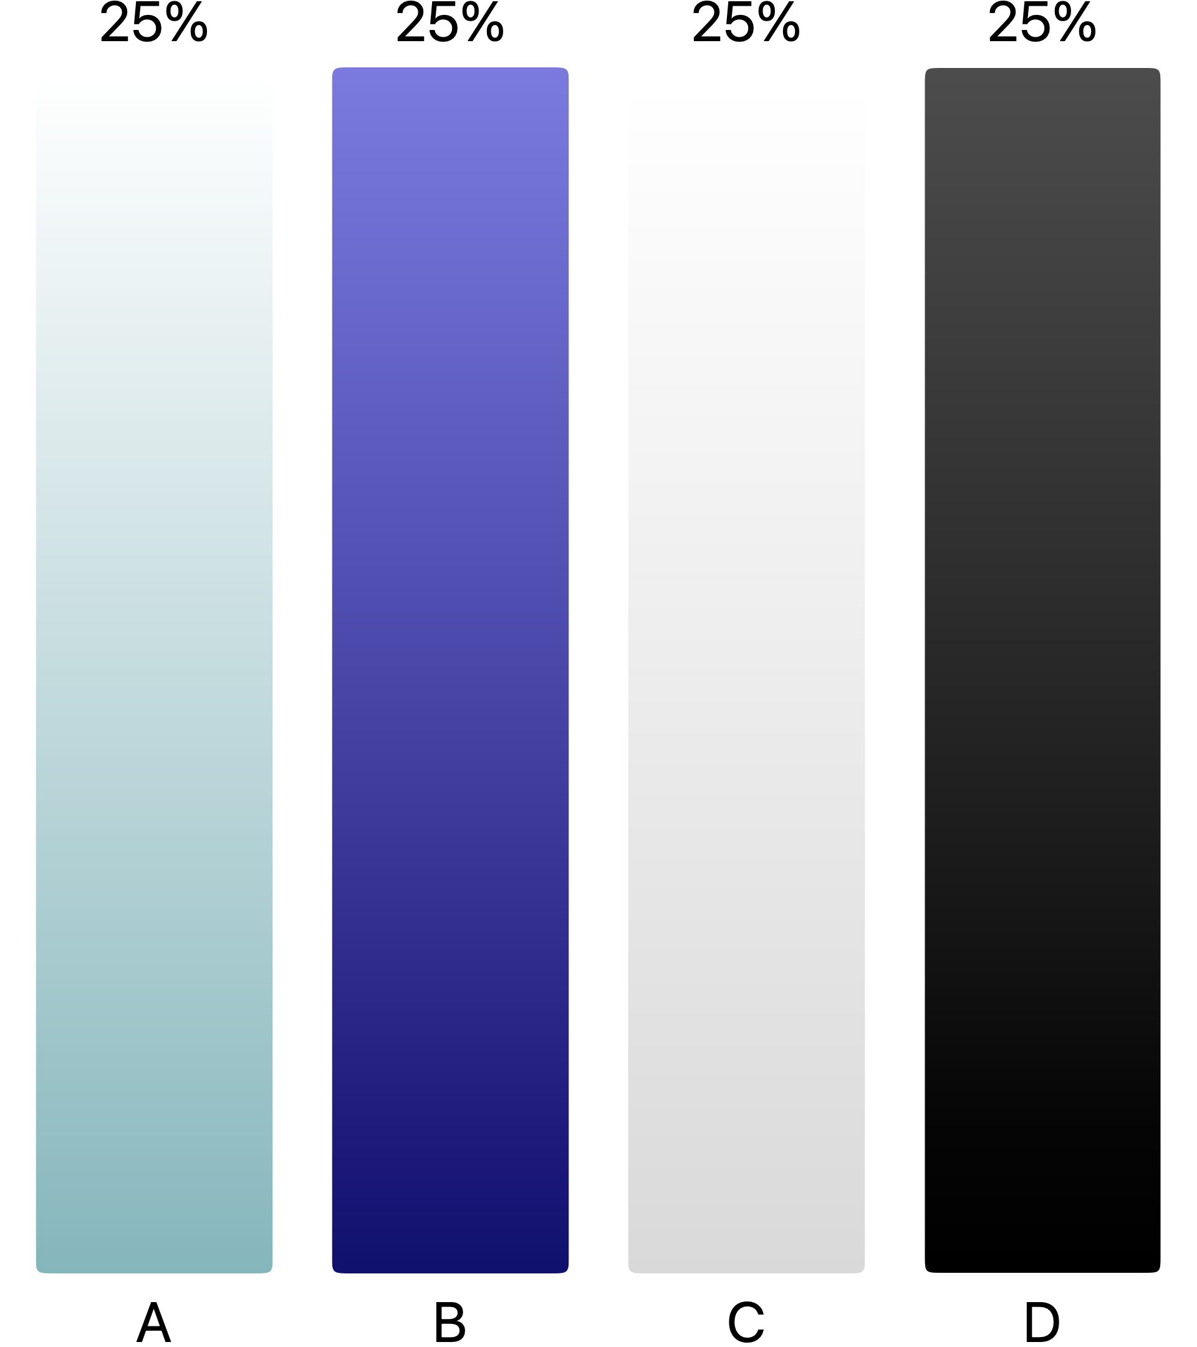
A human individual with 47 chromosomes has a _____.
monosomy
trisomy
euploidy
diploidy
triploidy

Slide 3
A human individual with 47 chromosomes has a _____.
trisomy
The normal human chromosome complement is 46. With 47 chromosomes, there is an extra member of one chromosomal pair; this is a trisomy. Triploid means that there are three complete sets of chromosomes (69).

Slide 4
The horse is 2n = 64, and the donkey is 2n = 62. If crossed, they produce the hybrid mule. How many chromosomes are found in a mule somatic cell? This cell is _________.
2n = 126; aneuploid
2n = 126; euploid
2n = 63; aneuploid
2n = 63; euploid
either 2n = 64 or 2n = 62, depending on whether the mother was the horse or the donkey; euploid.

Slide 5
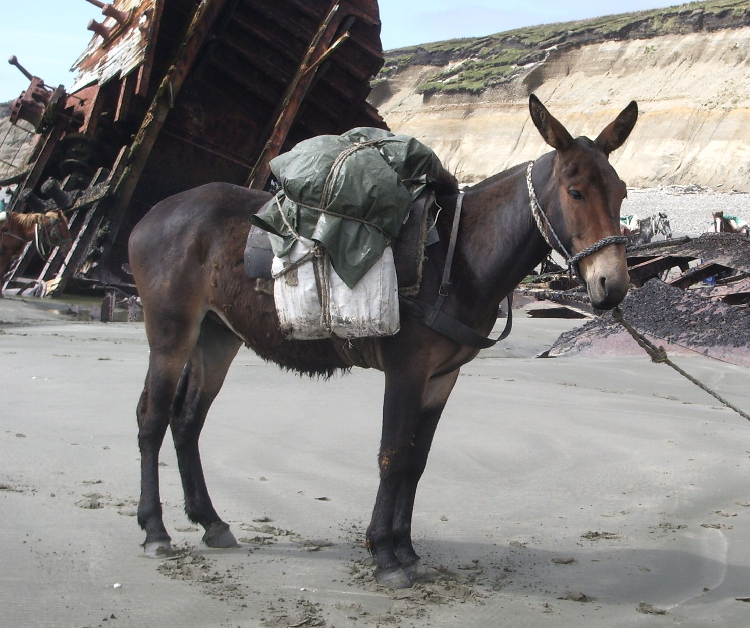
The horse is 2n = 64, and the donkey is 2n = 62. If crossed, they produce the hybrid mule. How many chromosomes are found in a mule somatic cell? This cell is _________.
2n = 63; euploid
The horse gamete has 1n = 32 chromosomes; the donkey gamete has 1n = 31 chromosomes. When they fuse, the resulting mule cell has 32 + 31 = 63 chromosomes. Because it has complete sets of chromosomes, it is a euploid cell, even though it has an odd number of chromosomes.

Slide 6
Which of the following statements about Down syndrome is correct?
Individuals with Down syndrome are triploid.
Down syndrome occurs due to nondisjunction in either meiotic division in the mother.
Most Down syndrome births happen to women over age 35.
Familial Down syndrome is due to nondisjunction.
All of the above are false.

Slide 7
Which of the following statements about Down syndrome is correct?
All of the above are false.
In most cases, individuals with Down syndrome have
47 chromosomes, with three copies of chromosome 21, or trisomy 21. This could occur due to nondisjunction in either parent. A triploid embryo (which is a lethal condition in humans) would have three complete sets of chromosomes, or 69 chromosomes. While the incidence of Down syndrome births increases in women over 35, most such births occur in younger women. Familial Down syndrome is due to translocation of chromosome 21 onto chromosome 14.

Slide 8
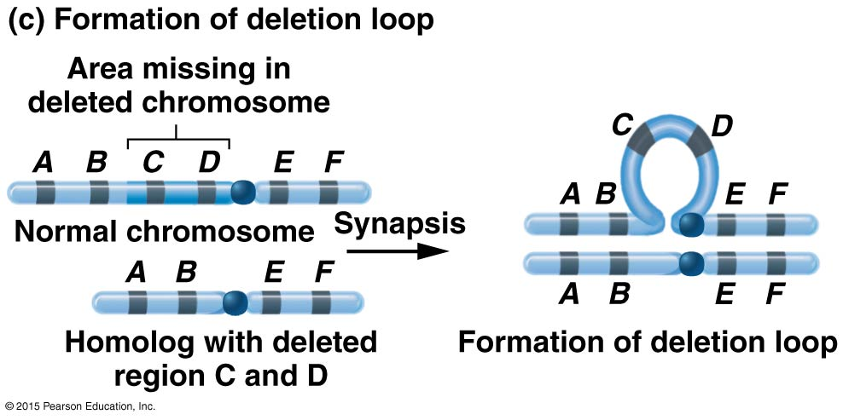
The following structure is observed during prophase 1. It could be due to which of the following conditions?
pericentric inversion
duplication
deletion
insertion
deletion or insertion

Slide 9
The following structure is observed during prophase 1. It could be due to which of the following conditions?
deletion or insertion
During synapsis, if there is DNA found in one homolog but not in the other, a loop of the “extra” material will form. This “extra” DNA could be from the normal chromosome failing to match up to a deletion on its homolog, or the loop could form on a homolog having extra DNA (insertion) that can’t match up to the normal chromosome.

Slide 10
Can a person have 45 chromosomes and be phenotypically normal?
Yes; this happens often
Yes, if the person is a translocation carrier
Yes, if it is the X chromosome that is monosomic
No; having 45 chromosomes always results in some phenotype
No; having only 45 chromosomes is lethal in humans

Slide 11
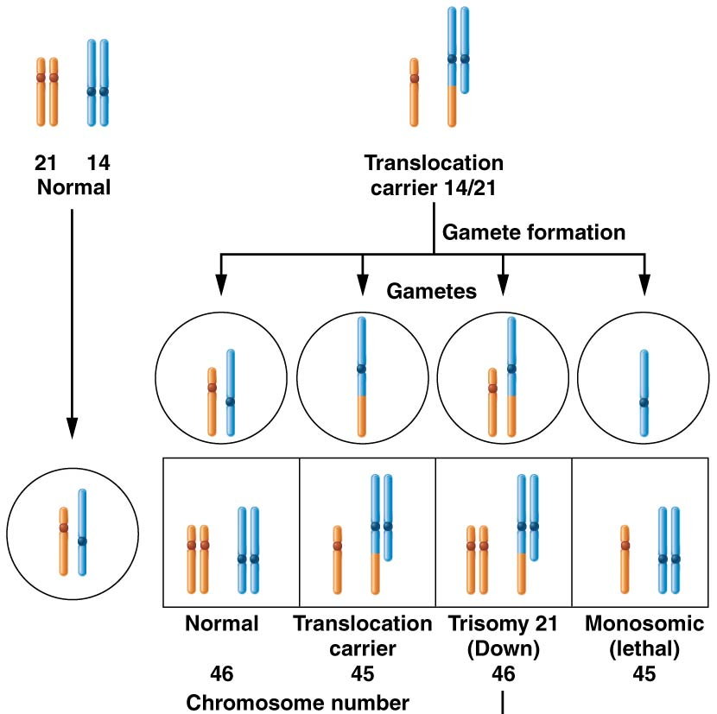
Can a person have 45 chromosomes and be phenotypically normal?
Yes, if the person is a translocation carrier
If there is a translocation of most of an entire chromosome (shown here as a 14/21 translocation), then there is no loss of information, even if there are only 45 physically separate chromosomes.

Slide 13
Which of the following categories of mutations is not possible to pass to offspring?
silent
somatic
frameshift
induced
X-linked

Slide 14
Which of the following categories of mutations is not possible to pass to offspring?
somatic
Somatic mutations occur in any cell of the body except germ cells (which divide to form gametes), so they cannot be inherited by offspring.

Slide 15
A tautomeric shift may result in _____.
transition mutations
transversion mutations
frameshift mutations
induced mutations
any of the above

Slide 16
A tautomeric shift may result in _____.
transition mutations
Bases can exist as different isomers, called tautomers. However, a purine remains a purine and a pyrimidine remains a pyrimidine. What does change is what it can base-pair with. In this form of spontaneous mutation, the base pairs with the wrong partner. This results in a purine-to-purine mutation and a pyrimidine-to-pyrimidine mutation, which are transition mutations.

Slide 17
Which of the following can result in frameshift mutations?
alkylating agent
tautomeric shift
base analog
intercalating agent
deamination

Slide 18
Which of the following can result in frameshift mutations?
intercalating agent
Intercalating agents wedge between base pairs in the double helix, causing deletions or insertions during replication or repair. The other choices generally result in mispairing, which leads to substitution mutations.

Slide 19
Which of the following DNA repair mechanisms is most often used by bacteria to repair thymine dimers?
photoreactivation repair
double-stranded DNA repair
mismatch repair
postreplication repair
proofreading

Slide 20
Which of the following DNA repair mechanisms is most often used by bacteria to repair thymine dimers?
photoreactivation repair
In this type of repair, the photoreactivation enzyme uses energy from a photon to cleave thymine dimers.

Slide 21
Which of the following is a potential effect of transposons in the genome?
gene inactivation by insertional mutagenesis
change in gene regulation by insertion in regulatory regions
alteration of splice sites of genes
exon shuffling
all of the above

Slide 22
Which of the following is a potential effect of transposons in the genome?
all of the above
Transposons have demonstrated a wide range of effects on the genome, including those listed among the answers.

Slide 23
While there are several mutations that give rise to cystic fibrosis, a common one is a three-base-pair deletion at position 508 of the CFTR gene. This would result in ______.
a frameshift
a transition
the deletion of a single amino acid in the protein
premature termination of translation
no effect on protein structure, but on transcription

Slide 24
While there are several mutations that give rise to cystic fibrosis, a common one is a three-base-pair deletion at position 508 of the CFTR gene. This would result in ______.
the deletion of a single amino acid in the protein
Removal of three bases (a codon) results in a single amino acid being absent in the protein. Nothing before and after is altered.

Slide 25
You have identified a mutation in your cell line in the lab that causes unregulated growth of the cells. This mutation is dominant and, when transfected into other cells, causes the unregulated growth phenotype. Further, you now know it produces a protein product. What type of gene has this mutation most likely affected?
proto-oncogene
tumor-suppressor
apototic
cyclin regulator
oncogene

Slide 26
You have identified a mutation in your cell line in the lab that causes unregulated growth of the cells. This mutation is dominant and, when transfected into other cells, causes the unregulated growth phenotype. Further, you now know it produces a protein product. What type of gene has this mutation most likely affected?
proto-oncogene
This description matches the hallmarks of a proto-oncogene, which is activated (and transformed into an oncogene) by a dominant mutation with a functional protein produced that spurs growth.

Slide 27
Apoptosis _____.
is a normal response to severe DNA damage
can abnormally occur during development
is a common characteristic of cancer cells
is a process that repairs damaged DNA
is controlled by genes unrelated to those controlling the cell cycle

Slide 28
Apoptosis _____.
is a normal response to severe DNA damage
Apoptosis, or programmed cell death, is a process by which a cell commits suicide if DNA damage is too extensive to repair. Cancer cells may have lost the ability to initiate apoptosis.

Slide 29
The protein p53 _____.
is found in high levels in all cells
may stimulate either apoptosis or the arrest of the cell cycle
stimulates apoptosis but not the arrest of the cell cycle
stimulates the arrest of the cell cycle but not apoptosis
is absent or nonfunctional in less than 30% of all cancers

Slide 30
The protein p53 _____.
may stimulate either apoptosis or the arrest of the cell cycle
p53 is found at low levels in all normal cells, and its gene (p53) is mutated in more than half of all cancers. After DNA damage is detected, p53 can direct arrest of cell cycle for repair or, if damage is extensive, direct the cell to enter apoptosis.

Slide 31
Calling cancer a “genetic disease” means _____.
that it is caused by inherited mutations in the germ line
that it is caused by mutations in somatic cells that can be transferred to the next generation of somatic cells
that it can be caused by changes in the chromatin that can be passed to offspring
that metastatic tumors are caused by malignancy genes
that the difference between benign and malignant tumors is due to genotype

Slide 32
Calling cancer a “genetic disease” means what?
that it is caused by mutations in somatic cells that can be transferred to the next generation of somatic cells
While predisposition to cancer can be inherited, when we think of cancer as a genetic disease, we are considering the change of genetic material in the mutant cells alone as providing the inherited basis of the disease, from one generation of tumor cells to the next.

