Slide 1
Bioremediation of Uranium using anaerobic Bacteria
Notes:
Nino Herve & Théophile Bouiller & Mehdi Hicham

Slide 2
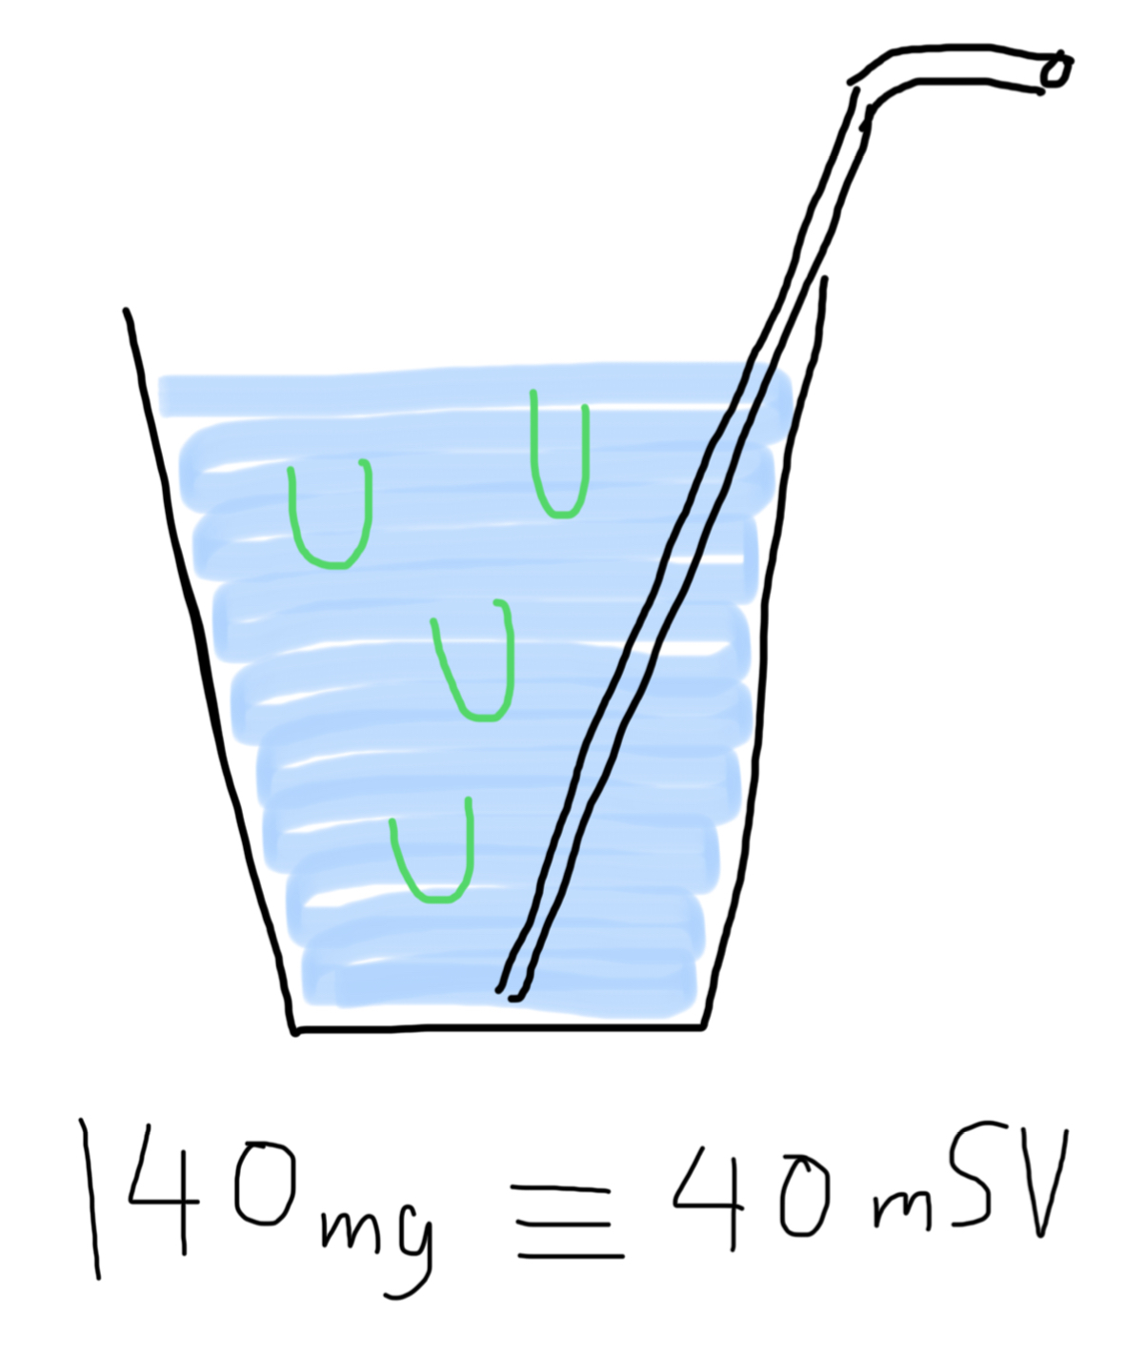
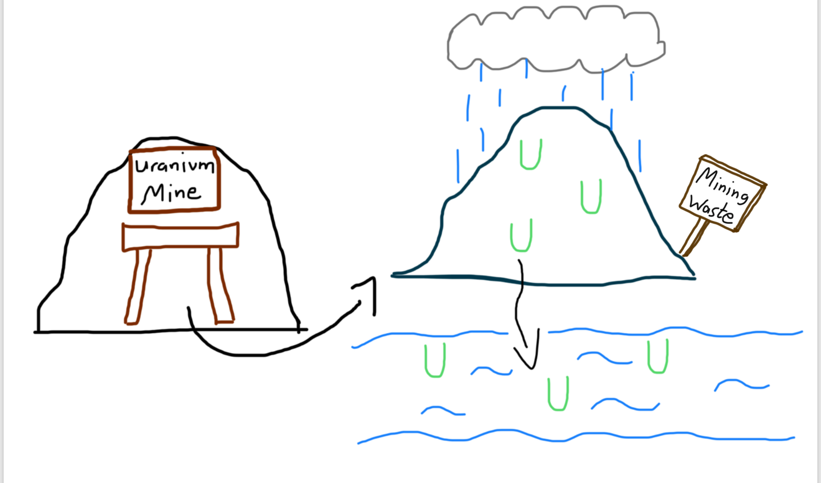
The harmful effects of Uranium Waste
Metal toxicity
lethal dose = 140mg [1]
Radioactivity :
lethal dose = 5000mSv [1]
Metal Toxicity : when metal ions wander between cells they might hinder biological metabolisms

Slide 3
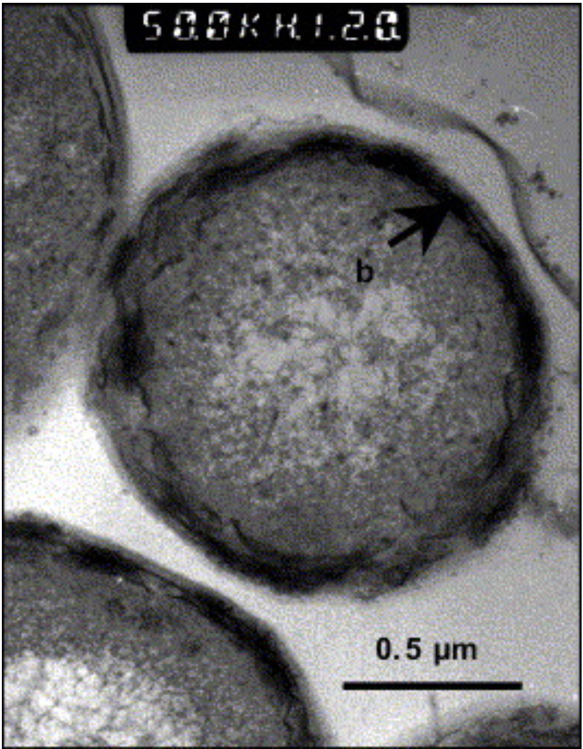

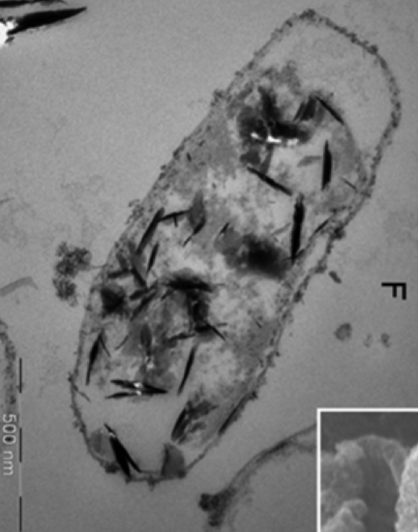
A solution : bioremediation using bioaccumulation
Source : [2]
Source : [3]
The goal is to immobilize uranium by making it insoluble.[4]

Slide 4
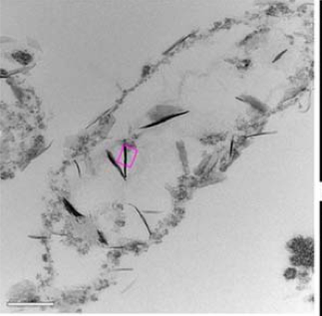
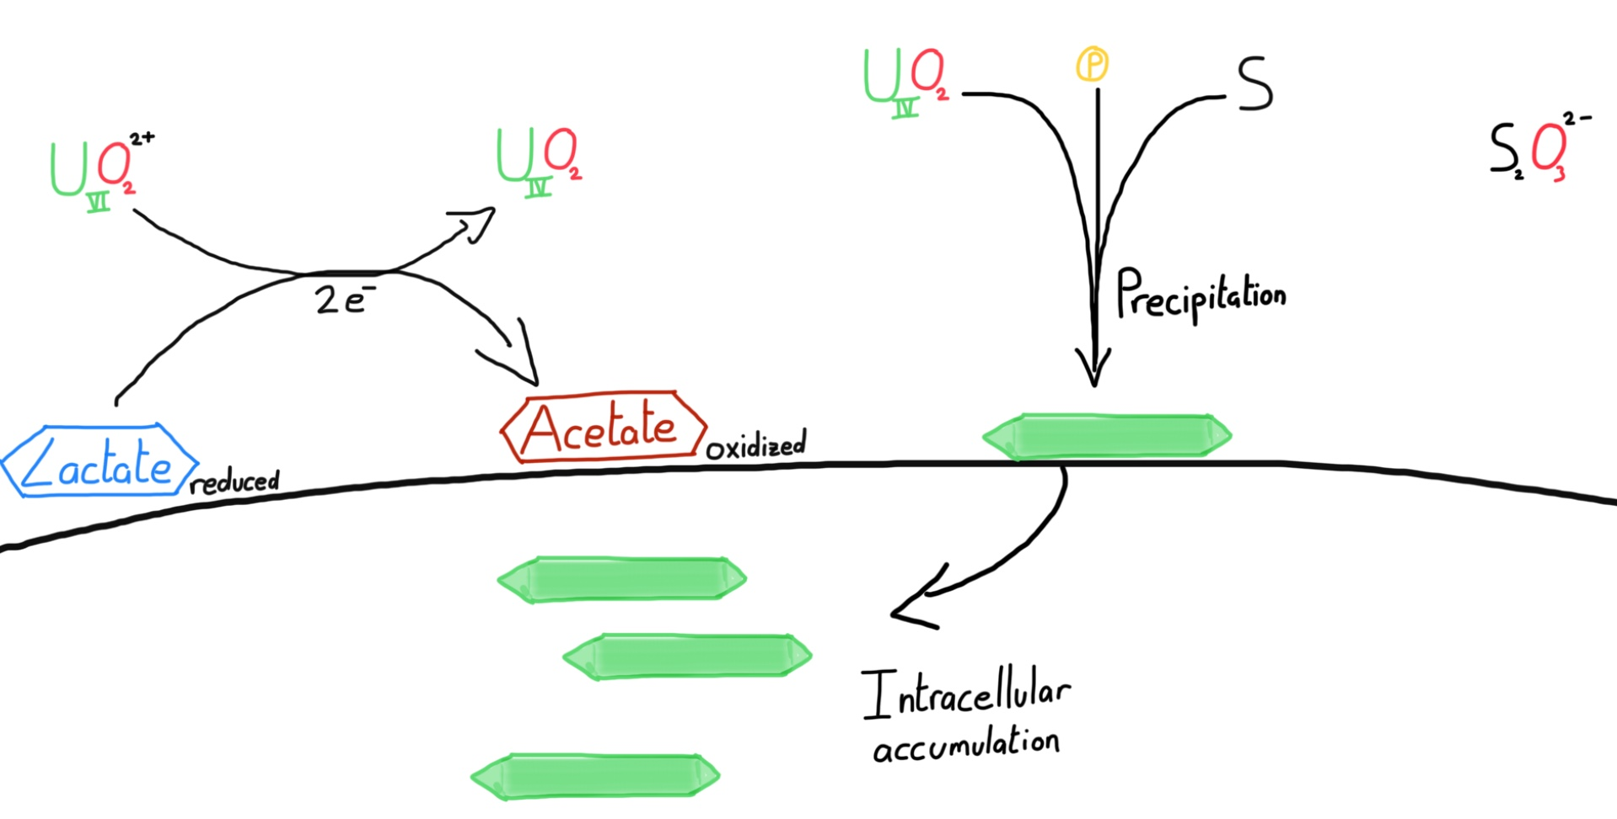
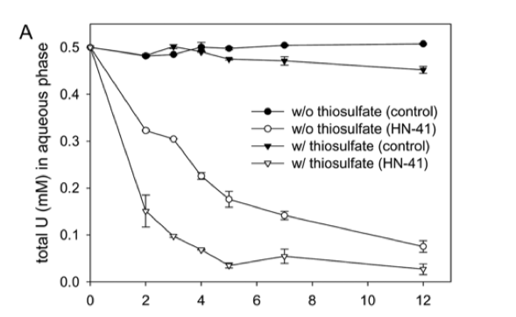
Intracellular bioaccumulation in Shewanella sp. HN-41
Source : [2]
Inspired from [2]
Source : [2]

Slide 5
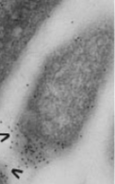
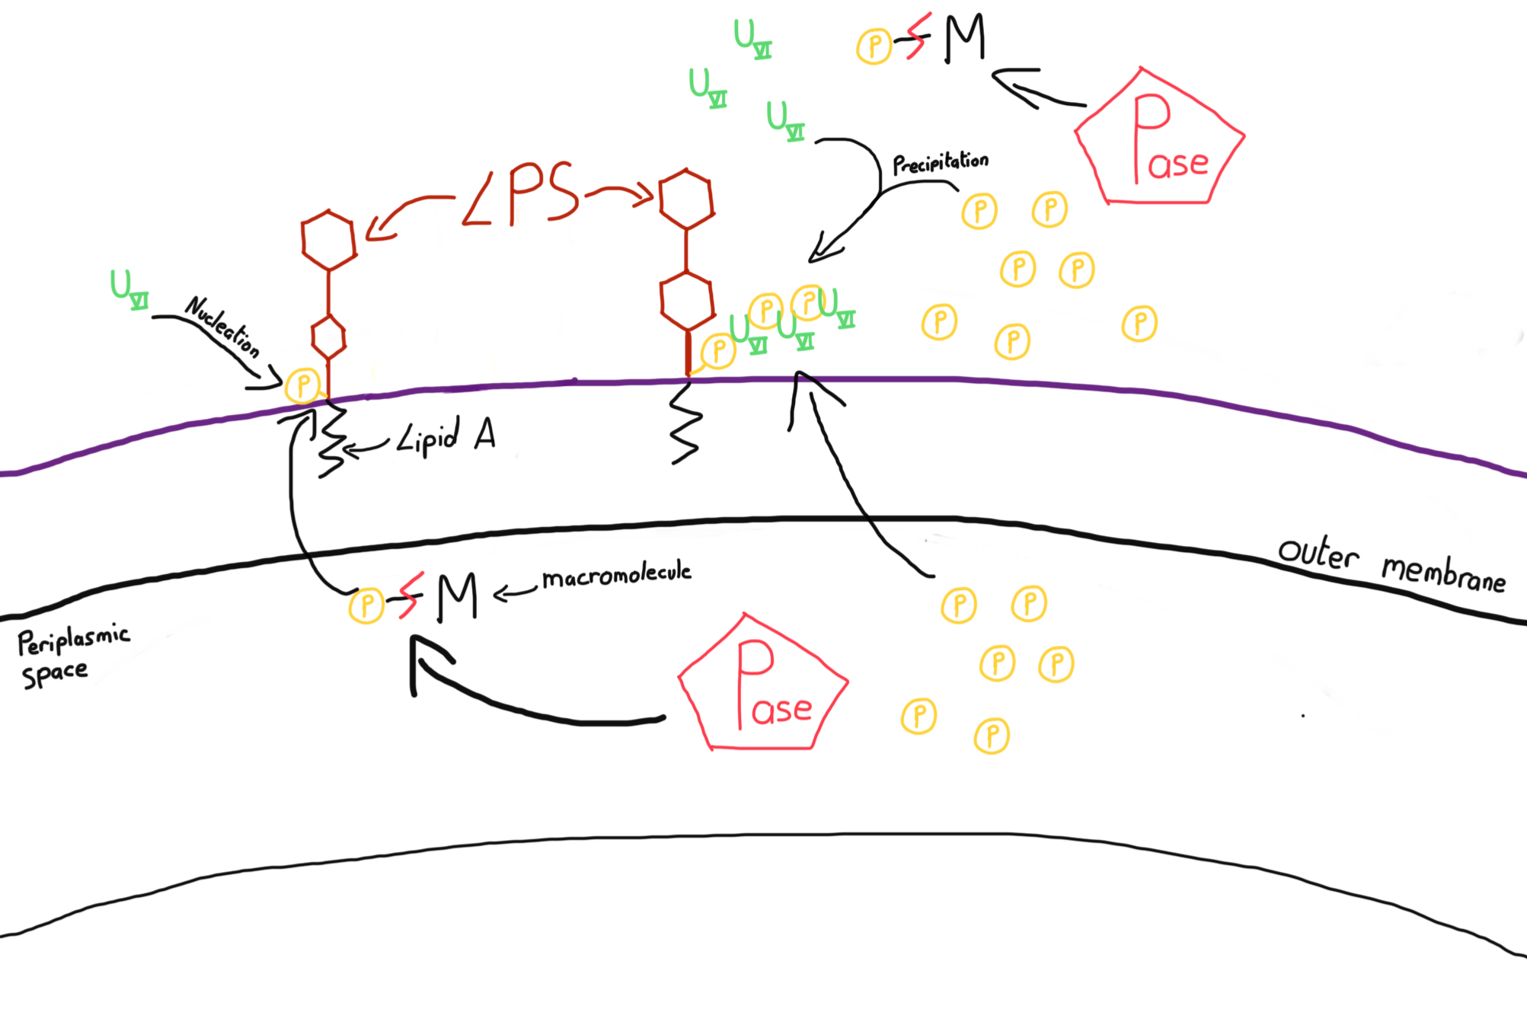
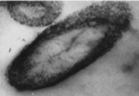
Extracellular bioaccumulation by Citrobacter sp.
Phosphatase in the periplasm and in the extracellular space [6]
Uranyl-phosphate bioaccumulation on the cell surface [7]
Citrobacter is able to accumulate up to 900% of its cellular dry weight
Inspired from [5,6,7]

Slide 6
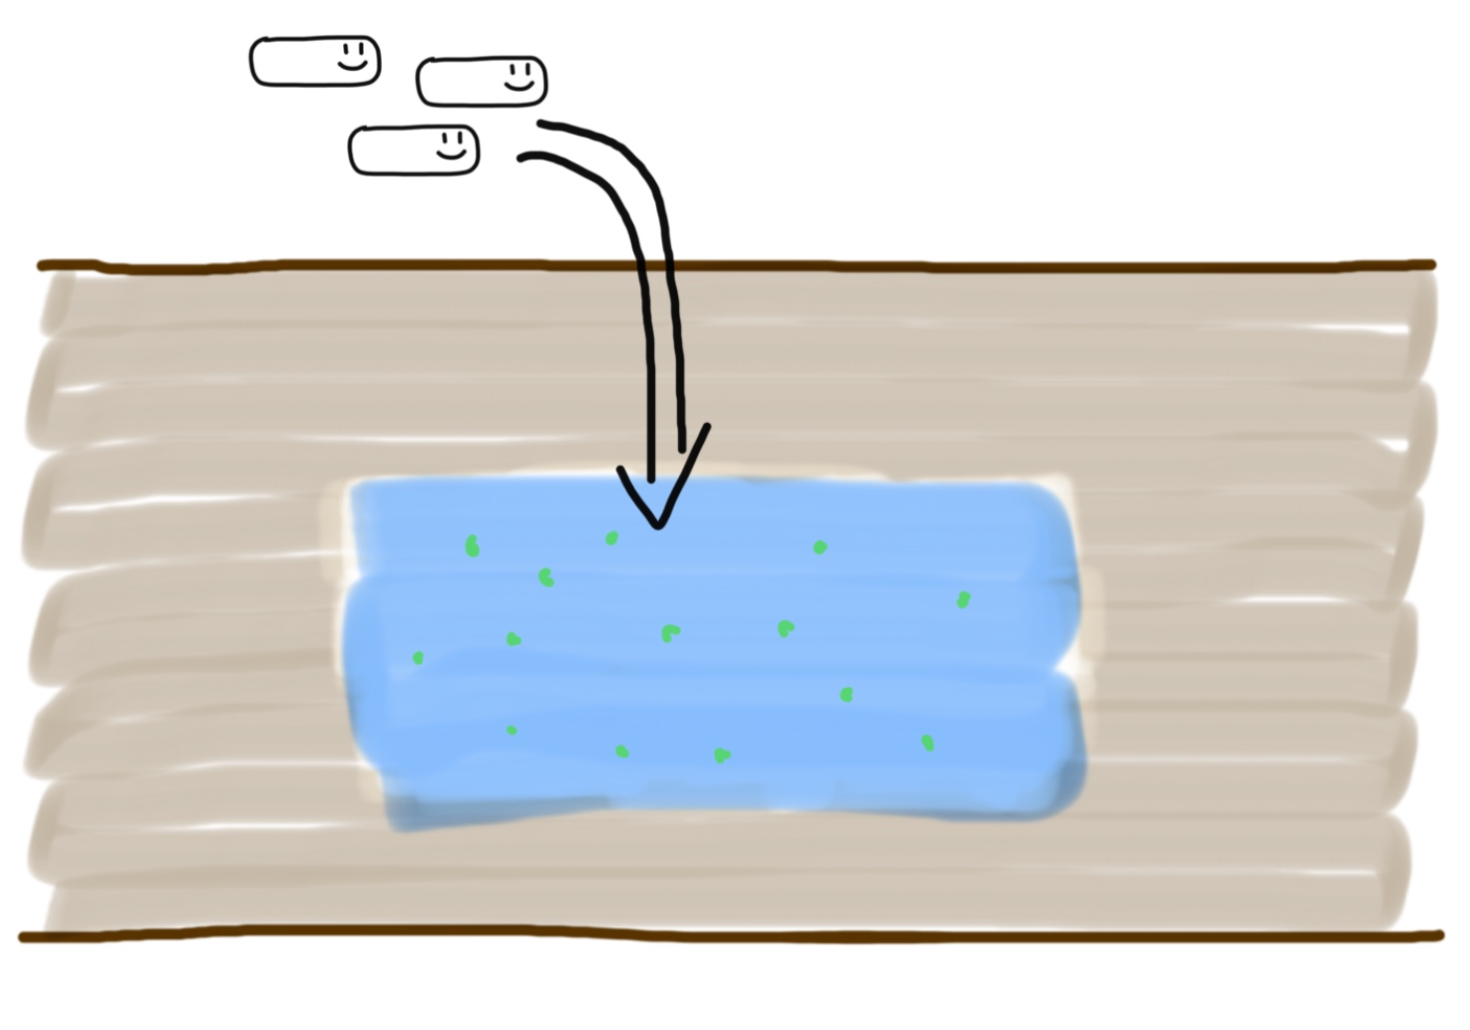
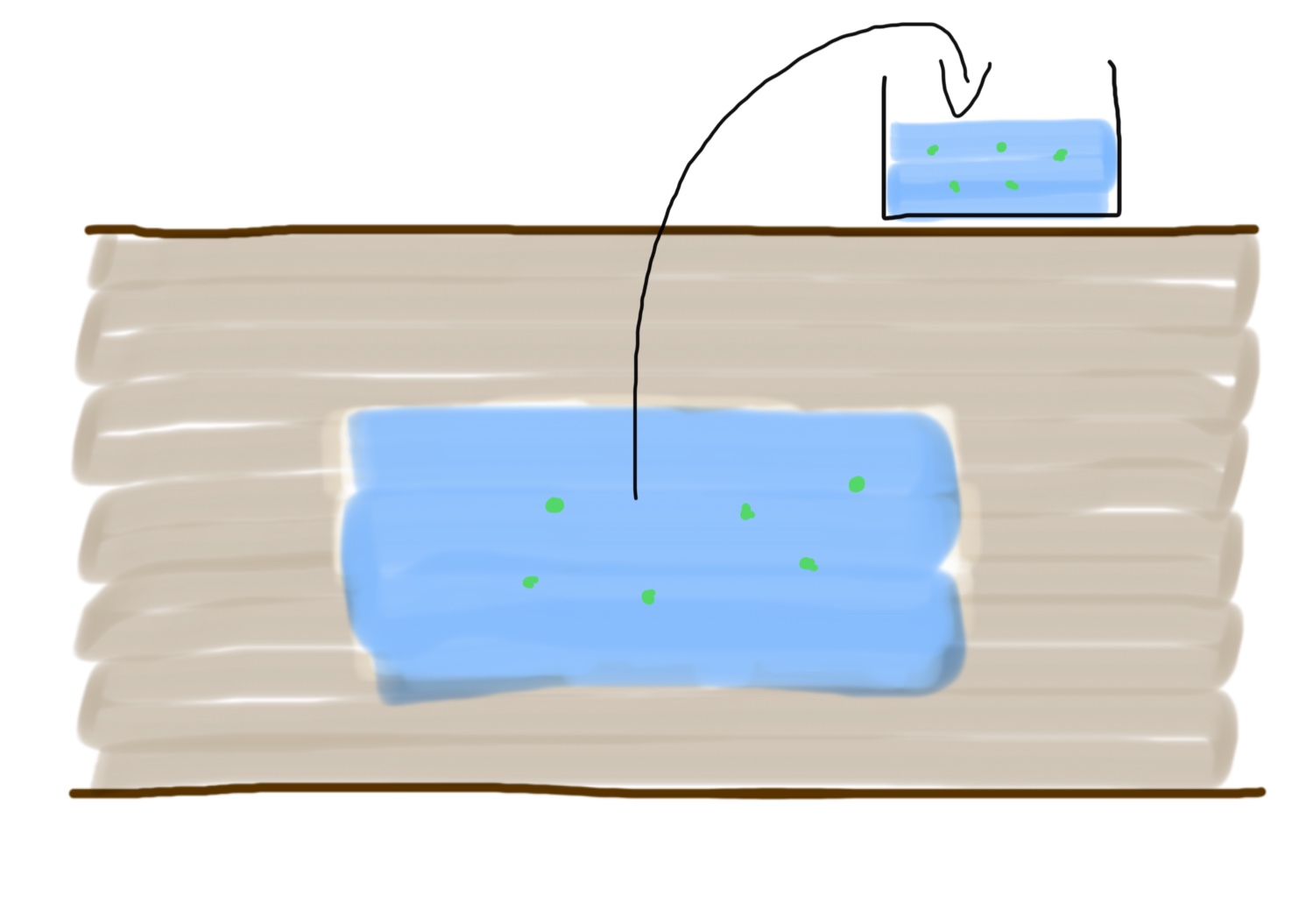
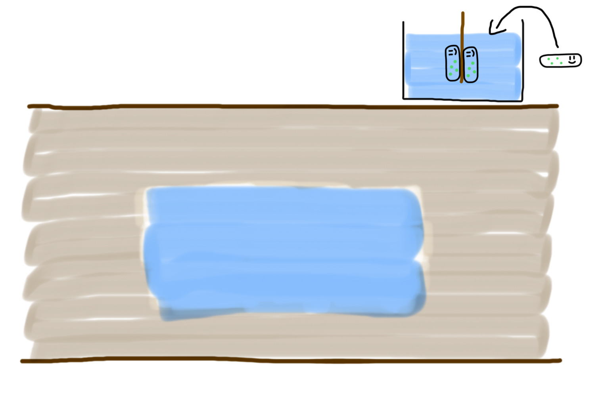
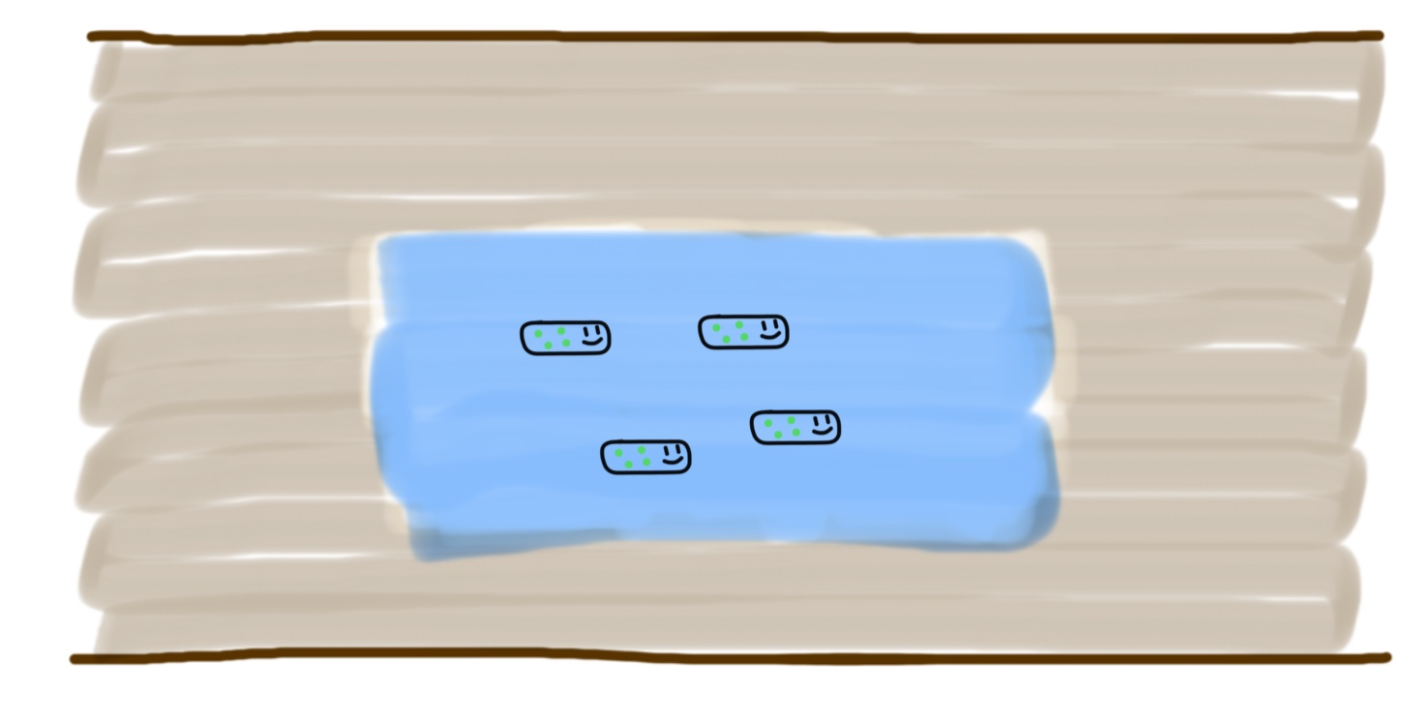
Possible Application in bioremediation
Uranium becomes insoluble and accumulates in bacteria. This can decrease the concentration of uranium in groundwater for instance.
2 methods :
In situ
Ex situ

Slide 7
Conclusion : Application to other pollutants
Good alternative to chemicals in depollution of Uranium in groundwaters.
Those bacteria are often able to decontaminate other heavy metals
Possibility to bioengineer GMOs to increase the decontamination of known pollutants or to find new pathway to bioremediate new types of pollutants (xenobiotics such as PCBs).
A tremendous thank to Pr. Rizlan Bernier-Latmani.
References :
[1] http://www.laradioactivite.com/site/pages/RadioPDF/Uranium_Unat_v1.pdf
[2] Lee, JH. & Hur, HG. J Korean Soc Appl Biol Chem (2014) Intracellular uranium accumulation by Shewanella sp. HN-41 under the thiosulfate-reducing condition 57: 117. https://doi.org/10.1007/s13765-014-4025-0
[3] Pollmann K, Raff J, Merroun M, Fahmy K, Selenska-Pobell S. Metal binding by bacteria from uranium mining waste piles and its technological applications. Biotechnol Adv. 2006;24: 58–68. 10.1016/j.biotechadv.2005.06.002
[4] A. Shukla, P. Parmar and M. Saraf, Radiation, radionuclides and bacteria: An in-perspective review, J. Environ. Radioact., 2017, 180, 27–35
[5] Macaskie, L., Empson, R., Cheetham, A., Grey, C., & Skarnulis, A. (1992). Uranium bioaccumulation by a Citrobacter sp. as a result of enzymically mediated growth of polycrystalline HUO2PO4. Science, 257(5071), 782–784. doi:10.1126/science.1496397
[6] Macaskie L, Bonthrone K, Yong P, Goddard D., Enzymically mediated bioprecipitation of uranium by a Citrobacter sp.: a concerted role for exocellular lipopolysaccharide and associated phosphatase in biomineral formation Microbiology 146(8):1855-1867 doi:10.1099/00221287-146-8-1855
[7] Jeong B, Hawes C, Bonthrone K, Macaskie L. Localization of enzymically enhanced heavy metal accumulation by Citrobacter sp. and metal accumulation in vitro by liposomes containing entrapped enzyme, Microbiology 143(7):2497-2507 doi:10.1099/00221287-143-7-2497

