Slide 1
Peptides, Decarboxylations, and Aldols
Quick Recap

Slide 2
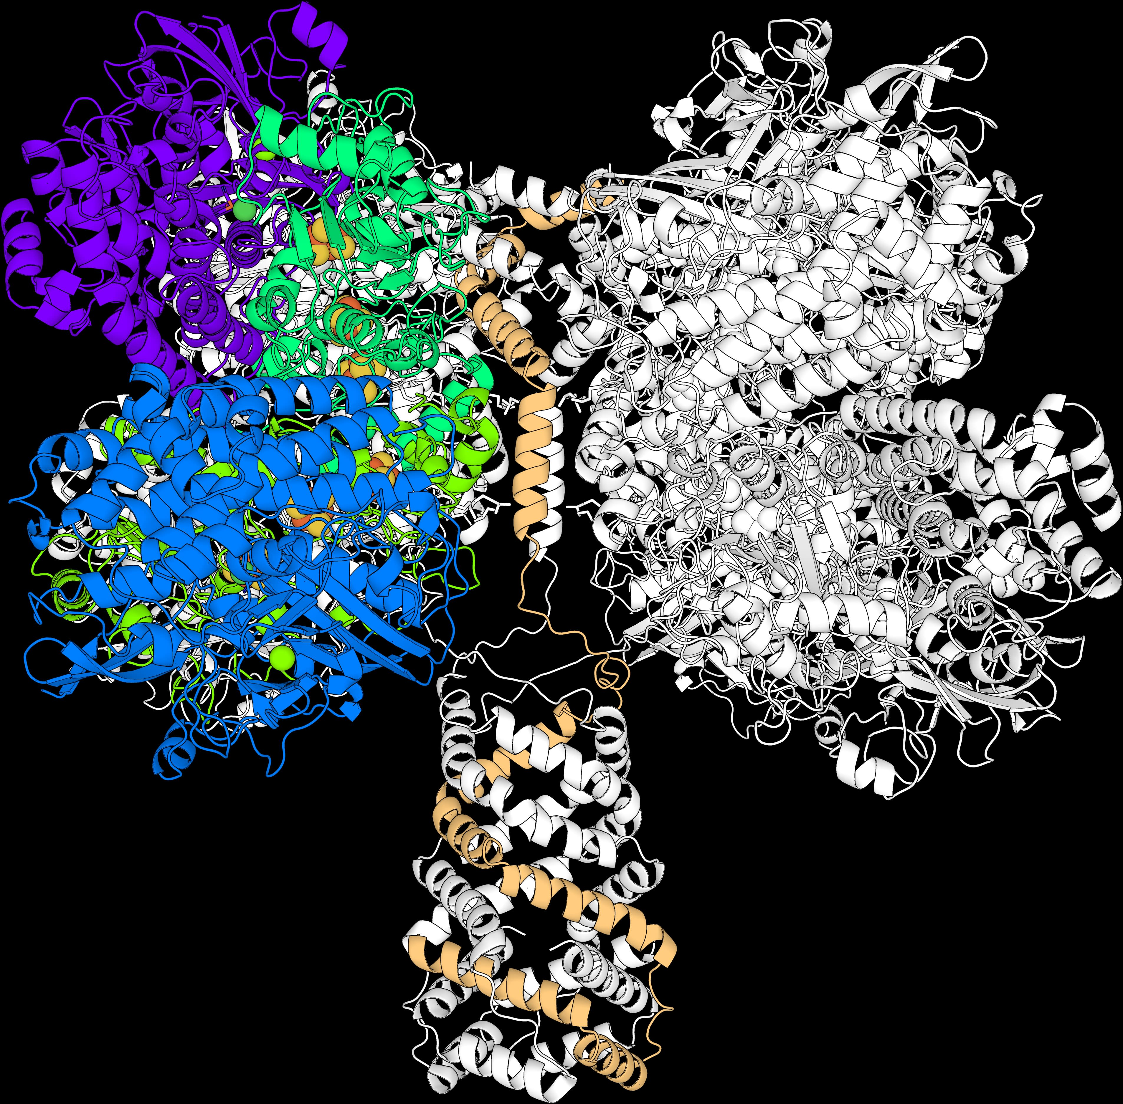
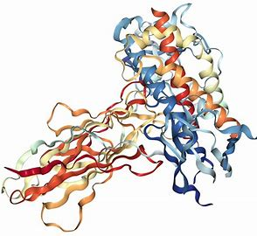
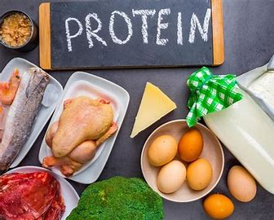


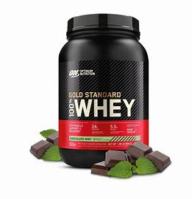
Peptides

Slide 3
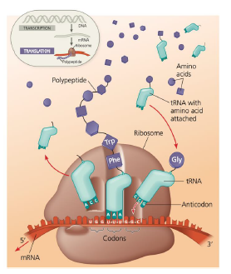
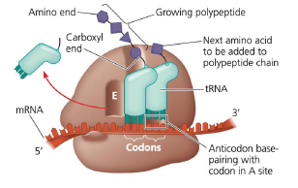
Peptide Bond - Biology
Peptide Bonds are what link amino acids to become proteins.
Amino Acids are attached to their respective tRNA.

Slide 4
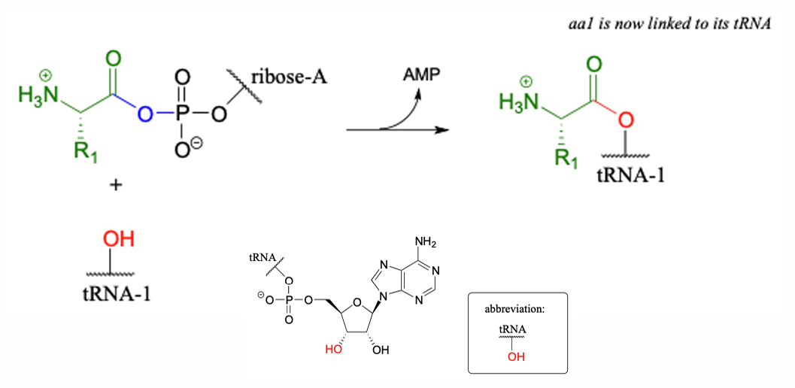
Peptide Bond - tRNA
Amino Acids are attached to their respective tRNA.

Slide 5
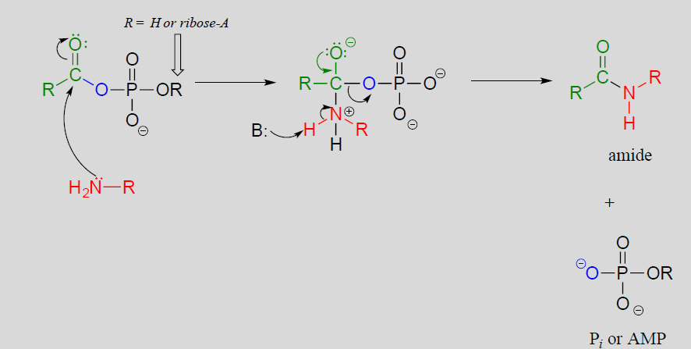

Peptide Bond - Mechanism
Peptide Bonds are an amide, which is formed through nucleophilic acyl substitution

Slide 6
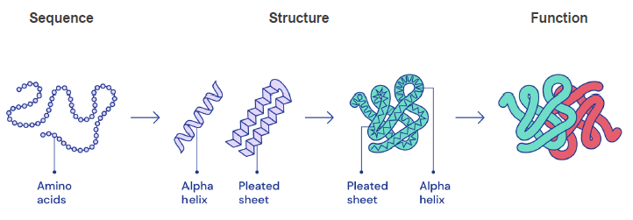
Peptide Bond – From AA to Function
Primary Secondary Tertiary Quaterny

Slide 7
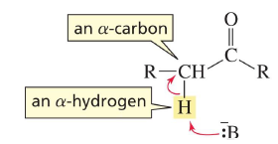
α-Carbon

Slide 8
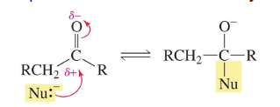
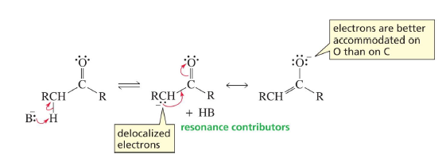
Nuc. Acyl Substitution vs. Alpha-Carbon
Both have an intermediate:
oxygen accommodates extra e-

Slide 9

Alpha Carbon Chemistry
But now what can we do with this?
Often found when forming or breaking C-C bonds
Aldol & Decarboxylation
This right here is an enolate btw

Slide 10
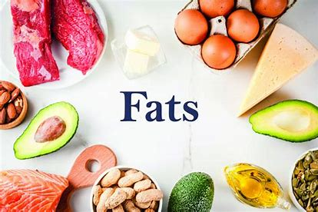
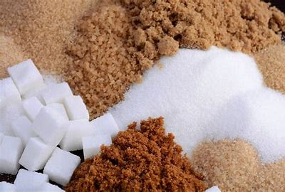
Aldols & Enols

Slide 11
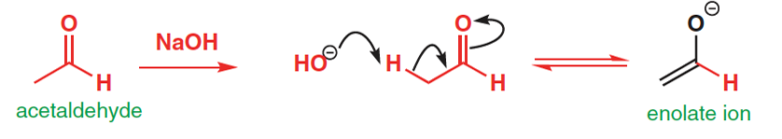
Step 1 - Enolate
We need basic conditions so this step can happen
Create a very nucleophilic molecule
Note: Possibility of Acid catalyzation (won’t have an enolate intermediate)

Slide 12
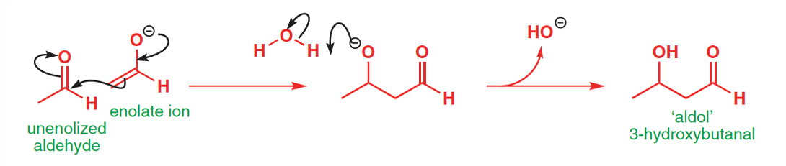
Step 2
Creates a C-C bond!
Already seen: nucleophilic addition
nucleophilic
electrophilic

Slide 13
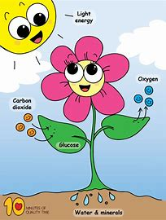
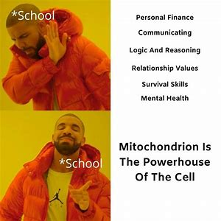
Decarboxylation

Slide 14
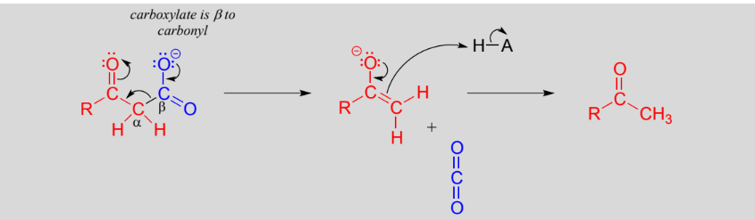
How does it work?
Instead of proton leaving the α-Carbon, it’s a C02

