Slide 1
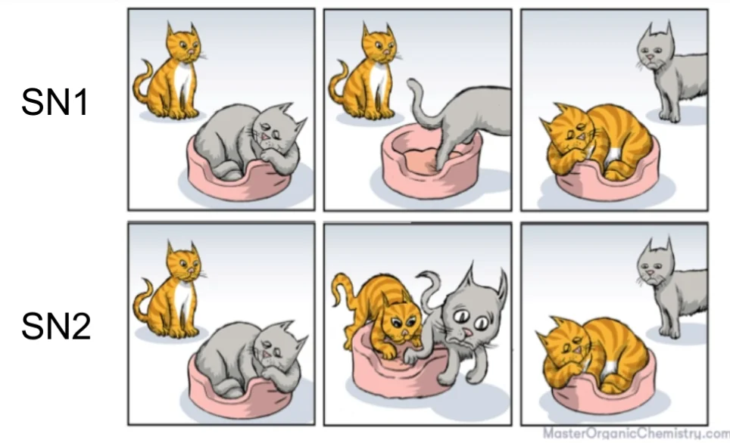
S_{N}1 - S_{N}2

Slide 2
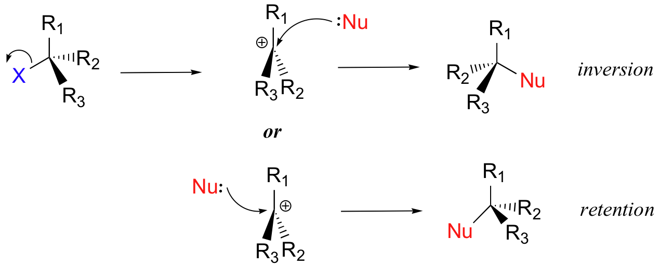
Nucleophilic substitution (S_{N})
Electrophile
Nu⁻
solvent
+
+
X⁻
Nucleophile
Leaving group (LG)

Slide 3
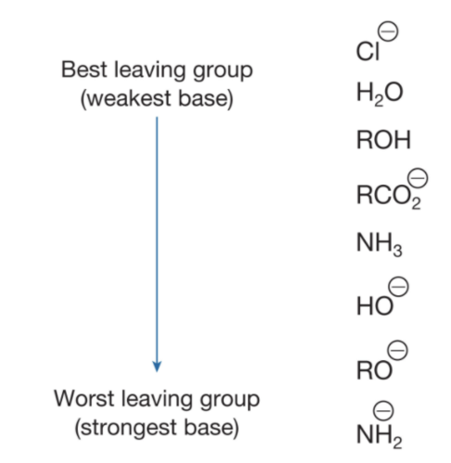
Leaving group
Nu⁻
+
+
X⁻
Leaving group (LG)
A good leaving group is a stable leaving group

Slide 4
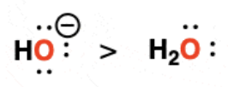

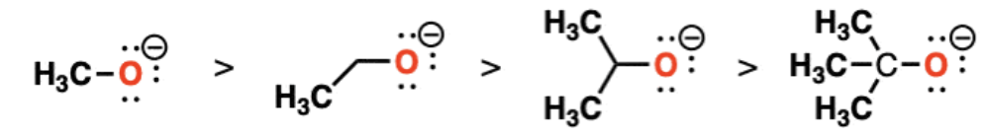
Nucleophile
Factors influencing Nucleophilicity
Charges
Electronegativity
Steric hindrance
Nu⁻
+
A nucleophile attacks the electrophile

Slide 5
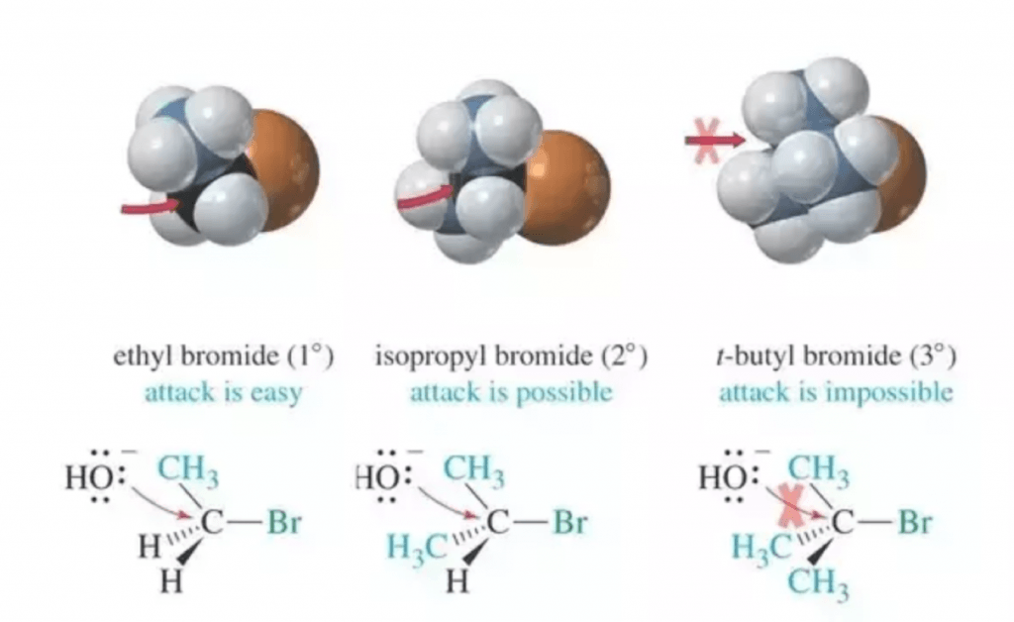
Electrophile
Factors influencing electrophiles
Charges
Steric hindrance
Electrophile
⁺CH₃ > CH₄
Nu⁻
+
Accepts electrons from the nucleophile

Slide 6
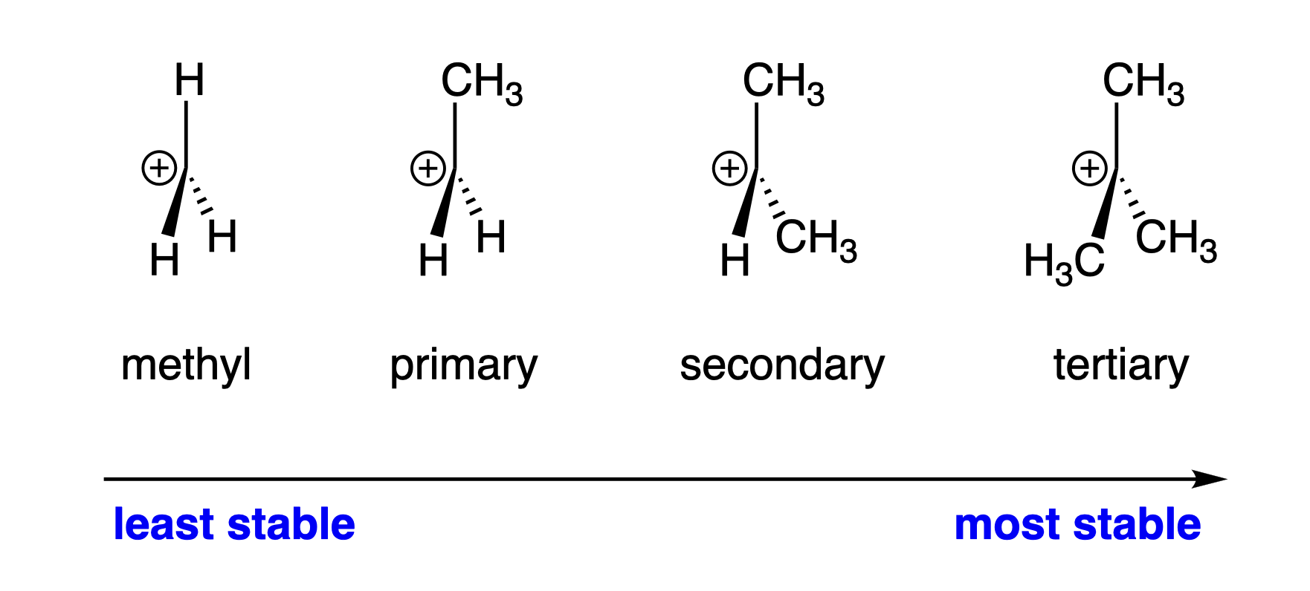
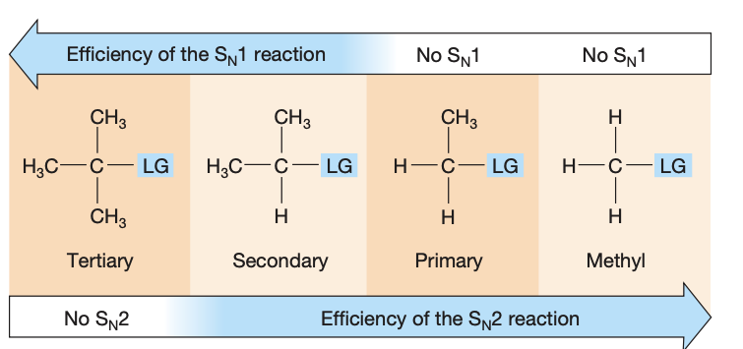
S_{N}1: mechanism
S_{N}1
XC
Leaving group (LG)

Slide 7
S_{N}1: mechanism
XC
Leaving group (LG)

Slide 8
S_{N}2: mechanism

Slide 9
S_{N}2: mechanism

Slide 10
Nucleophilic substitution (S_{N})

Slide 11
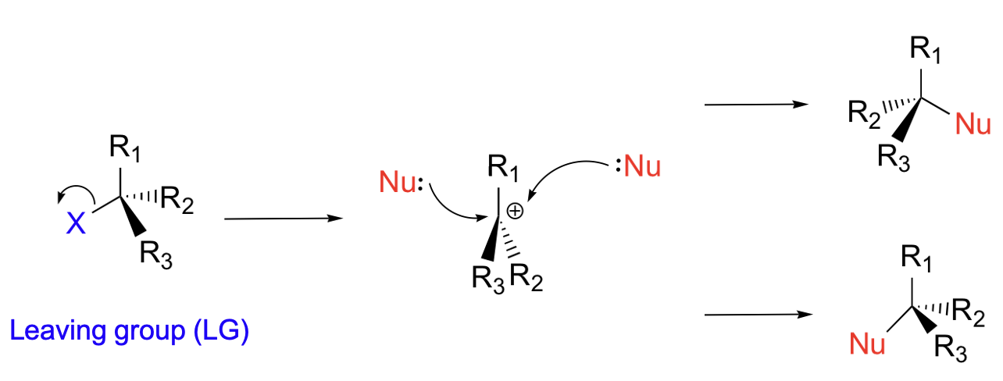
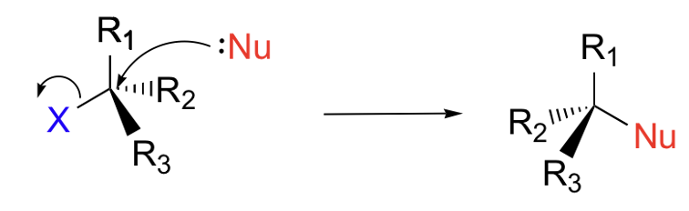
Why do we care?
S_{N}1
S_{N}2
Stereochemistry
Kinetics
Rate ∝ [Electrophile]
Rate ∝ [Electrophile]*[Nucleophile]

Slide 12
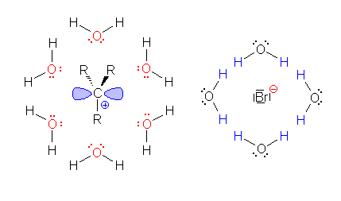
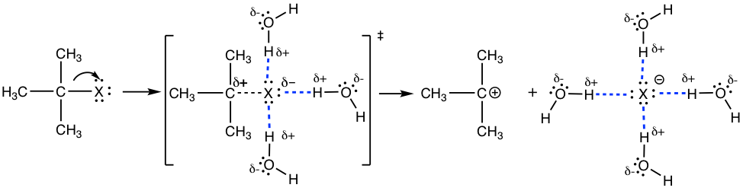
Solvent
S_{N}1
S_{N}2
Polar:
Protic:

Slide 13
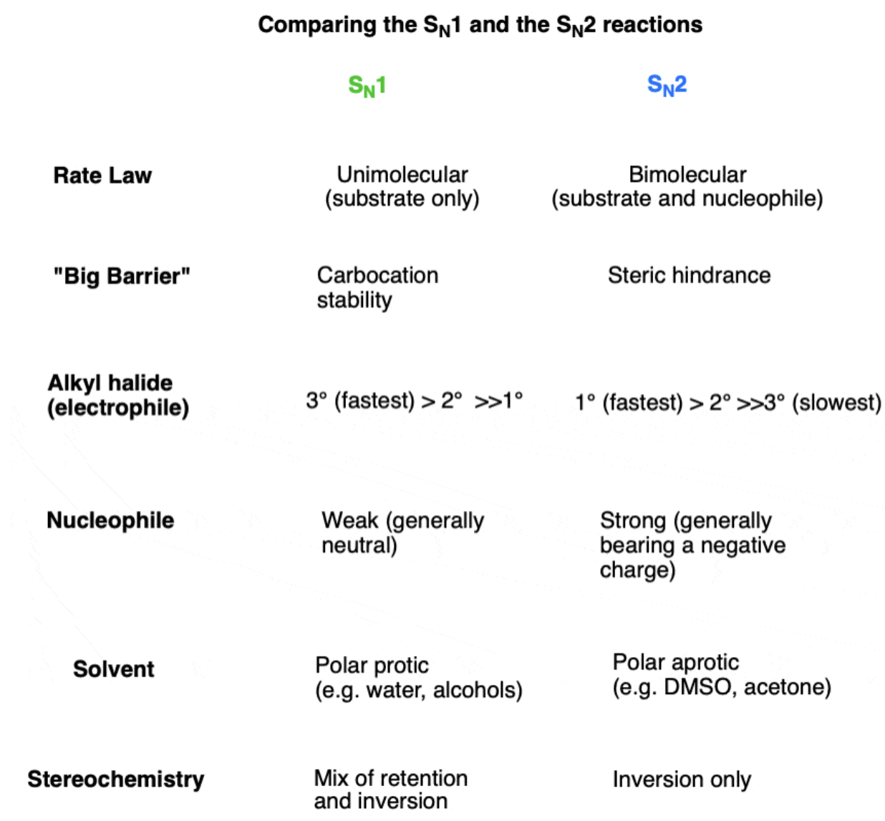
Nucleophilic substitution (S_{N})

Slide 14
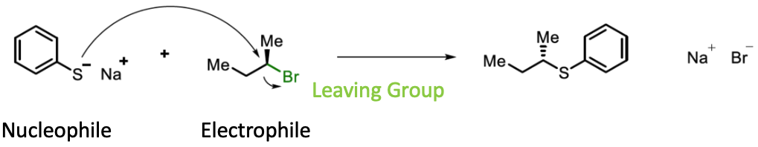
Exercice 6.2
S_{N}1 or S_{N}2 ?

Slide 15
Nucleophilic substitution (S_{N})
S_{N}2

Slide 16
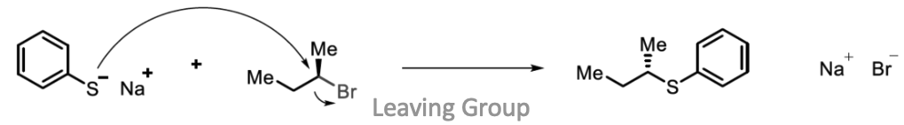
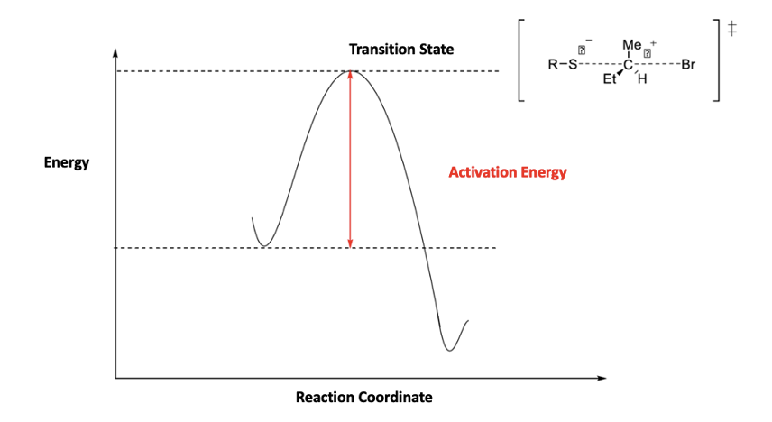
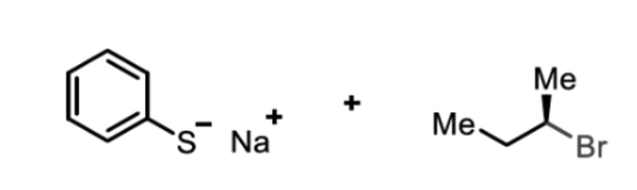
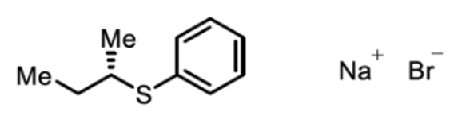
Exercice 6.2

Slide 17
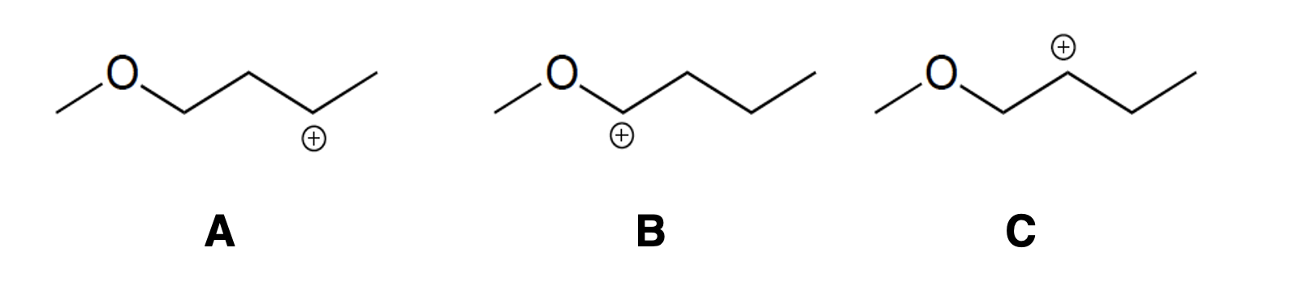
Exercice 6.6
+
1
δ⁻
δ⁻
δ⁺
δ⁺
δ⁺
2
3

Slide 18
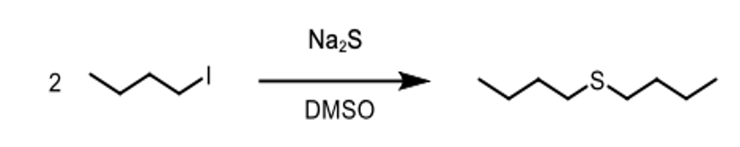
Exercice 6.9

Slide 19
Exercice 6.9
Nucleophile? Electrophile? Solvent?
2 Na⁺ + S²⁻
Polar aprotic

Slide 20

Exercice 6.9
S⁻
2 Na⁺ + S²⁻

Slide 21
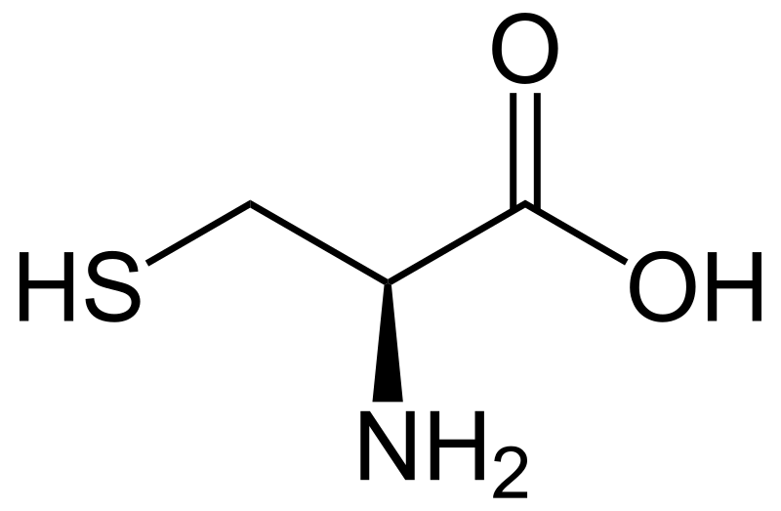
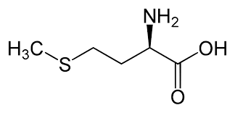
Exercice 6.5 h) and 6.8
What is or are the nucleophilic functional group?
Cystein
Methionine

Slide 22
Exercice 6.5 h) and 6.8
“A cysteine side chain is a better nucleophile than a methionine side chain”
Cystein
Methionine

Slide 23
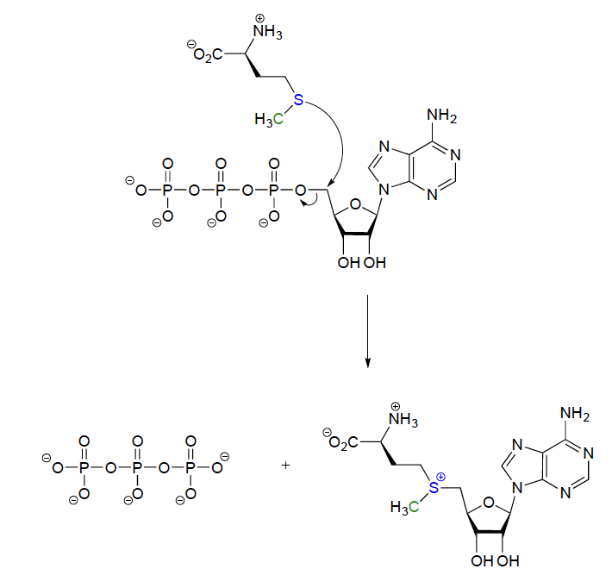
Exercice 6.5 h) and 6.8
+
+
+
3
-
pH 7

Slide 24
Exercice 6.5 h) and 6.8
+
+
Primary carbon, good leaving group, weak nucleophile→ SN1

Slide 25
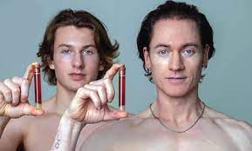
Exercice 6.5 h) and 6.8
+
+
Unstable?
YES! It’s a methyl donor!
SAM + DNA → DNA-Me
Epigenetic clock

