Slide 1
Exercise 7 session
11/04/2025

Slide 2
Content of recaption from last week
E1 Elimination
E2 Elimination
E1cb Elimination
Zaitsev’s rule
Substitution vs Elimination
Electrophilic Addition
Markovnikov’s Rule

Slide 3
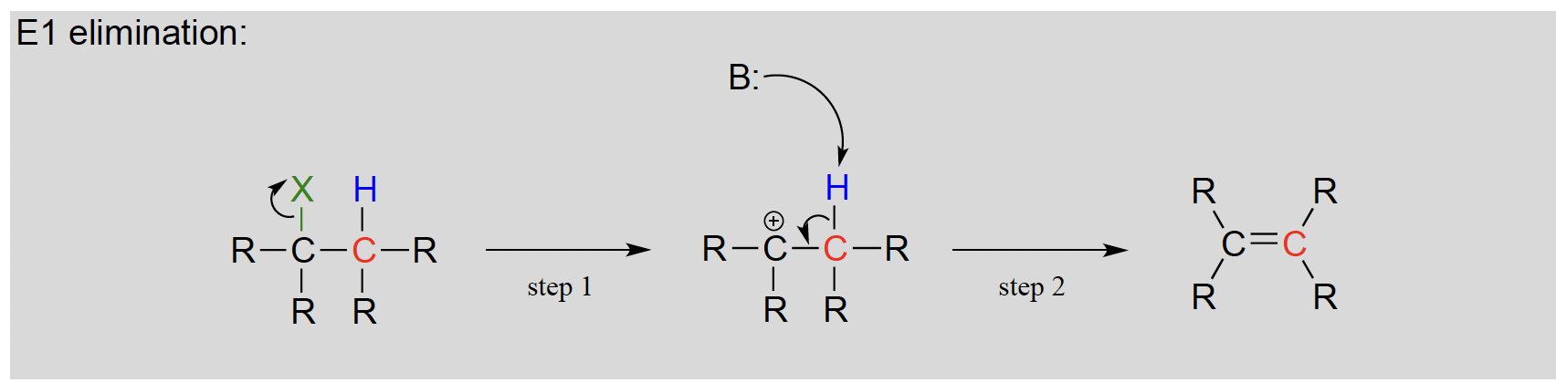
E1 Elimination
Step1 : An E1 elimination begins with the departure of a leaving group and formation of a carbocation intermediate.
Step2 : Abstraction of a proton from an adjacent carbon sends two electrons down to fill the empty p orbital of the carbocation, forming a new pi bond.

Slide 4
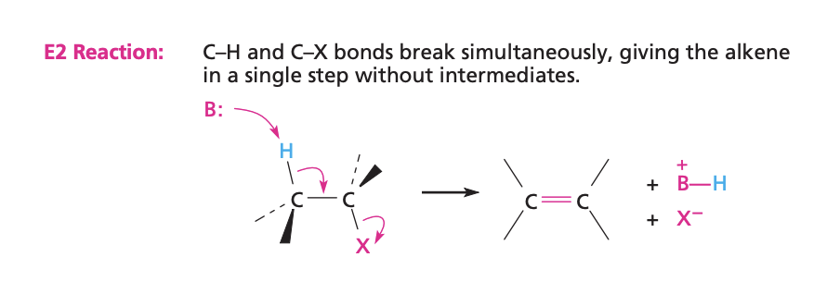
E2 Elimination
When a strong base is combined with an alkyl halide ,elimination generally occurs by the E2 pathway, in which proton abstraction and loss of the leaving group occur simultaneously, without an intervening carbocation intermediate.

Slide 5
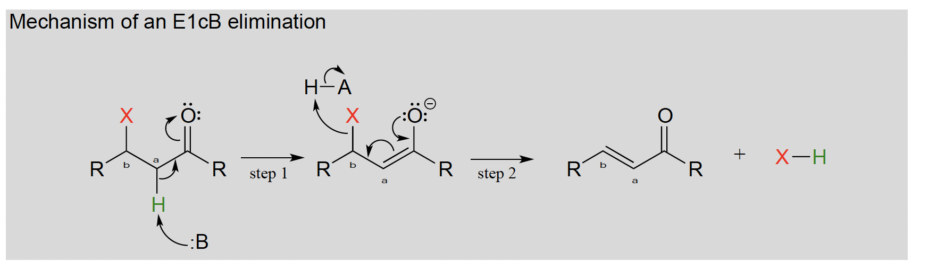
E1cb Elimination
The E stands for 'elimination'; the numeral 1 refers that it is a stepwise reaction with first order kinetics like SN1. The 'cB' designation refers to the intermediate, which is the Conjugate Base of the starting compound.
In step 1, an alpha-carbon is deprotonated to produce an enolate.
In step 2, the excess electron density on the enolate expels a leaving group at the b position.

Slide 6
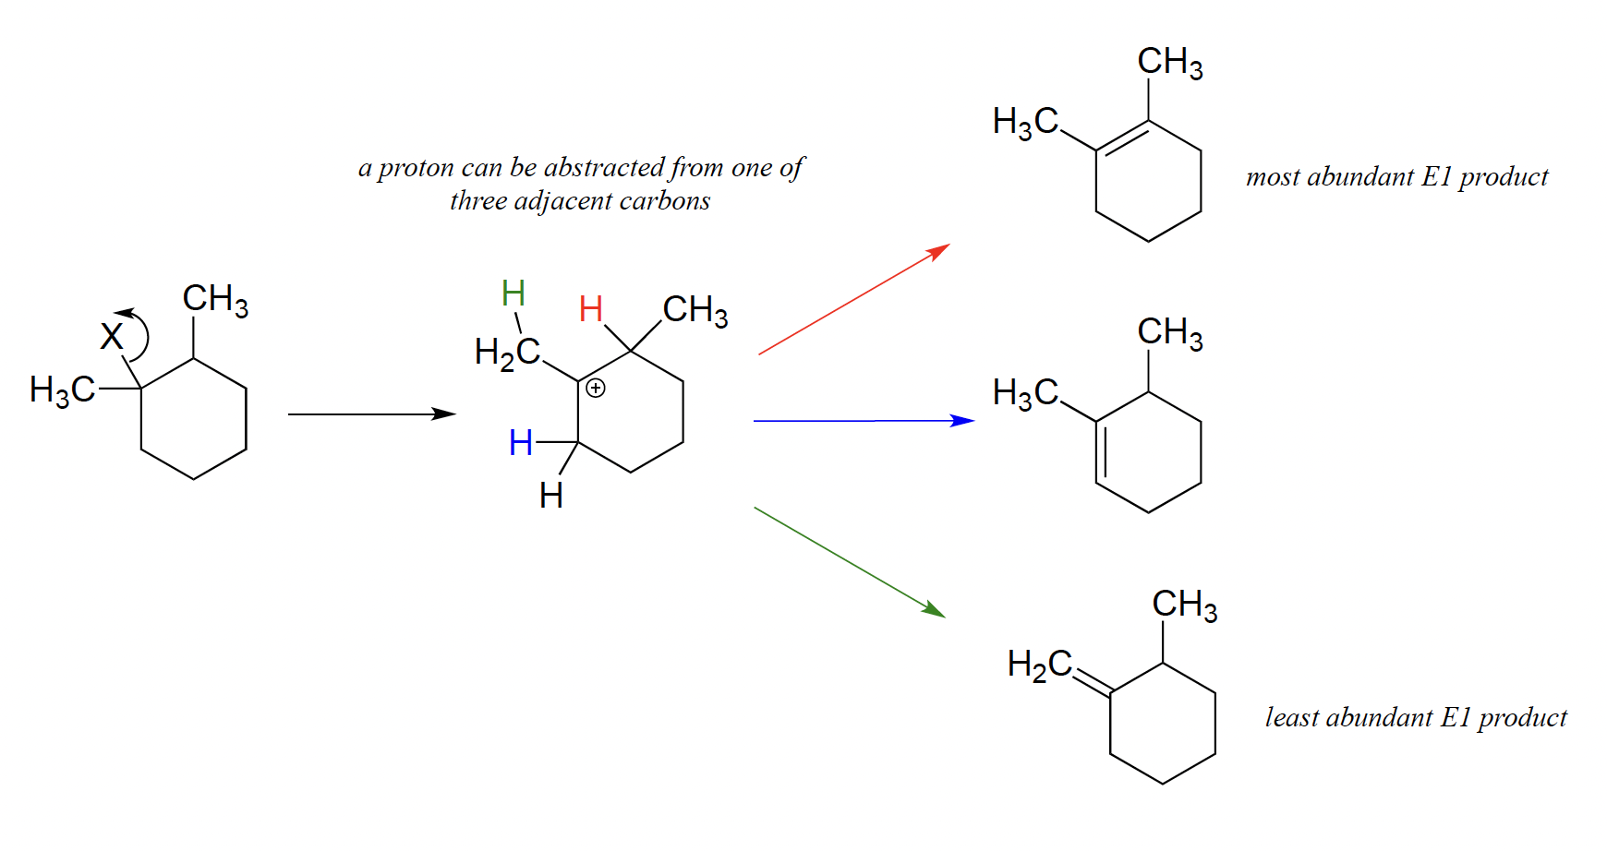
Zaitsev’s rule
The most abundant alkene product is that which is most substituted .

Slide 7
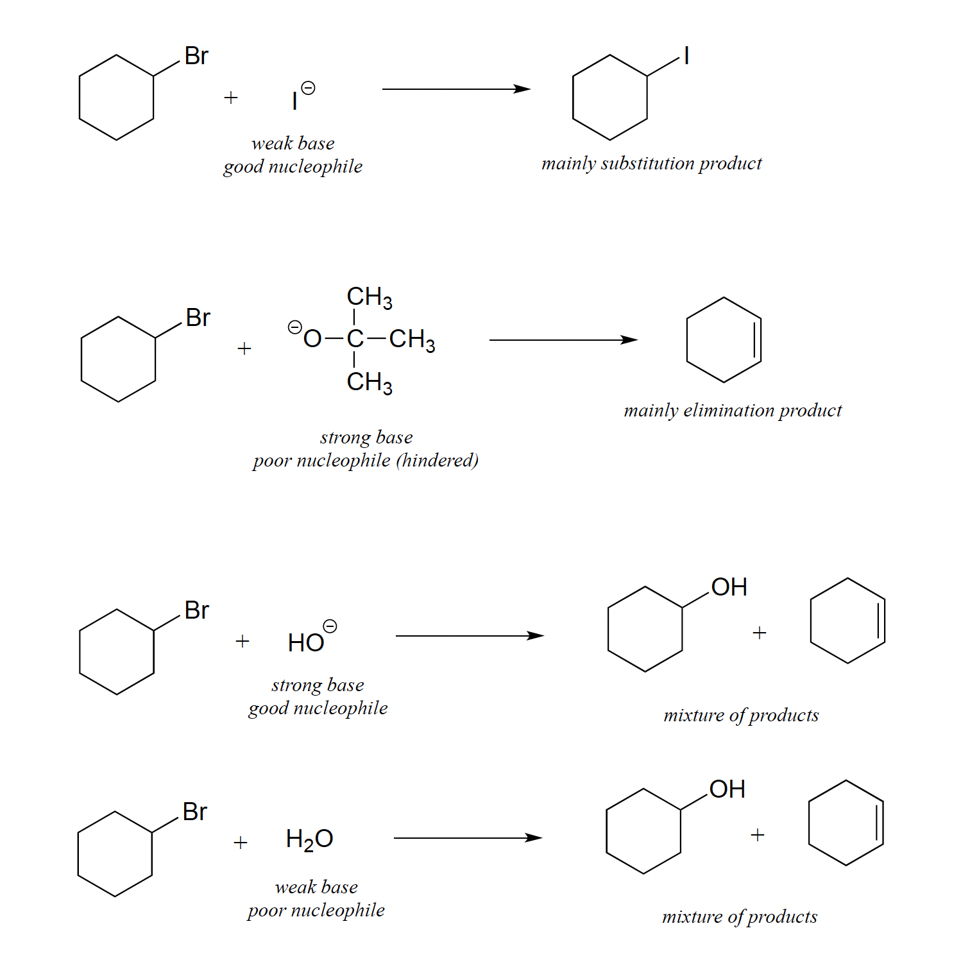
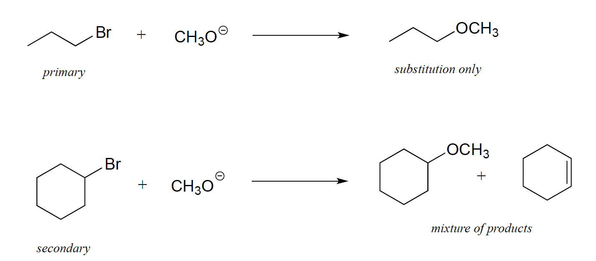
Substitution vs Elimination
You should consider several factors (SN1 vs SN2 vs E1 vs E2):
Solvent (may or may not deactivate nucleophile)
Sterics (of substrate or nucleophile;
more sterics = less second-order reactions, and vice versa)
Reagent pKas (high pKas allow elimination as a possible side mechanism)
Temperature (high temperatures favor elimination)
Leaving group propensity (great leaving groups favor first-order reactions, such as E1 or SN1)

Slide 8
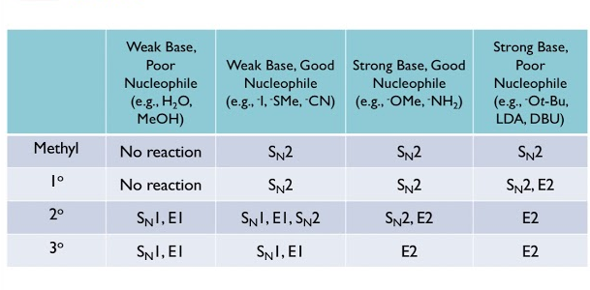
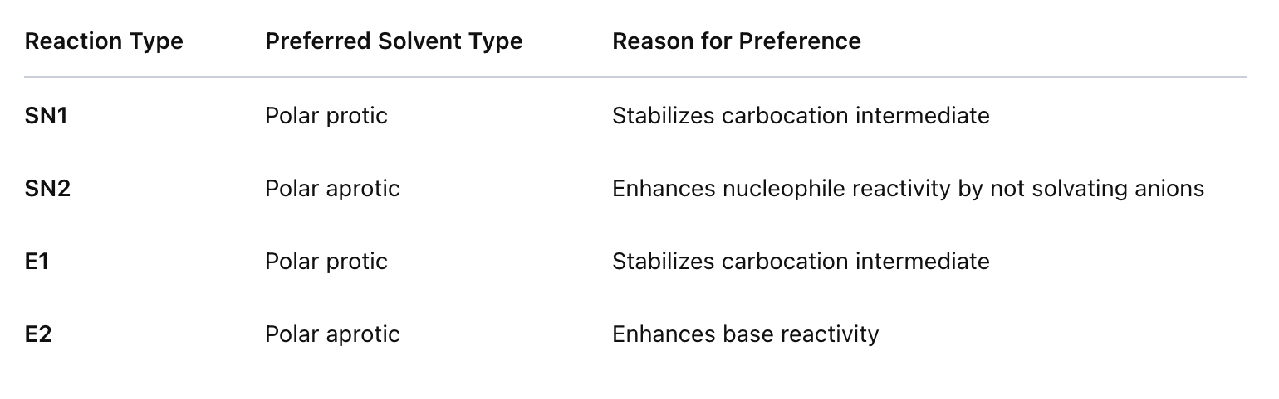
Substitution vs Elimination

Slide 9
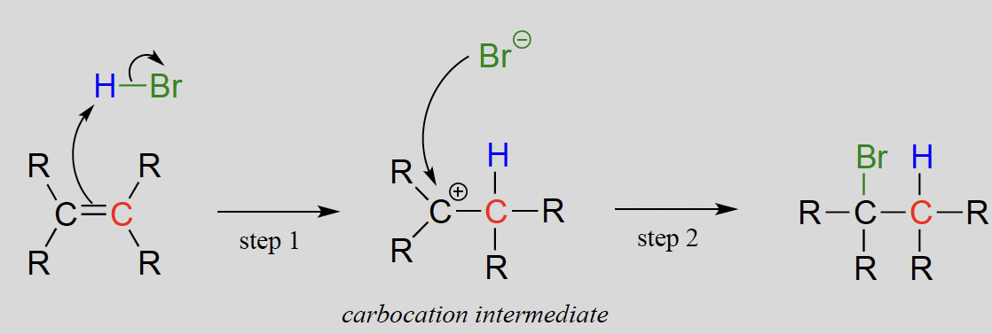
Electrophilic Addition of HBr
Step1: π - electrons of the alkene act as a base and extract the acidic proton of HBr
Step2: Nucleophilic bromide anion attacks the electrophilic carbocation to form a new carbon-bromine bond

Slide 10
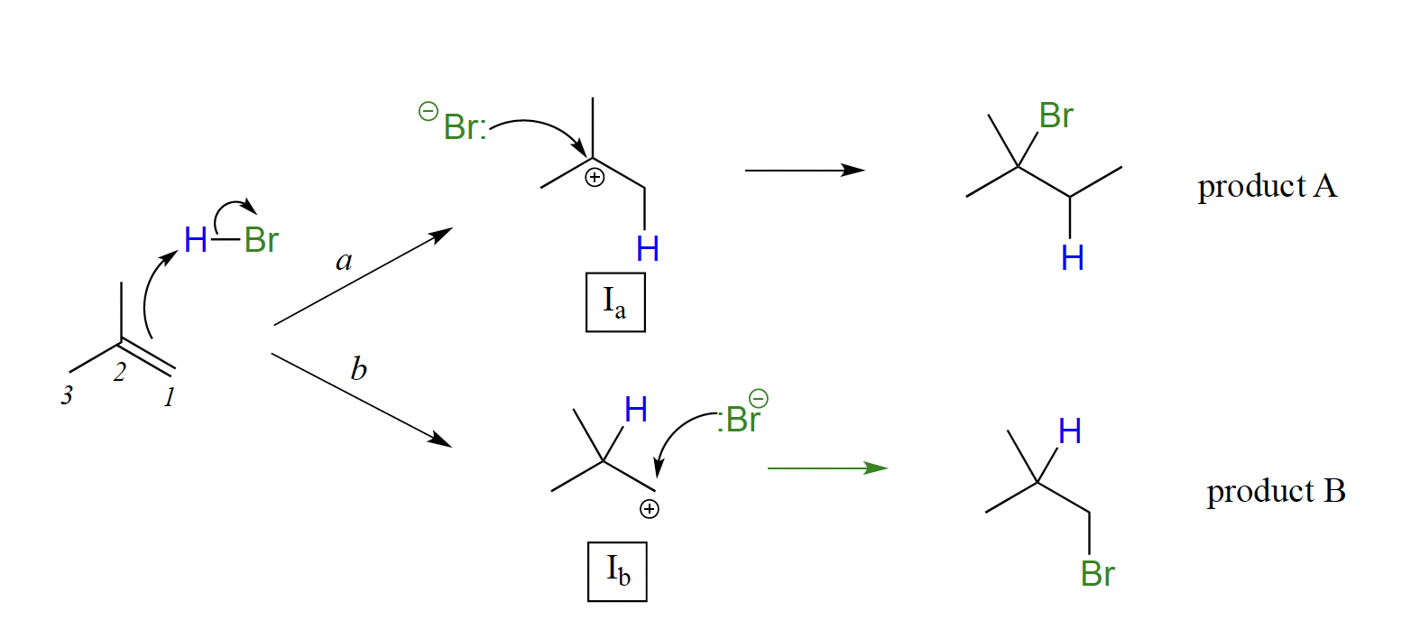
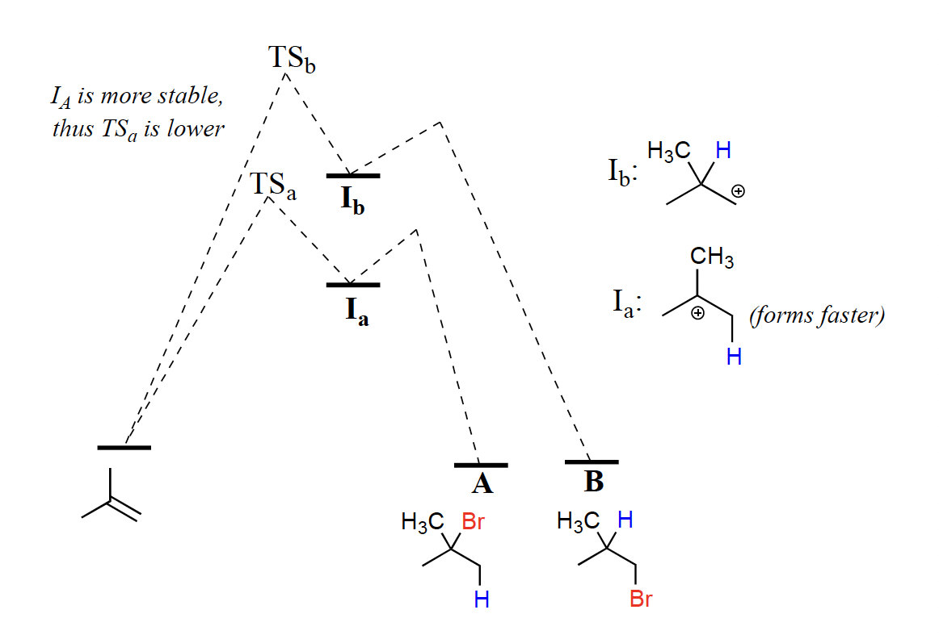
Markovnikov’s Rule
It is generally observed that in electrophilic addition of haloacids to alkenes, the more substituted carbon is the one that ends up bonded to the heteroatom of the acid, while the less substituted carbon is protonated. This 'rule of thumb' is known as Markovnikov's rule.

Slide 11
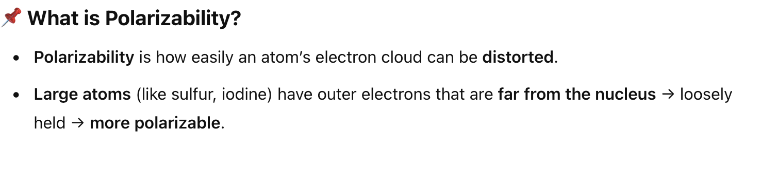
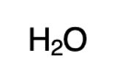
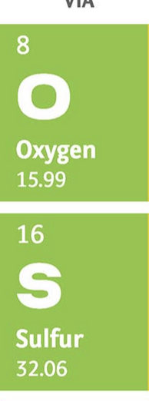
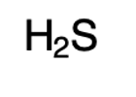
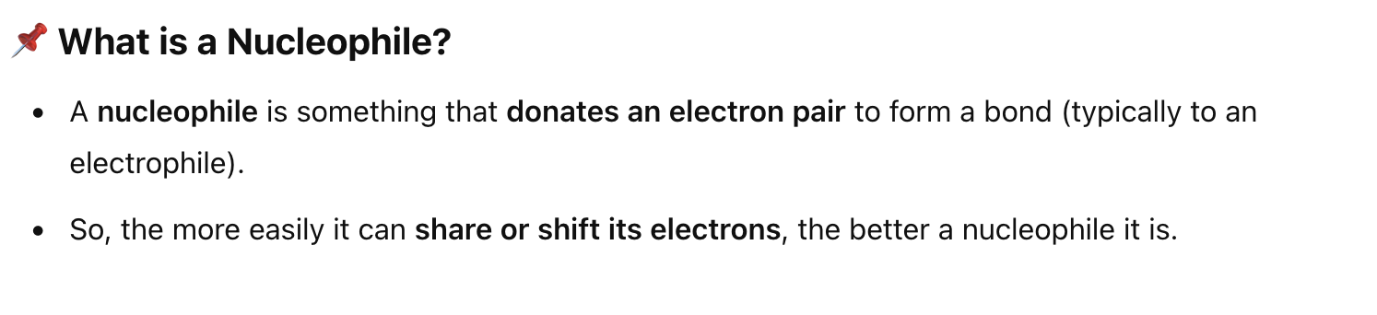
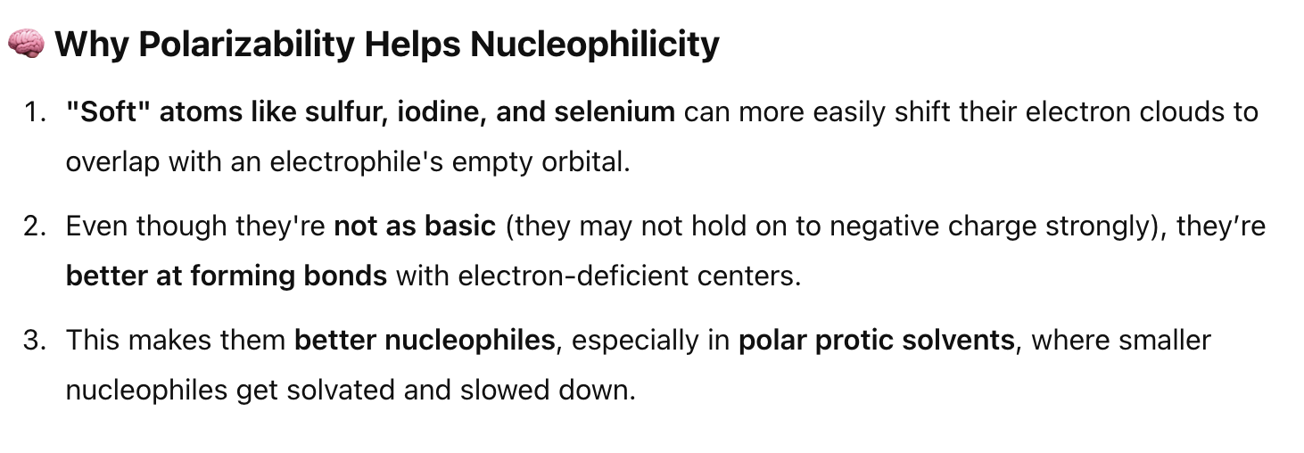
Polarizability & Nucleophilicity
Take H₂S and H₂O as example(will show in exercise):
vs
:
H₂O: pKa ≈ 16 → more basic
H₂S: pKa ≈ 7 → less basic
However, S is below O on the periodic table → larger and more polarizable.
H₂S acts as a better nucleophile, despite being less basic.

Slide 12
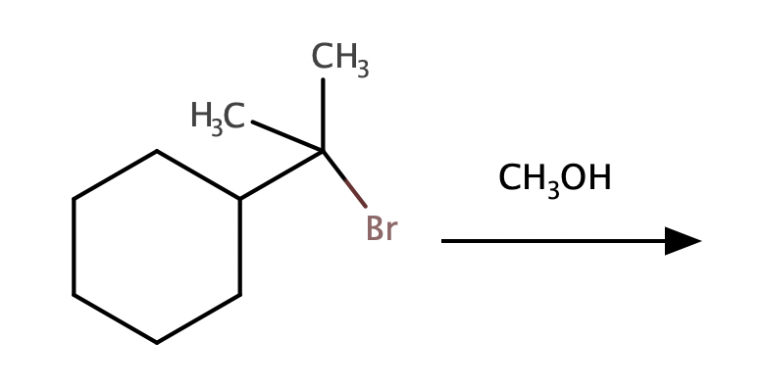
Justification for Exercise7.6D
Room Temperature

Slide 13
Exercise 7 Solution

Slide 14
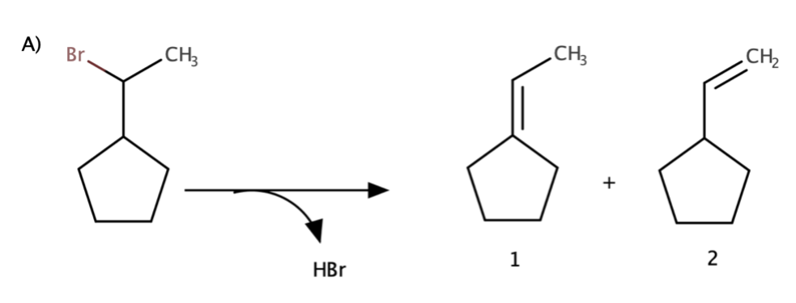
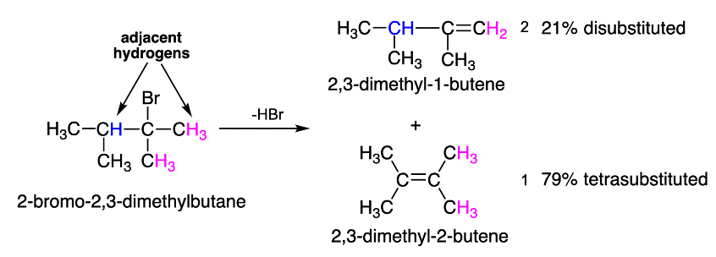
7.1 Elimination by the E1 mechanism
Zaitsev's rule : The most abundant alkene product is that which is most substituted!
More general rule: the most abundant product that is formed through the most stable carbocation!
The least abundant product – the least stable carbocation!
Most abundant

Slide 15
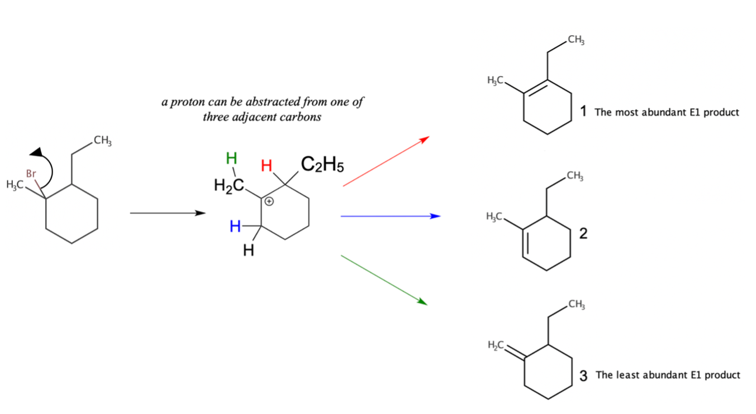
7.1 Elimination by the E1 mechanism
B)
C)

Slide 16
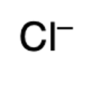
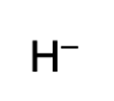
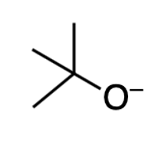
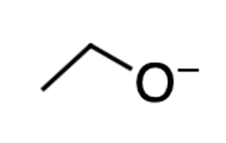

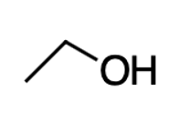
7.2a Substitution vs. elimination
(high electron density => good nucleophile; weak base)
SN2
Nucleophile only:
( strong Nu due to polarizability: Sulfur is a large atom, and electrons are far away from the nucleus; weak base)
(tiny atom size, thus, not polarizable; H₂ is a weak acid)
E2
Base only:
(strong base; 3 methyl hindered)
Strong nucleophile and base:
(high electron density on Oxygen; H₂O and C₂H₅OH is a weak acid)
SN2 & E2
Weak nucleophile and base
(Low electron density on Oxygen; H₃O⁺ and C₂H₅OH₂⁺ is a strong acid)
SN2 & E2
(low yields)

Slide 17
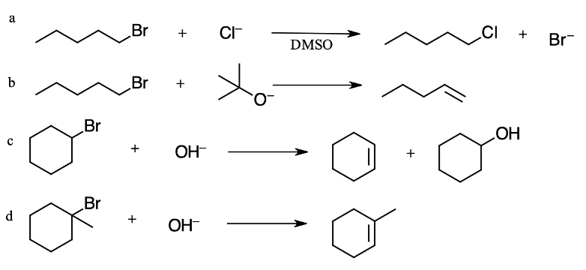
7.2 b Substitution vs. elimination
Primary haloalkane + strong Nu = SN2
Nucleophilicity of halides in aprotic solvent (F−>Cl−>Br−>I−).
In protic solvent: F−<Cl−<Br−<I− .
b. Primary haloalkane + strong Base = E2
c. Secondary haloalkane + strong Base/Nu = SN2&E2
d. Tertiary haloalkane + strong Base/Nu = E2

Slide 18
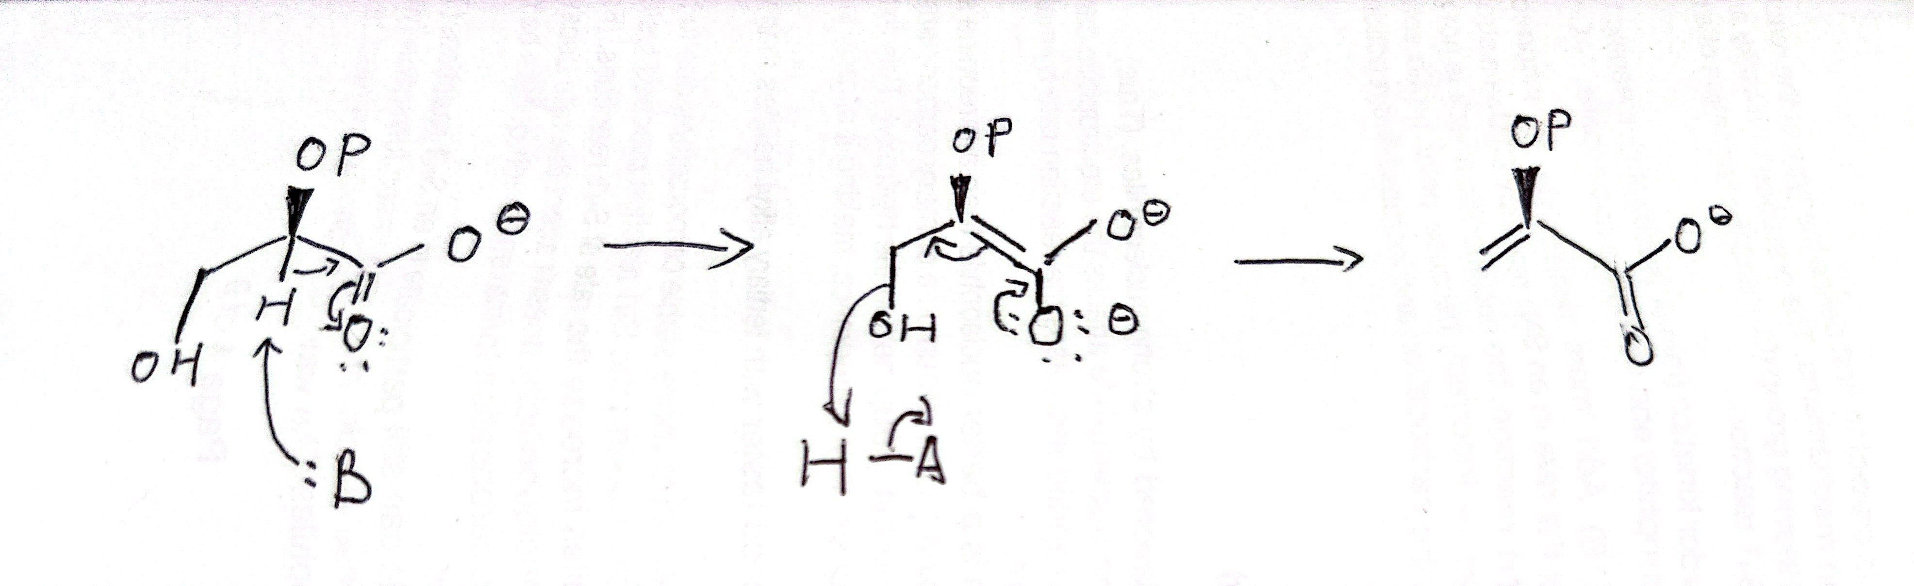
7.3 E1cb Elimination
Solution:
In step 1, an alpha-carbon is deprotonated to produce an enolate.
In step 2, the excess electron density on the enolate expels a leaving group at the b position.

Slide 19
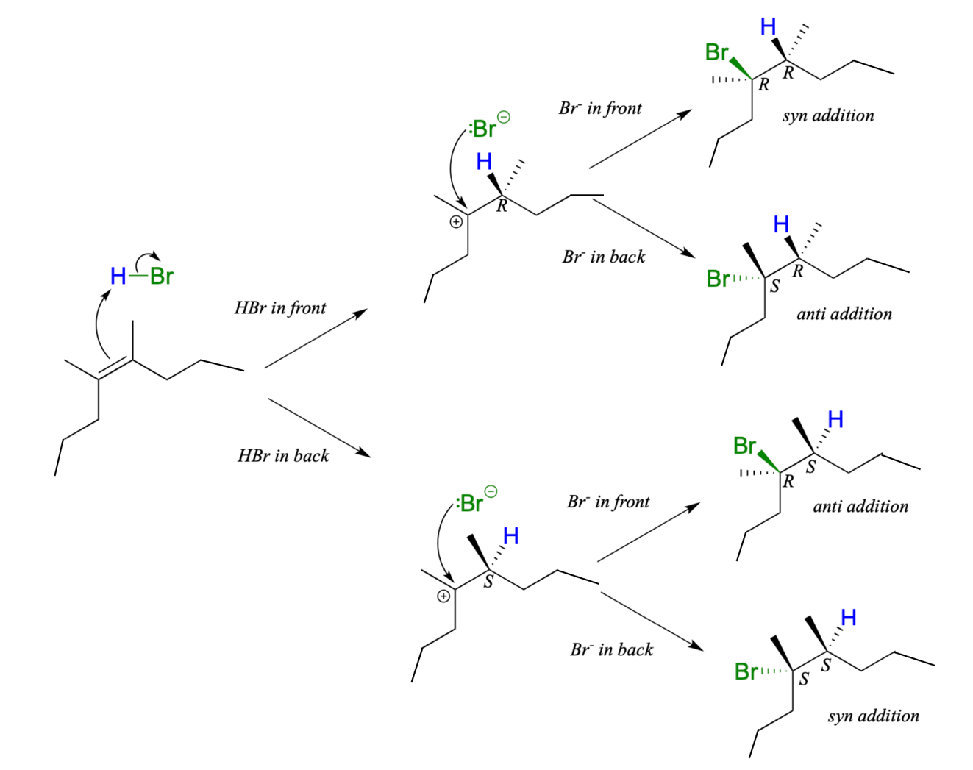
7.4 Electrophilic addition of HBr to symmetric alkenes
The mechanism:
The reaction goes through 2 identical on their stability carbocations!
2 stereocenters!
Addition of HBr to an alkene is not stereoselective:
In case of symmetric alkenes: 2 identical stable carbocation
The reaction results in racemization at both of the alkene carbons.
The initial proton abstraction step creates a new chiral center, and because the acidic proton could be added to either side of the planar alkene carbon with equal probability, the center could have either S or R configuration.
A)

Slide 20
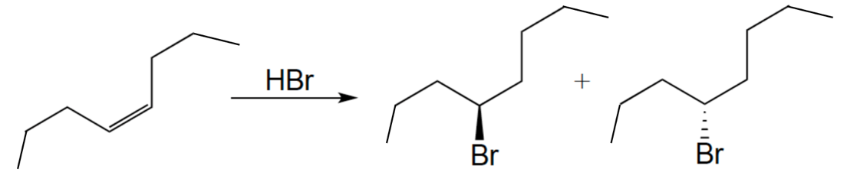
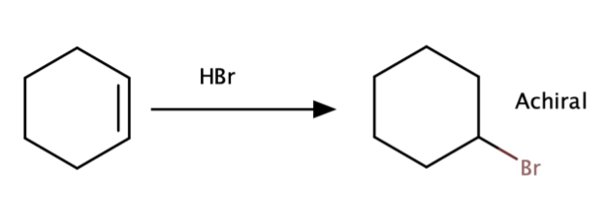
7.4 electrophilic addition of HBr
B)
C)
+
Not a charal center

Slide 21
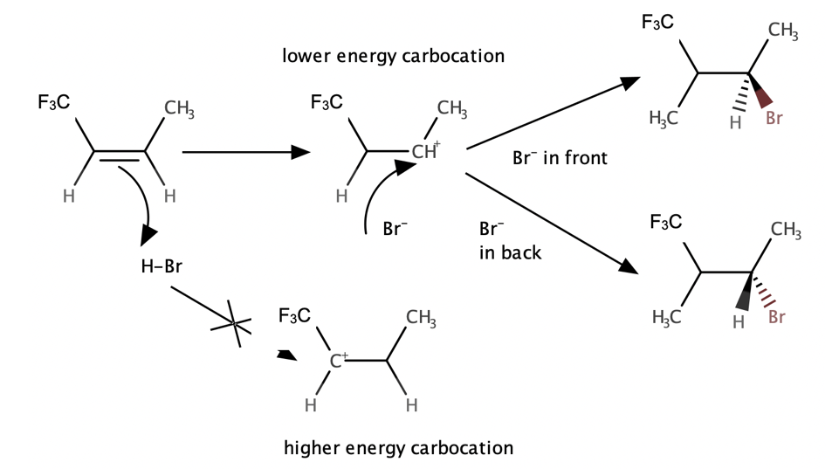
7.5 Electrophilic addition of HBr to non-symmetric alkenes
When HBr is added, it is the less substituted carbocation that forms faster in the rate- determining protonation step, because in this intermediate the carbon bearing the positive charge is located further away from the electron-withdrawing, cation-destabilizing fluorine (CF₃).
The regioselectivity of electrophilic addition rule :
When an asymmetrical alkene undergoes electrophilic addition, the product that predominates is the one that results from the more stable of the two possible carbocation intermediates.

Slide 22
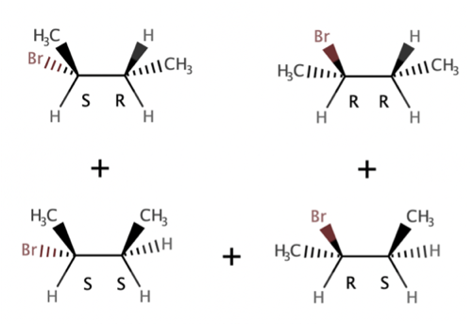
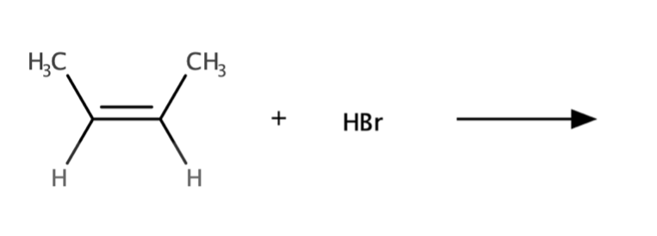
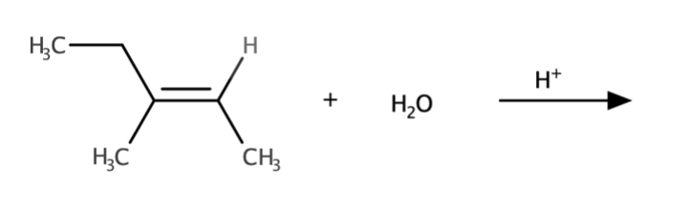
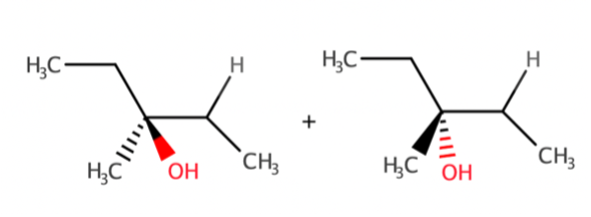
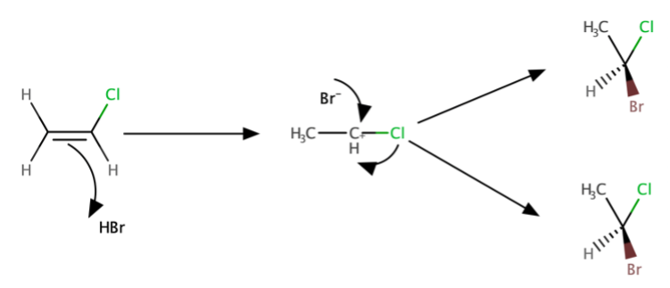
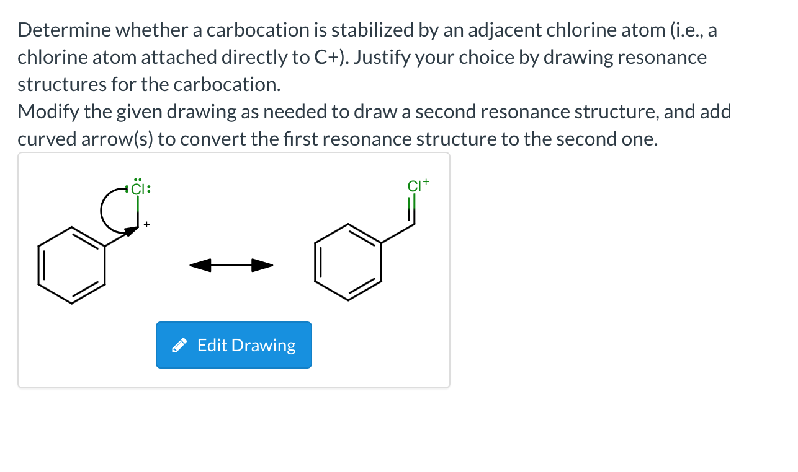
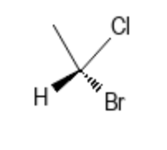
7.5 Electrophilic addition of HBr to non-symmetric alkenes
B)
C)
Markovnikov’s Rule
D)
Cl can stabilize the carbocation through resonance.

Slide 23
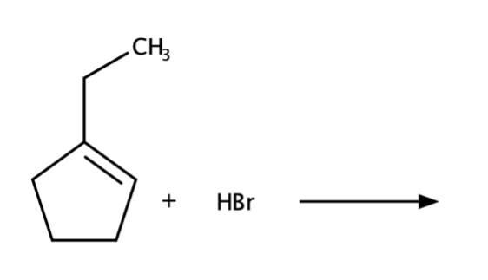
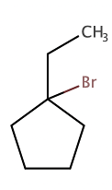
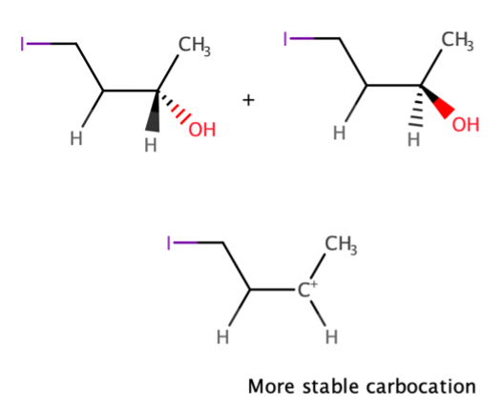
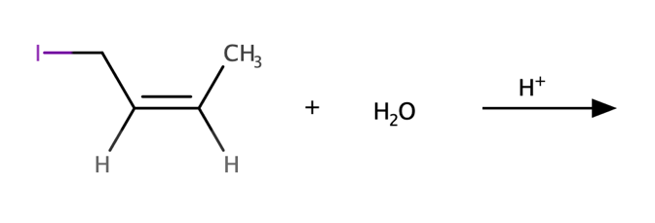
7.5 Electrophilic addition of HBr to non-symmetric alkenes
E)
Markovnikov’s Rule
F)
G)
Markovnikov’s Rule

Slide 24
7.6 E1 vs SN1 vs E2 vs SN2
Basicity and nucleophilicity influence
You should consider several factors:
Solvent (may or may not deactivate nucleophile)
Sterics (of substrate or nucleophile;
more sterics = less second-order reactions, and vice versa)
Reagent pKas (high pKas allow elimination as a possible side mechanism)
Temperature (high temperatures favor elimination)
Leaving group propensity (great leaving groups favor first-order reactions, such as E1 or SN1)
Solvent influence

Slide 25
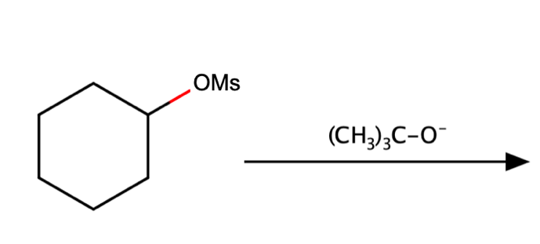
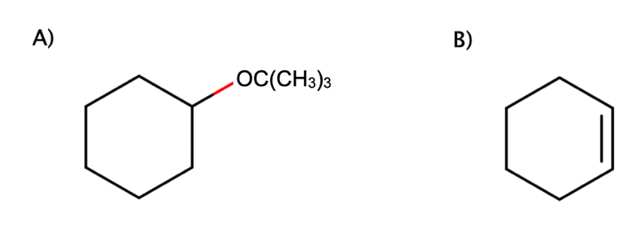
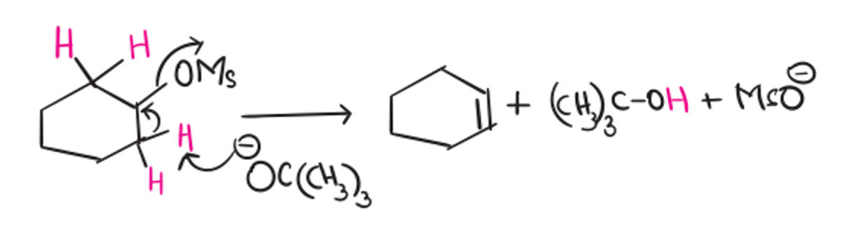
7.6 E1 vs SN1 vs E2 vs SN
A)
on secondary substrate. Can not tell much.
(CH₃)₃CO⁻ is a strong base and a very poor nucleophile owing to its bulkiness and steric hindrance.
It will go E2 reaction.

Slide 26
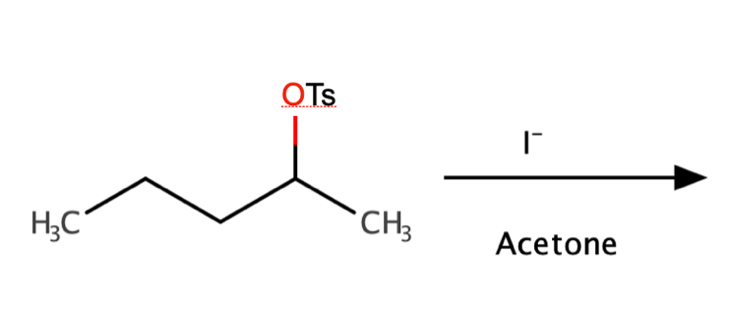
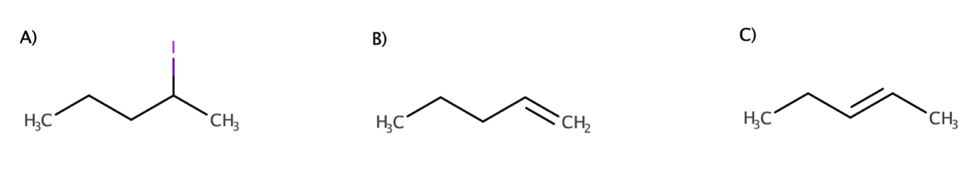
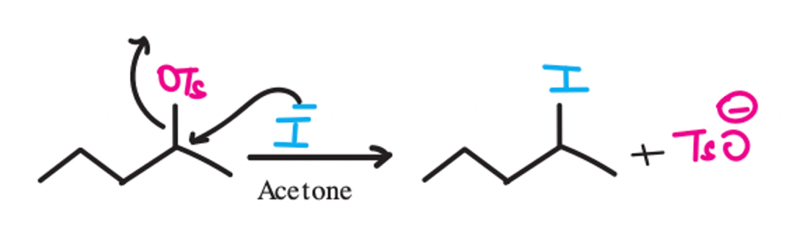
7.6 E1 vs SN1 vs E2 vs SN
B)
on secondary substrate. Can not tell much.
I⁻ is a highly polarisable ion. It is also the weak conjugate base of a strong acid (HI). That means, it is a good nucleophile but a poor base.
Slovent: acetone -> polar aprotic solvents -> favor SN2
It will go SN2.

Slide 27
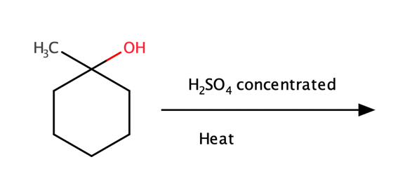


7.6 E1 vs SN1 vs E2 vs SN
C)
on secondary substrate. Can not tell much.
H₂SO₄ is a strong acid. In the presence of a strong acid, the alcohol will most likely undergo SN1 or E1 reaction.
3. Heat favors elimination reaction over substitution
4. It will go E1, and based on Zaitsev’s rule. It will be more stable with C.

Slide 28


7.6 E1 vs SN1 vs E2 vs SN
D)
on tertiary substrate, we can exclude SN2.
CH3OH a weak nucleophile and weak base. It might be SN1 or E1.
3. There is no heat. SN1 is more likely to predominate at lower temperatures.
4. it will go SN1.

Slide 29



7.6 E1 vs SN1 vs E2 vs SN
E)
on secondary substrate. Can not tell much.
Ethoxide ion (OEt⁻) is a strong base as well as a strong nucleophile.
It can go both SN2 and E2
Note: A polar aprotic solvent would tip the reaction towards an SN2 reaction while a polar protic solvent would favour E2. Even then, with secondary substrates, a mixture of products is quite common.

Slide 30

Questions?

Slide 31
vs
:
For H2S why is a goog neucliphile
Sulfur is much larger than oxygen (think H₂O vs H₂S).
Its outer electrons are further from the nucleus, meaning they are less tightly held.
These loosely held electrons are more easily distorted, which is what we call polarizability.
A polarizable atom can form partial bonds with an electrophile more easily, making it more reactive in nucleophilic attack.

Slide 32
For H2S why is a goog neucliphile
Sulfur is much larger than oxygen (think H₂O vs H₂S).
Its outer electrons are further from the nucleus, meaning they are less tightly held.
These loosely held electrons are more easily distorted, which is what we call polarizability.
A polarizable atom can form partial bonds with an electrophile more easily, making it more reactive in nucleophilic attack.
Theoretical correlation:
Without solvent effects, stronger bases are usually better nucleophiles.
Rationale: a less stable species "wants to react" — both as a base and a nucleophile.
pKa comparison:
H₂O: pKa ≈ 16 → more basic
H₂S: pKa ≈ 7 → less basic
So, theory would suggest H₂O is the stronger nucleophile.
But nucleophilicity also depends on size and polarizability:
Sulfur (S) is below oxygen (O) on the periodic table → larger and more polarizable.
In SN1 and SN2 reactions, the transition state involves a partial positive charge (δ⁺).
A more polarizable atom can better stabilize this polarized transition state.
Hence, H₂S acts as a better nucleophile, despite being less basic.
Counterpoint (your critique):
Acting as a base also involves electron sharing with a partially positive hydrogen (δ⁺).
So if polarizability helps nucleophilicity, it should help basicity too — but this isn't always observed.
Suggests the distinction may be more nuanced than often taught.

