Slide 1
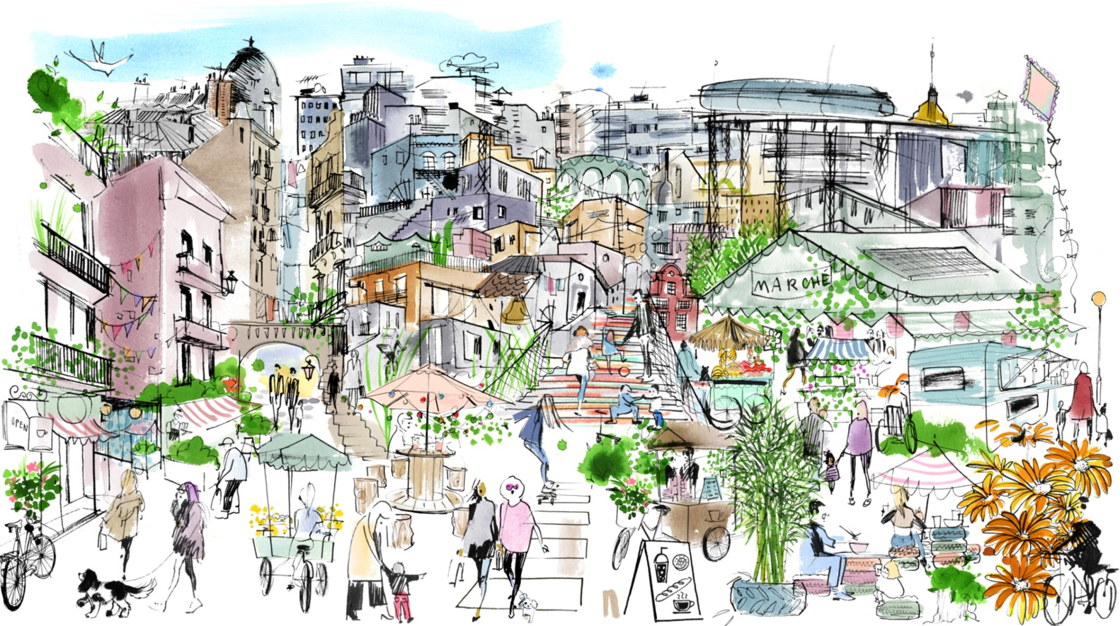
URB401: Systems Approaches for Urban Transitions
Introduction
Maria Anna Hecher
September 10, 2025
Courtesy of UN-Habitat and Global Utmaning

Slide 2
Agenda
Course content & learning objectives
Systems approach for sustainable cities
Course organization
Special guest: Darius Karácsony
Exercise & project session: Role play

Slide 3
Course content
This course offers an interdisciplinary perspective of urban systems and transitions through a qualitative systems thinking approach.
It provides the foundation to analyze the multifaceted nature of urban transitions, encompassing technical urban infrastructure, ecological aspects, and social dynamics like governance and social innovation.

Slide 4
Learning objectives
Develop system thinking skills to understand complex urban systems.
Apply transition theory concepts to analyze urban systems and their dynamics.
Recognize urban systems as social-technical-ecological systems.
Recognize systemic approaches combining green-blue-grey and social infrastructures.
Recognize the social dynamics of urban transitions.
Develop strategies for governing and fostering sustainable urban transitions.

Slide 5
Systems approach for sustainable cities

Slide 6
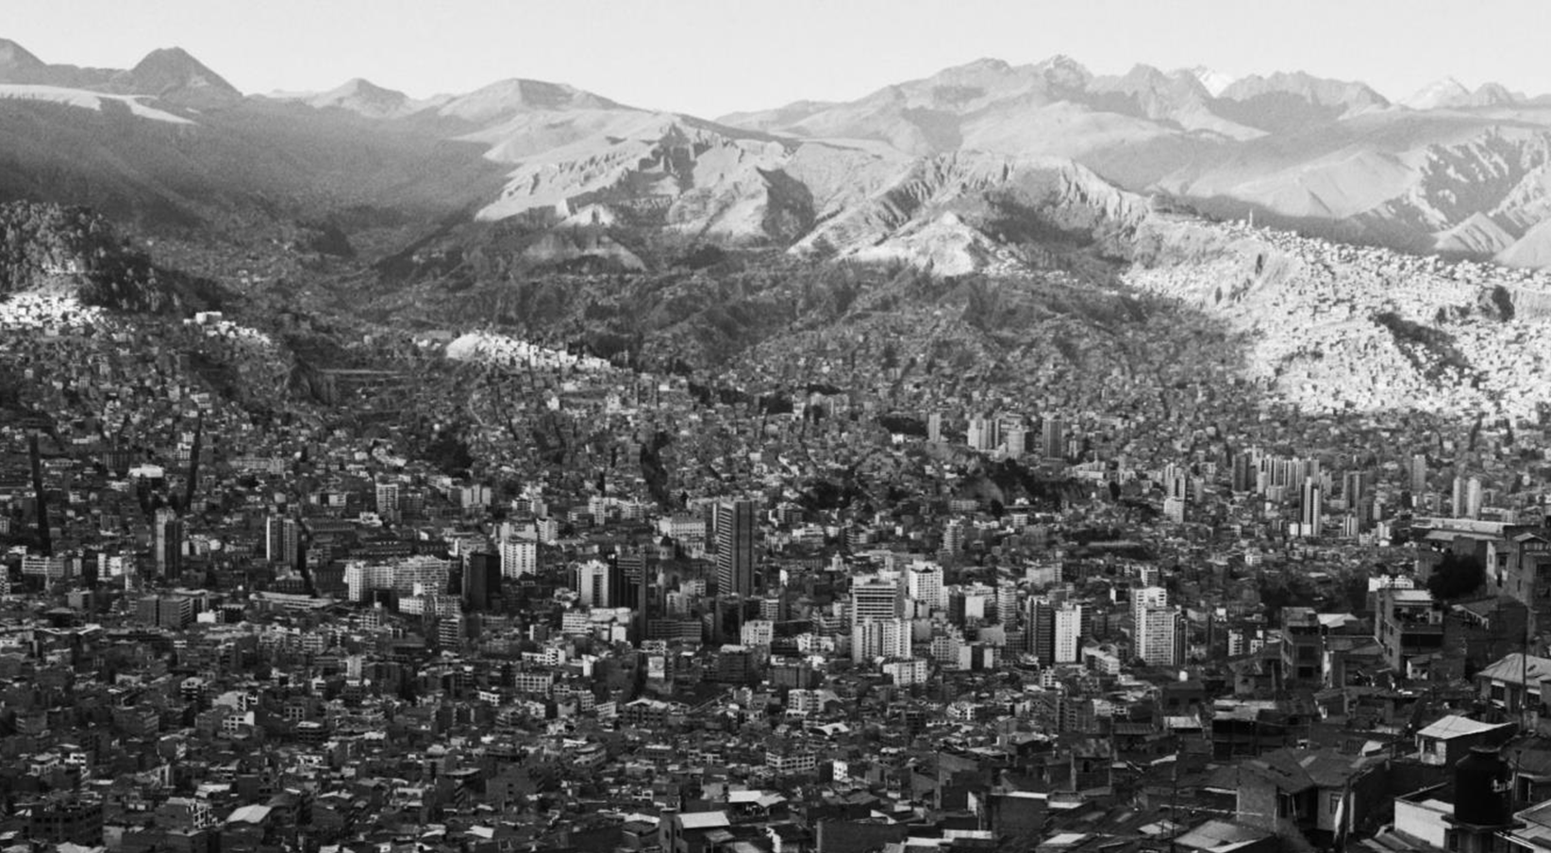
Cities influence the world in various ways
3 – 50 – 80 – 75
Notes:
3% of the world's surface area is urban.
More than 50% of the population lives in cities (projected to be around 70% by 2050).
Over 80% of global economic activity is generated in cities.
Cities account for 75% of global final energy demand and 75% of global carbon emissions.

Slide 7

Challenge and opportunity
We need a transition of cities towards sustainability.
Notes:
Urbanization is increasingly recognized as one of the biggest challenges of our time as well as one of the most effective leverage points for achieving the Sustainable Development Goals.

Slide 8
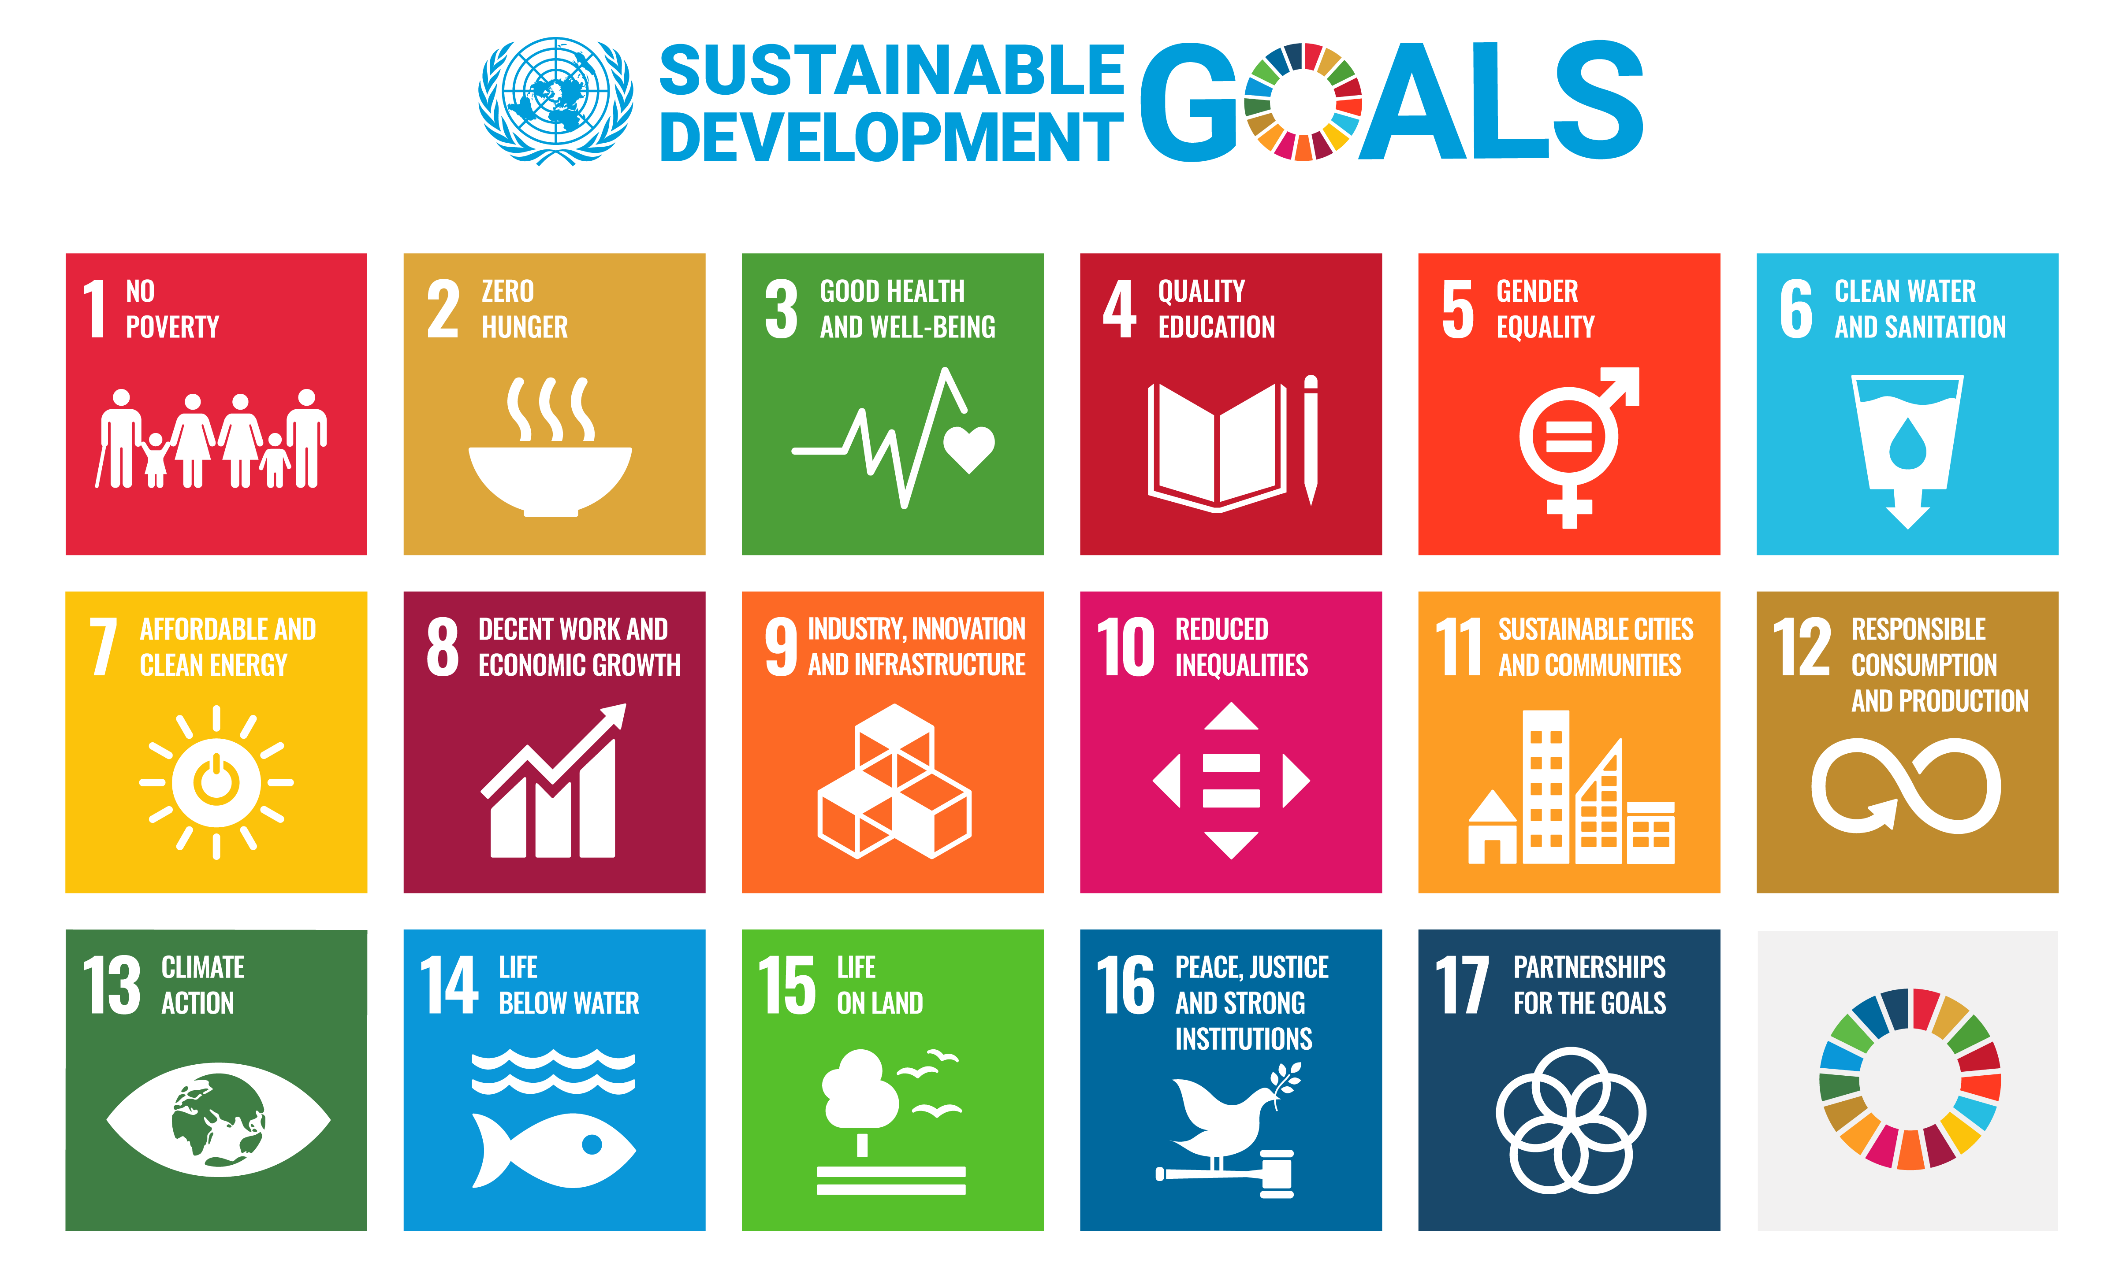

Slide 9
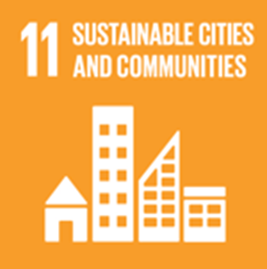
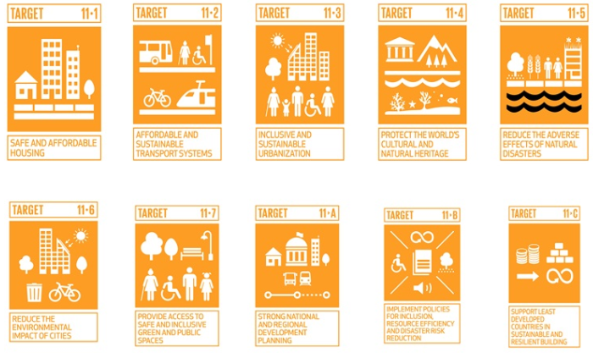
Make cities and human settlements inclusive, safe, resilient and sustainable

Slide 10
Systems approach for sustainable cities
UN's SDG 11 focuses on cities, in fact, most SDG goals and targets are directly relevant for cities.
Cities are central to global sustainability, their collective actions are critical for the world's future.
City-level governments have unique potential for change because they are closer to their citizens and can be more responsive than national governments.
Bai et al. (2016). Defining and advancing a systems approach for sustainable cities. Current Opinion in Environmental Sustainability, 23, 69–78. https://doi.org/10.1016/j.cosust.2016.11.010

Slide 11
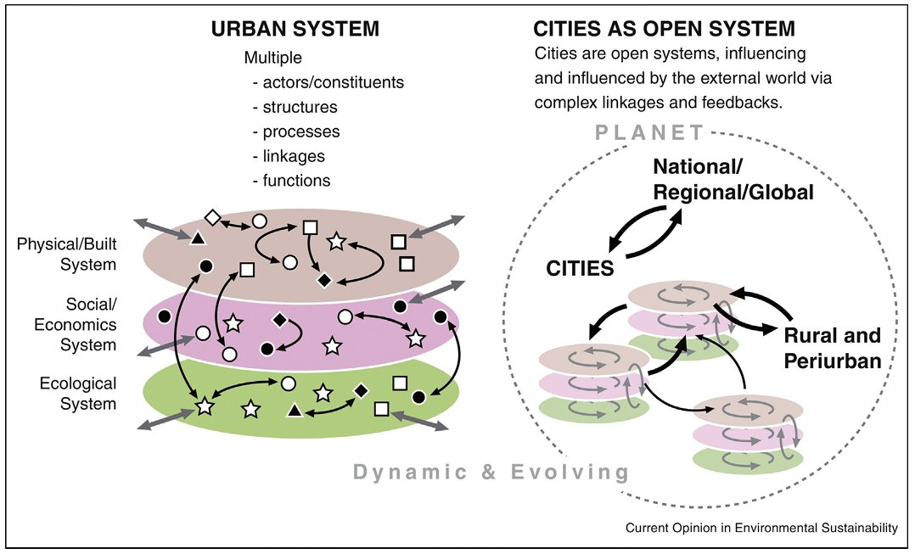
Cities are interconnected social–ecological–technological systems
Bai et al. (2016). Defining and advancing a systems approach for sustainable cities. Current Opinion in Environmental Sustainability, 23, 69–78. https://doi.org/10.1016/j.cosust.2016.11.010

Slide 12
Systems approach for sustainable cities
"Silo-thinking" in urban governance leads to uncoordinated action and unintended consequences.
Understanding connections helps to find synergies for more effective change.
Moving from reactive to proactive governance.
Coordinated action leads to long-term, resilient, and sustainable solutions.
Bai et al. (2016). Defining and advancing a systems approach for sustainable cities. Current Opinion in Environmental Sustainability, 23, 69–78. https://doi.org/10.1016/j.cosust.2016.11.010

Slide 13
Urban systems
"Systems thinking allows us to imagine cities in their multifaceted manifestations, as geophysical spaces, physical infrastructures, economic relationships, social entities, and cultural practices.​"
​
Bai et al. (2016). Defining and advancing a systems approach for sustainable cities. Current Opinion in Environmental Sustainability, 23, 69–78. https://doi.org/10.1016/j.cosust.2016.11.010

Slide 14
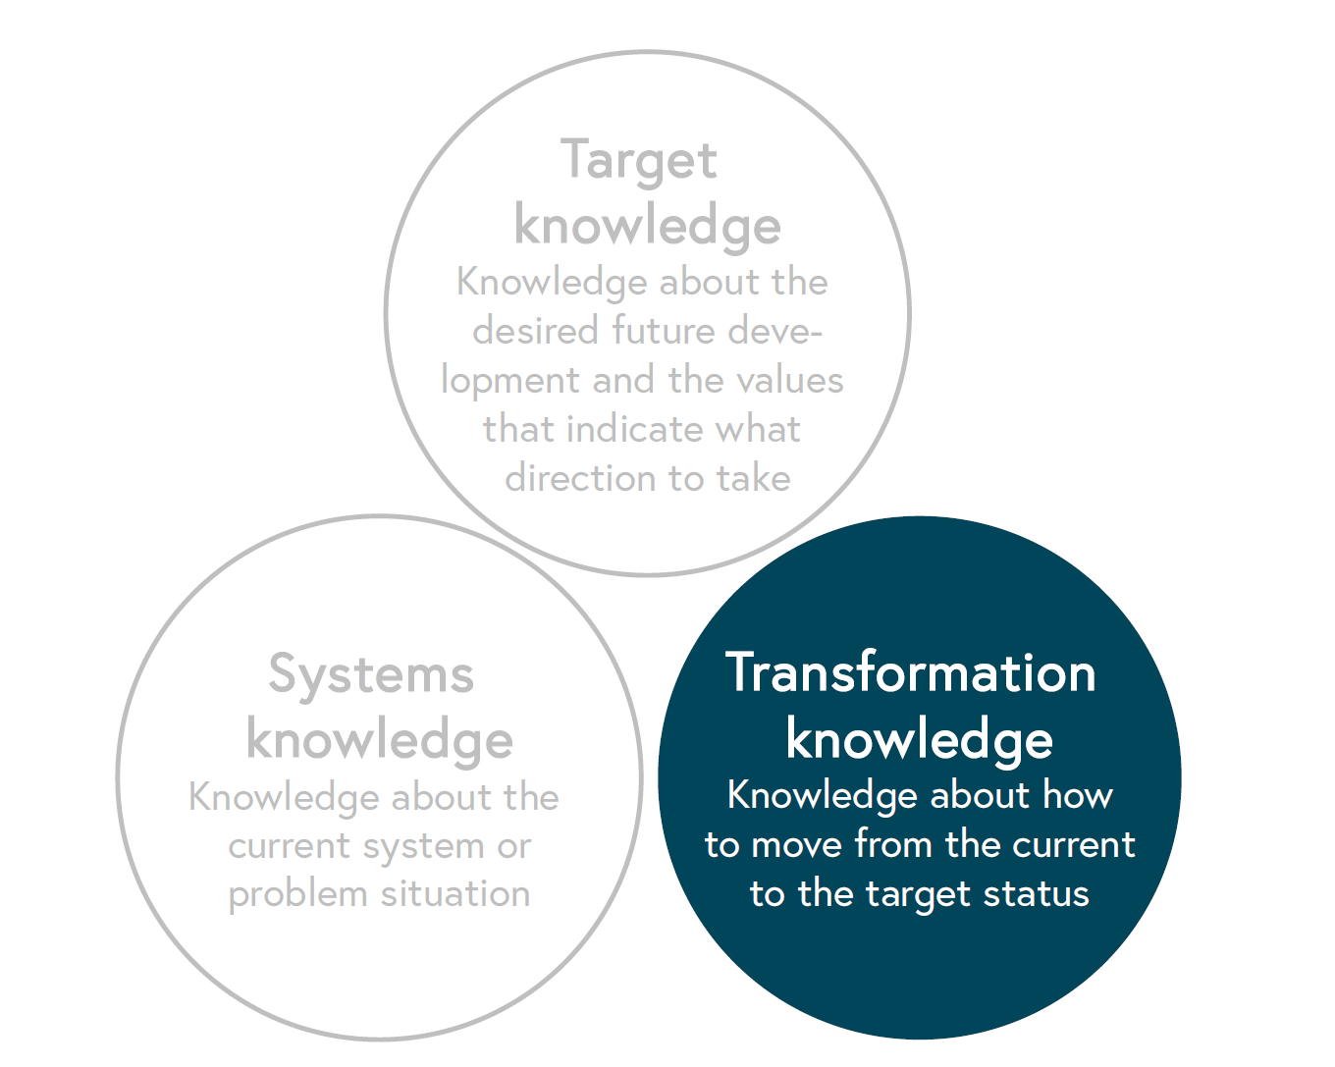
Three types of knowledge
Pohl, C., & Hirsch Hadorn, G. (2008). Methodological challenges of transdisciplinary research. Natures Sciences Sociétés, 16(2), 111–121. https://doi.org/10.1051/nss:2008035

Slide 15
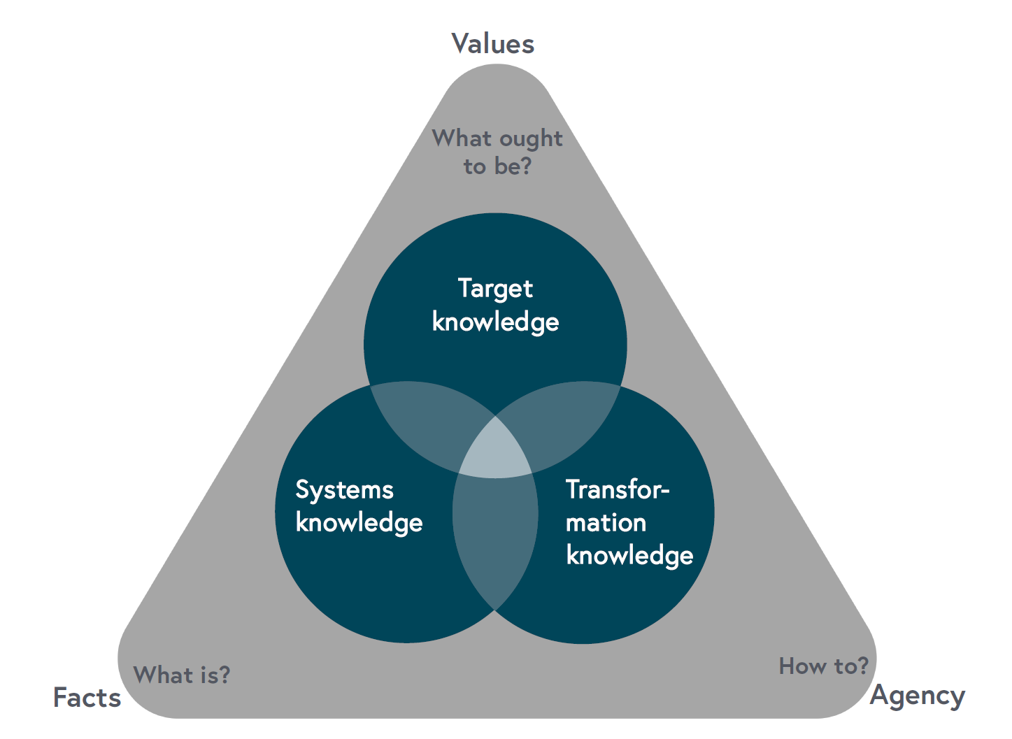
Three types of knowledge
Pohl, C., & Hirsch Hadorn, G. (2008). Methodological challenges of transdisciplinary research. Natures Sciences Sociétés, 16(2), 111–121. https://doi.org/10.1051/nss:2008035

Slide 16
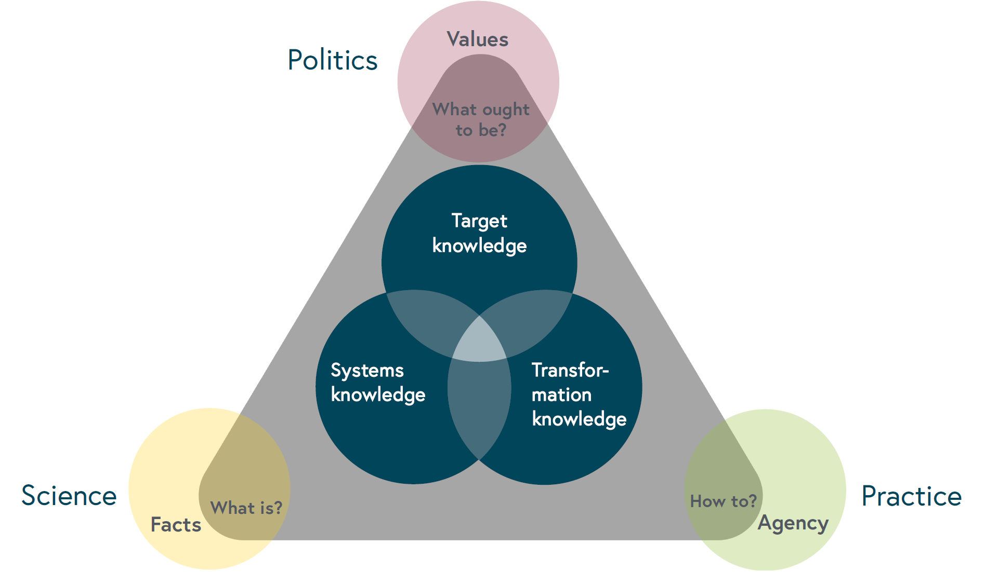
Three types of knowledge
Pohl, C., & Hirsch Hadorn, G. (2008). Methodological challenges of transdisciplinary research. Natures Sciences Sociétés, 16(2), 111–121. https://doi.org/10.1051/nss:2008035

Slide 17
Course organization

Slide 18
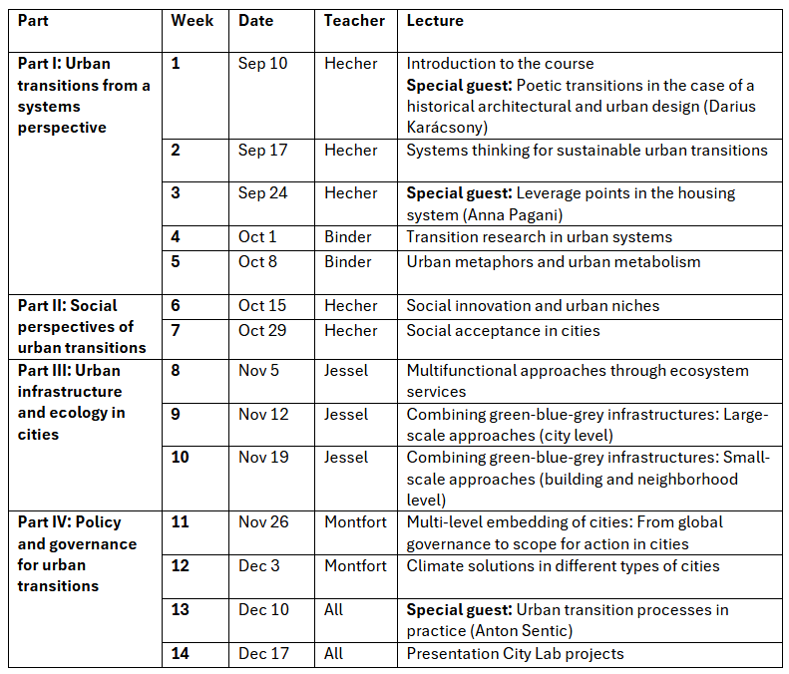
Course syllabus
Lectures 9:00-11:00
GC D0 386

Slide 19
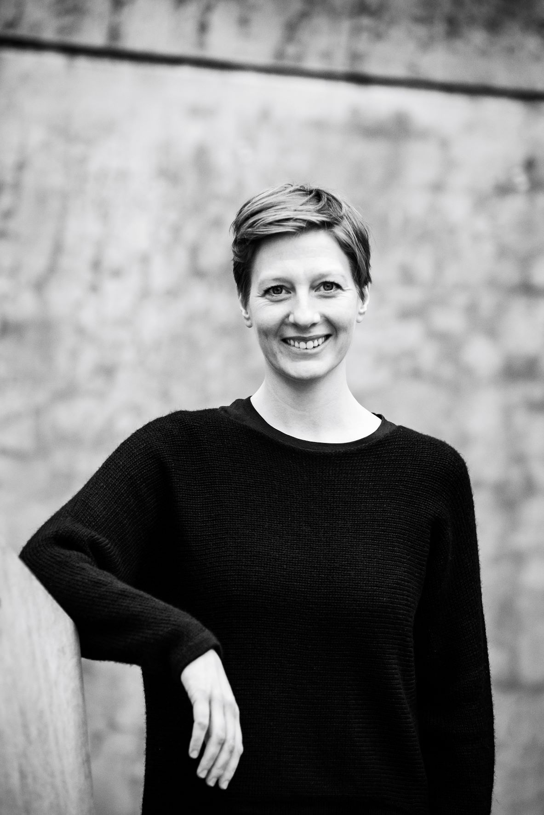
Dr. Maria Anna Hecher
Laboratory for Human-Environment Relations in Urban Systems (HERUS)
Environmental System Scientist with major in Business Administration (BSc, MSc) • Interdisciplinary Doctoral Program at Institute of Systems Science, Innovation and Sustainability Research (PhD) • University of Graz, AT
Scientist at EPFL (since 2020) • Energy consultant and project manager (2018-2020) • Regional energy manager (2016-2018)
Research on sustainability transitions through a socio-technical lens focusing on behavioral dynamics of energy systems

Slide 20
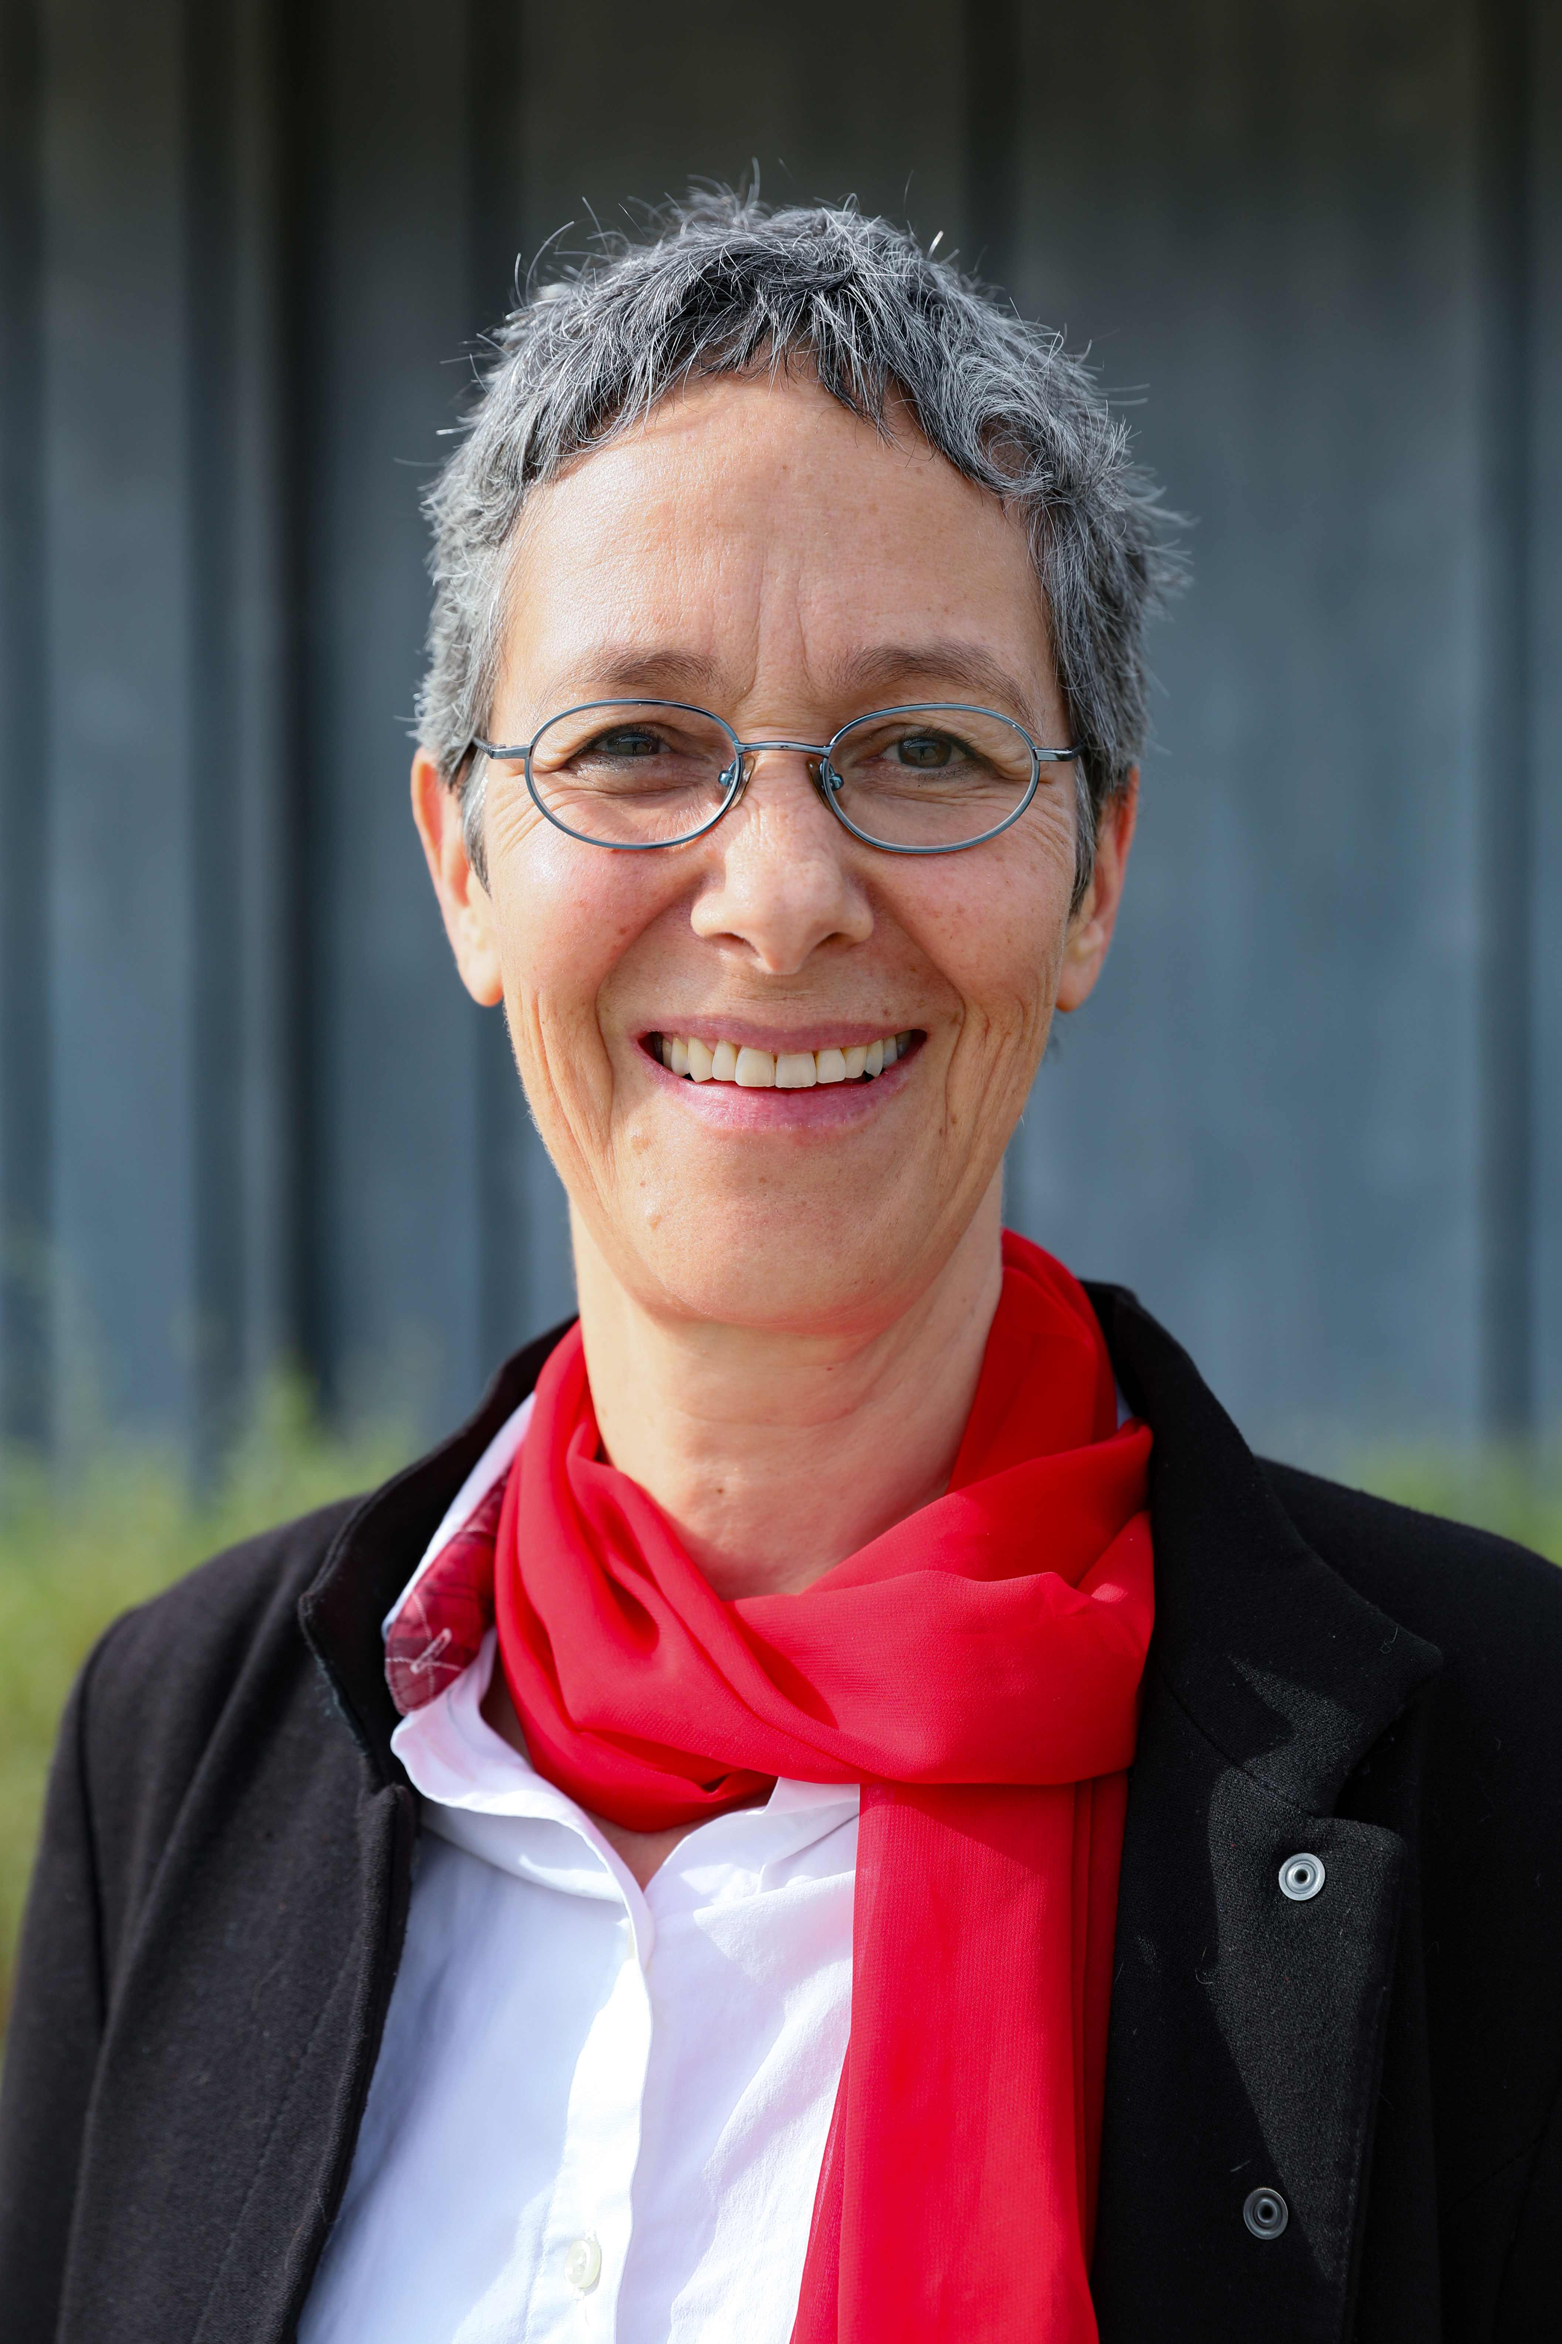
Prof. Claudia R. Binder
Laboratory for Human-Environment Relations in Urban Systems (HERUS)
Full Professor for Human-Environment Relations in
Urban Systems, EPFL (since 2016)
Positions held:
Dean School of Architecture, Civil & Environmental Engineering (ENAC), EPFL (2020-2023)
Full Professor for Human-Environment Relations, Ludwig-Maximilian-University Munich (2011-2016)
Full Professor for Systems Sciences, University of Graz, Austria (2009-2011)
Assistant Professor for Social and Industrial Ecology,
Institute for Geography, University of Zurich (2006-2009)

Slide 21

Prof. Beate Jessel
Laboratory of Landscape
Development (LAND)
Full Professor for Landscape Development (LAND) at
EPFL since 2021
Positions held:
Director of the Swiss Federal Institute for Forest, Snow and Landscape Research (WSL), Switzerland
Full Professor for Landscape Planning at University of Potsdam, Germany
Full Professor for Strategy and Management of Landscape Development at the Technical University of Munich, Germany
President of the German Federal Agency for Nature Conservation in Bonn, Germany (2007-2021)

Slide 22
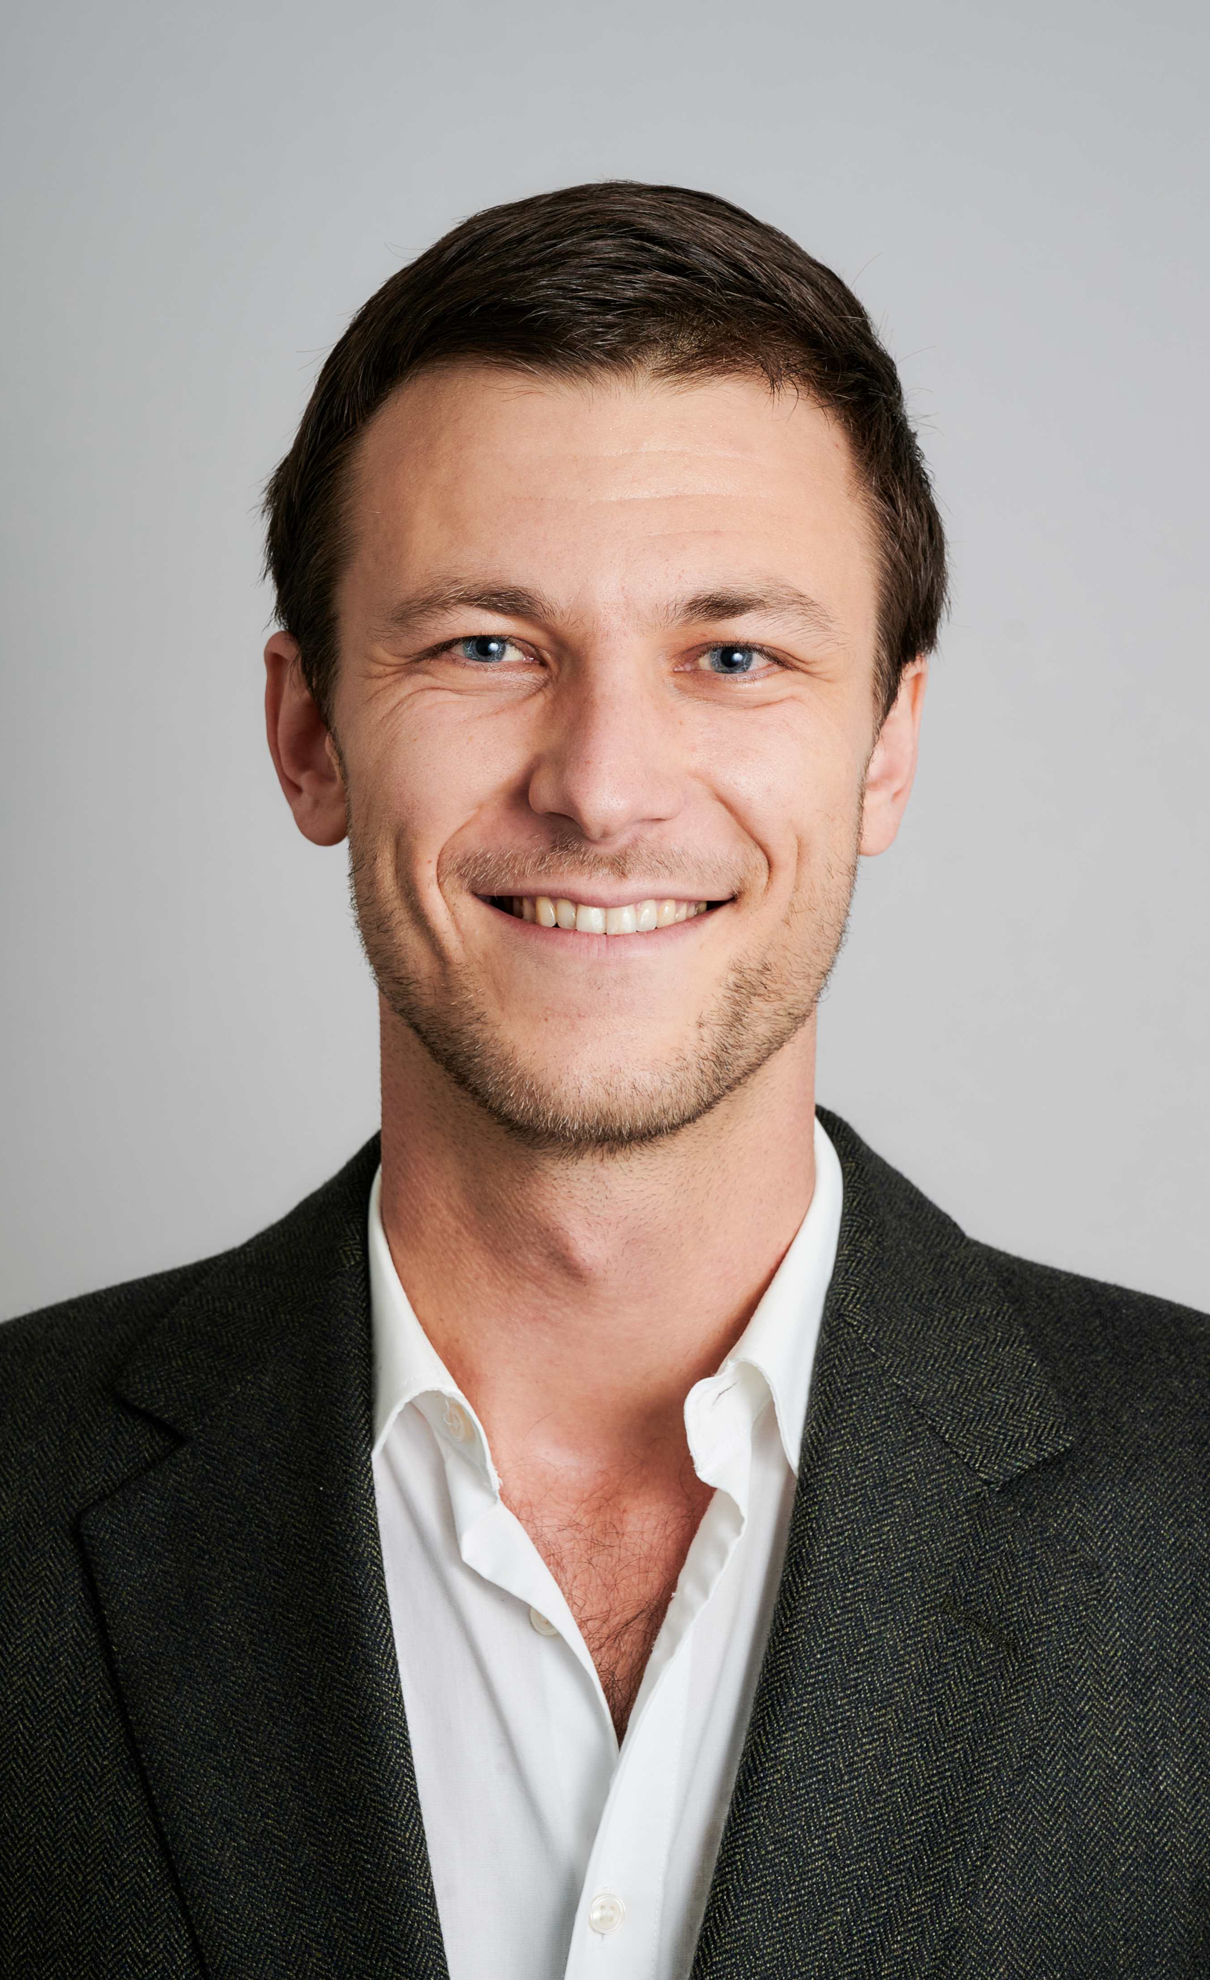
Dr. Simon Montfort
Laboratory for Human-Environment Relations in Urban Systems (HERUS)
PhD in Political Science with minor in Climate Sciences (University of Bern / Oeschger Centre for Climate Change Research) • MA in Political Science / International Relations (Graduate Institute Geneva / ETH Zurich) • BA in Economics (University of Basel)
Postdoctoral researcher at EPFL (since 2024) • Research assistant at the Graduate Institute Geneva (2019) • Research assistant at the University of Basel (2016)
Research: Computational social sciences • Evidence synthesis • Social networks • Survey experiments

Slide 23
City Lab group projects

Slide 24

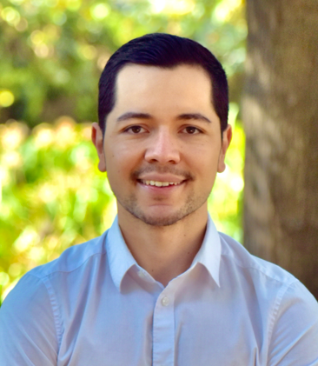
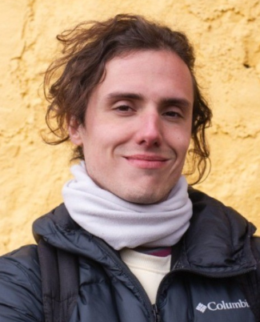
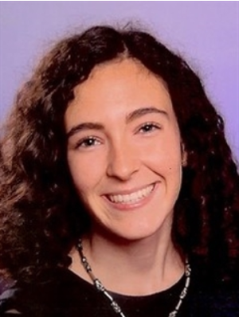
Teaching assistant team
Hanbit Lee • Simón Ladino Cano • Alejandro Gómez Tejera • Alicia del Carmen Pérez Domouso

Slide 25
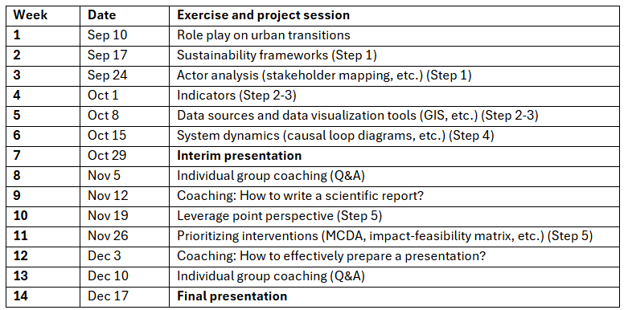
City Lab group projects
Exercise & project sessions 11:00-13:00
GC D0 386

Slide 26
Assessment
Individual assessment 50%
  Oral exam
Group assessment 50%
  Scientific report of project (30%)
  Presentation of project (20%)

Slide 27
Assessment criteria
Oral exam
  Course content and conceptual understanding
  Practical understanding and justification
  Critical reflection on systems thinking
Group project
  Scientific report: content quality • analytical depth • scientific writing
  Presentation: societal impact • communication effectiveness

Slide 28
Moodle platform
General section
  Course content and syllabus
  Project guidelines and schedule
  Assessment and related criteria
  Announcement forum and Q&A forum
Group project section with all exercises
Lecture sections

Slide 29
Darius Karácsony
Urban infrastructure’s social impact through the lens of philosophy and poetry​
Studied Architecture and Urbanism in Zurich, Tokyo, and Rio de Janeiro, with additional training at Diller+Scofidio and OMA New York.
After graduating from ETH Zurich, he taught design studio and lectured on architectural drawing at EPFL.
To study Renaissance art, he lived in Florence and Rome before returning to Switzerland to lead a design research program at EPFL, where he initiated a collaboration with the Brain Mind Institute.
As a member of the British School of Archaeology at Athens, he recently completed a treatise on the poetics of architecture and co-directed a landscape archaeology project.

Slide 30
Contact
Maria Anna Hecher, PhD
Laboratory on Human-Environmental Relations in Urban Systems
maria.hecher@epfl.ch

