Slide 1
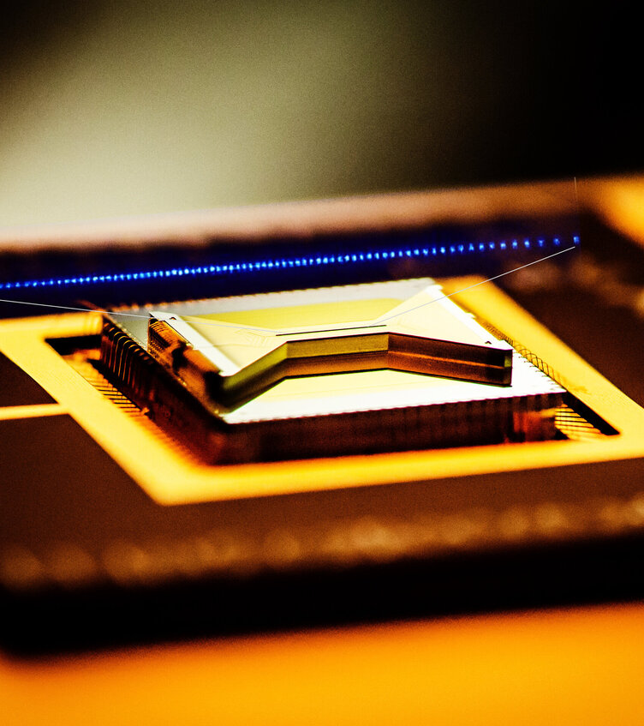
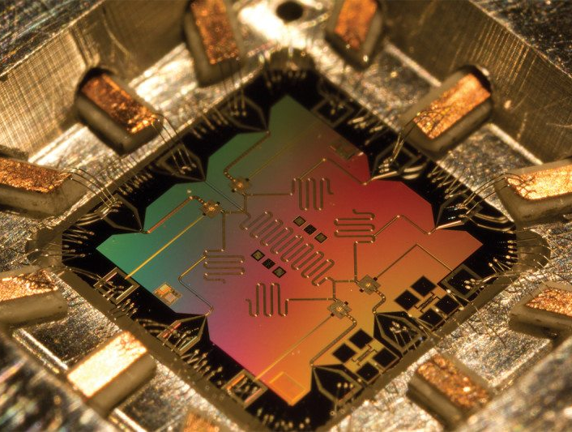
Variational Quantum Algorithms for Near-term Intermediary Scale Quantum (NISQ) Computing
Why, what and how to use them

Slide 2
Preface: Title of my talk
An intro to:
Variational quantum algorithms (VQA)?
Quantum neural networks (QNN)?
Quantum machine learning (QML)?

Slide 3
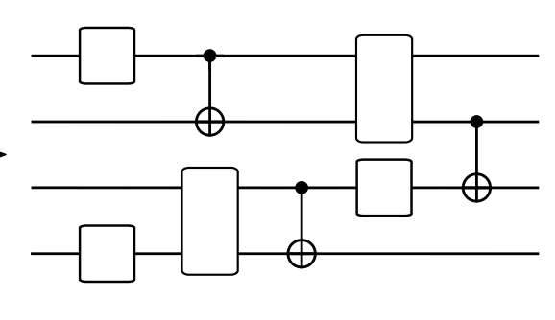
Preface: Title of my talk
“Any method that optimizes a QNN (i.e. a parameterized quantum circuit) by minimizing a quantum cost function (potentially using training data)”
An intro to:
Variational quantum algorithms?
Quantum neural networks?
Quantum machine learning?
This includes VQAs
+ many (but not all) QML methods

Slide 4


Preface: Title of my talk
“Any method that optimizes a QNN (i.e. a parameterized quantum circuit) by minimizing a quantum cost function (potentially using training data)”
An intro to:
Variational quantum algorithms?
Quantum neural networks?
Quantum machine learning?

Slide 5
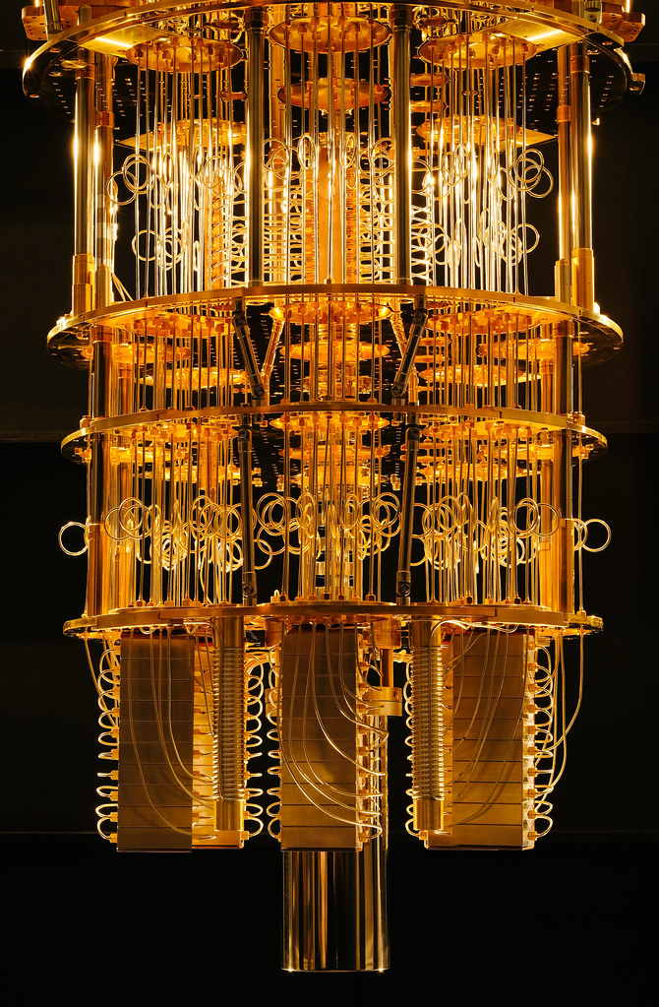

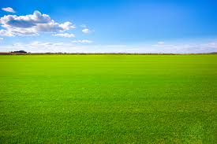
Overview
Part 1: What are variational quantum algorithms (VQAs) and why use them.
Motivation
What are variational quantum algorithms
Example uses
Part 2: Ingredients for a successful VQA.
Expressibility
Trainability

Slide 6
Overview
Part 1: What are variational quantum algorithms (VQAs) and why use them.
Motivation
What are variational quantum algorithms
Example uses
Part 2: Ingredients for a successful VQA.
Expressibility
Trainability

Slide 7
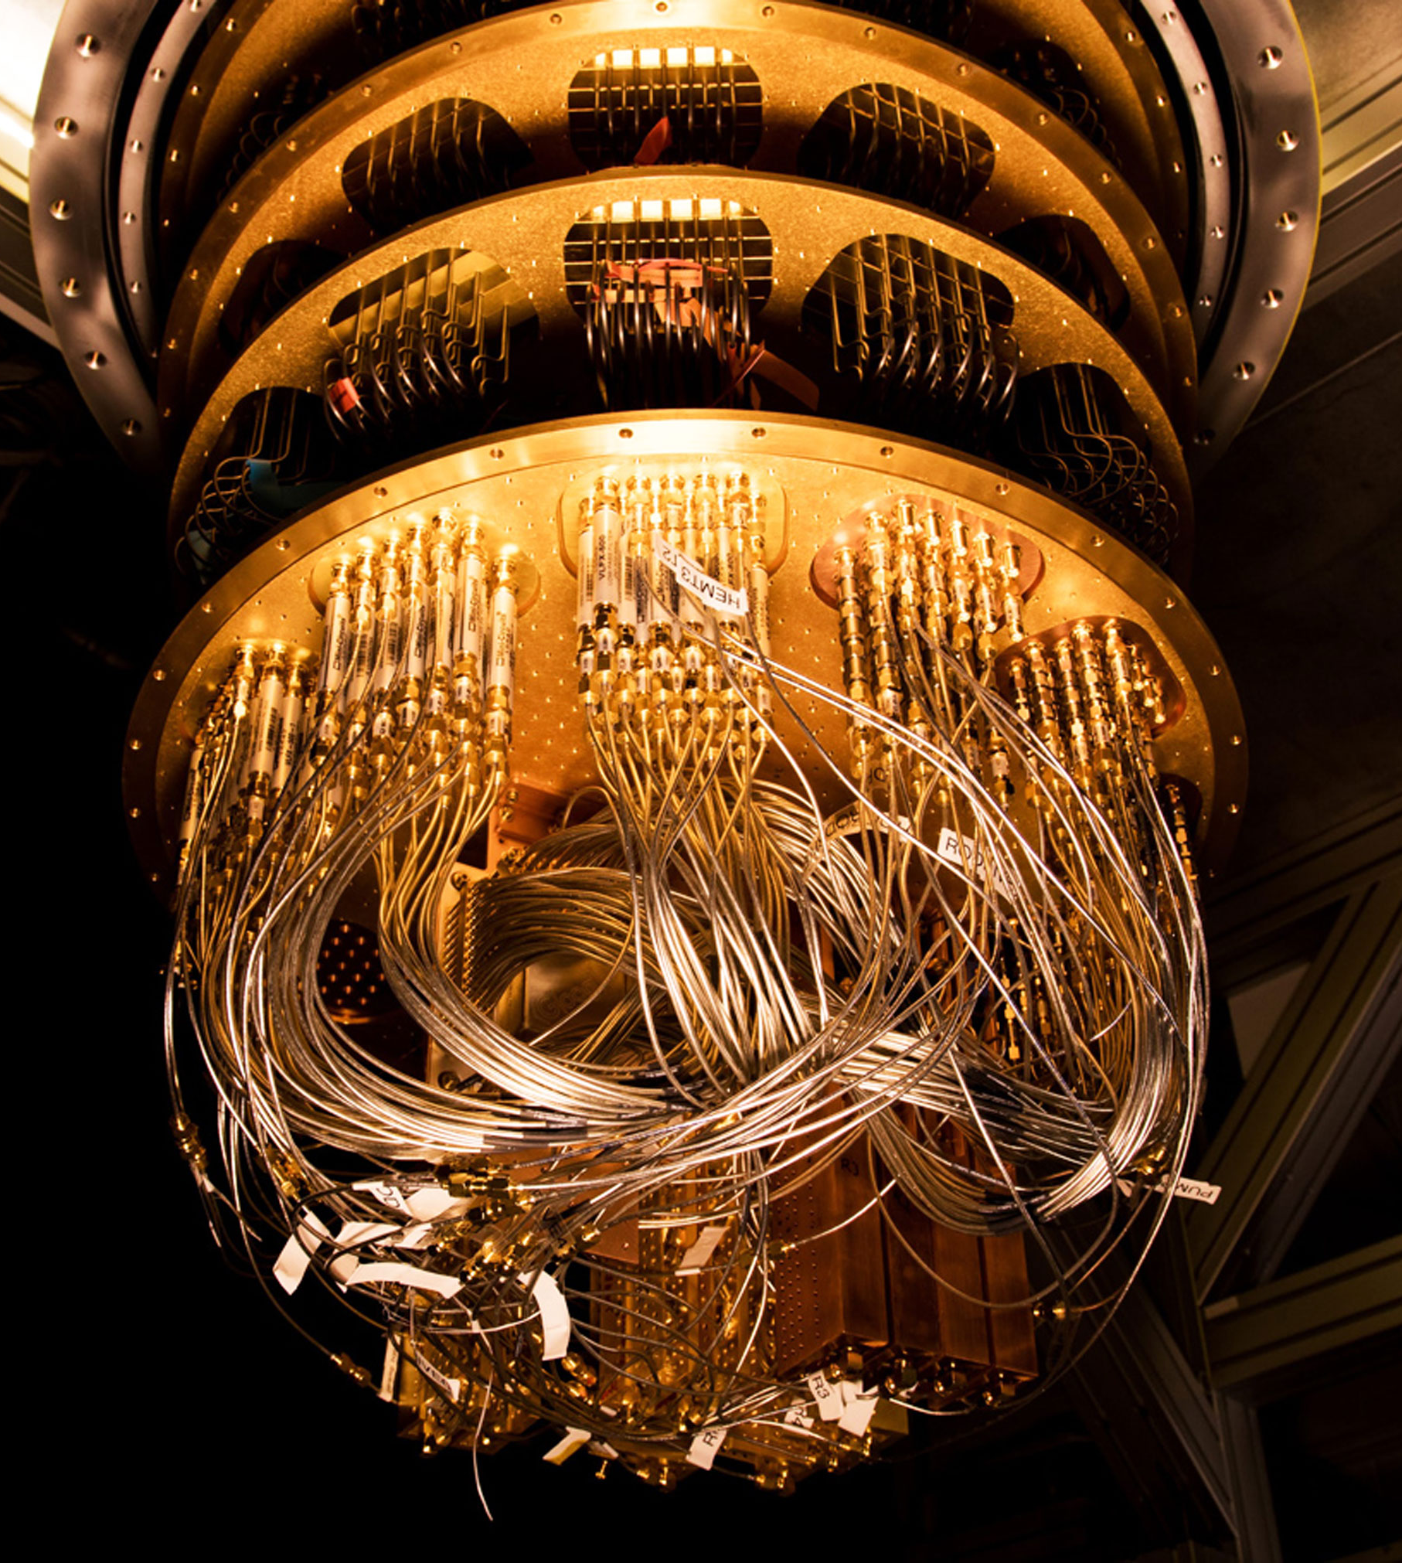
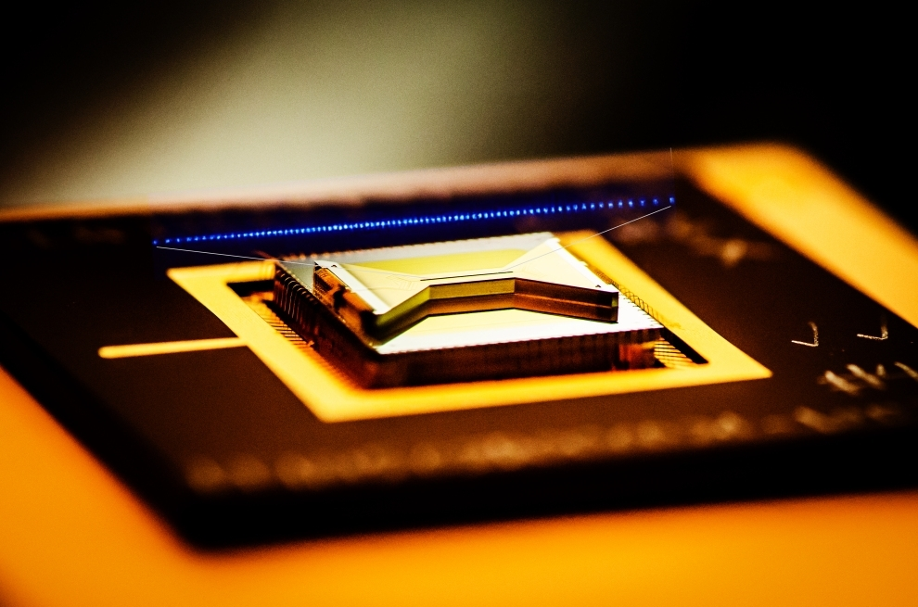
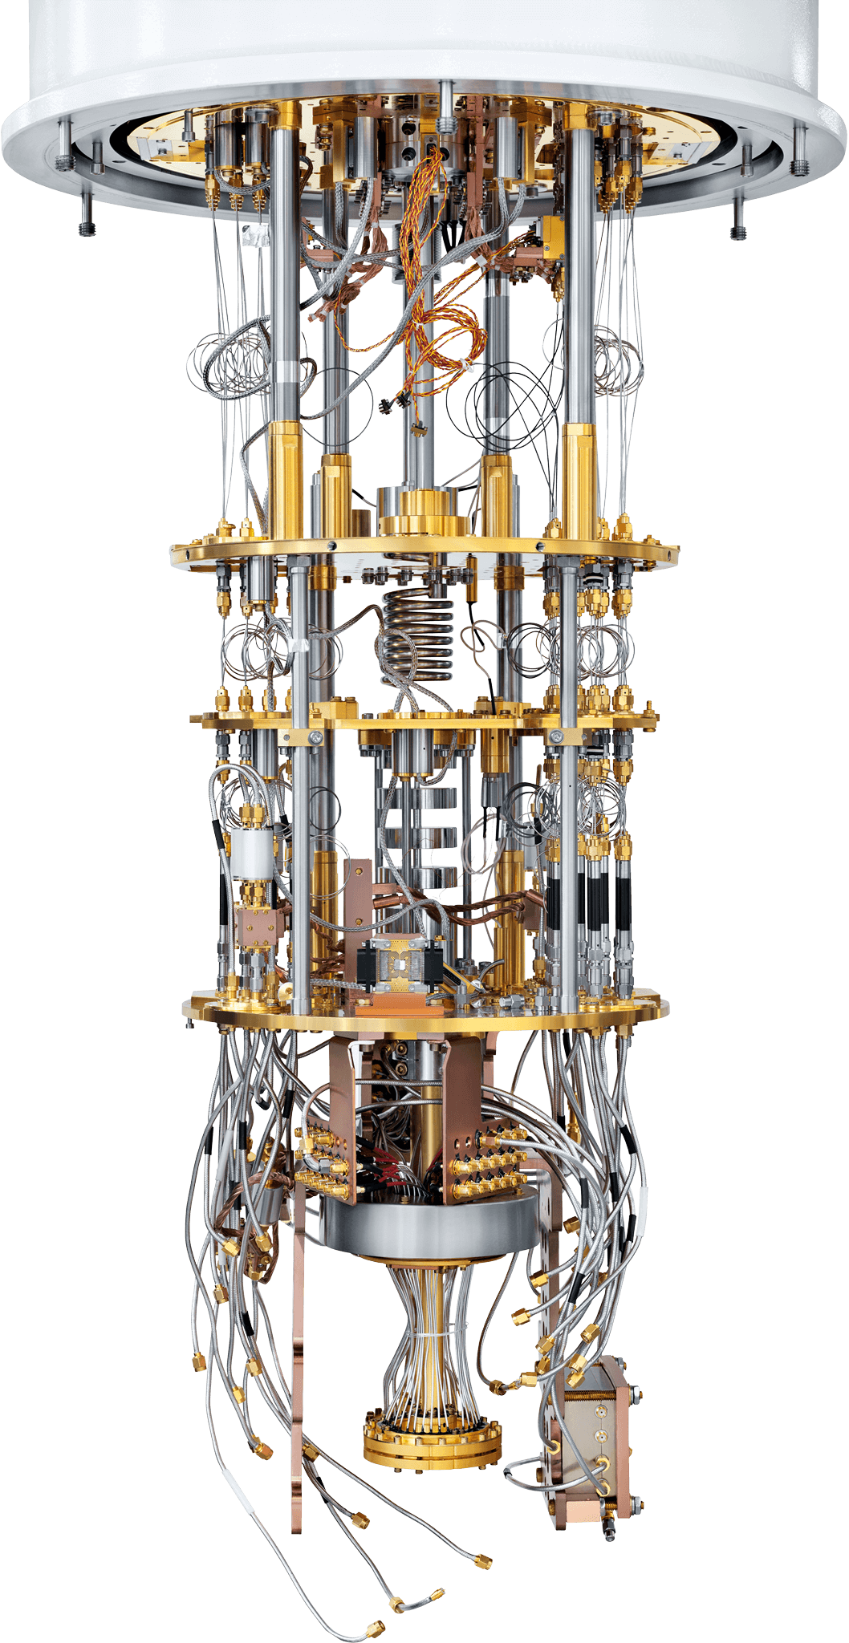
Motivation
Google
IBMQ
Quantum computers are here…
They’re incredibly impressive pieces of engineering
IonQ
Rigetti

Slide 8

Motivation
Google
IBMQ
Quantum computers are here…
They’re incredibly impressive pieces of engineering
You can access some over the cloud
IonQ
Rigetti
https://qiskit.org/

Slide 9
Motivation
Google
IBMQ
Quantum computers are here…
They’re incredibly impressive pieces of engineering
You can access some over the cloud
But from the users perspective, if we’re honest, they are a little underwhelming
IonQ
Rigetti
https://qiskit.org/

Slide 10

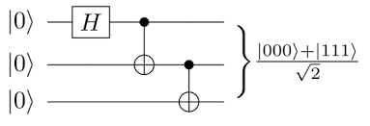
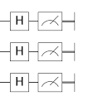
Motivation
(Thanks Max!)
IBMQ- Hanoi

Slide 11
Motivation
(Thanks Max!)
IBMQ- Hanoi

Slide 12
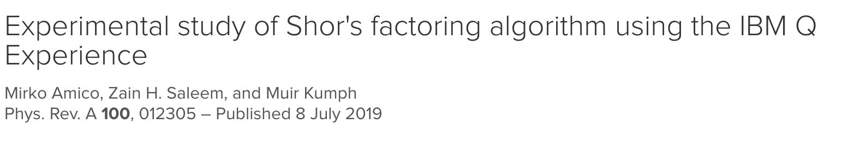
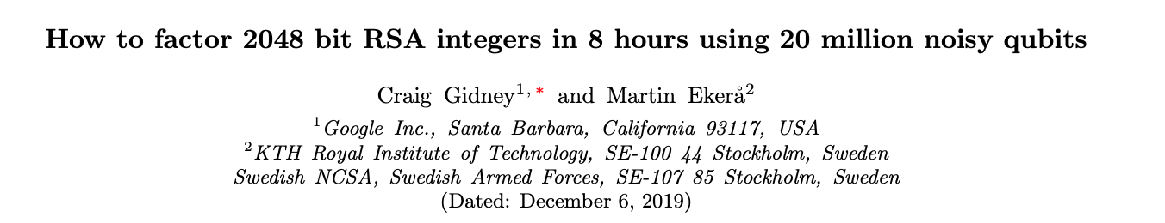
Motivation
IBMQ
127 qubits
Factors: 15 21 35

Slide 13
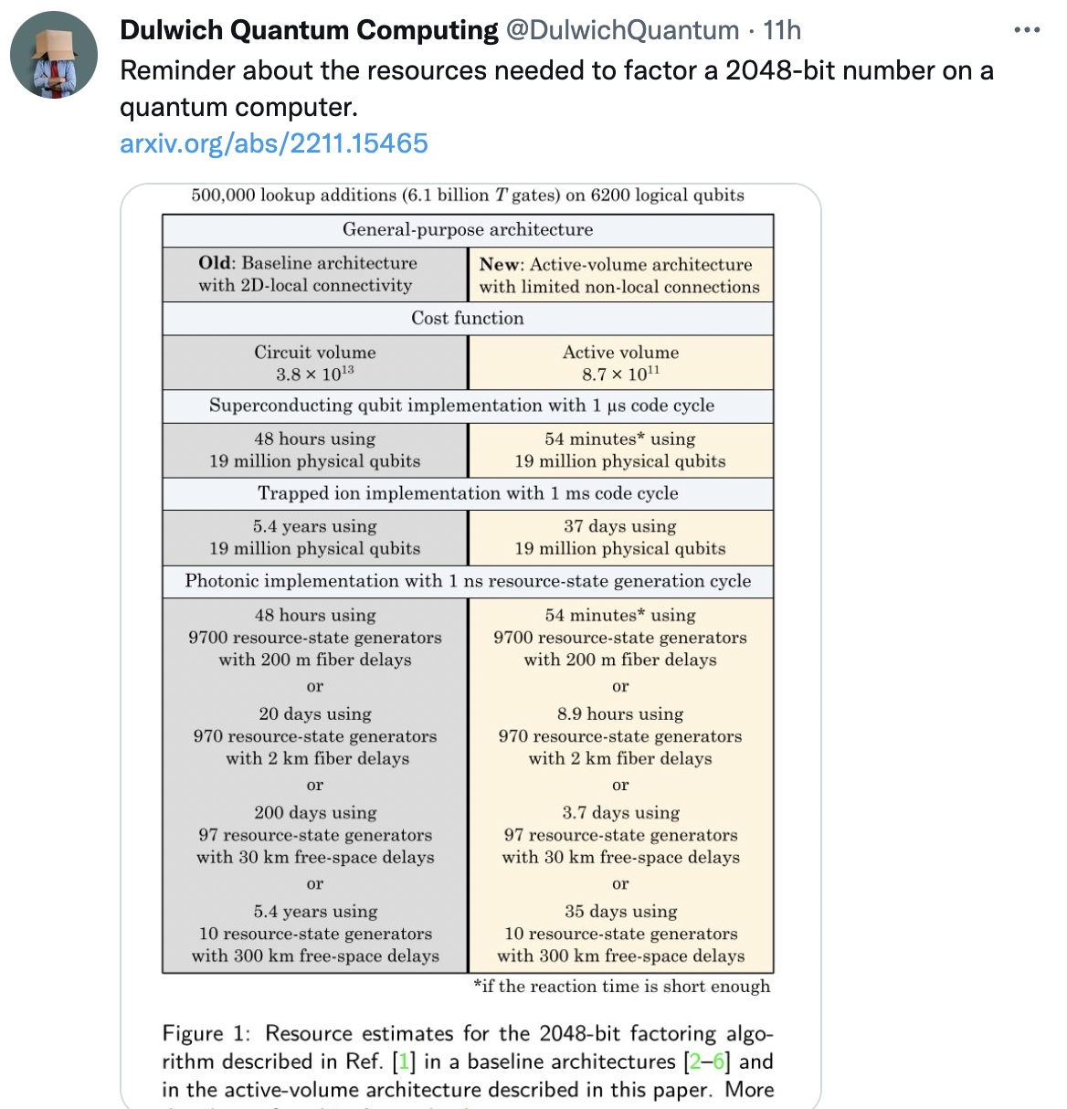
Motivation
IBMQ
127 qubits
Saw on twitter today: resource counts haven’t improved substantially in the last 3 years!

Slide 14
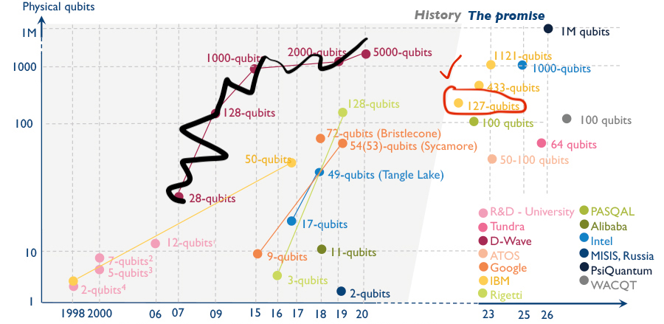
Motivation

Slide 15
Motivation
???

Slide 16
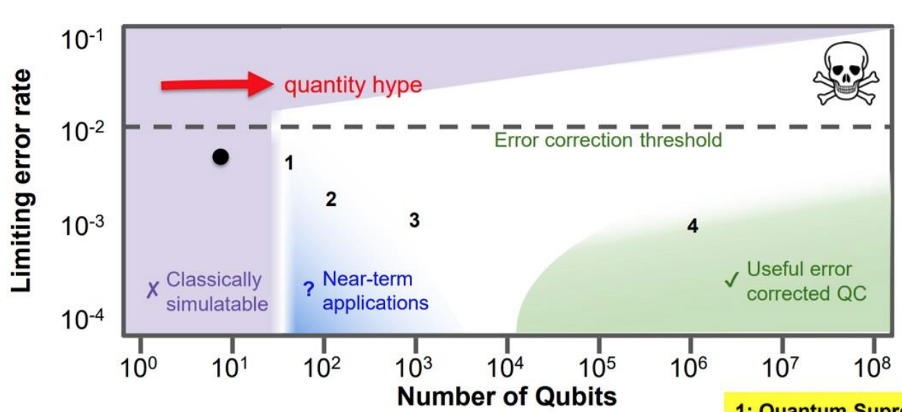
Motivation

Slide 17
Motivation

Slide 18
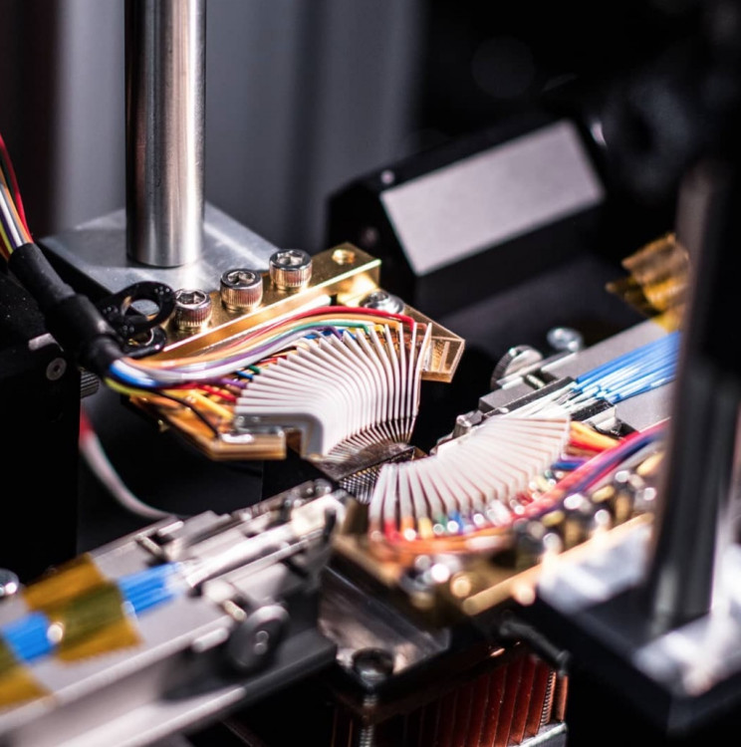
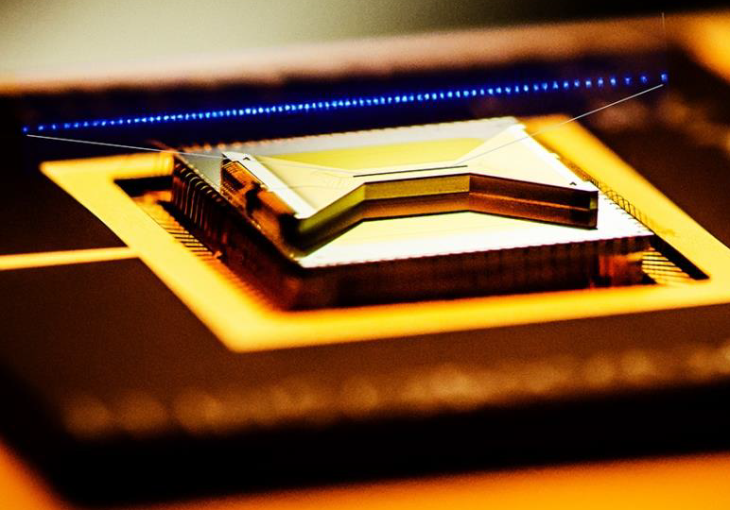
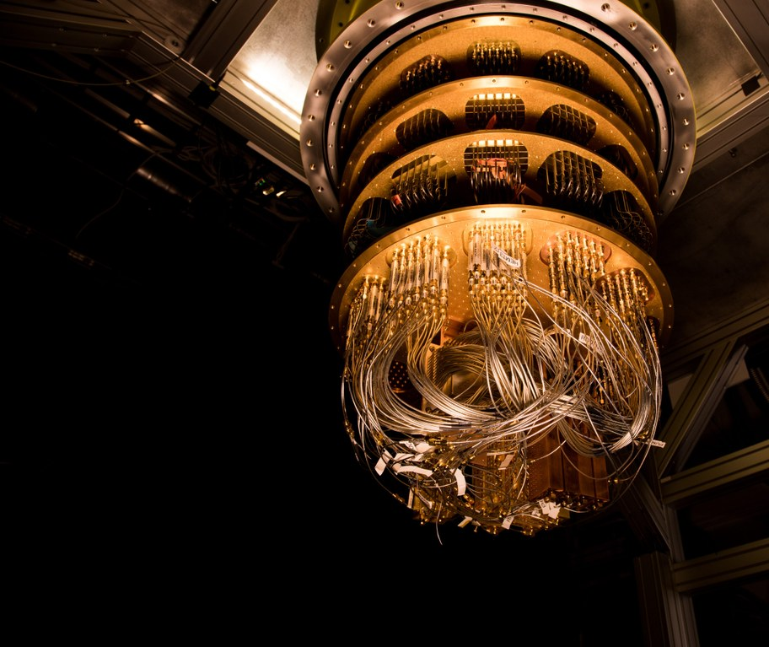
Motivation
Near term Intermediary Scale (NISQ) quantum computers are:
Not very big (too small for error correction/complex algorithms)
Noisy (prone to errors)
This limits their utility

Slide 19
Motivation
Near term Intermediary Scale (NISQ) quantum computers are:
Not very big (too small for error correction/complex algorithms)
Noisy (prone to errors)
This limits their utility/means we need to be more imaginative

Slide 20


Motivation
Trick to using a noisy quantum computer? Use it as little as possible.
Key component of the algorithm will be run on the quantum computer…. but complement this with classical computing.

Slide 21

Quantum Machine Learning (QML) &
Variational Quantum Algorithms (VQAs)
training data
Classical
Computation
Quantum Computation
Optimization Loop
For the purpose of this talk I will focus on:
“Any method that optimizes a QNN (i.e. a parameterized quantum circuit) by minimizing a quantum cost function (potentially using training data)”
Encapsulates: VQAs + many (but not all) QML methods

Slide 22
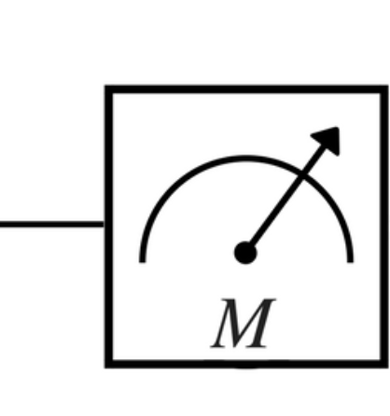
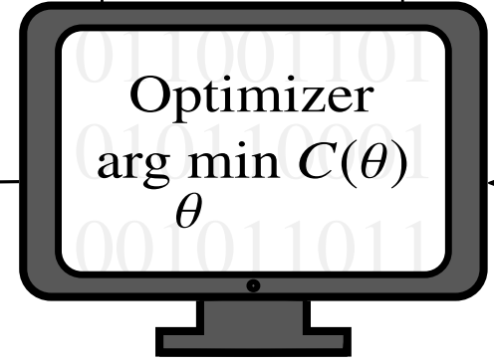





Variational Quantum Algorithm (VQA)
Goal: Train a QNN to minimize a problem-specific cost function
Pick cost + QNN s.t. if successfully trained: the optimal parameters/circuit/cost = approx. solution to problem
Quantum Computation
Measured
Cost
Classical Computation
$$θ_{1}$$
$$θ_{4}$$
$$θ_{5}$$
$$θ_{3}$$
$$θ_{2}$$
Update
parameters
Parameterised
Quantum Circuit/QNN
How do you train? Using a hybrid-quantum classical optimization loop

Slide 23

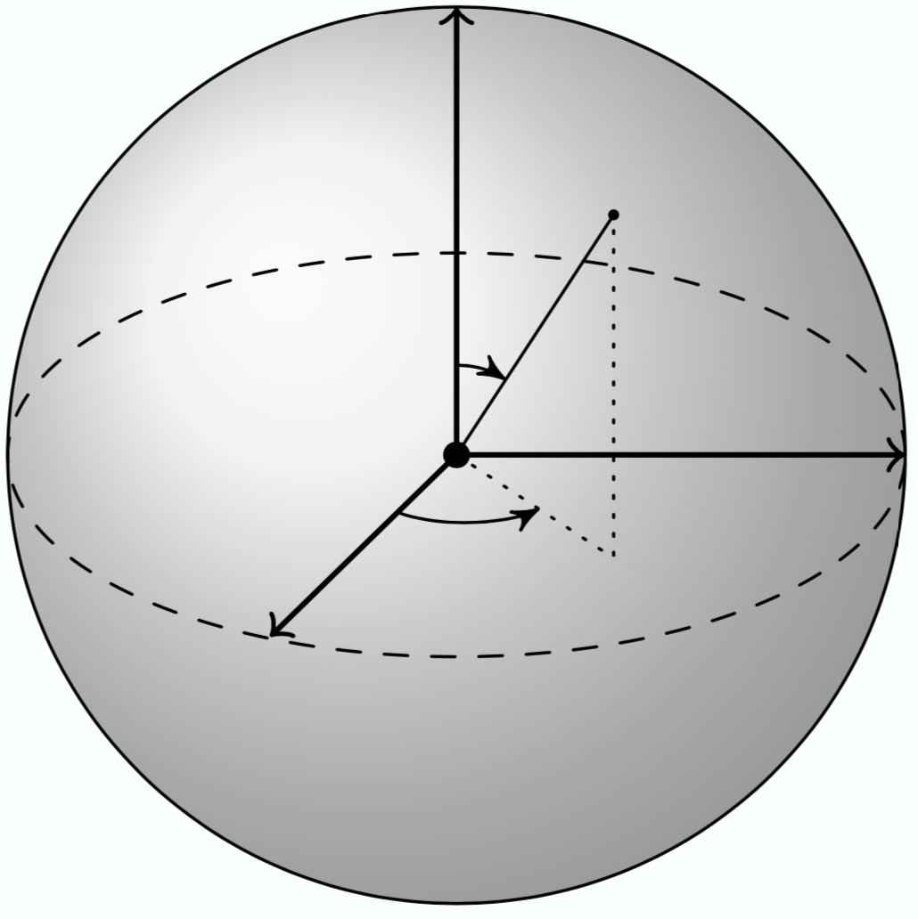




Variational Quantum Algorithm (VQA)
Quantum Computation
Measured
Cost
Classical Computation
$$θ_{1}$$
$$θ_{4}$$
$$θ_{5}$$
$$θ_{3}$$
$$θ_{2}$$
Update
parameters
Parameterised
Quantum Circuit
Z
Parameterised rotation gate e.g.
X

Slide 24
Variational Quantum Algorithm (VQA)
Quantum Computation
Measured
Cost
Classical Computation
$$θ_{1}$$
$$θ_{4}$$
$$θ_{5}$$
$$θ_{3}$$
$$θ_{2}$$
Update
parameters
Parameterised
Quantum Circuit
Parameterised rotation gate
Or e.g. a control phase

Slide 25





Peruzzo A, McClean, et al. Nat Commun. 2014; 5:4213.
Example: The Variational Quantum Eigensolver
Quantum Computation
Measured
Cost
Classical Computation
$$θ_{1}$$
$$θ_{4}$$
$$θ_{5}$$
$$θ_{3}$$
$$θ_{2}$$
Update
parameters
Parameterised
Quantum Circuit
Minimize energy of Hamiltonian
Learn ground state & ground state energy

Slide 26
Peruzzo A, McClean, et al. Nat Commun. 2014; 5:4213.
Example: The Variational Quantum Eigensolver
Quantum Computation
Measured
Cost
Classical Computation
$$θ_{1}$$
$$θ_{4}$$
Minimize energy of Hamiltonian
$$θ_{5}$$
$$θ_{3}$$
$$θ_{2}$$
Learn ground state & ground state energy
Update
parameters
Parameterised
Quantum Circuit
How do you measure the cost?
Write as sum of Pauli products of operators, e.g.,
Measure in the computational basis

Slide 27
Peruzzo A, McClean, et al. Nat Commun. 2014; 5:4213.
Example: The Variational Quantum Eigensolver
Quantum Computation
Measured
Cost
Classical Computation
$$θ_{1}$$
$$θ_{4}$$
Minimize energy of Hamiltonian
$$θ_{5}$$
$$θ_{3}$$
$$θ_{2}$$
Learn ground state & ground state energy
Update
parameters
Parameterised
Quantum Circuit
How do you measure the cost?
Write as sum of Pauli products of operators, e.g.,
Rotate to x-basis (apply Hadamard) then measure in the computational basis

Slide 28
Peruzzo A, McClean, et al. Nat Commun. 2014; 5:4213.
Example: The Variational Quantum Eigensolver
Quantum Computation
Measured
Cost
Classical Computation
$$θ_{1}$$
$$θ_{4}$$
Minimize energy of Hamiltonian
$$θ_{5}$$
$$θ_{3}$$
$$θ_{2}$$
Learn ground state & ground state energy
Update
parameters
Parameterised
Quantum Circuit
How do you measure the cost?
Write as sum of Pauli products of operators, e.g.,
Rotate to y-basis then measure in the computational basis
Do nothing

Slide 29
Peruzzo A, McClean, et al. Nat Commun. 2014; 5:4213.
Example: The Variational Quantum Eigensolver
Quantum Computation
Measured
Cost
Classical Computation
$$θ_{1}$$
$$θ_{4}$$
Minimize energy of Hamiltonian
$$θ_{5}$$
$$θ_{3}$$
$$θ_{2}$$
Learn ground state & ground state energy
Update
parameters
Parameterised
Quantum Circuit
Uses:
Quantum Chemistry (finding ground states of molecules)
Condensed Matter (finding ground states of complex spin chains)
Lots of other optimization problems (where the solution is encoded as the ground state of some Hamiltonian)

Slide 30
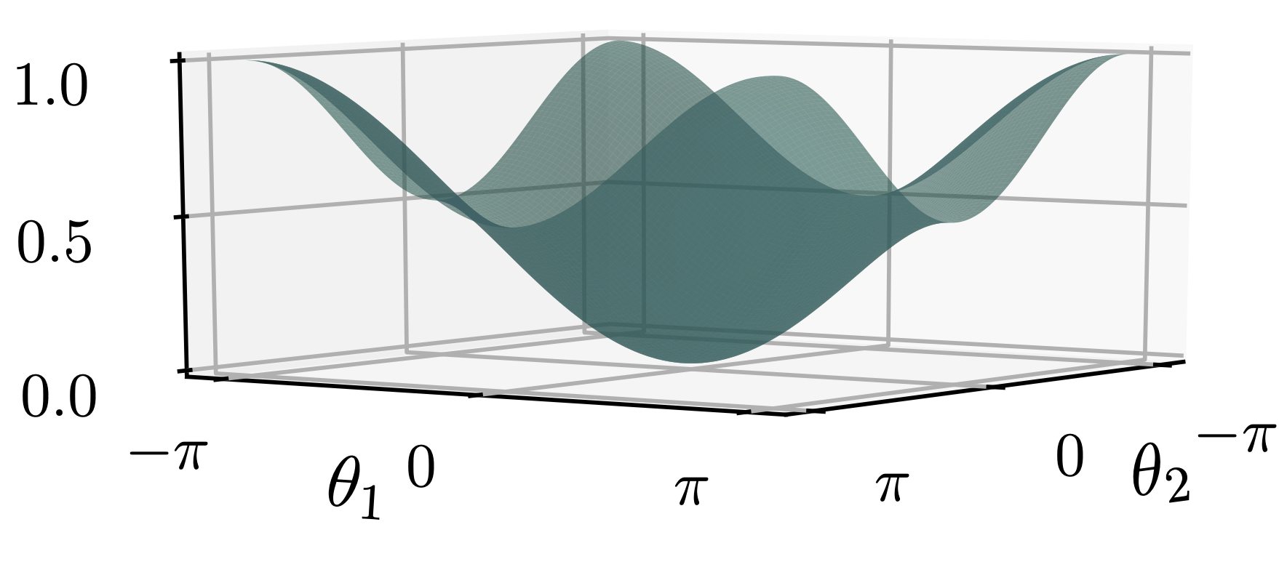
Constructing your own VQA
Need to pick your cost function such that it is faithful:
Set of
(approximate)
solutions

Slide 31
Constructing your own VQA
Need to pick your cost function such that it is faithful:
Set of
(approximate)
solutions
e.g. for learning the ground state of a Hamiltonian this is just the set of unitaries that prepare the ground state from the all zero state.

Slide 32
Constructing your own VQA
Need to pick your cost function such that it is faithful:
Set of
(approximate)
solutions
If the minimum of your cost function is 0 then condition to be faithful simplifies to

Slide 33
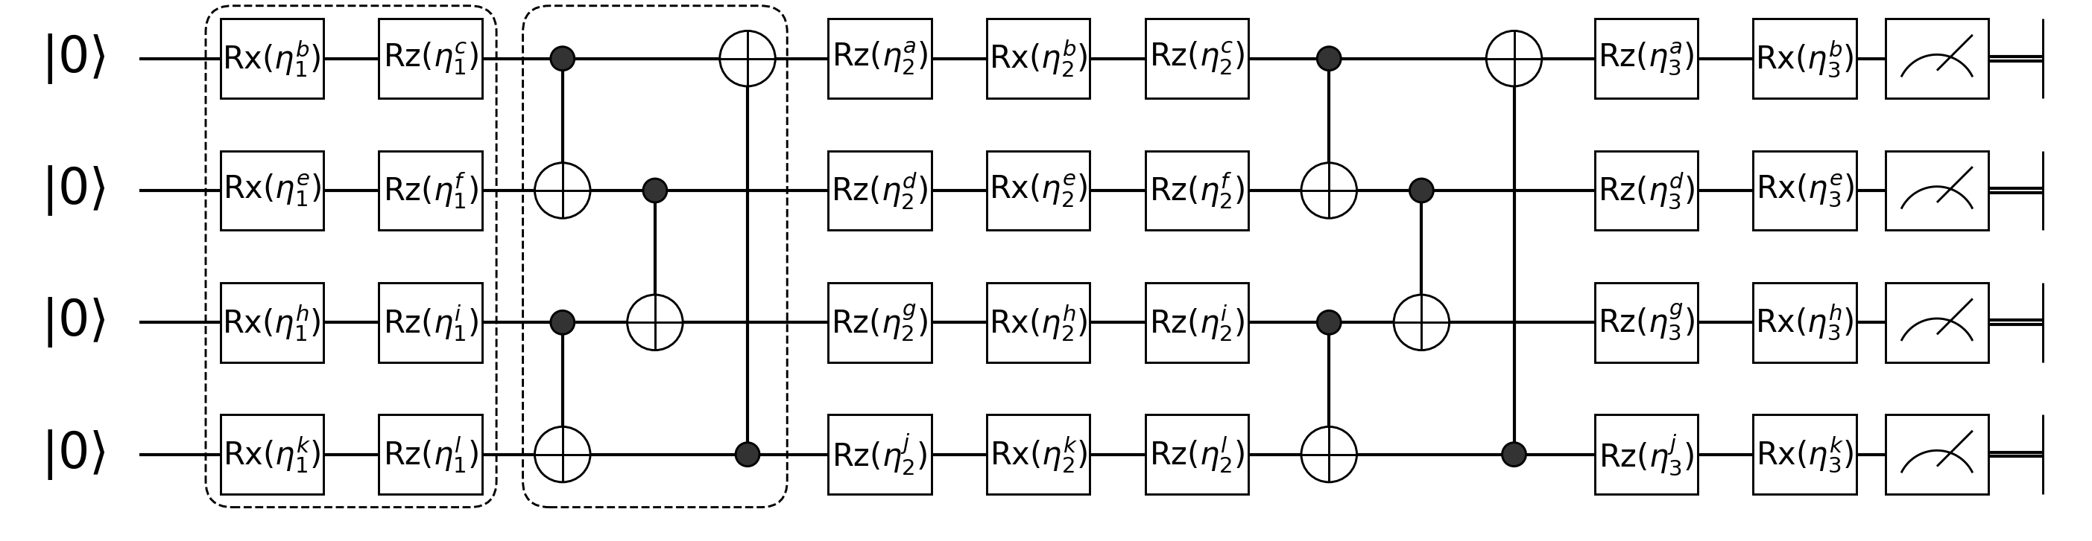
Constructing your own VQA
Need to pick your cost function such that it is faithful:
And is efficient to compute
Set of
(approximate)
solutions
i.e. Requires only a few short depth circuits

Slide 34
Example: Learning an unknown unitary
Need to pick your cost function such that it is faithful:
And is efficient to compute
Set of
(approximate)
solutions
Task:
Optimised
quantum circuit
Target unitary
Q: What is the set of approximate solutions here?

Slide 35
Example: Learning an unknown unitary
Need to pick your cost function such that it is faithful:
And is efficient to compute
Set of
(approximate)
solutions
Task:
Optimised
quantum circuit
Target unitary
Q: What is the set of approximate solutions here?
A: The set of unitaries that well approximate V

Slide 36
Example: Learning an unknown unitary
Need to pick your cost function such that it is faithful:
And is efficient to compute
Set of
(approximate)
solutions
Task:
Optimised
quantum circuit
Target unitary
Q: What is the set of approximate solutions here?
A: Or simply, just the unitary, V

Slide 37
Example: Learning an unknown unitary
Need to pick your cost function such that it is faithful:
And is efficient to compute
Set of
(approximate)
solutions
Task:
Optimised
quantum circuit
Target unitary
Q: What cost could be used?

Slide 38
Example: Learning an unknown unitary
Need to pick your cost function such that it is faithful:
And is efficient to compute
Set of
(approximate)
solutions
Task:
Optimised
quantum circuit
Target unitary
Q: What cost could be used?
A:

Slide 39

Example: Learning an unknown unitary
Need to pick your cost function such that it is faithful:
And is efficient to compute
Set of
(approximate)
solutions
Task:
Optimised
quantum circuit
Target unitary
Q: What cost could be used?
A:

Slide 40
Example: Learning an unknown unitary
Need to pick your cost function such that it is faithful:
And is efficient to compute
Set of
(approximate)
solutions
Depends on your choice in matrix norm!
Task:
Optimised
quantum circuit
Target unitary
Q: What cost could be used?
A:

Slide 41
Example: Learning an unknown unitary
Need to pick your cost function such that it is faithful:
And is efficient to compute
Set of
(approximate)
solutions
Depends on your choice in matrix norm!
Lots of choices in matrix norm (wiki page is helpful source)
Most aren’t readily computable on a QC
Task:
Optimised
quantum circuit
Target unitary
Q: What cost could be used?
A:

Slide 42
Example: Learning an unknown unitary
Need to pick your cost function such that it is faithful:
And is efficient to compute
Set of
(approximate)
solutions
Depends on your choice in matrix norm!
Lots of choices in matrix norm (wiki page is helpful source)
Most aren’t readily computable on a QC
But the 2 Norm/Hilbert-Schmidt (HS) norm is
Task:
Optimised
quantum circuit
Target unitary
Q: What cost could be used?
A:

Slide 43
Example: Learning an unknown unitary
Need to pick your cost function such that it is faithful:
And is efficient to compute
Set of
(approximate)
solutions
Depends on your choice in matrix norm!
Lots of choices in matrix norm (wiki page is helpful source)
Most aren’t readily computable on a QC
But the 2 Norm/Hilbert-Schmidt (HS) norm is
Task:
Optimised
quantum circuit
Target unitary
Q: What cost could be used?
A:

Slide 44
Example: Learning an unknown unitary
Need to pick your cost function such that it is faithful:
And is efficient to compute
Set of
(approximate)
solutions
Depends on your choice in matrix norm!
Lots of choices in matrix norm (wiki page is helpful source)
Most aren’t readily computable on a QC
But the 2 Norm/Hilbert-Schmidt (HS) norm is
Task:
Optimised
quantum circuit
Target unitary
Q: What cost could be used?
A:

Slide 45
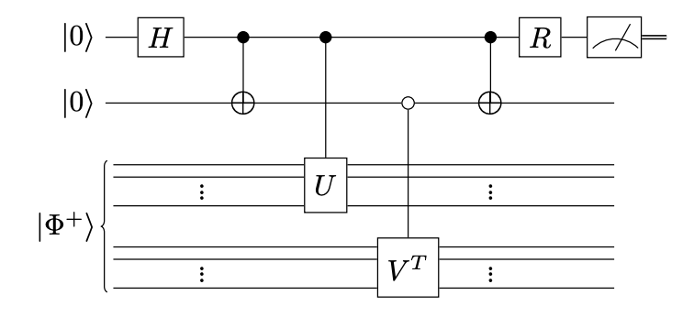
Example: Learning an unknown unitary
Need to pick your cost function such that it is faithful:
And is efficient to compute
Set of
(approximate)
solutions
Task:
Optimised
quantum circuit
Target unitary
Q: What cost could be used?
A:

Slide 46
Example: Learning an unknown unitary
Need to pick your cost function such that it is faithful:
And is efficient to compute
Set of
(approximate)
solutions
Task:
Optimised
quantum circuit
Target unitary
Q: What cost could be used?
A:
Not very NISQ friendly!

Slide 47
Example: Learning an unknown unitary
Need to pick your cost function such that it is faithful:
And is efficient to compute
Set of
(approximate)
solutions
Task:
Optimised
quantum circuit
Target unitary
Back to the drawing board!
Q: What cost could be used?

Slide 48
Example: Learning an unknown unitary
Need to pick your cost function such that it is faithful:
And is efficient to compute
Set of
(approximate)
solutions
Task:
Optimised
quantum circuit
Target unitary
Q: What cost could be used?
Try a QML type approach using training data:

Slide 49
Example: Learning an unknown unitary
Need to pick your cost function such that it is faithful:
And is efficient to compute
Set of
(approximate)
solutions
Task:
Optimised
quantum circuit
Target unitary
Q: What cost could be used?
A:
Cost measures average fidelity between guess output state and true output state over training set:

Slide 50
Example: Learning an unknown unitary
Need to pick your cost function such that it is faithful:
And is efficient to compute
Set of
(approximate)
solutions
Task:
Optimised
quantum circuit
Target unitary
Q: What cost could be used?
A:

Slide 51
Example: Learning an unknown unitary
Need to pick your cost function such that it is faithful:
And is efficient to compute
Set of
(approximate)
solutions
Task:
Optimised
quantum circuit
Target unitary
Q: What cost could be used?
A:
with

Slide 52
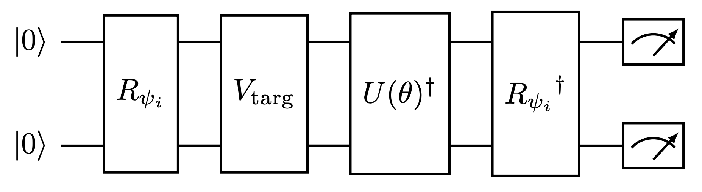
Example: Learning an unknown unitary
Need to pick your cost function such that it is faithful:
And is efficient to compute
Set of
(approximate)
solutions
Task:
Optimised
quantum circuit
Target unitary
Q: What cost could be used?
A:
with
Prepare state

Slide 53
Example: Learning an unknown unitary
Need to pick your cost function such that it is faithful:
And is efficient to compute
Set of
(approximate)
solutions
Task:
Optimised
quantum circuit
Target unitary
Q: What cost could be used?
A:
with
Evolve under target unitary

Slide 54
Example: Learning an unknown unitary
Need to pick your cost function such that it is faithful:
And is efficient to compute
Set of
(approximate)
solutions
Task:
Optimised
quantum circuit
Target unitary
Q: What cost could be used?
A:
with
Apply inverse of PQC

Slide 55
Example: Learning an unknown unitary
Need to pick your cost function such that it is faithful:
And is efficient to compute
Set of
(approximate)
solutions
Task:
Optimised
quantum circuit
Target unitary
Q: What cost could be used?
A:
Measure

Slide 56
Example: Learning an unknown unitary
Need to pick your cost function such that it is faithful:
And is efficient to compute
Set of
(approximate)
solutions
But: How many circuits do we need to run?
Task:
Optimised
quantum circuit
Target unitary
Q: What cost could be used?
A:
with

Slide 57
Example: Learning an unknown unitary
Need to pick your cost function such that it is faithful:
And is efficient to compute
Set of
(approximate)
solutions
But: How many circuits do we need to run?
& are the initial states efficient to prepare/measure?
Task:
Optimised
quantum circuit
Target unitary
Q: What cost could be used?
A:
with

Slide 58
Example: Learning an unknown unitary
Need to pick your cost function such that it is faithful:
And is efficient to compute
Set of
(approximate)
solutions
But: How many circuits do we need to run?
& are the initial states efficient to prepare/measure?
Task:
How many training states do we need?
& what sorts of training states?
Optimised
quantum circuit
Target unitary
Q: What cost could be used?
A:

Slide 59
Example: Learning an unknown unitary
Need to pick your cost function such that it is faithful:
And is efficient to compute
Set of
(approximate)
solutions
But: How many circuits do we need to run?
& are the initial states efficient to prepare/measure?
Task:
How many training states do we need?
& what sorts of training states?
Optimised
quantum circuit
Target unitary
Training on one state- easy but not faithful
Training on d random states (not computational basis states) is faithful but not efficiently scalable.
Q: What cost could be used?
A:

Slide 60
Example: Learning an unknown unitary
Need to pick your cost function such that it is faithful:
And is efficient to compute
Set of
(approximate)
solutions
But: How many circuits do we need to run?
& are the initial states efficient to prepare/measure?
Task:
How many training states do we need?
& what sorts of training states?
Optimised
quantum circuit
Target unitary
This is the question of generalizability
Q: What cost could be used?
A:

Slide 61
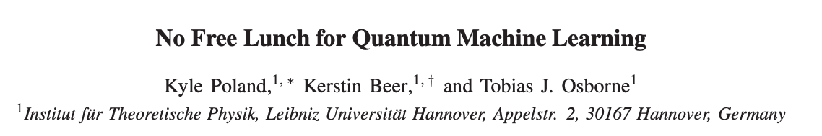
Example: Learning an unknown unitary
Need to pick your cost function such that it is faithful:
And is efficient to compute
Set of
(approximate)
solutions
But: How many circuits do we need to run?
& are the initial states efficient to prepare/measure?
Task:
How many training states do we need?
& what sorts of training states?
Optimised
quantum circuit
Target unitary
Initially thought an exponential number of random states were required
Q: What cost could be used?
A:

Slide 62
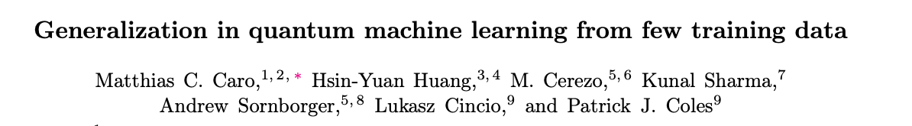
Example: Learning an unknown unitary
Need to pick your cost function such that it is faithful:
And is efficient to compute
Set of
(approximate)
solutions
But: How many circuits do we need to run?
& are the initial states efficient to prepare/measure?
Task:
How many training states do we need?
& what sorts of training states?
Optimised
quantum circuit
Target unitary
Only a polynomial number of random states are required to learn efficiently representable unitaries
Q: What cost could be used?
A:

Slide 63
Example: Learning an unknown unitary
Need to pick your cost function such that it is faithful:
And is efficient to compute
Set of
(approximate)
solutions
But: How many circuits do we need to run?
& are the initial states efficient to prepare/measure?
No. of training states
No. of trainable parameters
Task:
How many training states do we need?
& what sorts of training states?
Optimised
quantum circuit
Target unitary
Only a polynomial number of random states are required to learn efficiently representable unitaries
Q: What cost could be used?
A:

Slide 64
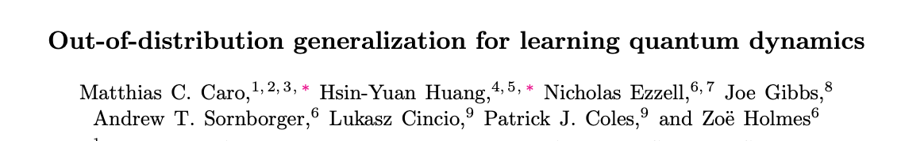
Example: Learning an unknown unitary
Need to pick your cost function such that it is faithful:
And is efficient to compute
Set of
(approximate)
solutions
But: How many circuits do we need to run?
& are the initial states efficient to prepare/measure?
Task:
How many training states do we need?
& what sorts of training states?
Optimised
quantum circuit
Target unitary
We recently showed only a polynomial number of random product states were required
Q: What cost could be used?
A:
Product states = easy to prepare! Cost is very efficient to compute!

Slide 65
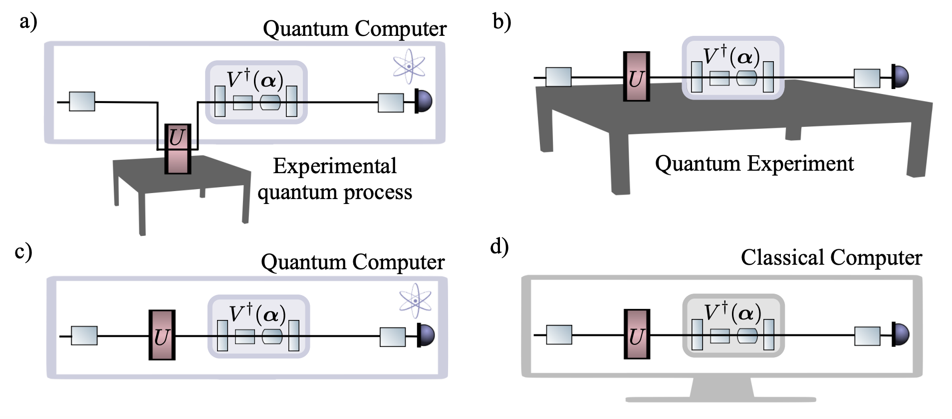
Learning an unknown unitary (Not just a toy problem!)
Why do we care about learning a unitary?
Useful for quantum compilation:
Target unitary is known
And parameterized circuit is designed to compile target into particular useful form
Compilation could be done on quantum computer or
fully classically (using tensor network methods)
IF the target unitary is low entangling

Slide 66
Learning an unknown unitary (Not just a toy problem!)
Uses limited gate set
Why do we care about learning a unitary?
Useful for quantum compilation:
Target unitary is known
And parameterized circuit is designed to compile target into particular useful form
Compilation could be done on quantum computer or
fully classically (using tensor network methods)
IF the target unitary is low entangling

Slide 67
Learning an unknown unitary (Not just a toy problem!)
Uses limited gate set
Short depth (e.g. compressing depth of Trotterisation for quantum simulation).
Why do we care about learning a unitary?
Useful for quantum compilation:
Target unitary is known
And parameterized circuit is designed to compile target into particular useful form
Compilation could be done on quantum computer or
fully classically (using tensor network methods)
IF the target unitary is low entangling

Slide 68
Learning an unknown unitary (Not just a toy problem!)
Uses limited gate set
Short depth (e.g. compressing depth of Trotterisation for quantum simulation).
Is noise resilient
Why do we care about learning a unitary?
Useful for quantum compilation:
Target unitary is known
And parameterized circuit is designed to compile target into particular useful form
Compilation could be done on quantum computer or
fully classically (using tensor network methods)
IF the target unitary is low entangling

Slide 69
Learning an unknown unitary (Not just a toy problem!)
Uses limited gate set
Short depth (e.g. compressing depth of Trotterisation for quantum simulation).
Is noise resilient
Is useful for a particular purpose (e.g. learning a diagonalization of an evolution unitary for a fixed depth quantum simulation)
Why do we care about learning a unitary?
Useful for quantum compilation:
Target unitary is known
And parameterized circuit is designed to compile target into particular useful form
Compilation could be done on quantum computer or
fully classically (using tensor network methods)
IF the target unitary is low entangling

Slide 70
Learning an unknown unitary (Not just a toy problem!)
Why do we care about learning a unitary?
Useful for learning unknown dynamics of experimental systems!
Target unitary is unknown analogue process
- Learn digitalization of it on quantum hardware
More viable using current hardware!
Requires quantum transducers/quantum sensors

Slide 71


Slide 72
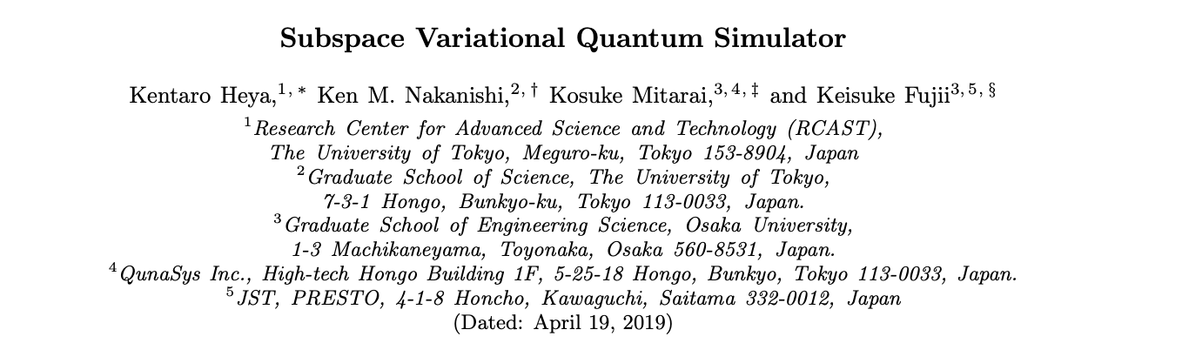
Notes:
This is an algorithm which finds the excited states and eigenergies of a Hamiltonian and then uses these excited states and eigenenergies to simulate the evolution of systems in that subspace.

Slide 73
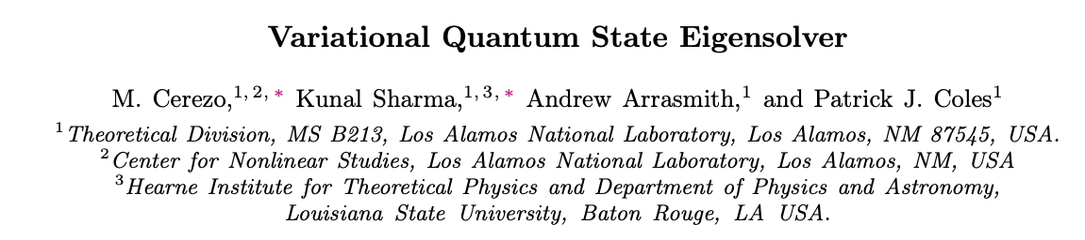
Notes:
This is an algorithm to diagonalise a quantum state.

Slide 74

Notes:
This is an algorithm to variationally compress quantum data into a more compact representation so it can be stored more efficiently.

Slide 75
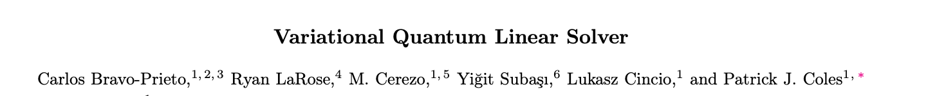
Notes:
Then there are a whole series of algorithms for solving linear systems of equations on a quantum computer

Slide 76


Slide 78
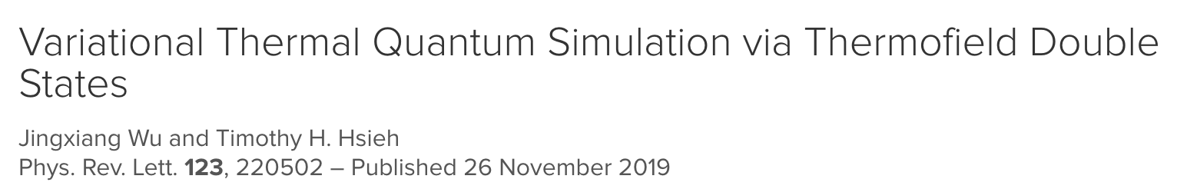
Notes:
There are a few algorithms for preparing thermal states on a quantum computer. This could be useful for machine learning processes using Boltzman machines. Or for measuring free energy changes potentially for quantum chemistry.

Slide 79
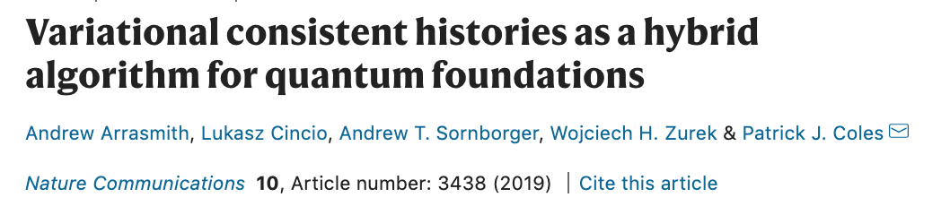
Notes:
Variational quantum algorithms have even been proposed to study the foundations of quantum mechanics. For example, this one for finding consistent histories. Consistent histories are central to the consistent histories interpretation of QM where decoherence replaces the role of the collapse postulate.

Slide 80
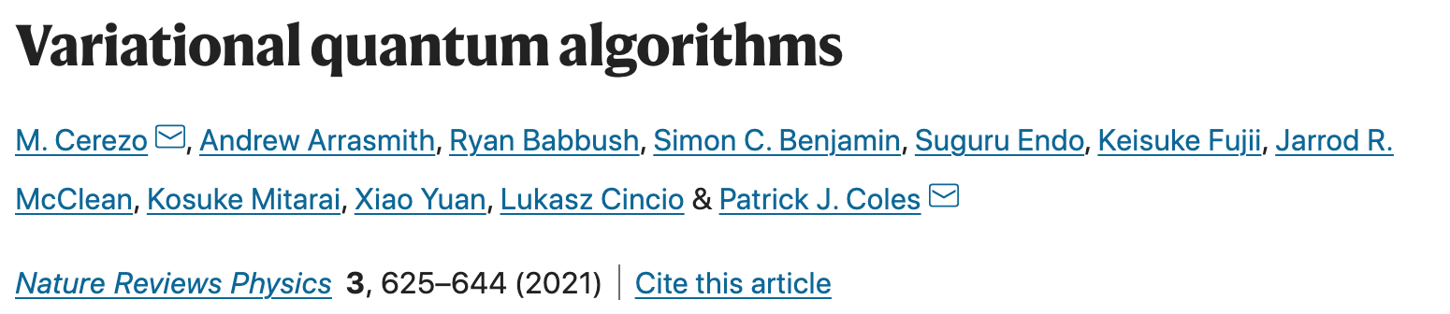

Slide 81
Lots of promising algorithms
But what makes a good one?

Slide 82
Overview
Part 1: What are variational quantum algorithms (VQAs) and why use them.
Motivation
What are variational quantum algorithms
Example uses
Part 2: Ingredients for a successful VQA.
Expressibility
Trainability

Slide 83
Overview
Part 1: What are variational quantum algorithms (VQAs) and why use them.
Motivation
What are variational quantum algorithms
Example uses
Part 2: Ingredients for a successful VQA.
Expressibility
Trainability

Slide 84





Ingredients of an effective variational quantum algorithm
Consider cost functions of the form:
Initial state
Measurement Operator
Parameterized Quantum circuit
$$θ_{1}$$
$$θ_{4}$$
$$θ_{5}$$
$$θ_{3}$$
$$θ_{2}$$

Slide 85
Ingredients for a successful VQA: Expressibility
Need to pick an ansatz for your parameterized quantum circuit
Notes:
Ok, so once you’ve decided on you ansatz…. each possible vector of parameters θ corresponds to a unitary U(θ) that is produced…

Slide 86
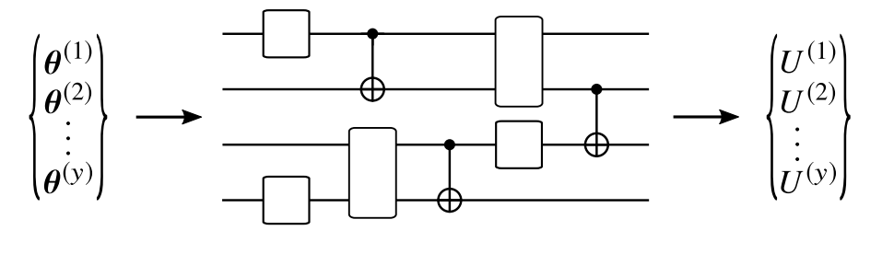
Ingredients for a successful VQA: Expressibility
Need to pick an ansatz for your parameterized quantum circuit

Slide 87
Ingredients for a successful VQA: Expressibility
Need to pick an ansatz for your parameterized quantum circuit
Set of
different parameters
Set of
accessible
unitaries

Slide 88
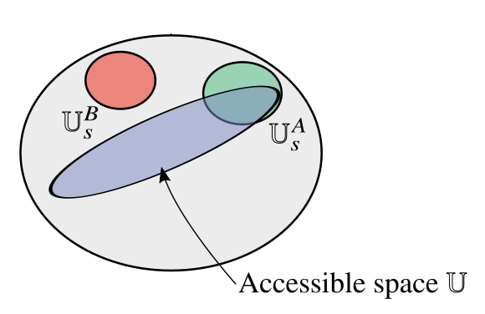
Ingredients for a successful VQA: Expressibility
Set of
(approximate)
solutions
Set of
accessible
unitaries
For the VQA to be successful need a solution unitary to be captured by ansatz:

Slide 89
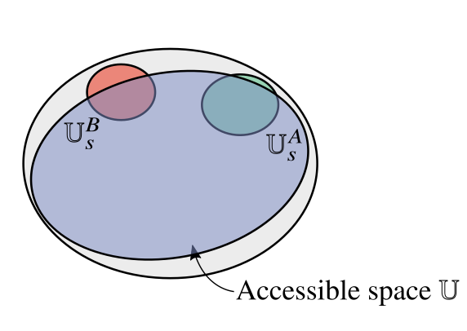
Ingredients for a successful VQA: Expressibility
Set of
(approximate)
solutions
Set of
accessible
unitaries
Inexpressive
Expressive
For the VQA to be successful need a solution unitary to be captured by ansatz:
In the absence of prior knowledge, best bet is to use an ansatz that explores
the space of unitaries as fully and uniformally as possible.
Such ansatze are known as expressive ansatze

Slide 90
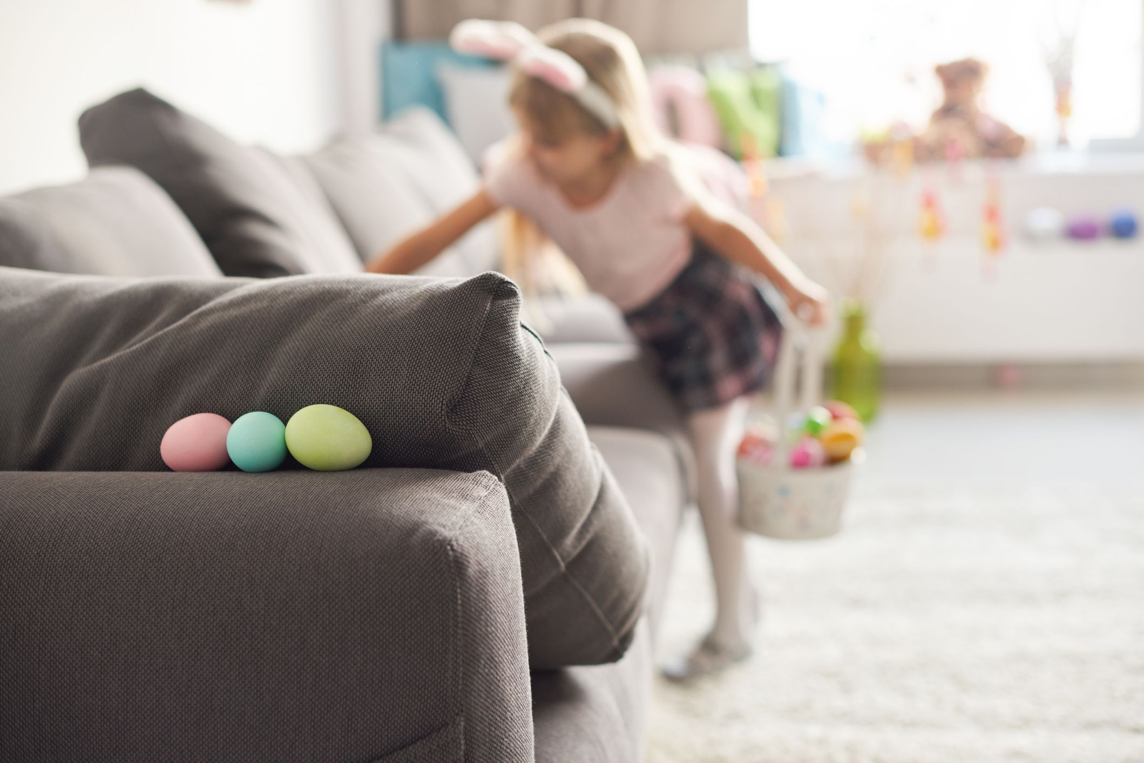
Ingredients for a successful VQA: Trainability
Just because the ansatz contains the solution…

Slide 91
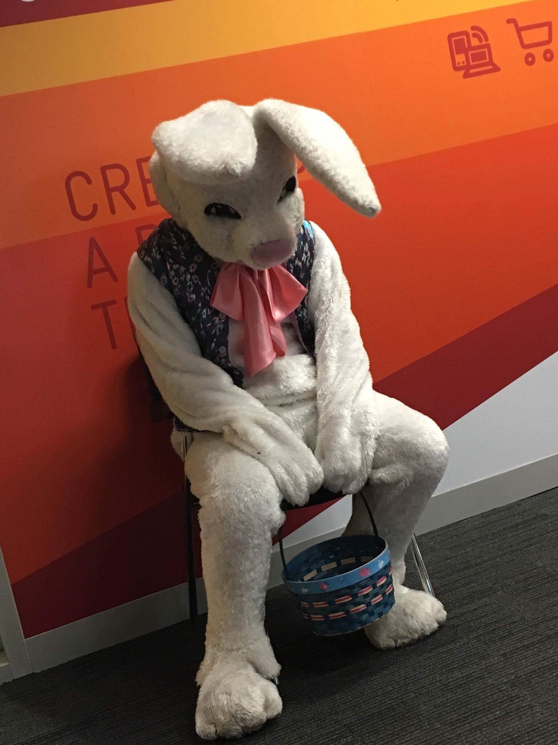
Ingredients for a successful VQA: Trainability
Just because the ansatz contains the solution… doesn’t mean you can find it…

Slide 92
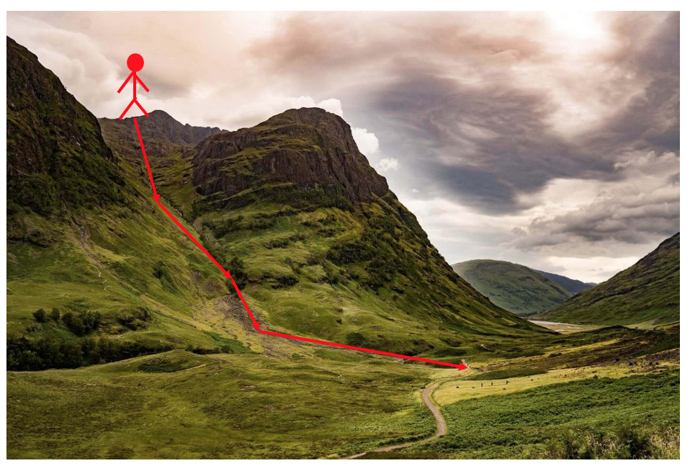
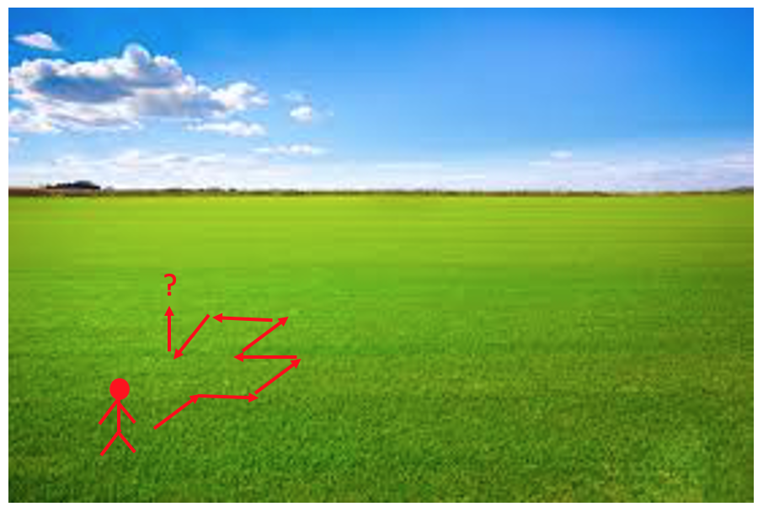
Ingredients for a successful VQA: Trainability
The cost landscape needs to be sufficiently featured to enable training

Slide 93
Ingredients for a successful VQA: Trainability
The cost landscape needs to be sufficiently featured to enable training
Small gradients high precision required to resource intensive
find cost minimizing direction
( shots are required
estimate a cost to precision )

Slide 94
Ingredients for a successful VQA: Trainability
The cost landscape needs to be sufficiently featured to enable training
How do we know if our landscape is nice and textured or flat and untrainable?

Slide 95
Ingredients for a successful VQA: Trainability
Assess trainability of a VQA by studying expected cost gradients
The average cost gradient vanishes
Chebyshev's inequality:
Small variance entails small cost gradients.

Slide 96
Ingredients for a successful VQA: Trainability
Assess trainability of a VQA by studying expected cost gradients
The average cost gradient vanishes
Chebyshev's inequality:
Small variance entails small cost gradients.

Slide 97
Ingredients for a successful VQA: Trainability
Assess trainability of a VQA by studying expected cost gradients
The average cost gradient vanishes
Chebyshev's inequality:
Small variance entails small cost gradients.

Slide 98
Ingredients for a successful VQA: Trainability
Assess trainability of a VQA by studying expected cost gradients
The average cost gradient vanishes
Chebyshev's inequality:
Small variance entails small cost gradients.

Slide 99
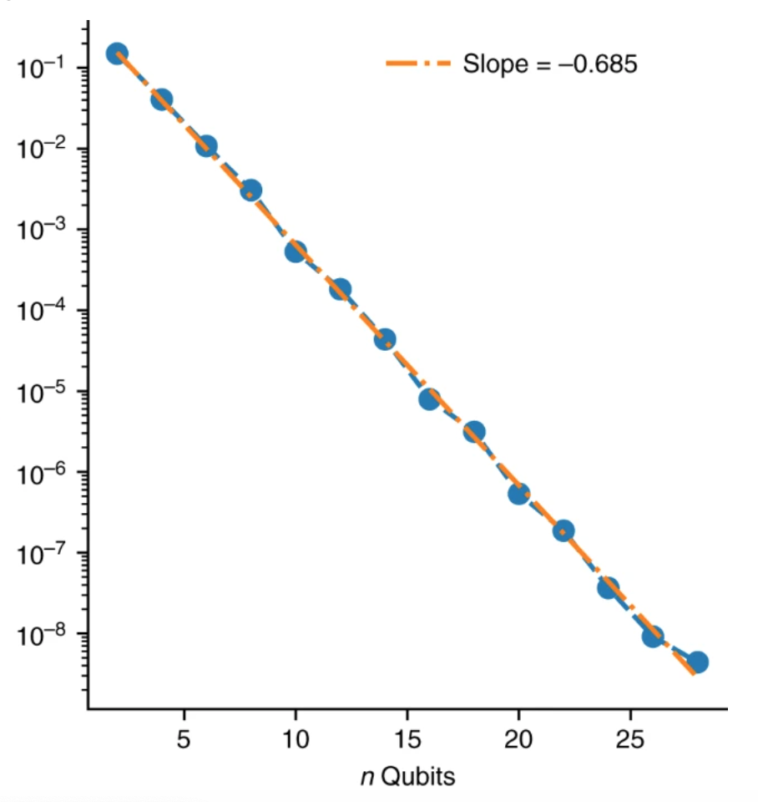
Ingredients for a successful VQA: Trainability
Barren plateau phenomena:
Probability of non-zero gradients vanishes exponentially with problem size.
Shot required for training grows exponentially with problem size.

Slide 100

Ingredients for a successful VQA: Trainability
Barren plateau phenomena can be induced by
Choice in circuit:

Slide 101
Ingredients for a successful VQA: Trainability
Barren plateau phenomena can be induced by
Choice in circuit:
If you want to better understand barren plateaus…. (and you do)
If analytically minded: work through the proof in the original barren plateau paper.
(1 page of algebra. Less intimidating than it looks.)
If numerically minded: play with the google colab file
https://www.tensorflow.org/quantum/tutorials/barren_plateaus

Slide 102
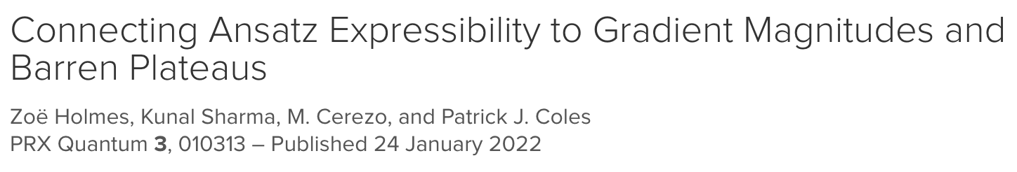
Ingredients for a successful VQA: Trainability
Barren plateau phenomena can be induced by
Choice in circuit:
Too expressive
Highly expressive ansatze have barren plateaus
Less expressive ansatze can be trainable or untrainable

Slide 103

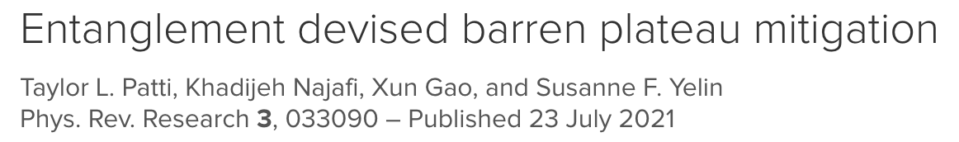
Ingredients for a successful VQA: Trainability
Barren plateau phenomena can be induced by
Choice in circuit:
Too expressive
Too entangling

Slide 104
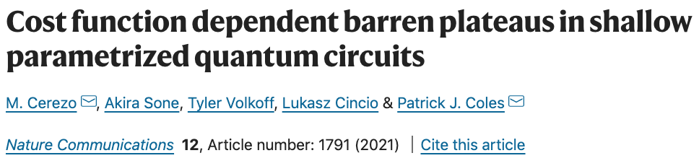
Ingredients for a successful VQA: Trainability
Barren plateau phenomena can be induced by
Choice in circuit:
Too expressive
Too entangling
Choice in cost function (globality of measurement):

Slide 105
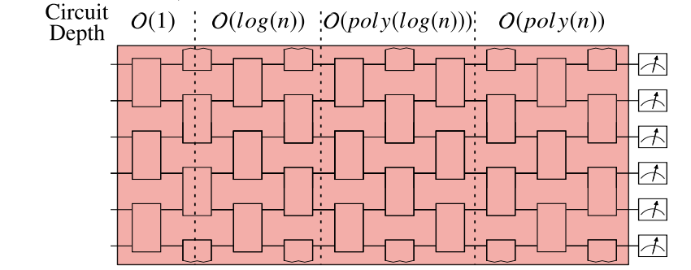
Ingredients for a successful VQA: Trainability
Barren plateau phenomena can be induced by
Choice in cost function (globality of measurement):
Global Cost:
H acts non-trivially on all qubits
Globality induced BP at all depths
(i.e. inexpressive/low-entangling ansatze also untrainable!)

Slide 106
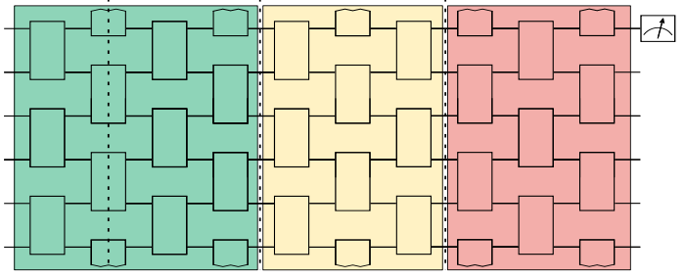
Ingredients for a successful VQA: Trainability
Barren plateau phenomena can be induced by
Choice in cost function (globality of measurement):
Local Cost:
H acts non-trivially on fixed number of qubits
Global Cost:
H acts non-trivially on all qubits
Globality induced BP at all depths
Low depth (inexpressive/low entangling) ansatze can be trainable
Expressibility/entanglement induced BPs
(i.e. inexpressive/low-entangling ansatze also untrainable!)

Slide 107
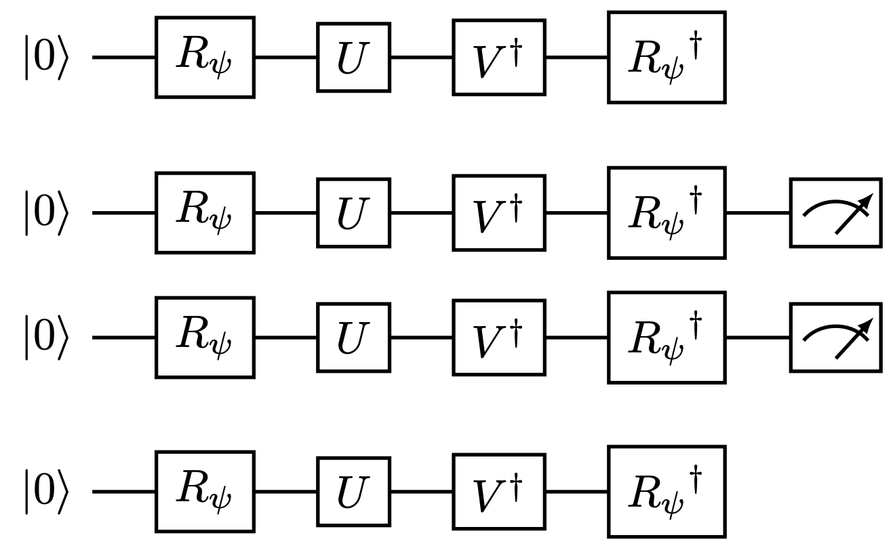
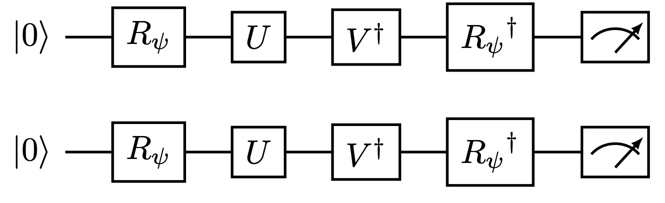
Ingredients for a successful VQA: Trainability
Barren plateau phenomena can be induced by
Local Cost:
H acts non-trivially on fixed number of qubits
Global Cost:
H acts non-trivially on all qubits

Slide 108

Ingredients for a successful VQA: Trainability
Barren plateau phenomena can be induced by
Local Cost:
H acts non-trivially on fixed number of qubits
Global Cost:
H acts non-trivially on all qubits
Concentrates exponentially to 1
Doesn’t concentrate exponentially

Slide 109
Ingredients for a successful VQA: Trainability
Barren plateau phenomena can be induced by
Local Cost:
H acts non-trivially on fixed number of qubits
Global Cost:
H acts non-trivially on all qubits
Again – good to work through proof!
See Appendix C of arXiv:1807.00800
Very useful bound showing local and global costs vanish in same circumstances

Slide 110
Ingredients for a successful VQA: Trainability
Barren plateau phenomena can be induced by
Local Cost:
H acts non-trivially on fixed number of qubits
Global Cost:
H acts non-trivially on all qubits
Very useful bound showing local and global costs vanish in same circumstances
i.e. local cost can be faithful and trainable!

Slide 111
Ingredients for a successful VQA: Trainability
Barren plateau phenomena can be induced by
Choice in circuit:
Too expressive
Too entangling
Choice in cost function (globality of measurement):

Slide 112

Ingredients for a successful VQA: Trainability
Barren plateau phenomena can be induced by
Choice in circuit:
Too expressive
Too entangling
Choice in cost function (globality of measurement):
Choice in target learning problem

Slide 113
Where does this leave us?
Use local costs
For more complex problems these aren’t always straightforward to construct

Slide 114

Where does this leave us?
Use local costs
Trainability
Expressibility
And it’s Expressibility who’s gotta leave…

Slide 115
Where does this leave us?
Use local costs
Use problem inspired, rather than maximally expressive/deep, QNNs.
Trainability
Expressibility
And it’s Expressibility who’s gotta leave…

Slide 116

Where does this leave us?
Use local costs
Use problem inspired, rather than maximally expressive/deep, QNNs.
Trainability
Expressibility
And it’s Expressibility who’s gotta leave…
e.g. use symmetries of problem

Slide 117

Where does this leave us?
Use local costs
Use problem inspired, rather than maximally expressive/deep, QNNs.
Use adaptive optimisation methods.
Trainability
Expressibility
And it’s Expressibility who’s gotta leave…

Slide 118
Where does this leave us?
Use local costs
Use problem inspired, rather than maximally expressive/deep, QNNs.
Use adaptive optimisation methods.
Trainability
Expressibility
And it’s Expressibility who’s gotta leave…
Job for future: come up with
good problem inspired QNNs & adaptive methods

Slide 119
Where does this leave us?
Use local costs
Use problem inspired, rather than maximally expressive/deep, QNNs.
Use adaptive optimisation methods.
Trainability
Expressibility
And it’s Expressibility who’s gotta leave…
Job for future: come up with
good problem inspired QNNs & adaptive methods
Other methods for avoiding barren plateaus?

Slide 120

Even if we come up with great ansatze that train beautifully in the ideal case we still have to contend with…

Slide 121

Even if we come up with great ansatze that train beautifully in the ideal case we still have to contend with…
Cost concentrates exponentially with circuit depth in presence of noise

Slide 122
Even if we come up with great ansatze that train beautifully in the ideal case we still have to contend with…
Cost concentrates exponentially with circuit depth in presence of noise
Not removed by error mitigation

Slide 123
Where does this leave us?
“Trick to using a noisy quantum computer? Use it as little as possible.”
Are variational quantum algorithms really ideal for the NISQ era?

Slide 124
Where does this leave us?
“Trick to using a noisy quantum computer? Use it as little as possible.”
Are variational quantum algorithms really ideal for the NISQ era?
Open question!

Slide 125
Where does this leave us?
“Trick to using a noisy quantum computer? Use it as little as possible.”
Are variational quantum algorithms really ideal for the NISQ era?
Open question! But trying to get them to work is certainly a fun challenge.

Slide 126
Where does this leave us?
“Trick to using a noisy quantum computer? Use it as little as possible.”
Are variational quantum algorithms really ideal for the NISQ era?
Open question! But trying to get them to work is certainly a fun challenge.
Also worth exploring other hybrid quantum-classical methods.

Slide 127
To do:
Have a go at constructing local costs
Go through original barren plateau proof
Go through original local cost proof
Run numerics demonstrating barren plateaus

