Slide 1
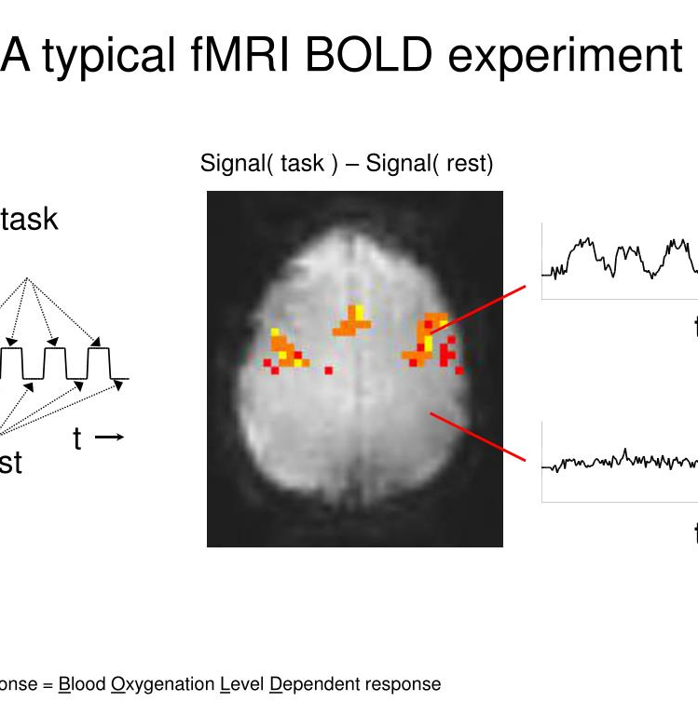
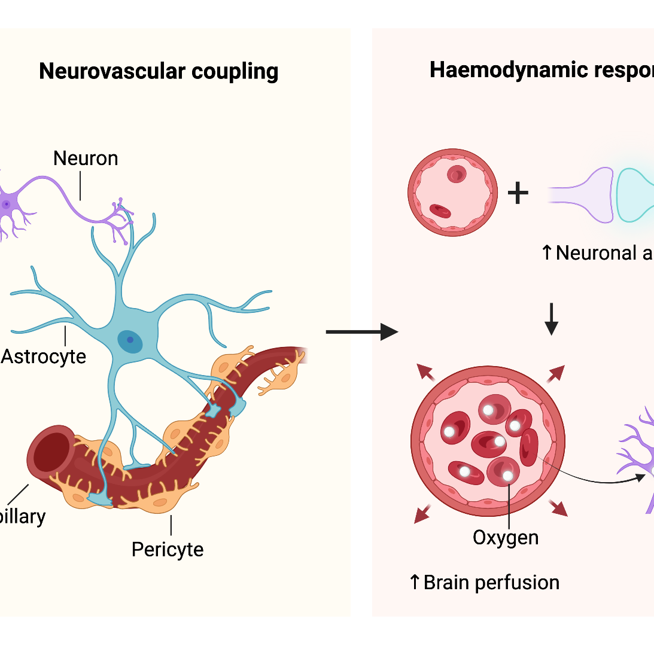

Introduction to BOLD fMRI: Principles and Practical Considerations
Nathalie Just, PhD, HDR
LIFMET, EPFL, CH

Slide 2
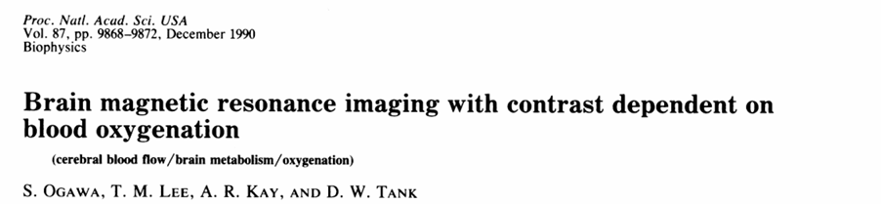
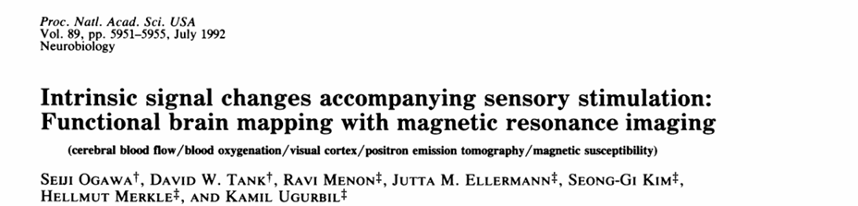
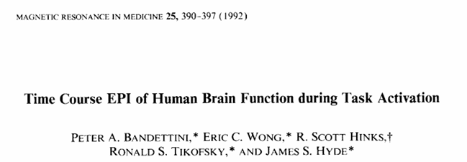
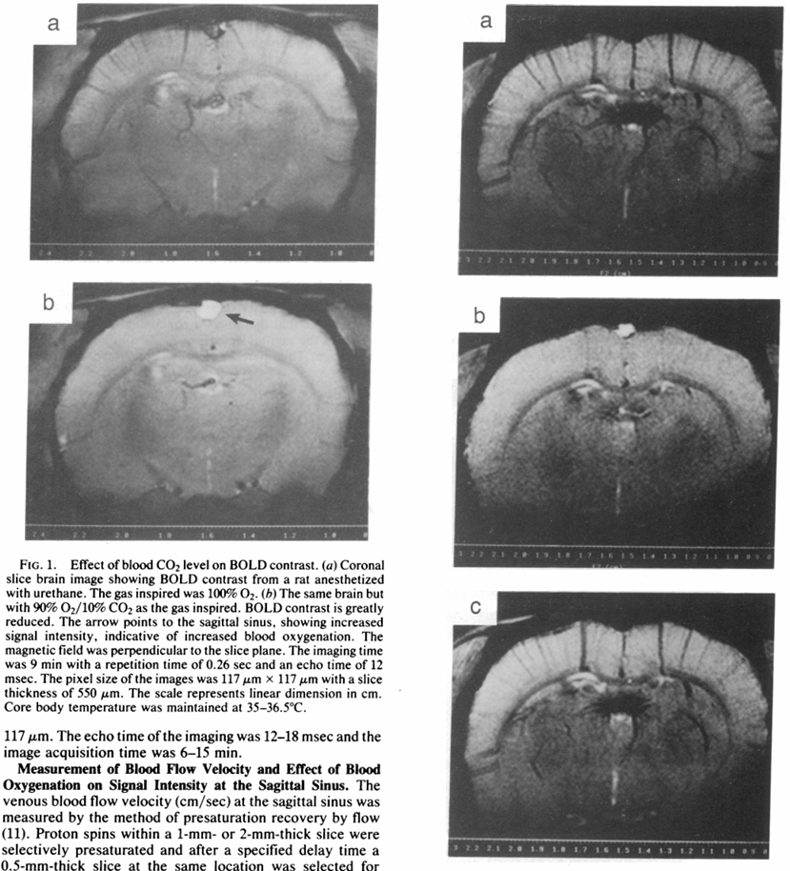
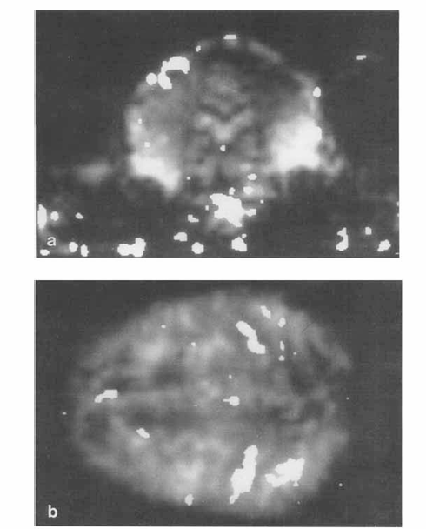
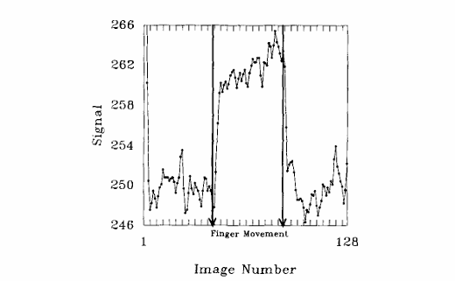
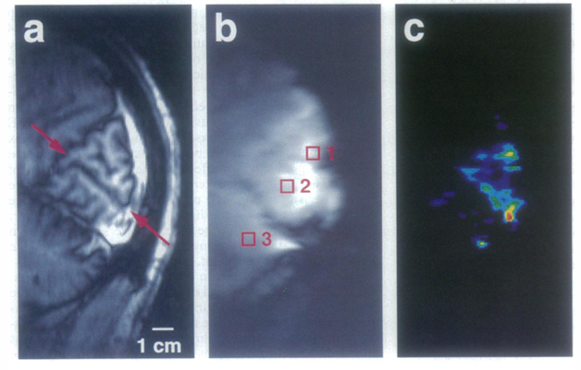
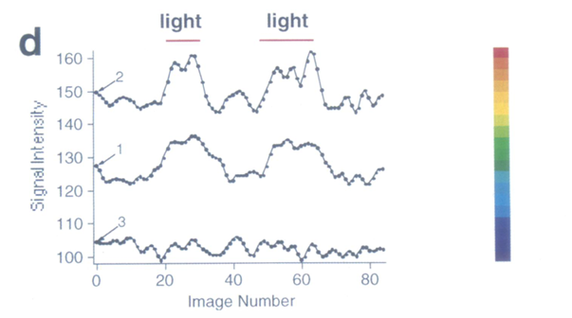
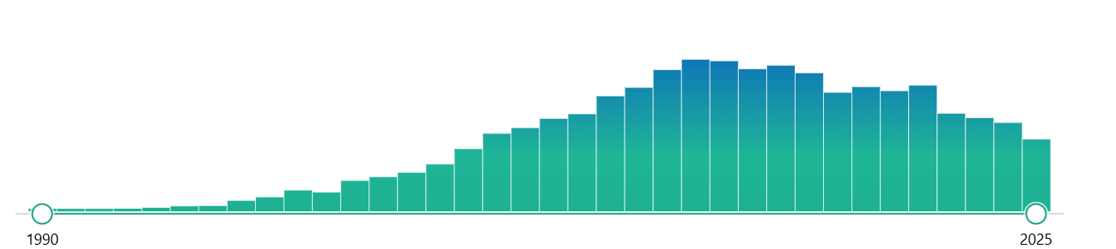
Basic concepts of BOLD fMRI
Blood Oxygen Level Dependent (BOLD) contrast reported in rodents in 1990 (Ogawa et al.)
(Ogawa et al., 1990)
(Ogawa et al., 1992)
(Bandettini et al., 1992)
Publications
BOLD fMRI is anavoidable nowadays but complex!

Slide 3
Overview of Topics
Understand what BOLD fMRI measures
Learn how BOLD responses relate to neural activity
Recognize spatial and temporal resolution considerations
Understand multiple comparisons in fMRI analysis
Explore ultra-high field benefits/drawbacks

Slide 5
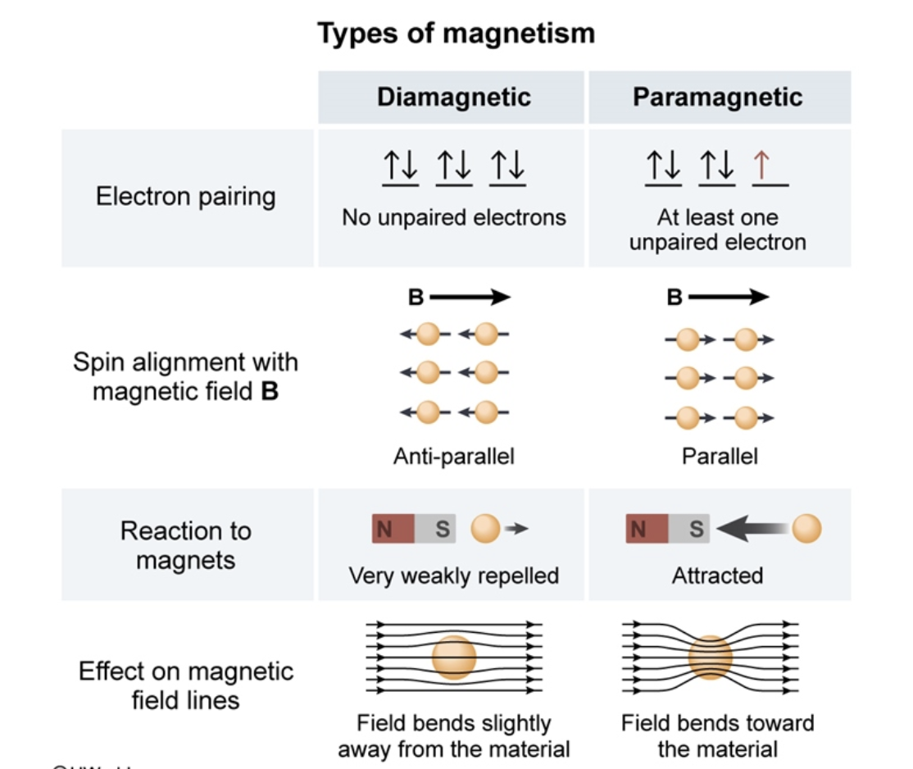
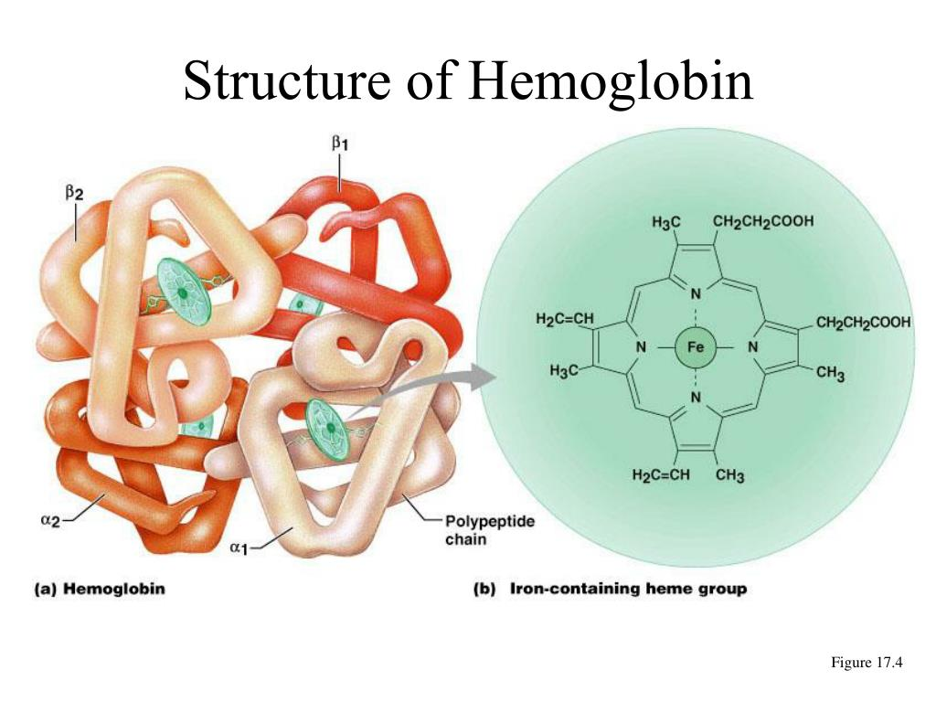
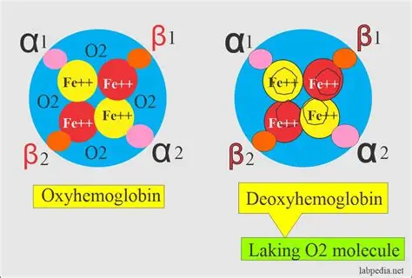
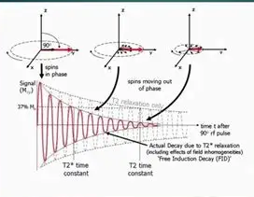
BOLD Contrast
Diamagnetism
Materials with no unpaired electrons.
Create a weak opposing magnetic field when placed in an external magnetic field.
Slightly repel the magnetic field.
Example: Oxyhemoglobin (HbO₂) → diamagnetic.
Paramagnetism
Materials with unpaired electrons.
Align partially with external magnetic fields, causing local field inhomogeneities.
Slightly enhance the magnetic field.
Example: Deoxyhemoglobin (Hb) → paramagnetic.
T₂ and T₂*
O₂ Slow decay
Less O₂ Fast decay

Slide 6
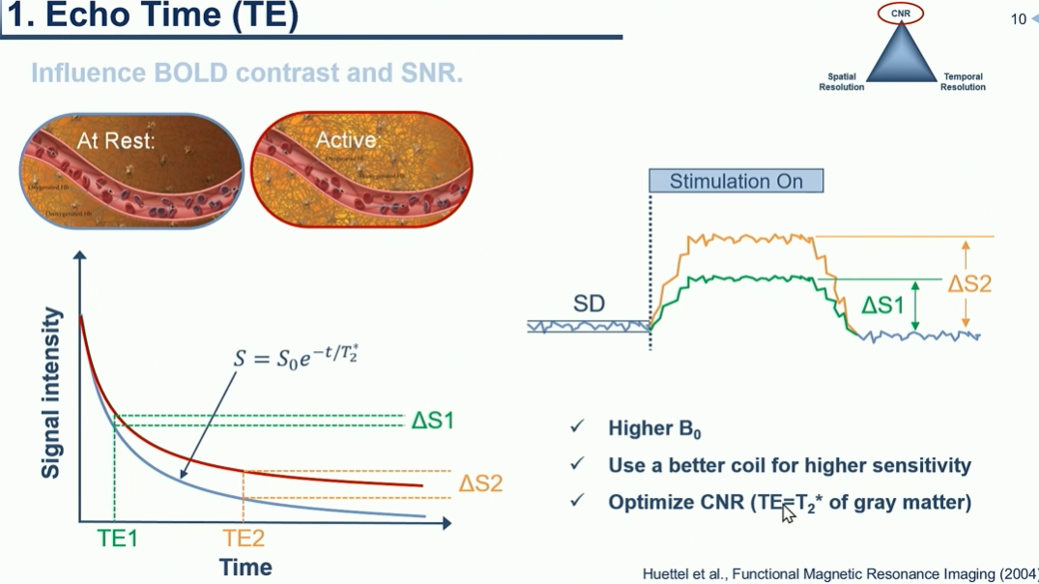

Slide 7
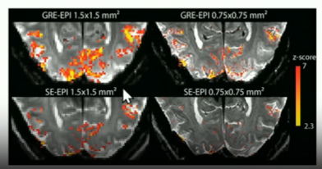

T2* effect near and Inside vessels
Obtained with GRE-EPI
Larger scale ΔB
Sensitivity Specific (Draining veins)
T2 effect Inside vessels
Obtained with SE-EPI
More local ΔB perturbations
Sensitivity Specific (Active regions)
Neural activation → ↑ blood flow → ↓ [deoxy-Hb] → ↓ magnetic inhomogeneity → ↑ MR signal (T₂* /T₂)
S(t)=S₀​x exp(−t/T₂∗​ )
where:
$S\left(t\right)$: MR signal at time $t$
$S_{0}$: initial signal amplitude
$T_{2}^{∗}$: effective transverse relaxation time (shorter when deoxy-Hb ↑)

Slide 8
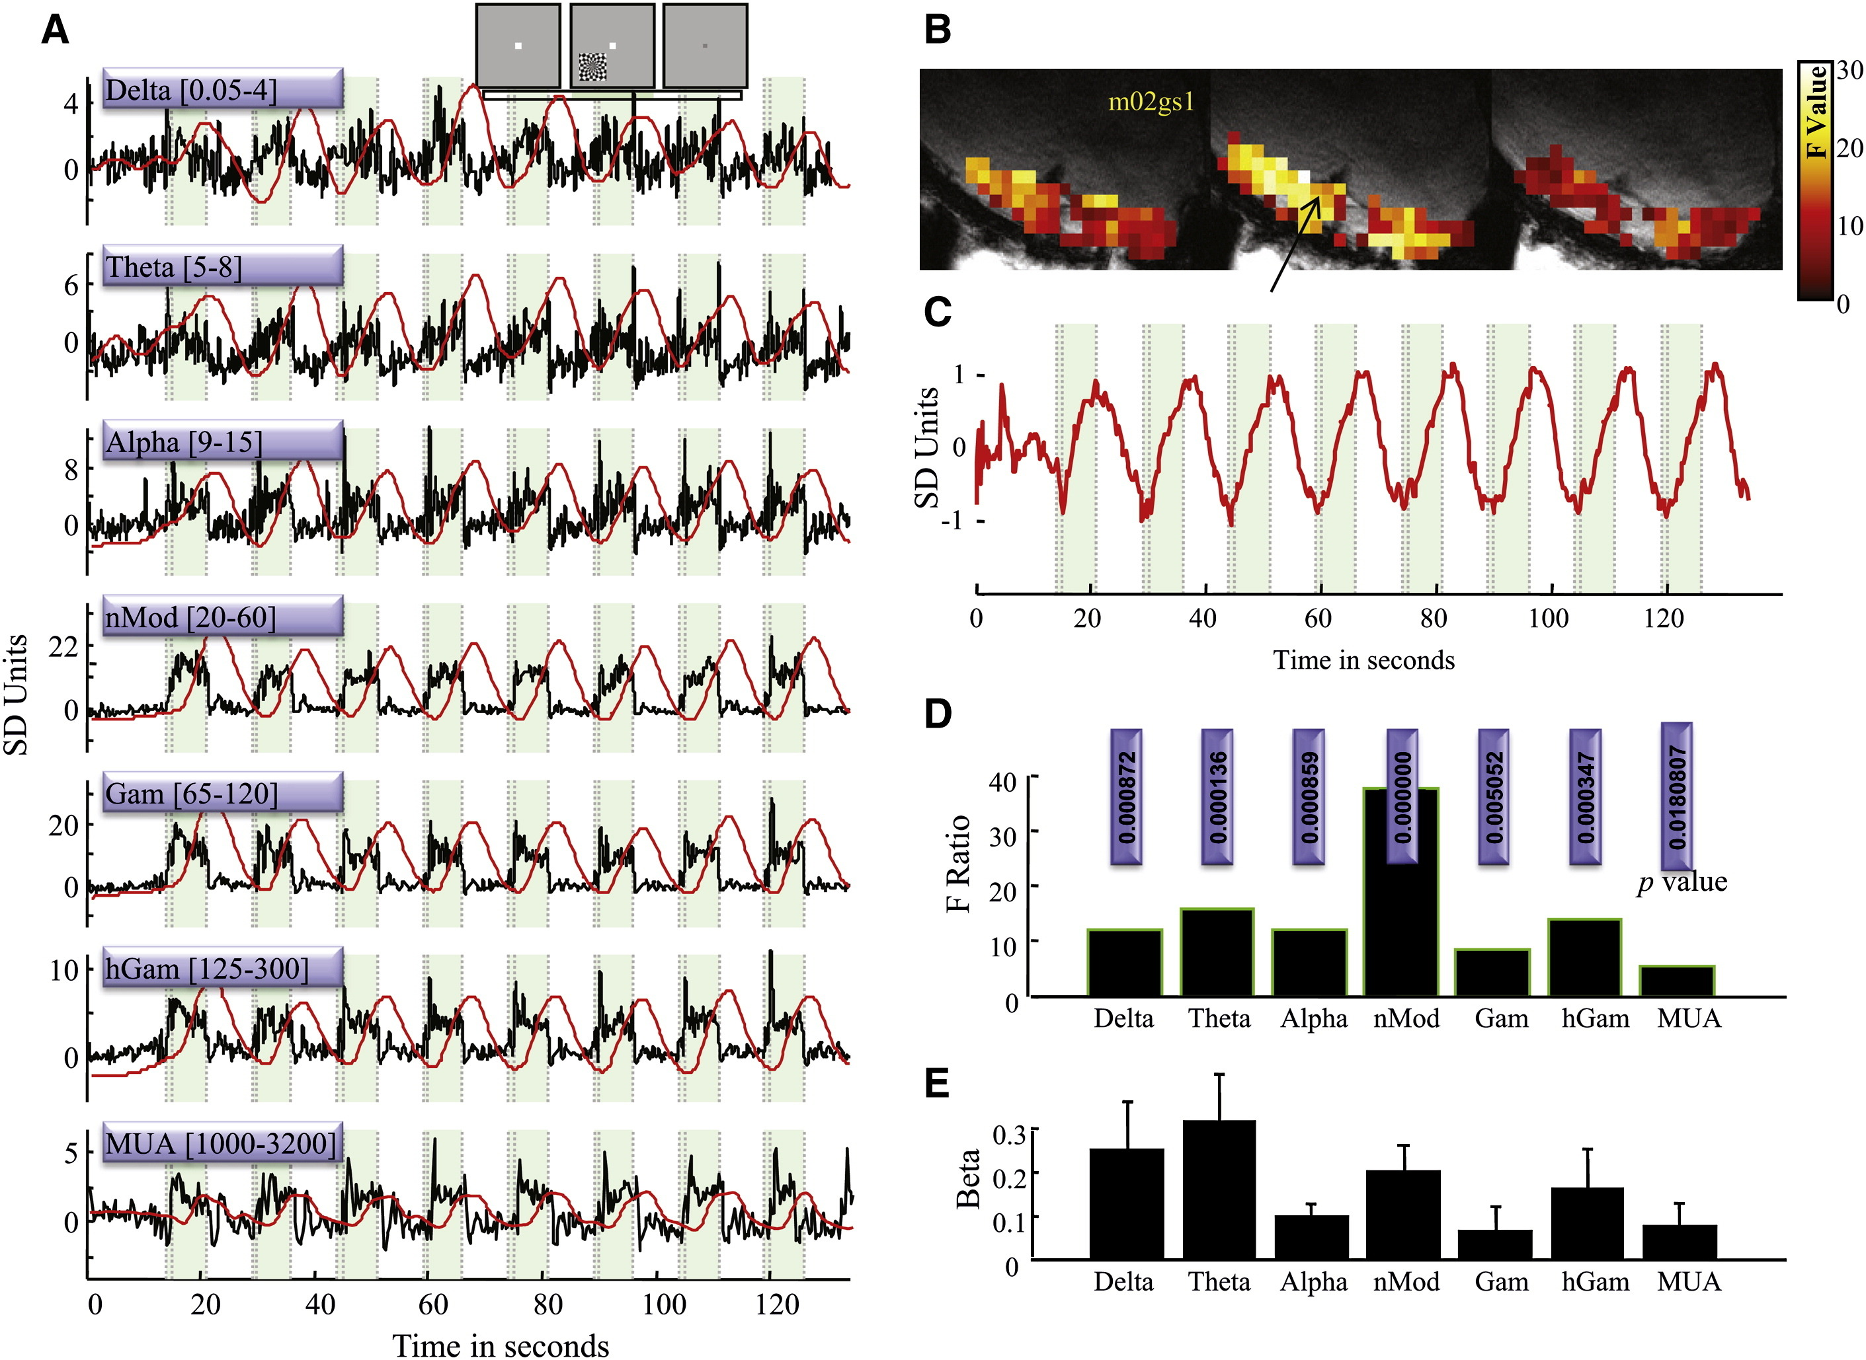
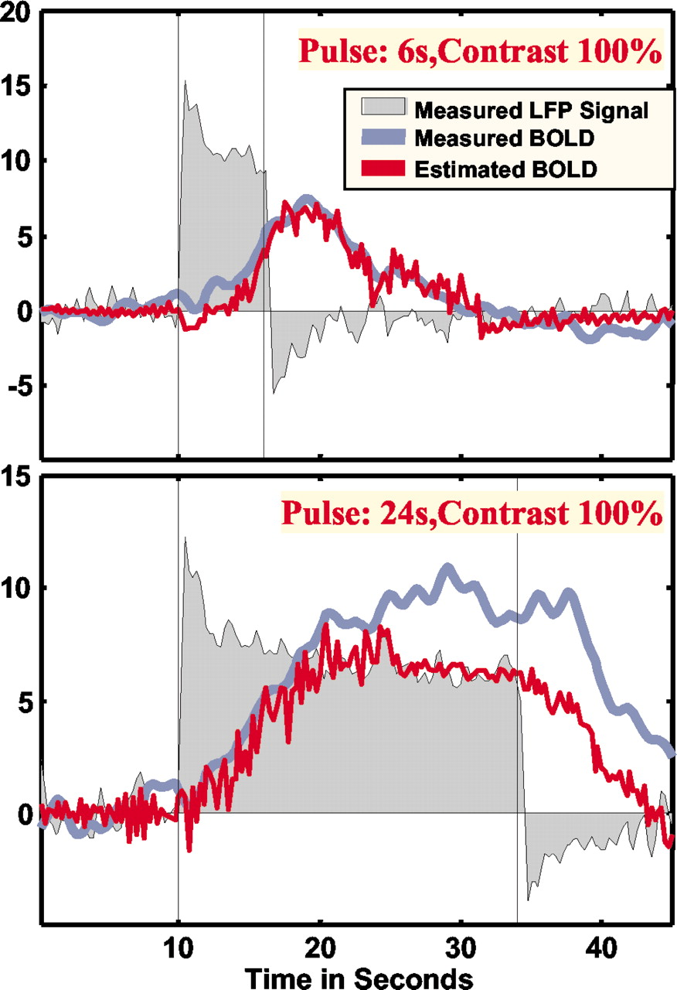
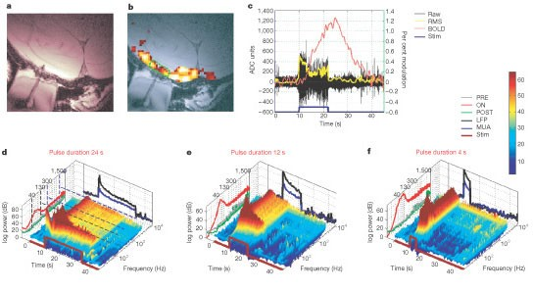
Logothetis et al. (2004): ‘The BOLD signal is an indirect measurement of neural activity … it reflects primarily the input and local processing of a region rather than the long-range output spiking.’
Simultaneous Electrophysiology & BOLD in
awake monkeys:
LFP: Better predictor of neural activity
MUA: Spiking output
«Indirectness» of the BOLD signal reflecting
The neural imput/Synaptic activity rather than
output spikes
(Goense & Logothetis, 2008)
(Logothetis et al., 2001)
“The Underpinnings of the BOLD Functional Magnetic Resonance Imaging Signal”, Logothetis 2003
Notes:
Key result: The BOLD response correlated better with the LFP than with MUA. The authors conclude that “the BOLD contrast mechanism … reflects the input and intracortical processing of a given area rather than its spiking output.”
Alert monkeys — LFP vs BOLD vs MUA (Goense & Logothetis, 2008)
Simultaneous electrophysiology & BOLD in monkeys (Logothetis et al, 2001)
Recording in awake monkeys performing a fixation task. They found that although both LFP and MUA contribute to the BOLD response, LFP is the stronger and more reliable predictor. This reinforces the “indirectness” of the BOLD signal: it reflects the neuronal input/synaptic activity (LFP) rather than simply the output spikes
Review article (“The Underpinnings of the BOLD Functional Magnetic Resonance Imaging Signal”, Logothetis 2003)
Provides a conceptual overview of how neuronal, metabolic, vascular and MR-signal dynamics link. Journal of Neuroscience
Figure shows neural vs hemodynamic responses, demonstrating the temporal lag and the chain of processes from synaptic/neural activity to BOLD.

Slide 9
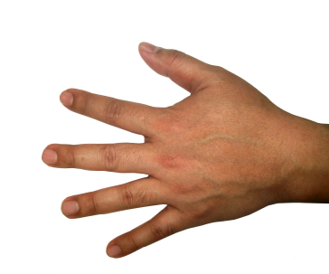
Neurovascular couplings
and Neurometabolic
Action potentials at pre-synaptic cell
  Release of glutamate
  Open-ion –channels on post-synaptic cell
  Re-uptake of glutamate and pump ions
  out of cell
  Uses energy and oxygen
Triggers Hemodynamic response
  Triggers blood vessel dilation
  Decreased ratio deoxygenated / oxygenated blood
  Decrease in paramagnetism
  Increase in T2*

Slide 10
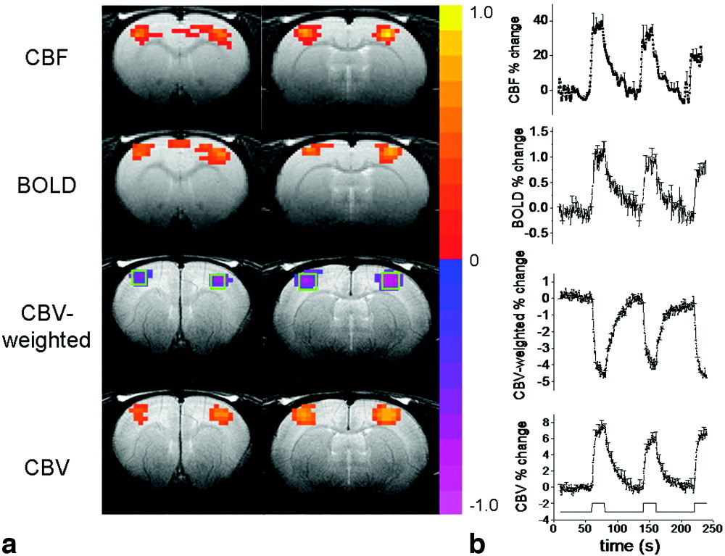
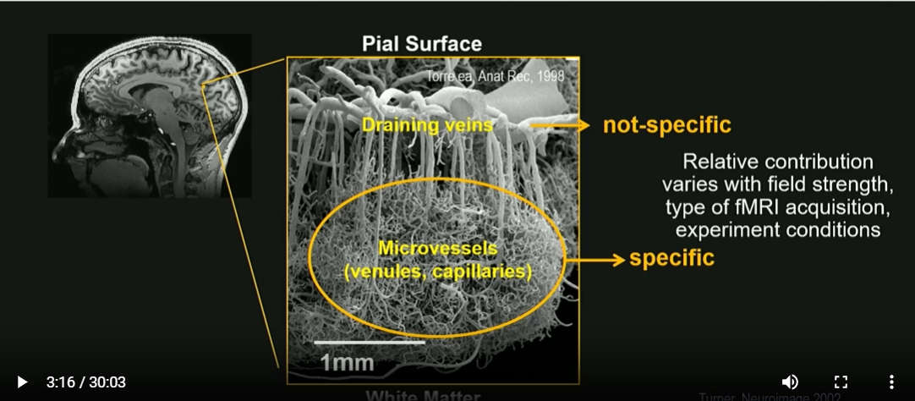
Neurovascular coupling refers to the process by which neuronal activity triggers local changes in cerebral blood flow (CBF), blood volume (CBV), and oxygenation, ensuring that active brain regions receive more oxygen and nutrients.
BOLD ∝ (CBF, CBV, CMRO2)

Slide 11
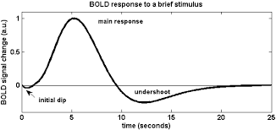
What is a typical BOLD response?
The Hemodynamic Response Function (HRF) is the time course of blood flow
and oxygenation changes in the brain following a brief burst of neural activity.
The HRF can be described as:
Initial dip: tiny, brief drop in oxygen (sometimes hard to detect).
Main positive peak: increased blood flow brings in more oxygen than was used, so deoxyhemoglobin decreases → the fMRI BOLD signal increases.
Post-stimulus undershoot: after the response, blood flow falls back quickly but blood volume and oxygenation can lag, producing a slow undershoot.
Humans: HRF peak ~4–6 s after stimulus.
Rodents (rats/mice): HRF is faster and narrower (peak ~1–2 s) because of smaller brains, faster blood flow, and shorter vascular transit times.

Slide 12
fMRI Acquisition

Slide 13
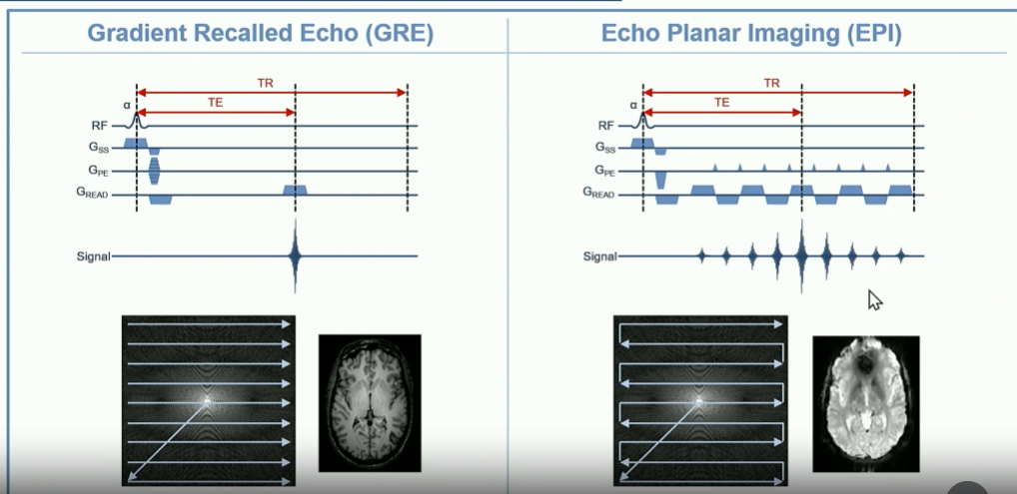
Echo Planar Imaging (EPI)
Fast
High Sensitivity
Artifacted
T_{acq}= TR x N_{PE}
T_{acq}= TR

Slide 14
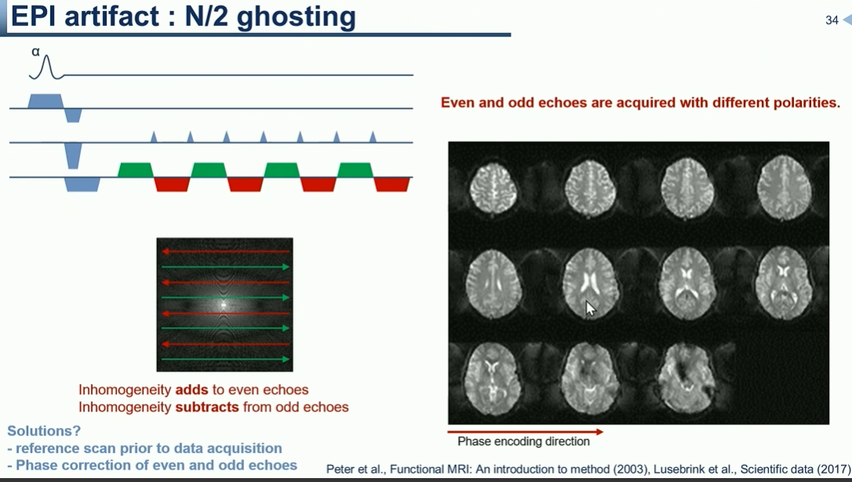
Notes:
You get a faint (or sometimes strong) duplicate (“ghost”) image of the object, typically shifted by half the field-of-view (FOV) in the phase-encoding direction. It results from a mismatch between the data acquired under positive versus negative (or alternating) gradient readouts / echoes.
Because the odd and even lines of k-space (or alternating echoes) are treated differently (or suffer slight timing/phase differences), when you reconstruct the image via Fourier transform you end up with that half-FOV ghost
EPI acquisition and alternating readout polarity
In an EPI sequence, many k-space lines are acquired in rapid succession, often with the readout gradient switching back and forth (positive then negative). This means that “even” echoes or “odd” echoes (or lines) are acquired under opposite polarity gradients (or different timing) from their neighbors. PubMed+1
Mismatch / inconsistency between those echo sets
If the system is perfect, the data from positive and negative readouts (or even and odd lines) will align perfectly (in phase, timing, amplitude).
But in reality there are hardware imperfections, such as:
Eddy currents induced by the rapidly switching gradients, causing phase shifts. Gradient delays or non-ideal gradient switching waveforms (i.e., the gradient doesn’t switch instantaneously or exactly). B₀ inhomogeneities, distortion, amplifier/receiver mismatches, or phase/frequency errors. pfeifer.phas.ubc.ca+1
Effect on k-space and image space
Because alternate lines of k-space (say even numbered) have a slightly different phase/timing than the odd ones, you end up with a periodic error: “every second line is slightly off”. When you perform inverse Fourier transform, that periodic error manifests as a ghost image shifted by N/2 pixels or half the FOV in the phase-encode direction. This is essentially the Nyquist ghost (hence N/2).

Slide 15
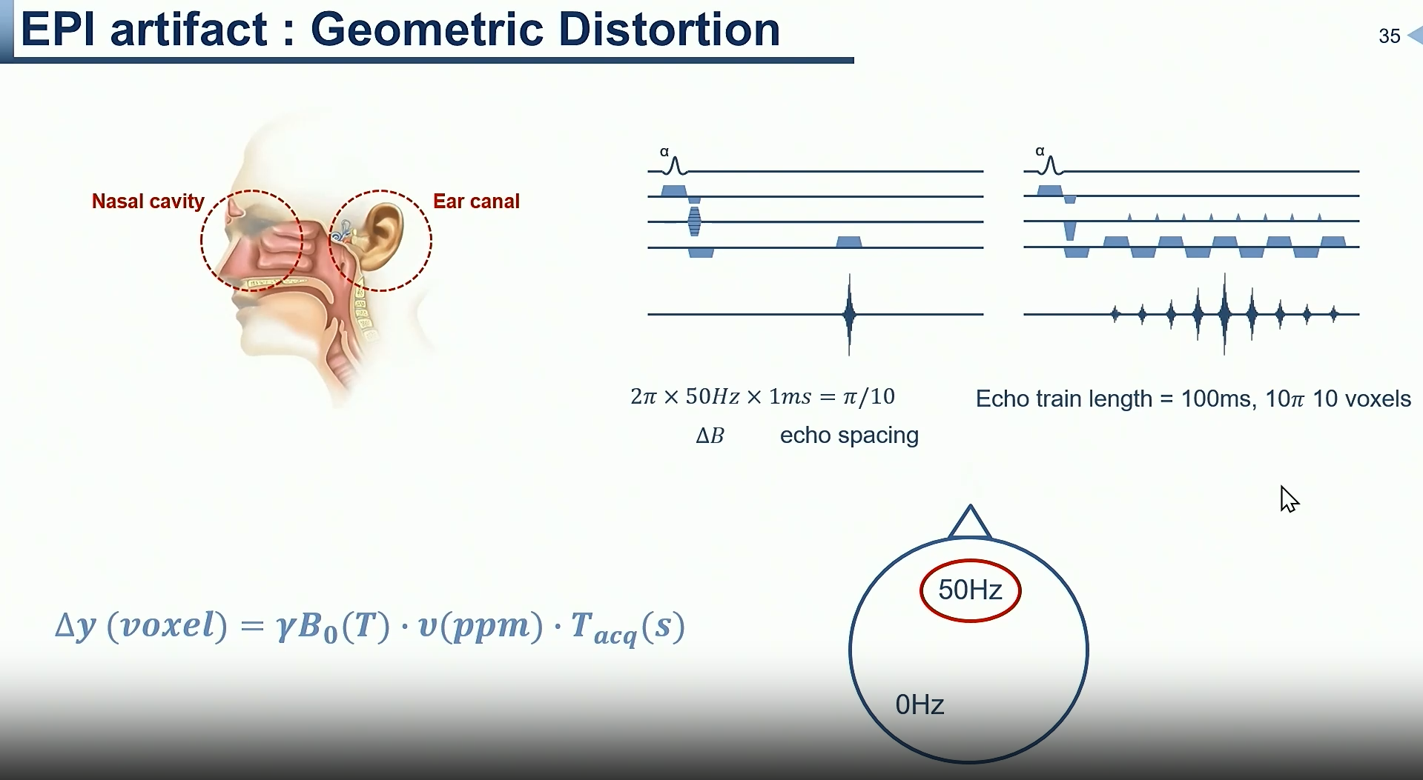

Slide 16
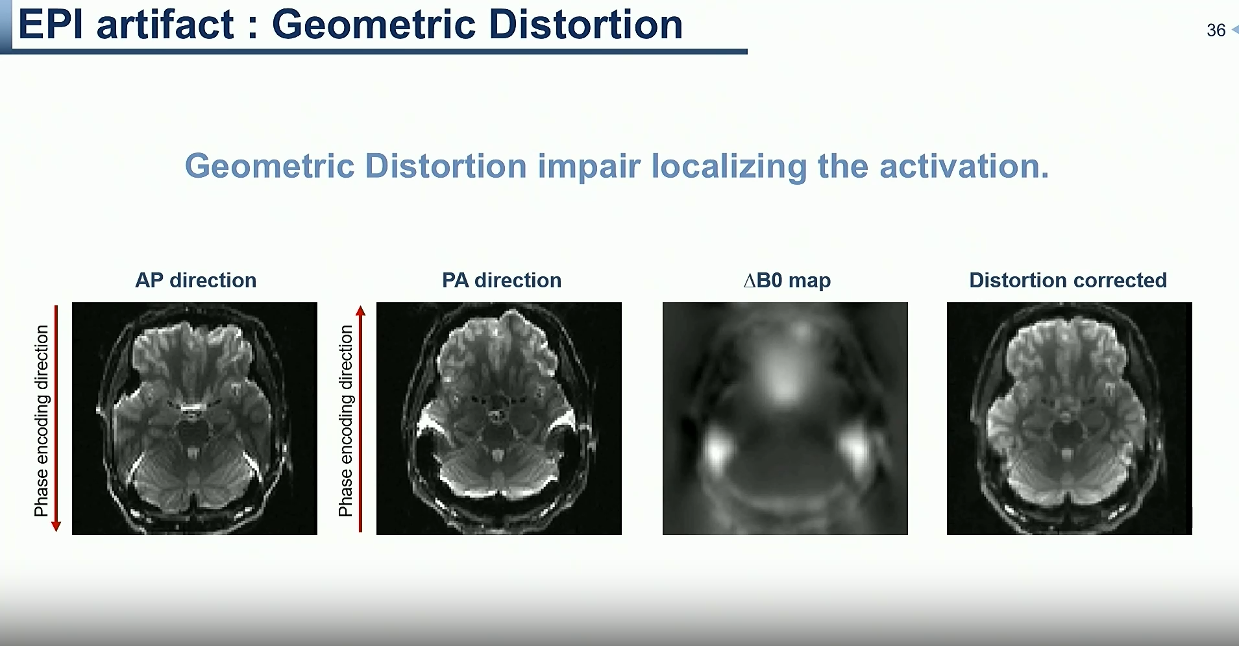

Slide 17
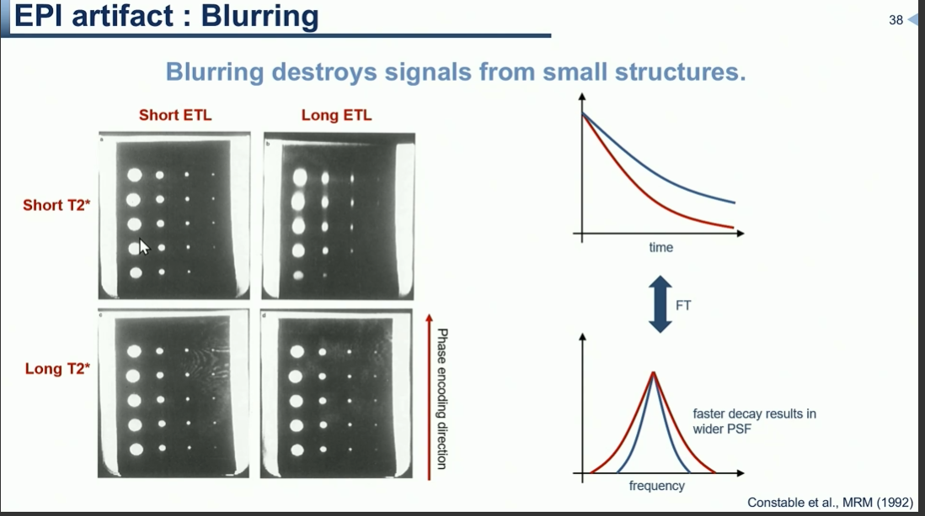

Slide 18
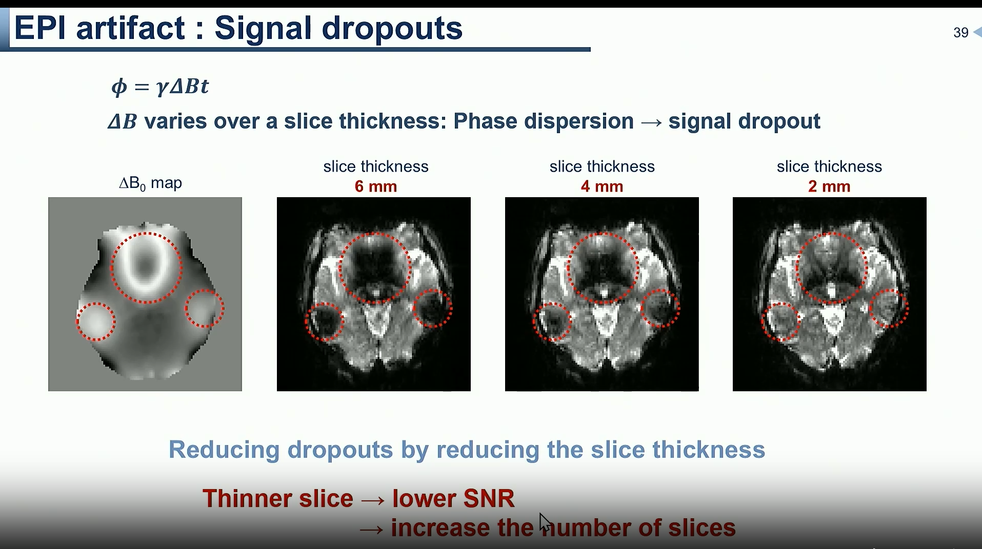

Slide 19
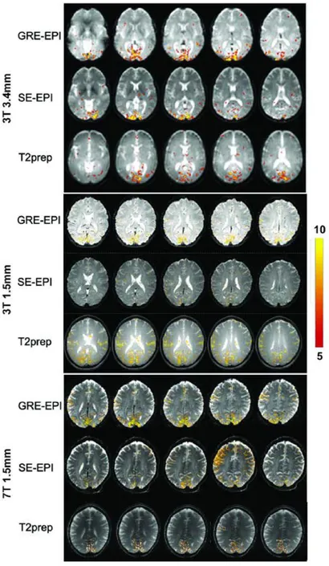
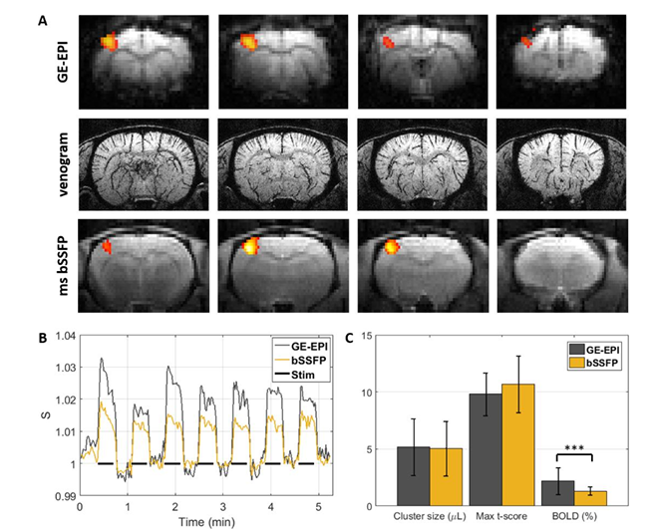
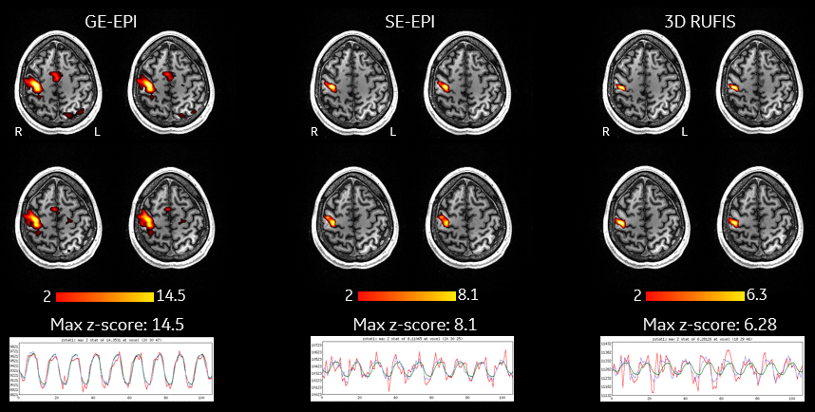
Alternative BOLD fMRI techniques to GRE-EPI and SE-EPI
T2-Prepared BOLD fMRI
Uses a T2-preparation module before image acquisition.
Offers improved reproducibility and hemodynamic response characterization.
Reduces susceptibility artifacts common in GRE-EPI.
Suitable for event-related tasks and high-field imaging.
Multi-Echo EPI
Acquires multiple echoes per excitation.
Enhances BOLD sensitivity and allows for better separation of physiological noise.
Particularly useful in regions prone to signal dropout, like the olfactory cortex.
Balanced Steady-State Free Precession (bSSFP)
Provides non-distorted activation maps with high SNR.
Effective at ultra-high field strengths (e.g., 7T).
Maintains signal in areas affected by B0 inhomogeneity.
Asymmetric Spin Echo Multi-Echo EPI (ASEME-EPI)
Combines benefits of GRE and SE-EPI.
Designed for high-field preclinical fMRI.
Balances sensitivity and specificity across cortical and subcortical regions.
Rotating Ultrafast Imaging Sequence (RUFIS)
A ZTE-based technique with low gradient switching.
Offers quiet, low-distortion whole-brain imaging at 7T.
Eliminates spatial distortions and signal dropout near air-tissue boundaries.

Slide 20
Parallel Imaging & Acceleration factors
Feature | SENSE | GRAPPA
Reconstruction Domain | Image space | k-space
Coil Sensitivity Maps | Required | Not strictly required
Robustness to Artifacts | Lower | Higher
Common Use Cases | Routine scans, low-field MRI | EPI, high-field, fMRI
Vendor Implementations | Philips (SENSE), GE (ASSET) | Siemens (GRAPPA), GE (ARC)
accelerates scan time by using multiple receiver coils.
SENSE and GRAPPA are two widely used reconstruction methods: SENSE operates in image space using coil sensitivity maps, while GRAPPA works in k-space using autocalibration signals.

Slide 21
Pre-Processing

Slide 22
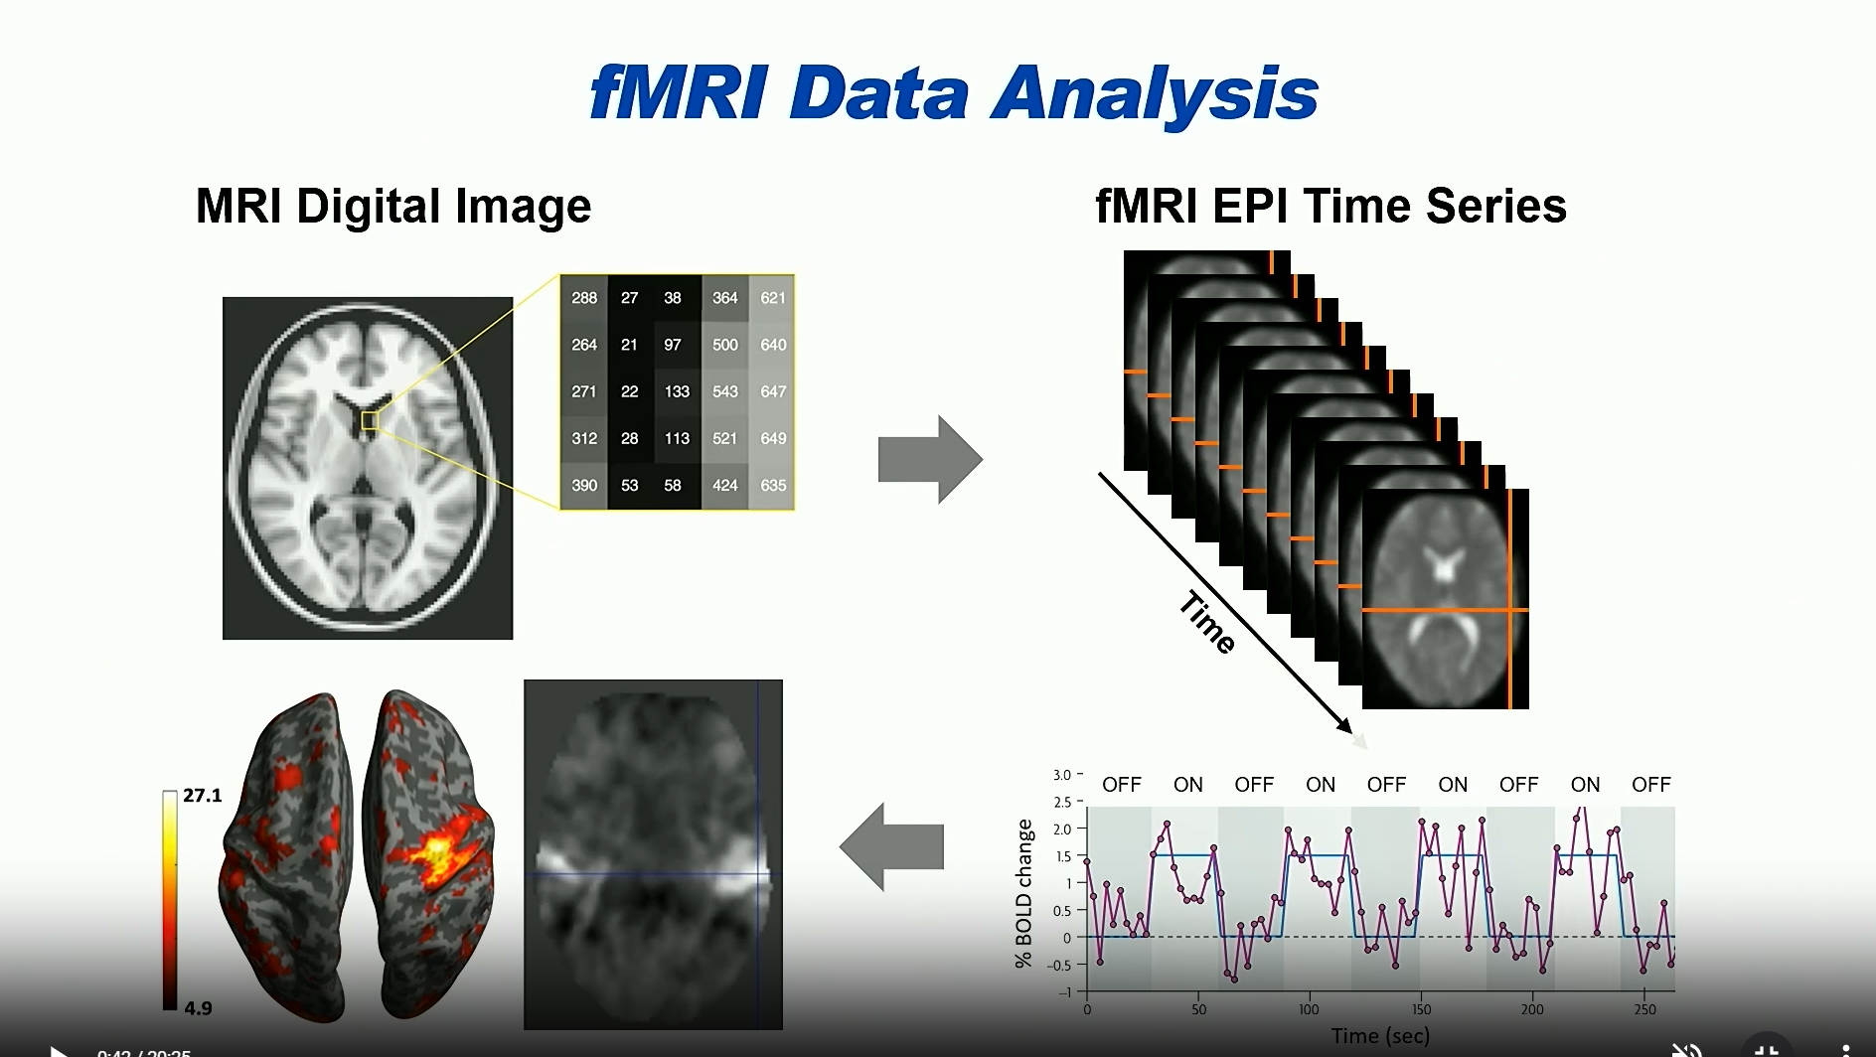

Slide 23
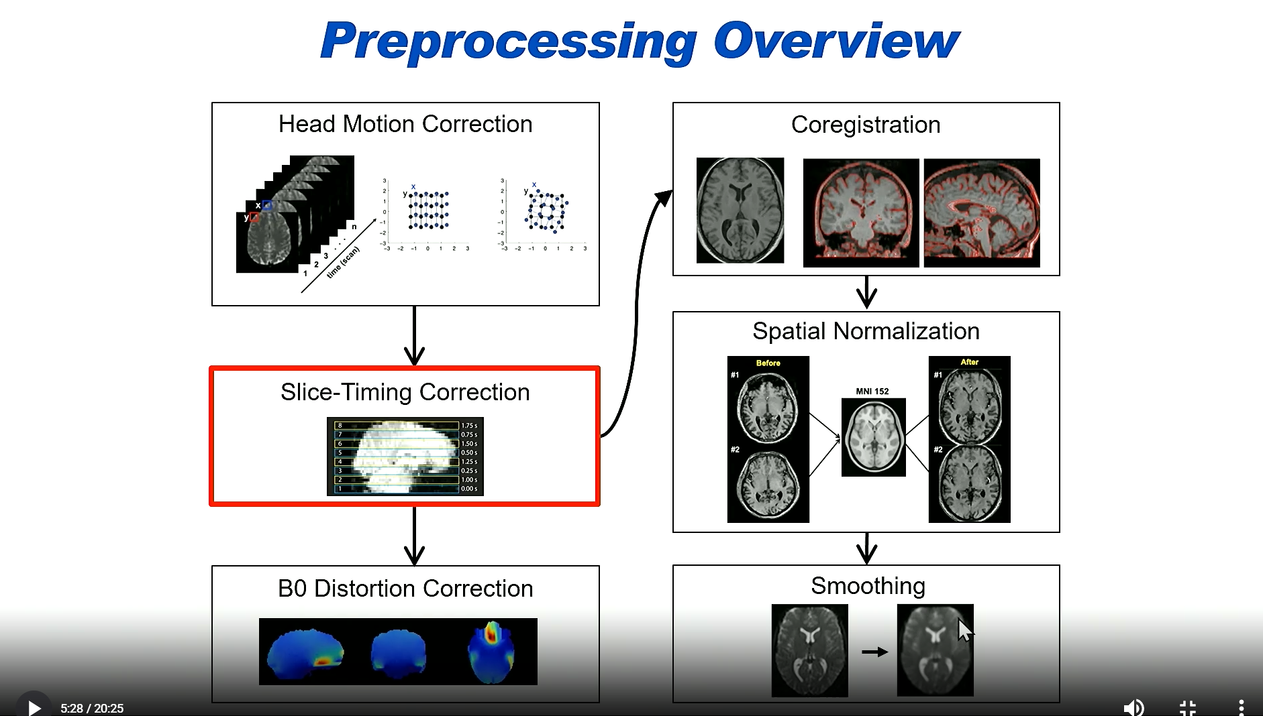

Slide 24
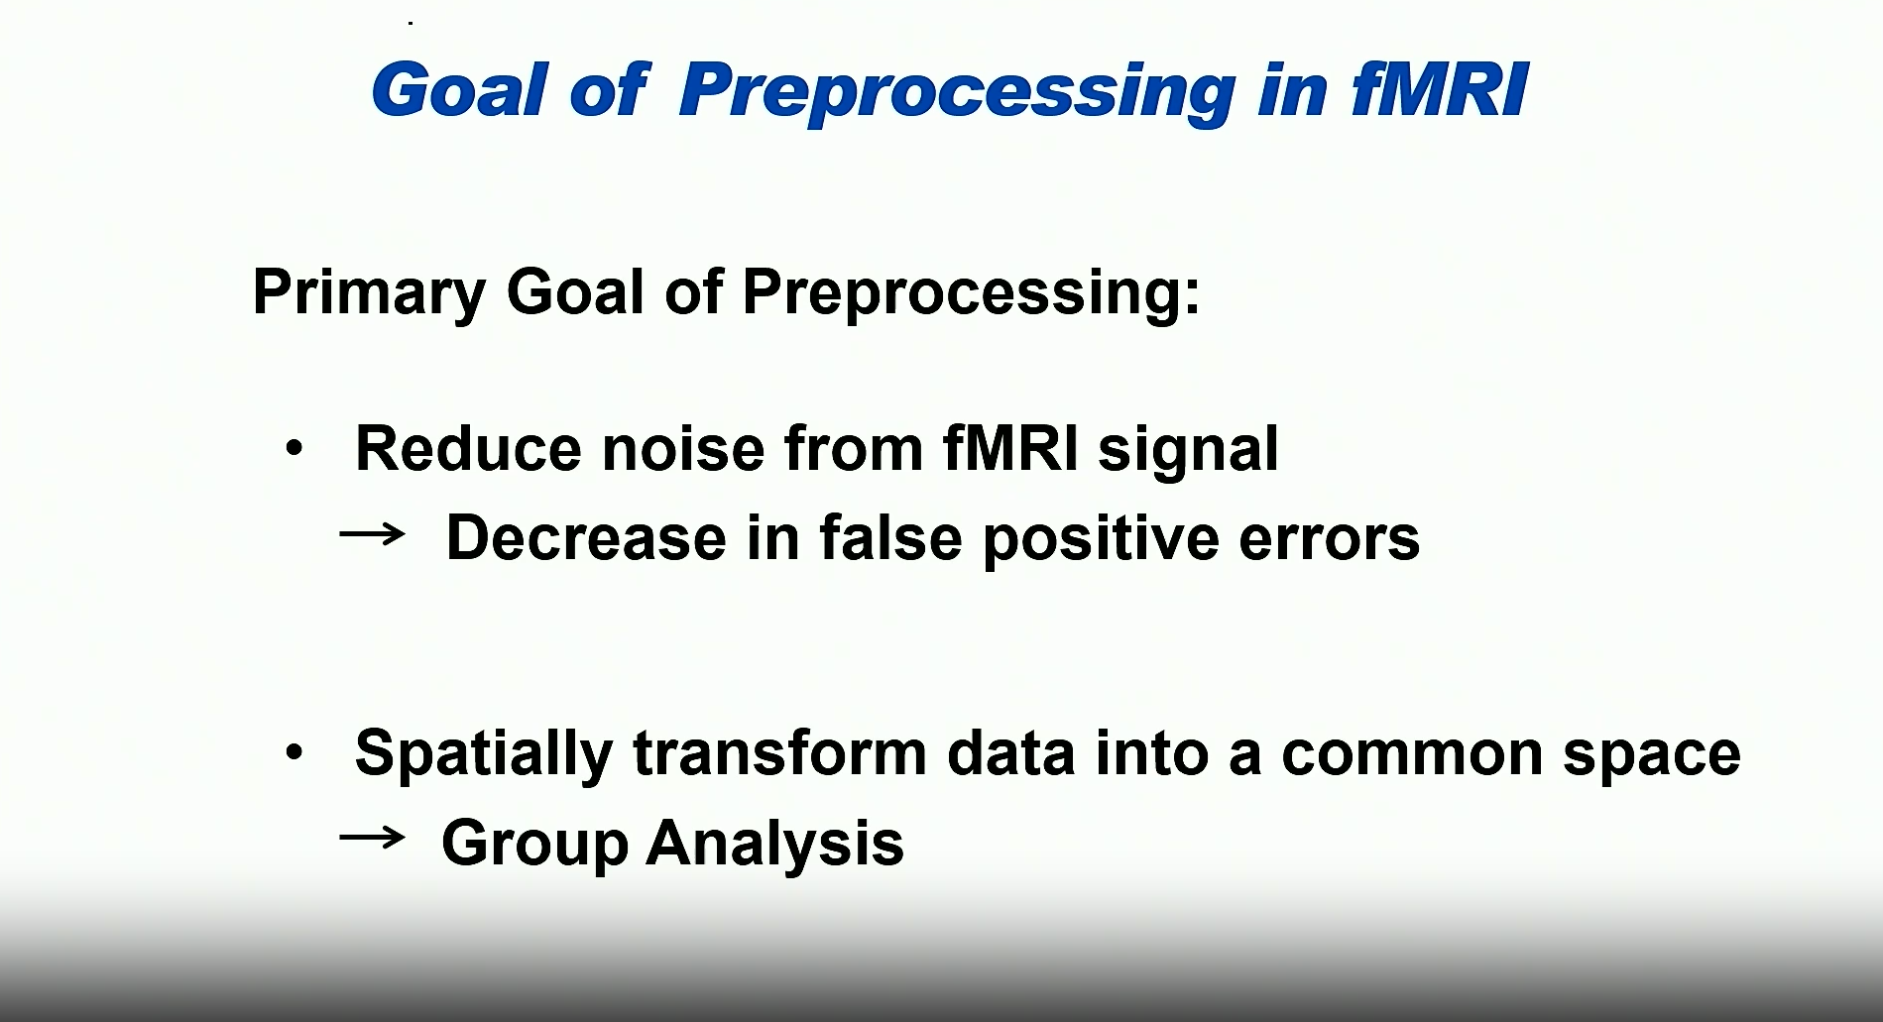

Slide 25
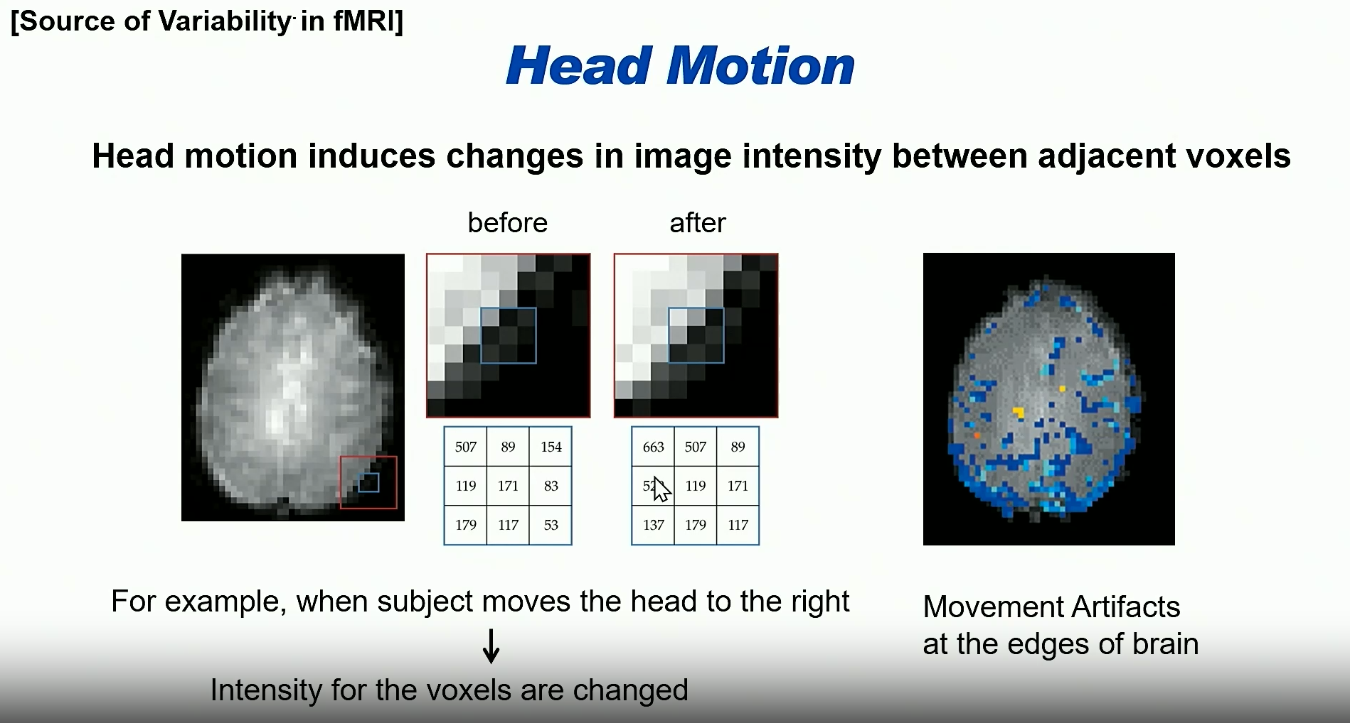

Slide 26
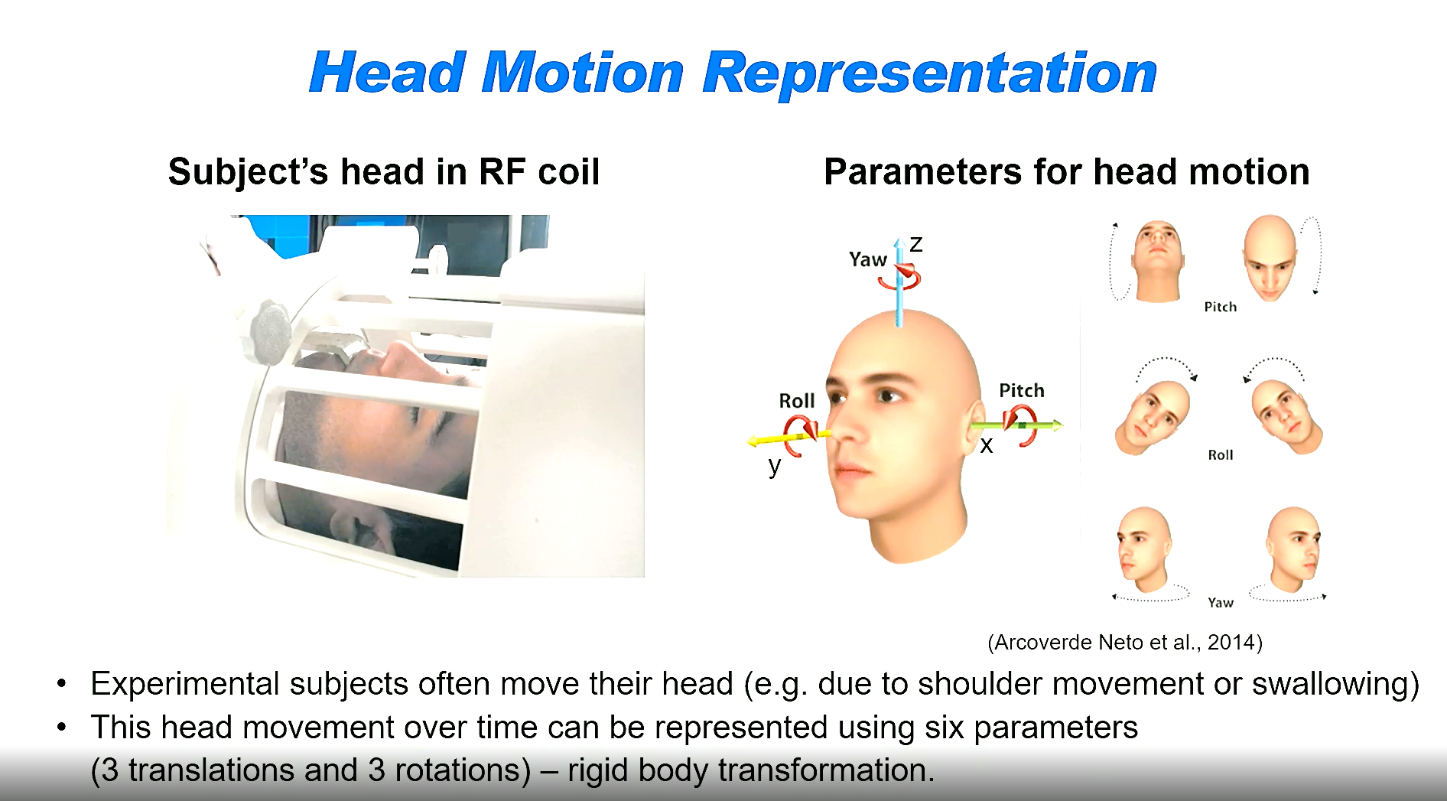
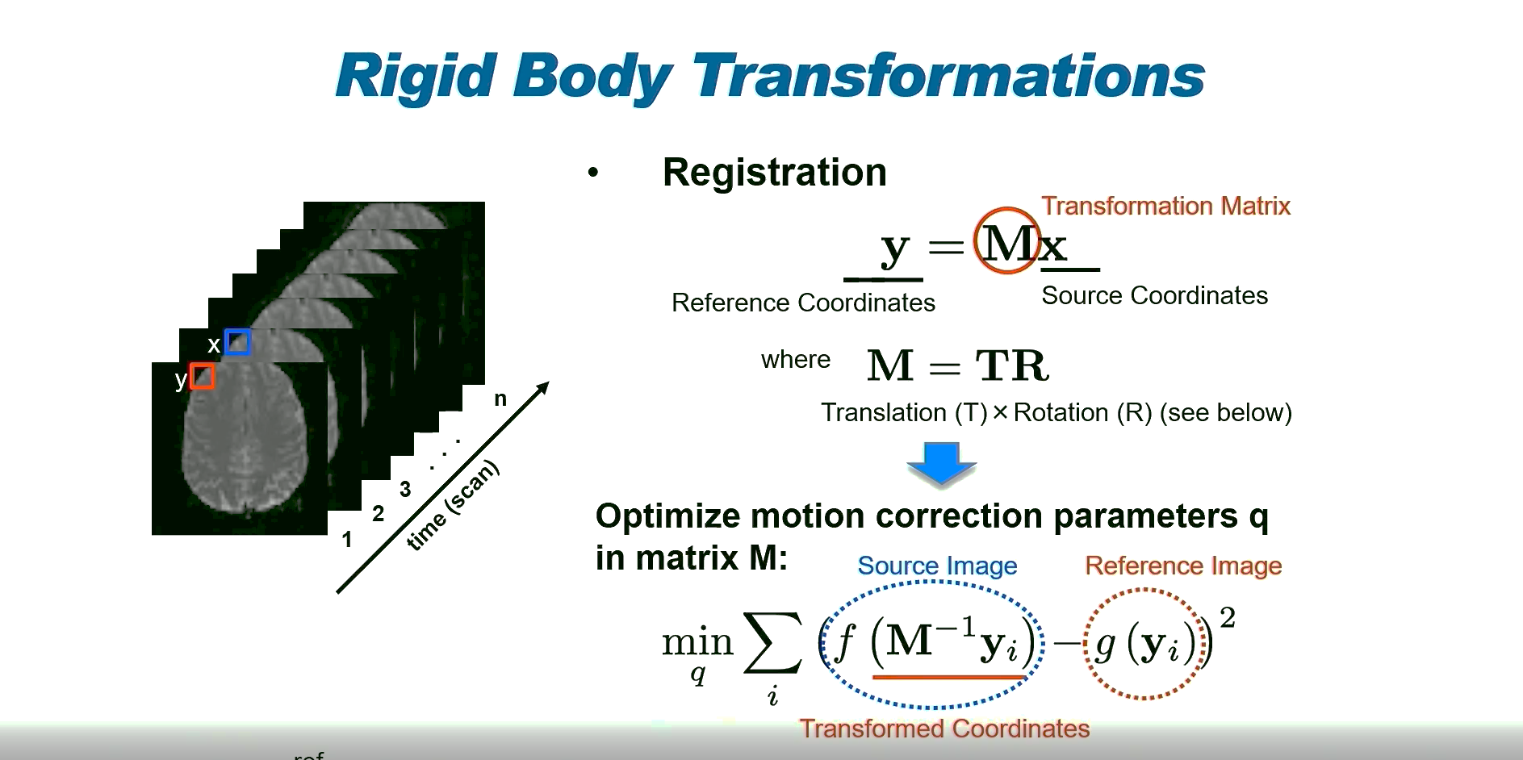
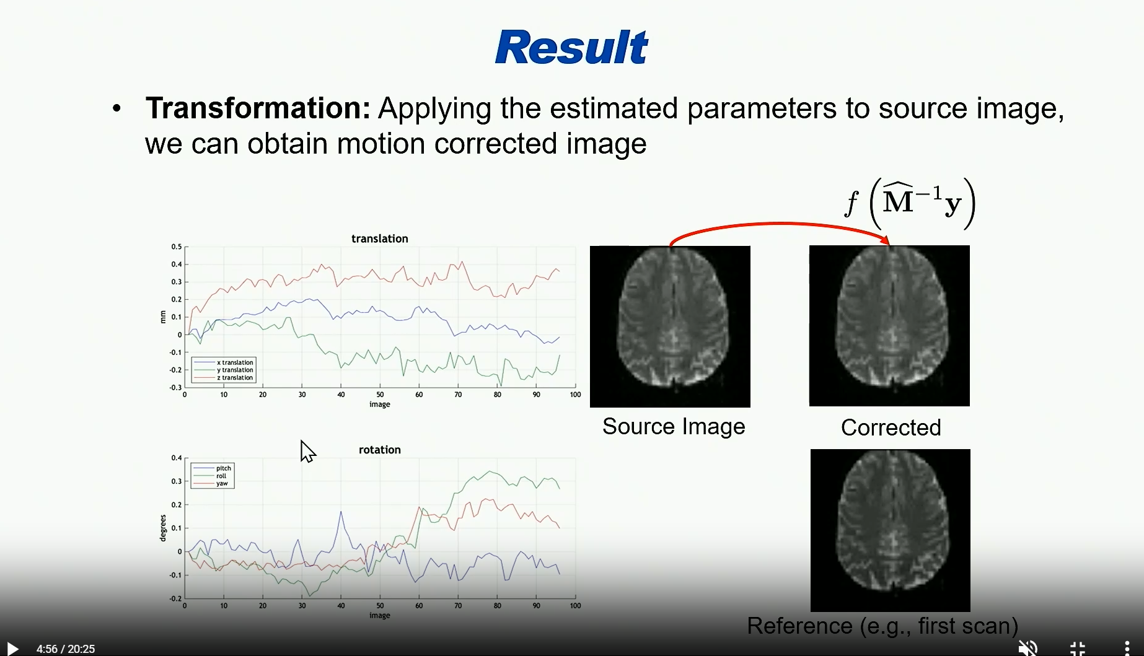
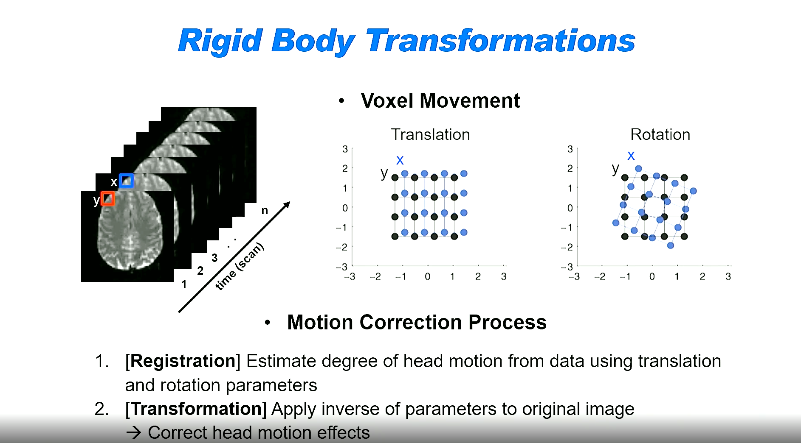

Slide 27
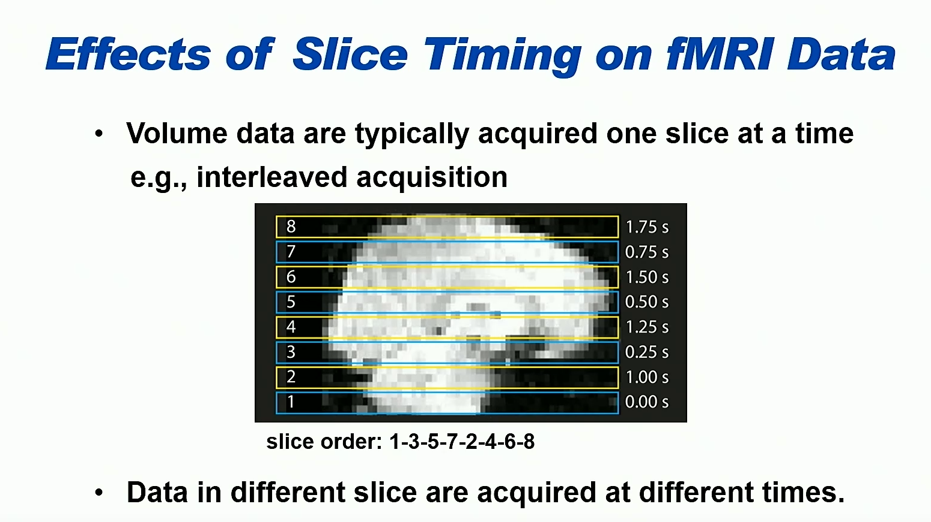

Slide 28
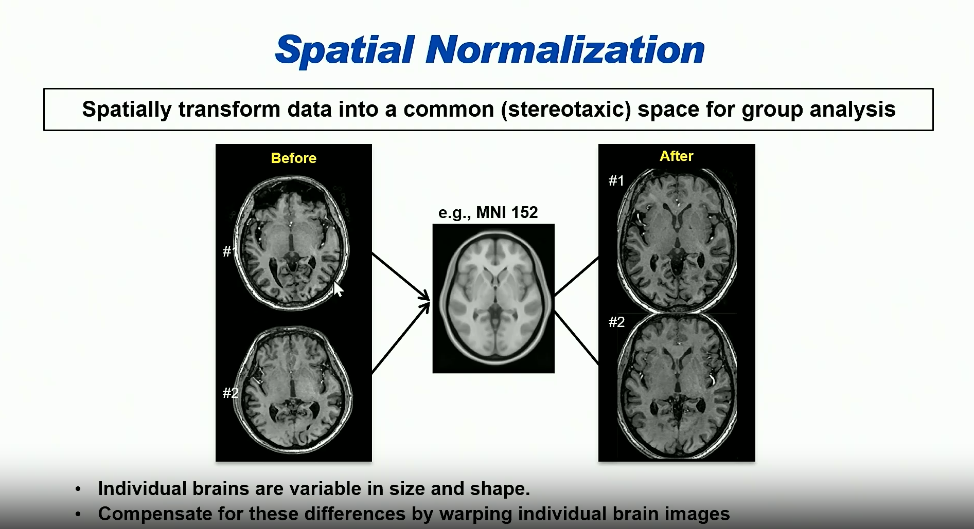

Slide 29
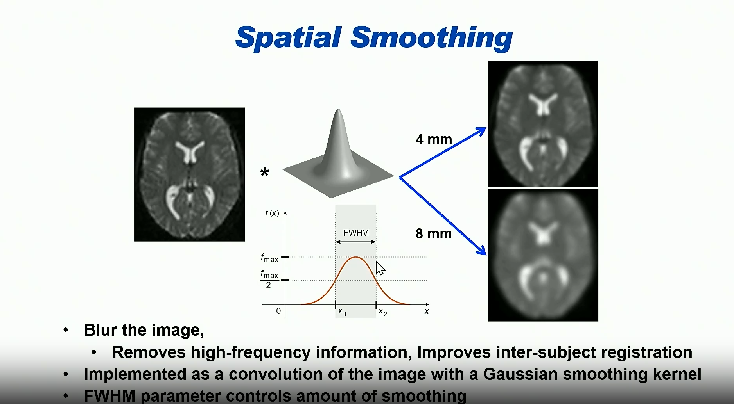

Slide 30
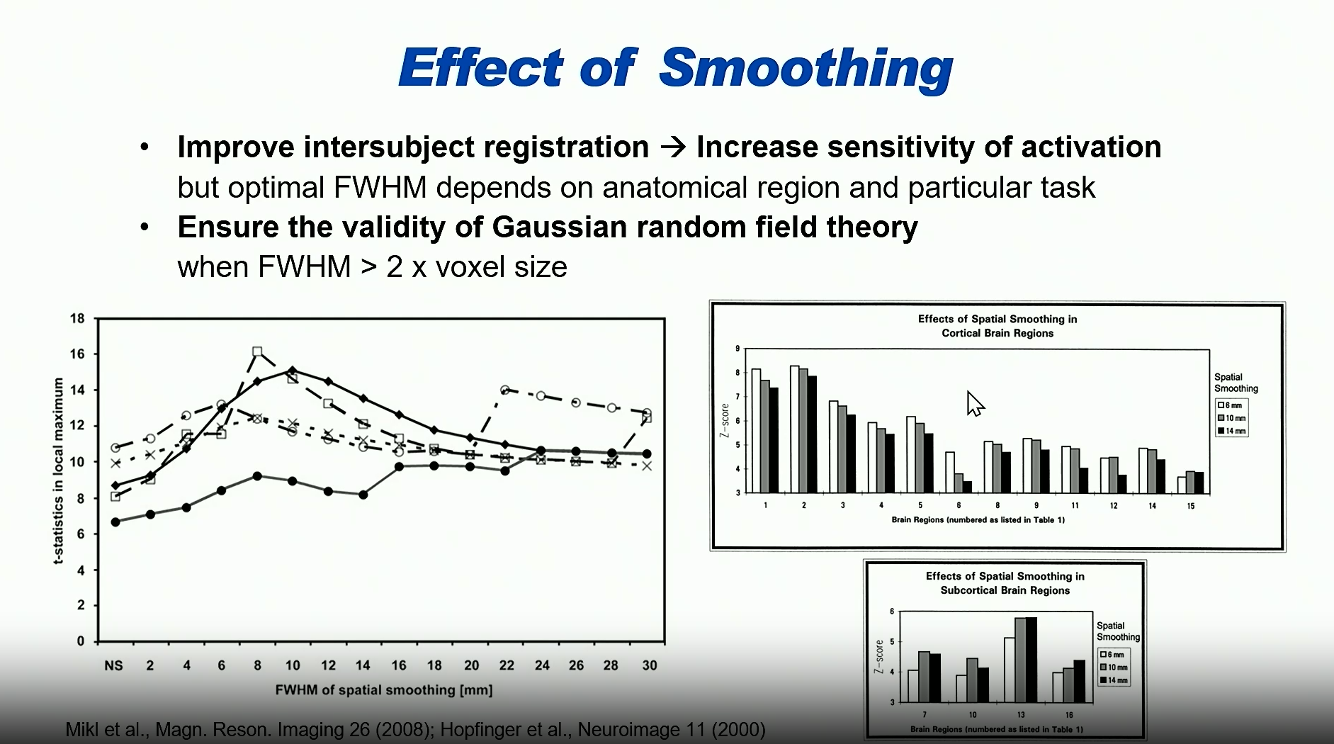

Slide 31
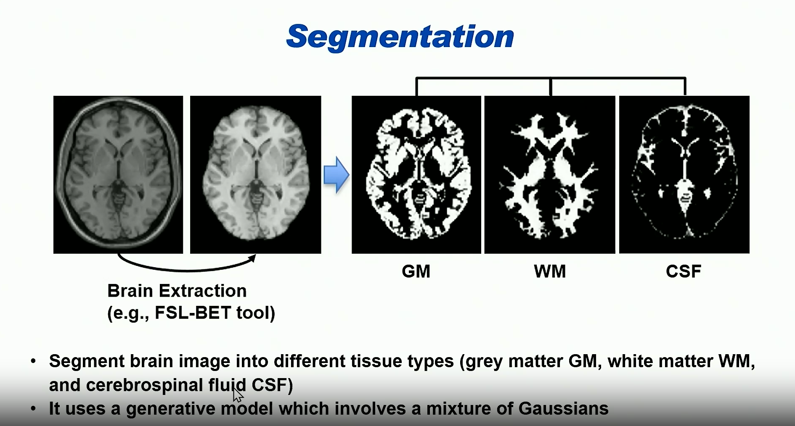

Slide 32
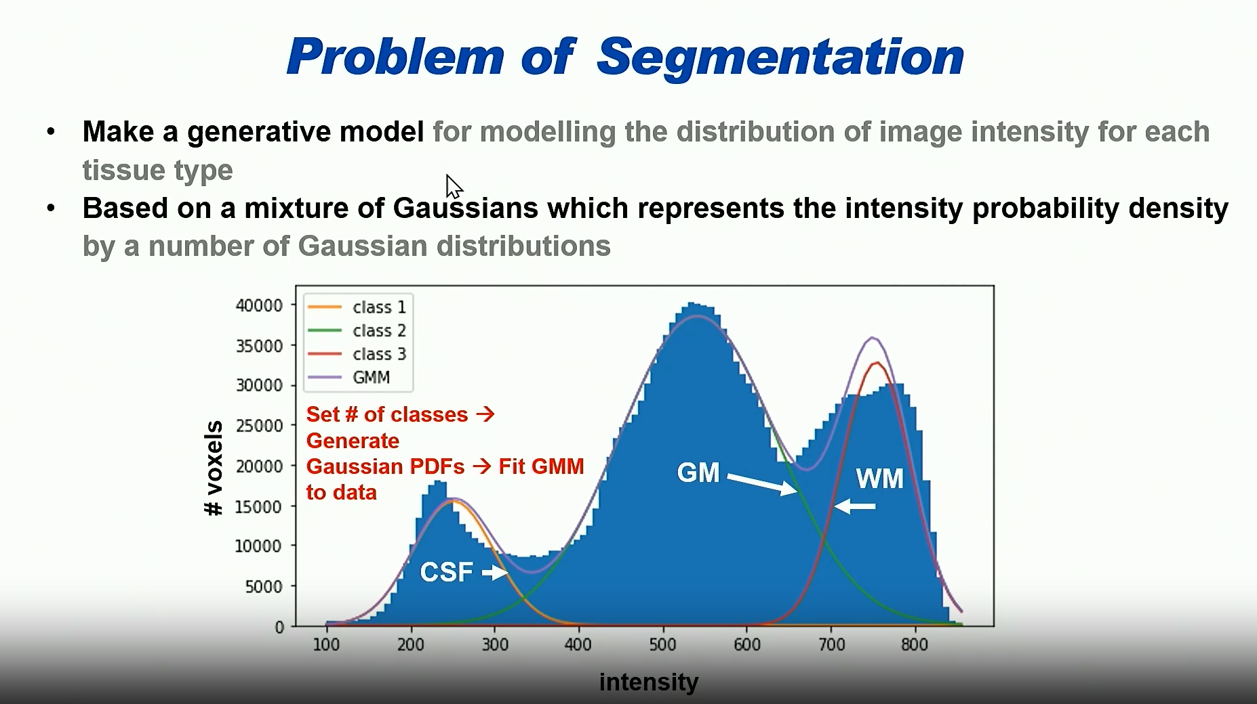

Slide 33
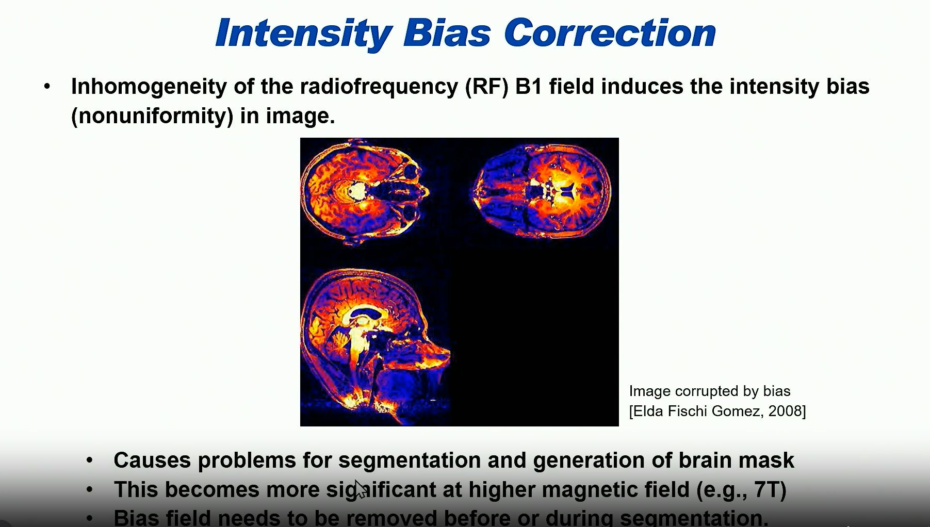

Slide 34
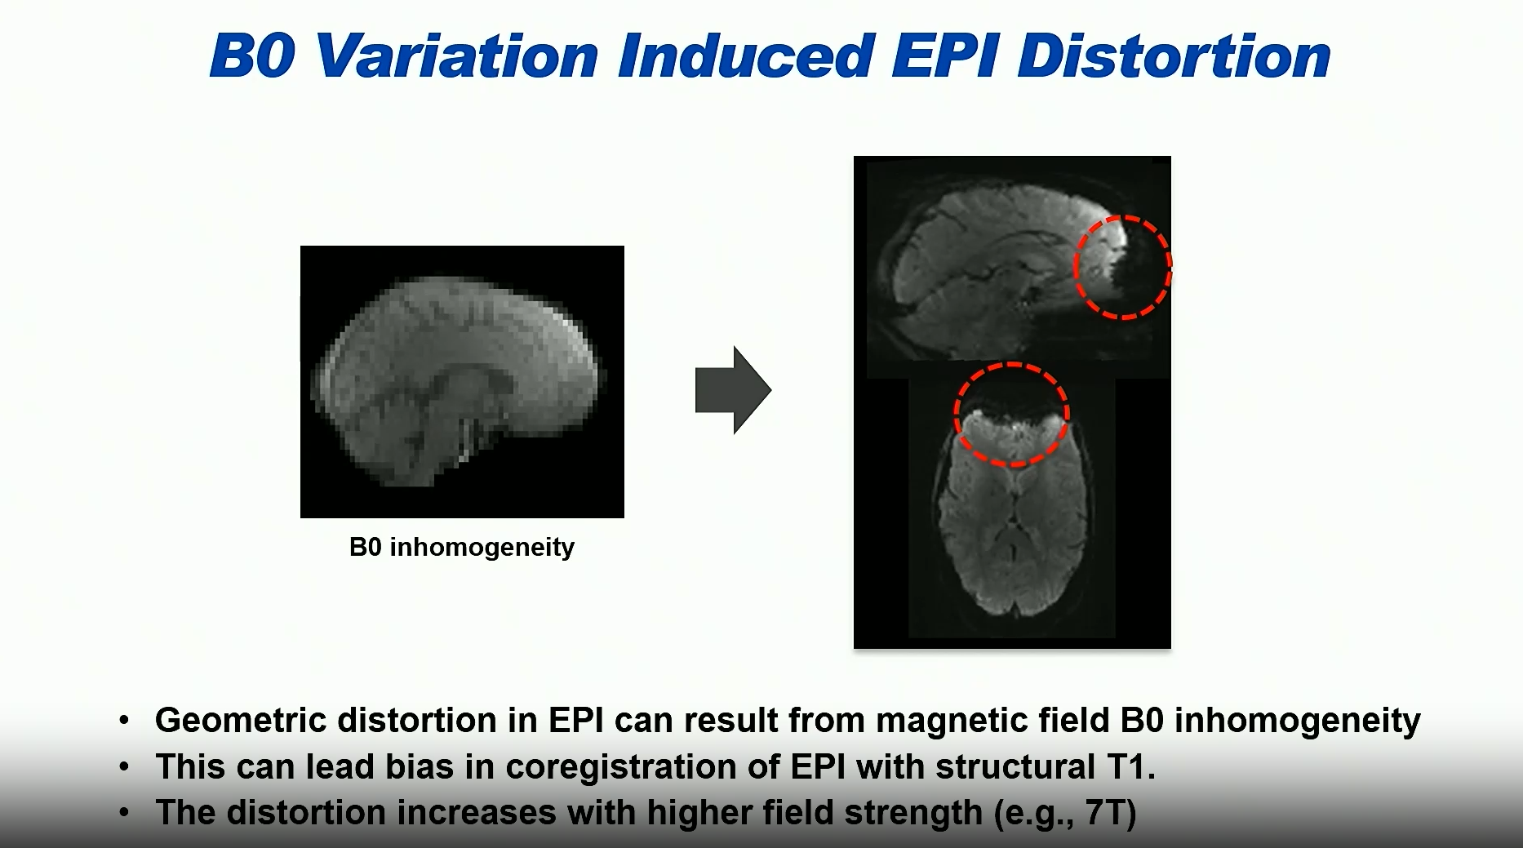

Slide 35


Slide 36


Slide 37


Slide 38



Slide 39


Slide 40


Slide 41


Slide 42


Slide 43

C =[1 0 0 0 0]

Slide 44


Slide 45



Slide 46



Slide 47


Slide 48

Genetic tools in preclinical BOLD fMRI

Slide 49

Investigation of the Locus Coeruleus (LC): Network Connectivity Investigation
Zerbi et al., Neuron 103, 702–718, August 21, 2019

Slide 50



Feasibility of o-fMRS in small animals at 9.4T
Optogenetics allow targeting specific cell populations:
O-fMRI enables mapping of specific brain
activities
  Opsin: AAV2-CamKII-C1V1 injected 4 weeks prior to MRI
  Medetomidine
  Electrical stimulation of S1FL
  10sOFF- 10sON-10sOFF; 10 ms pulses at 9Hz and 1.2mA)
  Green light (552nm)
O-fMRS to increase the specificity and precision of metabolic readouts
O-fMRS : STEAM (TR/TE/TM=4000/2.6ms, 4960 Hz, 4096 points)
FASTMAP Shim
5min OFF-5min ON
New possibilities for exploring energetic demands of specific cell populations and underpinnings of energy metabolism during brain activity
Just et Faber, J. of Neurochemistry 2019;Just N. NMR in Biomed, 2020

Slide 51
Ultra-High Field MRI: Benefits vs. Drawback
DRAWBACKs
  Increased Susceptibility Artifacts
  More distortion near air-tissue interfaces (e.g., sinuses, lungs) due to magnetic field inhomogeneities.
  Safety & Comfort Concerns
  Higher SAR (specific absorption rate) limits scan duration; patients may experience dizziness or heating.
  Limited Accessibility & Cost
  7T+ scanners are expensive, bulky, and not widely available; regulatory approval is still evolving.
  Technical Complexity
  Requires specialized RF coils, pulse sequences, and expertise to manage field-dependent challenges.
BENEFITS
  Superior Resolution & Contrast
  Enables ultra-fine anatomical detail, especially in brain, vascular, and musculoskeletal imaging.
  Enhanced Signal-to-Noise Ratio (SNR)
  Higher field strength boosts SNR, improving image clarity and reducing scan time.
  Advanced Functional & Metabolic Imaging
  Better detection of subtle changes in tissue composition and brain activity (e.g., fMRI, spectroscopy).
  Improved Diagnostic Accuracy
  Particularly useful in neurological disorders, oncology, and cardiovascular imaging.

Slide 52


Ultra-High Field fMRI Reveals Finger-Level Somatotopy
¨Human Finger Somatotopy in Areas 3b, 1, and 2 (Martuzzi et al., 2014)
Scanner: 7 Tesla
Finding: Clear, distinct cortical representations of individual fingers in somatosensory areas 3b, 1, and 2.
Method: Natural tactile stimulation of fingers during high-resolution fMRI.
Significance: Demonstrated that 7T fMRI can resolve fine-scale somatotopic maps that are blurred or undetectable at lower field strengths.
Relation Between Palm and Finger Representations (Akselrod et al., 2021)
Scanner: 7 Tesla
Finding: Mapped the spatial relationship between palm and individual finger representations in S1.
Significance: Showed functional interactions and topographic precision that would be difficult to capture at 3T.
ultra-high field fMRI enables neuroscientists to move from coarse hand maps at 1.5T/3T to fine-grained finger-level resolution at 7T — a leap that opens new doors for understanding sensorimotor function, neuroprosthetics, and cortical plasticity.

Slide 53


Proprioceptive Engagement of the Human Cerebellum Studied with 7T-fMRI
This study pushes the boundaries of what’s possible in cerebellar imaging. It shows that ultra-high field fMRI can uncover fine-grained functional architecture in regions previously considered too complex or noisy to study in vivo.
The cerebellum’s thin, highly folded cortex makes it difficult to image with conventional MRI. This study leveraged 7T’s enhanced spatial resolution to overcome that.
Emma J.P. Brouwer, Nikos Priovoulos, Julie Hashimoto, Wietske van der Zwaag
Imaging Neuroscience, August 2024
Identified distinct cerebellar activation patterns associated with proprioceptive input.
Demonstrated that 7T fMRI can resolve functional subdivisions within the cerebellar cortex that are not visible at lower field strengths.
Highlighted the cerebellum’s role in self-perception and sensorimotor integration.

Slide 54




Slide 55


High-Resolution fMRI: line-scanning
Targeted Acquisition: Instead of imaging an entire brain slice, line-scanning fMRI acquires data from a thin line (typically sub-millimeter wide) that runs perpendicular to the cortical layers.
Laminar Resolution: This line is carefully positioned to span across cortical layers, allowing researchers to resolve layer-specific BOLD signals — crucial for studying feedforward and feedback processing.
High Temporal Resolution: Because only a small region is scanned, acquisition can be much faster (e.g., 100–200 ms per line), enabling tracking of rapid neural dynamics.
Reduced Artifacts: By limiting the field of view, line-scanning minimizes motion and susceptibility artifacts, especially useful in animal models or ultra-high field human studies.
Albers et al., 2018
Raimundo et al- 2023

Slide 56
Thanks for your attention!

