Slide 1


Advanced biomedical imaging methods and instrumentation
Lecture 5
Principles of image encoding
Antoine Lutti
Laboratory for Neuroimaging Research, Lausanne University Hospital

Slide 2
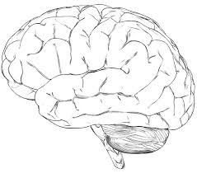
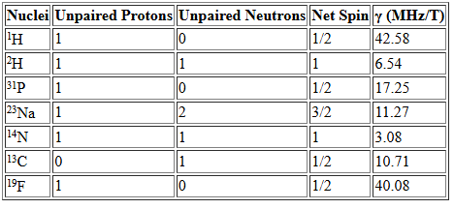
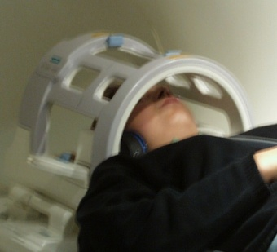

Origin of the MRI signal
Magnetic field B₀ = 0
$$M_{0}∝\sum{s}=0$$
Net magnetization:
receiver coil
https://www.cis.rit.edu/htbooks/nmr/chap-3/chap-3.htm

Slide 3
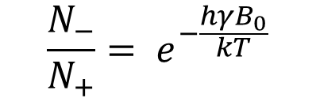

Origin of the MRI signal
Magnetic field B₀ ≠ 0
B₀
M₀
$$M_{0}∝\sum{s}≠0$$
Net magnetization:
$$\frac{N_{−}}{N_{+}}= e^{−\frac{hγB_{0}}{kT}}$$
γ: gyromagnetic ratio
B₀: field strength
receiver coil
https://www.cis.rit.edu/htbooks/nmr/chap-3/chap-3.htm

Slide 4
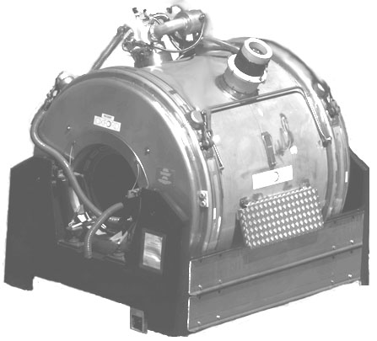
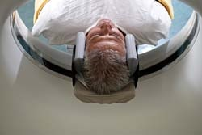
Hardware
B₀
B₀
The static magnetic field B₀ is generated by a superconducting magnet
In human MRI systems, B₀ is oriented along the main direction of the bore

Slide 5

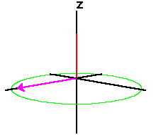
MRI signal detection
Radio Frequency (RF) excitation flips the magnetization in the transverse plane
B₀
B₀
M₀
M₀
Radio Frequency excitation
B₀

Slide 6
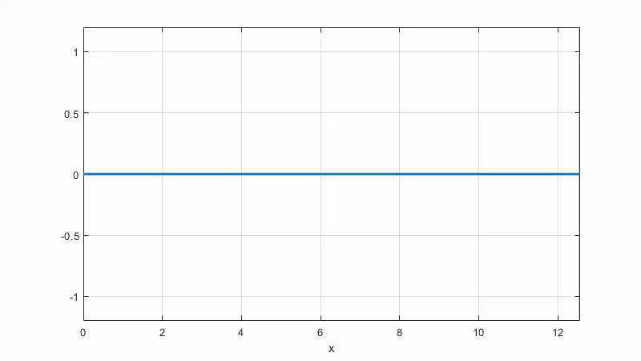
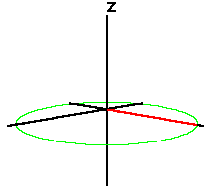
MRI signal detection
B₀
receive coil
Precession of the magnetization induces an electrical current in the receiver coil. ‘Larmor’ precession frequency:

Slide 7
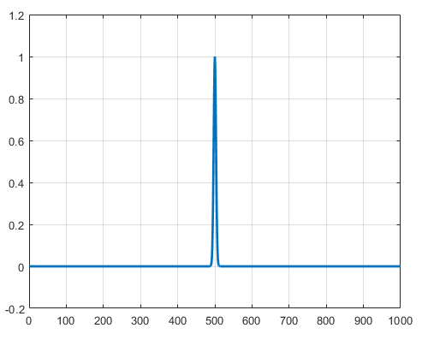


Principles of image formation
Uniform B₀
B₀
B(x)=B₀
x
$$ω_{0}= γB_{0}$$
?? image formation ??

Slide 8
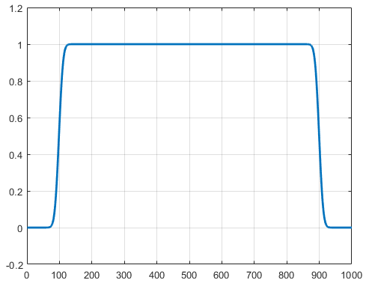




Principles of image formation
Image formation requires gradients of magnetic field (G)
Magnetic field
Larmor frequency
$$B\left(x\right)=B_{0}+G_{x}∗x$$
$$ω\left(x\right)=\text{γ}(B_{0}+G_{x}∗x)$$
G_{x}
x
$$ω_{min}$$
$$ω_{max}$$

Slide 9
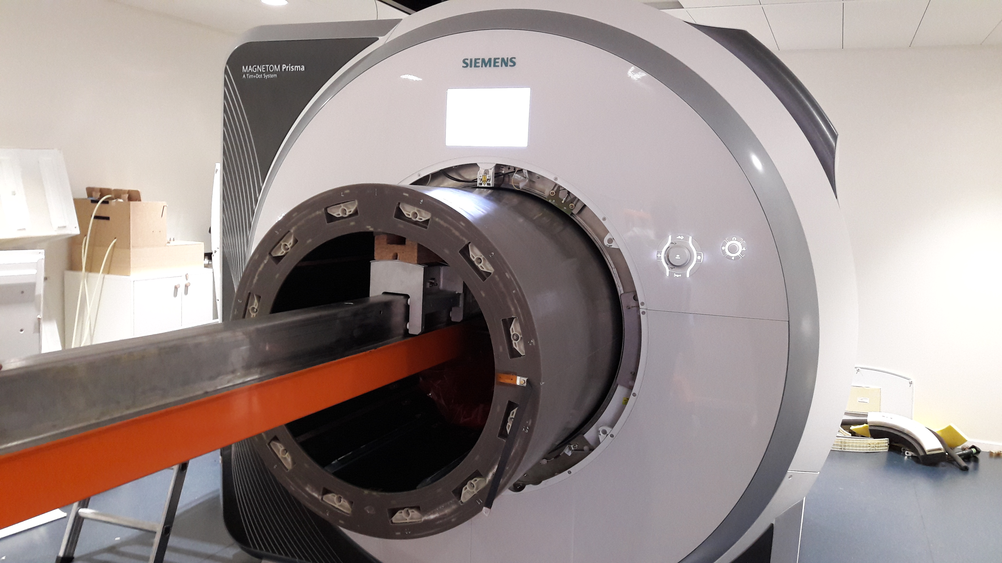
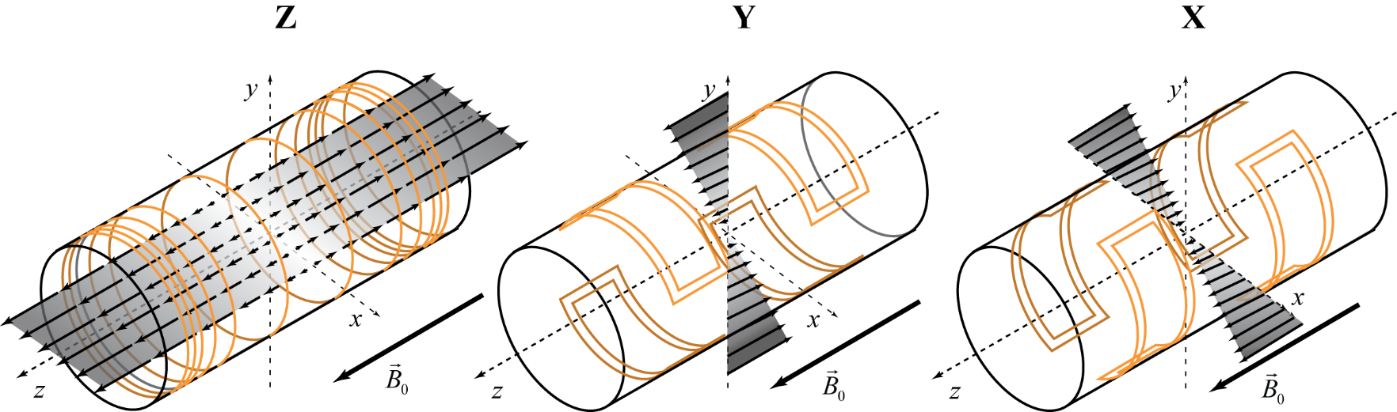
Hardware
Gradients of magnetic fields are generated by dedicated coils
The gradients’ amplitude and timing are driven in real-time by the MRI scanner during image acquisition

Slide 10



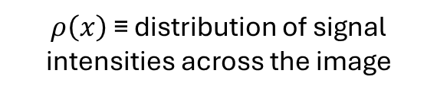


Principles of image formation
Image formation requires gradients of magnetic field (G)
Magnetic field
Larmor frequency
Image
$$B\left(x\right)=B_{0}+G_{x}∗x$$
$$ω\left(x\right)=\text{γ}(B_{0}+G_{x}∗x)$$
$$x= ω/(γG_{x})$$
$$ρ\left(x\right)$$
G_{x}
x
$$ω_{min}$$
$$ω_{max}$$
$$x_{min}$$
$$x_{max}$$
$$x$$
$ρ\left(x\right)$ ≡ distribution of signal intensities across the image

Slide 11


Principles of image formation
B=B₀
Opera
x
http://fr.depositphotos.com/4901723/stock-illustration-Opera-singer.html
z
MRI
$$ω_{0}= γB_{0}$$
ω(x) = ω₀
x
y

Slide 12



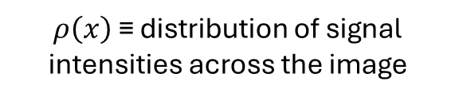

Principles of image formation
B=B₀+Gx
Image
G
$$ρ\left(x\right)$$
Opera
http://fr.depositphotos.com/4901723/stock-illustration-Opera-singer.html
z
x
MRI
ω(x) = ω₀+γ∗G*x
x
$$x_{min}$$
$$x_{max}$$
$$x$$
y
$ρ\left(x\right)$ ≡ distribution of signal intensities across the image

Slide 13
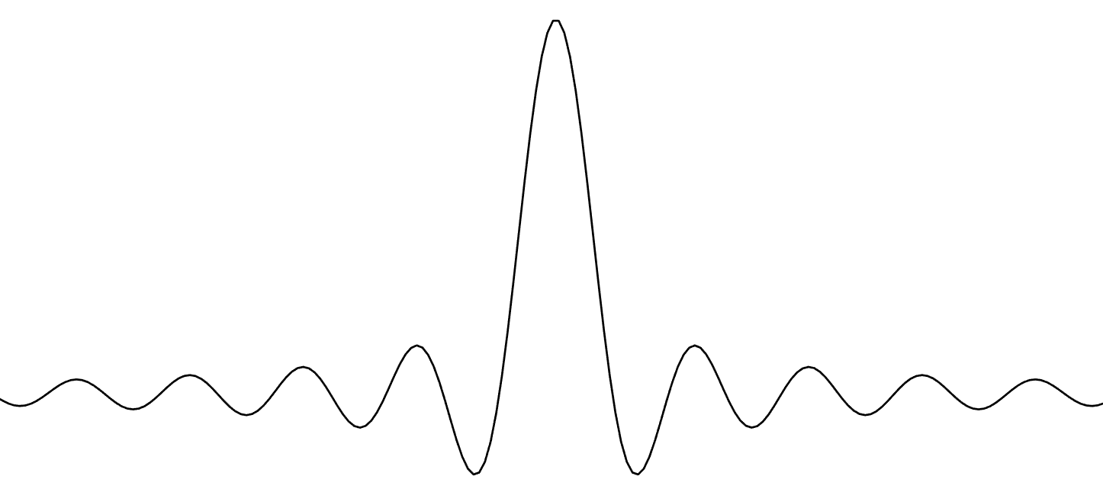
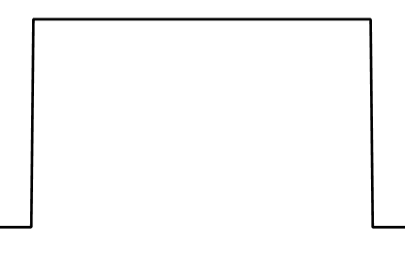
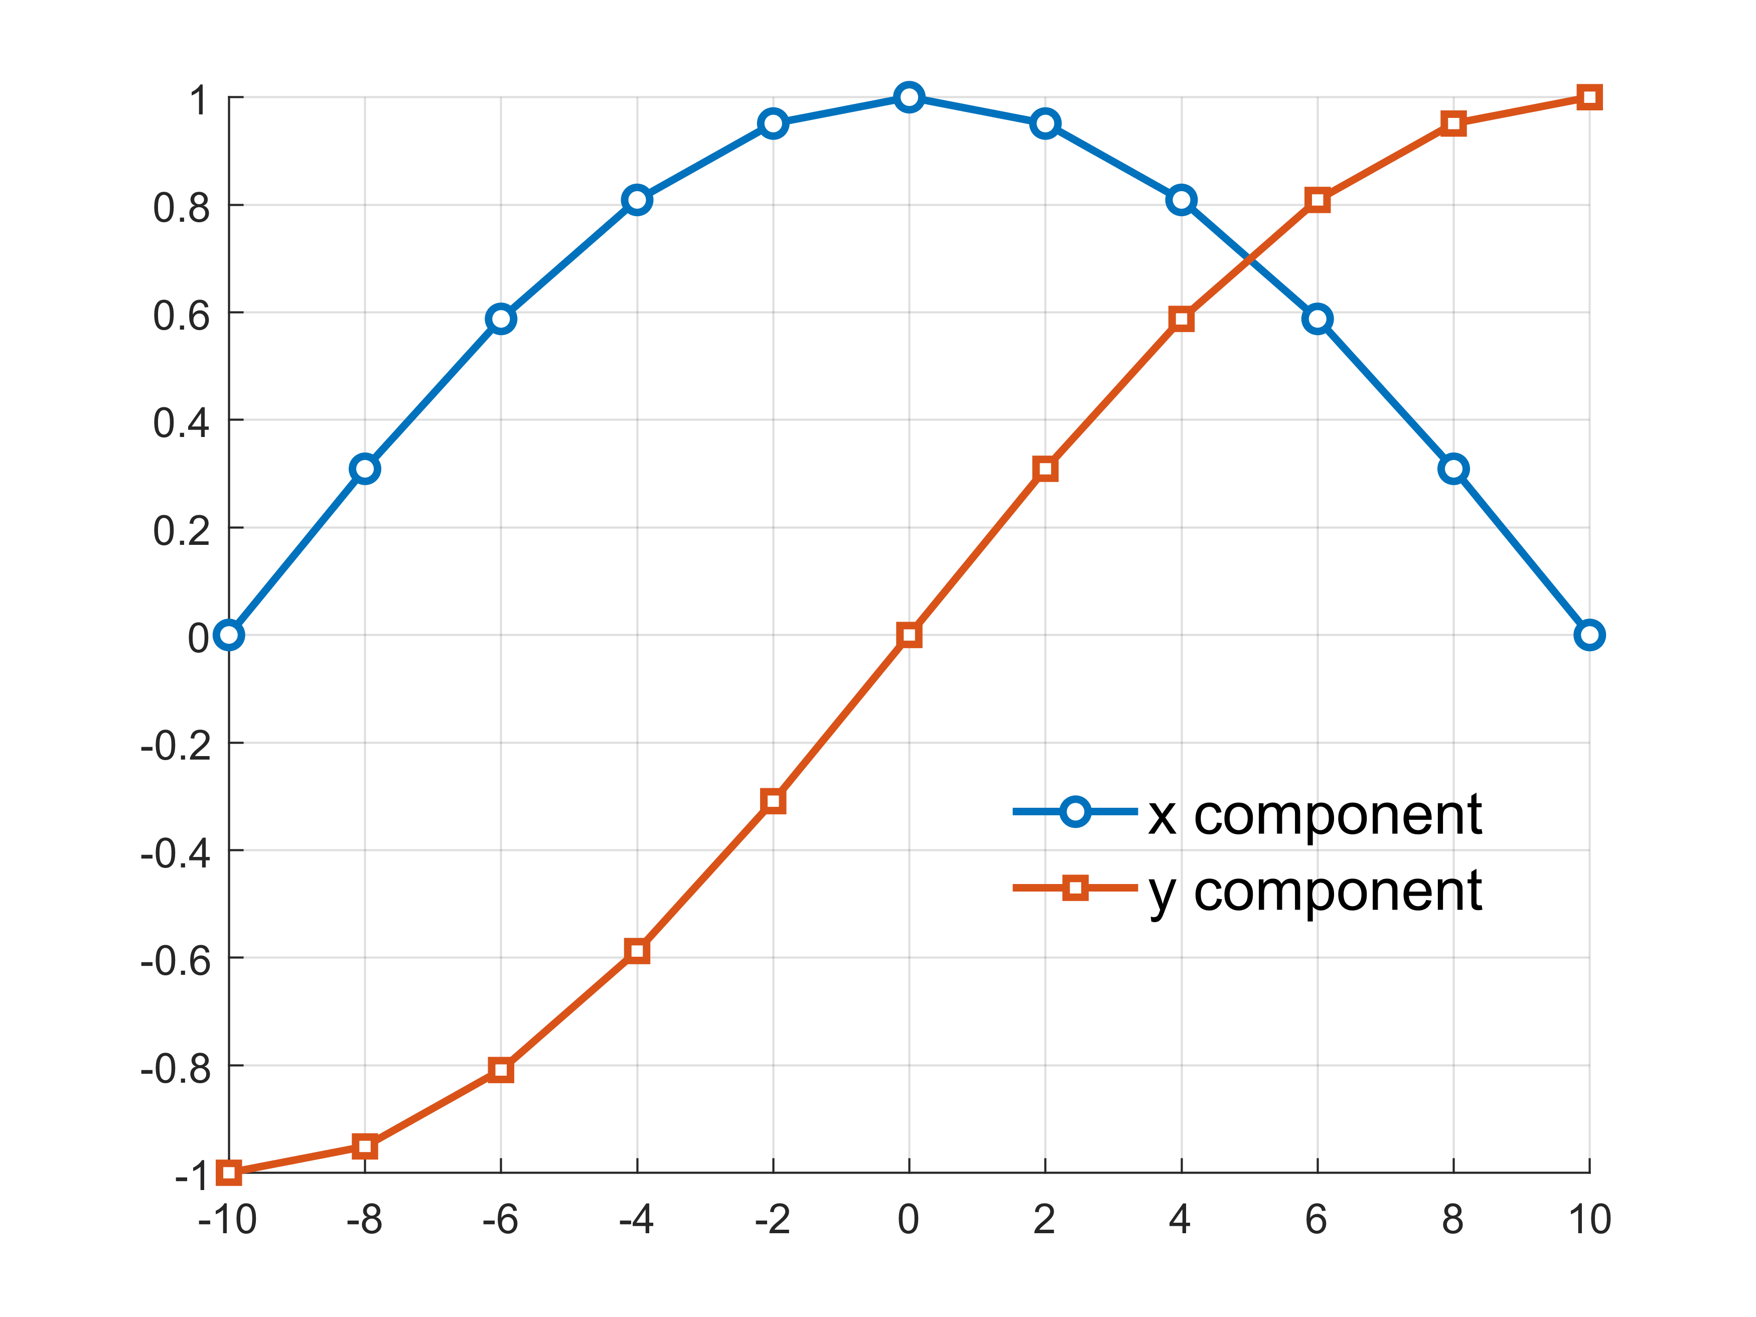
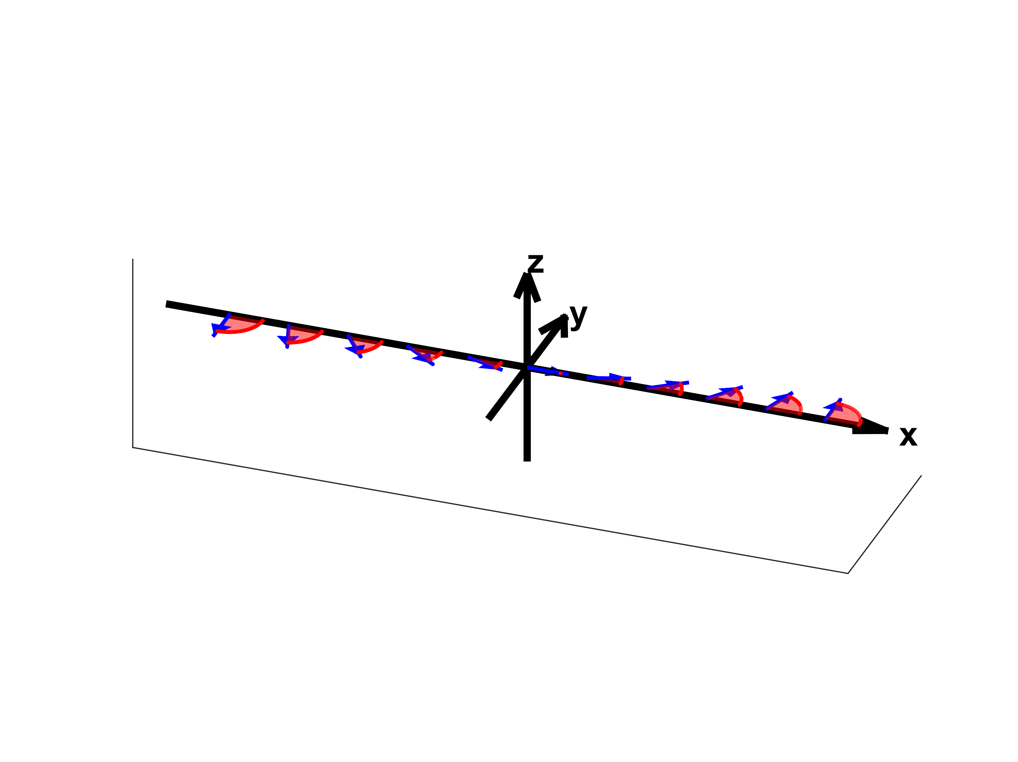


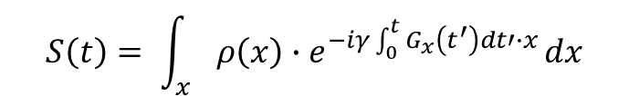
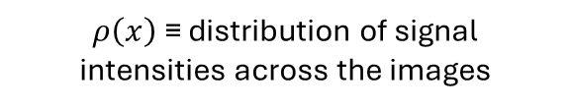


Excitation
$$S\left(t\right)$$
Image encoding combines data acquisition with an encoding gradient
RF
$$t$$
G_{x}
$$t$$
$$S\left(t\right)= \int_{x}{ρ\left(x\right)∙e^{−iγ\int_{0}^{t}{G_{x}}\left(t^{′}\right)dt′∙x}}dx$$
$ρ\left(x\right)$ ≡ distribution of signal intensities across the images
Components of the magnetization
G_{x}
$$x$$
G modulates the phase of the magnetization across the field of view
receiver coil

Slide 14




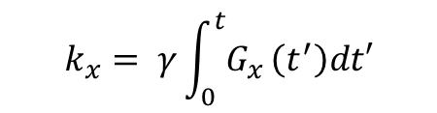


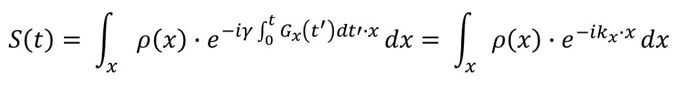



K-space
Excitation
$$S\left(t\right)$$
$$S\left(t\right)= \int_{x}{ρ\left(x\right)∙e^{−iγ\int_{0}^{t}{G_{x}}\left(t^{′}\right)dt′∙x}}dx= \int_{x}{ρ\left(x\right)∙e^{−ik_{x}∙x}}dx$$
RF
$$t$$
$$k_{x}= γ\int_{0}^{t}{G_{x}}\left(t^{′}\right)dt′$$
G_{x}
with
≡ ‘accumulated phase’ induced by gradient time course ([k]=mm⁻¹)
$$t$$
$$k_{x}=G×δ_{1}$$
$$k_{x}=G×δ_{2}$$
Excitation
Excitation
ADC (RF)
ADC (RF)
$$t$$
$$t$$
G
G
G_{x}
$$t$$
G_{x}
$$t$$
δ₁
δ₂

Slide 15
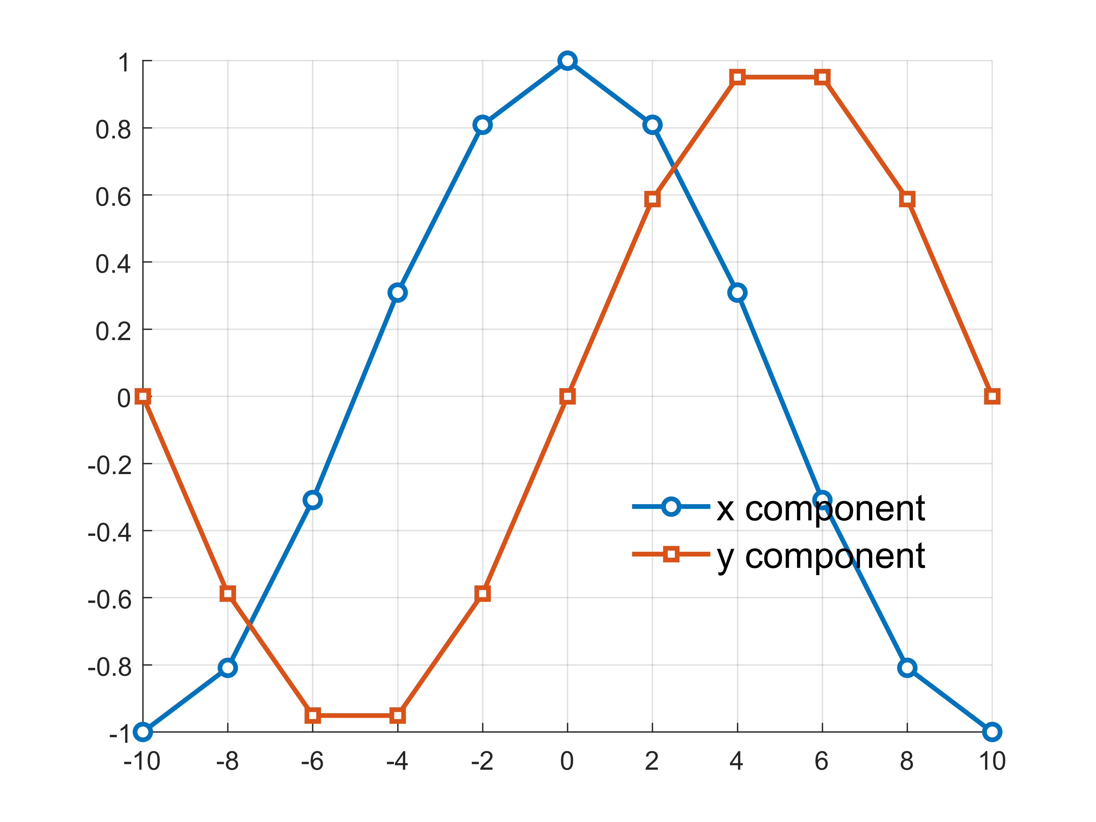
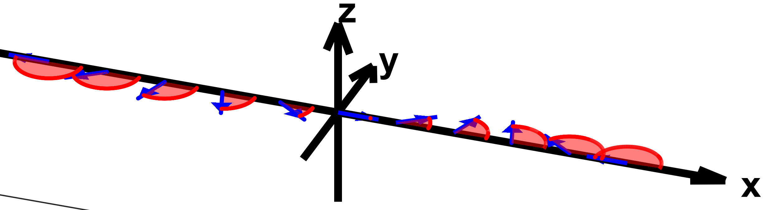











K-space
$$S\left(k\right)$$
δt
RF
$$t$$
Phase modulation
x/y components
G_{x}
$$t$$
δt
RF
G_{x}
Data point #1
$$t$$
$$k_{x1}=G×δt$$
$$x$$
G_{x}
$$t$$
δt
RF
2∗δt
$$t$$
G_{x}
Data point #2
$$k_{x2}=2×G×δt$$
$$x$$
G_{x}
$$t$$

Slide 16
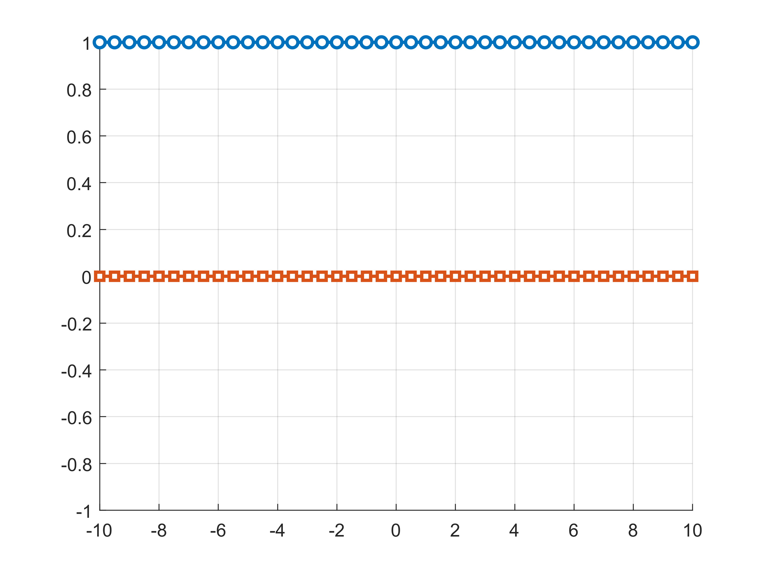
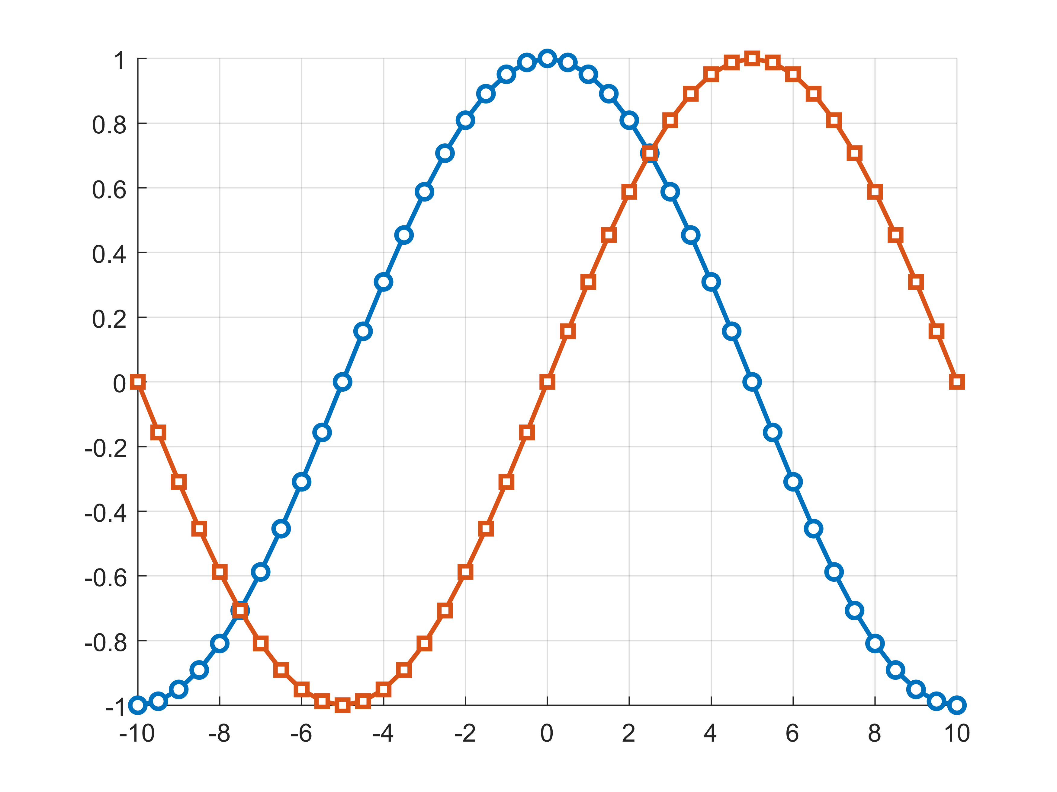
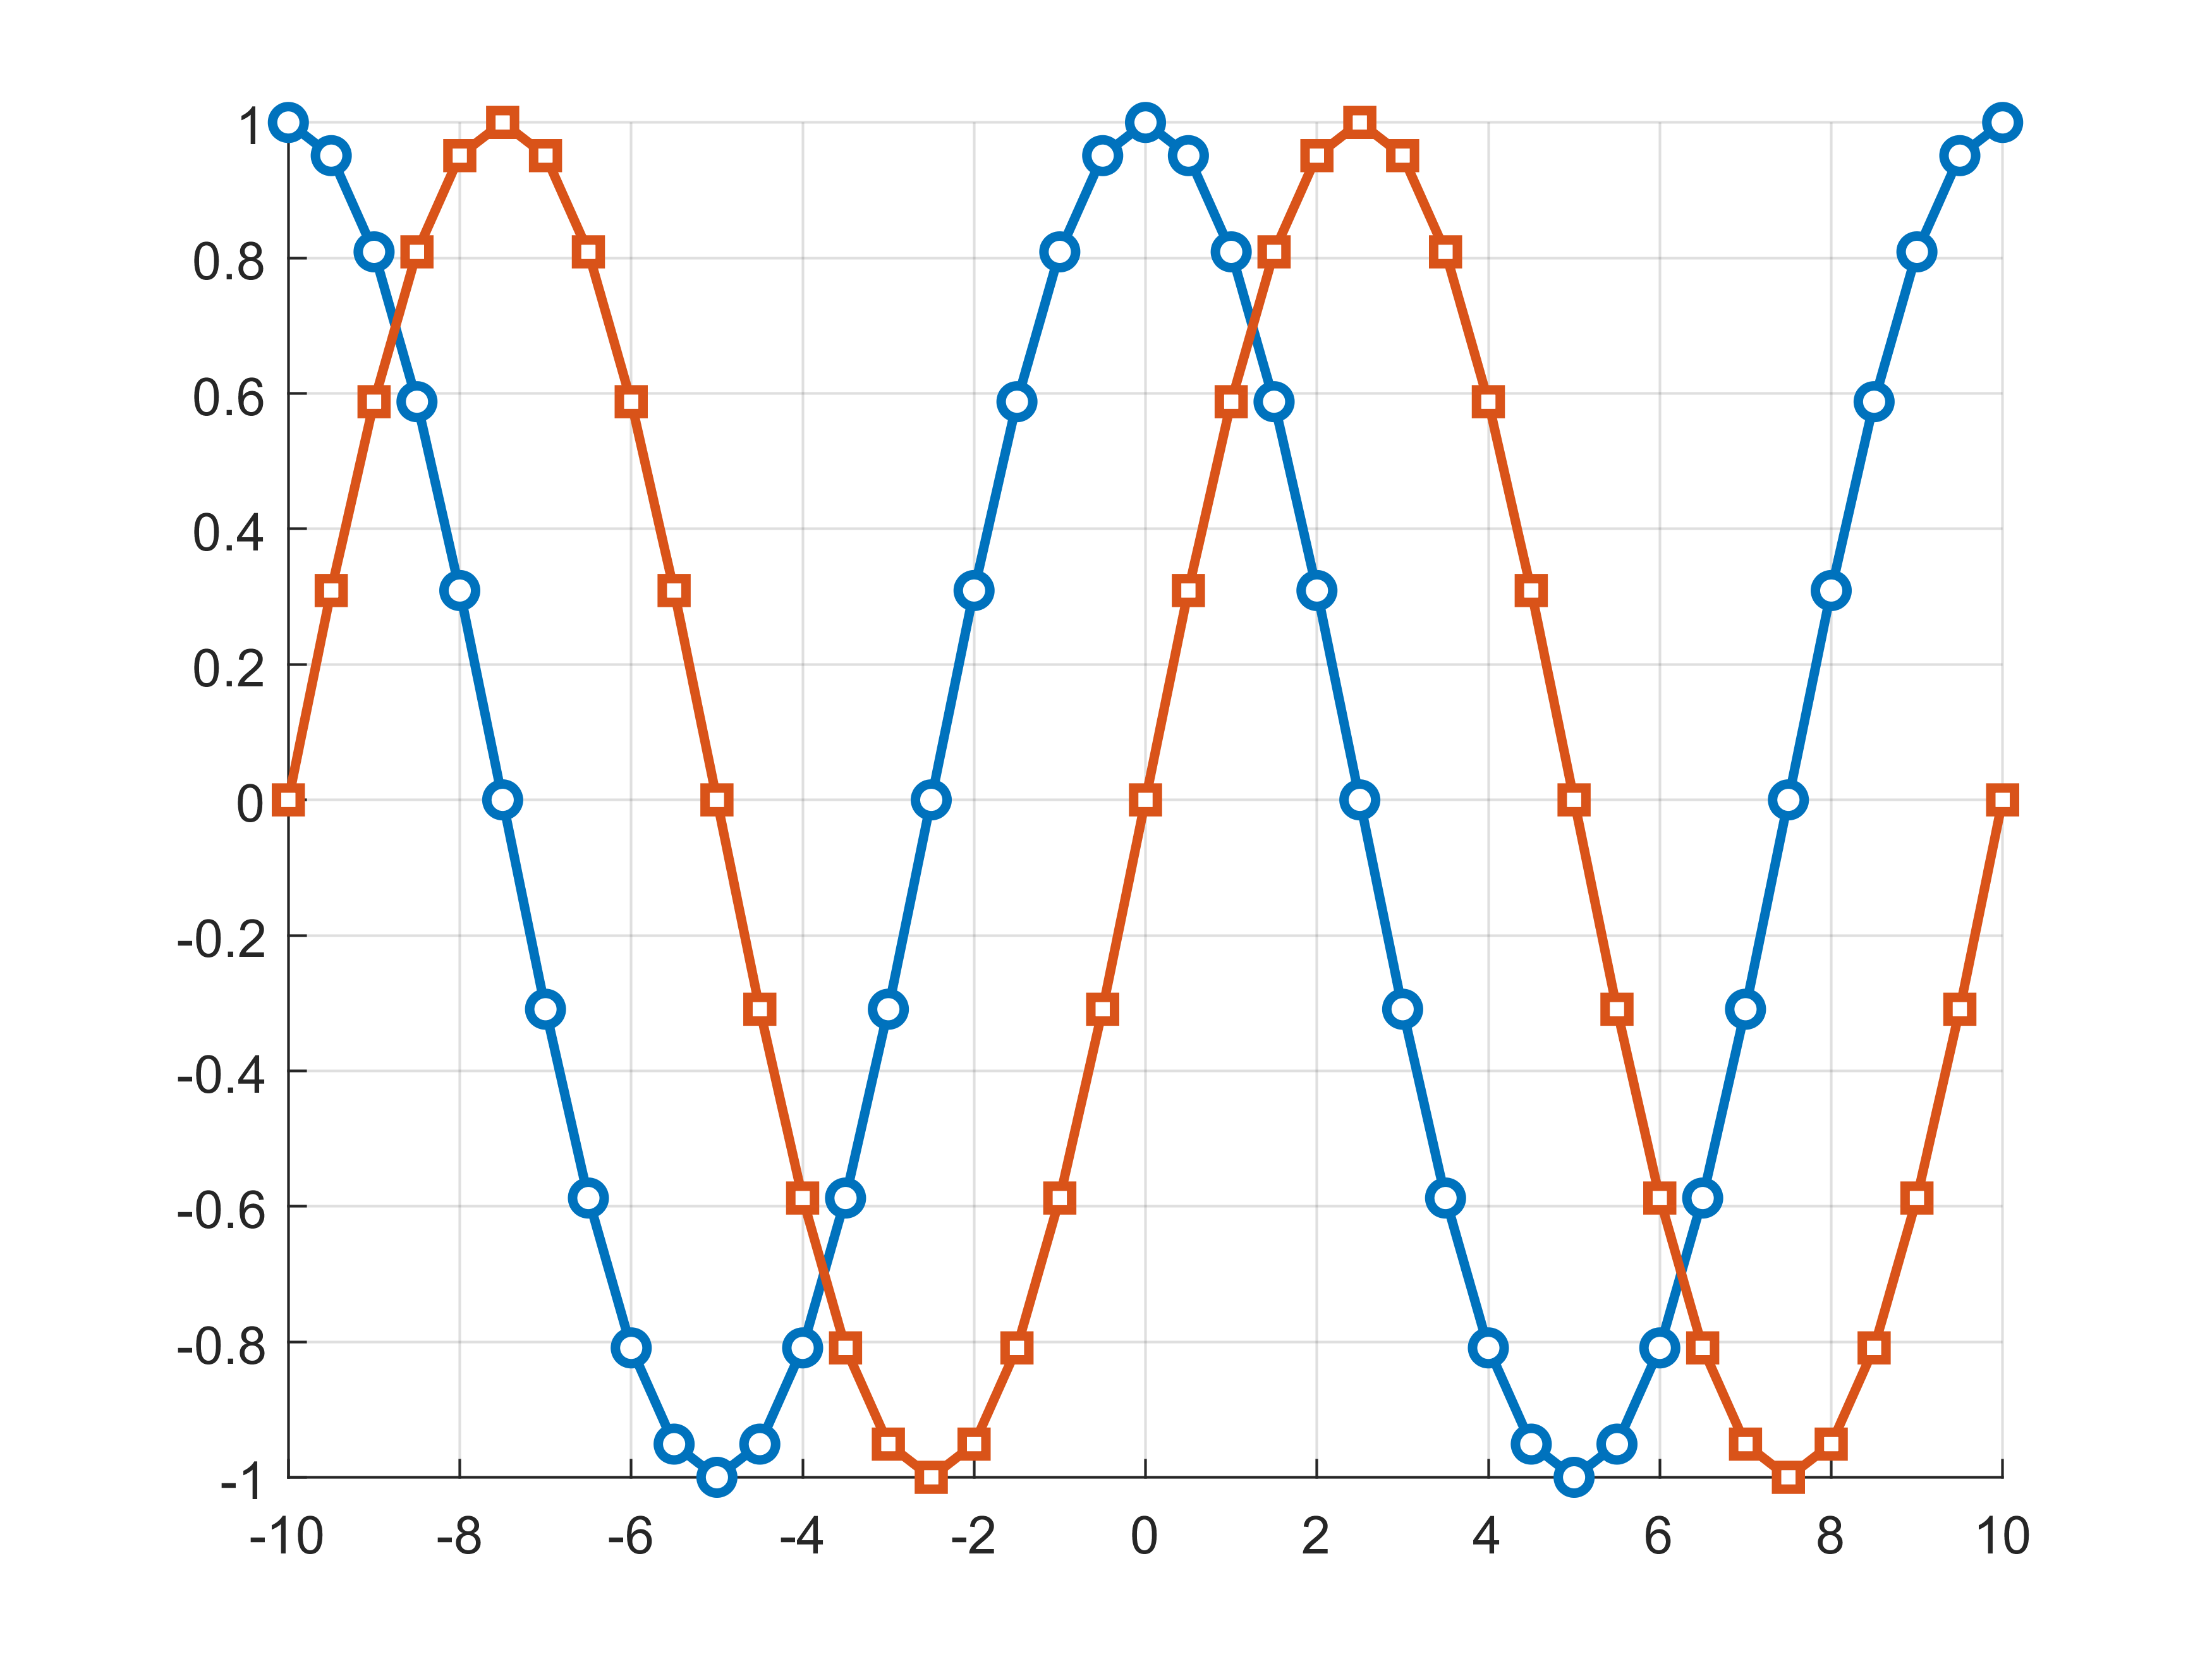
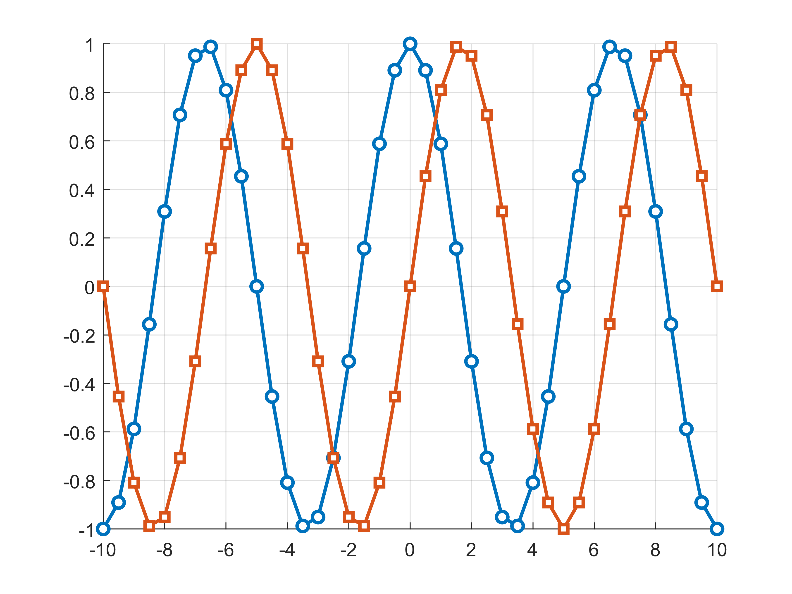



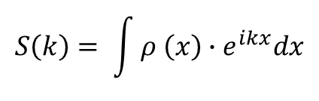


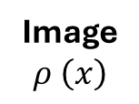

K-space
$$S\left(k\right)$$
δt
RF
$$t$$
$$S\left(k\right)= \int{ρ \left(x\right)∙e^{ikx}dx}$$
G_{x}
Image
$$ρ \left(x\right)$$
$$t$$
Raw data
$$S\left(k\right)$$
Fourier Transform (e^{-iΦ})
$$k_{x1}=G×δt$$
$$k_{x2}=2×G×δt$$
$$k_{x3}=2×G×δt$$
*
=
$$k_{x4}=4×G×δt$$
$$k_{xN}=N×G×δt$$

Slide 17
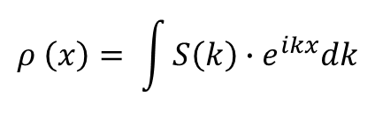

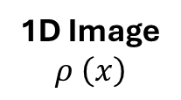
Image reconstruction
$$ρ \left(x\right)= \int{S\left(k\right)∙e^{ikx}dk}$$
Raw data
Fourier Transform (e^{iΦ})
$$S\left(k\right)$$
1D Image
$$ρ \left(x\right)$$
*
=

Slide 18
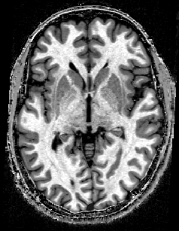
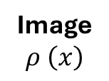

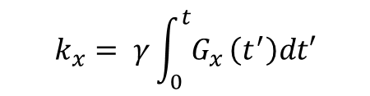
Recap
Gradients of magnetic fields modulate the phase of the magnetization
The Fourier Transform governs the relationship between the raw k-space data and its image space
Raw data
Fourier Transform (e^{-iΦ})
Image
$$ρ \left(x\right)$$
$$S\left(k\right)$$
G_{x}
=
*
$$k_{x}= γ\int_{0}^{t}{G_{x}}\left(t^{′}\right)dt′$$
≡ ‘accumulated phase’ induced by gradient time course ([k]=mm⁻¹)

Slide 19

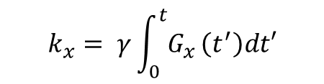




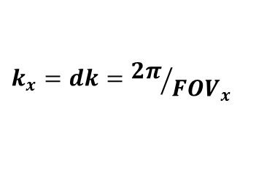


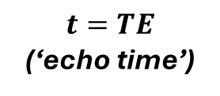







$$k_{x}=0$$
Excitation
$$ρ \left(x\right)$$
δt
RF
$$t$$
G_{x}
$$t$$
$$t=TE$$
(‘echo time’)
$$k_{x}= γ\int_{0}^{t}{G_{x}}\left(t^{′}\right)dt′$$
$$FOVx$$
$$S\left(k\right)$$
FT
$${Res}_{x}$$
=
$$1$$
$$0$$
$$k_{x}=0$$
Small k_{x} ≡ ‘low spatial frequencies’
$$1$$
$$k_{x} ∗{FOV}_{x}=2π$$
$$0$$
$$k_{x}=dk={2π}/{{FOV}_{x}}$$
$$1$$
High k_{x} ≡ ‘high spatial frequencies’
$$k_{x}∗{2∗Res}_{x}=2π$$
$$0$$
$$k_{x}=π/{{Res}_{x}}=dk∗N/2$$
$$FOVx$$

Slide 20


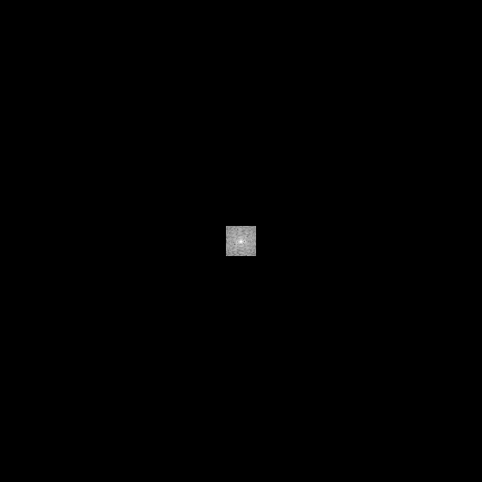
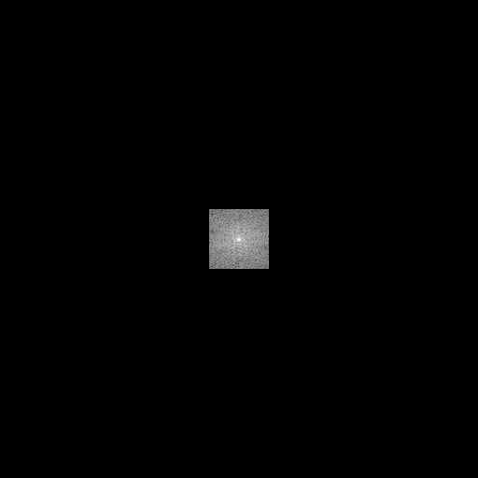
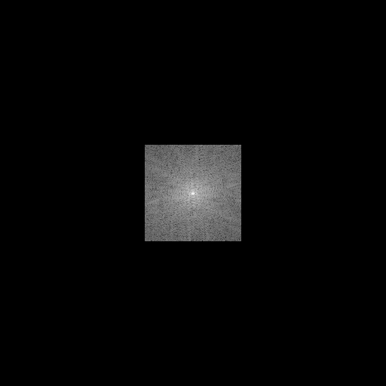
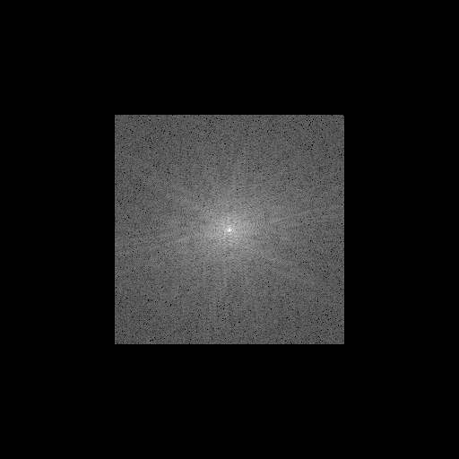

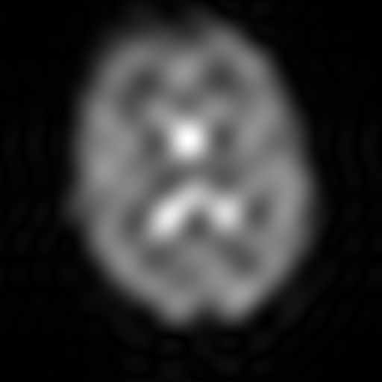
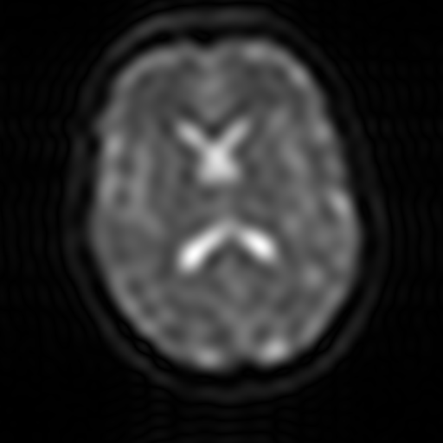


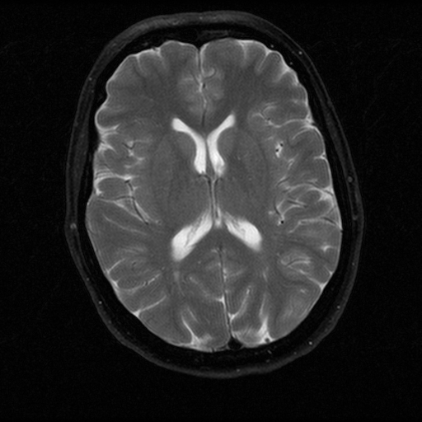
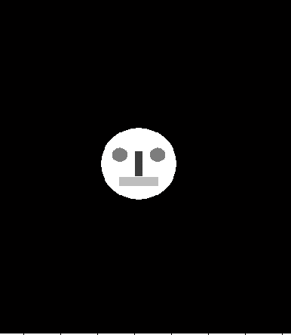

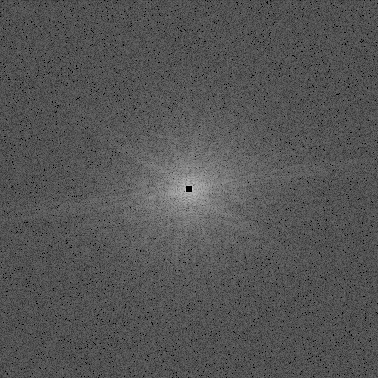

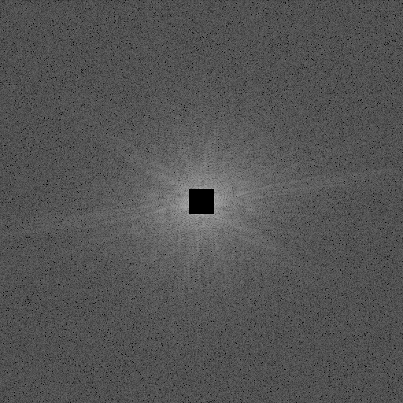









sampled k-space
reconstructed
object
512x512
512x512
k_{y}
y
k_{x}
x
k_{y}
y
k_{x}
x

Slide 21




A basic MRI sequence
Excitation
readout
RF
$$t$$
1D image
$$ρ \left(x\right)$$
G_{x}
$$t$$
B₀
2D Image
??

Slide 22








Slice-selective excitation
Slice-selective RF pulse
$$t$$
Slice-selective gradient (G_{z})
$$t$$
Slice-selective RF pulse
Slice-selective gradient (G_{z})
Slice-selective excitation
Bandwith $BW_{RF}$
$$ω\left(z\right)=\text{γ}G_{z}∗z)$$
$$G_{z}$$
$$δz$$
$$δz=\frac{BW_{RF}}{γG_{z}}$$

Slide 23






2D Image encoding
Gradient-recalled (‘GRE’) sequence
$$S\left(t\right)= \iint_{x,y}{ρ\left(x,y\right)∙e^{−ik_{x}∙x}∙e^{−ik_{y}∙y}∙dxdy}$$
$$k_{i}= γ\int_{0}^{t}{G_{i}}\left(t^{′}\right)dt′$$
with
TE
Slice-selective excitation
RF
$$t$$
Echo time TE:
G_{z}
$$k_{x}=\int_{0}^{TE}{G_{x}dt}=0$$
0
Readout gradient
G_{x}
$$t$$
0
‘Phase’ gradient
G_{y}
$$t$$
0

Slide 24




2D Image encoding
Gradient-recalled (‘GRE’) sequence
Excitation
readout
RF
$$t$$
Readout gradient
G_{x}
$$t$$
‘Phase’ gradient
G_{y}
0
$$t$$

Slide 25




2D Image encoding
Gradient-recalled (‘GRE’) sequence
TR
TR – repetition time
TR
TR
RF
t=0
t=0
t=0
$$t$$
Readout gradient
$$t$$
‘Phase’ gradient
$$t$$
y
Phase
2D FT
x
Read

Slide 26


2D Image encoding
Gradient-recalled (‘GRE’) sequence
TR
slice #1
slice #2
slice #1
RF
slice #2
t=0
G_{x}
G_{y}
Repetition of data acquisition for a given slice can be interleaved with data acquisition from other slices
TR_{effective} = Nslices * TR
Enhanced T₂ –weighted image contrast, reduced T₁ –weighted image contrast
Slice-selective excitation
~large slice thickness, imperfect slice profile
https://case.edu/med/neurology/NR/MRI%20Basics.htm

Slide 27
3D Image encoding
Gradient-recalled (‘GRE’) sequence
TR
RF
Readout direction(x)
Direction #2 (y)
MRI signal is acquired from a 3D volume during all the acquisition
Direction #3 (z)
High SNR
Increased motion sensitivity
N_{y}
NO slice-selective excitation
N_{z}
Improved anatomical accuracy

Slide 28


Echo Planar Imaging (EPI)
high imaging speed
Example applications
  Functional imaging (fMRI)
  Variation of signal intensities across repetitions ~ brain activation
  Diffusion-weighted imaging
  Variation of signal intensities across repetitions ~ fiber (orientation, diameter,…)

Slide 29
Echo Planar Imaging (EPI)
RF
phase
readout
read
‘Phase’ gradient
G_{y}
Readout gradient
G_{x}

Slide 30
Echo Planar Imaging (EPI)
RF
phase
read
‘Phase’ gradient
G_{y}
Readout gradient
G_{x}
‘Blips’ along phase (y) directions incrementally vary the modulation of the true signal distributions

Slide 31
Echo Planar Imaging (EPI)
RF
TE
phase
TE – echo time
read
‘Phase’ gradient
G_{y}
Readout gradient
G_{x}
EPI : whole 2D plane (slice) acquired following one RF excitation - FAST

Slide 32
Echo Planar Imaging (EPI)
RF
TR
RF
TR
RF
RF
TR
TR~ 50-100ms
TR_{volume} = Nslices x TR
2D Image
t

Slide 33
EPI limitations
RF
‘Phase’
Phase direction
Readout
T_{acq} ~ N_{voxels}*1ms
Bandwidth ~50Hz
Readout direction
T_{acq} ~ 1ms
Bandwidth ~1000Hz

Slide 34








EPI limitations
Image distortions
Magnetic field
Larmor frequency
Image
REMINDER
$$B\left(x\right)=B_{0}+G_{x}∗x$$
$$ω\left(x\right)=\text{γ}(B_{0}+G_{x}∗x)$$
$$ρ\left(x\right)$$
$$x= ω/(γG_{x})$$
G_{x}
x
$$ω_{min}$$
$$ω_{max}$$
$$x_{min}$$
$$x_{max}$$

Slide 35



EPI limitations
Image distortions
B₀ inhomogeneities at air/tissue interface
ω(x)=γ*(B₀+B(x) + B_{susc}(x))
150
B_{susc} (Hz)
-100

Slide 36


EPI limitations
Image distortions
150
B_{susc} (Hz)
Phase direction
-100
Bandwidth ~50Hz
Image distorsions along the phase-encode direction
Readout direction
Bandwidth ~1000Hz
blip-up
corrected
Fieldmap-based
blip-down
Distortion correction techniques
Andersson et al, 2003, Neuroimage
Hutton et al, 2002, Neuroimage

Slide 37

Image contrast
Return to equilibrium
M₀
M₀
M₀
RF
After RF excitation M₀ returns to its initial state (equilibrium)

Slide 38
Image contrast
Return to equilibrium
M_{l}
M₀
M_{t}
RF
t
M_{l}
M₀
M_{l}
Equilibrium
Equilibrium

Slide 39
Image contrast
Return to equilibrium
M_{l}
M₀
M_{t}
RF
T₂
T₁
t
Following RF excitation M₀:
- Longitudinal component of M₀ increases. Recovery time T1
- Transverse component of M₀ decreases. Decay time T2

Slide 40



T2* image contrast
Signal intensity decreases with increasing echo time
T₂
RF
TE: echo time
TE

Slide 41

T2* image contrast
RF
TE
TE << T2
proton density-weighted image
TE ~ T2
T2-weighted image
Image contrast is TE-dependent

Slide 42

T2* image contrast
Caudate Nucleus / GM
(T₂=100ms)
CSF
(T₂=2000ms)
M_{xy}
100%
CSF
WM
37%
GM
time
Corpus Callosum / WM
(T₂=90ms)
T_{2,CSF}>T_{2,GM/WM} => On T₂-weighted images, CSF appears bright
WM and GM have similar T₂ values => low WM/GM contrast in T₂-weighted images

Slide 43
Longitudinal relaxation
M_{l}
M₀
M_{t}
Return to equilibrium:
Increase of longitudinal component time constant T₁
REMINDER
T₁
RF
t

Slide 44

Longitudinal relaxation
A simple imaging acquisition:
RF
TR
RF
TR
RF
Image
Image
t
T₁
T₁
T1 relaxation during TR governs amount of magnetization available for next excitation

Slide 45

Longitudinal relaxation
WM
GM
CSF
T1 differences between brain tissues yield image contrast in anatomical imaging

Slide 46

PD contrast – long TR
WM
TR >> T1:
  All tissues fully relax
    No T1w contrast
  Image contrast: water density
  PDw contrast
Inconveniences:
  Very time consuming
  Fairly poor GM/WM contrast
GM
CSF

Slide 47

T1 contrast – short TR
TR<<T1
WM
GM
CSF
Optimal GM/WM contrast
Generally preferred for anatomical imaging
Frahm J. et al. MRM 1986
47

Slide 48

T1 contrast – short TR
RF (α)
TR
RF (α)
TR=20ms
t
WM
GM
α=6º
PDw
α=20º
T1w
CSF
At short TR, image contrast depends on nominal flip angle of RF excitation

Slide 49
Conclusions
Principles of image encoding
The role of image encoding gradients
K-space and Fourier Transform
G_{x}
Image
$$ρ \left(x\right)$$
Raw data
=
*
Slides: José Marques, Nicolas Kunz, Assaf Tal, Mor-Miri Mishkovsky

Slide 50
Conclusions
Gradient-recalled (‘GRE’) sequence
Image contrast
T₂-weighted image
TR
RF
Readout direction(x)
PD-weighted image
T₁-weighted image
Direction #2 (y)
Direction #3 (z)
N_{y}
N_{z}
Slides: José Marques, Nicolas Kunz, Assaf Tal, Mor-Miri Mishkovsky

