Slide 2
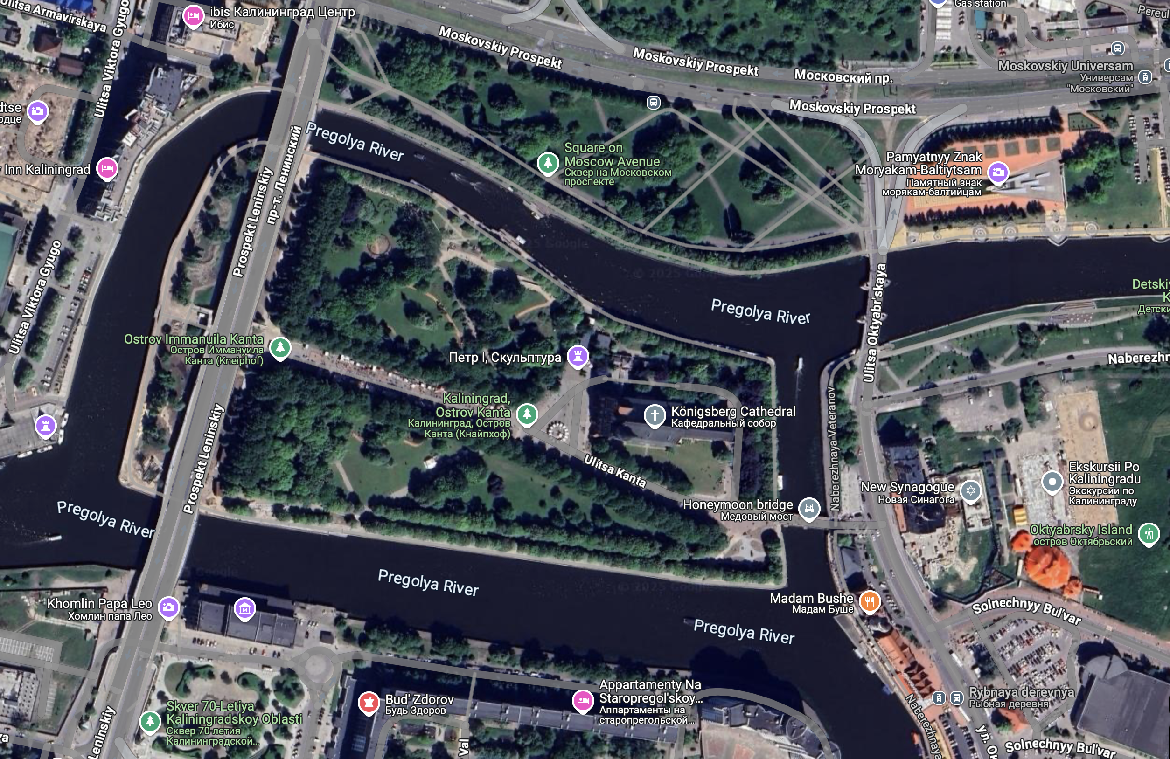

Slide 3
H. Zhang et al. Nature Physics 5, 438 (2009)

Slide 4
Bi
Sb
L. Fu, C. L. Kane, PRB 76, 045302 (2007)

Slide 6
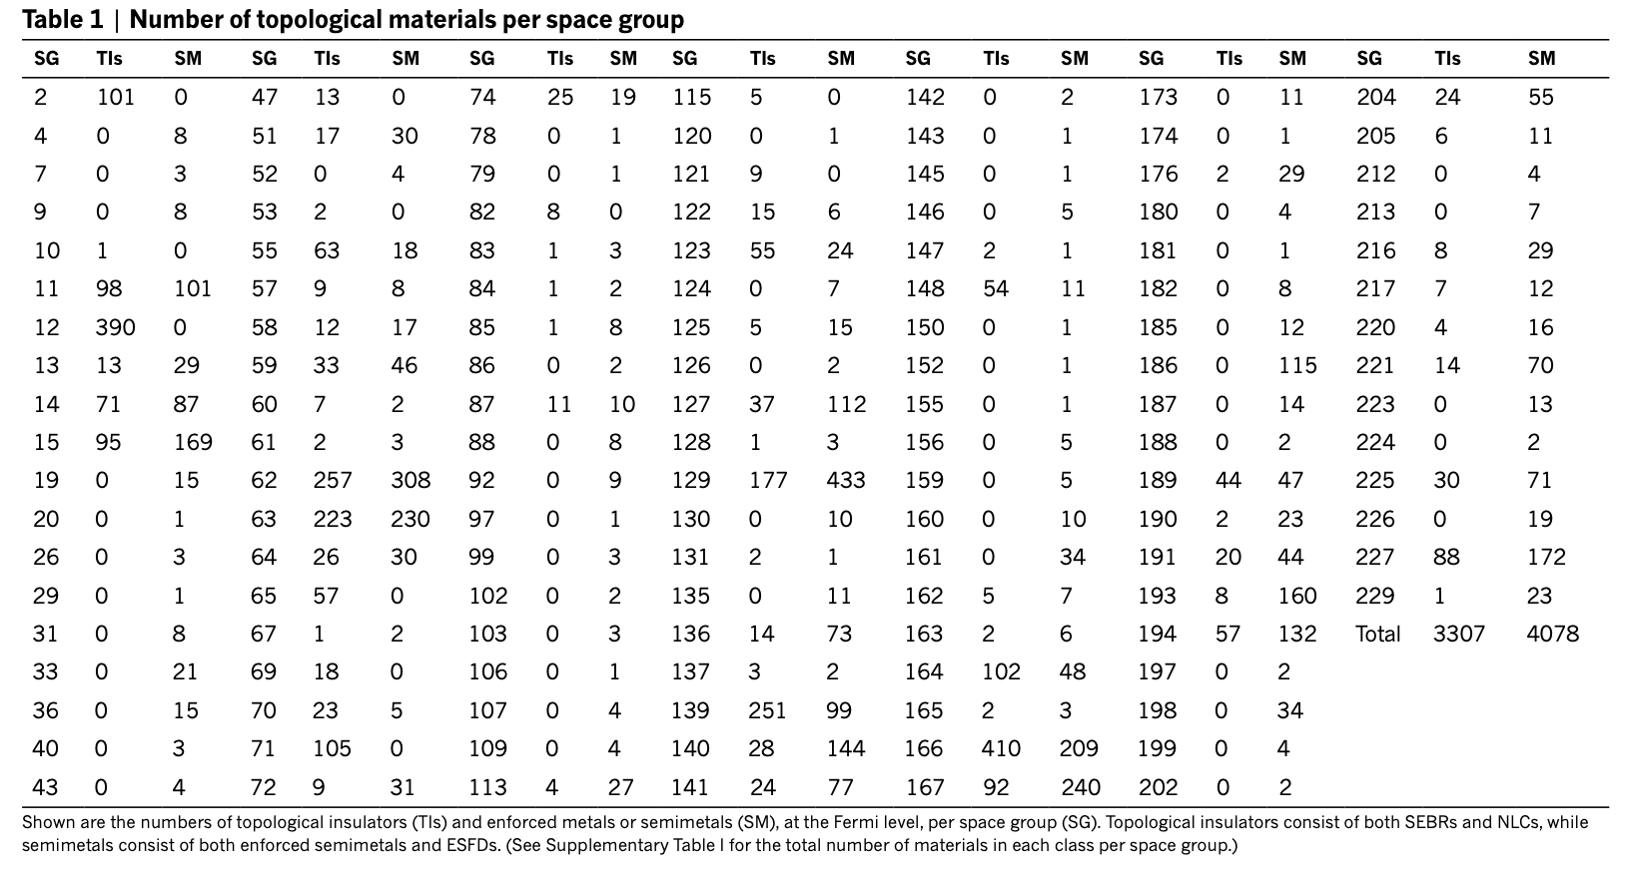
“Our results show that more than 27 per cent of all materials in nature are topological.”
Much more if higher-order topological insulators and larger region around Fermi level is included (Latest count: 24,825 total, 8,370 trivial insulator, 4,321 topological insulator, 10,007 topological (semi)metal, for ~2,000 more detailed calculation needed)
What is a normal metal?
M. Vergniory et al, Nature 566, 480 (2019)

Slide 7
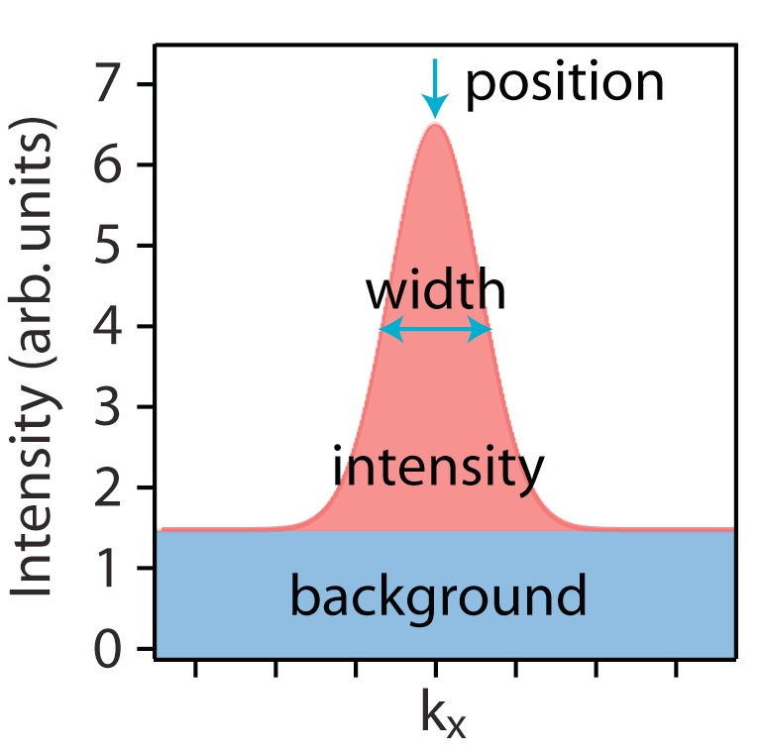
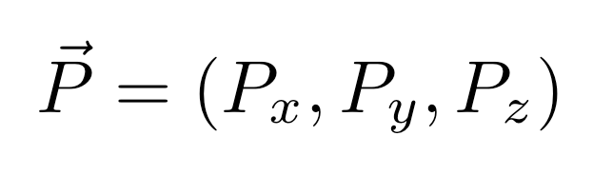
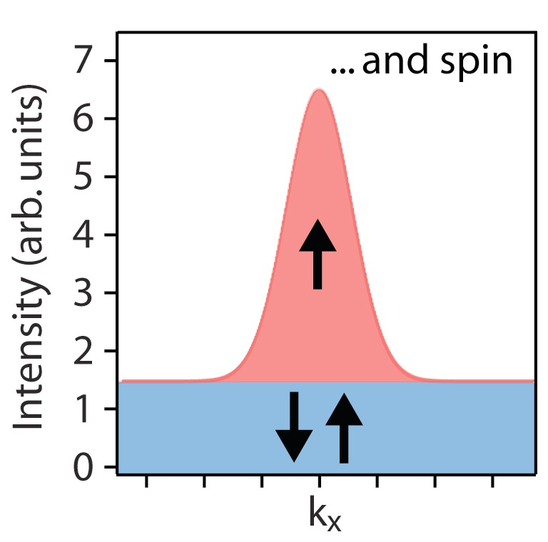
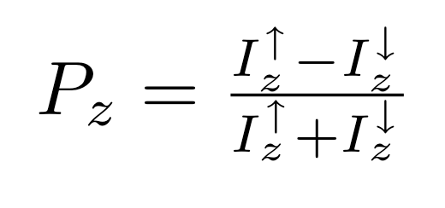
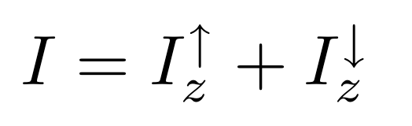
The “observables” in photoemission
Position:
• E(k)
• many-body interactions
Re(Σ(E, k))
Width and peak shape:
• many-body interactions
Im(Σ(E, k))
photohole lifetime
Intensity:
• matrix elements
• wave functions
Background:
• inelastic processes
• many-body interactions
Spin polarization vector
e.g. expectation value
of z-component:

Slide 8
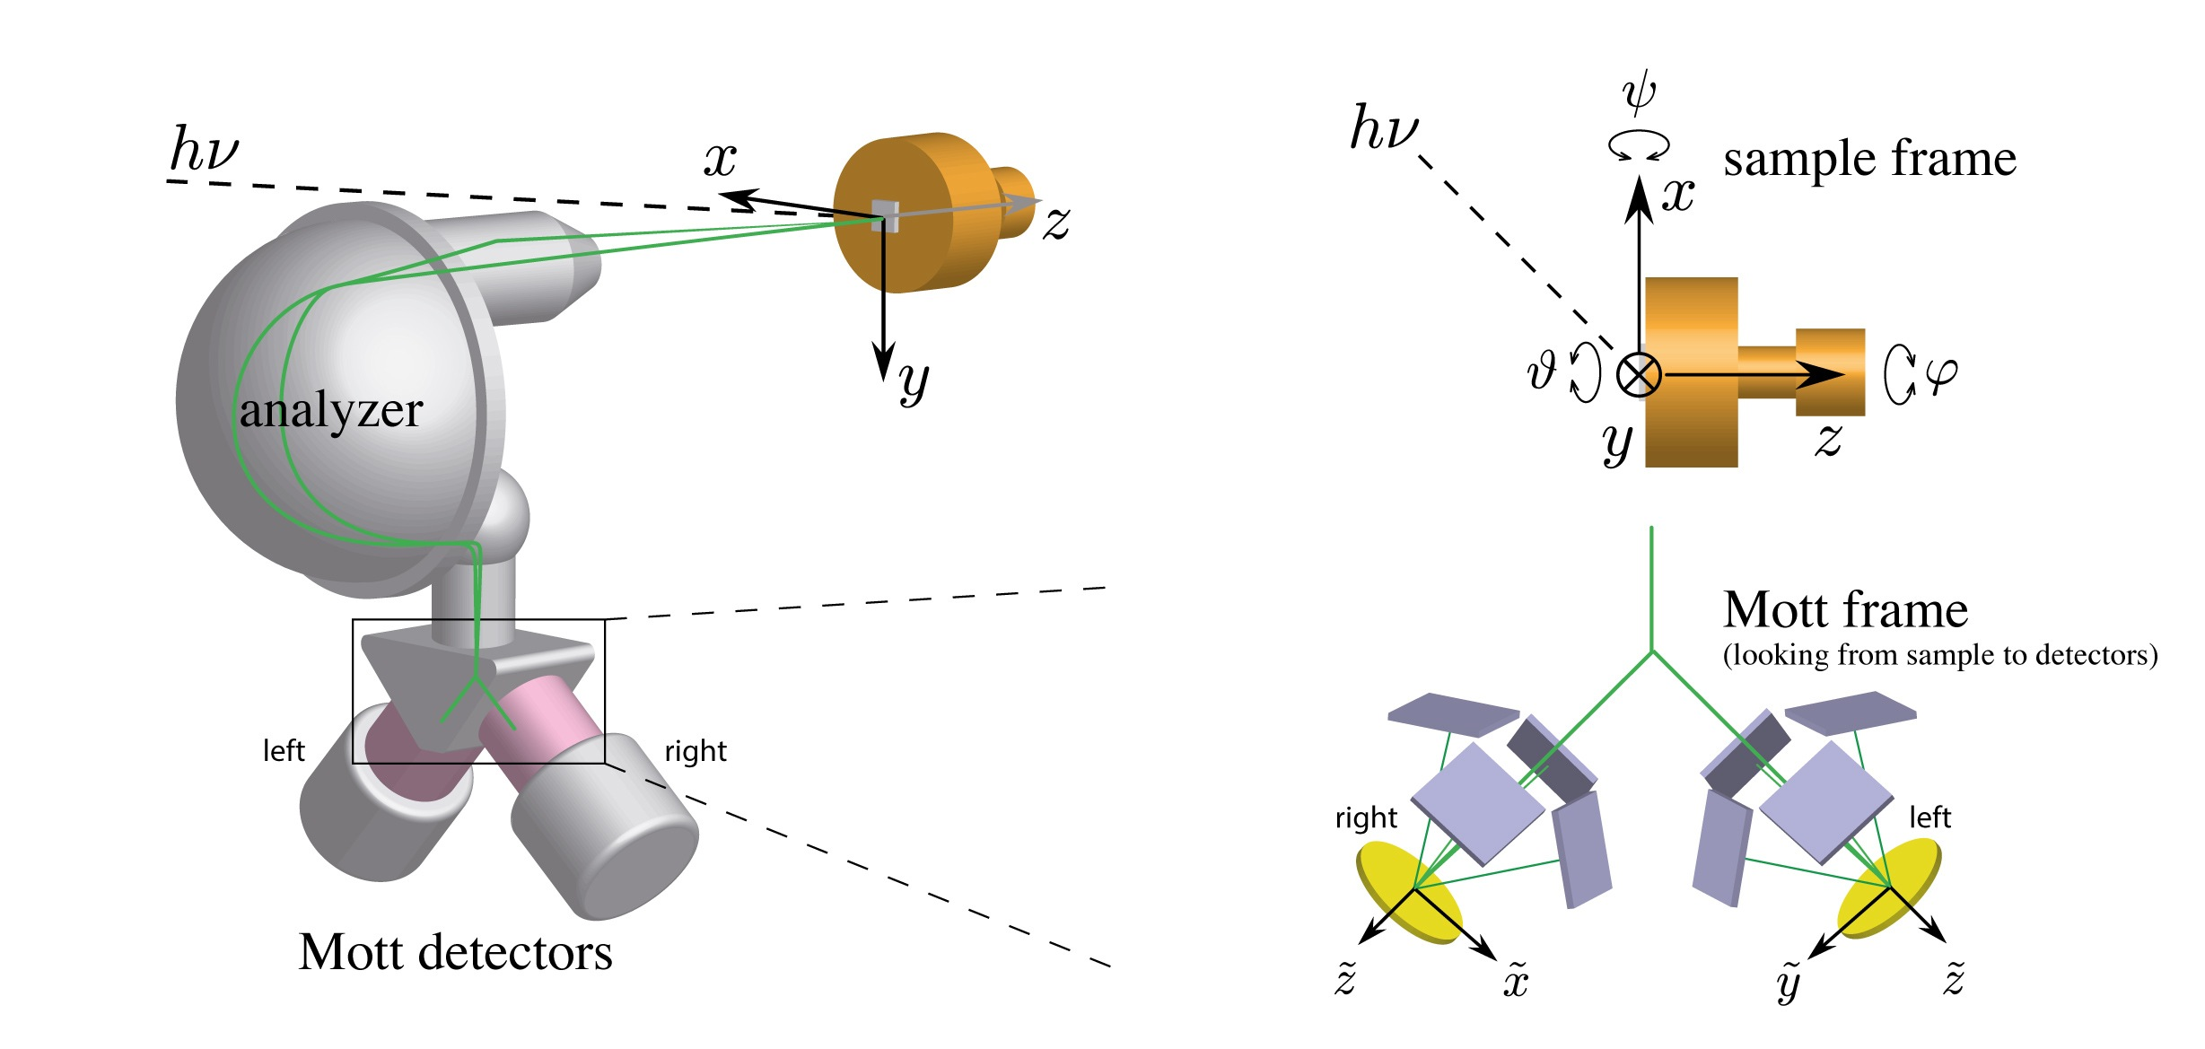
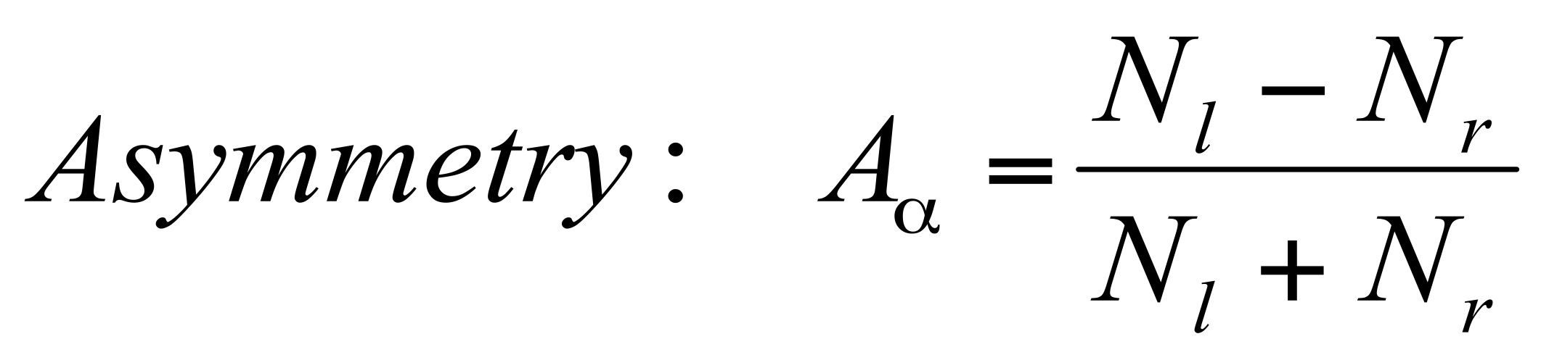
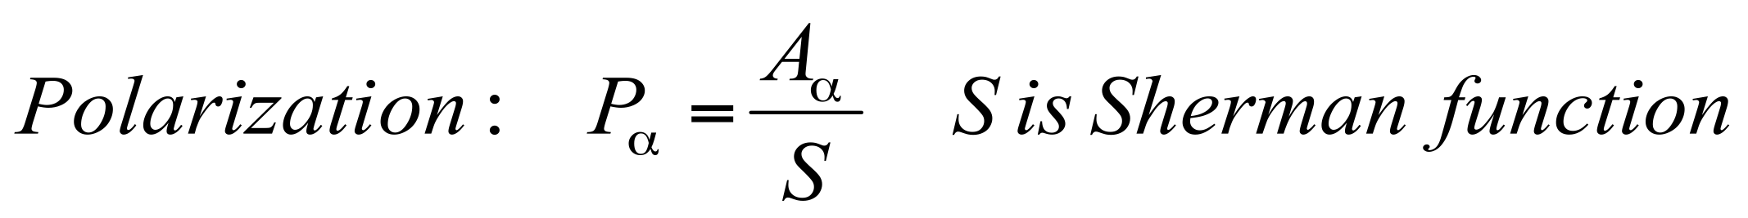
COPHEE at the Swiss Light Source
COPHEE = The COmplete PHotoEmission Experiment
Two orthogonal classical (40 kV) Mott detectors
Access to “all” quantum numbers of the electron: energy, momentum (3D) and spin (3D)
High resolution ARPES at SIS (Scienta R4000, 10K)
Soft X-ray ARPES at ADRESS (Phoibos 150, 10K)
For reviews on SARPES on SOI systems see: J. H. Dil J. Phys.: Cond. Matt. 21, 403001 (2009)
and U. Heinzmann and J.H. Dil, J. Phys.: Cond. Matt. 24, 173001 (2012)

Slide 9
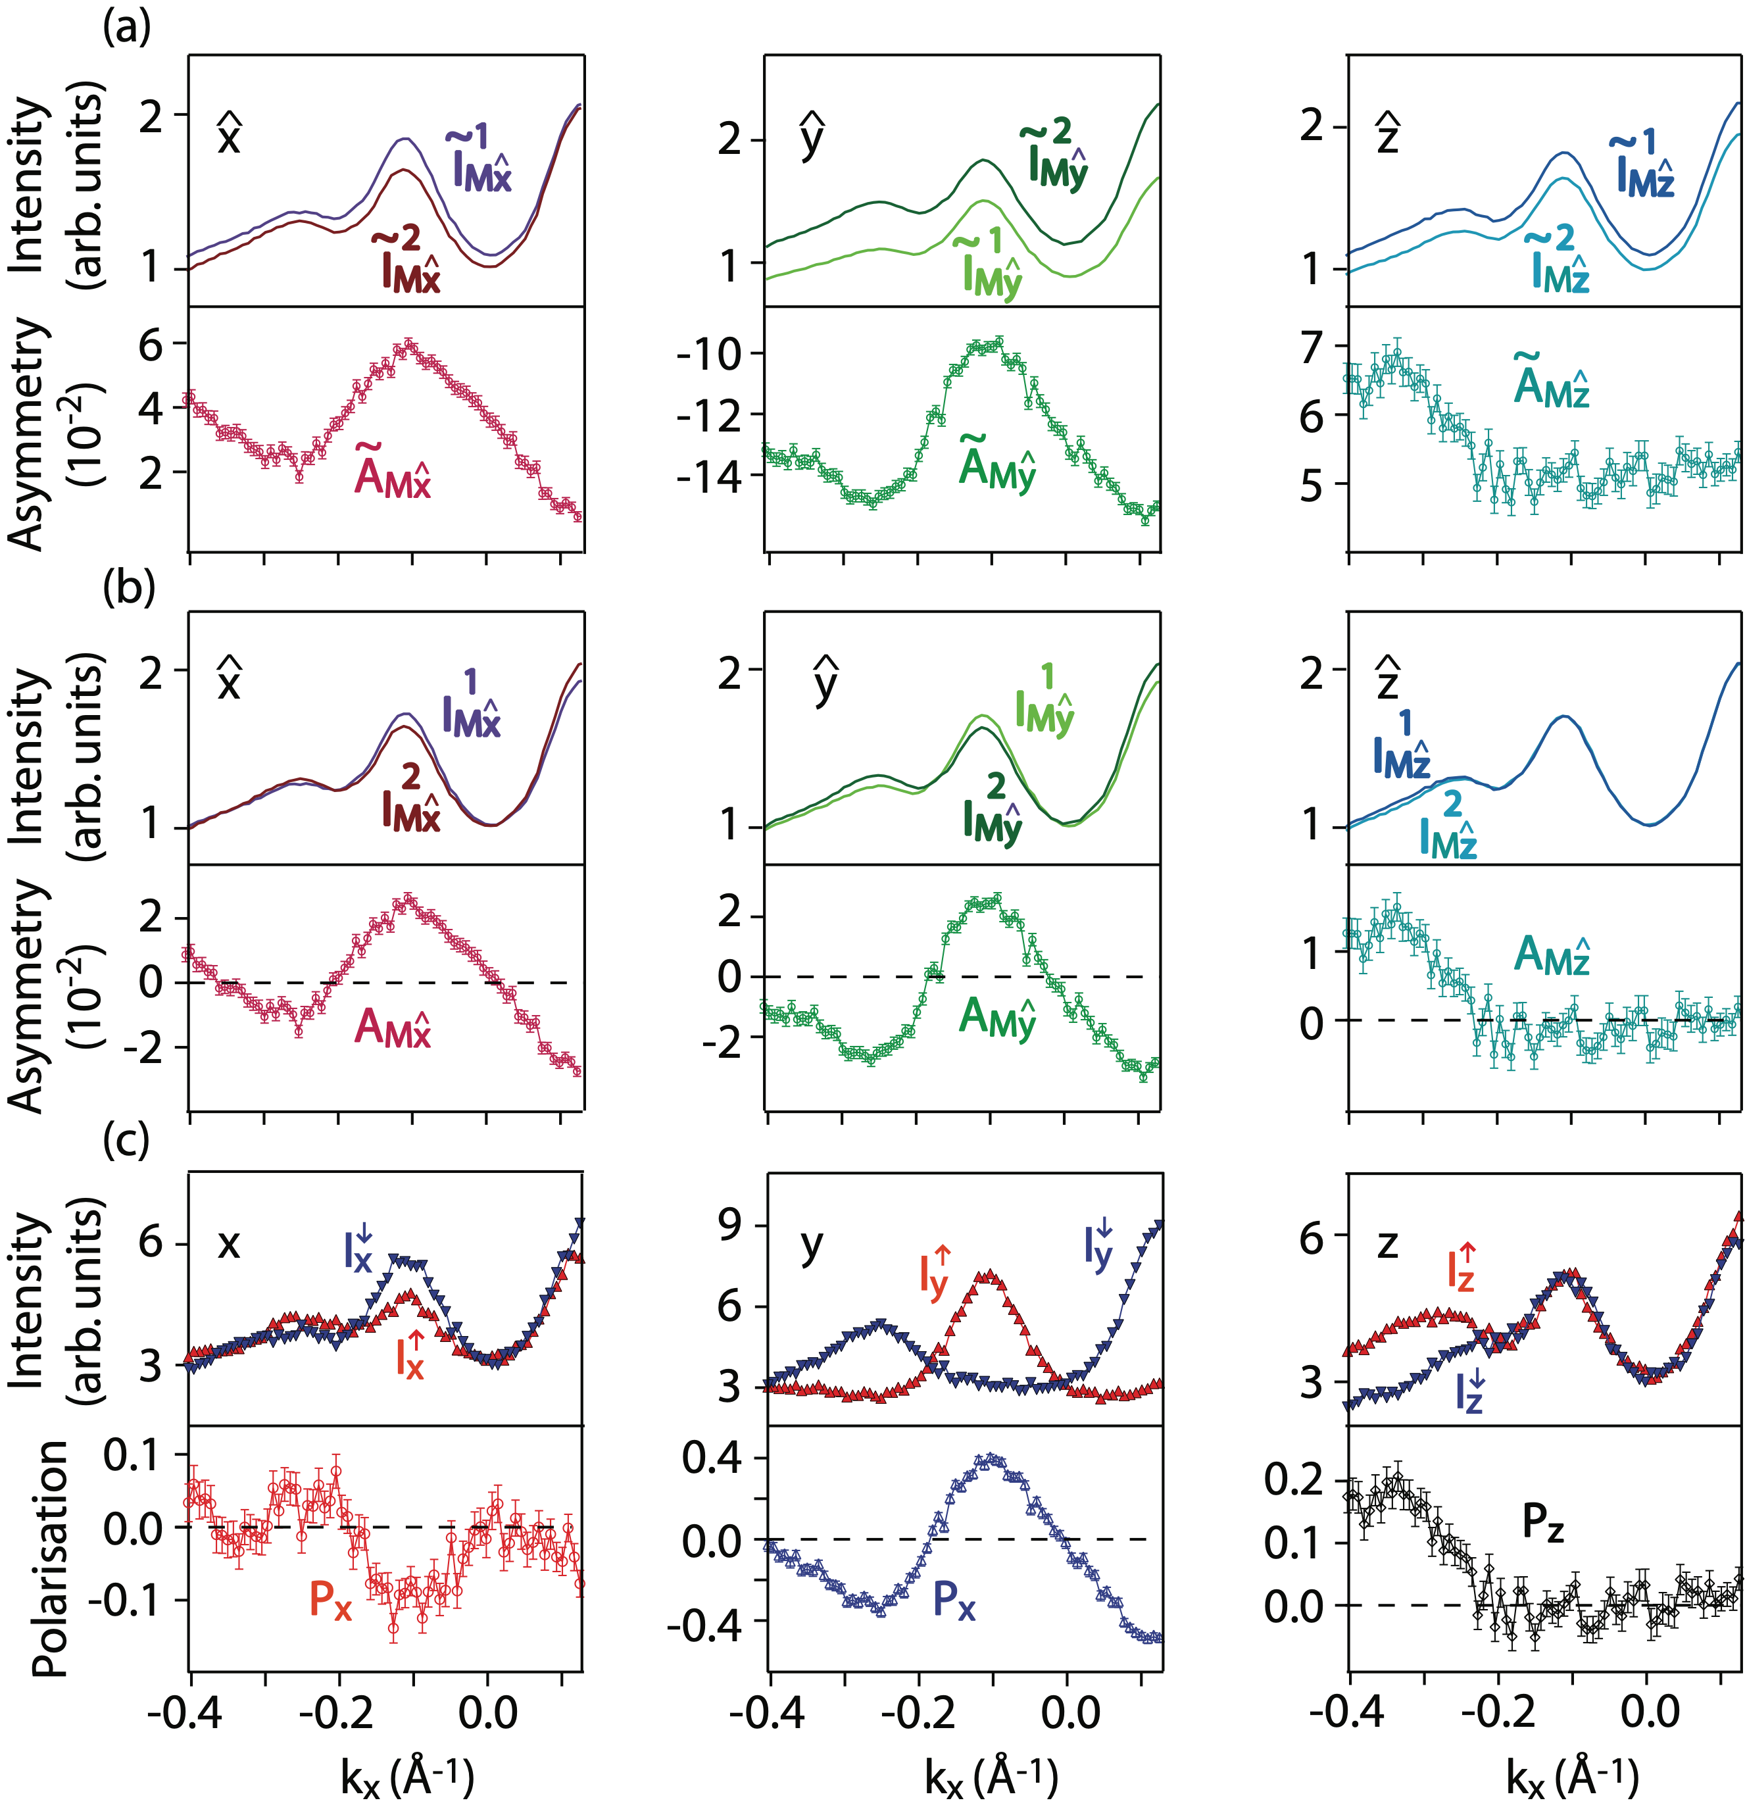

From raw data to spin polarization
Instrumental asymmetries:
efficiency of individual counters
Coordinate transformation
from Mott to sample.
Sherman function (~10%)
Py

Slide 10
Sources of spin polarization in SARPES
“All” photoelectrons are highly spin polarised
Spin polarized initial states (this is what we typically want to measure):
Magnetic systems
Spin-orbit interaction (Rashba, topological insulators)
Photoemission induced effects:
Change of initial state spin: spin interference, geometry induced effects, …
Spin induced in spin-degenerate initial state: geometry effects, dipole selection rules, interference of transitions, …
  For a review: U. Heinzmann and J.H. Dil, J. Phys.: Condens. Matter 24, 173001 (2012)

Slide 11
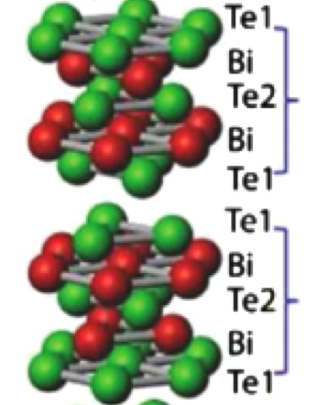
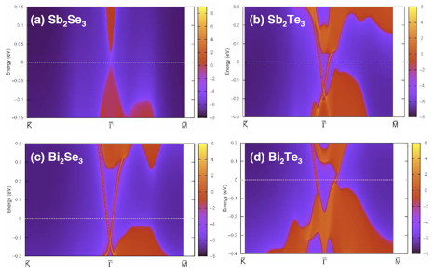
3D topological insulators
The second generation: Bi₂Se₃ and related compounds
Layered crystal structure
Large energy gaps:
Bi₂Se₃: 350 meV
J. Black et al., J. Phys.
Chem. Solids 2, 240 (1957)
Bi₂Te₃: 180 meV
G. A. Thomas et al., PRB 46, 1553 (1992)
Predicted to be room temperature topological insulators
H. Zhang et al., Nature Physics 5, 438 (2009)
• Only a single, non-degenerate (spin-polarized) surface state

Slide 12
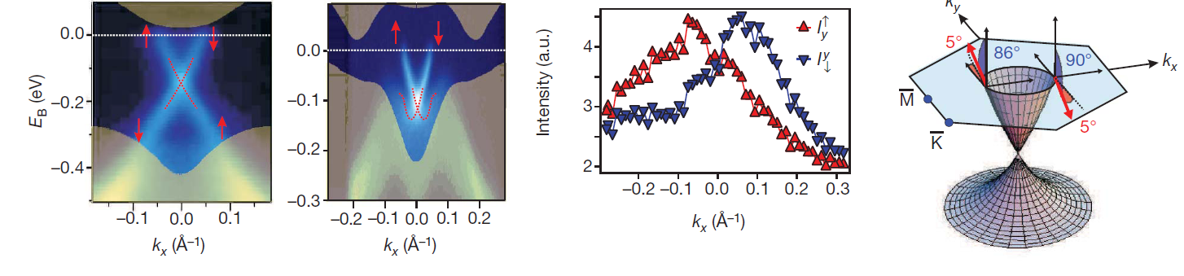
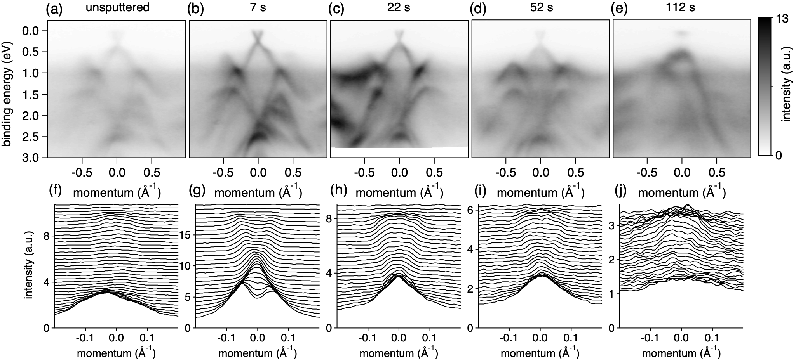
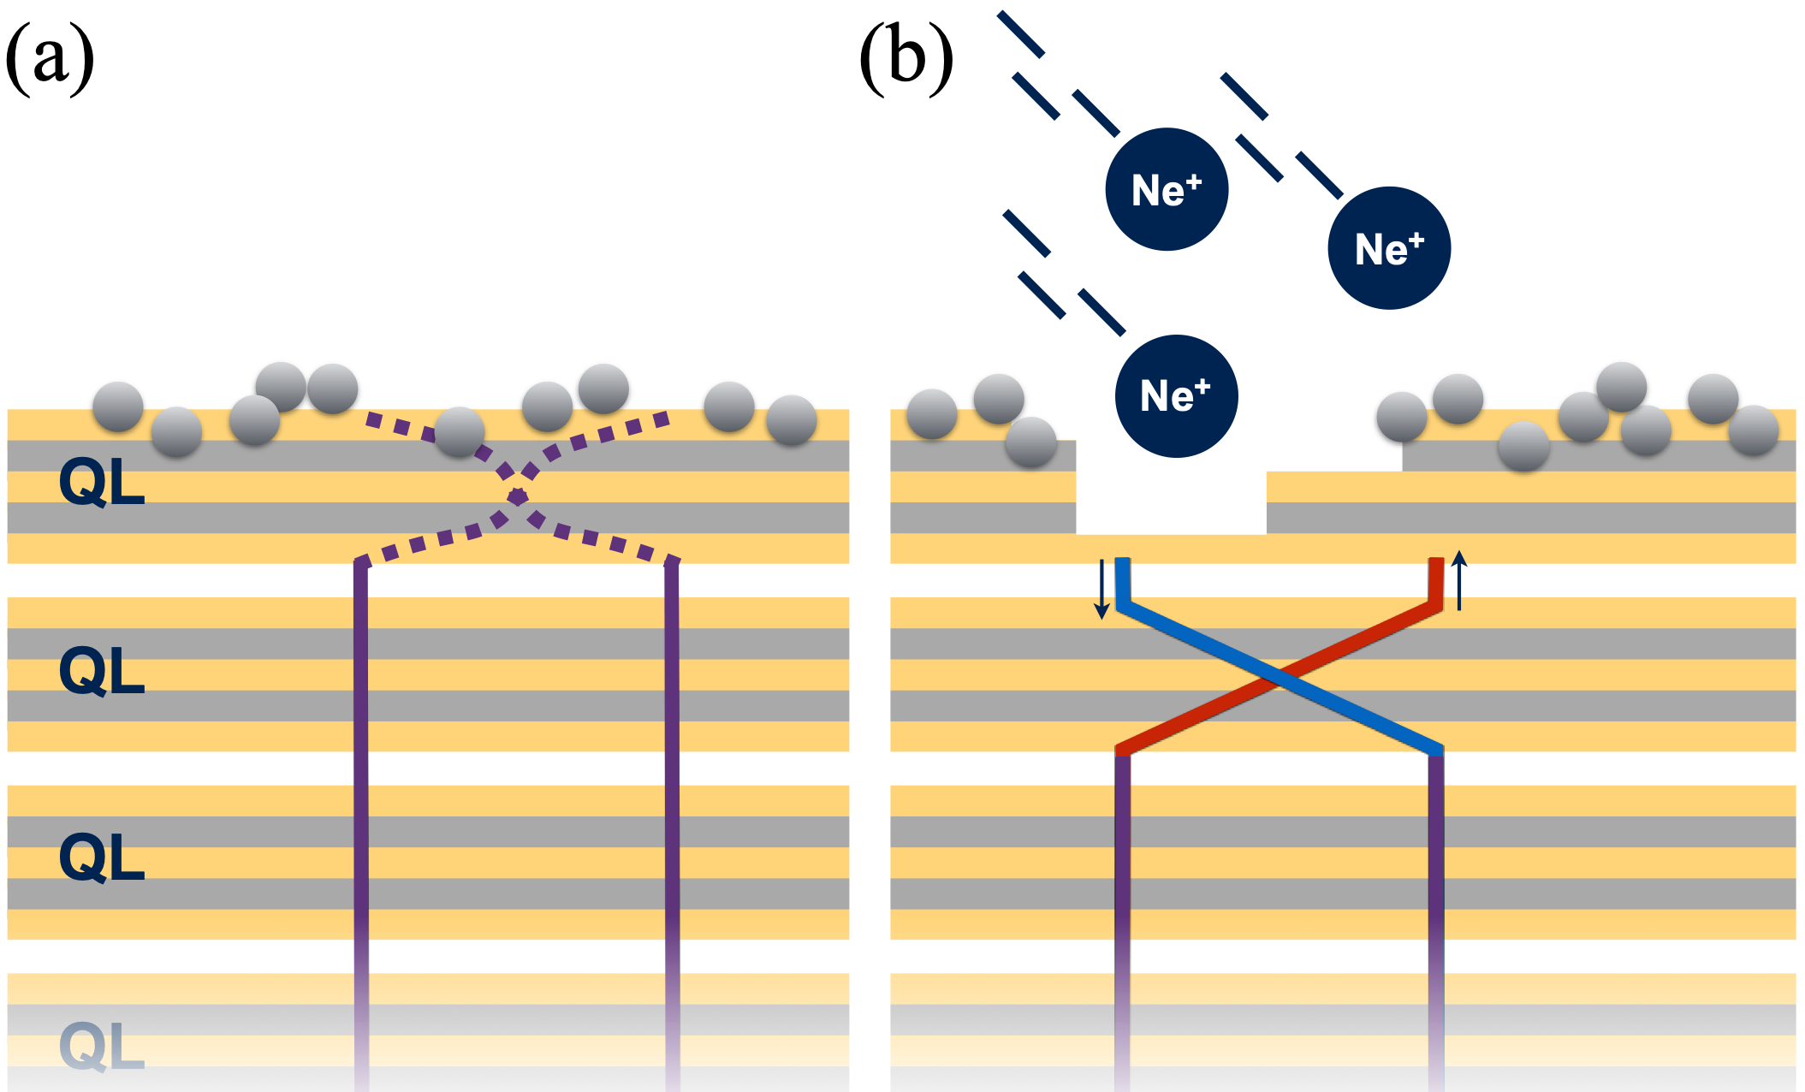
Main properties of 3D topological insulators
1. Topological protection in reciprocal space: spin-polarised Dirac cone
D. Hsieh et al., Nature 460 (2009) and many others since then
2. Topological protection in real space
R. Quieroz et al PRB 93, 165409 (2016)

Slide 13
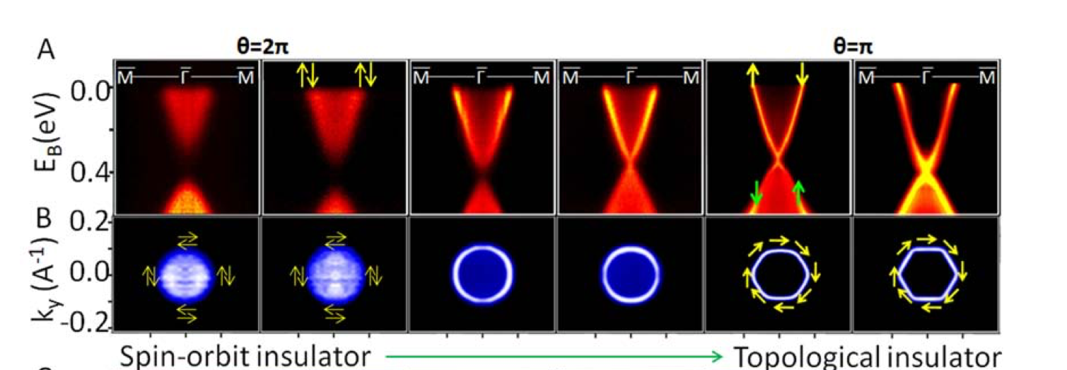
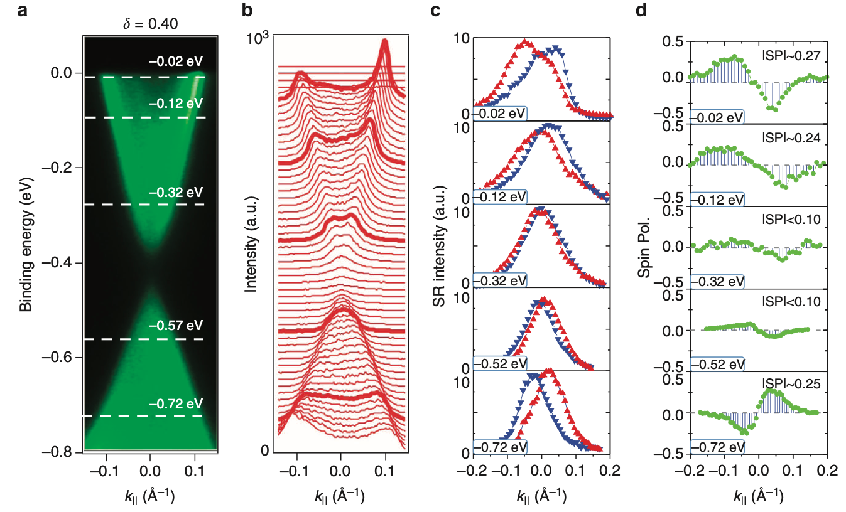
3. Topological transition
TlBi(S(1-x)Sex)2
Go through topological transition by changing strength of SOI
S-Y Xu et al. Science 332, 560 (2011)
TlBiS2
TlBi(S(1-x)Sex)2
TlBiSe2
Close to transition (on trivial side) states are already spin polarised
Topological transition is smooth!
S-Y Xu et al. Nature Communications 6, 6870 (2015)

Slide 14
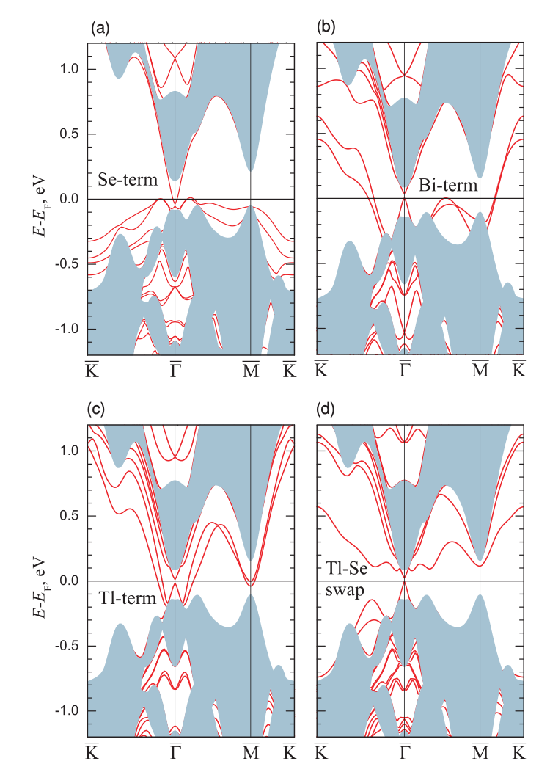
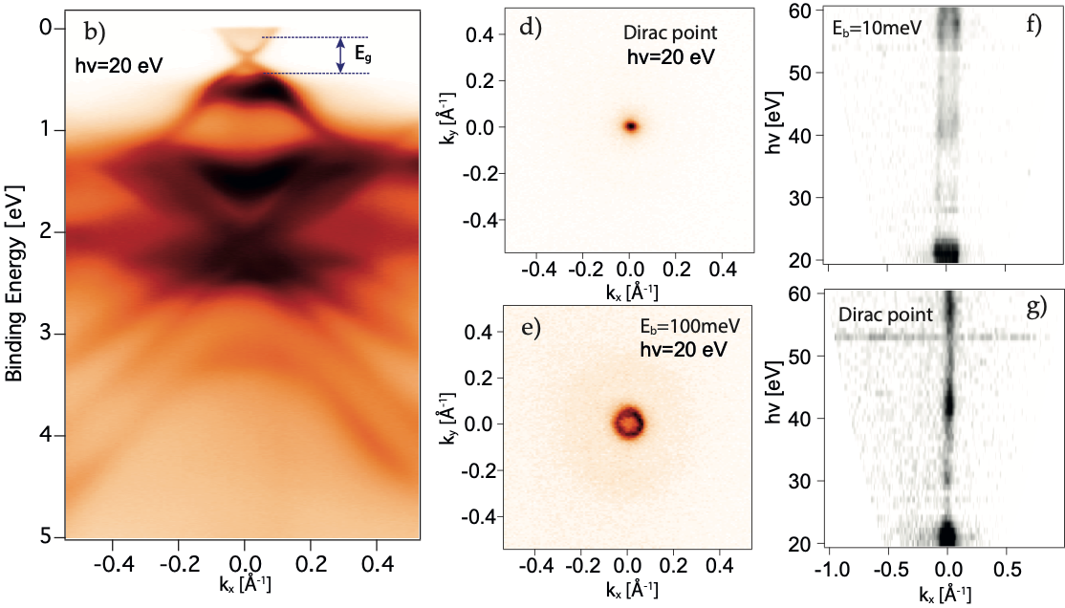
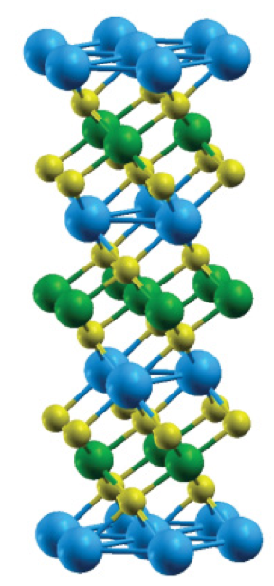
Topological protection: TlBiSe2
No trivial SS in ARPES
TlBiSe2
All calculations also show trivial surface states
S.V. Eremeev et al. PRB 83, 205129 (2011)

Slide 15
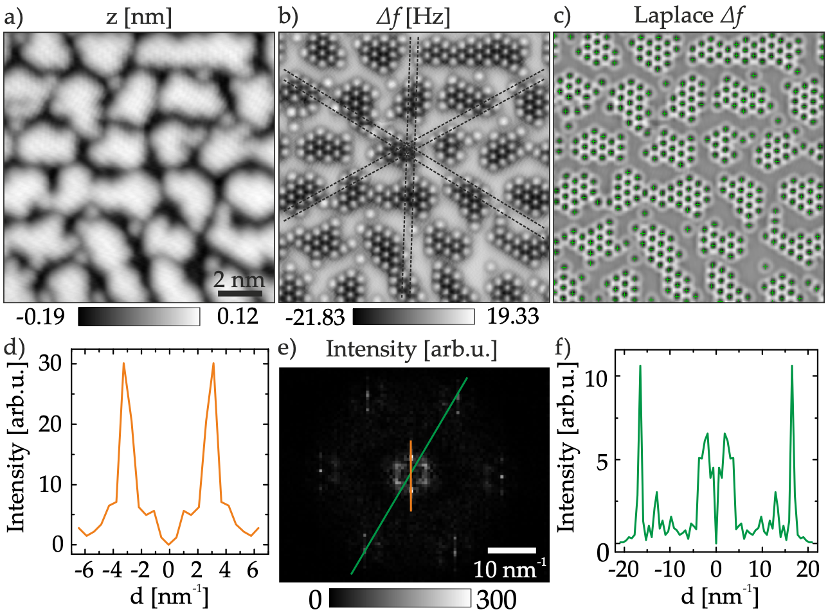
Detailed structure determination
Combined STM and AFM
Clear atomic structure in AFM
50% of top Tl atomic layer left
TlBiSe2
Crystalline patches are too small for electronic structure to form:
no trivial surface states
becomes topologically trivial and interface shifts down
F. Pielmeier et al. NJP 17, 023067 (2015)

Slide 16
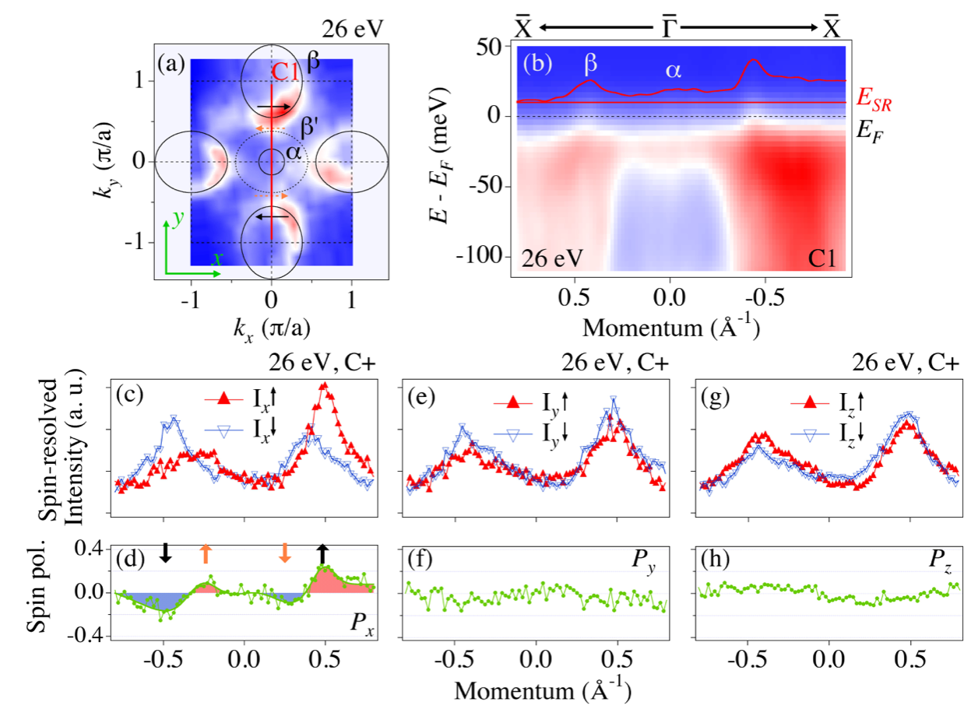
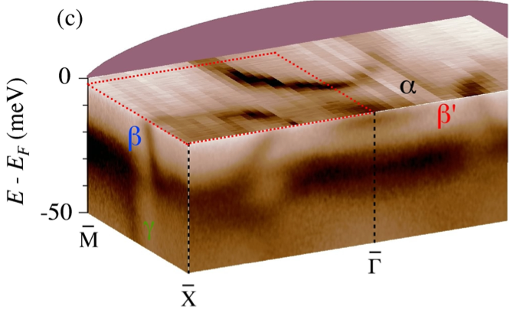
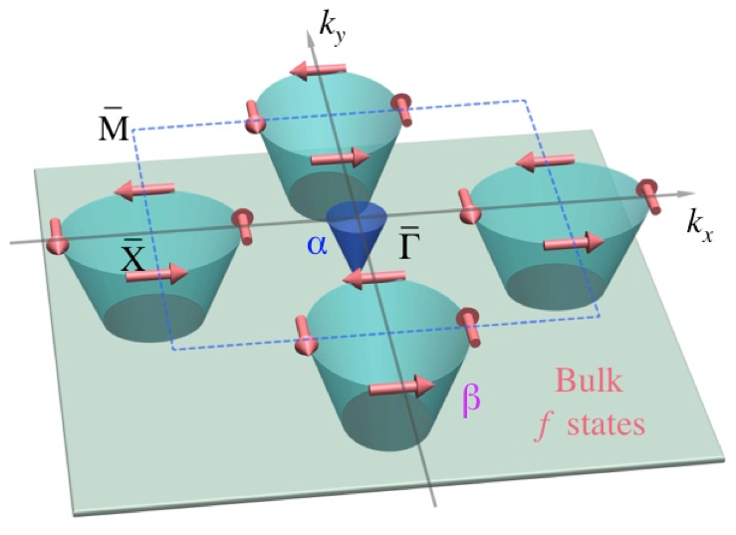
SmB6 a topological Kondo insulator
Band gap (40 meV) by definition always around Fermi level due to Kondo effect
Spin polarised topological surface states in band gap
No sign of correlations in the spin structure
N. Xu et al. Nature Communications 5, 4566 (2014).

Slide 17
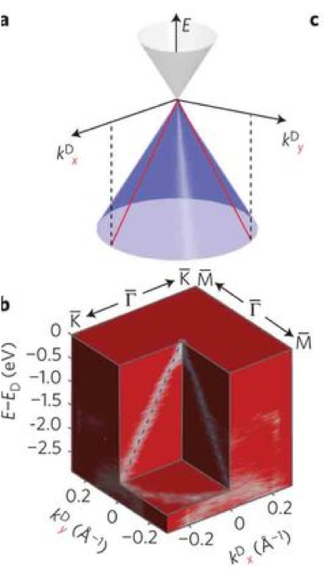
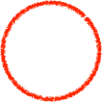
Topological semimetals
Dirac semimetals
Z.K. Liu et al., Nature Materials 13, 677 (2014)
Cd3As2
TlBiS2
TlBi(S(1-x)Sex)2
TlBiSe2
Weyl semimetals
break space inversion symmetry

Slide 18
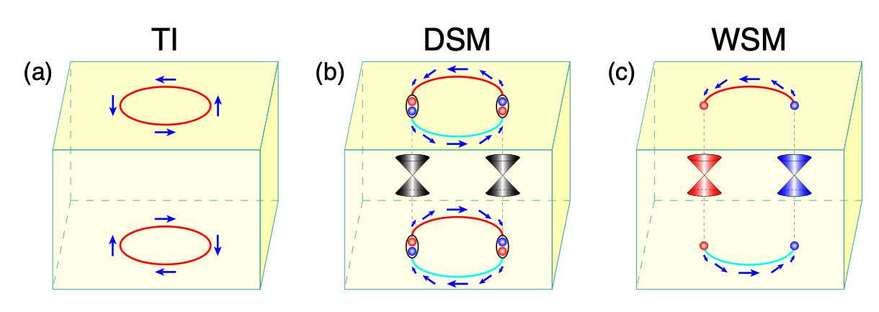
From free particles to bands
Lower symmetry in crystal compared to free Weyl fermion
Weyl points protected by crystal symmetry only for certain classes
Weyl
Rashba
EF
Surface states
Fermi arcs
𝚪
Weyl points are source/drain of Berry curvature

Slide 19
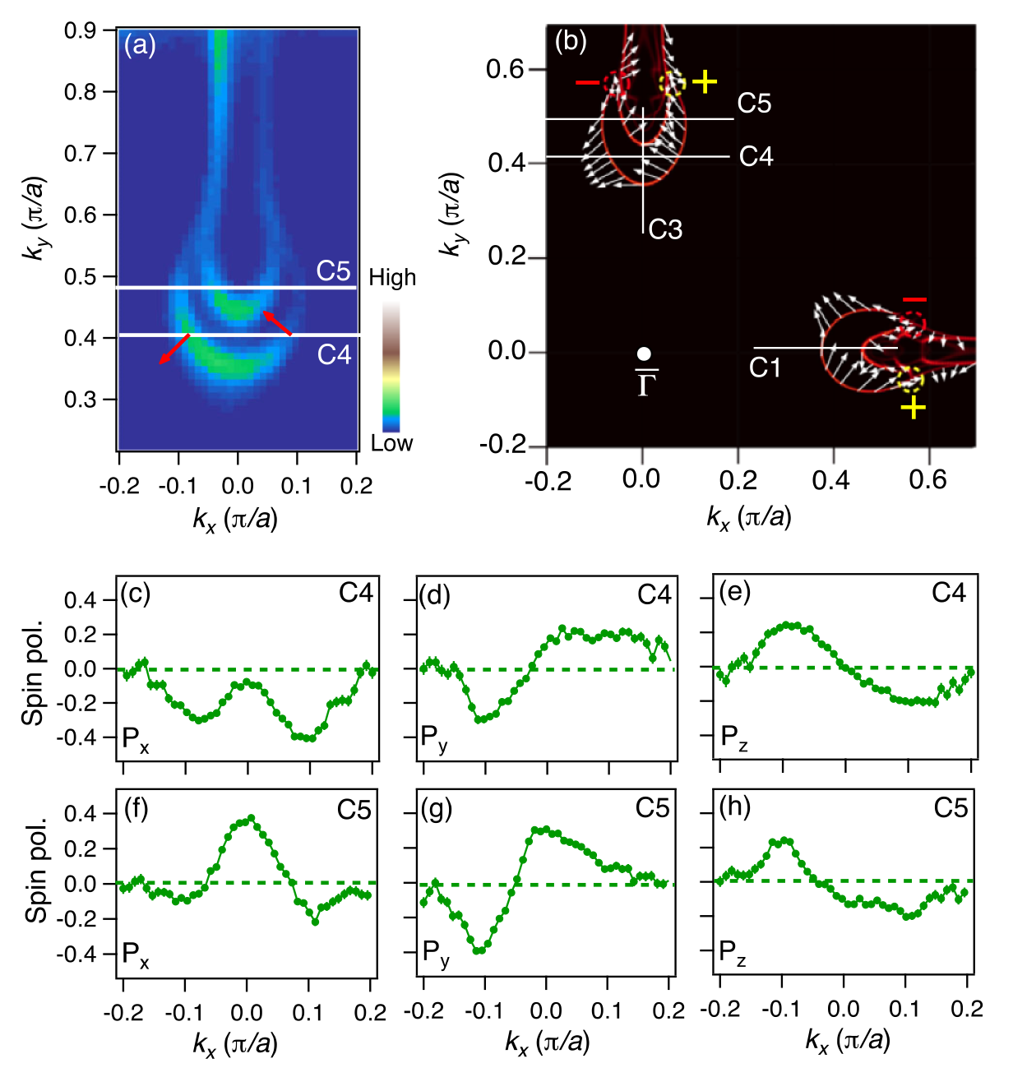
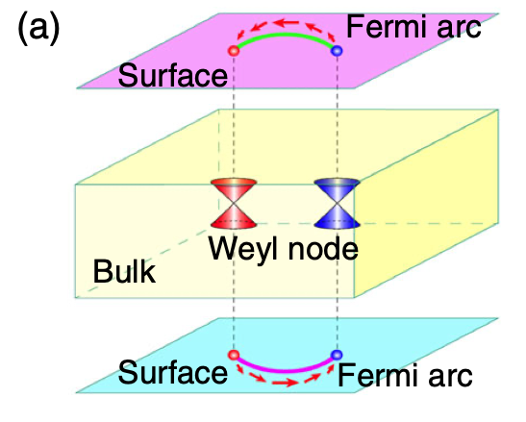
Complex spin texture of Weyl semimetal TaAs
Spin texture follows time reversal symmetry and crystal symmetry
Location of states away from high symmetry lines yields complex spin winding
Well reproduced by DFT
B.Q. Lv, S. Muff et al. PRL 115, 217601 (2015)

Slide 20
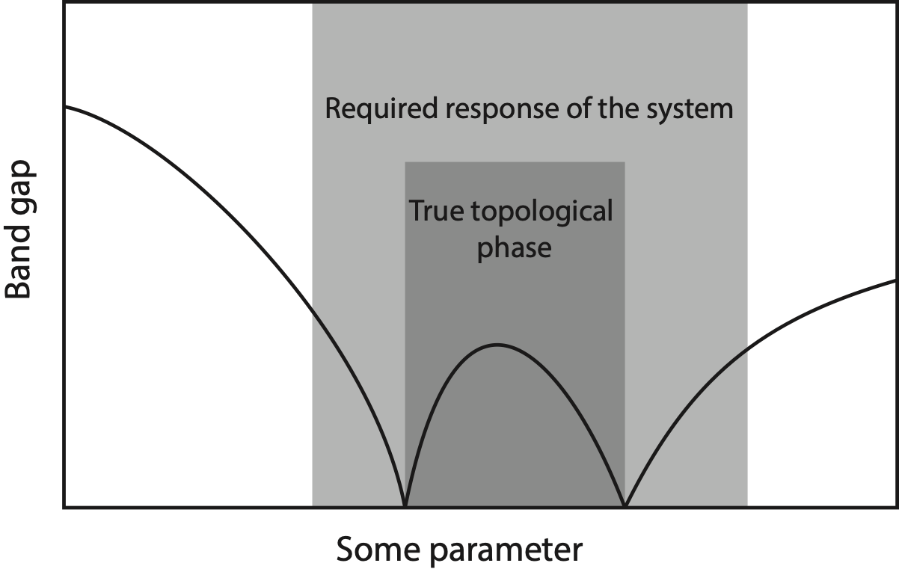
Something to remember
Single (odd) spin polarised surface state is necessary, but not sufficient condition for topological state
To confirm topology also Dirac or Weyl point has to be observed or check response to perturbations
Negative: more difficult to detect whether something is “topological”
Positive: response of system “independent” on topology, transport etc. will be the same, more flexibility!

Slide 21
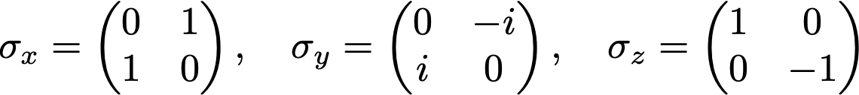
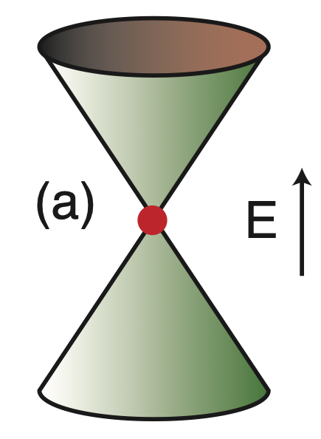

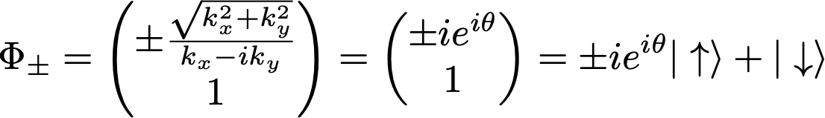
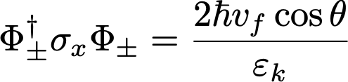
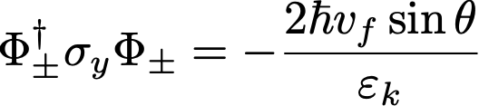



Is spin still a good quantum number?
Effective Hamiltonian for topological surface state
eigen values
(+)
eigen states
(-)
helical spin structure
Problem: Spin-orbit interaction
are not the operators for the real spin
total angular momentum

Slide 22


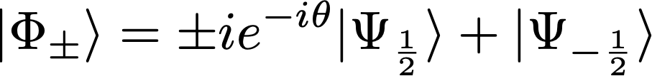
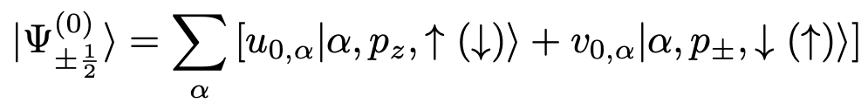

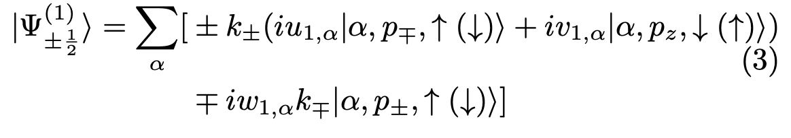
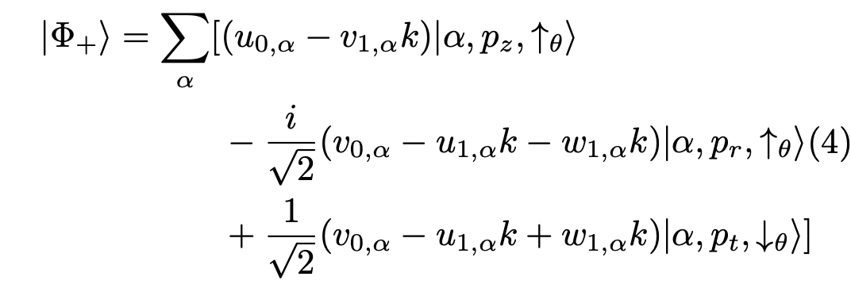
Is spin still a good quantum number?
Solution along lines of Zhang et al. PRL 111, 066801 (2013)
Write eigenstates in basis of
Bi2Se3: Bi and Se p-orbitals
Result: Real spin-helicity depends on orbital orientation
clockwise (dominant)
upper cone:
clockwise
Radial and tangential orbitals
counter-clockwise

Slide 23
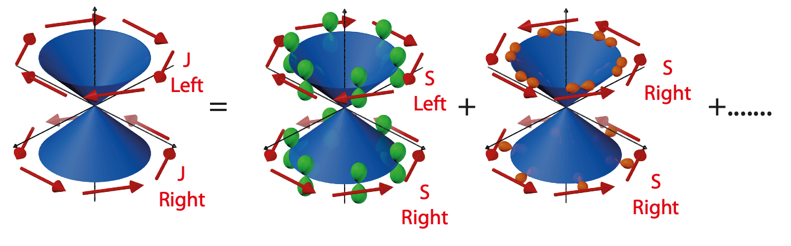
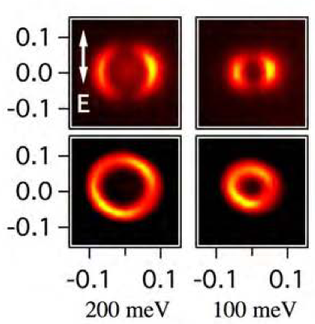
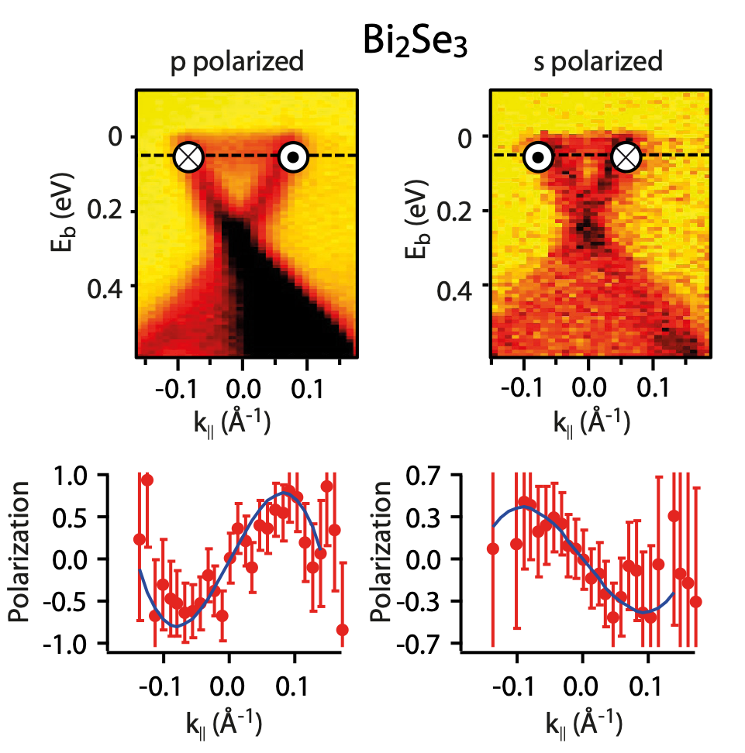
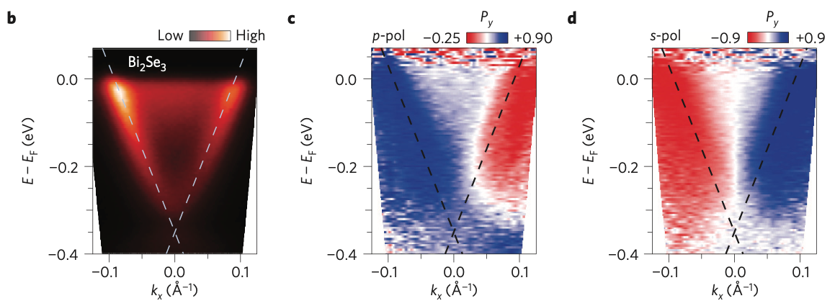
Spin polarization change with light polarization
s pol. probes py
p pol. probes pz
Y. Cao et al. arXiv:1211.5998v1
Helicity reverses when changing light polarization
Different orbitals probed for p and s polarized light
Measured spin polarization always 100%
Well understood phenomena, but has to be taken into account
C. Jozwiak et al, Nature Phys. 2013

Slide 24
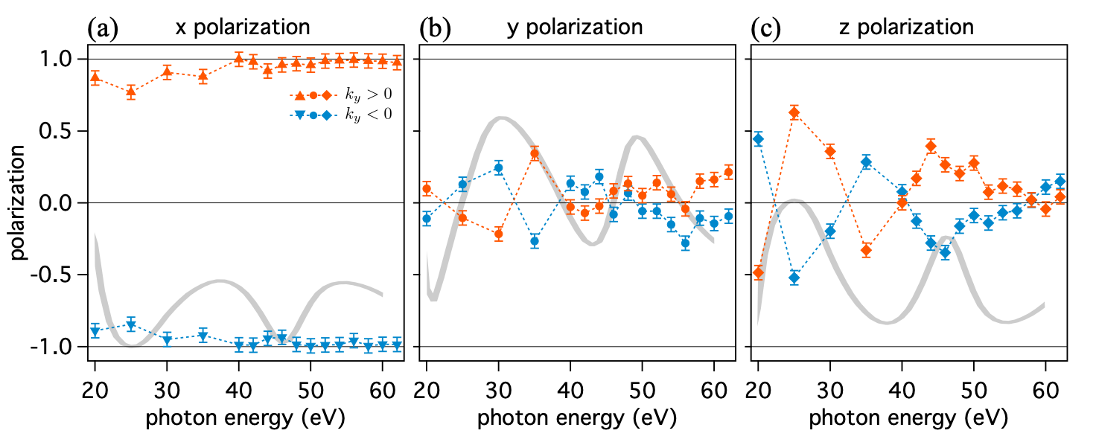
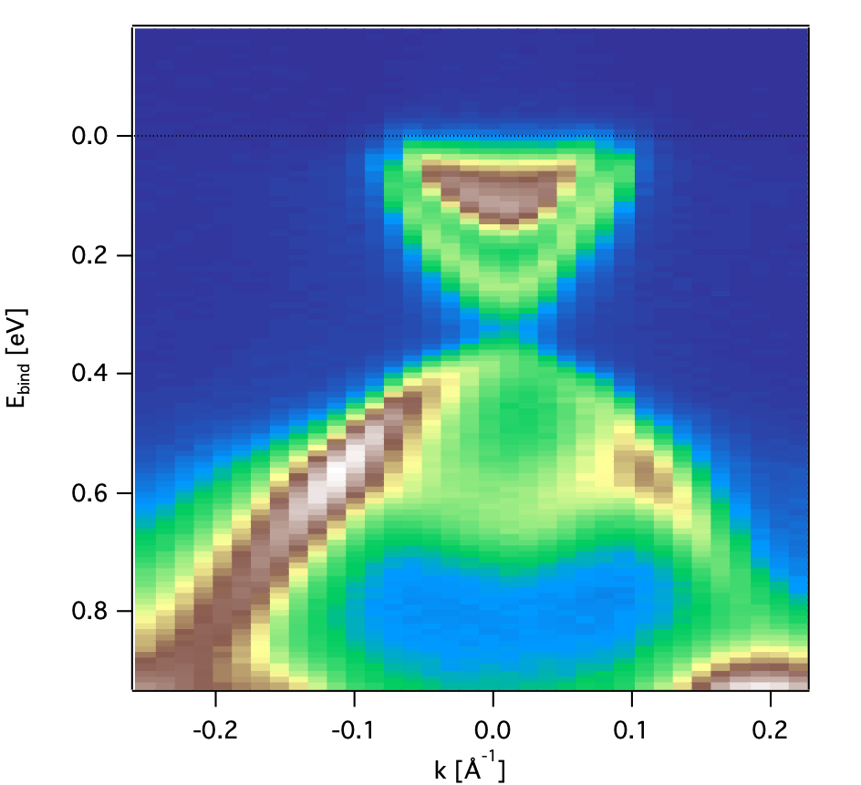
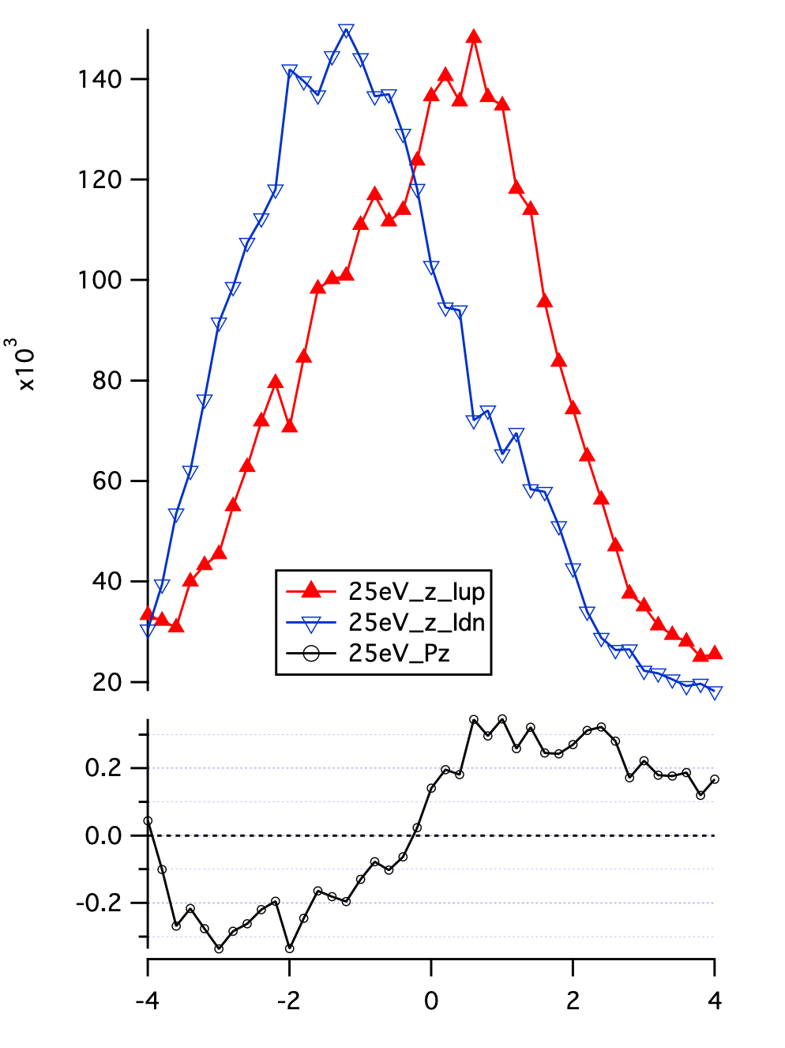
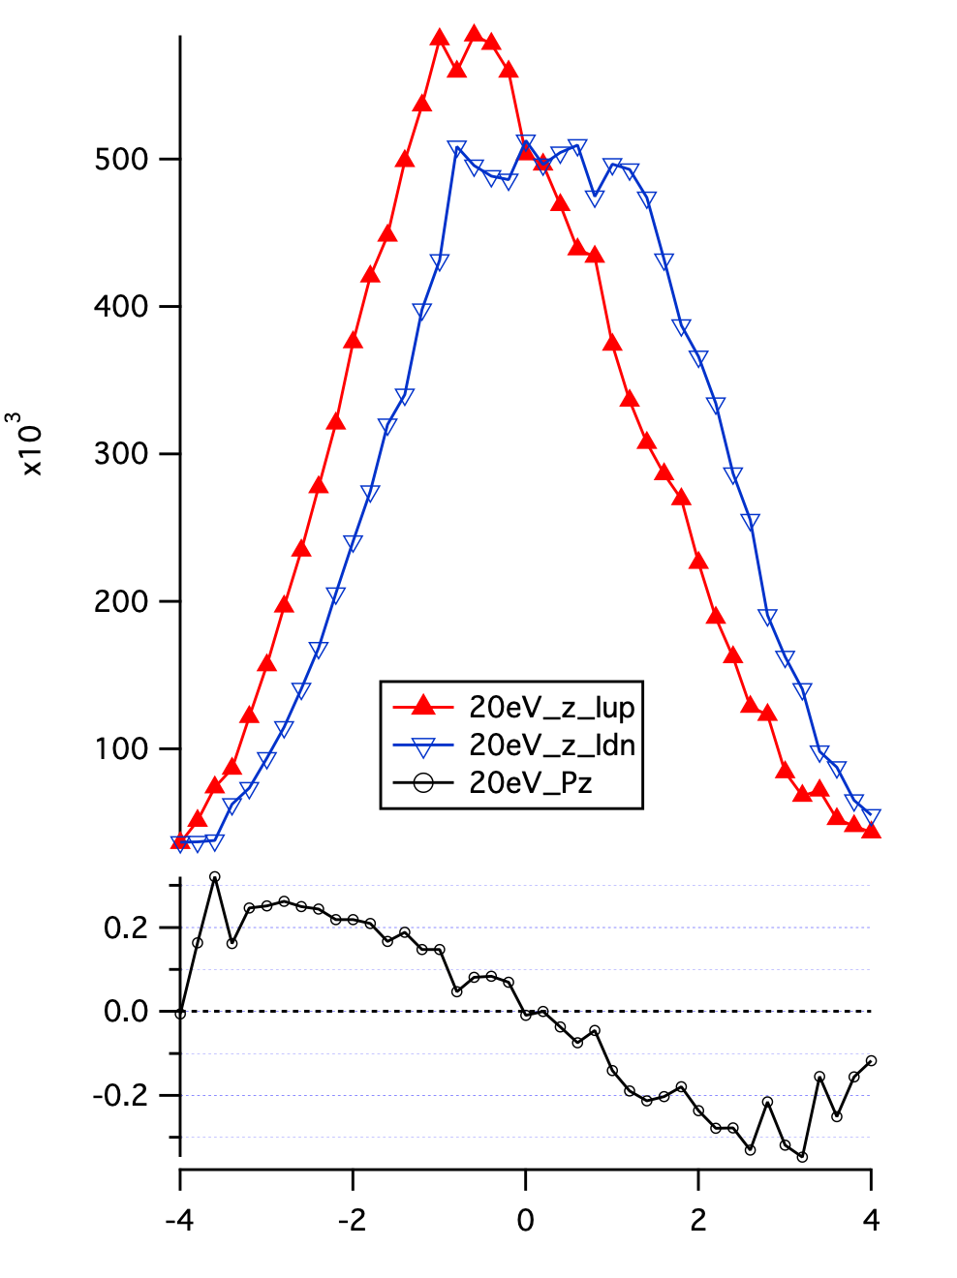
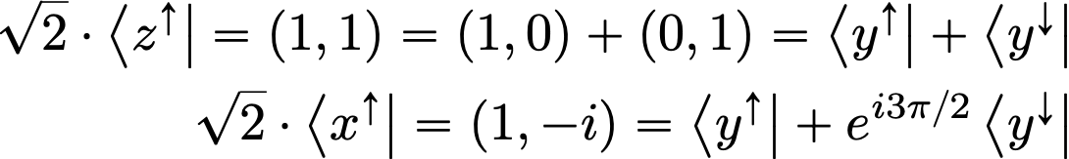
Some consequences for Bi2Se3
Polarization in perpendicular plane changes with hv
Origin lies in spin interference
Out-of-plane spin polarization
Spin algebra
hv=25eV
hv=20eV

Slide 25
Simple picture for Bi2Se3
M(hv, pol, θ, φ)
Two channels with different transition matrix elements
Final state interference with varying phase
Pz
hv=25eV
Pz
hv=20eV

Slide 26
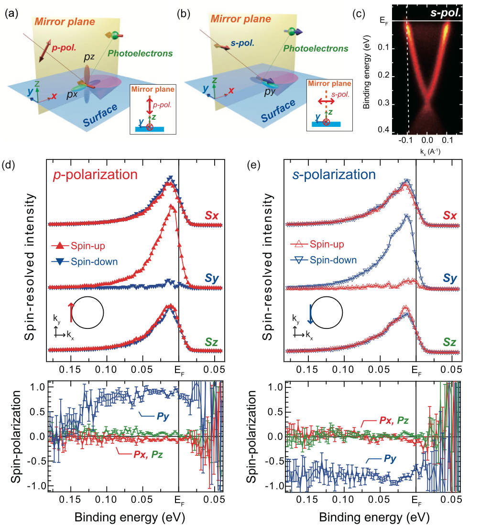

Interference as function of light polarisation
Change relative amplitude for fixed phase
Also here measured |P|=1
From p/s intensity ratio intrinsic |P|≈0.7
K. Kuroda et al. PRB 94, 165162 (2016)

