Slide 2
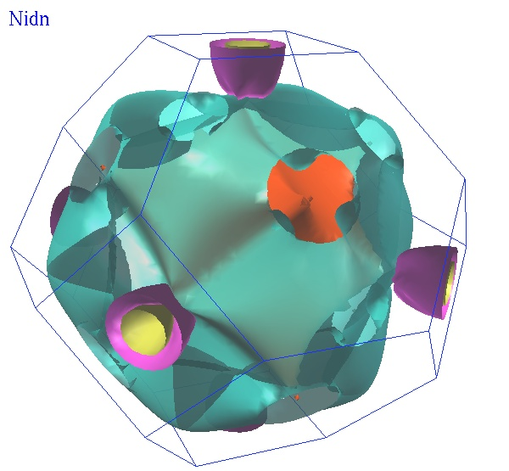
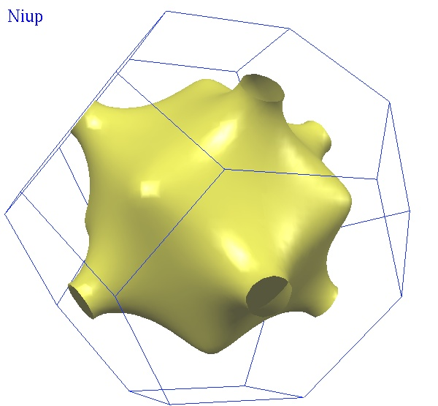

Slide 3
Fermi Surface of Ni(111)
Experiment
DFT theory
majority spin
minority spin
(Spin integrated)
M. Hoesch et al., JES 124, 263 (2002)

Slide 4
Temperature dependent exchange splitting: Stoner Model
Kreutz et al., Phys. Rev. B 58, 1300 (1998)
0.47 T_{C}
0.80 T_{C}
1.21 T_{C}

Slide 5


Spin-Resolved Momentum Mapping on Ni(111)
θ = 78°
Azimuthal Scan
minority spin
majority spin
M. Hoesch et al., JES 124, 263 (2002)

