Slide 4


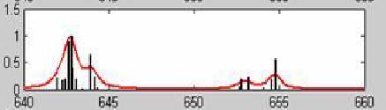


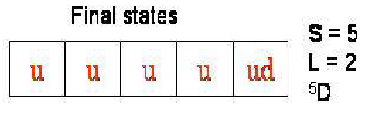
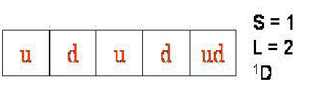

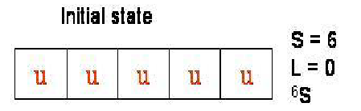
XAS spectrum of 3d5 Mn 2+ ⁶S_{5/2}
Different final states are coupled via spin-orbit interaction
Their coupling with the ground state considered gives
the multiplets structure

Slide 5
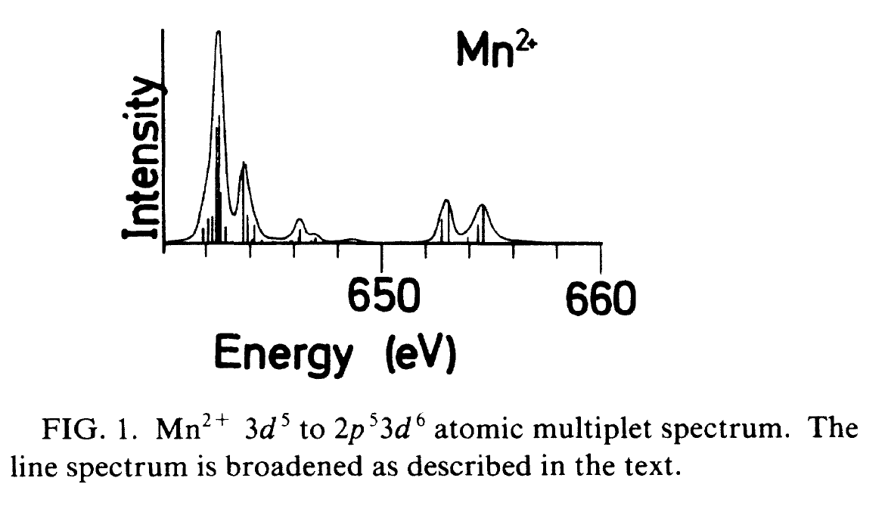
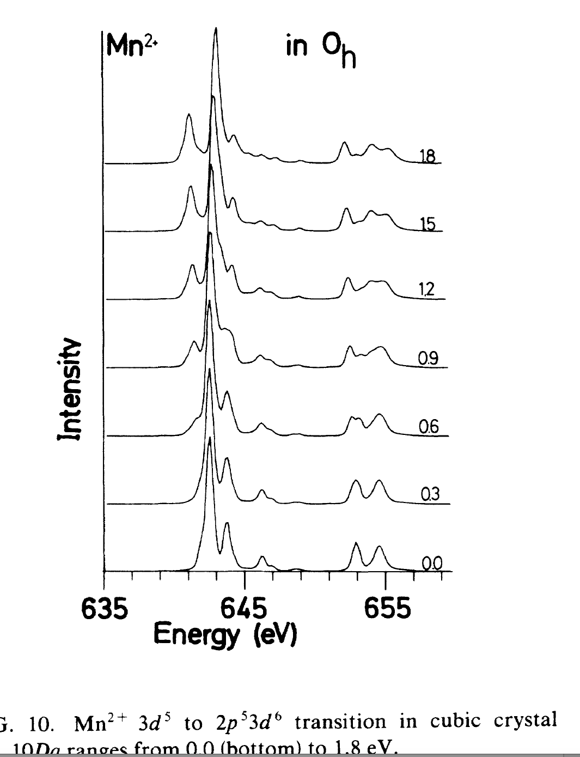
In a CF, theory
Atomic, theory + experiment

Slide 6
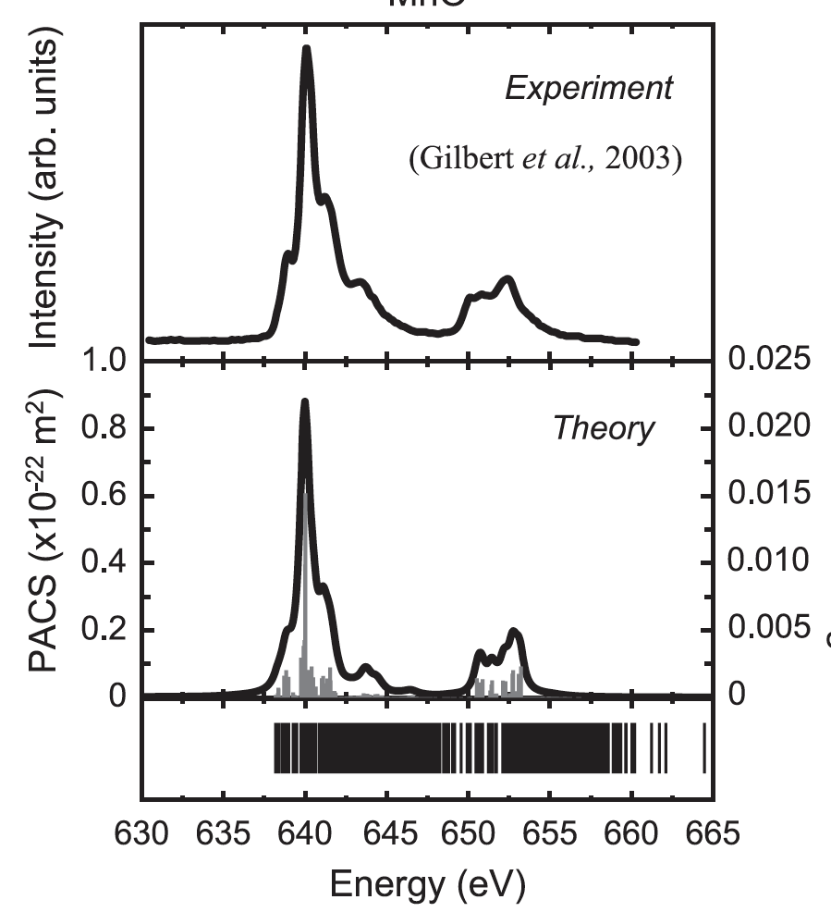
Experimental + theory
MnO₂ Mn²⁺ 3d⁵ in cubic CF

Slide 7
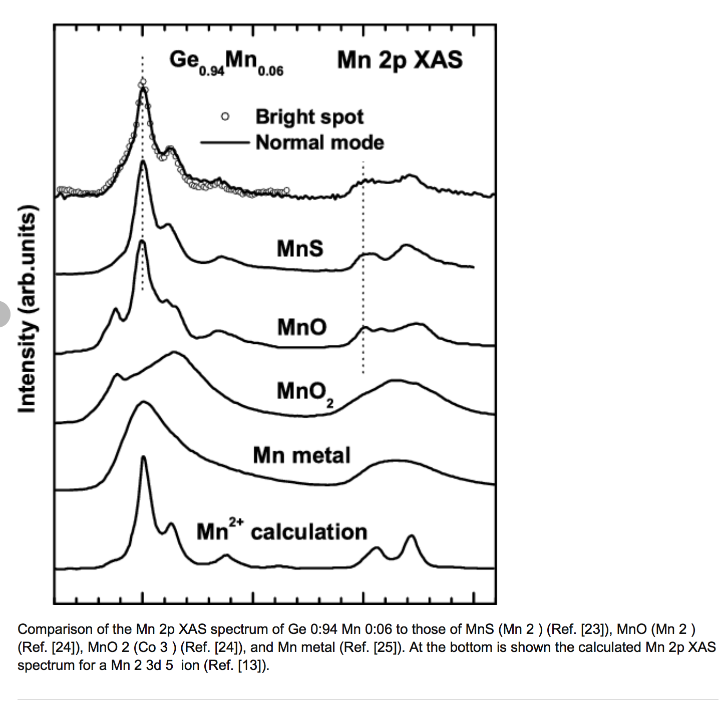

Slide 8

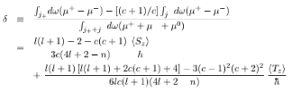
XMCD sum rules
orbital
spin

