Slide 2
J. Krempasky et al. Nature 626, 517 (2024)

Slide 3
Chiral spin waves (magnons)
Phys. Rev. Lett. 131, 256703
Z. Liu et al. PRL 133, 156702 (2024)

Slide 6
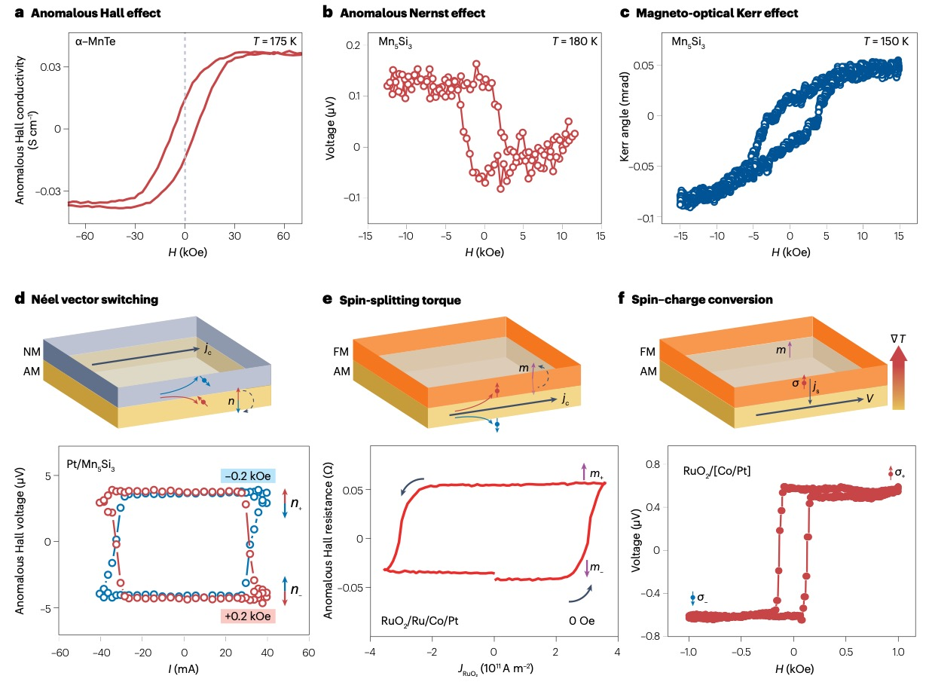

Slide 7
O.J. Amin et al. Nature 636, 348 (2024)

Slide 8
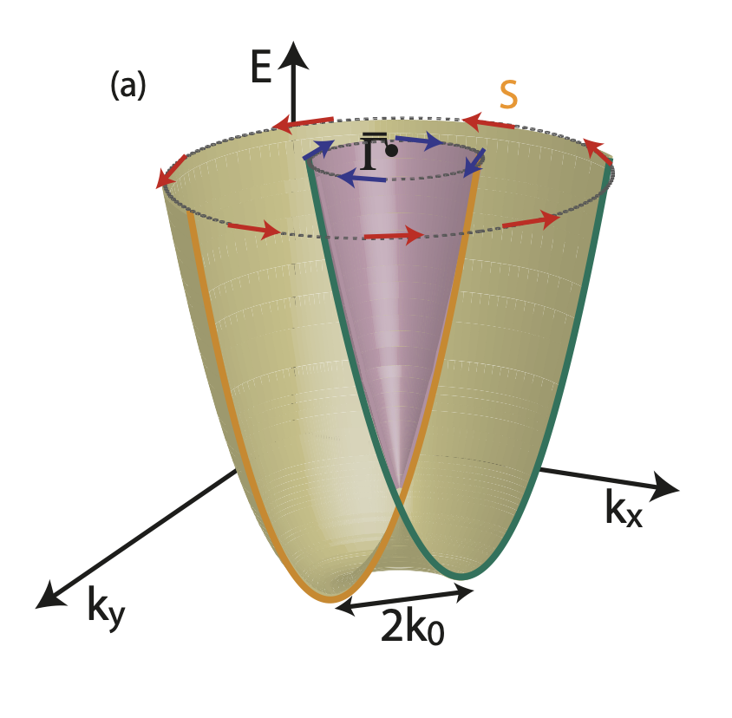

Slide 9
Link to superconductivity:
E. Cappelluti, C. Grimaldi and F. Marsiglio, Topological Change of the Fermi Surface in Low-Density Rashba Gases: Application to Superconductivity. Phys. Rev. Lett. 98, 167002 (2007).
F Meier et al. PRB 79, 241408 (2009)

