Slide 1



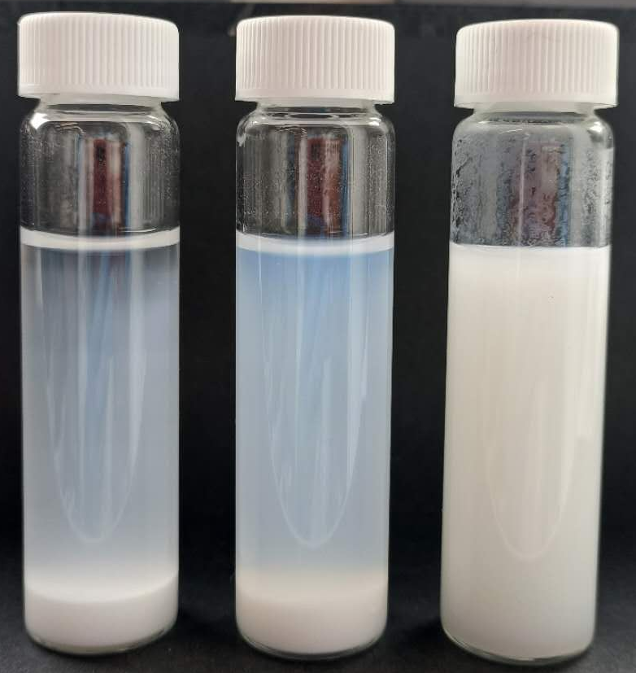

Controlled drying and redispersion of microcrystalline cellulose (MCC) particles
Ziwei Zhou, PhD from EPFL SML
Start date: 01.01.2025
Challenge: MCC is easily sedimented in water.
Initial trial: After 1 day of rest, MCC with black box system clearly outperforms both pure MCC and MCC/CNC blends.
Research topic: Which component(s) and interactions are responsible for its superior stability? Once we know the “recipe,” how to prevent these dispersants from aggregation after drying?
MCC
MCC + CNC
MCC + “black box”
Notes:
调pH

