Slide 1
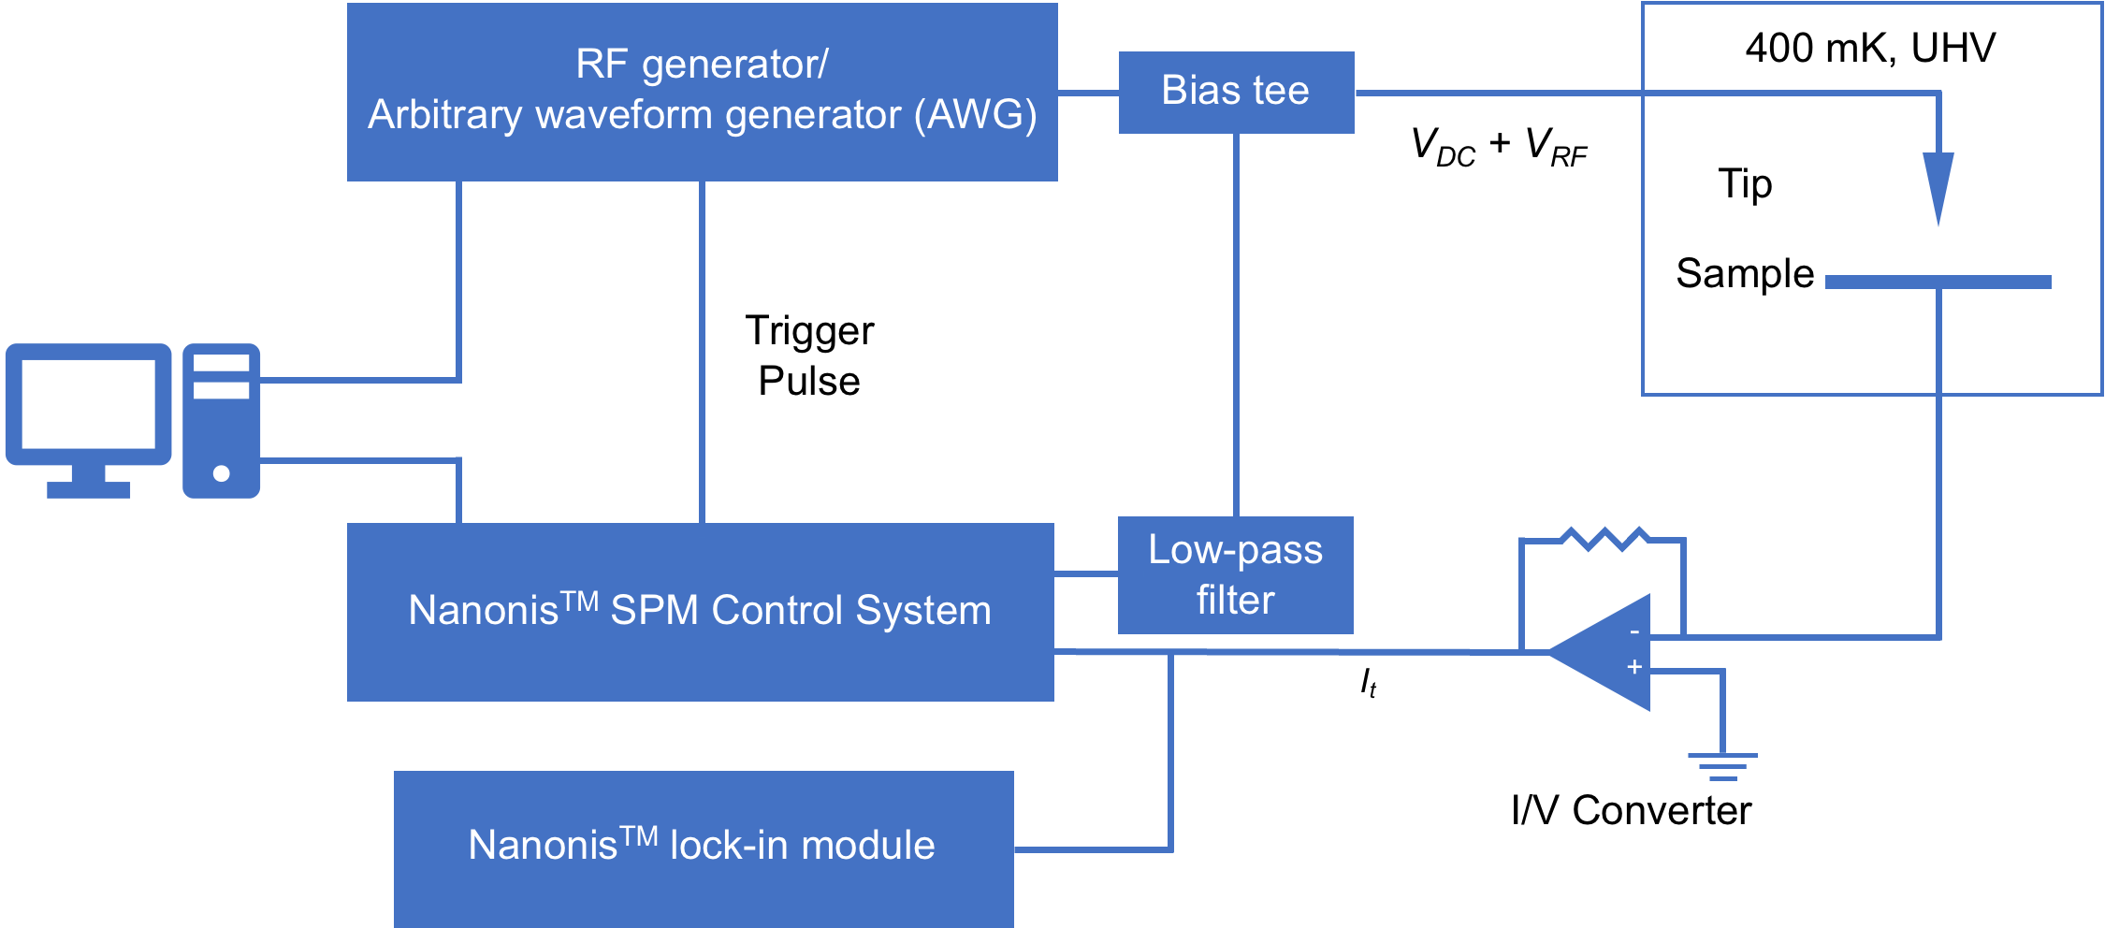
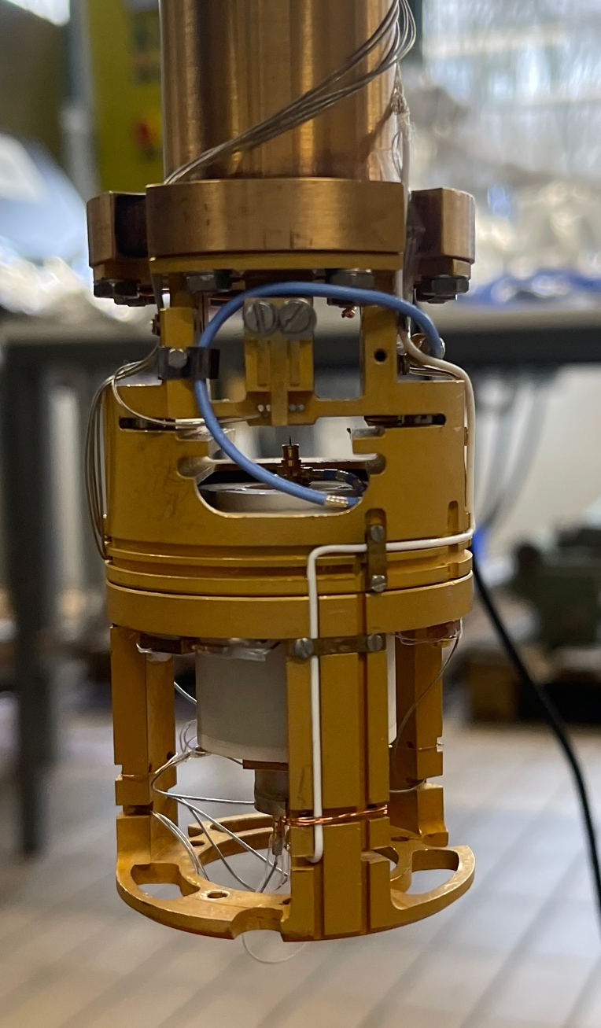
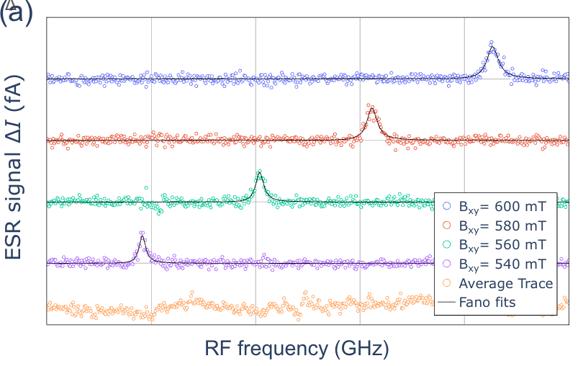
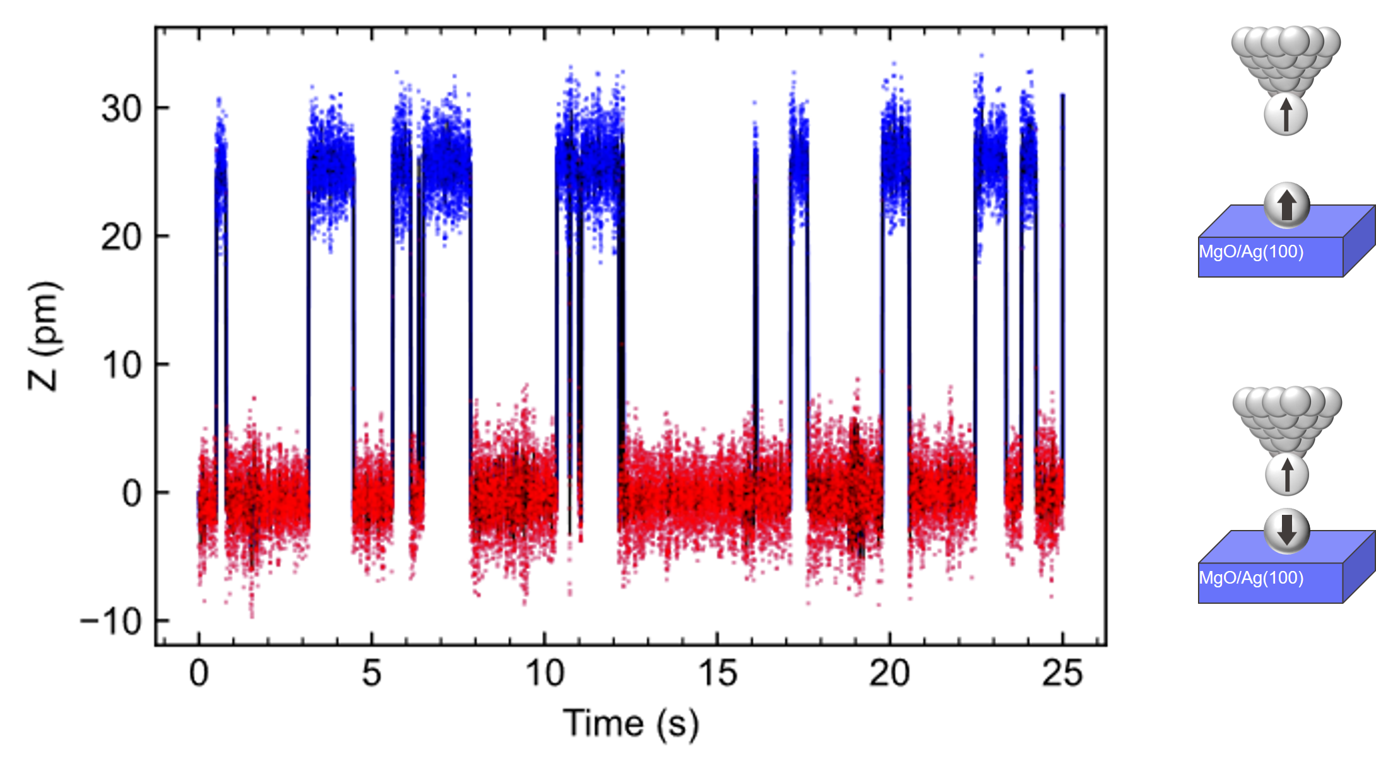
Scanning tunneling microscope
ESR signal ΔI (fA)
800
600
400
200
0
15 15.5 16 16.5 17 17.5
Magnetic switching of oxygen-top Tb on MgO/Ag(100)
(I_{t} = 20 pA, V_{DC} = 190 mV, B_{z} = 1.5 T, T = 400 mK)
RF frequency (GHz)
ESR signals from an oxygen-bridge Ti on MgO/Ag(100).

