Slide 1
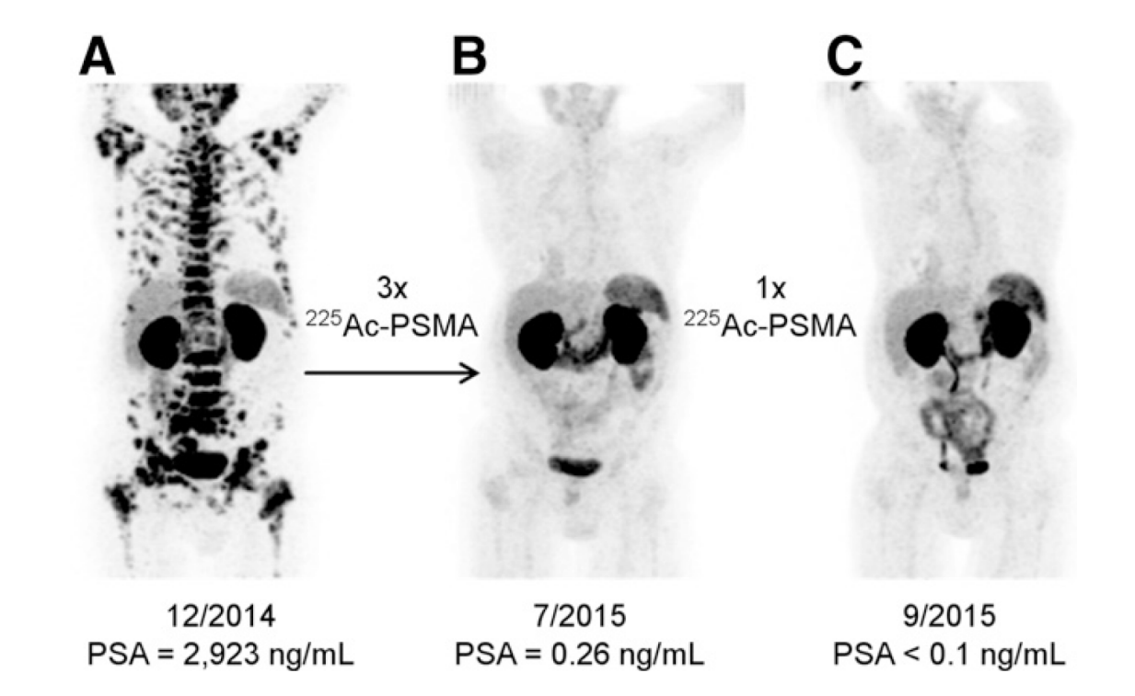
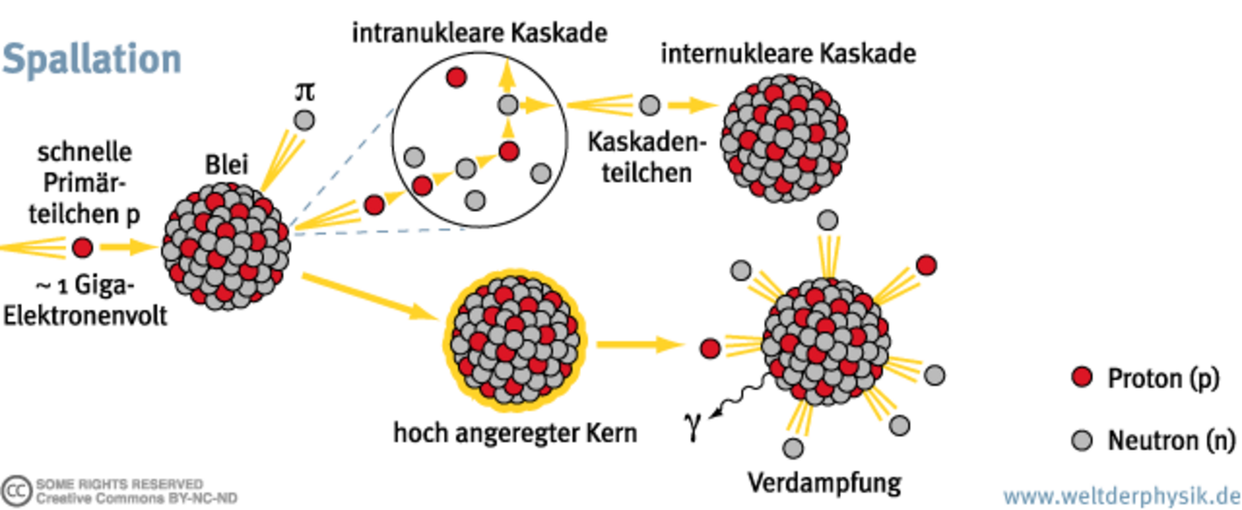
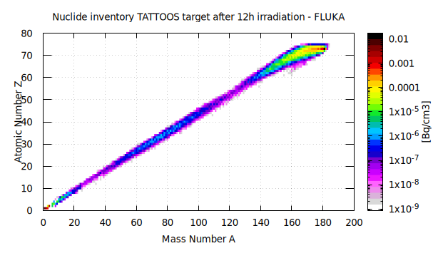
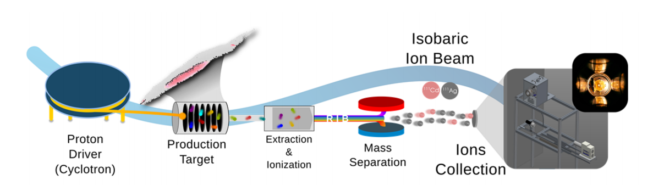
Radioisotope production for theranostics applications
How to produce large amounts of radioisotopes for clinical trials ?

Slide 2
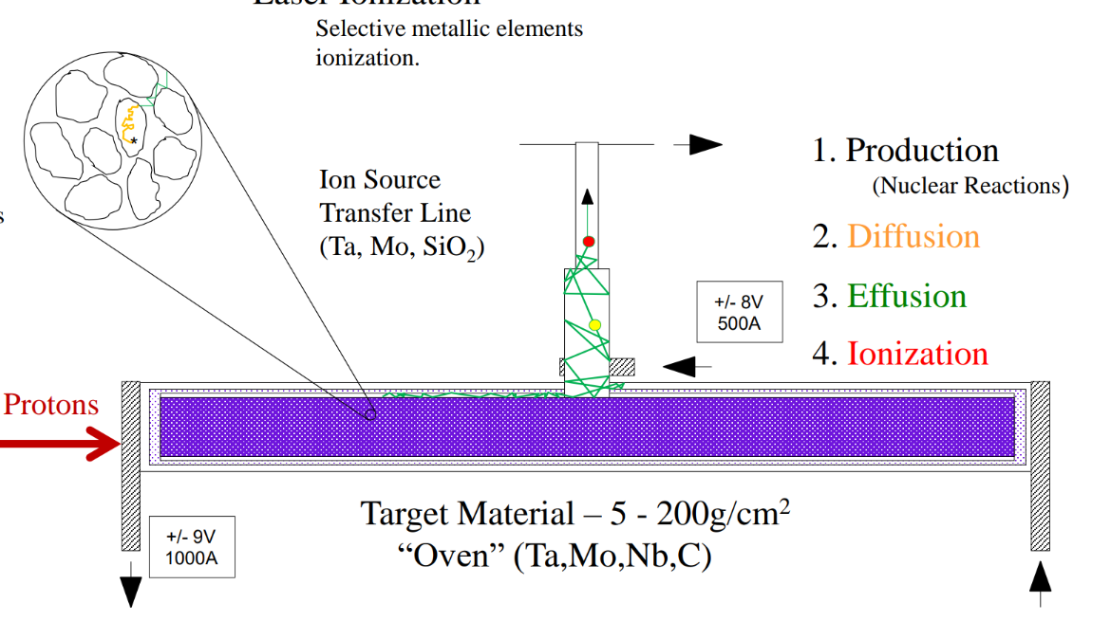
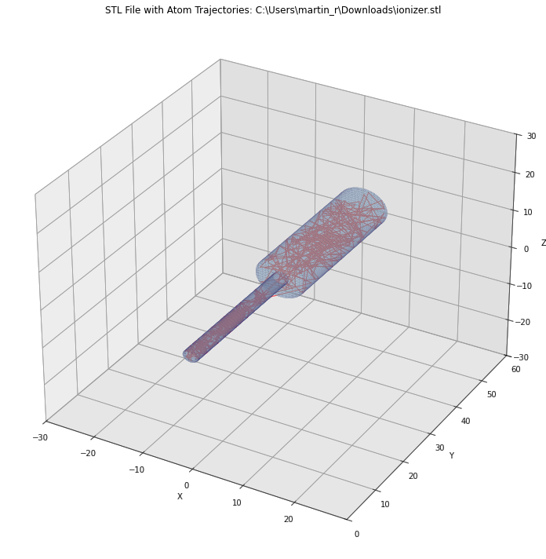
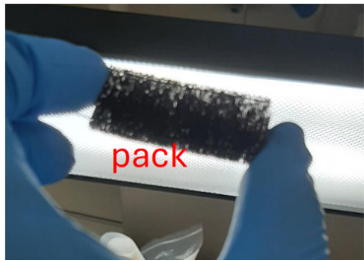
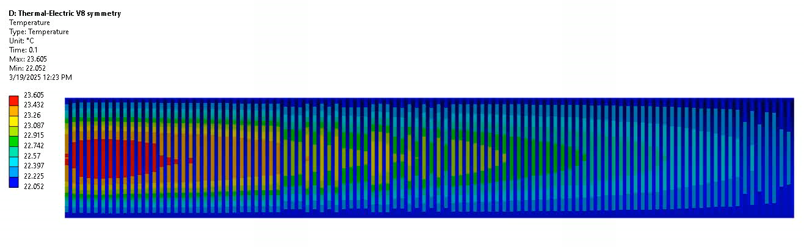
Tantalum target development
Desorption tracking code
LPBF of tantalum lattices with BCC unit cell
Unoptimized target thermal transients
Thin foils packing
Next steps: Development of Ta-W alloy and TaC porous powders

