Slide 1
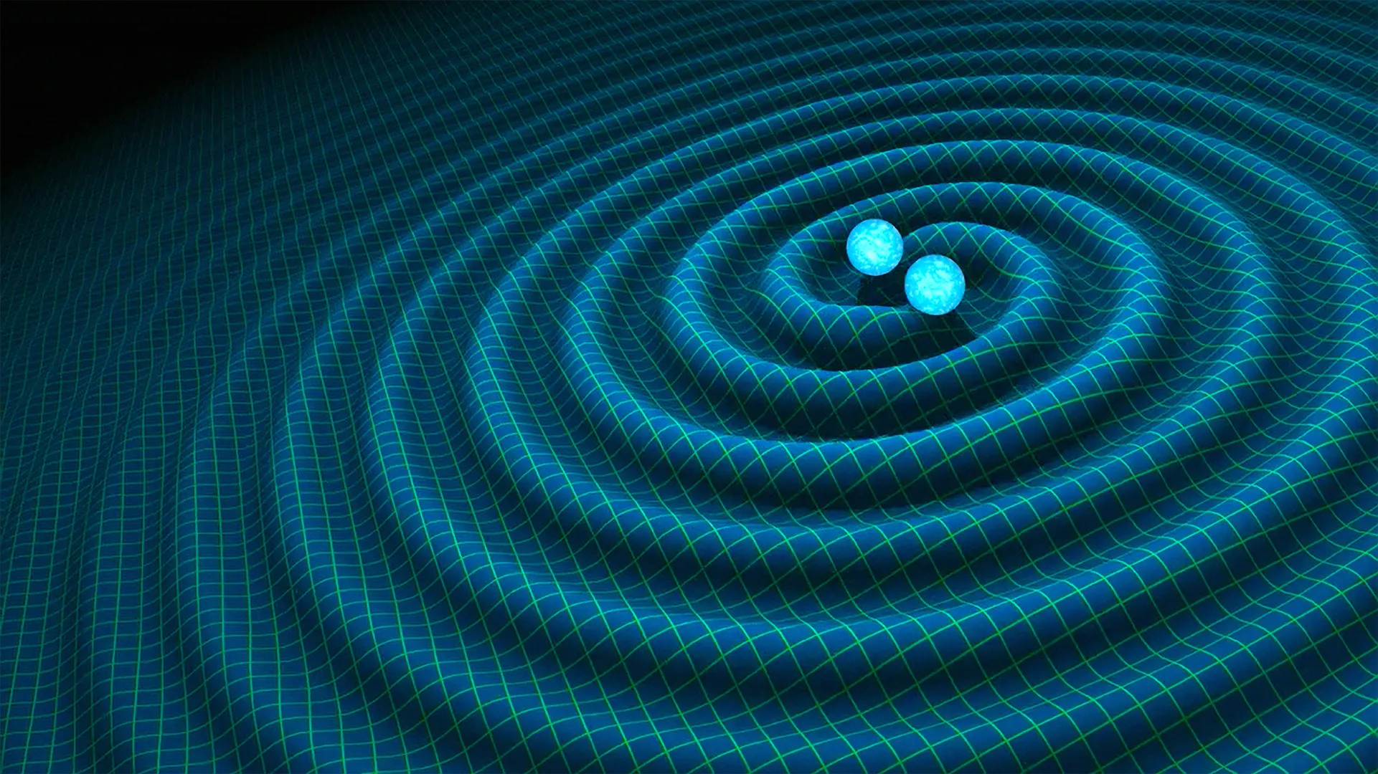
Optics and Thermo-Optics of dielectric coatings for Gravitational wave Interferometer
Presented by- Prajkta Nehete
Supervisor- Prof. Francesco Quochi
UniCa and UniPd

Slide 2
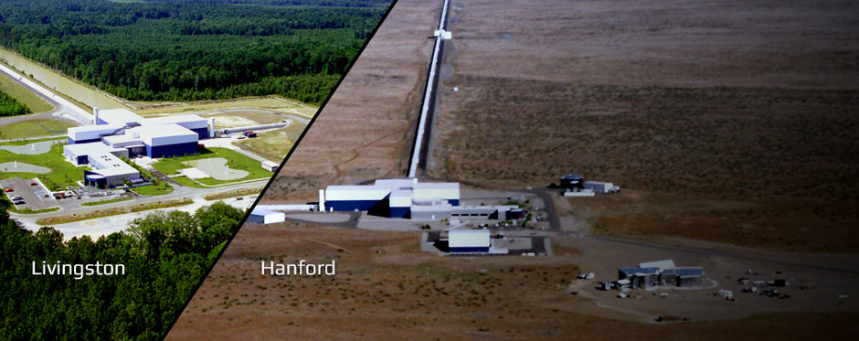
  Current Gravitational Wave Detectors
  4 Km arms
  Bragg reflector coating
  IBS System
  Materials- TiO₂:Ta₂O₅ and SiO₂
  Thickness- 5.9μm
  Annealing - 500°C for 10H

Slide 3
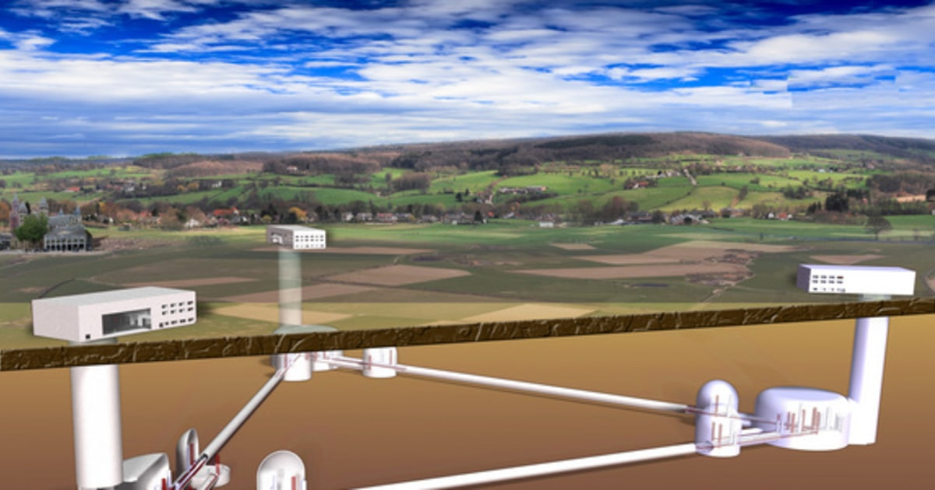
Einstein Telescope-
Underground
6 interferometers
10 Km arms
Triangular shape
RT and Cryogenic temperature (10-20K)
Increased Operating frequency band- 1550nm- 2100nm
Aim- One order of magnitude higher sensitivity

Slide 4
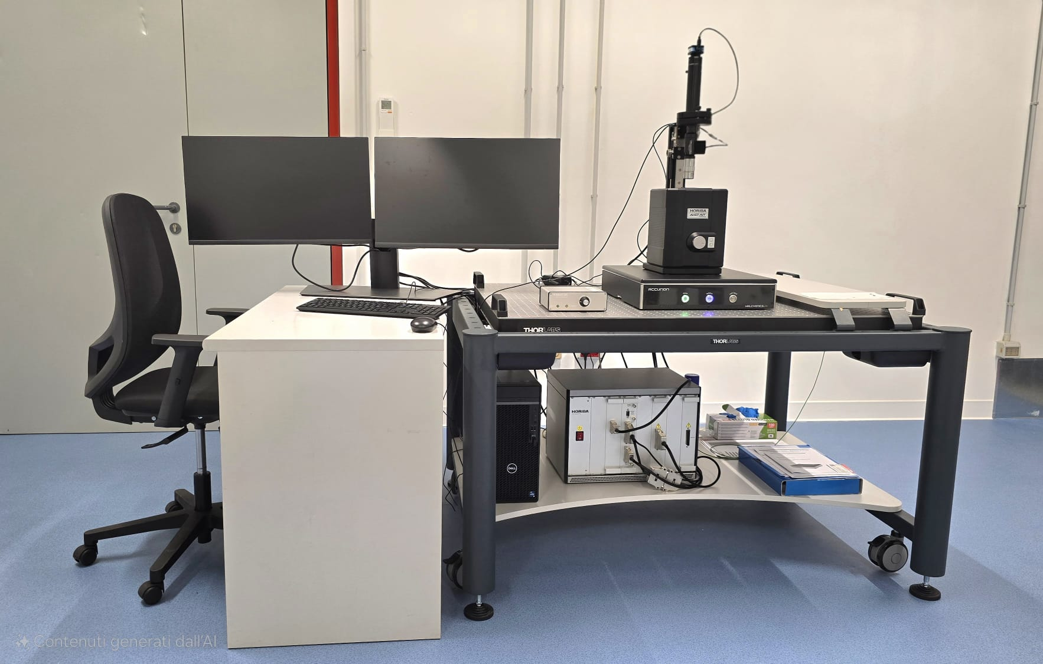

Slide 5
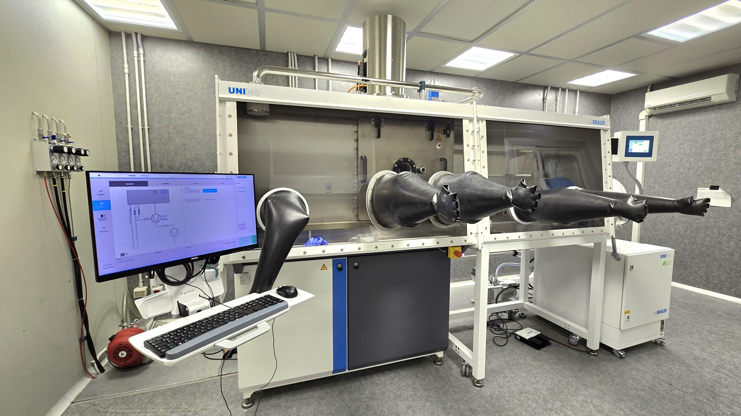
Evaporator -

Slide 6
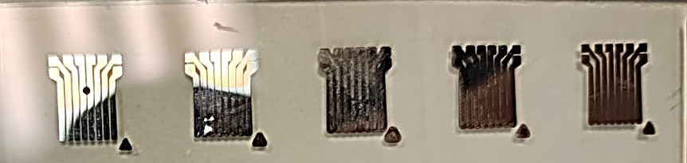
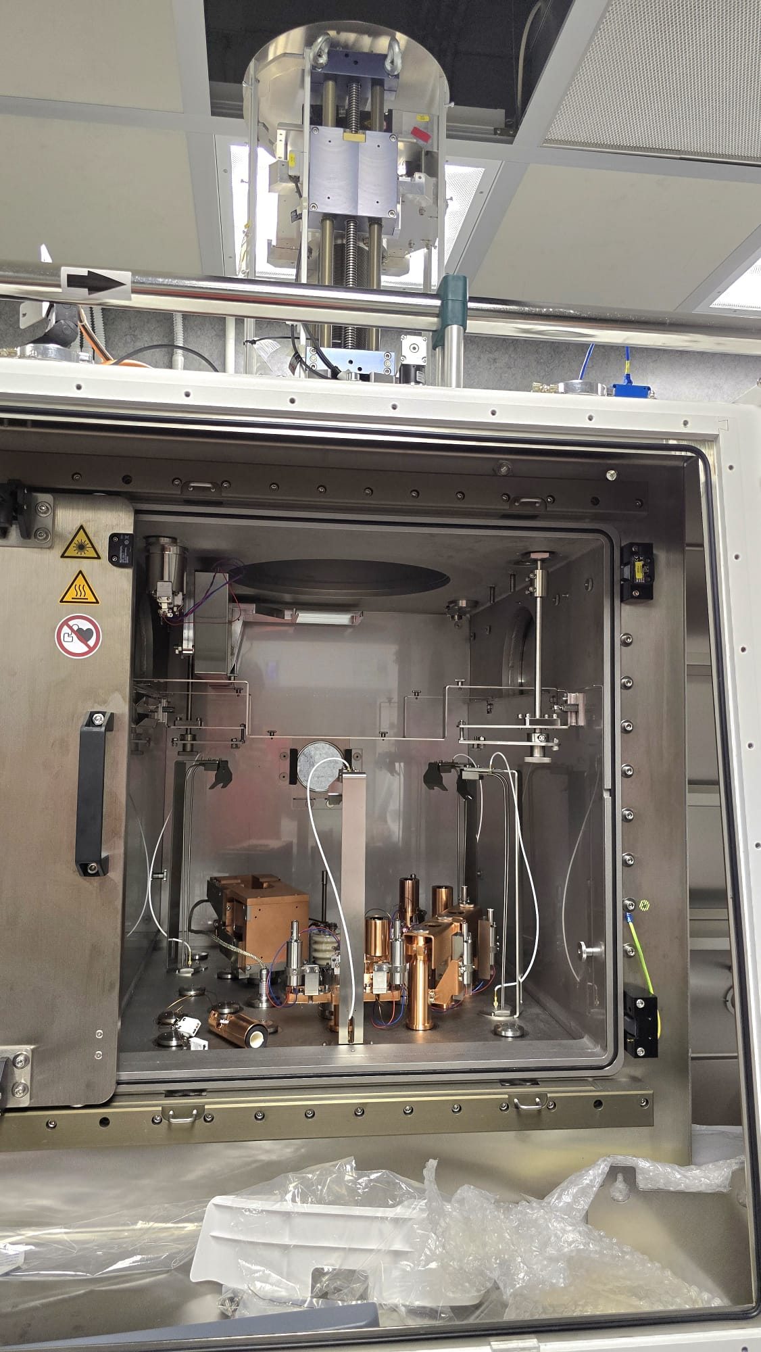
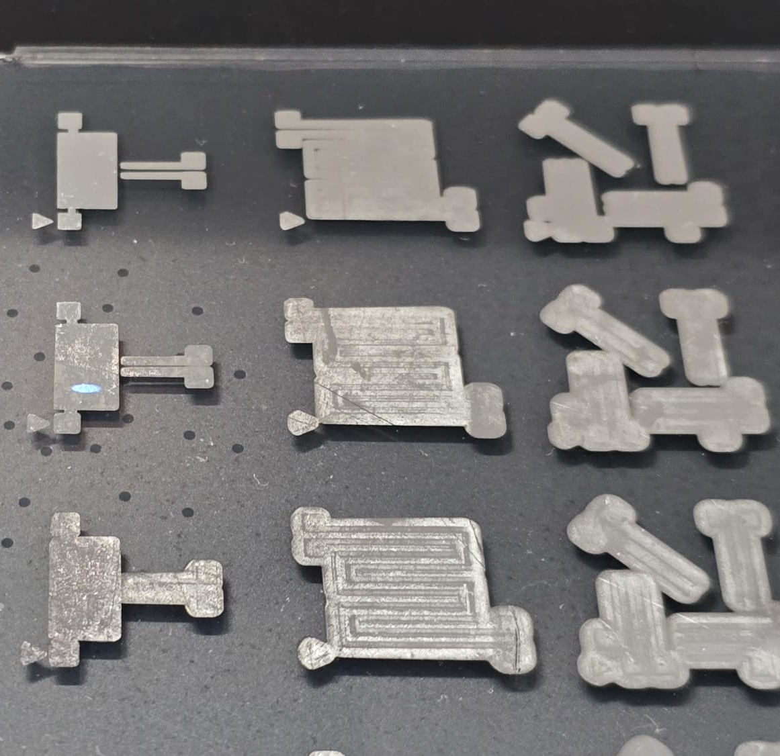

Slide 7
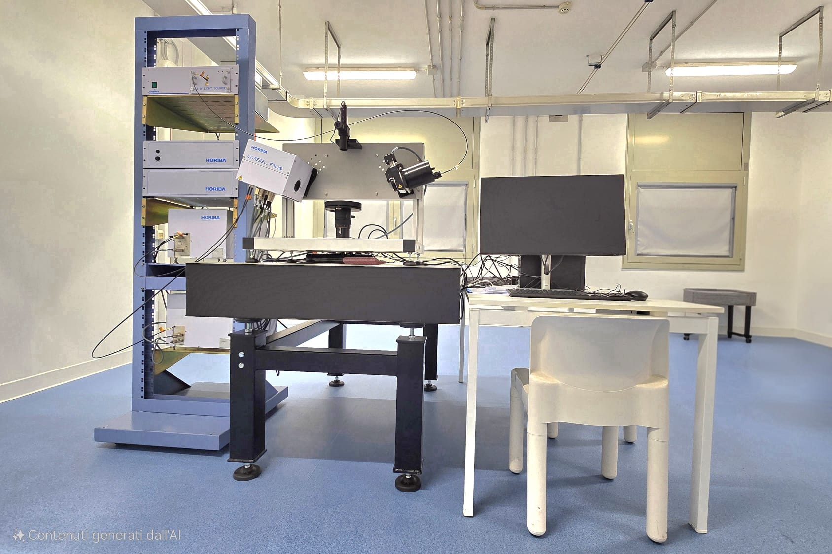
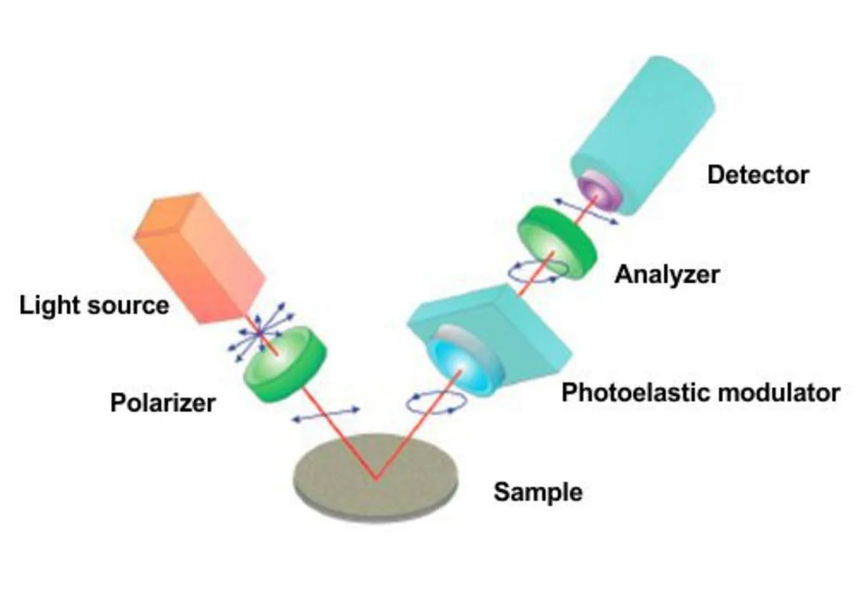
Ellipsometry -

Slide 8
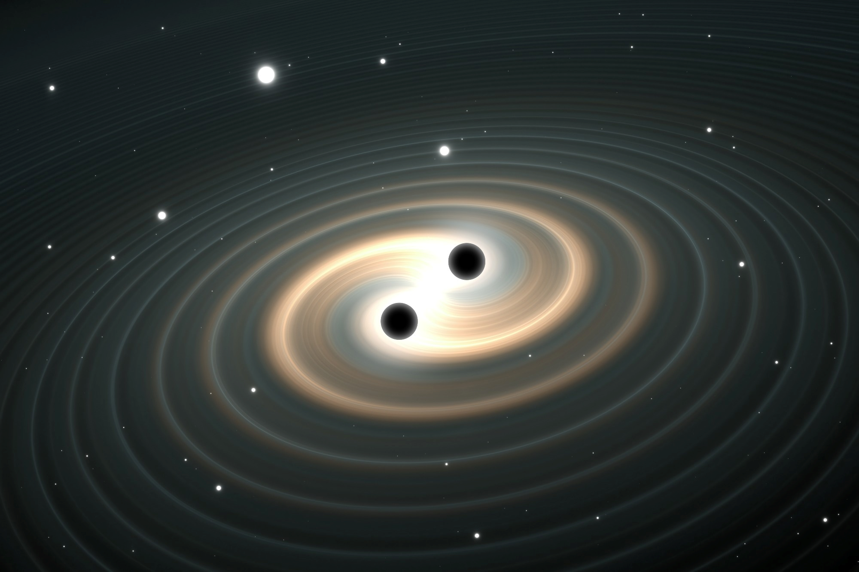
Thank You!!

