Slide 1
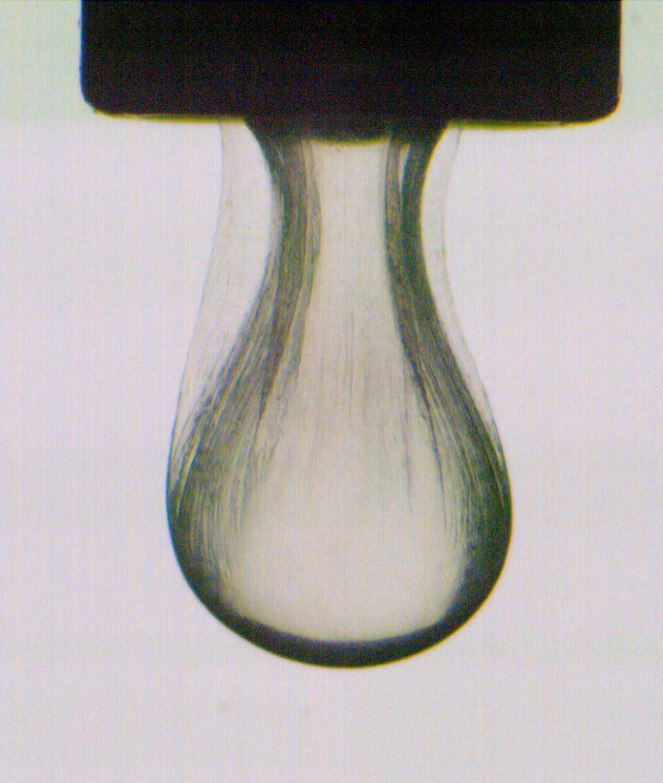
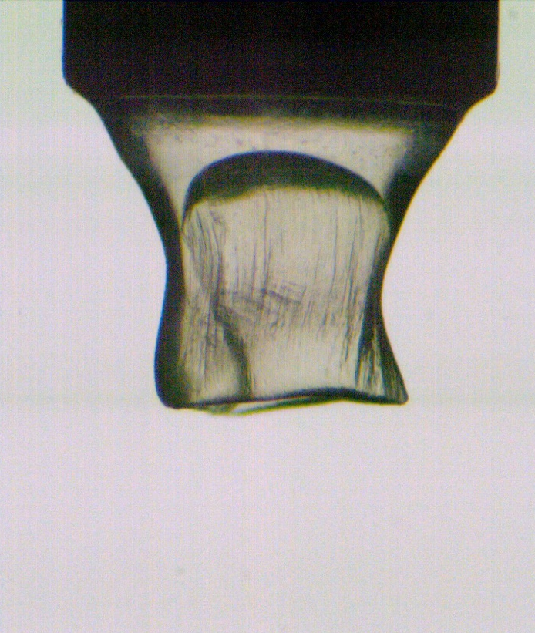
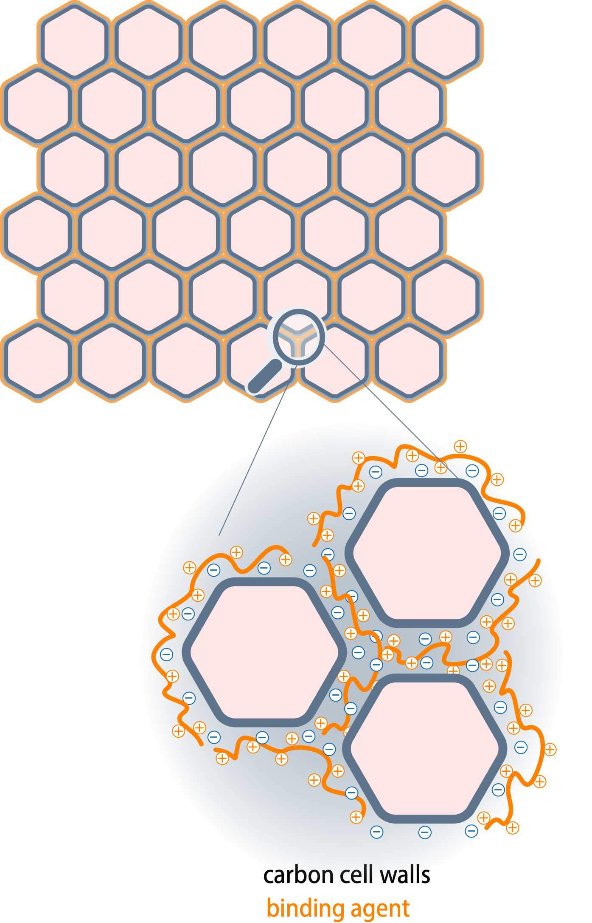
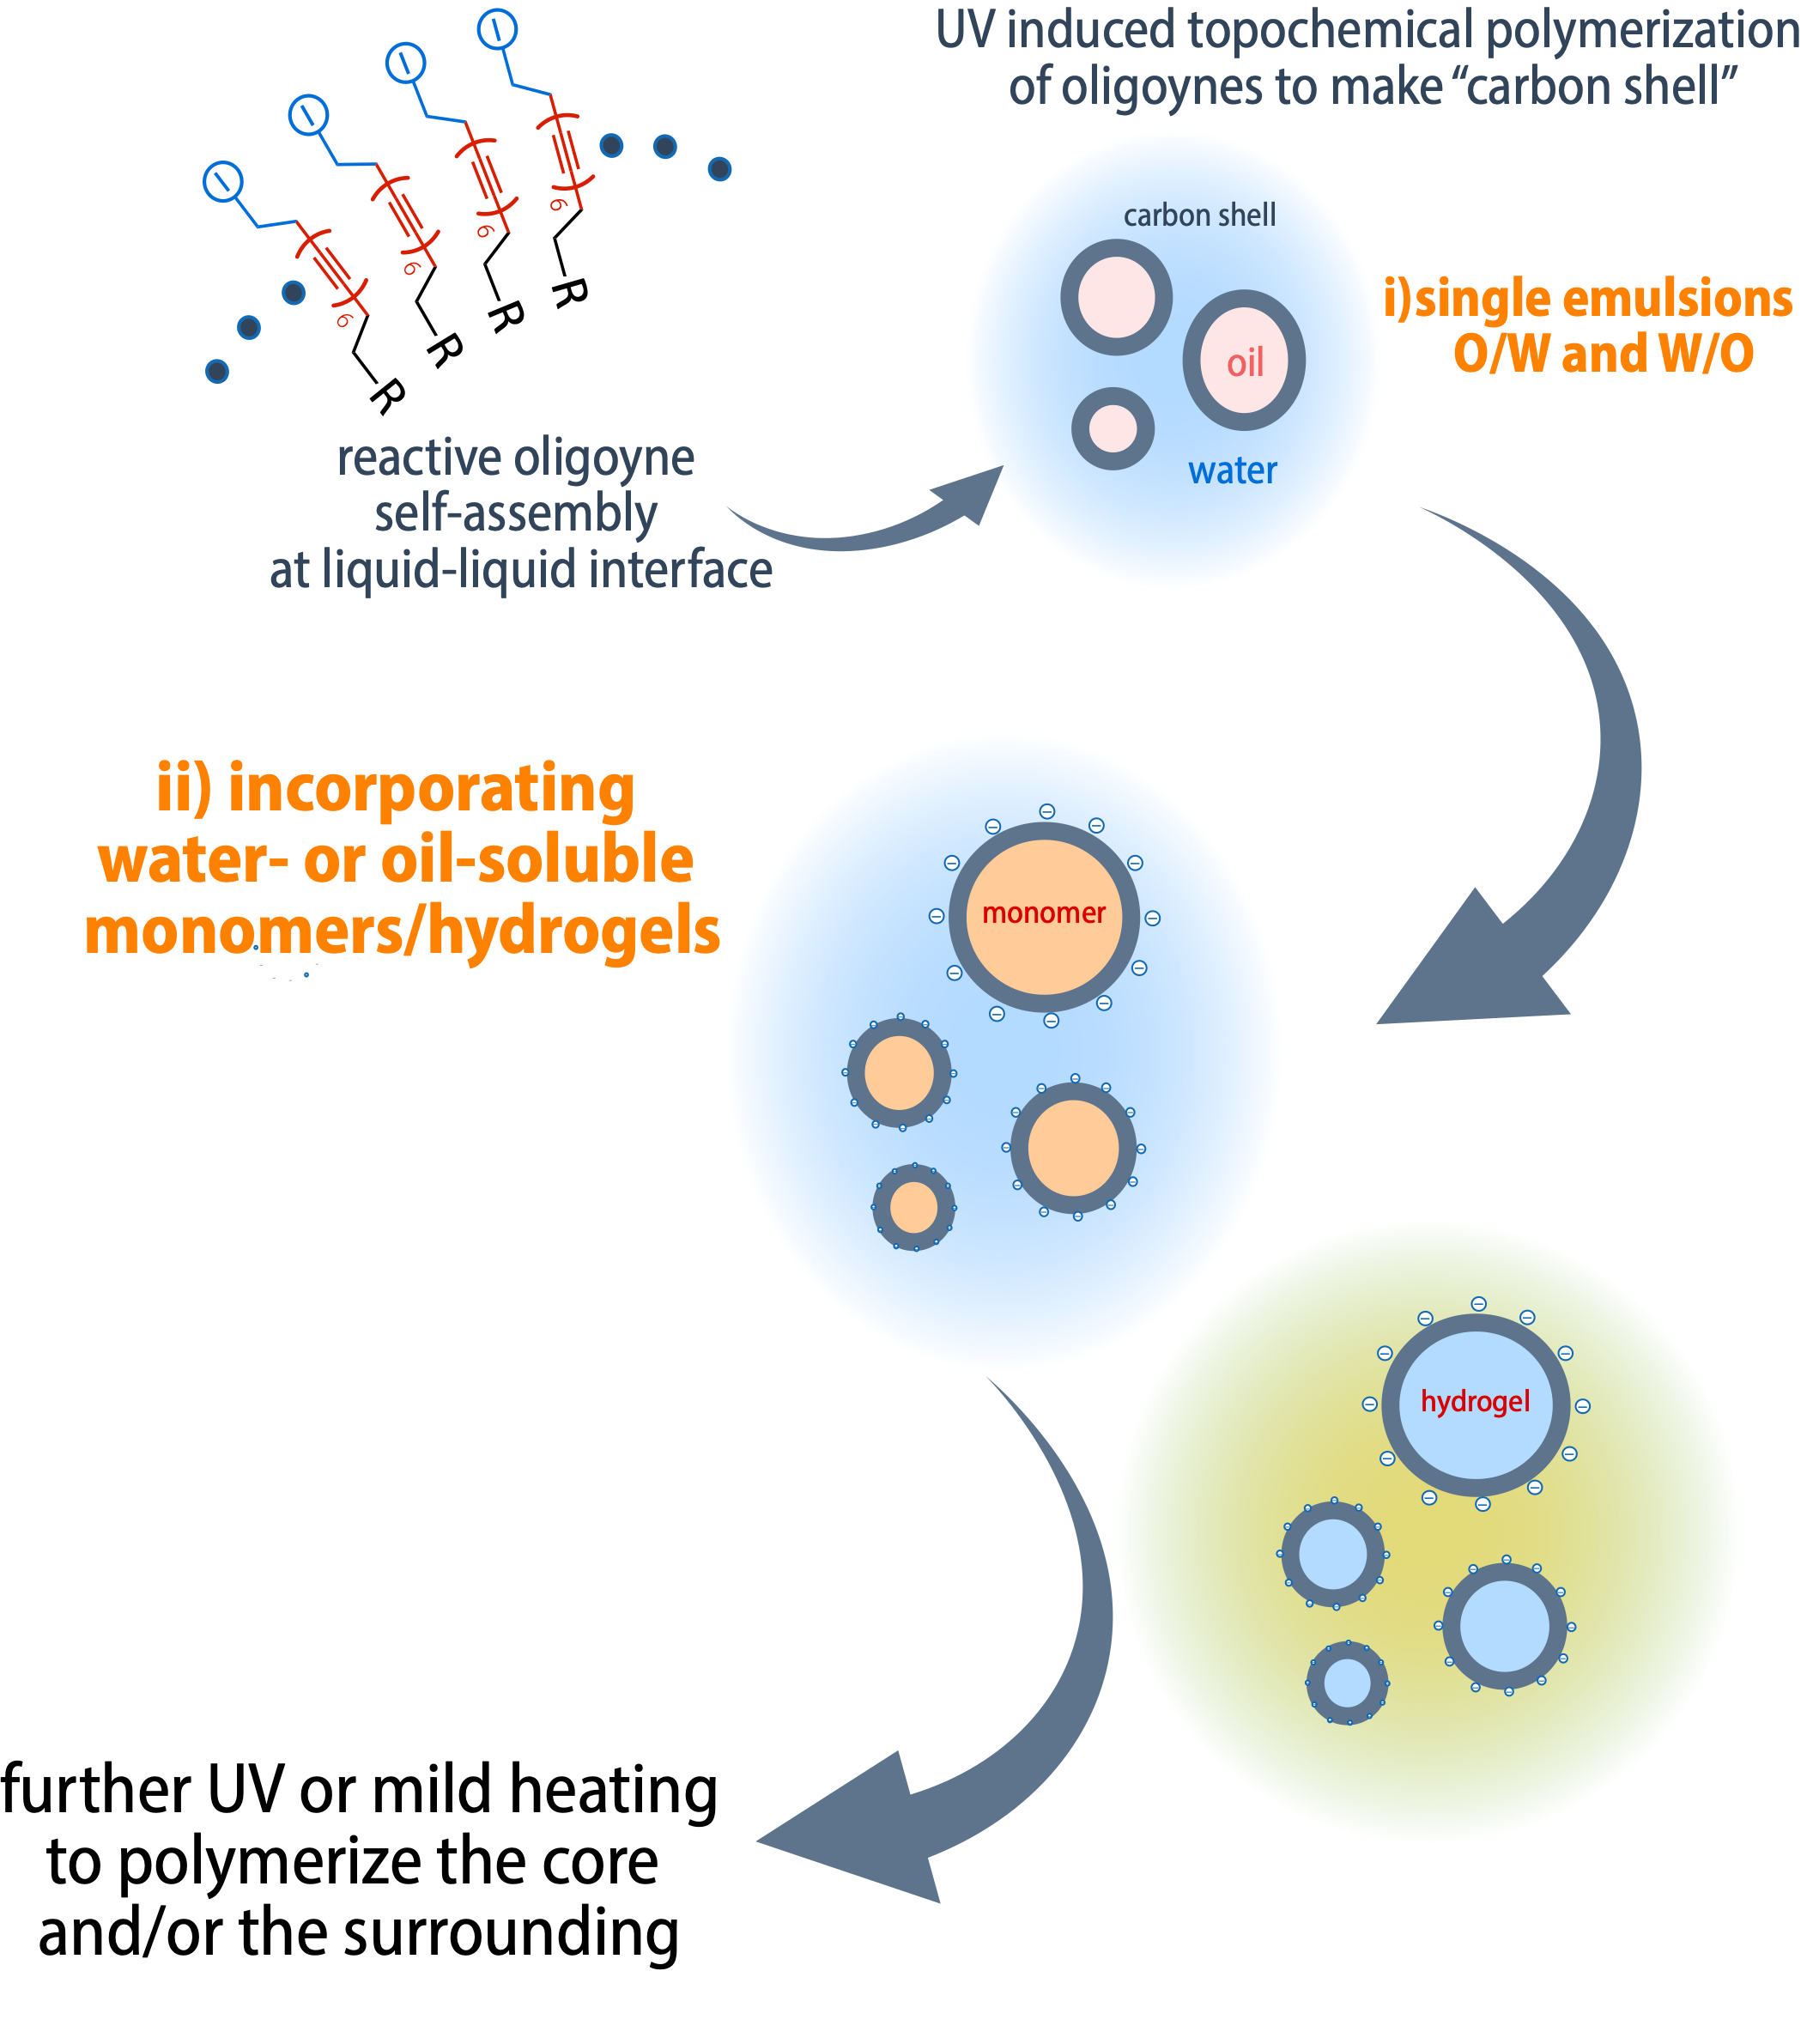
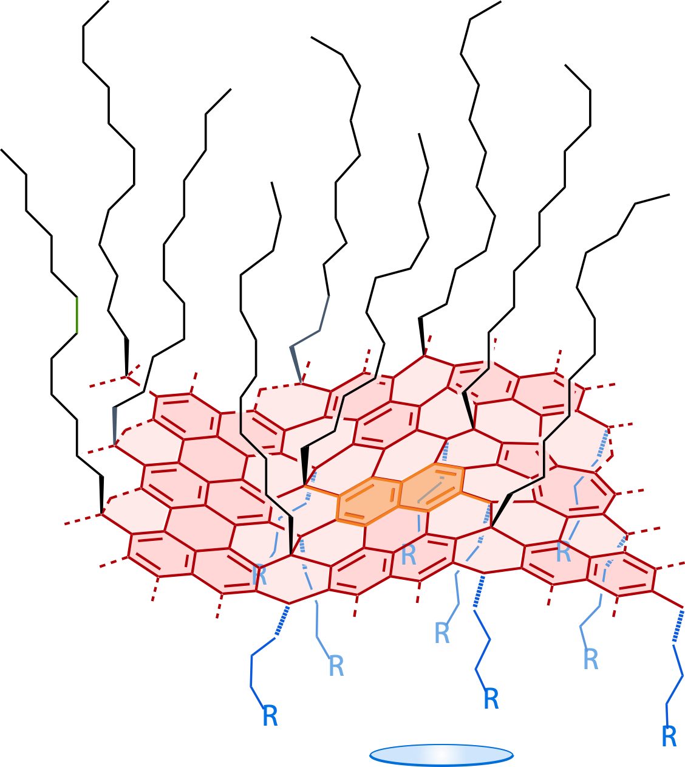

Self-Assembly of Reactive Oligoynes for Hierarchically Structured Carbon Nanomaterials
self-assembly of oligoyne surfactants at liq-liq interface
droplet-based integration into polymeric materials
macroscopic assembly of capsules having carbon wall
0.5 mm
0.5 mm
24 Å²
topochemical polymerization > sp² rich amorphous carbon layer formation at mild conditions
solution-borne, chemical functionalization, surfactant-like molecules that are reactive
intrinsic self-healing property > hierarchically designed dynamic materials
Gizem Beliktay

