Slide 1
3D Printing Metamaterials
Amirhossein Sotoodehfar
Laboratory of Wave Engineering
December 2025

Slide 2
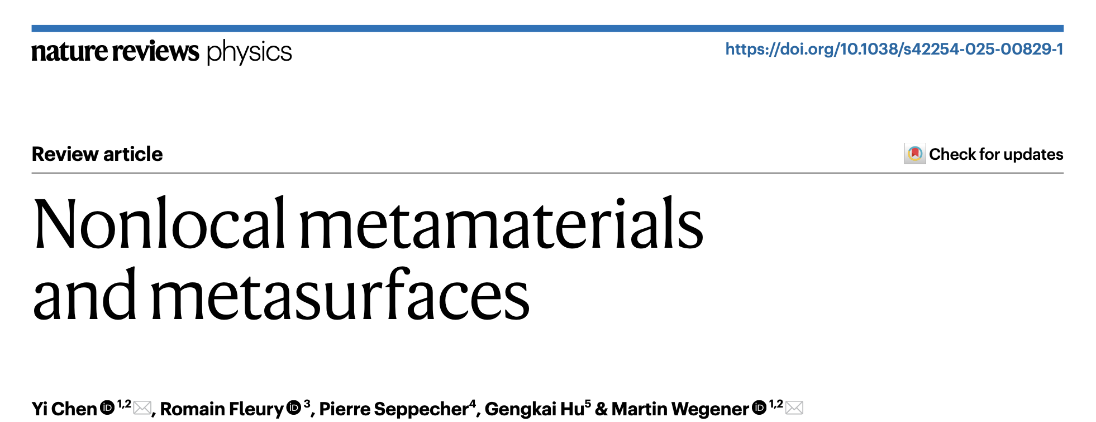
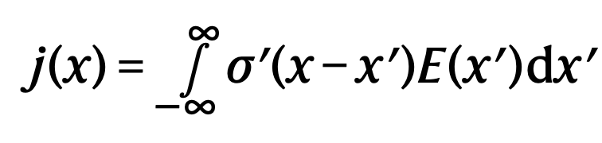
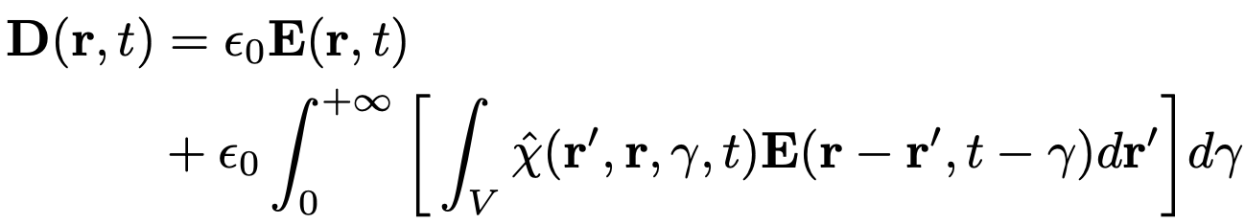
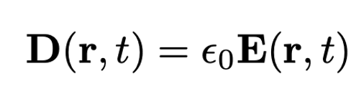
Nonlocal Metamaterials?

Slide 3
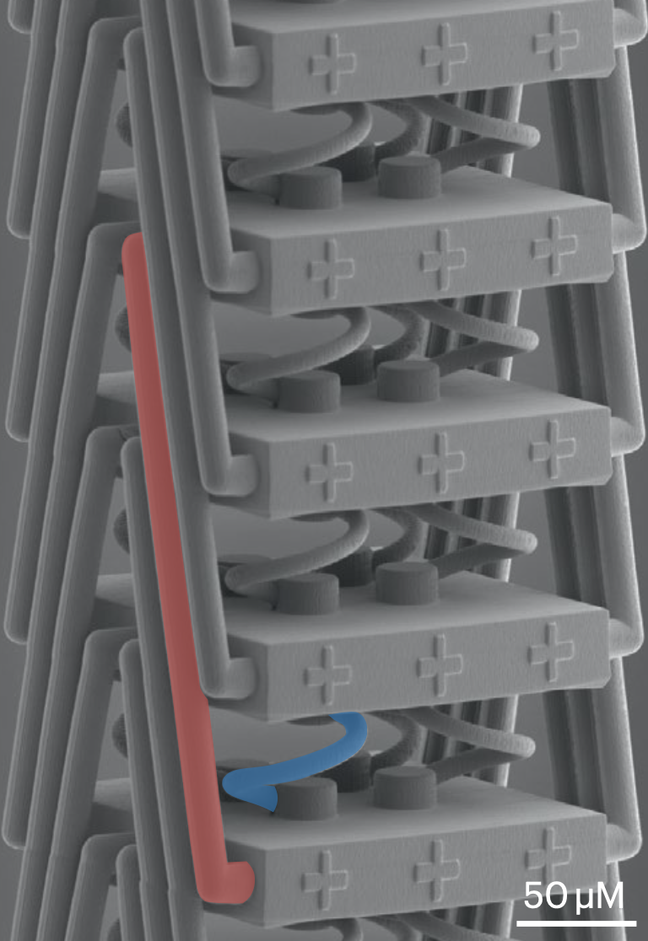
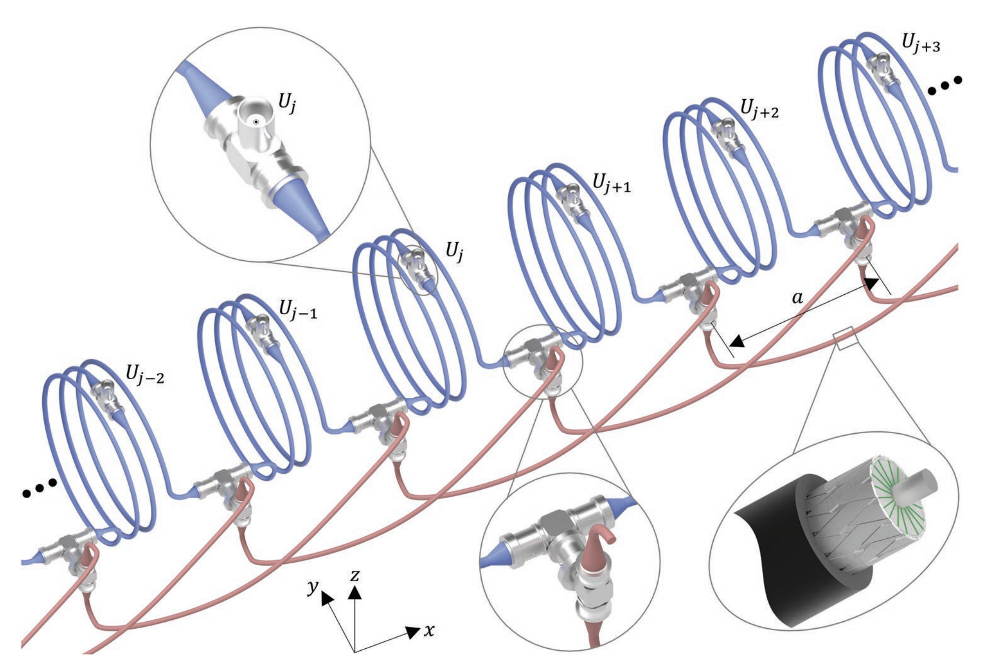
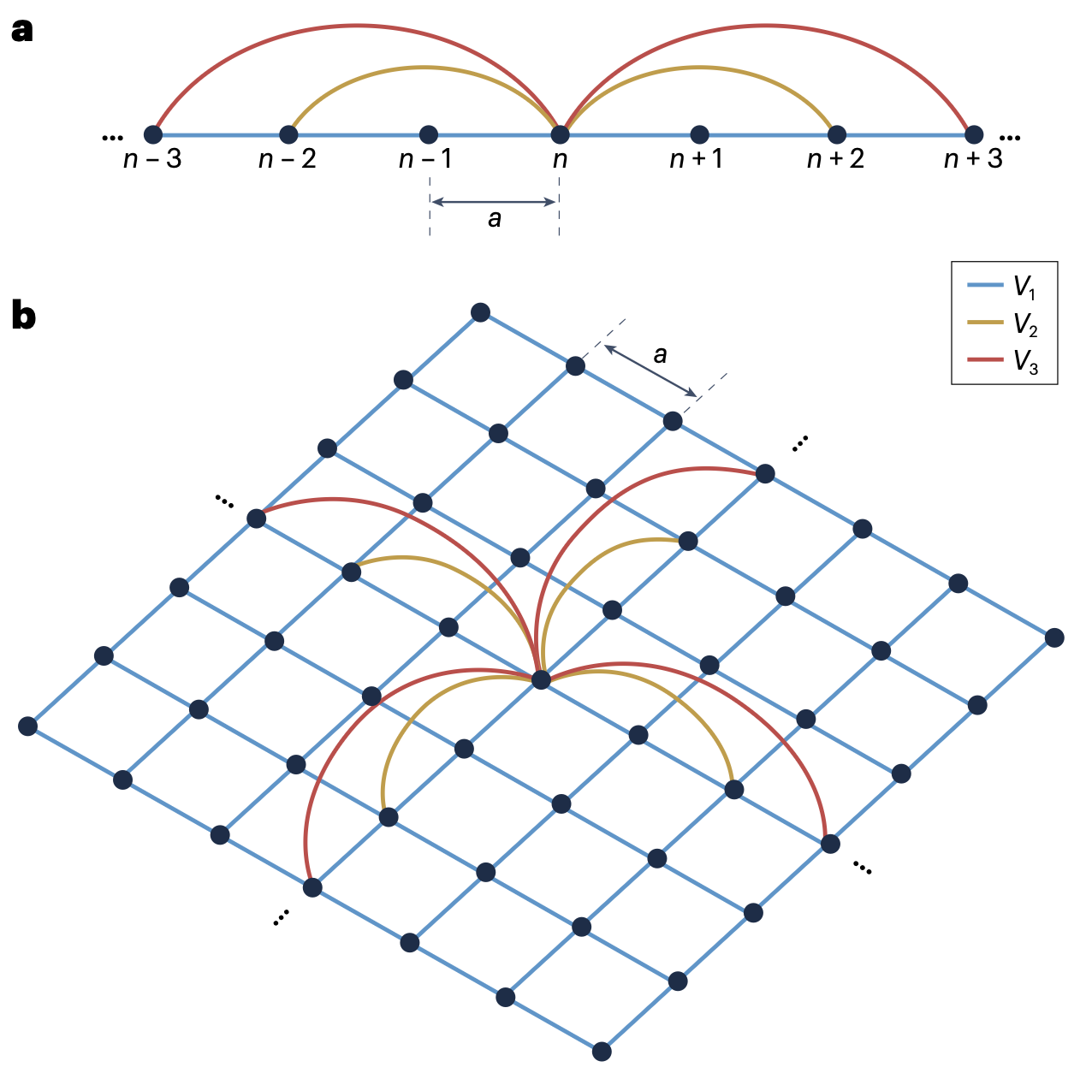
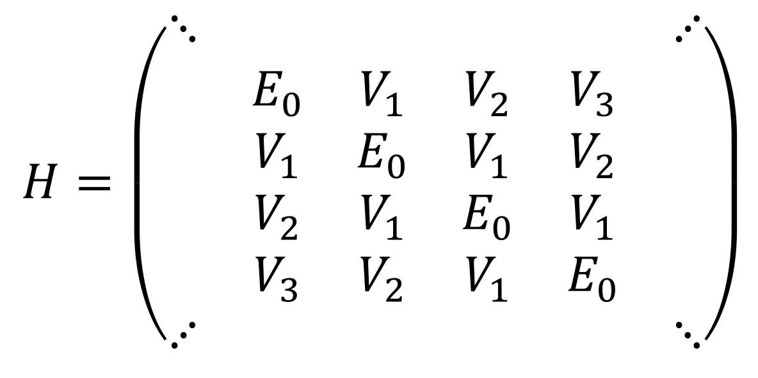
What are Nonlocal Metamaterials?
Commercial 3D laser printer (Professional GT, Nanoscribe GmbH)

Slide 4
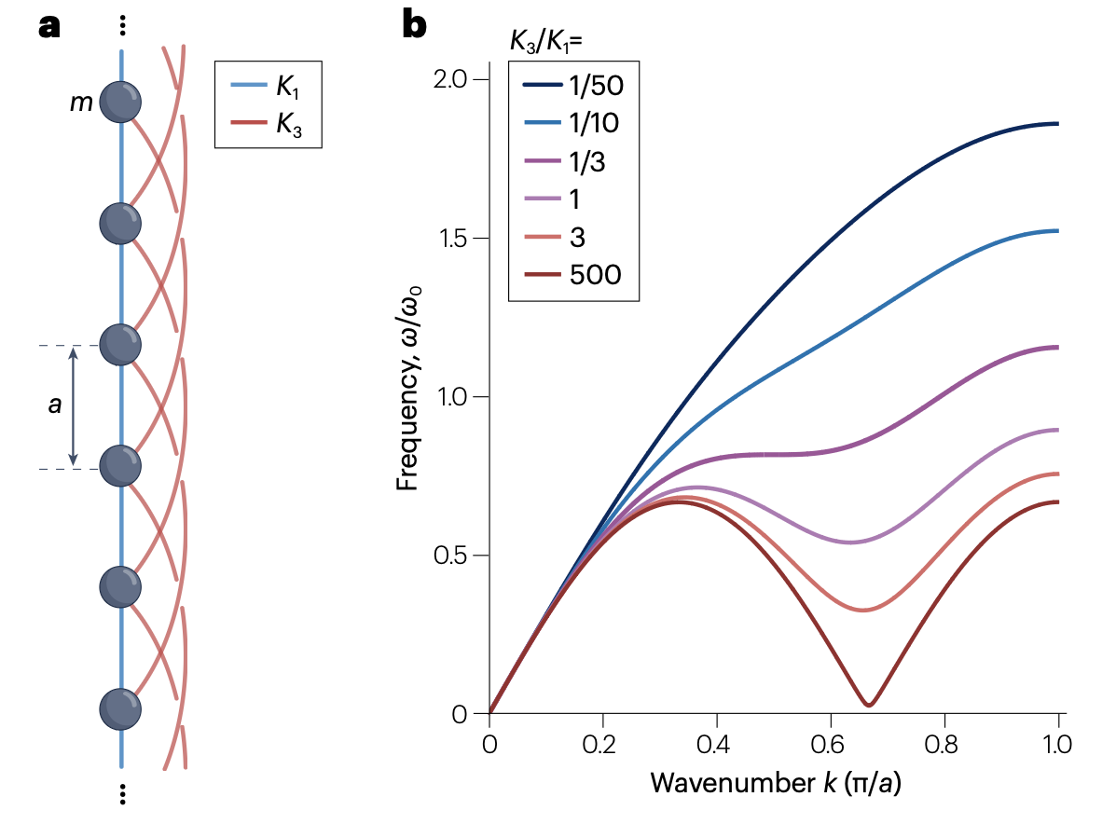
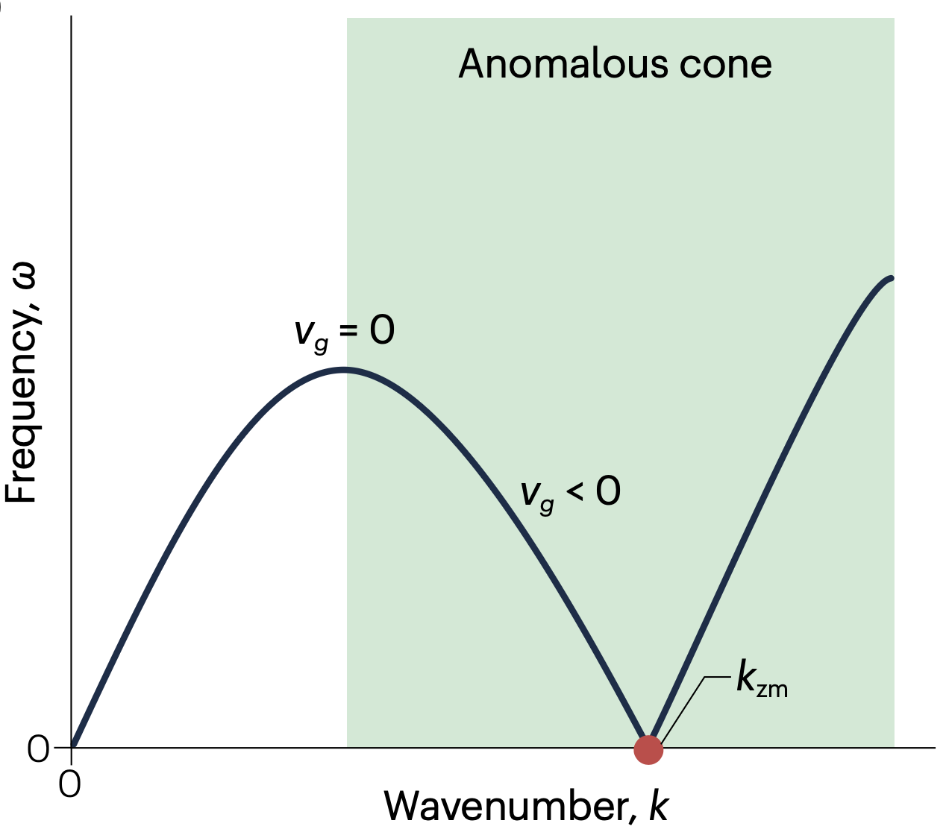
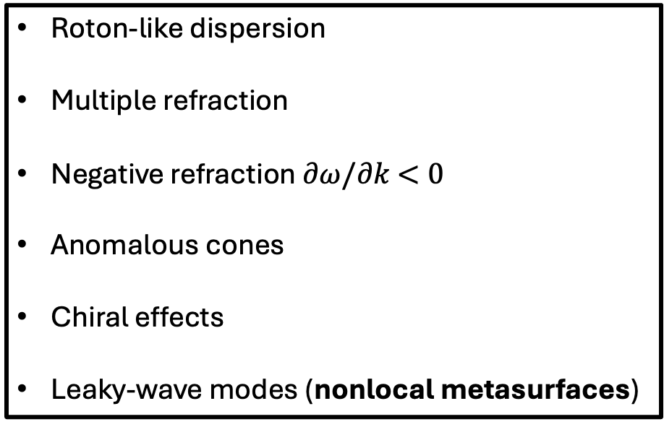
Why Nonlocal Metamaterials?
Roton-like dispersion
Multiple refraction
Negative refraction $∂ω/∂k$ $<0$
Anomalous cones
Chiral effects
Leaky-wave modes (nonlocal metasurfaces)

Slide 5
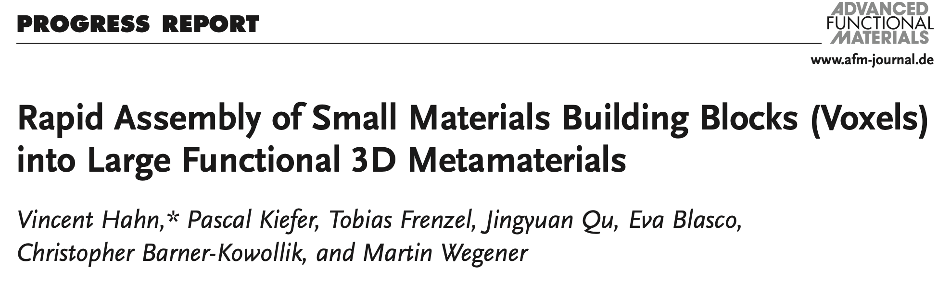
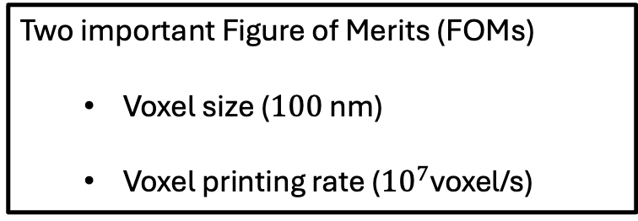
How to 3D Print Nonlocal Metamaterials?
Two important Figure of Merits (FOMs)
  Voxel size ($100$ nm)
  Voxel printing rate (${10}^{7}$voxel/s)

Slide 6
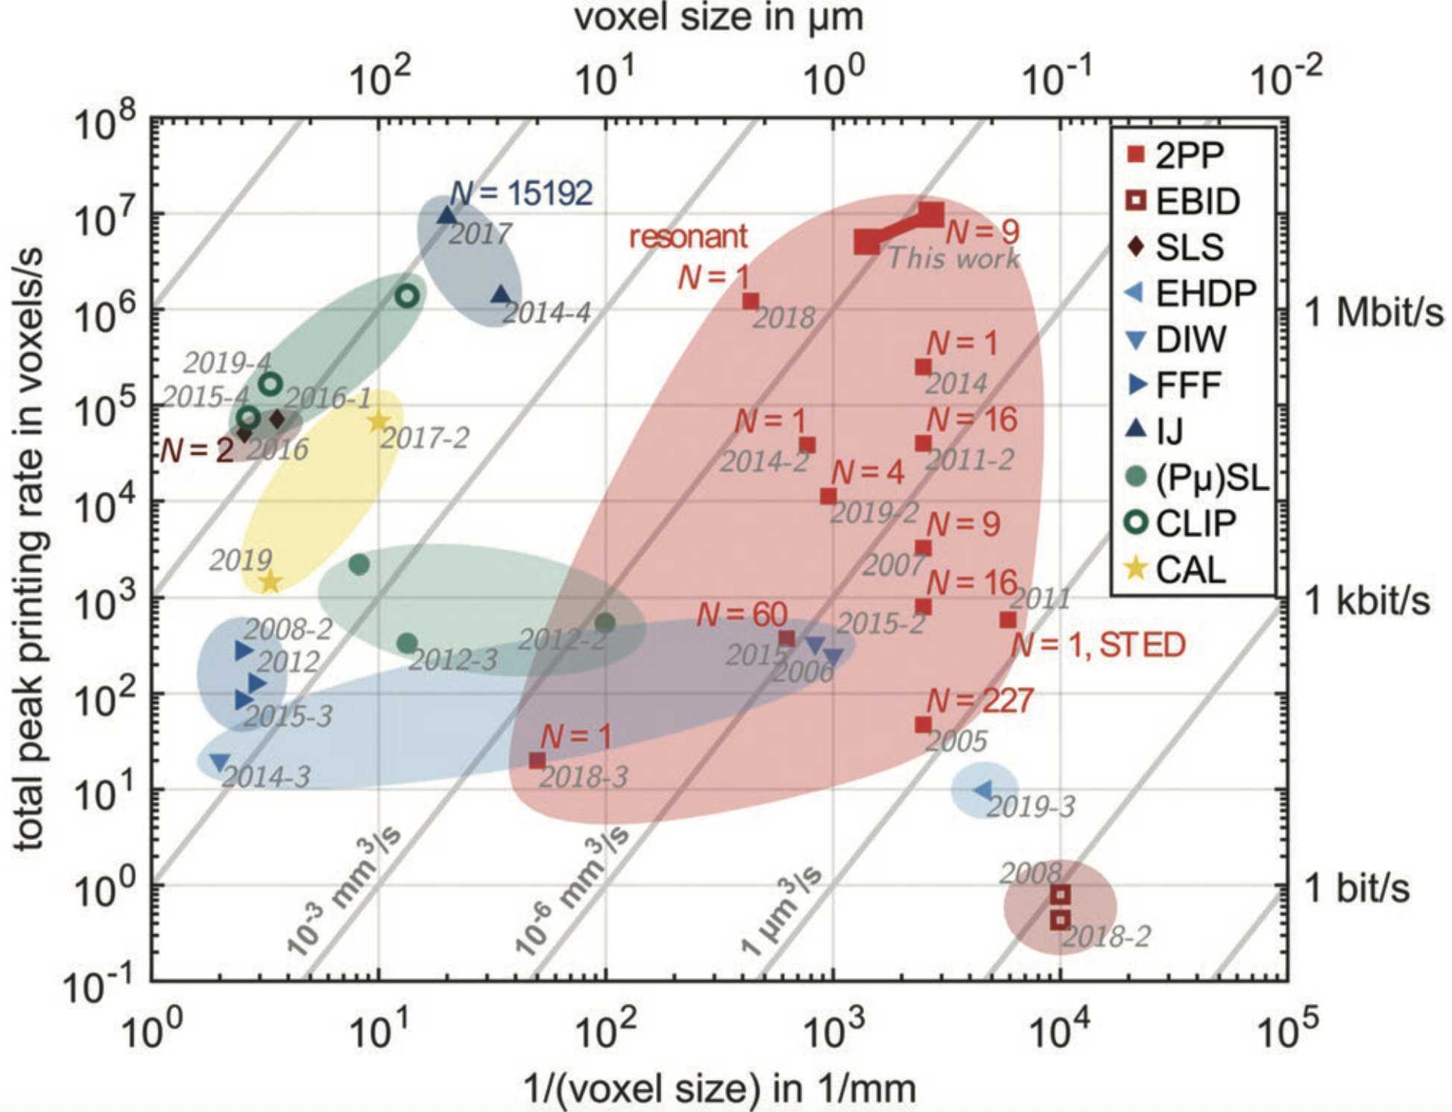
How to 3D Print Nonlocal Metamaterials?
Electron Beam Induced Deposition (EBID)
Selective Laser Sintering (SLS)
Electrohydrodynamic Printing (EHDP)
Fused Filament Fabrication (FFF)
Direct Ink Writing (DIW)
Inkjet 3D Printing (IJ)
Projection Microstereolithography (PµSL)
Continuous Liquid Interface Production (CLIP)
Computed Axial Lithography (CAL)
Two-Photon Printing (2PP / Multiphoton Printing)
Constant 3D volume printing rates
Notes:
1. Electron Beam Induced Deposition (EBID)
• Uses a focused electron beam to deposit material from gas.
• Very high potential resolution (limited by molecule size).
• Major limitation: extremely slow (~1 voxel/s).
• Cannot easily print geometries orthogonal to the beam.
2. Selective Laser Sintering (SLS)
• A laser scans and fuses a powder bed layer-by-layer.
• High scan speeds (meters/s).
• Resolution ~500 μm.
• Speed: ~10⁵ voxels/s.
• Works for plastics and metals (requires high power).
3. Electrohydrodynamic Printing (EHDP)
• Metal ions from a sacrificial anode are reduced and deposited.
• Produces metallic structures.
• Speed: up to 10 voxels/s.
• Feature size: ~250 nm.
4. Fused Filament Fabrication (FFF)
• Standard thermoplastic filament melted and deposited through a nozzle.
• Inexpensive and common.
• Speed: hundreds of voxels/s.
• Resolution ~500 μm.
5. Direct Ink Writing (DIW)
• Similar to FFF, but uses liquid inks that solidify (thermal curing, coagulation).
• Speed: similar to FFF.
• Resolution ranges from millimeters to micrometers depending on ink.
6. Inkjet 3D Printing (IJ)
• Arrays of tiny nozzles eject droplets of material or glue (for powder beds).
• Very fast (up to 10⁷ voxels/s, fastest in the comparison).
• Voxel size 10–100 μm.
• Limitations: not all geometries feasible; effective voxel size may be larger.
7. Projection Microstereolithography (PµSL)
• Projects 2D images into a photoresin layer-by-layer (parallel in 2D).
• Resolution determined by diffraction laterally and by Beer’s law axially.
• Despite parallelism, voxel rates are low; voxel sizes ~10–100s μm.
• Requires layer settling (“top-down”) or careful delamination (“bottom-up”).
8. Continuous Liquid Interface Production (CLIP)
• Similar to PµSL, but uses oxygen-permeable membrane to prevent layer adhesion, removing waiting steps.
• Faster than PµSL.
• Voxel sizes: ~100 μm to 1 mm.
• High speeds (up to >10⁵ voxels/s for advanced variants).
9. Computed Axial Lithography (CAL)
• Fully parallel in all 3 dimensions.
• Based on tomographic reconstruction: many projections illuminate a rotating resin tank.
• After exposure, unpolymerized resin is washed away.
• Current limitations: voxel sizes 100 μm–1 mm and speeds 10³–10⁴ voxels/s.
• Only solid objects demonstrated so far.
10. Two-Photon Printing (2PP / Multiphoton Printing)
• Mentioned only in the list; high resolution but typically slow (not described in detail here).

Slide 7
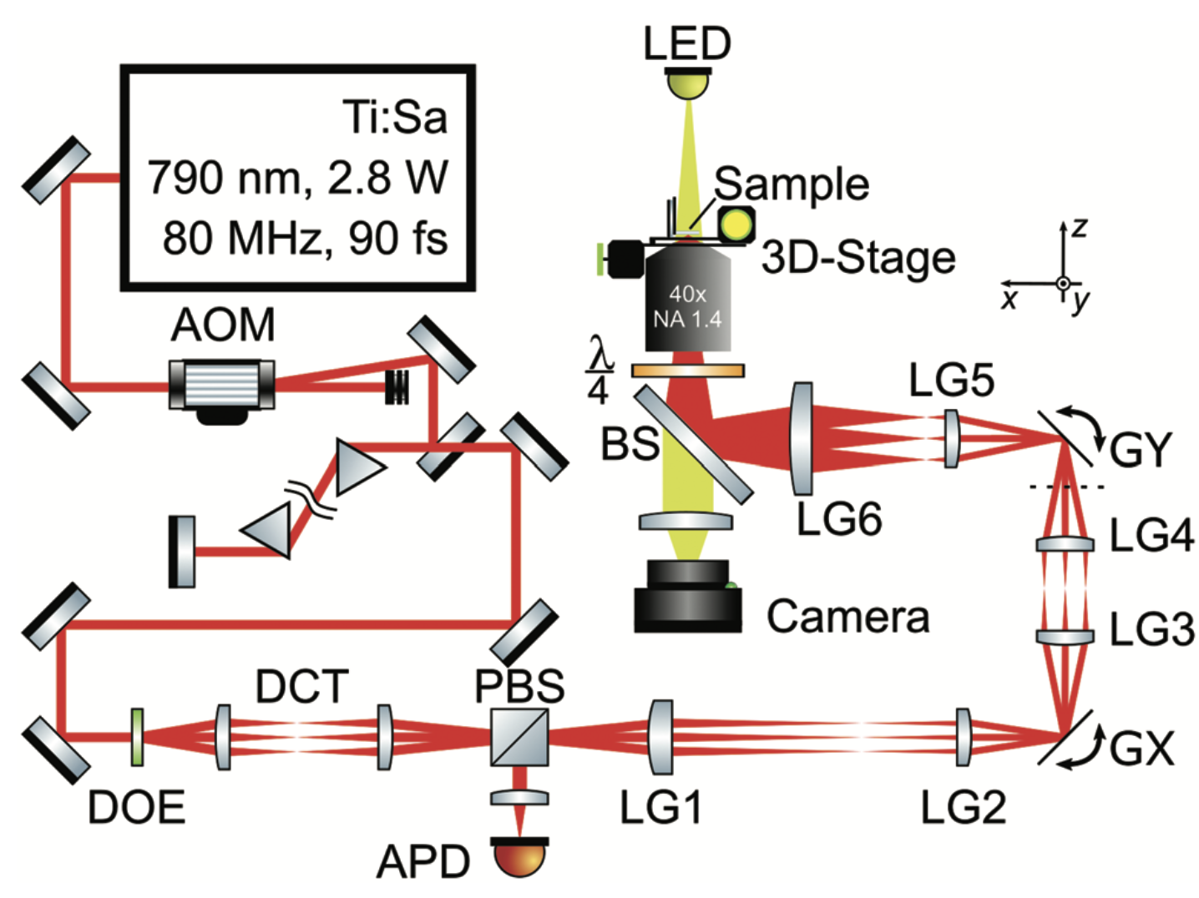
How to 3D Print Nonlocal Metamaterials?

Slide 8
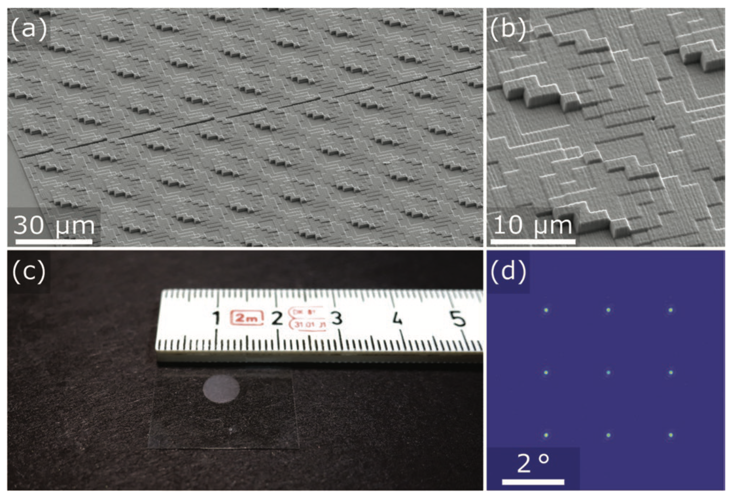
How to 3D Print Nonlocal Metamaterials?
The diffractive optical element
Nanoscribe Photonic Professional GT 3D laser printer

Slide 9
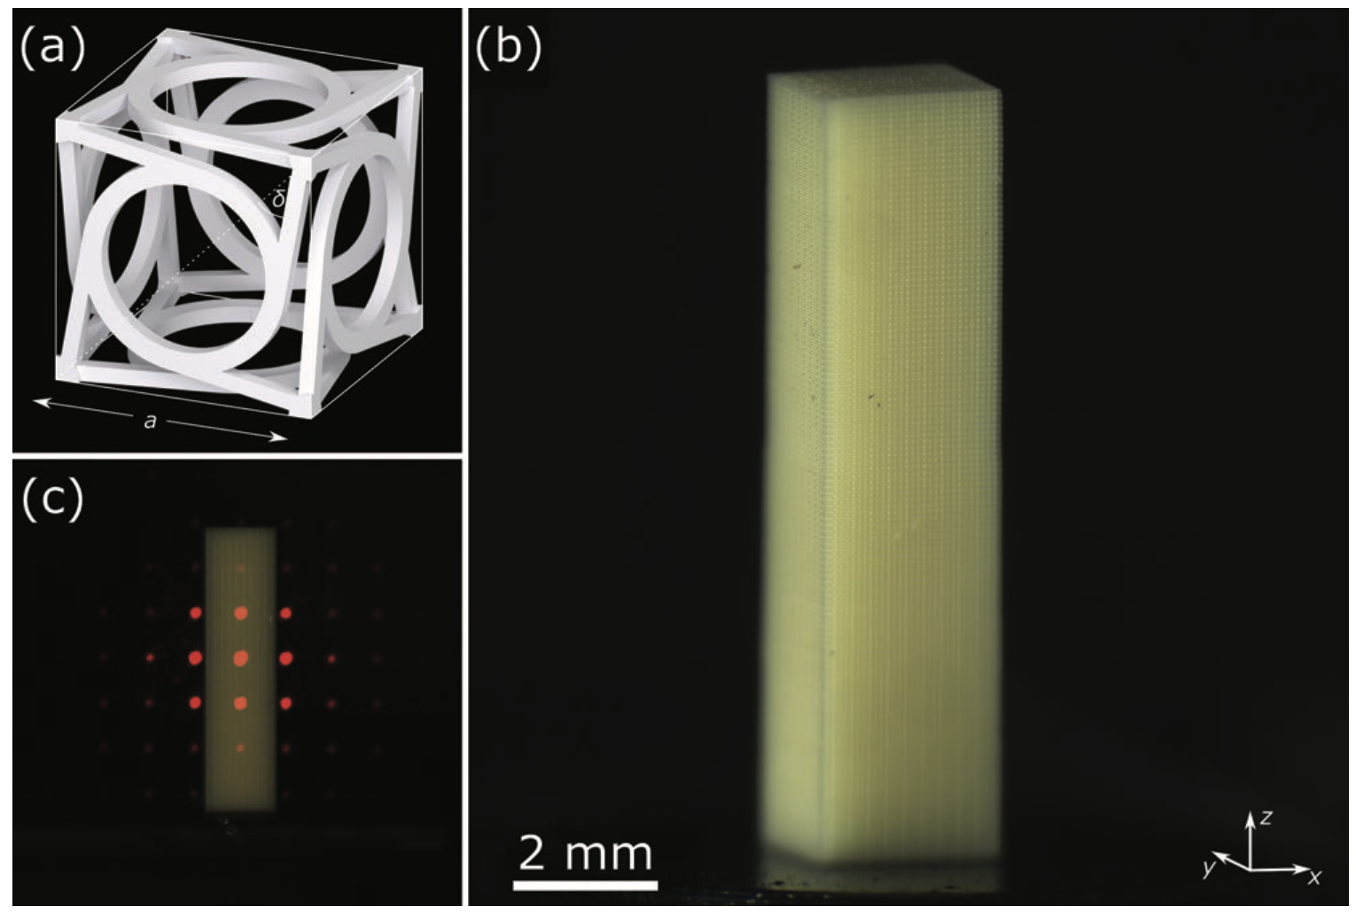
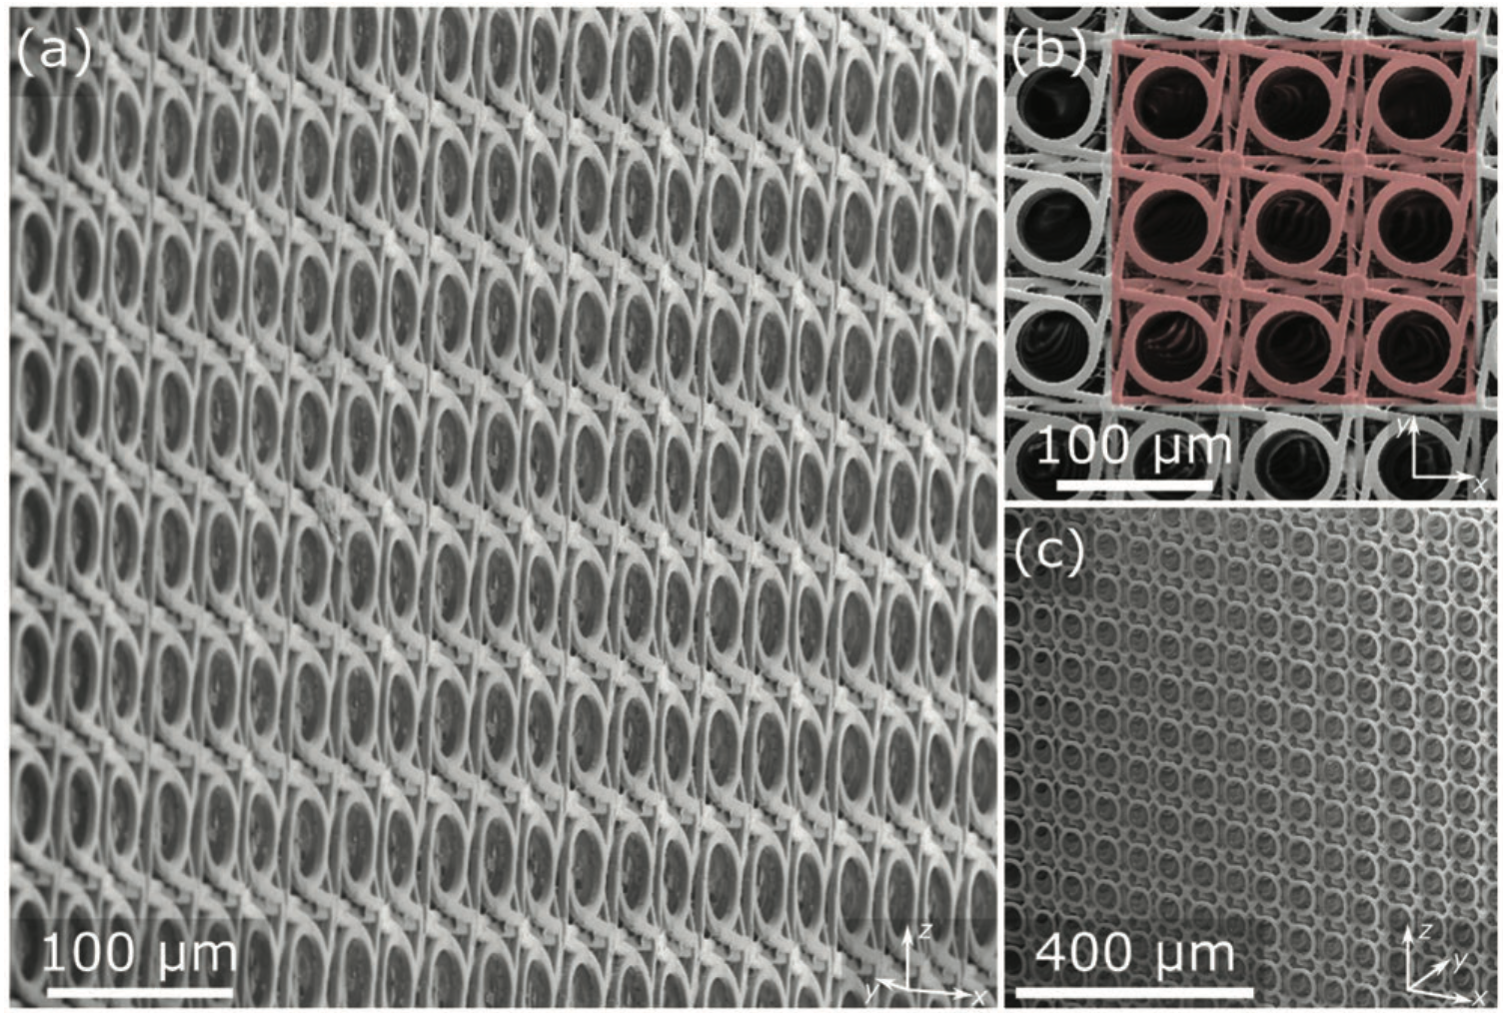
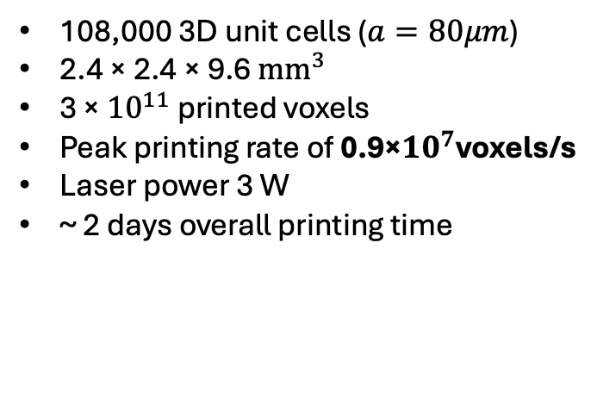
Some Results
Foci spacing limitation: more foci must be packed closer together, eventually causing interference and distortion in the exposure pattern.
Laser power scaling: Increasing the number of foci requires higher laser power, making low-threshold photoresists essential.
108,000 3D unit cells ($a=80μm$)
2.4 × 2.4 × 9.6 $mm^{3}$
3 × ${10}^{11}$ printed voxels
Peak printing rate of 0.9×${10}^{7}$voxels/s
Laser power 3 W
~ 2 days overall printing time

Slide 10
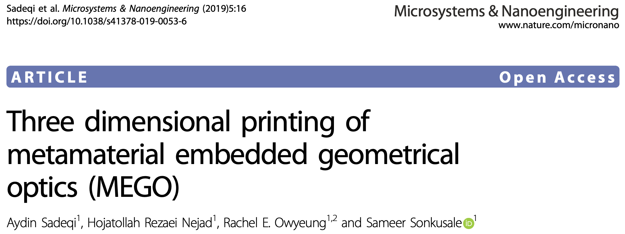
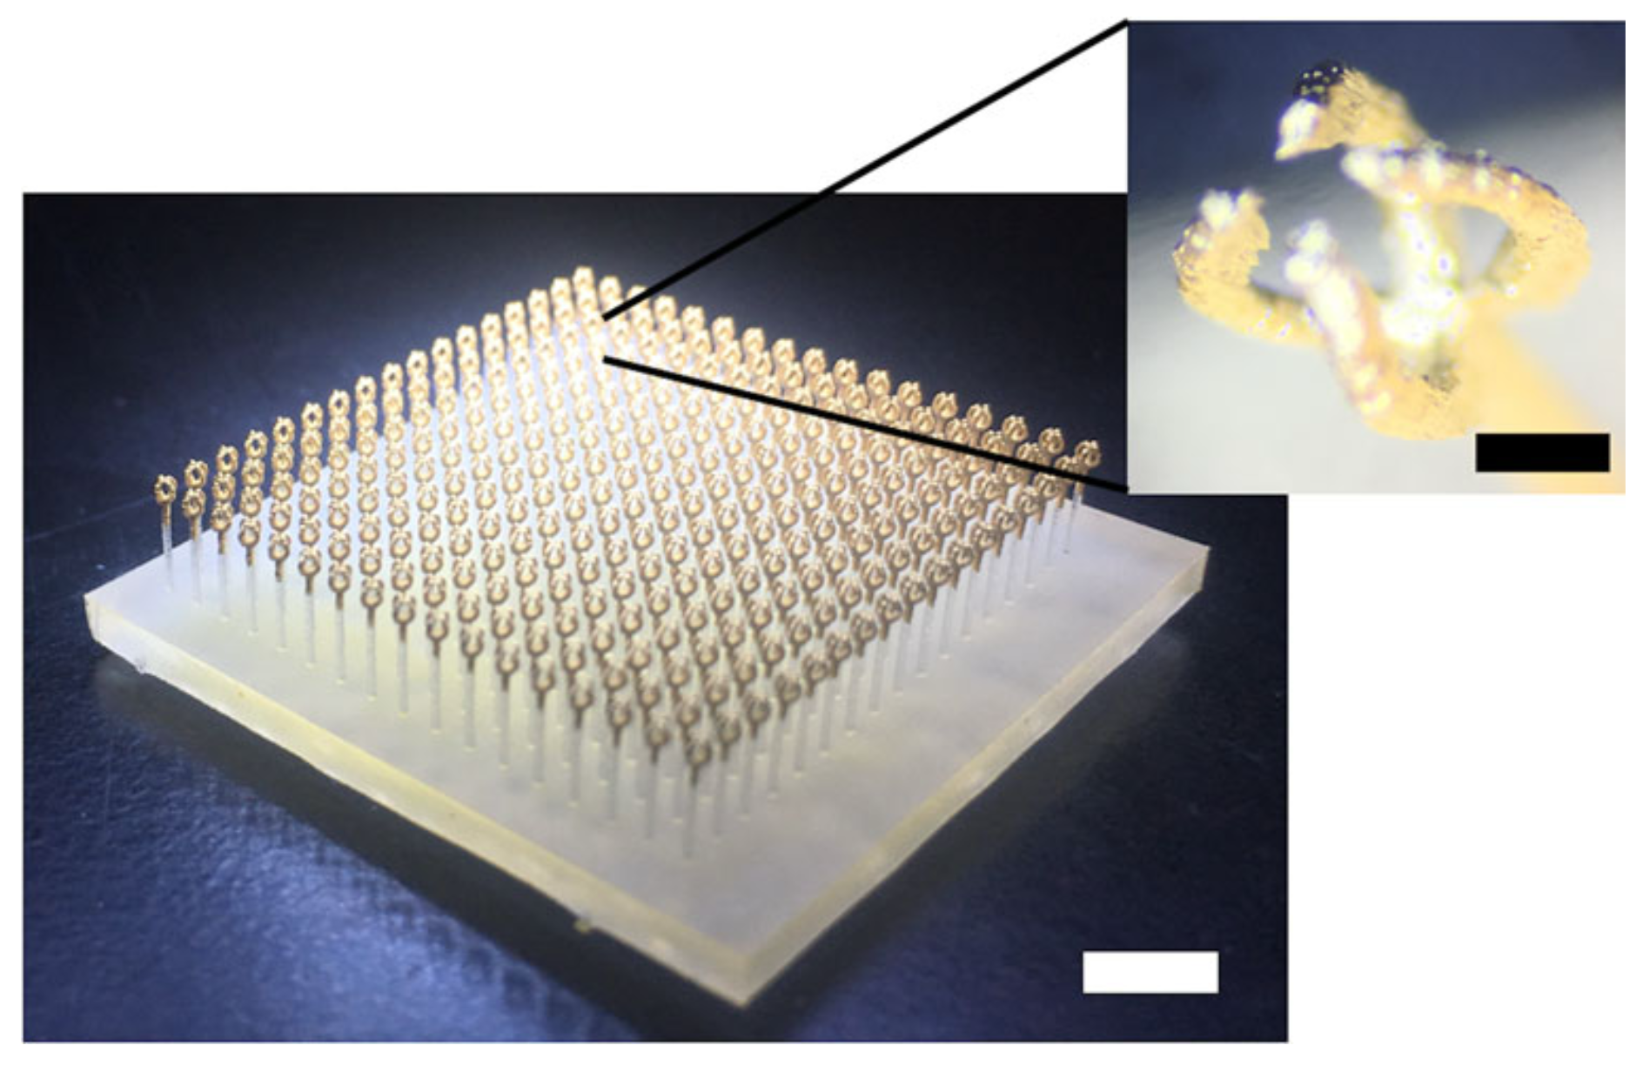
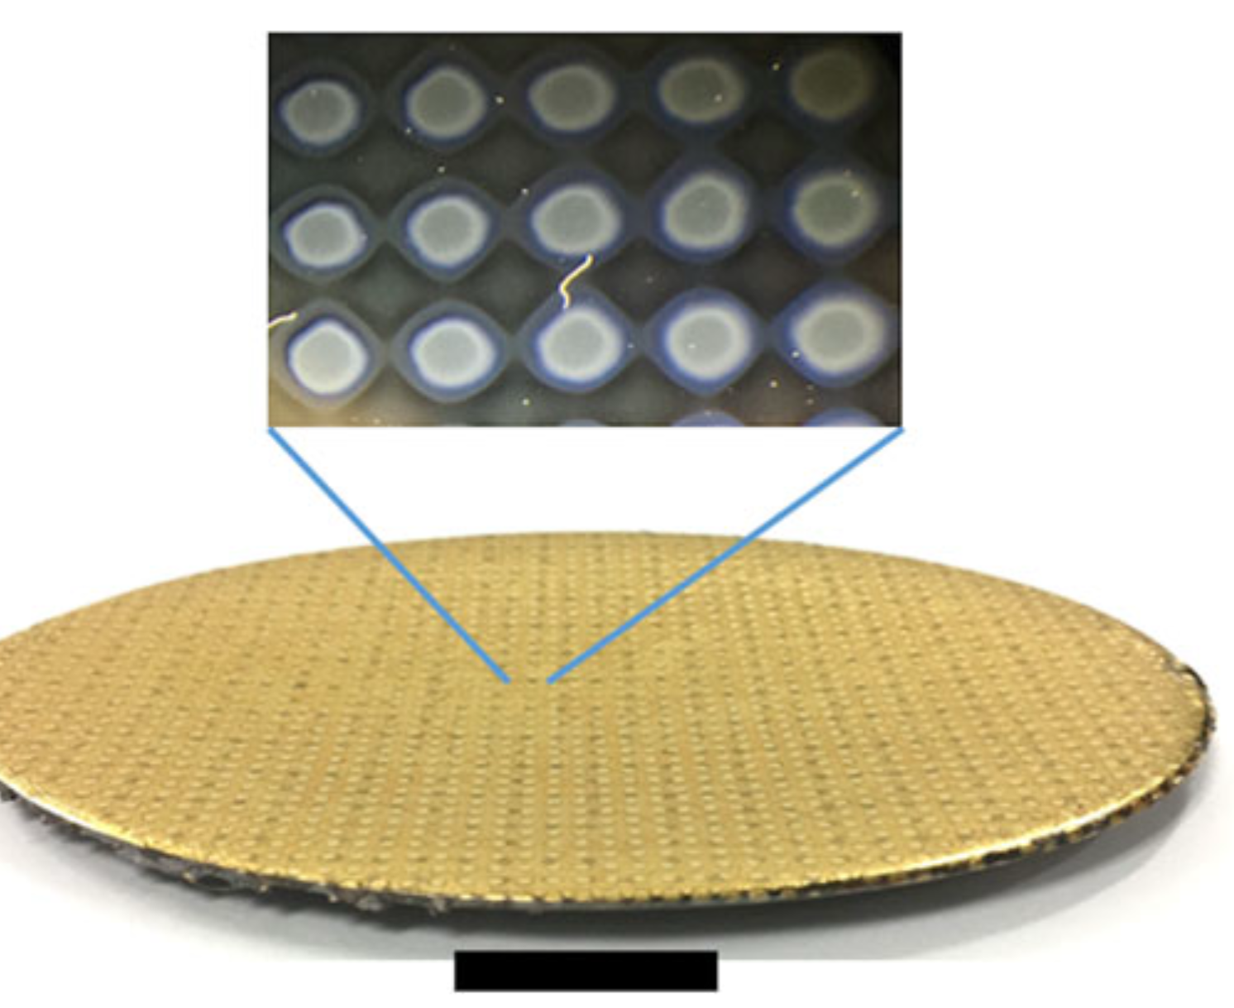
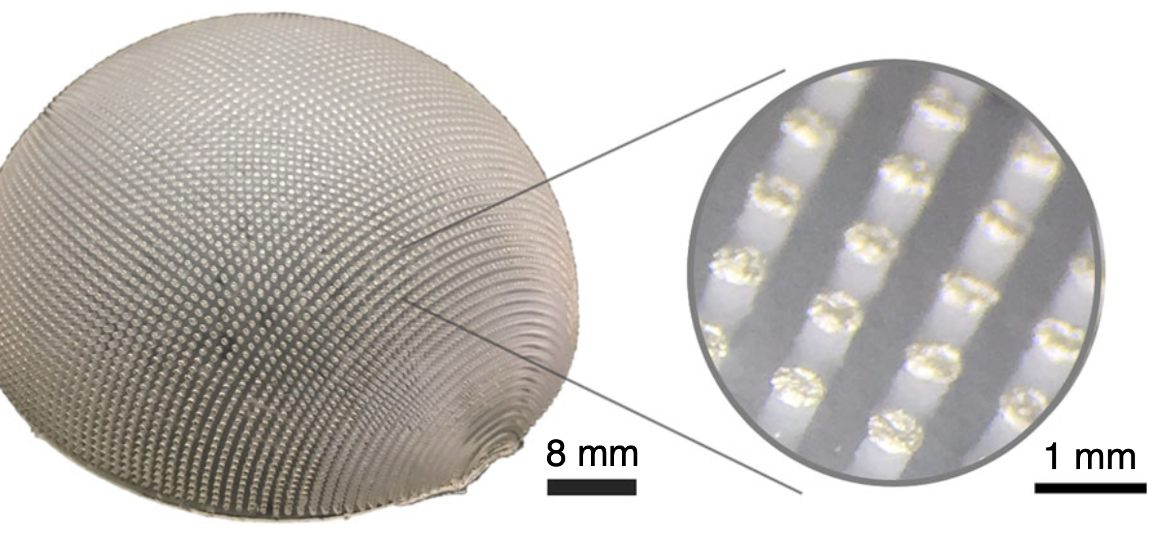
An Innovative Method

Slide 11
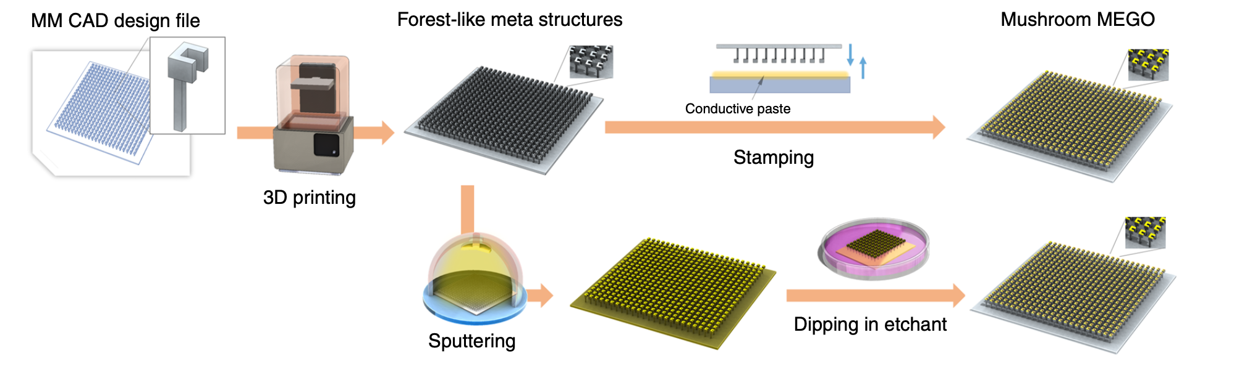
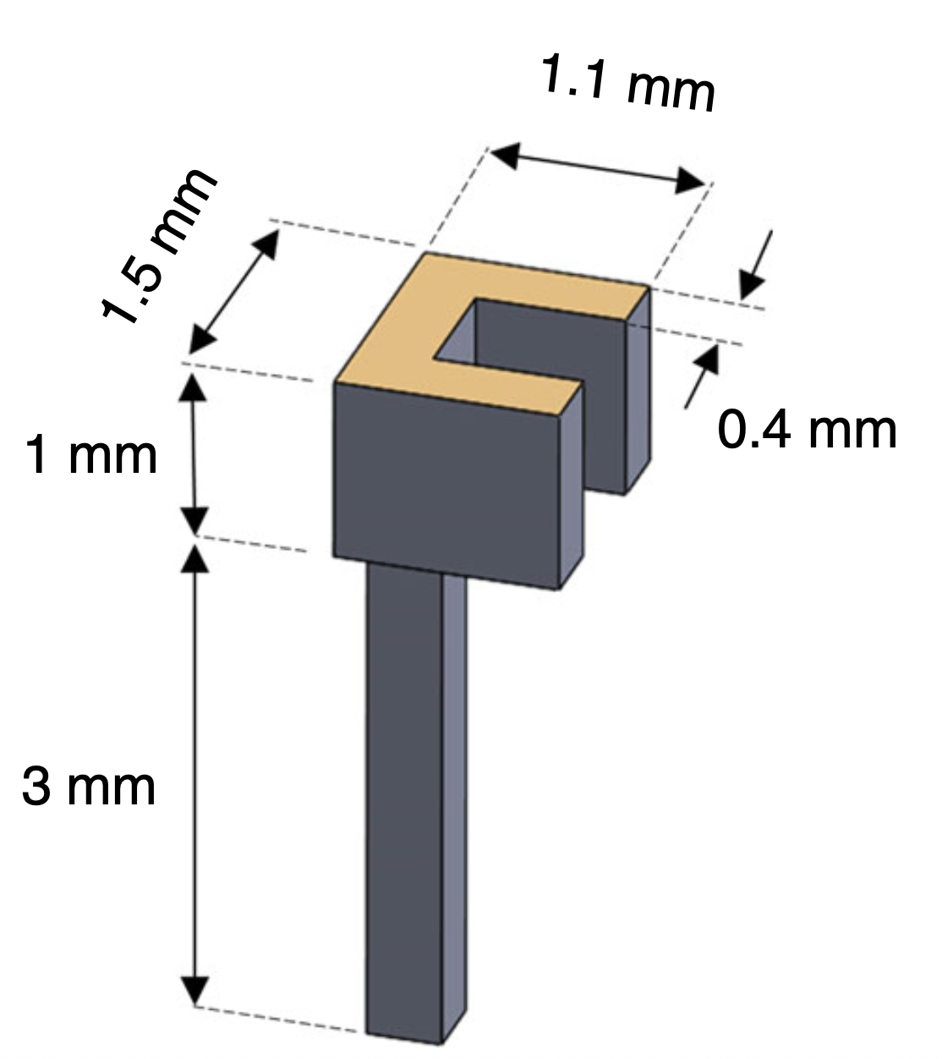
Fabrication Flow

Slide 12
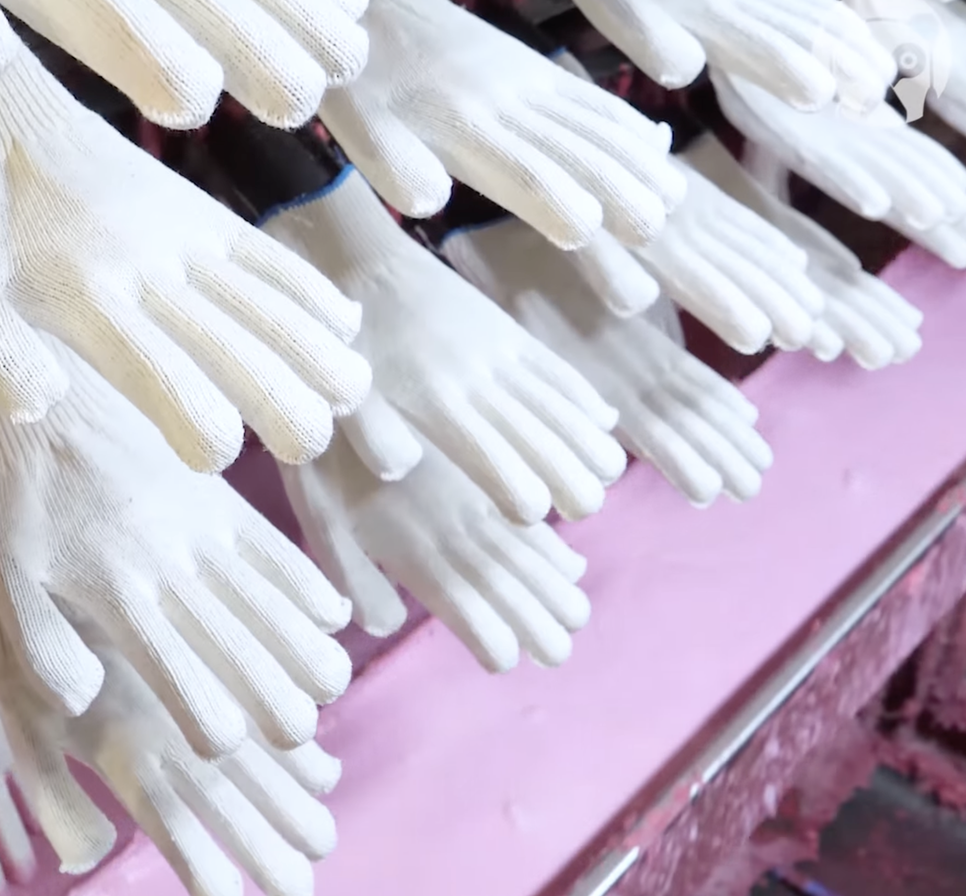
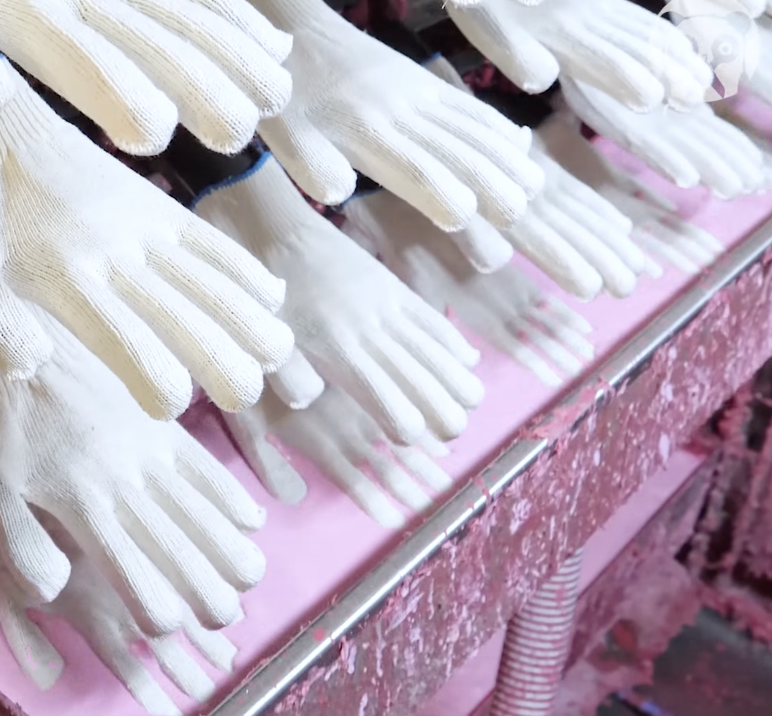
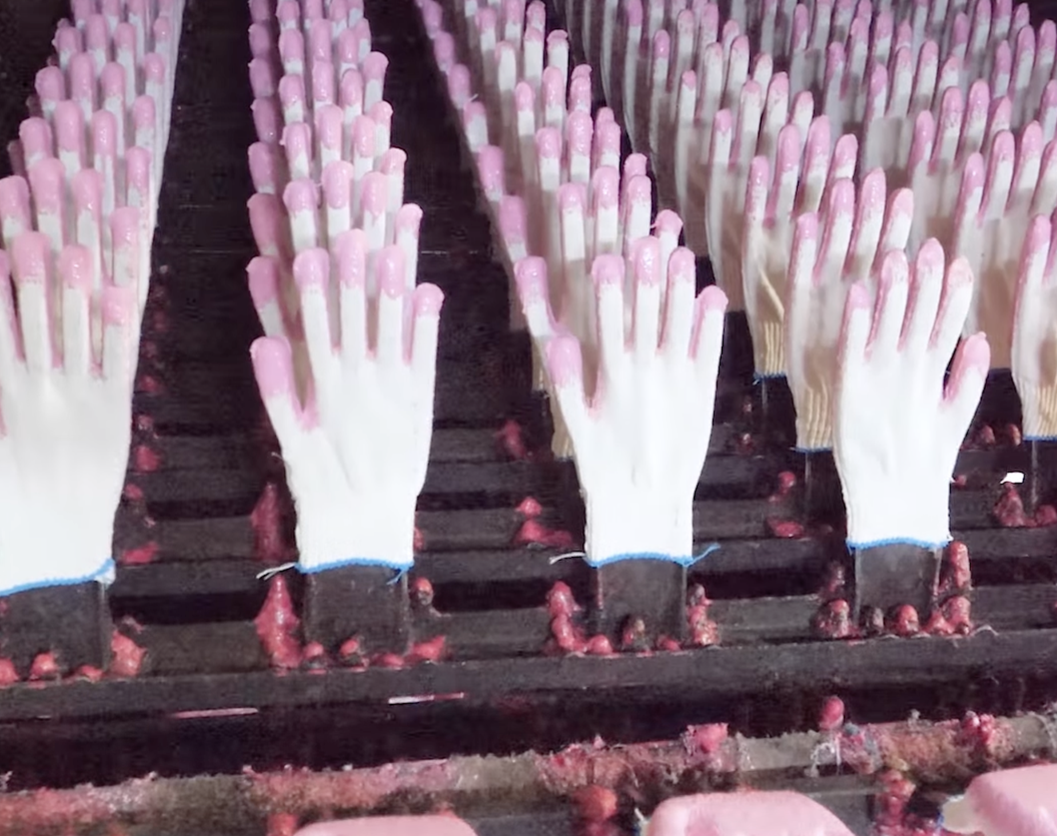

Slide 13
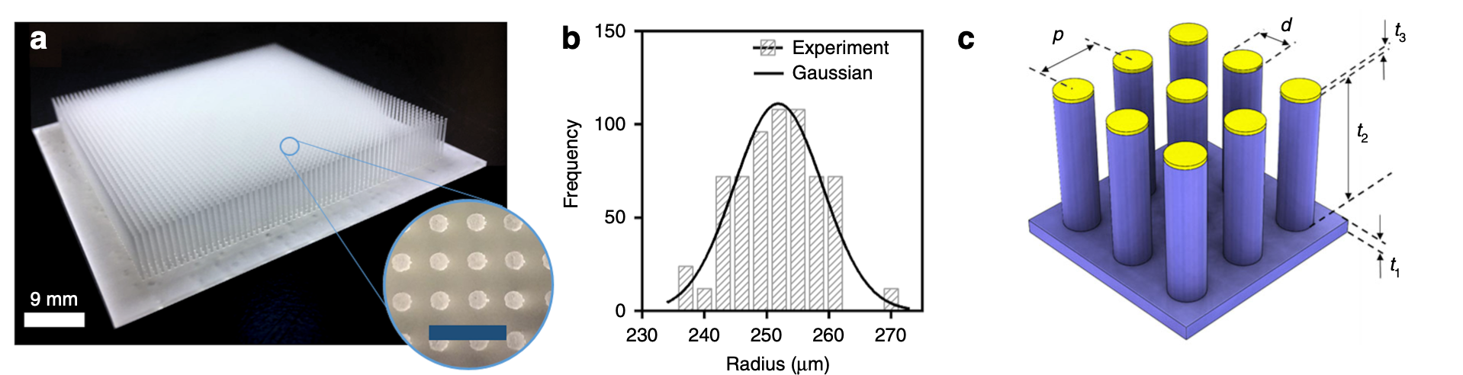
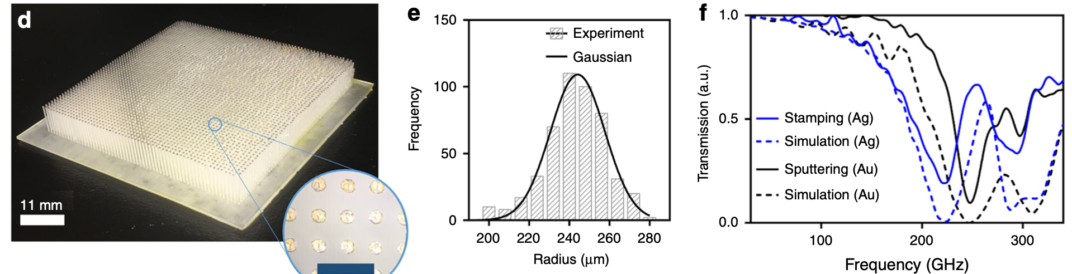
Cylindrical Mushroom MEGO

Slide 14
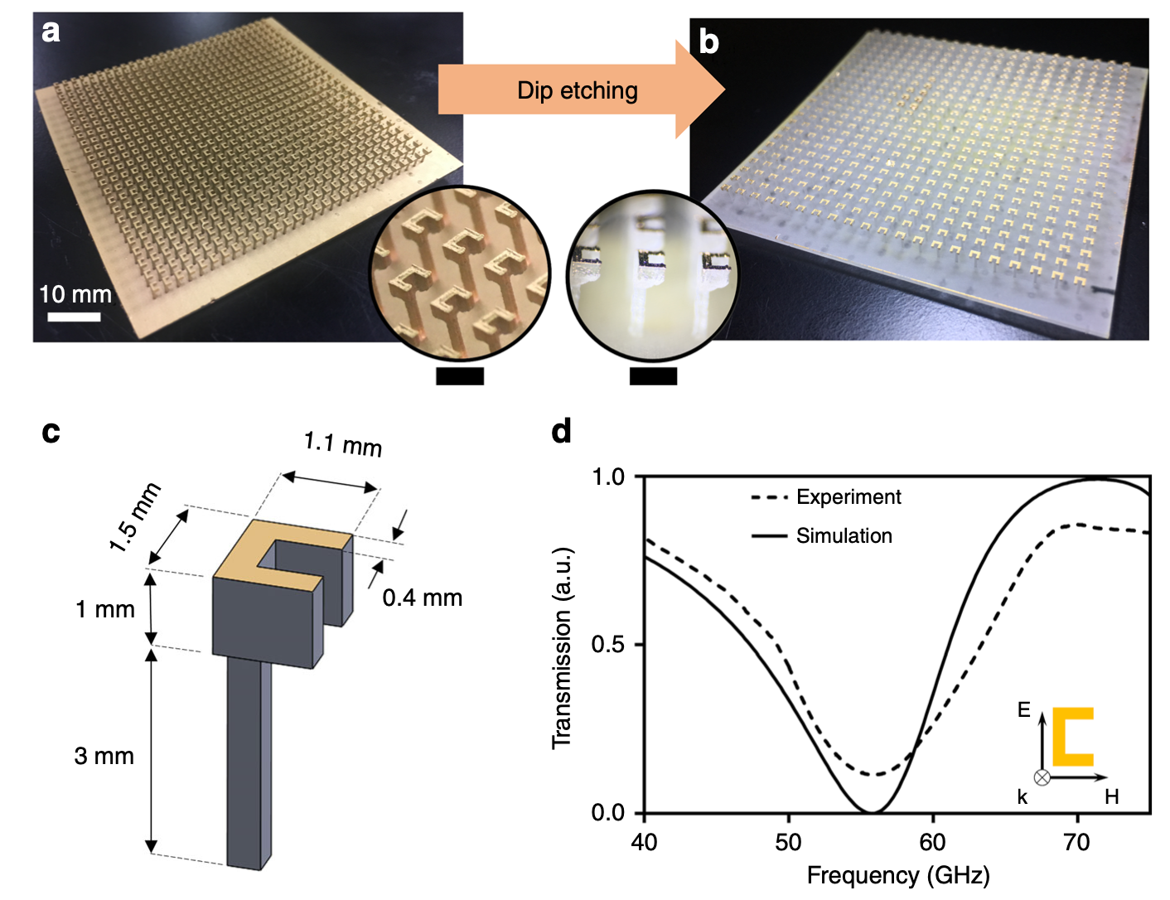
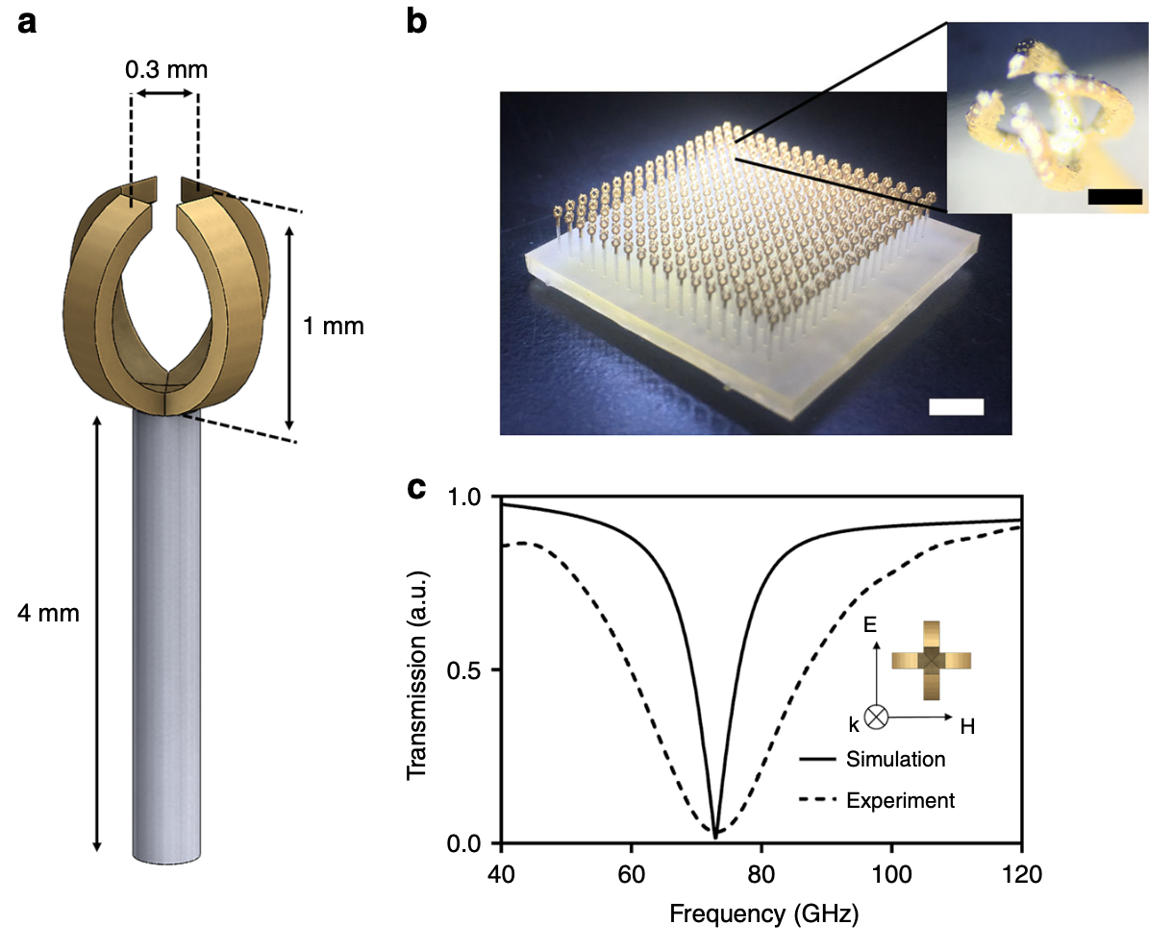
(Two) Split Ring Resonator Mushroom MEGO

Slide 15
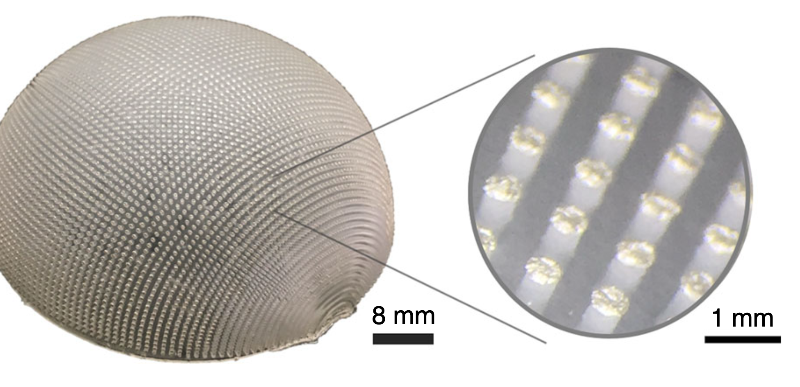
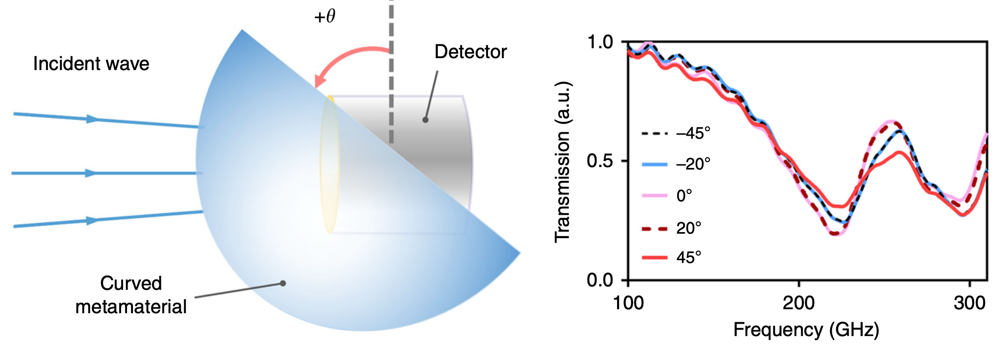
Hemispherical Moth-Eye MEGO Absorber
The first ever realization of an angle‐ Insensitive narrow‐band metamaterial absorber in the form of hemispherical moth-eye absorber fabricated on curved substrate

Slide 16
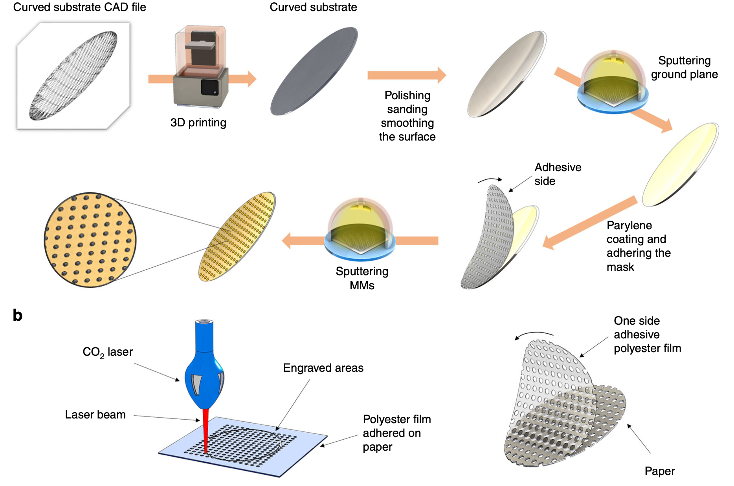
Parabolic MEGO Reflector

