Slide 1
MICRO-561
Fundamentals of Biomicroscopy

Slide 2
Syllabus (tentative)
Lecture 1 Introduction & Ray Optics-1
Lecture 2 Ray Optics-2 & Matrix Optics-1
Lecture 3 Matrix Optics-2
Lecture 4 Matrix Optics-3 & Microscopy Design-1
Lecture 5 Microscopy Design-2
Lecture 6 Microscopy Design-3 & Resolution -1
Lecture 7 Resolution-2
Lecture 8 Resolution-3
Lecture 9 Contrast
Lecture 10 Fluorescence-1
Lecture 11 Fluorescence-2
Lecture 12 Fluorescence-3, Sources, Filters
Lecture 13 Detectors
Lecture 14 Bio-application Examples

Slide 3
Properties of the Fourier Transform
f (t)
F(ν)
0
t
0
ν
Scaling
f (t/τ)
|τ |F(τ ν)
0
t
0
ν
Translation
f (t- τ)
F(ν) exp(-i2πντ)
0
t
0
ν

Slide 4
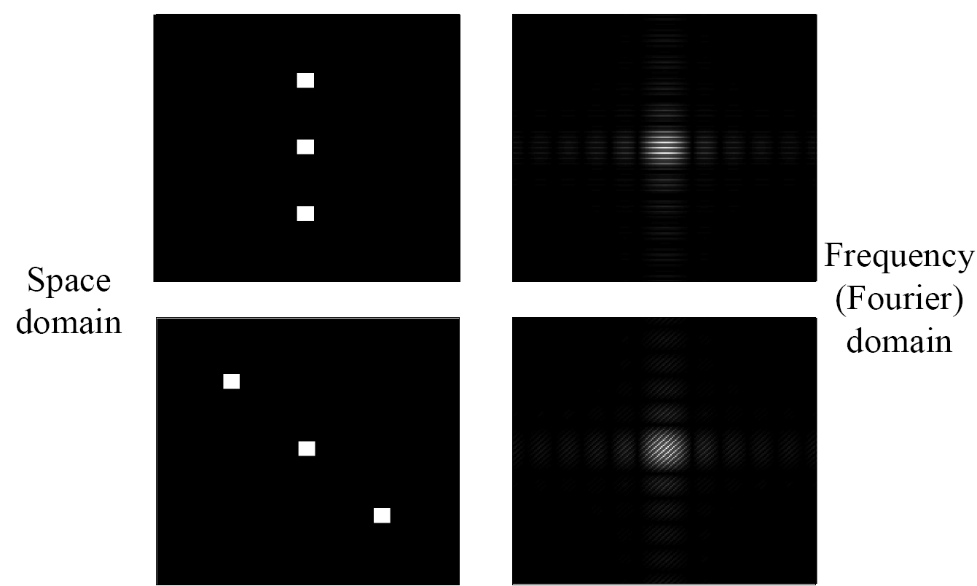
Example: Superimpose Shifted Objects
Specimen
Plane
Fourier
Plane
+a
0
-a
If we assume a 1D case, then input function is:
f(x) = rect[(x-0)/D_{x}] + rect[(x-a)/D_{x}] + rect[(x+a)/D_{x}]
The diffraction pattern at the far-field (Fourier plane) is proportional to the square of:
F(ν) = sinc(ν) [1 + exp(-i2πνa)+exp(+i2πνa)]

Slide 5
Properties of the Fourier Transform
f (t)
F(ν)
0
t
0
ν
Scaling
f (t/τ)
|τ |F(τ ν)
0
t
0
ν
Translation
f (t- τ)
F(ν) exp(-i2πντ)
0
t
0
ν
Modulation
f (t) cos(2πν_{o}t)
−ν_{o}
0
ν_{o}
ν
F(ν+ν_{o})/2 + F(ν−ν_{o})/2

Slide 6
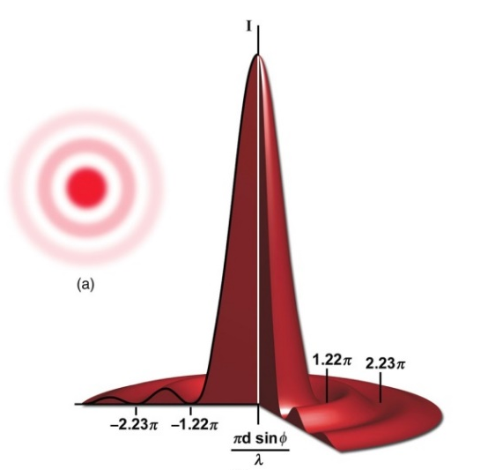
Example: Spatially Modulated 2D Object
F(ν_{x},ν_{y})
f (x,y)
y
ν_{y}
F.T.
x
ν_{x}
f (x,y) cos(2πν_{0x}x)
F(ν_{x}-ν_{0x},ν_{y}) + F(ν_{x}+ν_{0x},ν_{y})
y
ν_{y}
F.T.
x
ν_{x}
−ν_{0x}
+ν_{0x}

Slide 7
Properties of the Fourier Transform
f (t)
F(ν)
0
t
0
ν
Scaling
f (t/τ)
|τ |F(τ ν)
0
t
0
ν
Translation
f (t- τ)
F(ν) exp(-i2πντ)
0
t
0
ν
Modulation
f (t) cos(2πν_{o}t)
−ν_{o}
0
ν_{o}
ν
F(ν+ν_{o})/2 + F(ν−ν_{o})/2
Convolution
f (t) * g(t)
F(ν ) . G(ν )

Slide 8
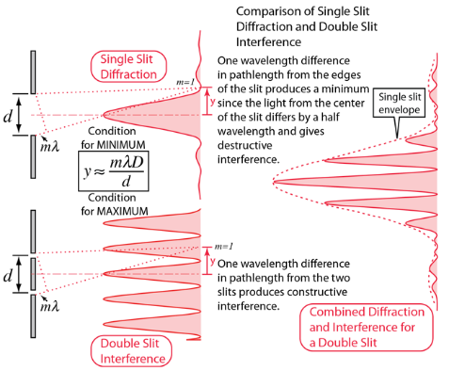
Example: Diffraction with single slit and double slits
Single slit with a finite width “w”
Convolution of these two yields:
Double slit with a finite width (w) and separation (d)
w
x
Double slit (without a width) separated by “d”
$$I=I_{0} {sinc}^{2}\left(\frac{β}{2}\right)\cos^{2}\left(\frac{φ}{2}\right)$$
$$β = \frac{2πw}{ λ}sinθ$$
$$= \frac{2πd}{ λ}sinθ$$

Slide 9
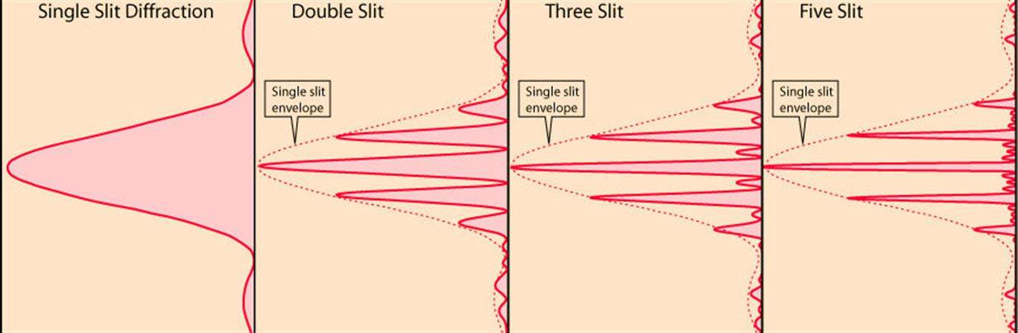
Diffraction by slits with finite width
➔ With increasing number of slits (to infinity), the system will gradually transition to a “grating”

Slide 10
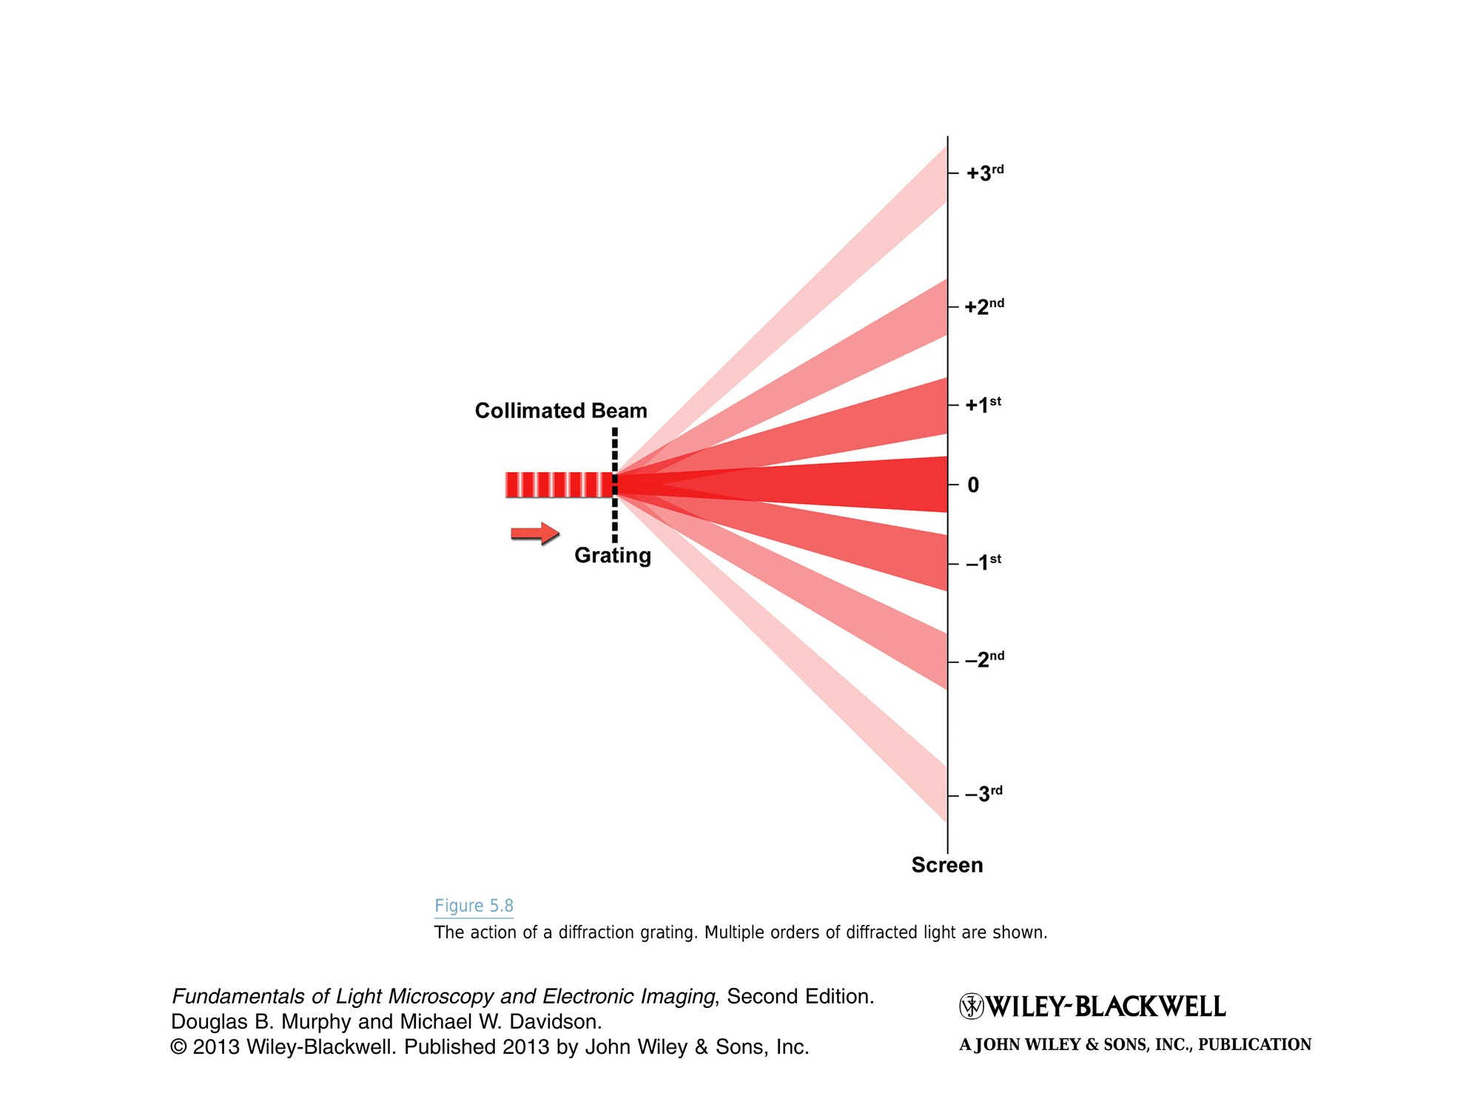
Recall: Diffraction of a “grating”
L>> d & λ
Grating Equation (m^{th} grating order):
$$sinθ_{m}=\frac{mλ}{d}$$
$$d sinθ_{m}=m $$
INPUT:
OUTPUT:
F.T.
x
Diffraction angle θ_{m} increases as the period d decreases
➔ Smaller features diffracts more!
Diffraction angle θ_{m} increases as the wavelength λ increases
➔ Diffraction grating can be used to disperse white light!

Slide 11
For a given input function, we obtain the output pattern (which corresponds to the F.T. of the input function) at a far distance….

Slide 12
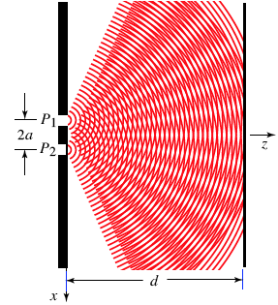

Recall: Double Slit Experiment
At a far observation point (L>> d & λ),
the output is given by the interference equation:
d
Interference term
L
F.T.
INPUT:
OUTPUT:
−x_{o}
0
x_{o}
x
x’
cos(2πν_{x}x)
PS: Ignore slit width

Slide 13
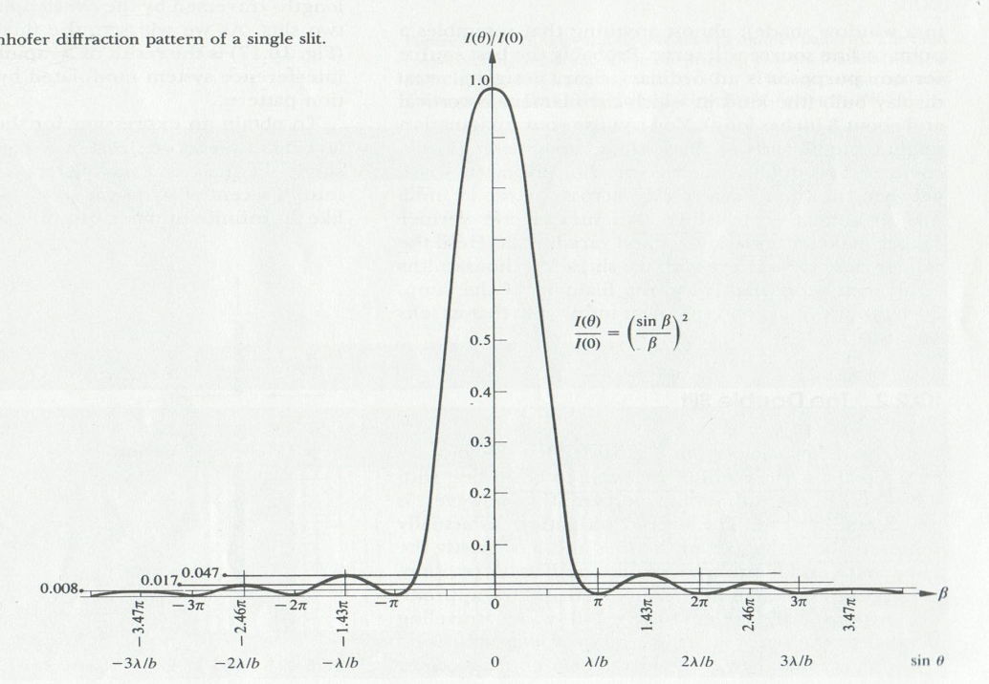
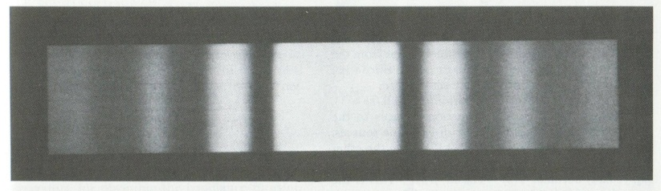
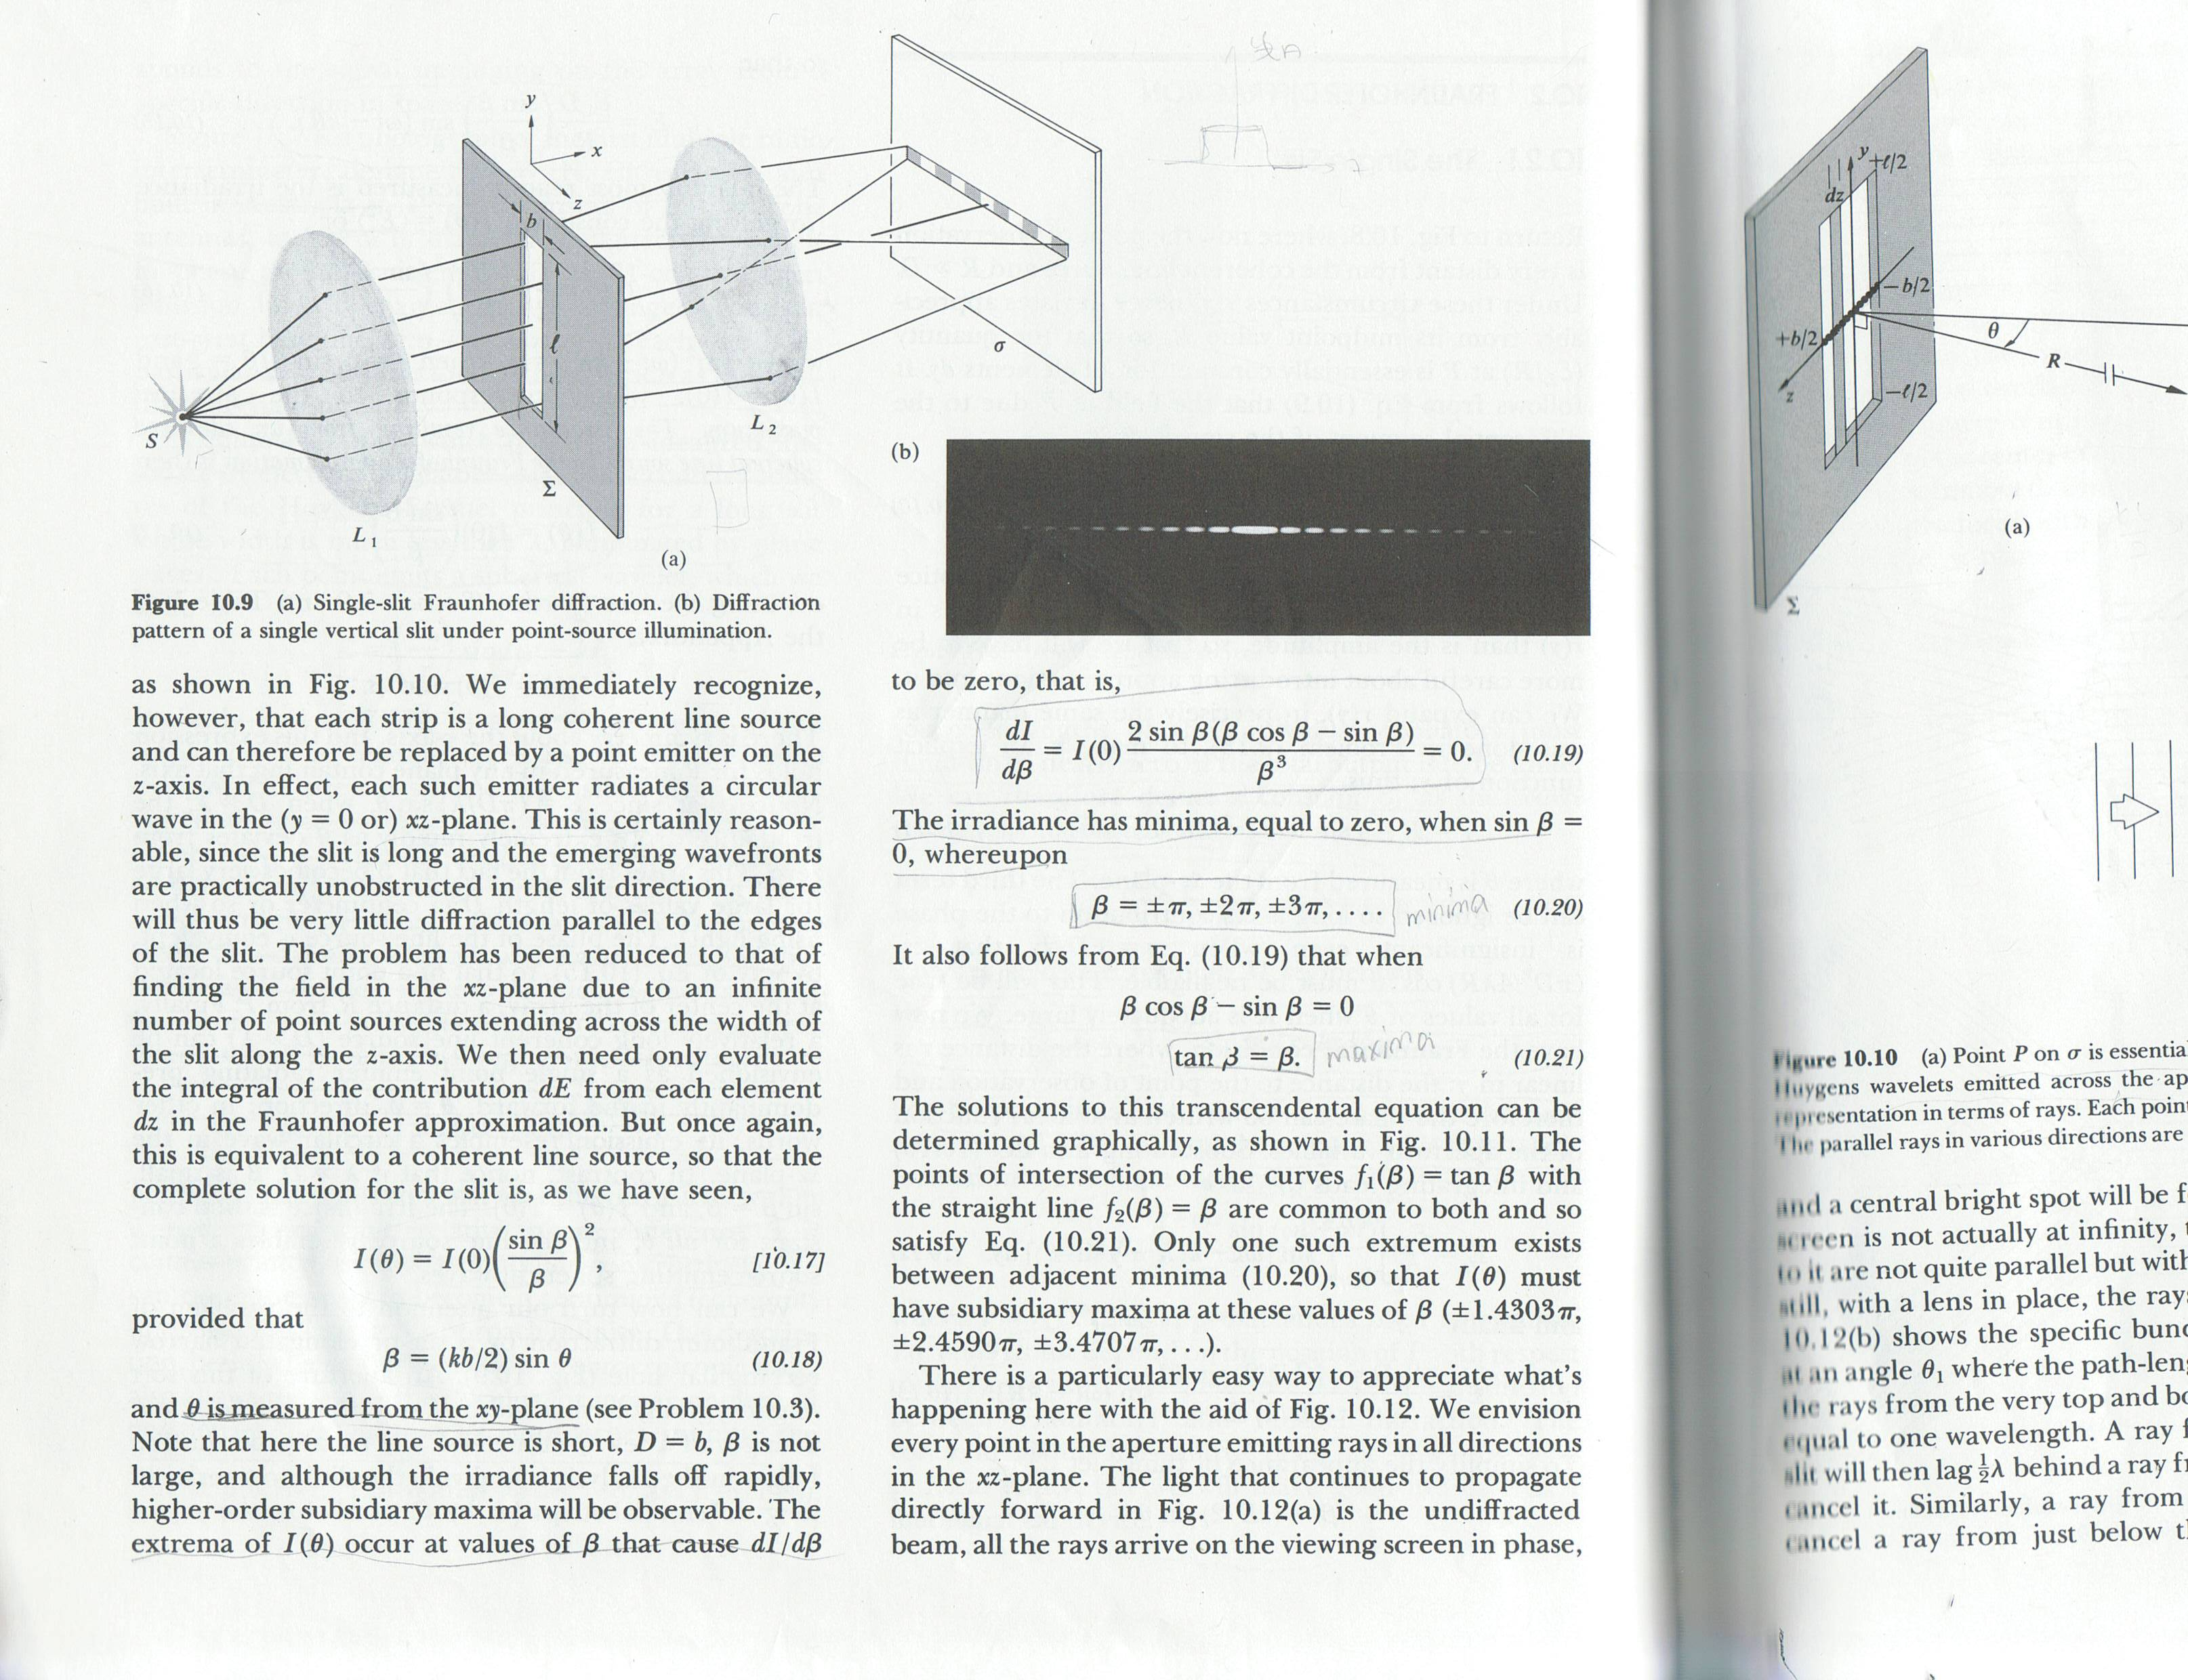
Recall: Diffraction of a 1D-Rectangular Aperture
1st zero at “λ/b”
Location of 1st zero is inversely related to the aperture size (d)
L>> d & λ
F.T.
INPUT:
rect(z/b)
OUTPUT:
-
b
0
b
z
2
2
http://micro.magnet.fsu.edu/primer/java/diffraction/basicdiffraction/index.html

Slide 14
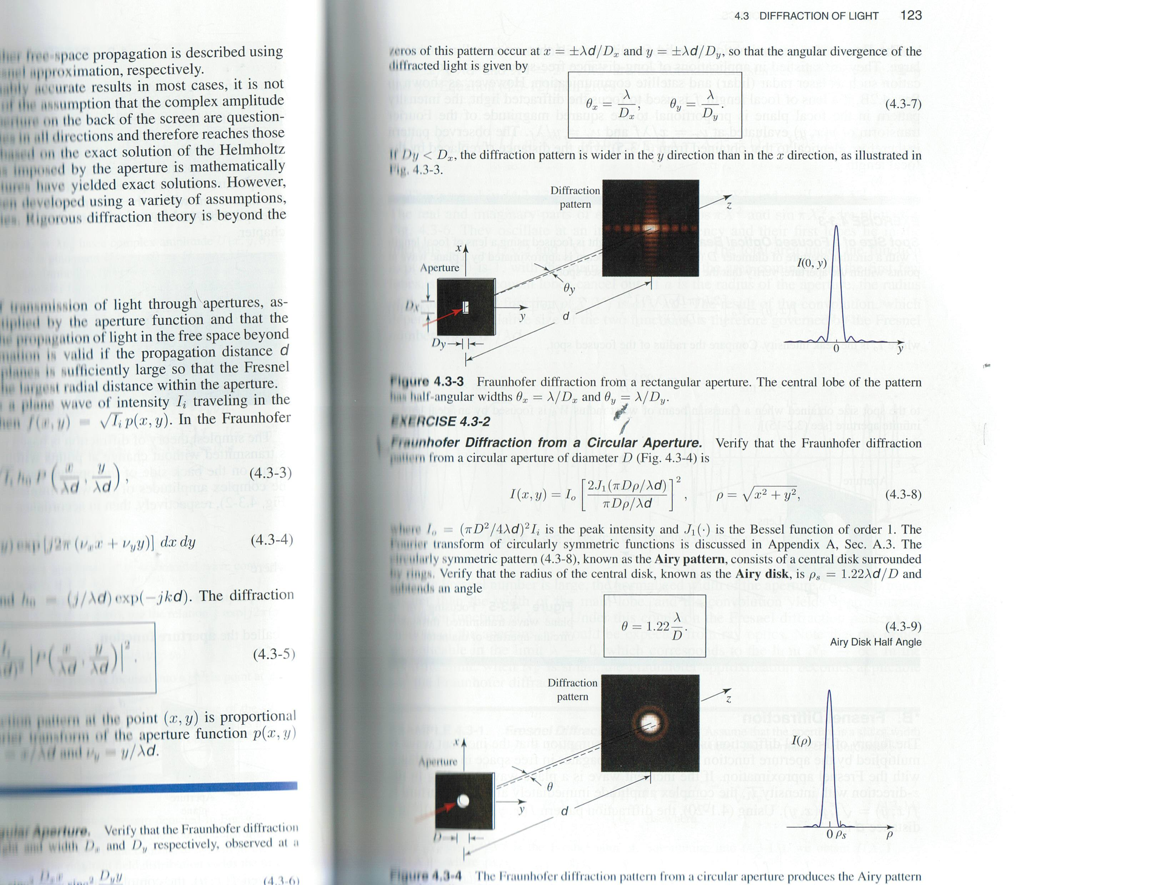
Recall: Diffraction of a 2D-Rectangular Aperture
In this example D_{y} is smaller than D_{x}
Thus, diffraction pattern spreads more (i.e. higher frequencies) along the y-axis compared to the x-axis.
L
L>> D_{x},D_{y} & λ
F.T.
INPUT:
OUTPUT:
f(x,y) = rect(x/D_{x}) rect(y/D_{y})

Slide 15
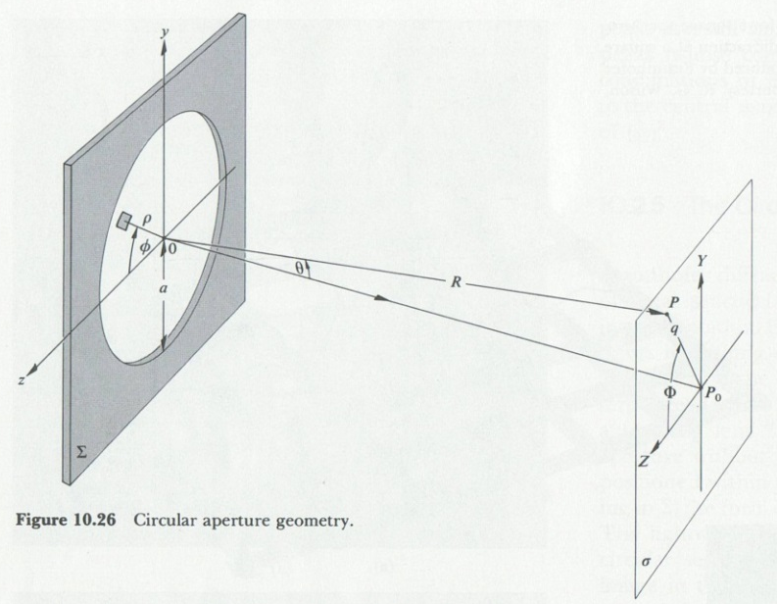
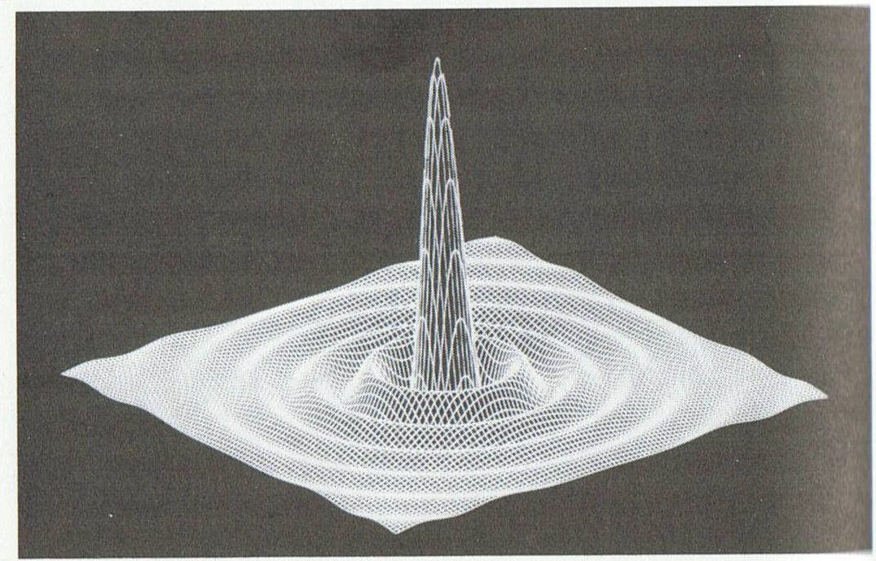
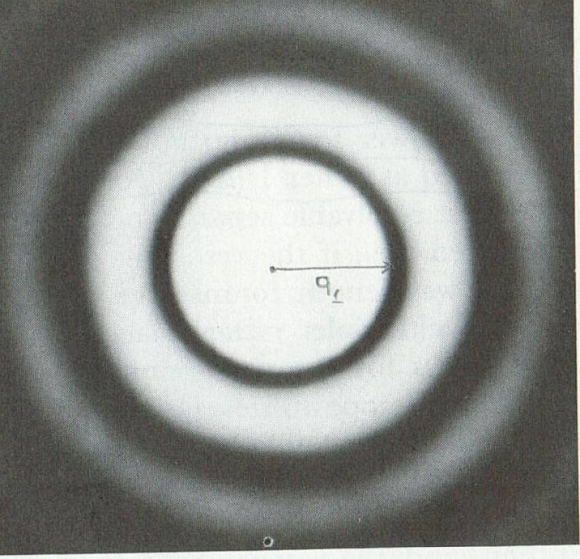
Recall: Diffraction of a Circular Aperture
3D-view
2D-view
Location of the first zero and the extend of angle spreading (thus the spatial frequency) is inversely proportional to the radius size (D)
AIRY RINGS
OUTPUT:
L
L>> D & λ
INPUT:
f(ρ) = circ(ρ/D)
F.T.
ρ = sqrt (x²+y²)

Slide 16
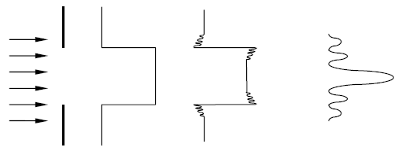
Diffraction of a 1D Rectangular Aperture
b
F.T.
Slit
Field @slit
Fresnel
Fraunhofer
0
… far-field
Distance
Fourier transform plane is located at the far-field!
➔ Far-field observation condition is given by Fraunhofer Approximation, which is b²/λL << 1
For λ= 500nm (green)
b =2.5 cm ➔ L >> 1.9 km !
b =1 mm ➔ L >> 6 m
b =2 μm ➔ L >> 0.15 mm

Slide 17
Diffraction of a 1D Rectangular Aperture
b
Slit
Field @slit
Fresnel
Fraunhofer
0
… far-field
Distance
Fourier transform plane is located at the far-field!
➔ Far-field observation condition is given by Fraunhofer Approximation, which is b²/λL << 1
For λ= 500nm (green)
b =2.5 cm ➔ L >> 1.9 km !
b =1 mm ➔ L >> 6 m
b =2 μm ➔ L >> 0.15 mm

Slide 18
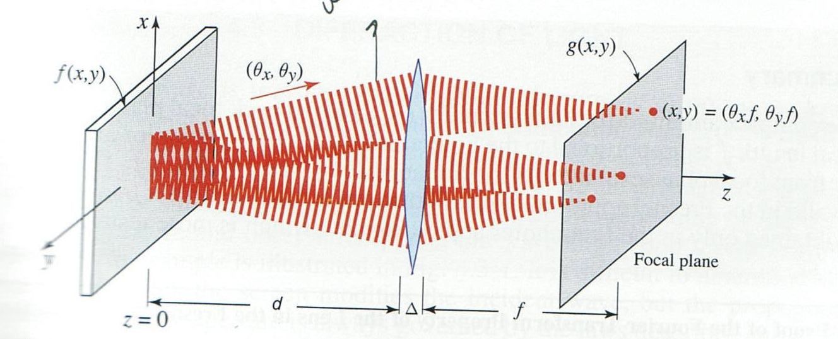
A lens can bring the F.T. plane from far-field to a closer distance
Input:
f(x,y)
Output at the back-focal plane of the lens:
F(ν_{x}, ν_{y})
Recall 1-to-1 relationship between:
Back Focal Plane of Lens = Fourier Plane
$$θ_{i}≈i$$
Each wave is focused in Fourier plane at:
$$x=θ_{x}f$$
angle
spatial frequency
$$x={v}_{x}f$$
Derivation is given in Saleh & Teich, Ch. 4

Slide 19

Reminder: Spatial Frequency & Angles
under paraxial
approximation
$$sinθ_{m}=\frac{mλ}{d}$$
$$θ_{m}≈\frac{mλ}{d}$$
$${For m=1 → θ}_{1}≈λ\frac{1}{d}$$
$${For m=2 → θ}_{2}≈λ\frac{2}{d}$$
.
.
.
$${For m=i → θ}_{i}≈λ\frac{i}{d}$$
$$θ_{i}≈i$$
angle
spatial frequency
“Larger angle” means “higher spatial frequency”
“Higher frequency” corresponds to “smaller feature”
➔ THUS, smaller features contain higher frequency

Slide 20
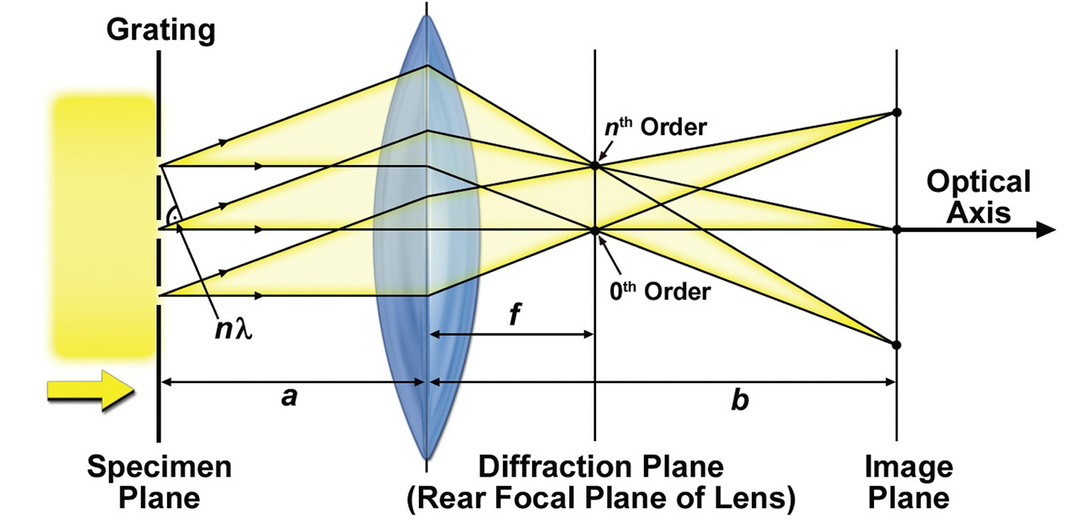
Reminder: Fourier (a.k.a Diffraction) Plane
Let’s assume that our object is a grating, and it is placed on specimen plane, which is located between f & 2f (2f>a>f).
- The objective lens produces a magnified real image of the grating (i.e. object) in the image plane.
The Fourier (or diffraction) plane is located at the back focal plane of the lens.
- The rays of different orders are separated at the diffraction plane
- But, the rays of different orders are merged (interfere) at the image plane

Slide 21
“4-f” Imaging System
x
z
f
f
f
f
Object Plane
Fourier Plane
Image Plane
Unity magnification (inverted)
Two cascaded Fourier transforming sub-systems (2-lenses with 4f setting) :
1st lens performs F.T.
& 2nd lens performs I.F.T.
Object plane
Fourier plane
Fourier plane
Image plane
$$\left(x,y\right)→\left(υ_{x},υ_{y}\right)$$
$$\left(_{x},υ_{y}\right)→\left(−x,−y\right)$$

Slide 22
4-f Imaging System
without any filter
All of the “spatial frequencies” of the object are separated here
(so called “Fourier plane”)
Let’s insert a spatial filter in the F.P:
This will lead to generation of a new image g(x,y), which is the filtered version of f(x,y)

Slide 23
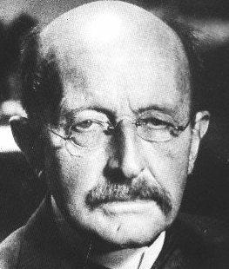
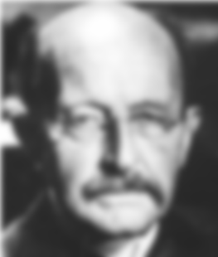
Spatial Filtering
$$F(x/{f},y/{f)}$$
?
$$\left(_{x},υ_{y}\right)$$
In this example, the filter is a circular aperture
$$\left(x,y\right)$$
υ_{x} is the spatial frequency ➔ $_{x}=x/{(f)}$
Its unit is [1/length]
Max Planck
Low-pass filter

Slide 24
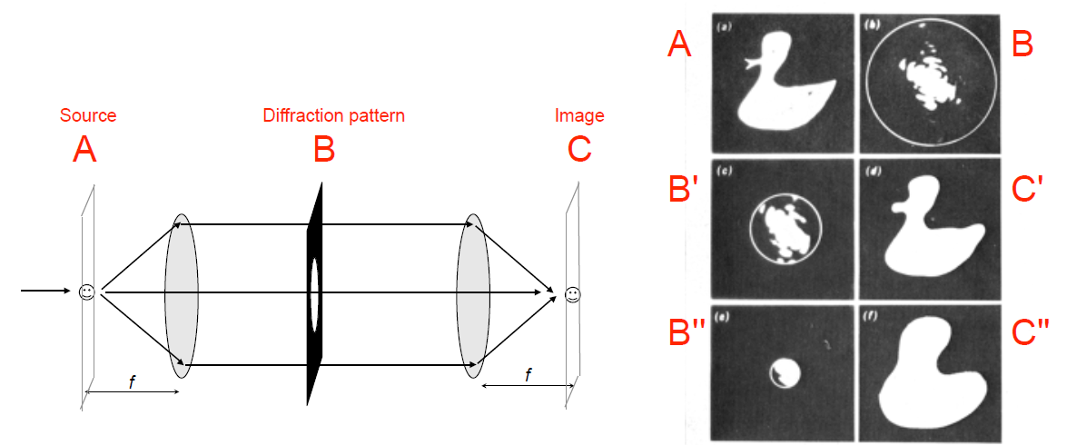
Removing higher diffracted orders in the Fourier Plane reduces the resolution of the final image
A mask is inserted at the Fourier (diffraction) plane to allow only the 0th order and lower order light to pass

Slide 25
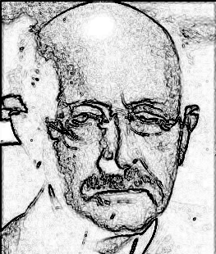
Examples of Spatial Filters
x
Filtered
image
Filter
Original
image
z
f
f
f
f
Max Planck
Low-pass filter
High-pass filter

Slide 26
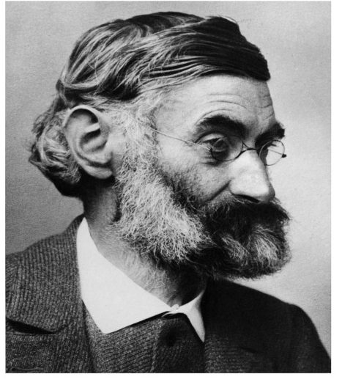
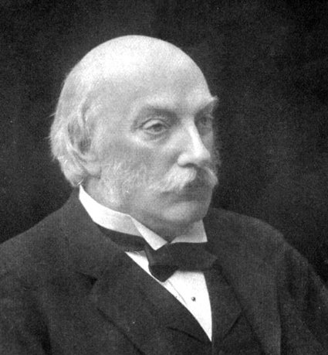
Determining microscopy resolution by 2 methods
1. Abbe’s theory of image formation
→ Collecting more diffraction orders for higher resolution
2. Rayleigh criteria
→ Diffraction of a circular aperture & Airy disks
Ernst Abbe [1840-1905]
Collaborated with Carl Zeiss (owner of a microscopy company) & Otto Schott (owner of a glass company) in Jena, Germany.
The Lord Rayleigh (John William Strutt) [1842-1919]
Discovered Rayleigh scattering (which is used to explain why the sky is blue!). Discovered Argon (with Ramsay), got Nobel Prize for Physics in 1904

Slide 27
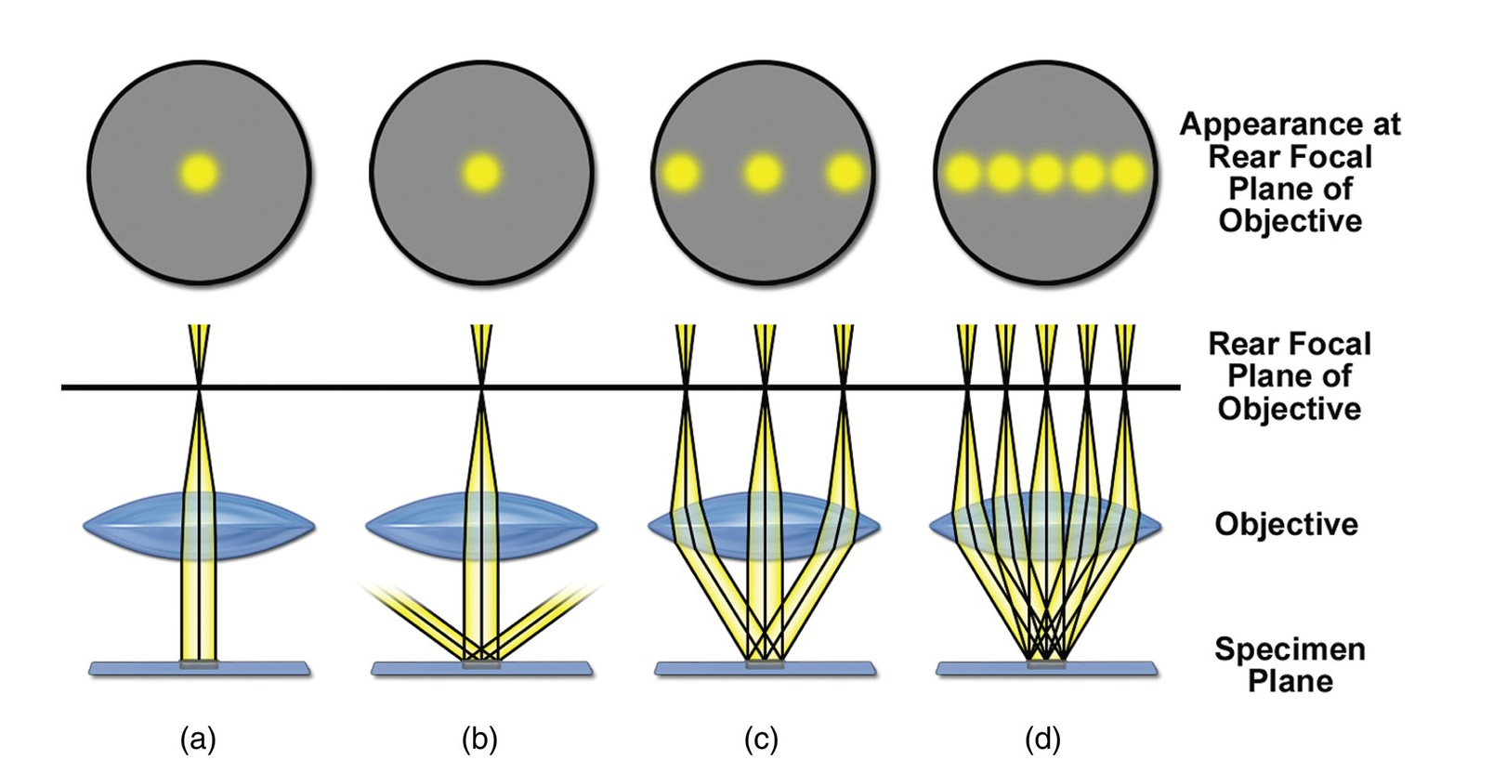
Abbe’s theory
(a) No diffracting object in the specimen plane: no image (only background)
(b) Grating as specimen. Collect no diffraction other than 0th order ➔ no new content for image
(c) Grating as specimen. Collect 0th & 1st orders diffraction ➔ Image with minimum resolution
(d) Grating as specimen. Collect multiple higher orders ➔ Image with higher resolution
Abbe showed that we need at least TWO adjacent orders
Example: 0th & 1st

Slide 28
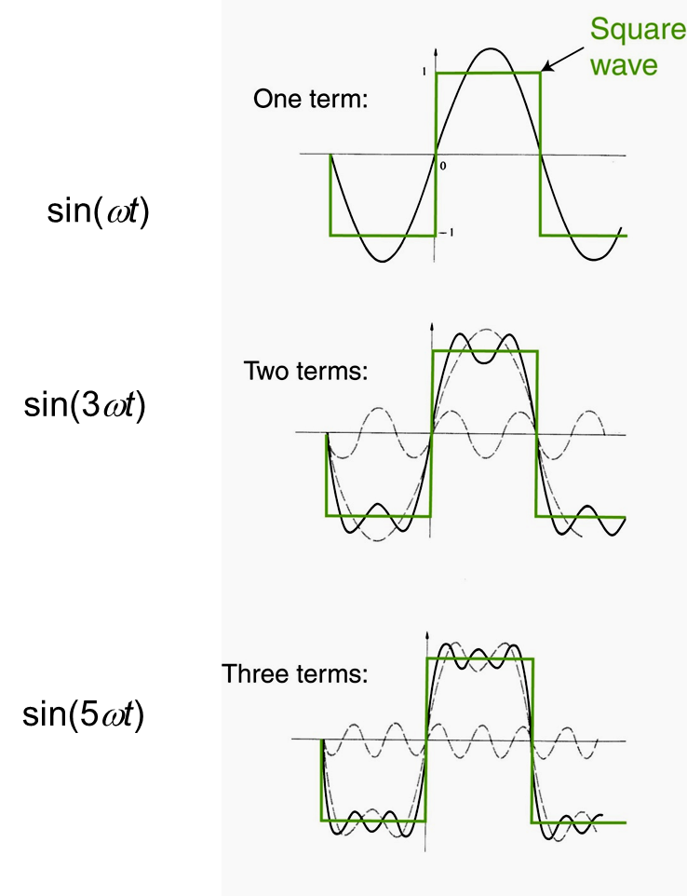
Adding More Fourier Terms (~Diffraction Orders)
Expansion of a function f(t) as a sum of harmonic functions (Fourier terms)
f(t)
=
+
+
+ …..
Analogy in microscopy: image is formed by the summation of diffraction orders
Accuracy (i.e. resemblance between the green & solid black curves) increases as we include more Fourier terms (i.e. higher orders terms)

Slide 29


Reminder: Fourier transform of exp(iω₀ t)
The harmonic function exp(iω₀t) is the basis of Fourier analysis.
It corresponds to a single frequency, ω₀.
exp(iω₀t)
Im
F.T.{exp(iω₀t)}
t
0
F.T
Re
t
ω
0
0
ω₀

Slide 30
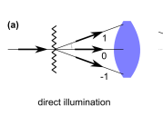
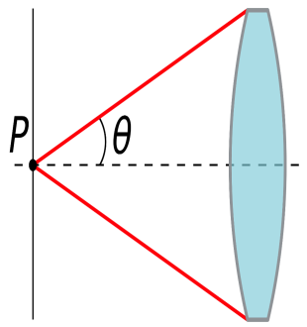
Abbe’s theory & resolution
A periodic specimen with a period d gives rise to the grading orders.
For a direct illumination, the grating equation is:
$$d sinθ_{m}=m λ0 \left(m=1, 2, …\right)$$
In order to resolve the object, the NA of the lens should be large enough to collect at least the first order:
$$NA=nSin\left(θ\right)>\frac{1xλo}{d}$$
D
Numerical aperture: A dimensionless number that defines the range of angles over which the lens can accept light.
$$NA=nsin⁡(θ)$$
θ is the half angle of the light cone accepted by the lens
n is the refractive index of the medium surrounding the lens
f

Slide 31
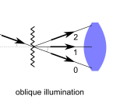
Abbe’s theory & resolution
A periodic specimen with a period d gives rise to the grading orders.
For a direct illumination, the grating equation is:
$$d sinθ_{m}=m λ0 \left(m=1, 2, …\right)$$
In order to resolve the object, the NA of the lens should be large enough to collect at least the first order:
$$NA=nSin\left(θ\right)>\frac{1xλo}{d}$$
$$d>\frac{λo}{NA}=\frac{λ0}{nSin\left(θ\right)}$$
For oblique illumination, Abbe’s criteria becomes:
$$d>\frac{λ0}{2NA}=\frac{λ0}{2nSin\left(θ\right)}$$
References:
https://arxiv.org/pdf/1412.3255.pdf (by Weisenburger & Sandoghdar)
Experimental – physic 2 (Elektrizitat und Optik) by Wolfgang Demtroder

Slide 32
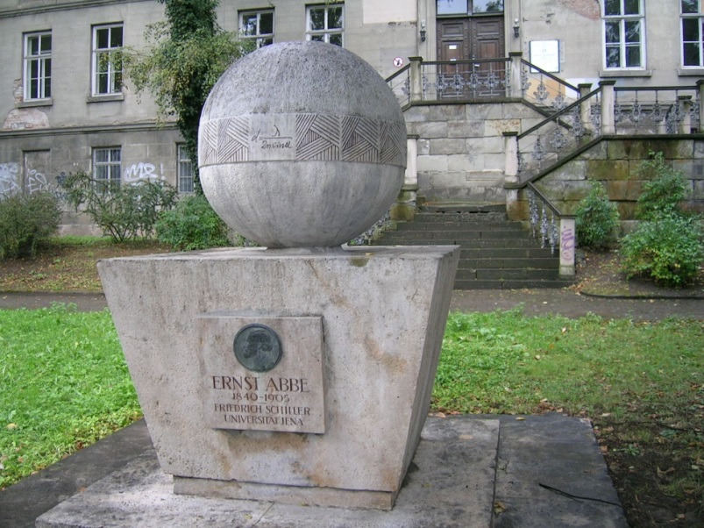
Determining microscopy resolution by 2 methods
1. Abbe’s theory for image formation
→Collecting more diffraction orders for higher resolution
$$d_{min}∝\frac{λo}{2nsin(θ)}$$
University of Jena (Germany)
Abbe School of Optics

Slide 33
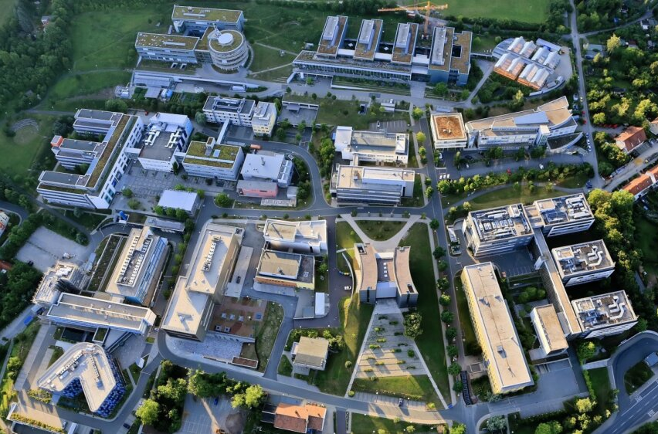
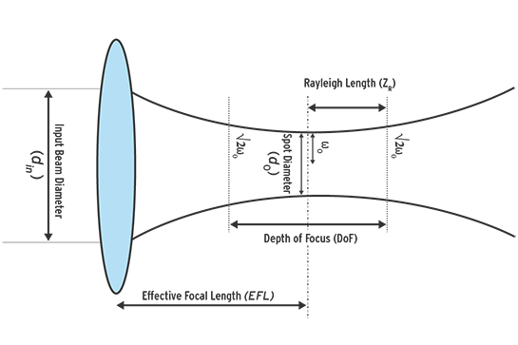
Abbe School of Photonics
Gaussian Beam
Spot diameter: d₀
Spot radius: ω_{o}

Slide 34
Determining microscopy resolution by 2 methods
1. Abbe’s theory for image formation
→ Collecting more diffraction orders for higher resolution
2. Rayleigh criterion
→ Diffraction of a circular aperture & Airy disks
Ernst Abbe [1840-1905]
Collaborated with Carl Zeiss (owner of a microscopy company) & Otto Schott (owner of a glass company) in Jena, Germany.
The Lord Rayleigh (John William Strutt) [1842-1919]
Discovered Rayleigh scattering (which is used to explain why the sky is blue!). Discovered Argon (with Ramsay), got Nobel Prize for Physics in 1904

Slide 35
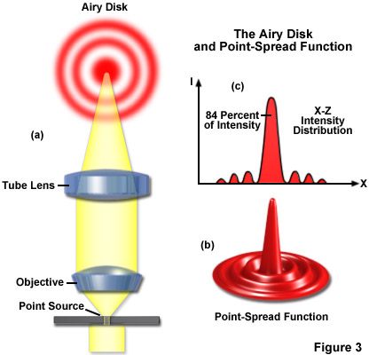
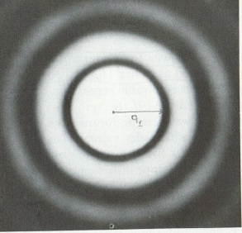
Rayleigh Criteria - Point Spread Function
Object/Specimen:
Pin-hole
F.P
Aperture
Image:
PSF
Consider a 2-lens imaging system in “4f” configuration.
At the object plane: As an input, let’s put an ideal point source (~zero diameter) → δ(x)
At the Fourier plane: Let’s INSERT a circular aperture.
→the aperture filters (such that removes) the higher frequencies!
(this aperture can represent the finite/limited size of a lens, aperture stop, etc)
At the image plane: We get the F.T. of the circular aperture → diffraction pattern (Airy Disks)
The system response to a point source (a.k.a. impulse function) is called Point Spread Function (PSF)

Slide 36
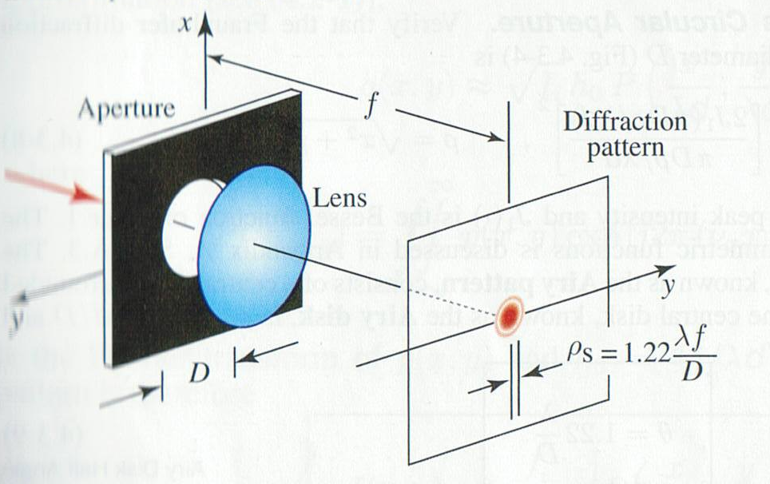

Diffraction Limited Spot Size According to Rayleigh Criteria
At the image plane, a collimated light beam with a finite size (D) will form a finite spot with a “diffraction-limited spot size”.
This spot corresponds to the central Airy disk of the diffraction pattern and its radius is given by:
$$ρ_{s}=1.22{f}/D$$
The central disk contains 84% of power

Slide 37
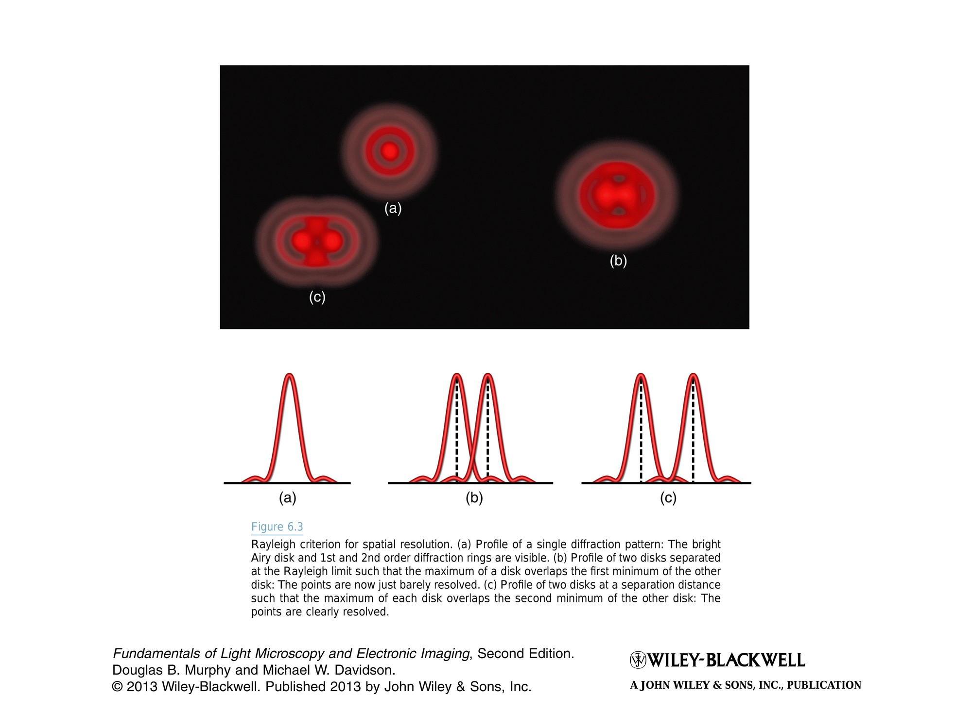
Rayleigh Criterion for Resolution
Top view
Cross-section view
The resolution of a microscope is the shortest distance between two points that can be separated and still observed as 2 points.
At the image plane:
a) Profile of a single diffraction pattern.
b) Profile of two disks separated at the Rayleigh limit: maximum of one disk overlaps with the 1st minimum of the other disk. These two points are barely resolvable.
➔ Minimum resolvable feature size is $ρ_{s}$
c) Profile of two disks at a separation such that the maximum of each disk overlaps the 2nd minimum of the other disk. These two points are clearly resolvable.

Slide 38
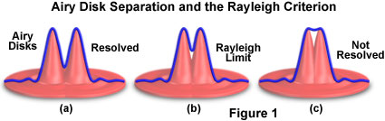
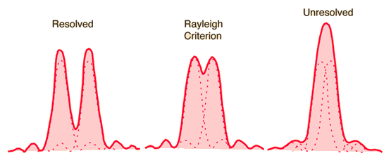
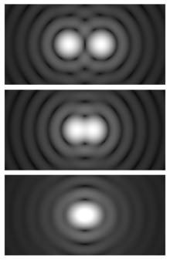
Airy Disk Separation and the Rayleigh Criterion
Resolved
Rayleigh Limit
Not Resolved

Slide 39
Rayleigh Criterion & Resolution
Diffraction-limited spot corresponds to the central Airy disk of the diffraction pattern and its radius is given by:
$$ρ_{s}=1.22{f}/D$$
D
Numerical aperture: A dimensionless number that defines the range of angles over which a lens can accept light.
$$NA=nsin⁡(θ)$$
θ is the half angle of the light cone accepted by the lens
n is the refractive index of the medium surrounding the lens
f
$$sin⁡(θ)≈\frac{D}{2f}$$
$$ρ_{s}≈\frac{1.22 λo}{2NA}≈0.61\frac{λ0}{nsin(θ)}$$

Slide 40
Summary: Microscopy resolution determined by 2 methods
1. Abbe’s theory for image formation/resolution
→Collect at least two diffraction orders to form an image
(collecting more orders will provide better resolution)
$$d_{min}≈0.5\frac{λ0}{NA}≈0.5\frac{λ0}{nsin(θ)}$$
2. Rayleigh criterion for image resolution
  → Diffraction of a circular aperture & Airy disk
$$ρ_{s}≈0.61\frac{λ0}{NA}≈0.61\frac{λ0}{nsin(θ)}$$
P.S.F

