Slide 1
Evanescent couplers
https://www.imec-int.com/en/integrated-photonics

Slide 2
Today
Last week:
  Start evanescent couplers
Today:
  Evanescent couplers as beam splitters

Slide 3
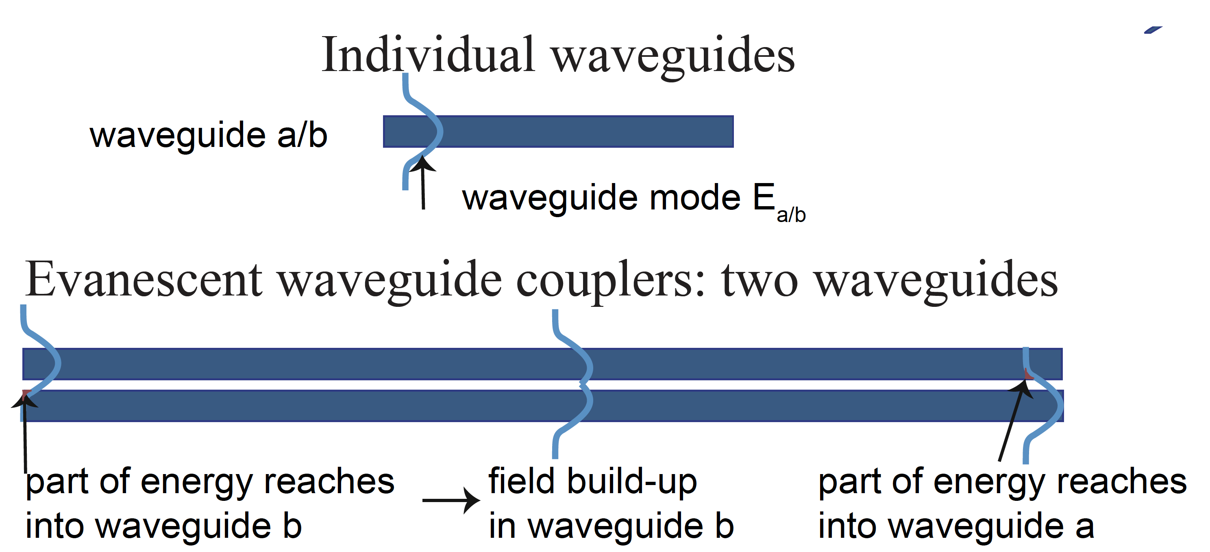
Evanescent couplers

Slide 4
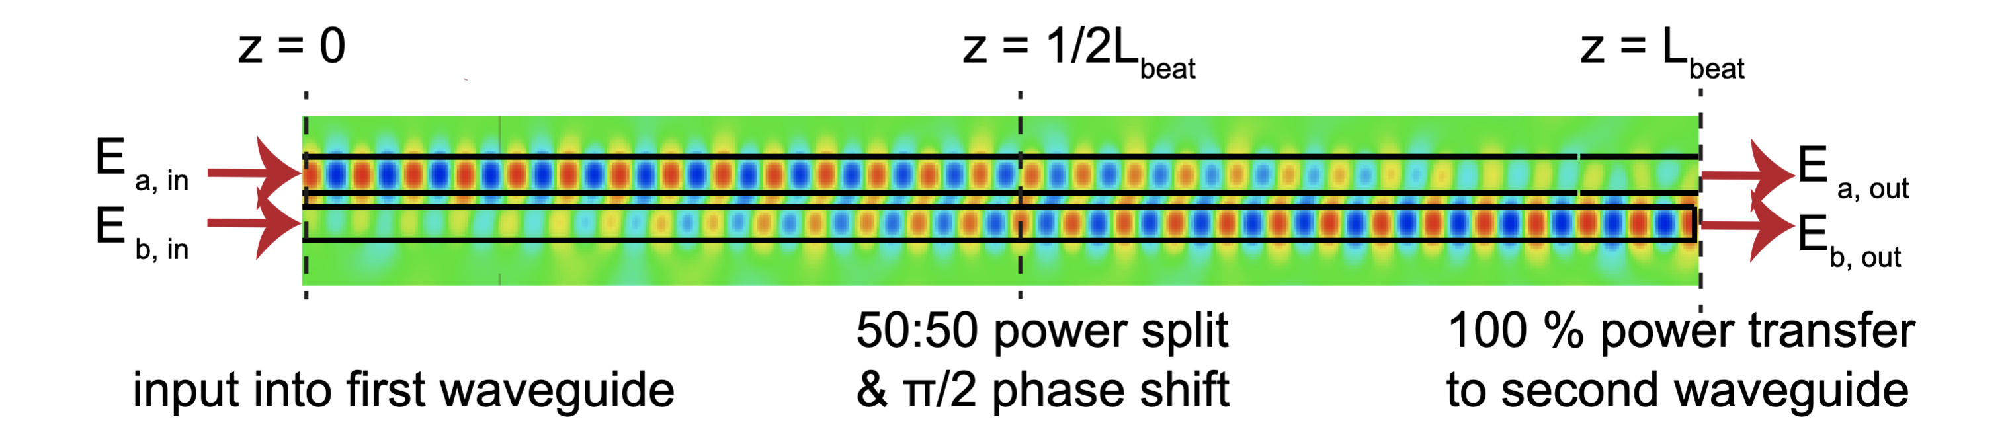
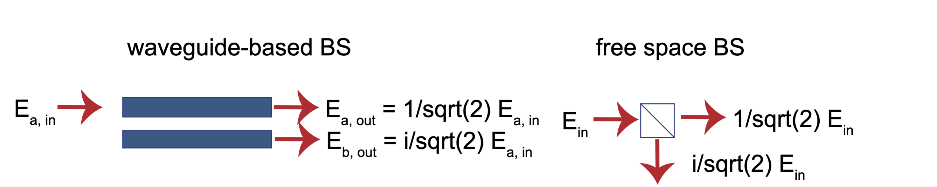

Evanescent couplers as beam splitters
At $z=\frac{L_{beat}}{2}$we obtain a 50:50 beam splitter

Slide 5
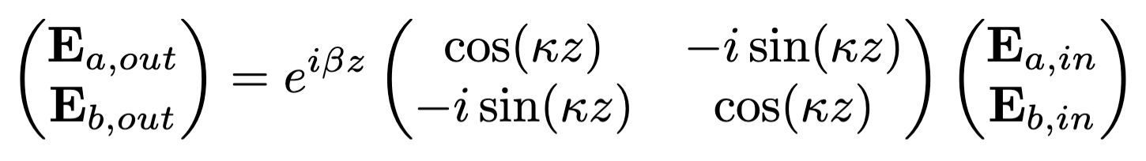
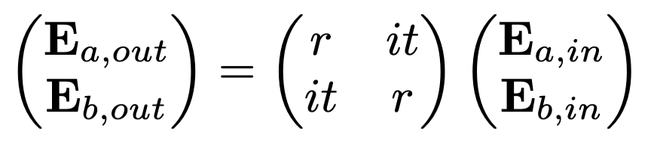

Arbitrary splitting ratio
At $z=arbitrary$we obtain a beam splitter with arbitrary splitting ratio
With $t=\cos\left(κz\right)$ and $r=sin⁡(κz)$

Slide 6

The coupling constant $κ$

Slide 7
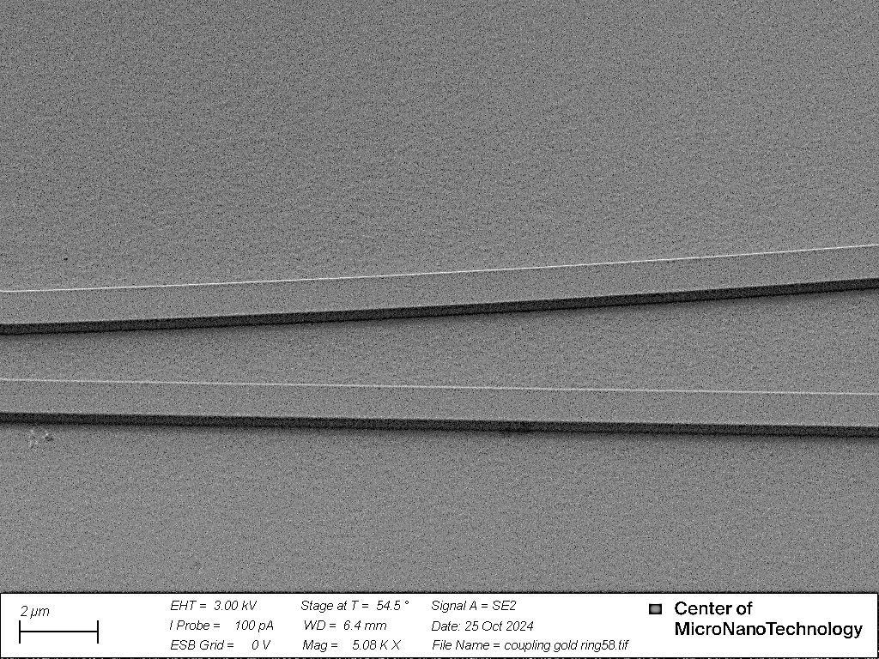
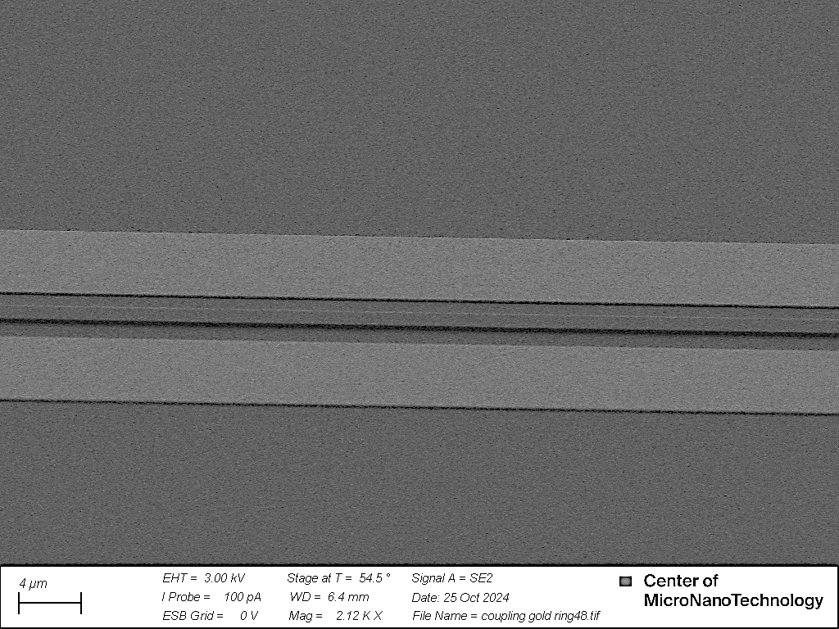
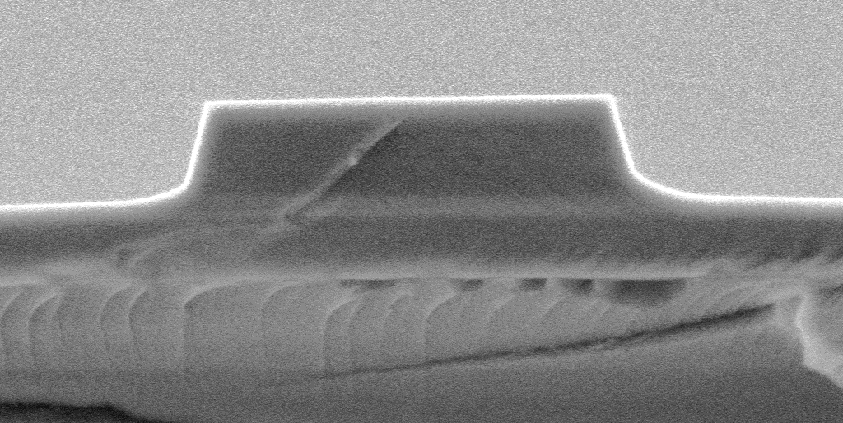
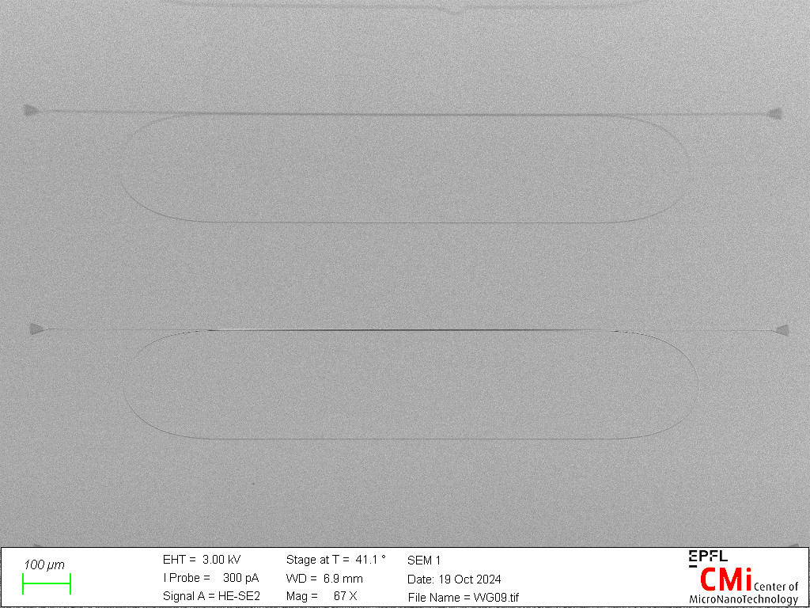
Lithium niobate fabrication in-house at Cmi cleanroom (HYLAB, EPFL)
(a)
(b)
(c)
76°
76°
352 nm
231 nm
(d)
100 µm

