Slide 1
Grating and evanescent couplers
https://www.imec-int.com/en/integrated-photonics

Slide 2
Today
Last week:
  Weakly guiding fibers
  Start grating couplers
Today:
  Forward and backward grating couplers
  Start evanescent couplers

Slide 3
Coupling to chips
https://www.imec-int.com/en/integrated-photonics

Slide 4
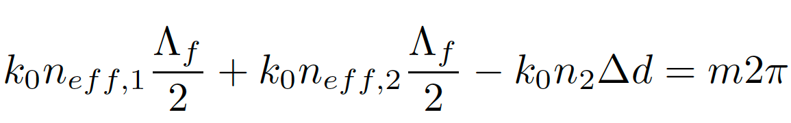

Grating couplers
From last time:

Slide 5
Grating couplers
(Derivation at the blackboard)

Slide 6
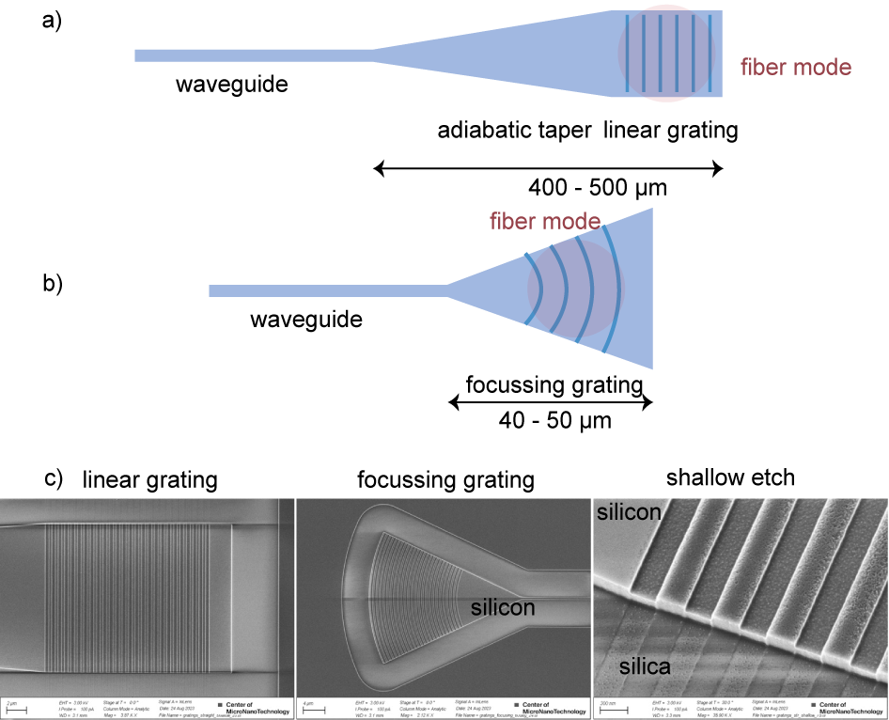
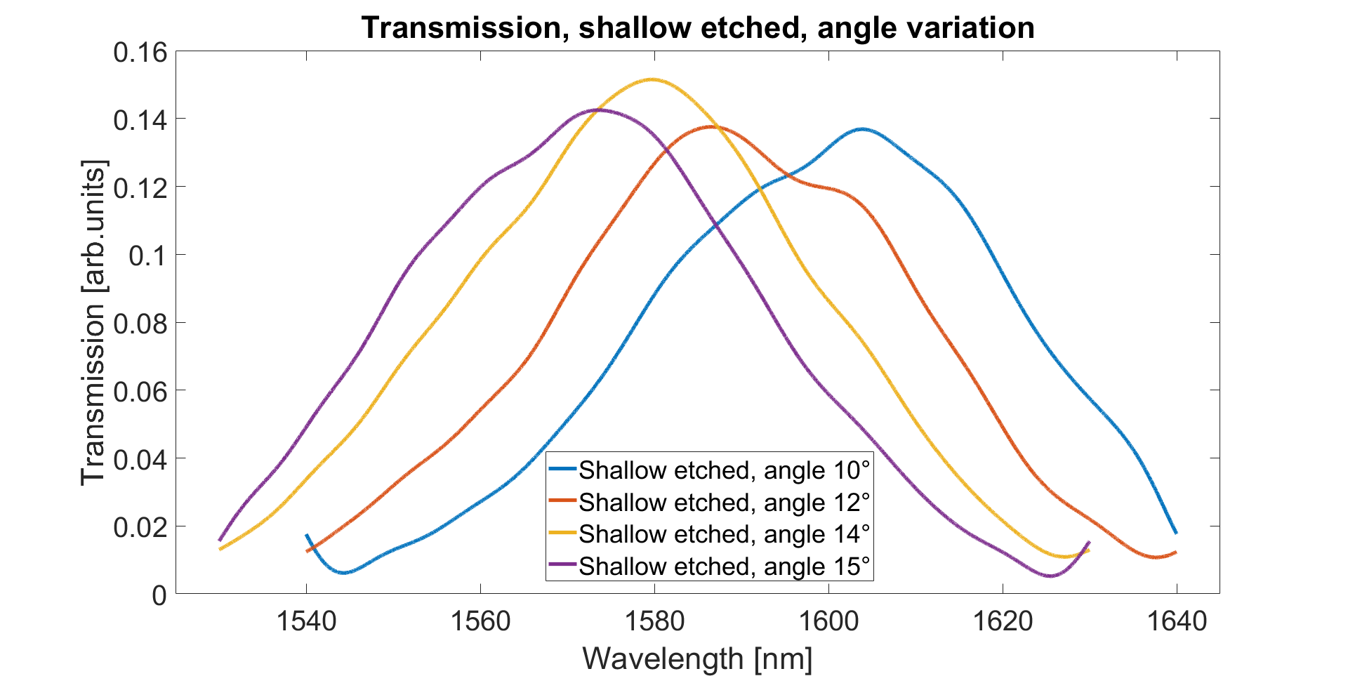
Grating coupler array
Ang

Slide 7
Do’s and don’ts
Why not coupling at normal incidence?
What is the ideal coupling angle? How does the coupling angle change with wavelength?
Why periodicity not multiple of the wavelength?
Why shallow vs deep etch?
Other ways to improve coupling efficiency?

Slide 8
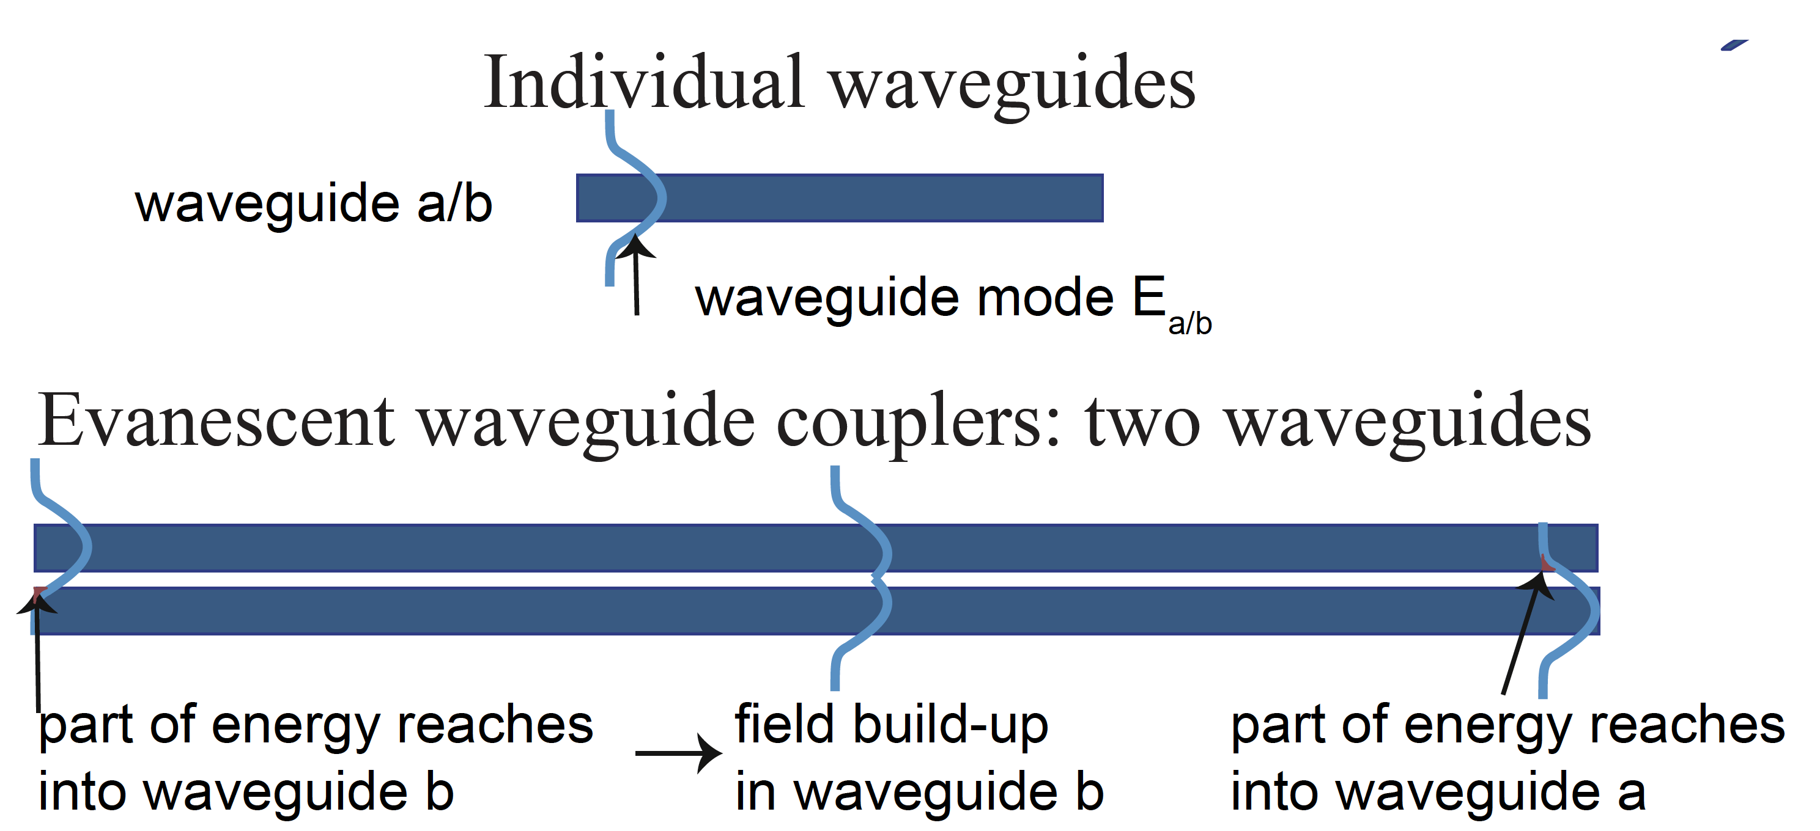
Evanescent couplers

Slide 9
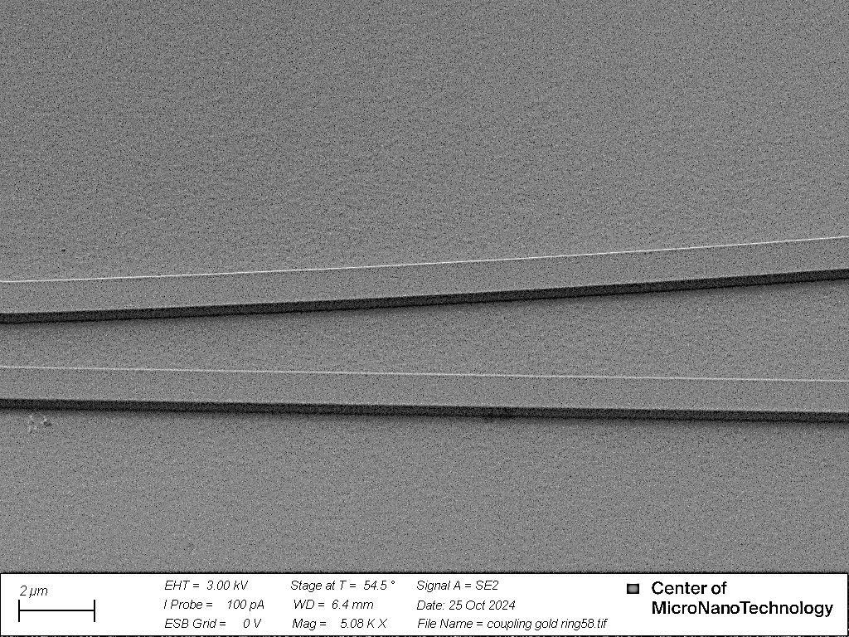
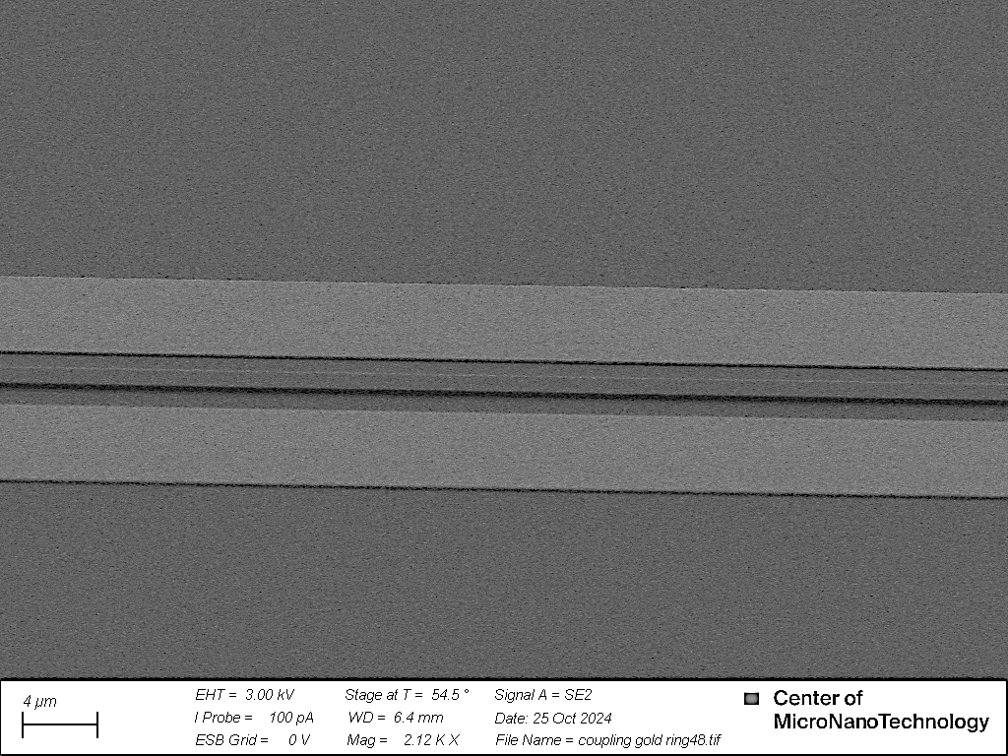
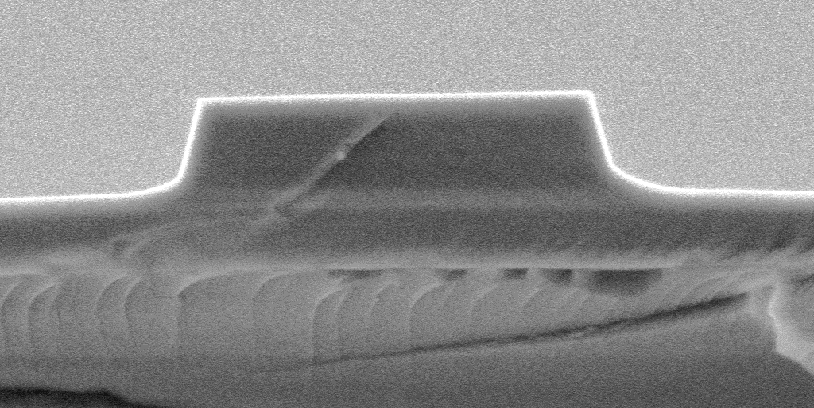
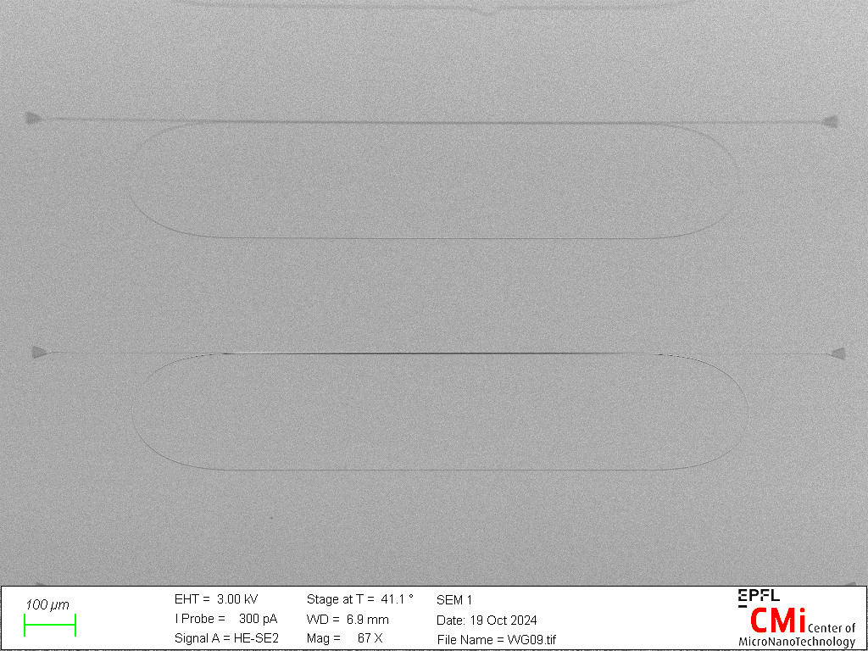
Lithium niobate fabrication in-house at Cmi cleanroom (HYLAB, EPFL)
(a)
(b)
(c)
76°
76°
352 nm
231 nm
(d)
100 µm

