Slide 1
Fiber modes and their coupling to chips
https://www.imec-int.com/en/integrated-photonics

Slide 2
Today
Last week:
  TE and TM modes in fibers
Today:
  Weakly guiding fibers
  Start grating couplers

Slide 3
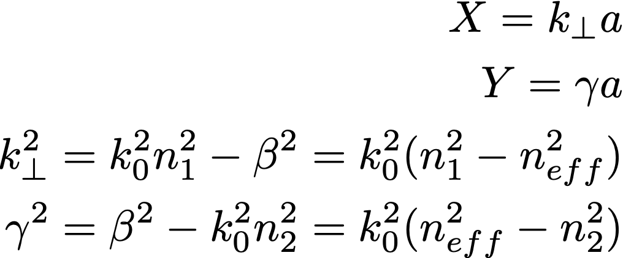

The transcendental equation
$$V^{2}=X^{2}+Y^{2}=k_{0}^{2}a^{2}(n_{1}^{2}−n_{2}^{2})$$
Depends only on fiber parameters!
How much can X maximally be?
How many modes?

Slide 4
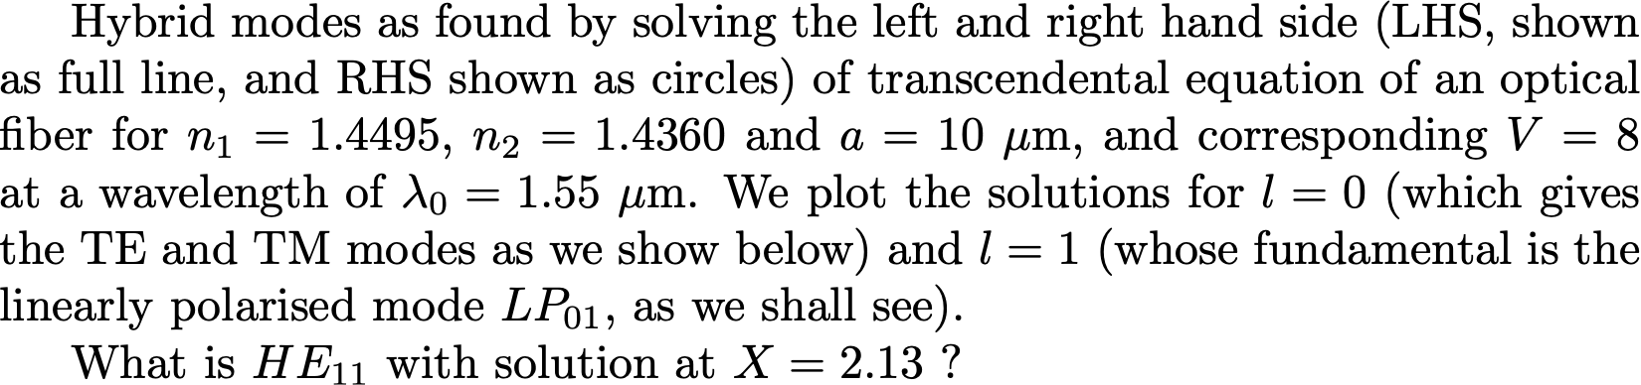
What about other solutions?

Slide 5
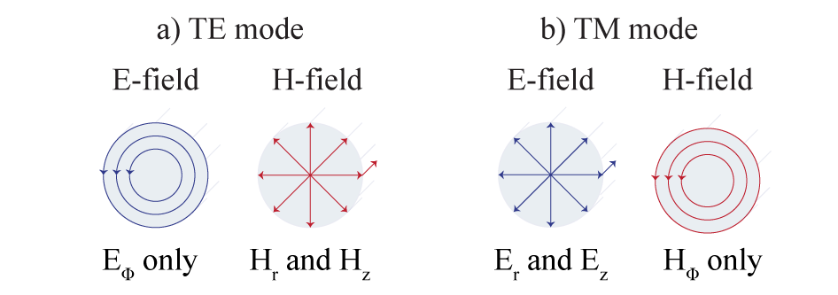
TE and TM modes
l = 0 (derived in class last time)
= 0 corresponds to TE mode
= 0 corresponds to TM mode

Slide 6
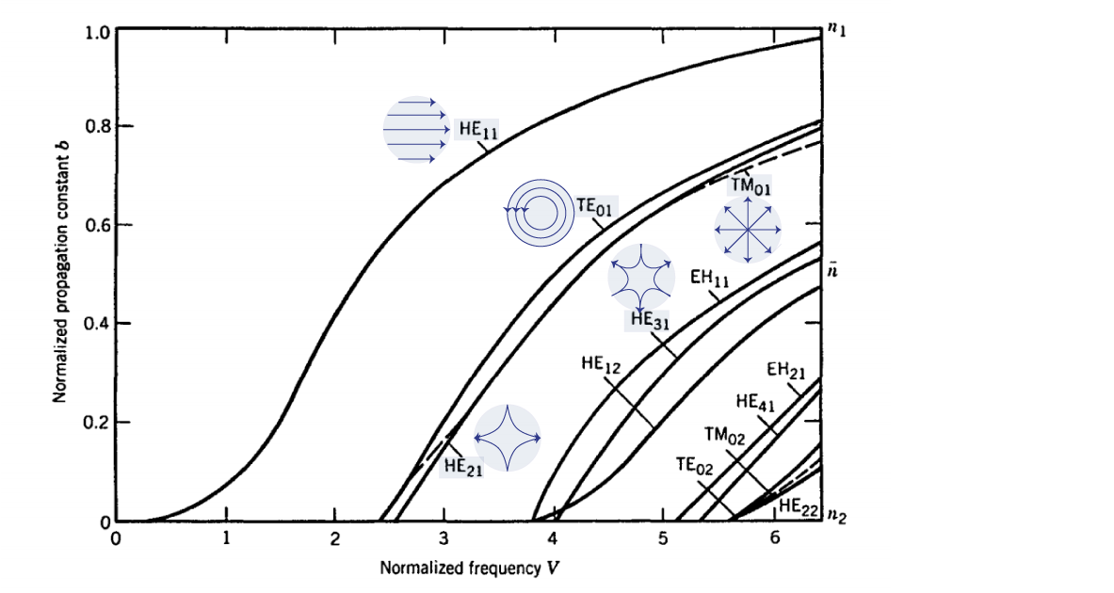
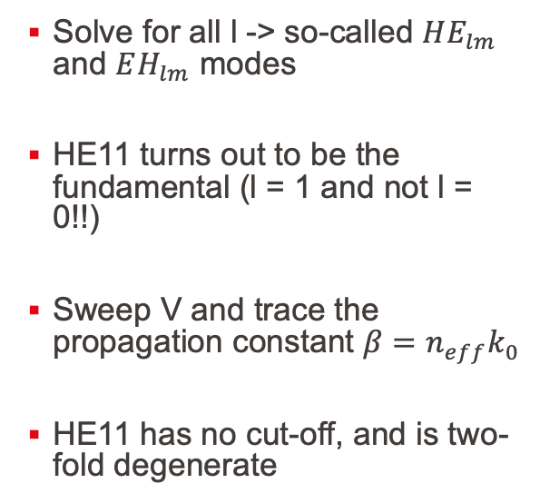

All solutions to the transcendental equation
Solve for all l -> so-called $HE_{lm}$ and $EH_{lm}$ modes
HE11 turns out to be the fundamental (l = 1 and not l = 0!!)
Sweep V and trace the propagation constant $β=n_{eff}k_{0}$
HE11 has no cut-off, and is two-fold degenerate
$$V^{2}=X^{2}+Y^{2}=k_{0}^{2}a^{2}(n_{1}^{2}−n_{2}^{2})$$

Slide 7
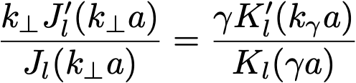
From hybrid modes to linearly polarized modes
Often easier to deal with linearly polarized modes
(new basis)
https://www.rp-photonics.com/lp_modes.html

Slide 8
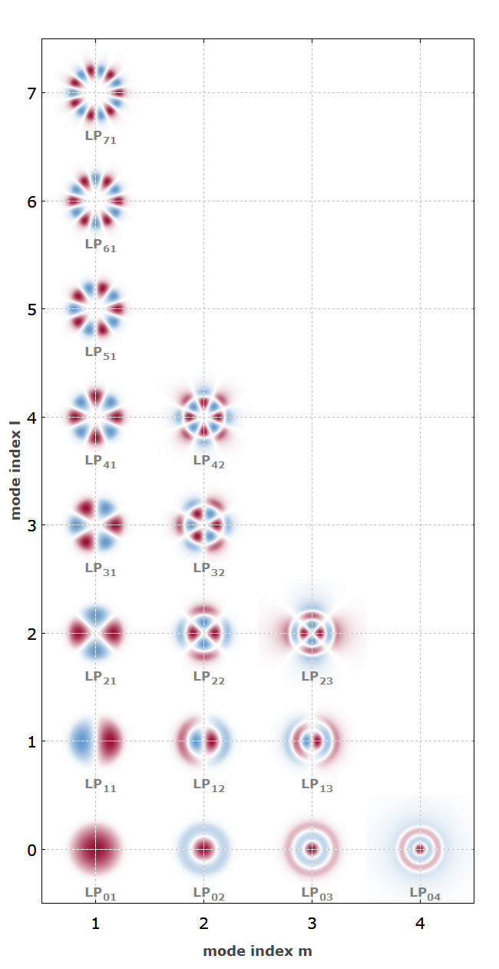
From hybrid modes to linearly polarized modes
Often easier to deal with linearly polarized modes
(new basis)
Each LP mode can be written as a sum of TE, TM and hybrid modes
LP01 is the fundamental
https://www.rp-photonics.com/lp_modes.html

Slide 9
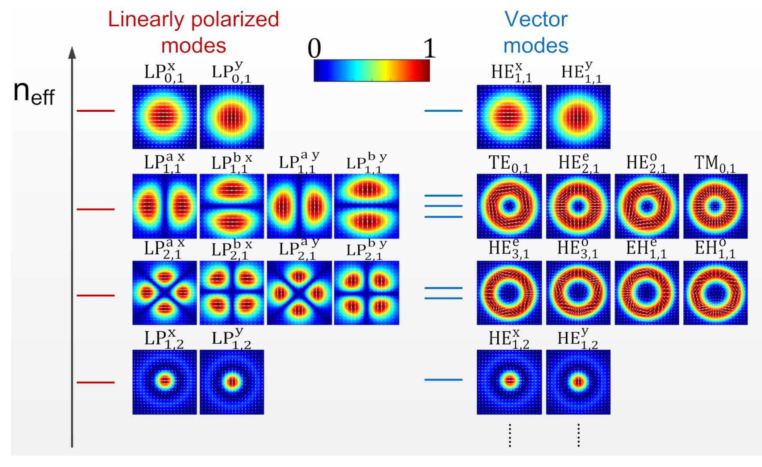
Passing from one basis to another
https://doi.org/10.3390/photonics8070246

Slide 10
Coupling to chips
https://www.imec-int.com/en/integrated-photonics

Slide 11
The problem: mode mismatch
10 – 20 um
0.1 – 2 um
From here….
to here….
Huge size mismatch
Huge shape mismatch
What must all be fulfilled to efficiently couple?

Slide 12
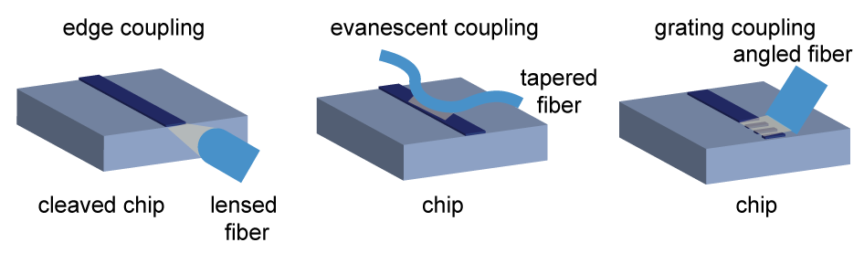
Various types of fiber-to-chip coupling

Slide 13
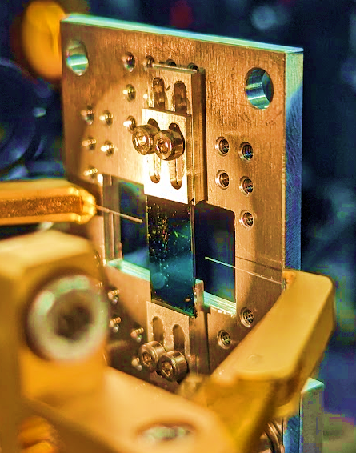
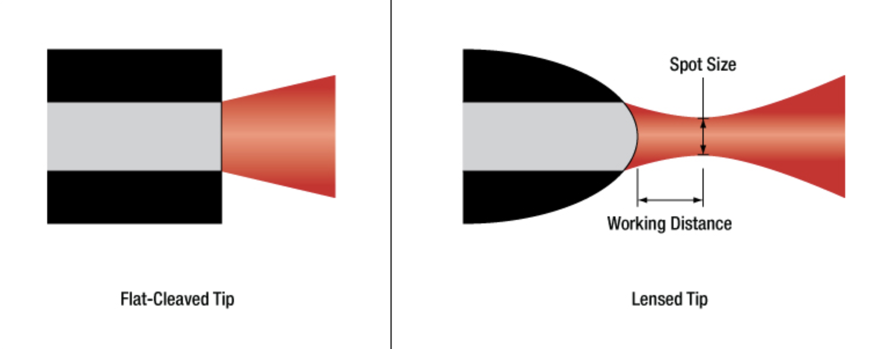
Edge coupling
Two strategies:
  Tapered waveguides
  Lensed fibers

Slide 14
Grating couplers

Slide 15
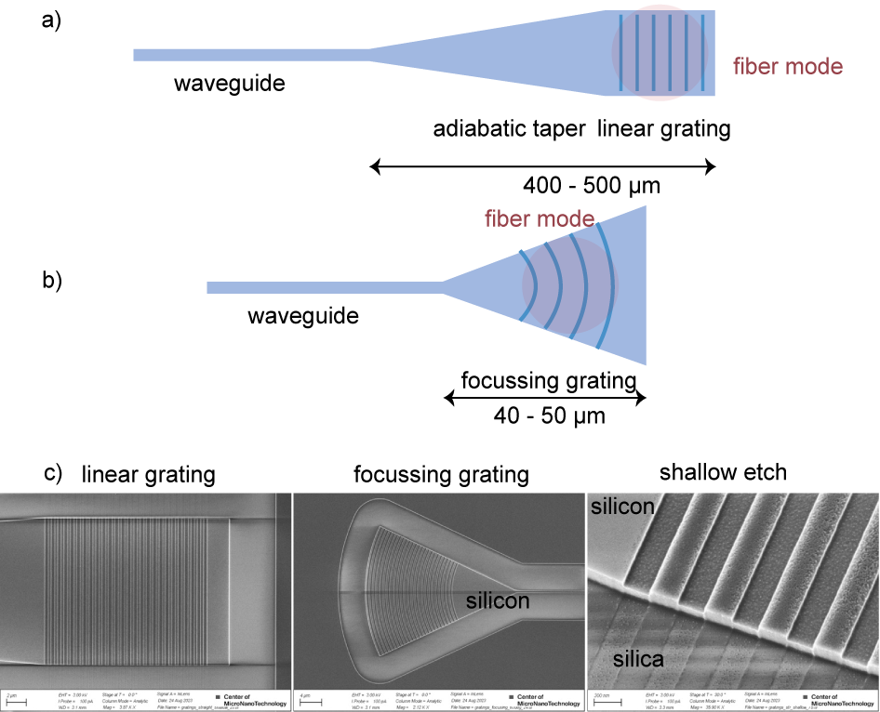
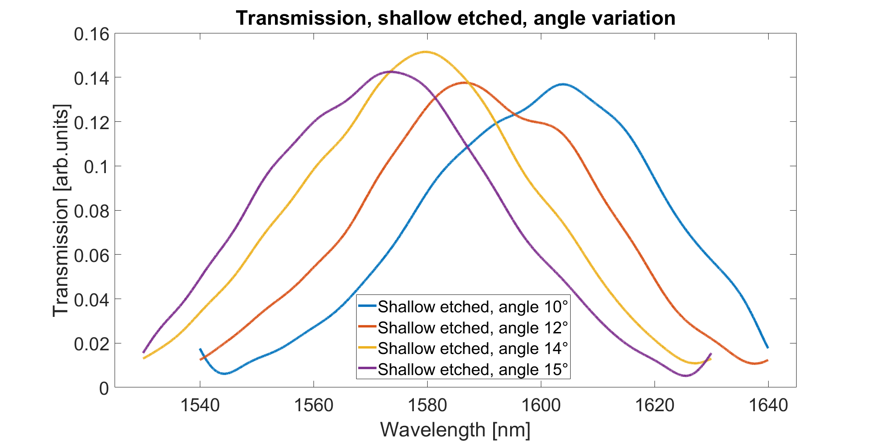
Grating coupler array
Ang

Slide 16
Do’s and don’ts
Why not coupling at normal incidence?
Why periodicity not multiple of the wavelength?
Why shallow vs deep etch?
Other ways to improve coupling efficiency?

