Slide 1
Optical fibers
https://www.imec-int.com/en/integrated-photonics

Slide 2
Today
Orga:
  Script!
Last week:
  Dispersion in waveguides
  Start optical fibers
Today:
  Continue optical fibers

Slide 3
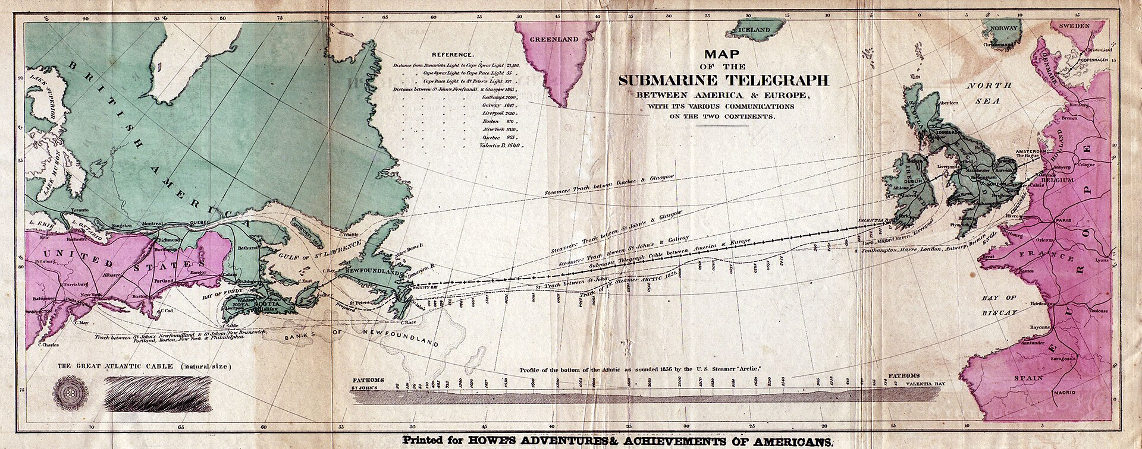
The beginning of a modern world
A couple of courageous people in the 1840s and 1850s advocated for the construction of a telegraph cable.
Notes:
https://en.wikipedia.org/wiki/Transatlantic_telegraph_cable

Slide 4
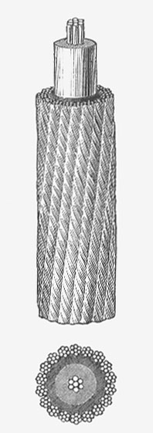
The beginning of a modern world
A couple of courageous people in the 1840s and 1850s advocated for the construction of a telegraph cable.
The technology: first cable 550 kg/km.
Notes:
https://en.wikipedia.org/wiki/Transatlantic_telegraph_cable

Slide 5
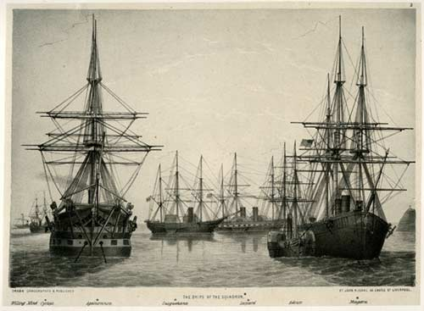
After many failed attempts ….
The first attempt was a failure: cable broke right at the shore
Was repaired, broke again over Telegraph plateau (3200 m deep) and 480 km of cable were lost
Two ships ships met in the middle of the Atlantic and spliced the two cables together
Agamemnon sailed eastwards towards Valentia and Niagara westwards towards Newfoundland
The cable broke again several times
Source: https://atlantic-cable.com/1858NY/index.htm

Slide 6
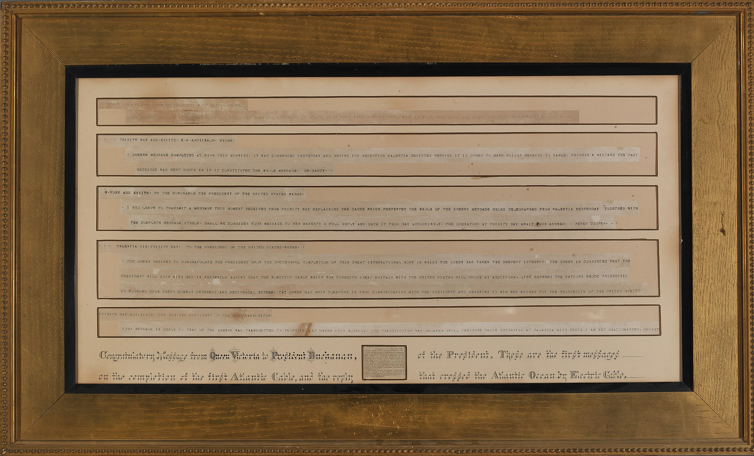
1858: the first successful transmission

Slide 7
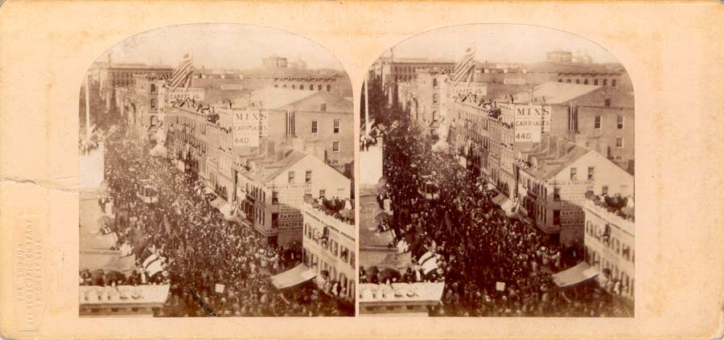
1858: the first successful transmission
The Atlantic Telegraph Jubilee, New York. Photograph by William England.

Slide 8
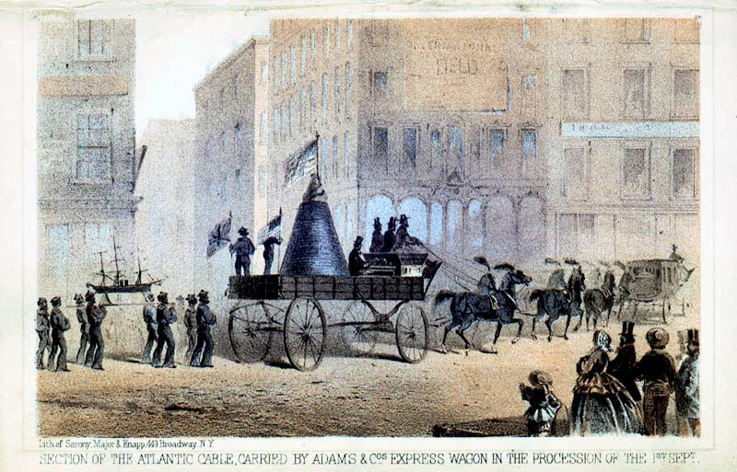
1858: the first successful transmission
The Atlantic Telegraph Jubilee, New York. Photograph by William England.

Slide 9
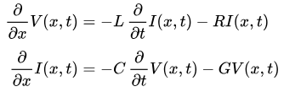
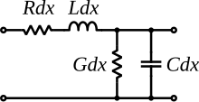
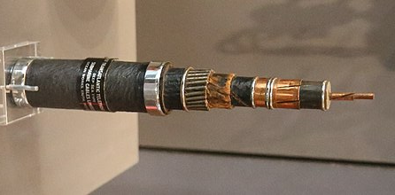
Data rush .. Towards more b/s , kb/s and Mb/s?
The first message of the Queen of 98 words took 16 hours to send (1 word in 10 mins)
Cable bandwidth was limited by an imbalance between capacitance and inductance, leading to distortion
The original cables were not fitted with repeaters, no practical way to power them in a submarine cable.
Telegraph equations from Oliver Heaviside!
Trans-Atlantic telephone cable (TAT-1) with 1 kHz bandwidth: co-axial cable
O. Heaviside, “On the extra current”, Aug. 1876

Slide 10
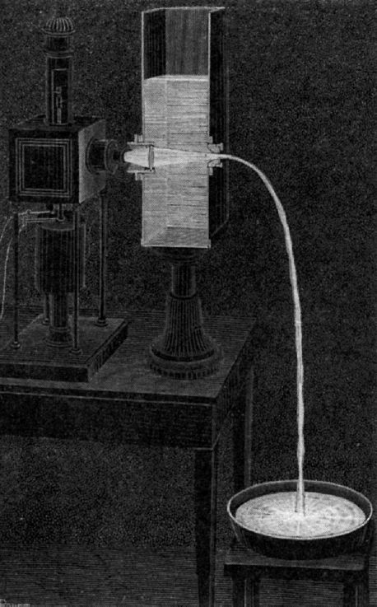
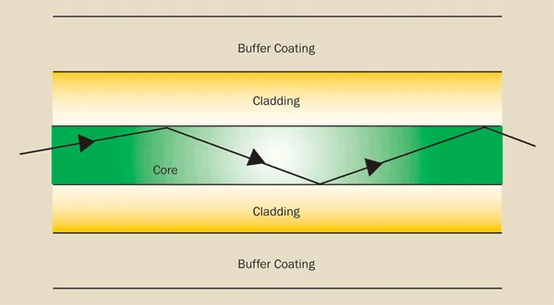
In parallel…. Optical fibers
Colladon’s and Babinet’s light fountain in 1840
Tyndal formulates total internal reflection in 1870
Charles K. Kao and George Hockham proposed that transmission should be possible with attenuation below 20 dB/km in silica fibers
Corning demonstrated attenuation of 17 dB/km and then 4 dB/km using impurities
“Dielectric-fibre surface waveguides for optical frequencies”, K.C.Kao & G.A.Hockham, Proceedings of the IEE, Vol. 113, No.7 (1966)

Slide 11
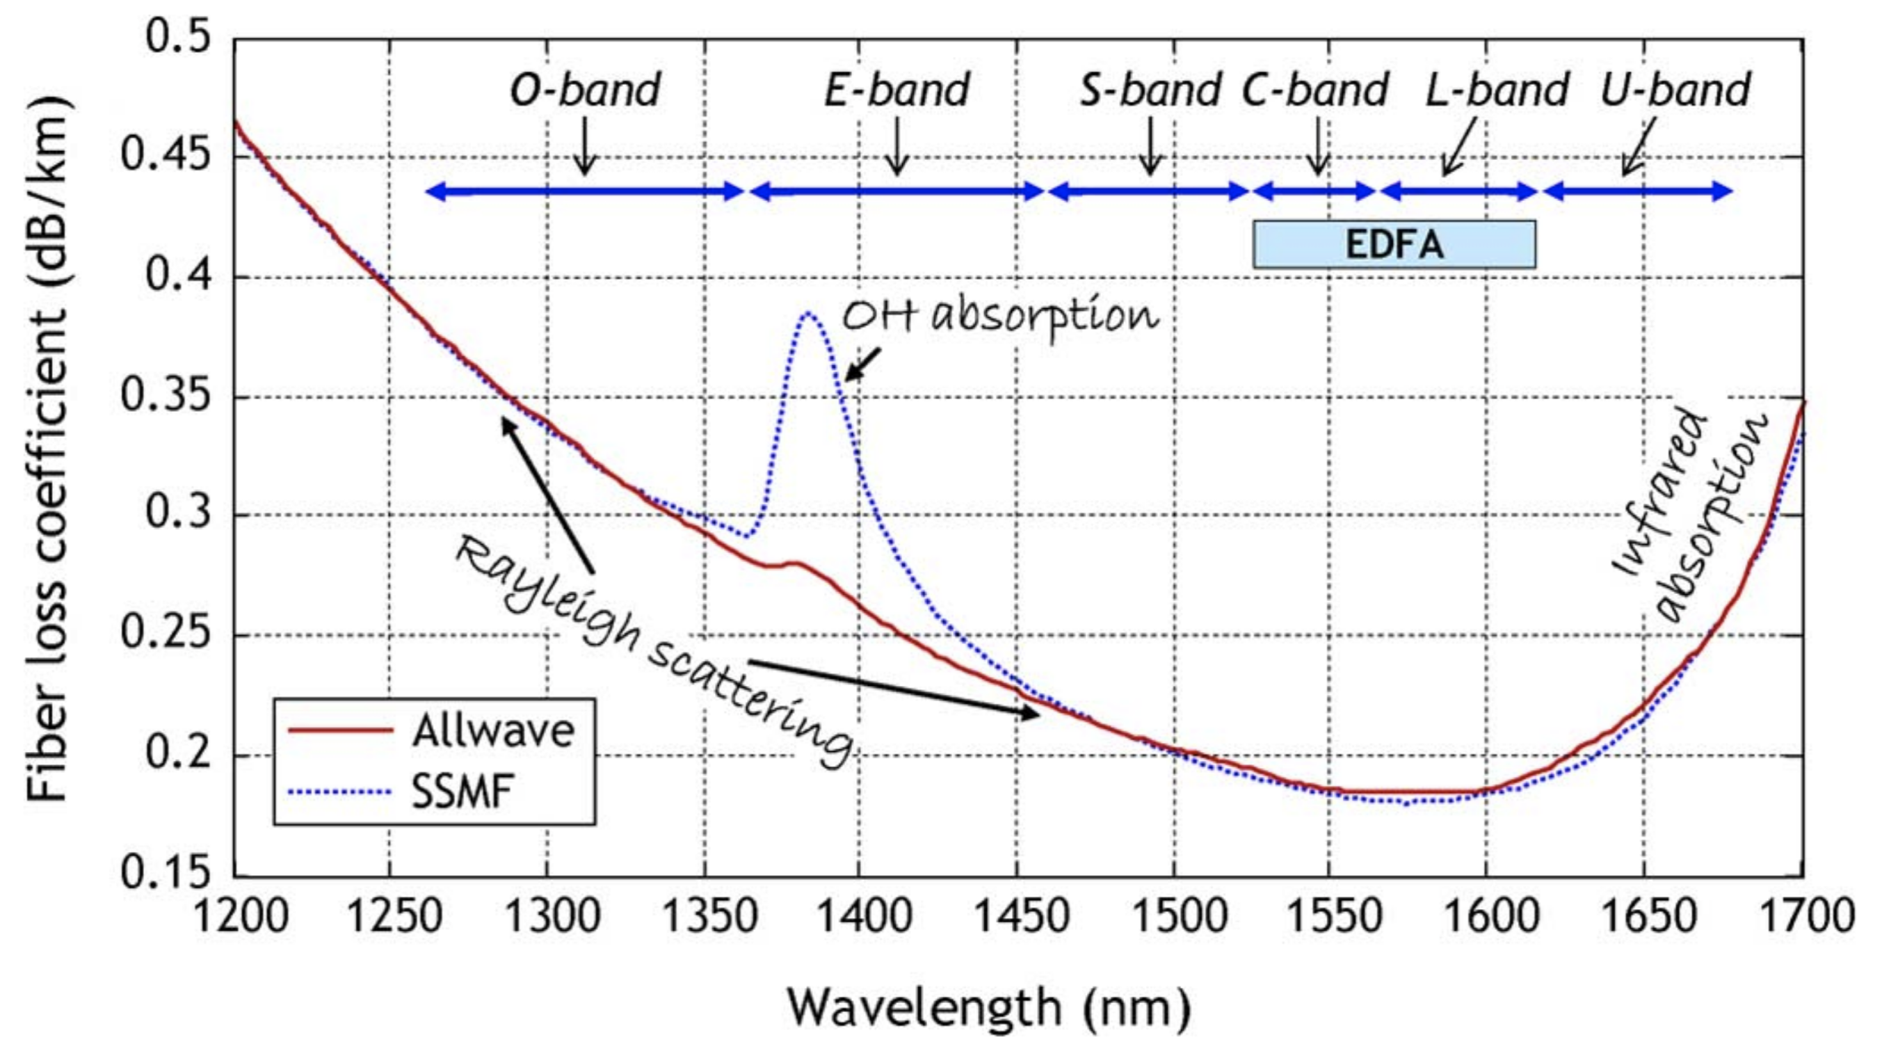
Properties and wavelengths
R.-J. Essiambre et al., “Capacity limits of optical fiber networks”, J. Lightwave Technol. 28 (4), 662 (2010);
https://doi.org/10.1109/JLT.2009.2039464

Slide 12
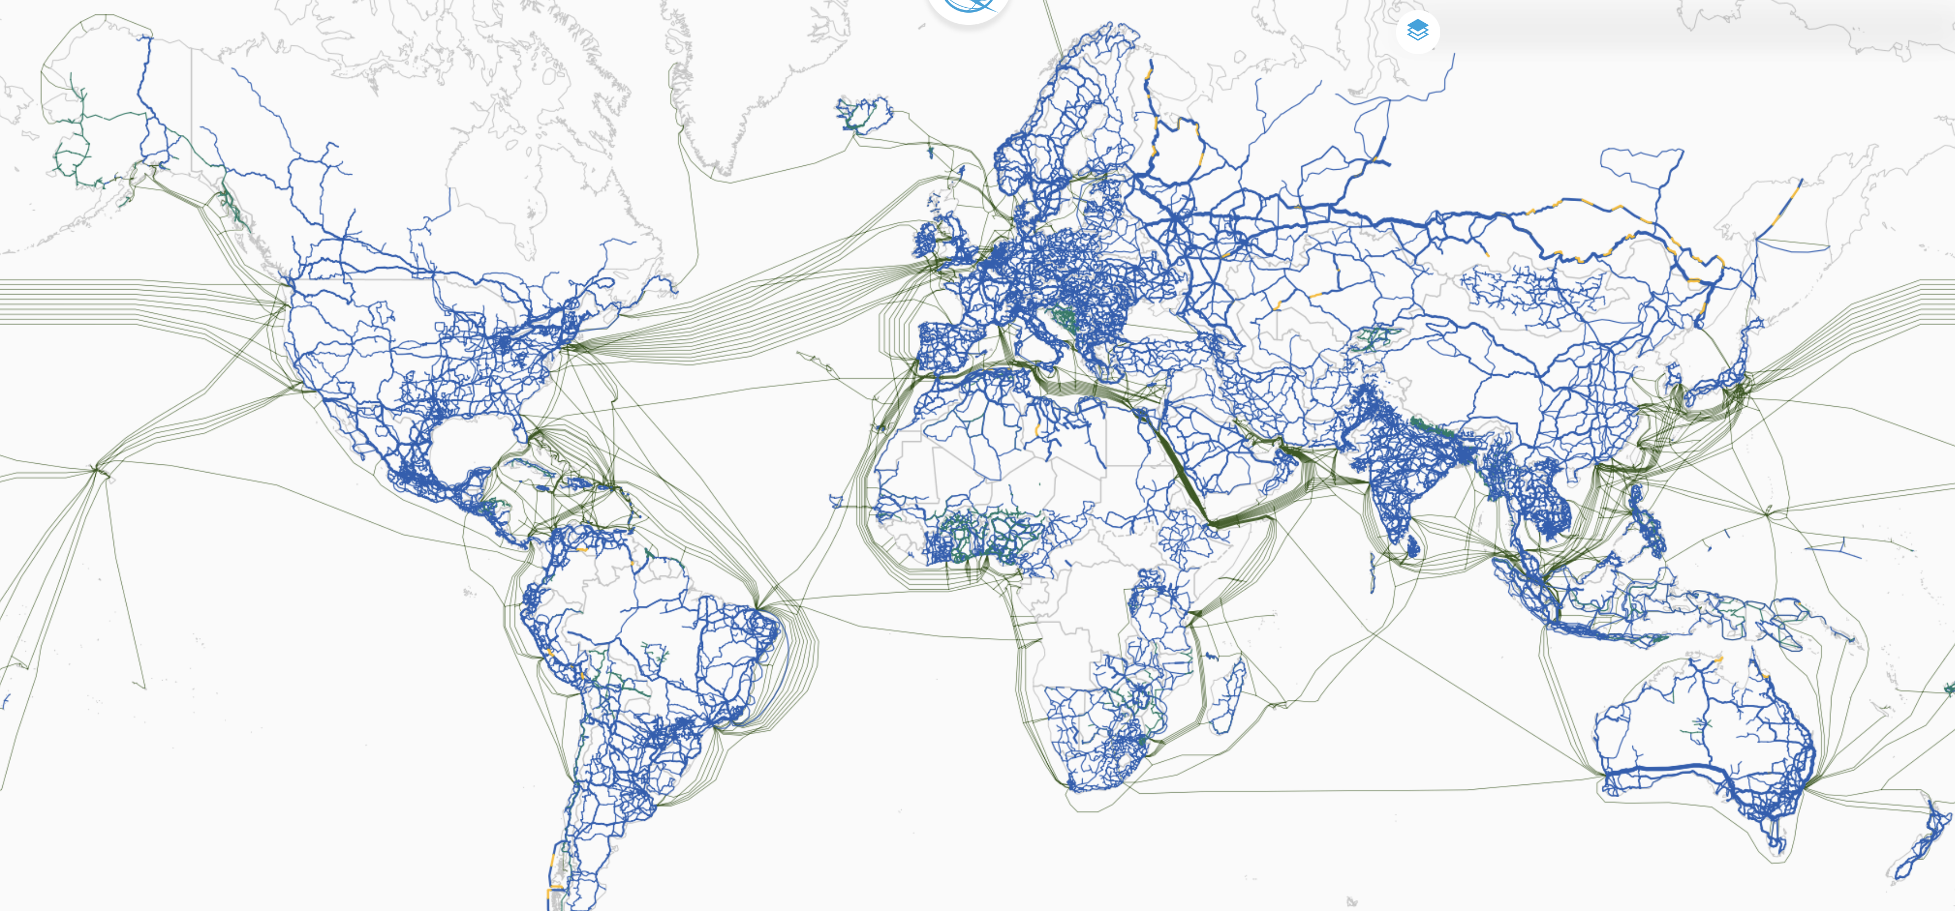
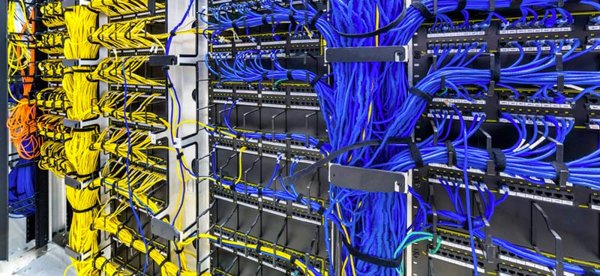
Why do we care about fibers?
Worldwide
Data centers
Low maintenance
High bandwidth
Prevent tangling
Select right type of fiber
Durability
Separating copper from fiber
https://bbmaps.itu.int/bbmaps/

Slide 13
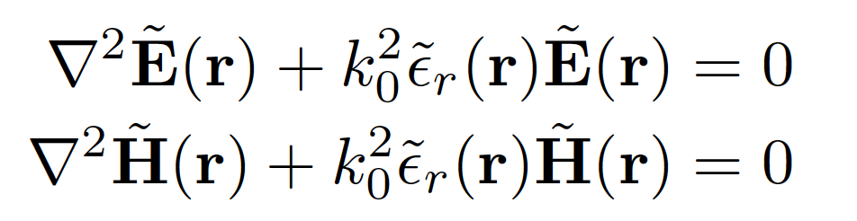
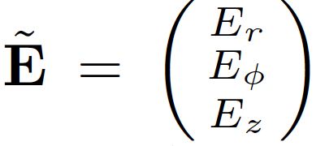
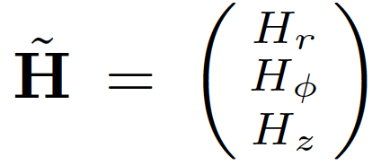
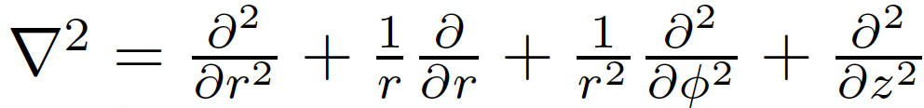
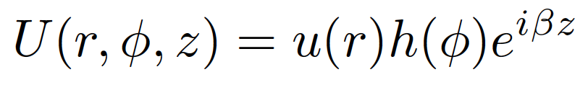
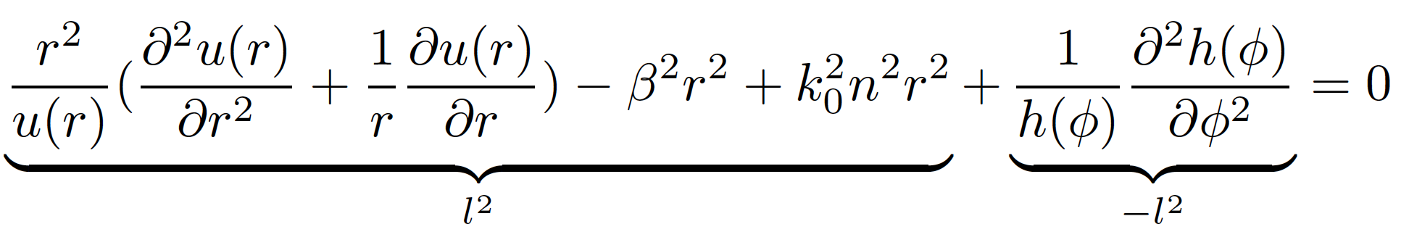
The math…
Helmholtz equation:
Cylindrical coordinates:
Ansatz:
To solve:

Slide 14

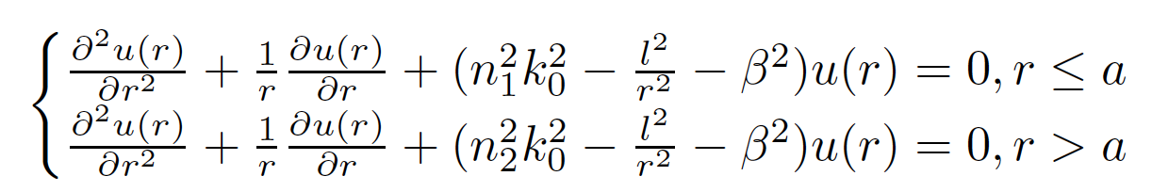
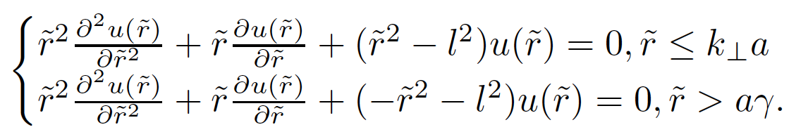

The math…continued
Angular dependence:
Radial dependence:
Substituting $γ^{2}=β^{2}−n_{2}^{2}k_{0}^{2}, k_{⊥}^{2}=n_{1}^{2}k_{0}^{2}−β^{2}, \tilde{r}=k_{⊥}r \left(r≤a\right)\tilde{ r}=γr (r>a)$

Slide 15
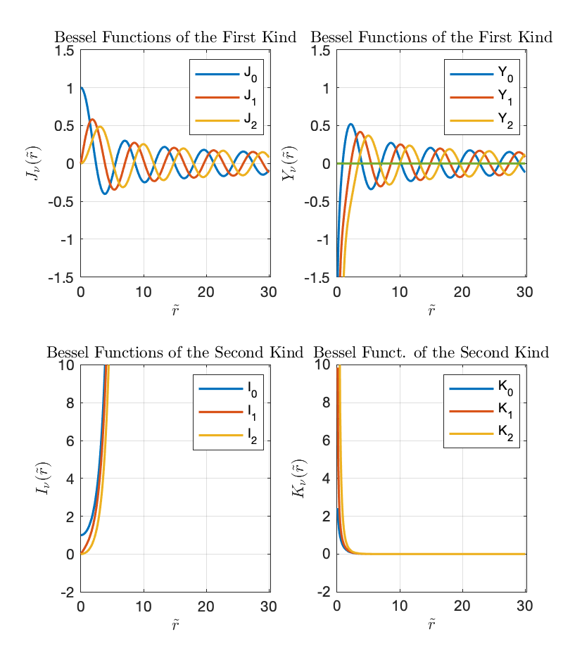
Bessel functions
What do you notice from the spatial field profile?
To which functions do these ressemble?
What is different?

Slide 16
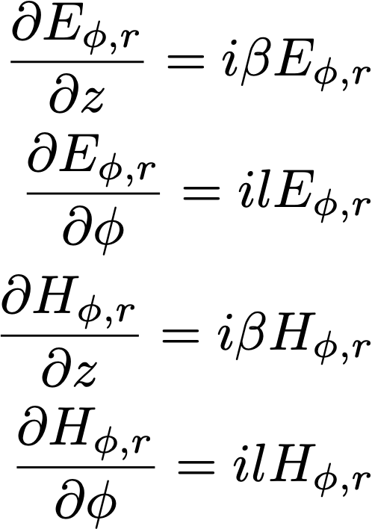
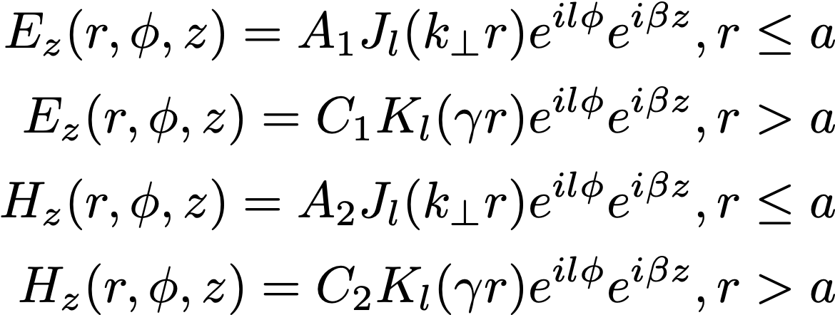
We start from….

Slide 17
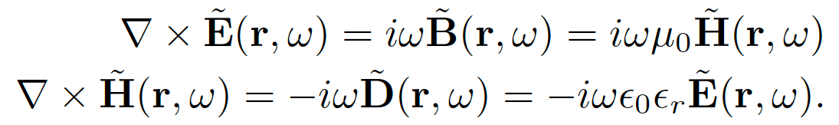
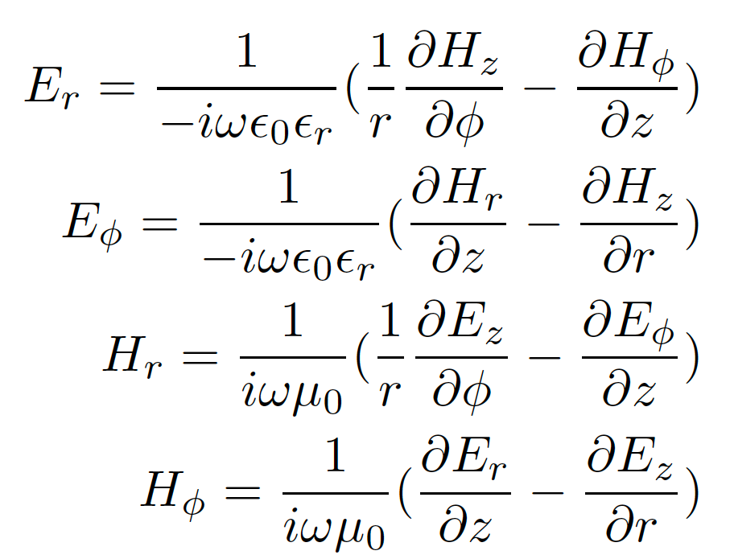
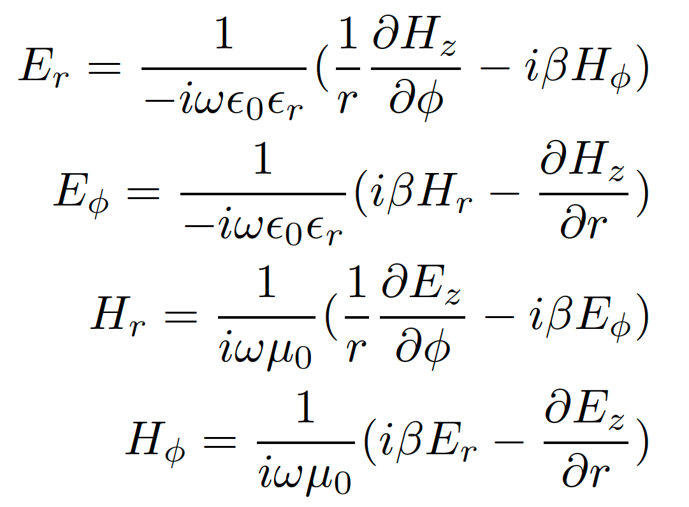
Now we use
And using cylindrical coordinates

Slide 18
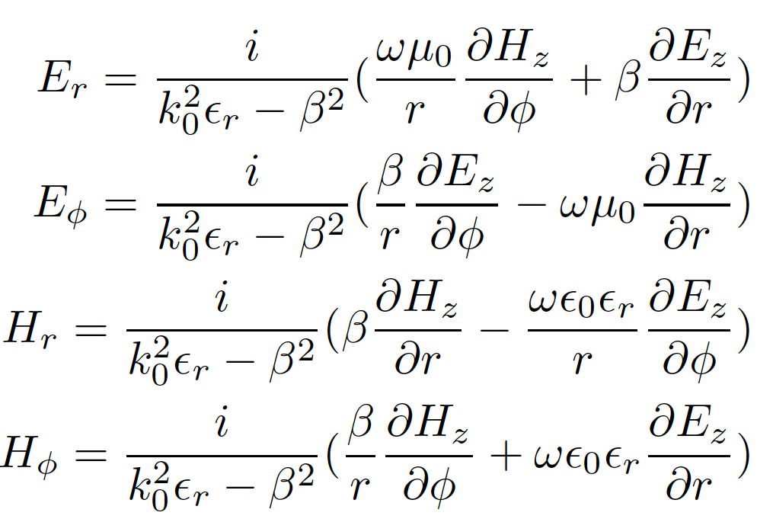

Reshuffling
We get
We can apply the boundary conditions for $E_{Z}, H_{z}, E_{φ}, H_{φ}$, all tangential to the interface.
(…. Ex 1 of Assignment 2)

Slide 19
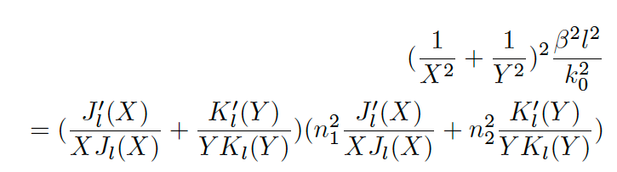

Boundary conditions
Defining $X=k_{⊥}a, Y=γa, V^{2}=X^{2}+Y^{2}=k_{0}a\sqrt{n_{1}^{2}−n_{2}^{2}, } k_{⊥}^{2}=k_{0}^{2}n_{1}^{2}−β^{2}, γ^{2}{=β}^{2}−k_{0}^{2}n_{2}^{2}$ we get the transcendental equation for fibers:

Slide 20
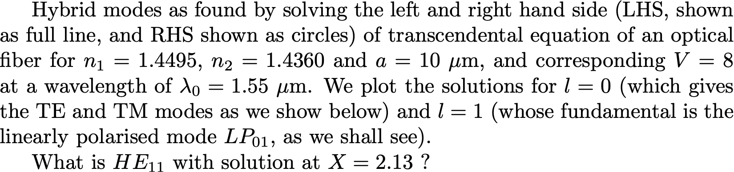
What are the solutions?

Slide 21
l = 0
(derive in class)
= 0 corresponds to ? mode
= 0 corresponds to ? mode

Slide 22
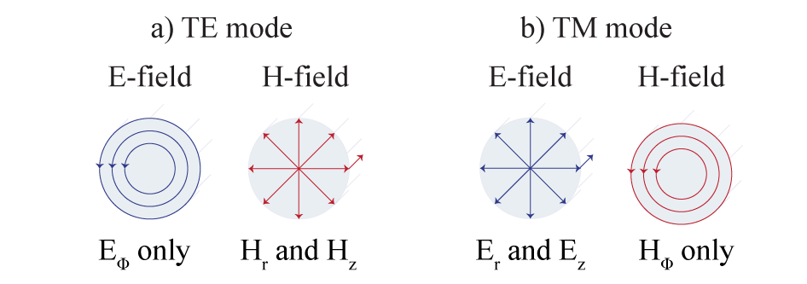
TE and TM modes
= 0 corresponds to TE mode
= 0 corresponds to TM mode

