Slide 1
Slab waveguides and other waveguides
https://www.imec-int.com/en/integrated-photonics

Slide 2
Today
Orga:
  Typo!
Last week:
  Slab waveguides
Today:
  Properties of slab waveguides: dispersion
  Types of waveguides
  Start optical fibers
$γ_{m}^{2}=β_{m}^{2}−k_{0}^{2}n_{2}^{2}=k_{0}^{2}n_{1}^{2}\cos^{2}{θ_{m}}−k_{0}^{2}n_{2}^{2}$(correct)

Slide 3
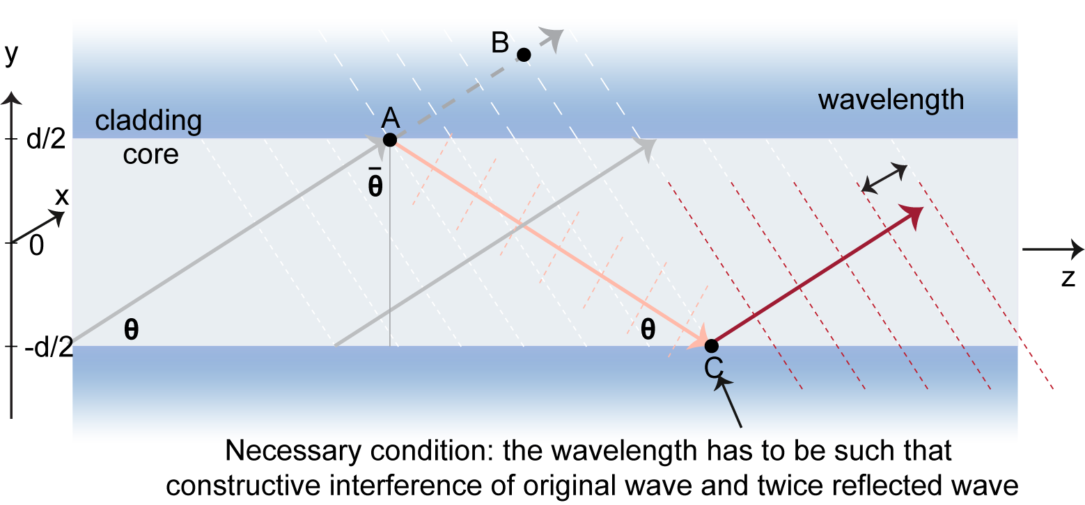
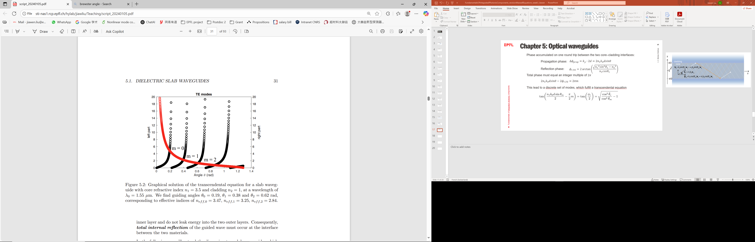
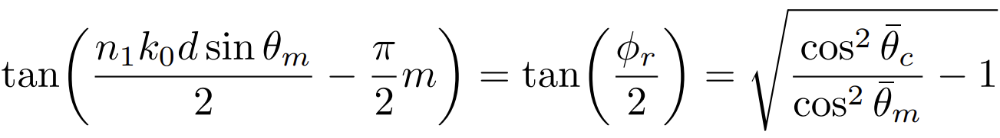




Last time: slab waveguide
Decompose the wavevector inside the core:
$$k_{1}= n_{1}k_{0}cosθe_{z}+n_{1}k_{0}sinθe_{y}$$
Transverse component:
$$k_{y}= n_{1}sinθk_{0}$$
Longitudinal component:
$$k_{z}= n_{1}cosθk_{0}=n_{eff}k_{0}$$
$θ_{m}$ depends on wavelength!

Slide 4
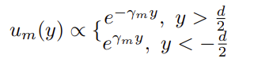

Last time: slab waveguide
Decompose the wavevector inside the core:
$$k_{1}= n_{1}k_{0}cosθe_{z}+n_{1}k_{0}sinθe_{y}$$
Transverse component:
$$k_{y}= n_{1}sinθk_{0}$$
Longitudinal component:
$$k_{z}= n_{1}cosθk_{0}=n_{eff}k_{0}$$
$$γ_{m}^{2}=β_{m}^{2}−k_{0}^{2}n_{2}^{2}=k_{0}^{2}n_{1}^{2}\cos^{2}{θ_{m}}−k_{0}^{2}n_{2}^{2}$$
Small $γ_{m}^{}$ -> long exponential decay
== large m in $θ_{m}$(gets closer to critical angle)

Slide 5
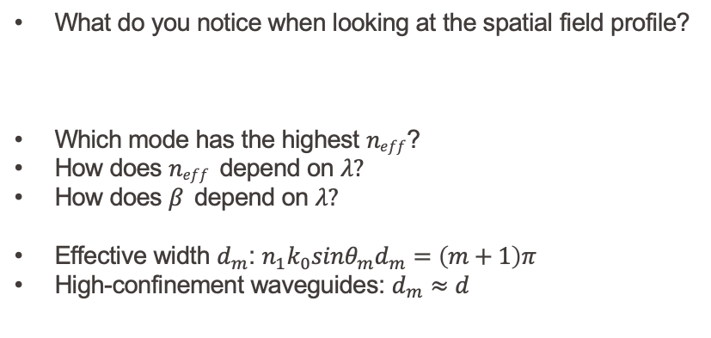
Last time: slab waveguide
What do you notice when looking at the spatial field profile?
Which mode has the highest $neff$?
How does $neff$ depend on $λ?$
How does $β$ depend on $λ?$
Effective width $d_{m}$: $n_{1}k_{0}sinθ_{m}d_{m}=\left(m+1\right)π$
High-confinement waveguides: $d_{m}≈d$

Slide 6
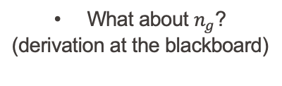
Example silicon slab waveguide
What about $n_{g}$?
(derivation at the blackboard)

Slide 7
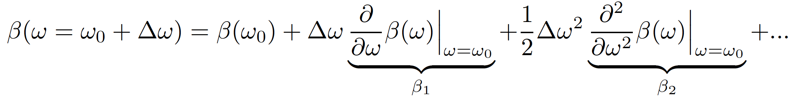
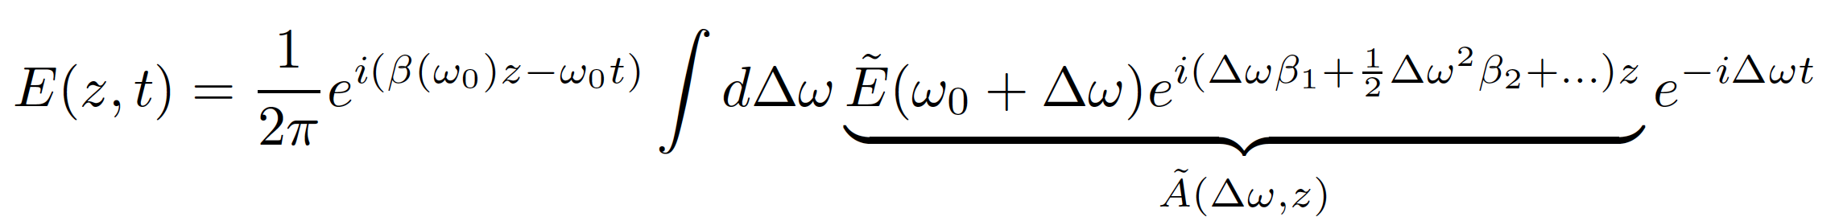
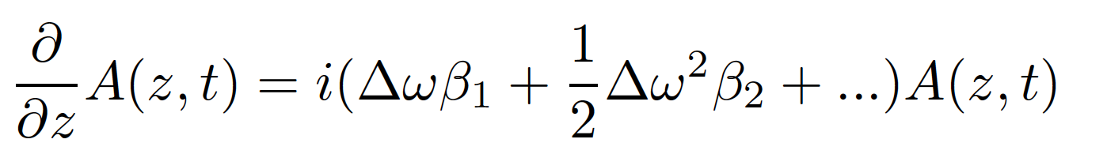
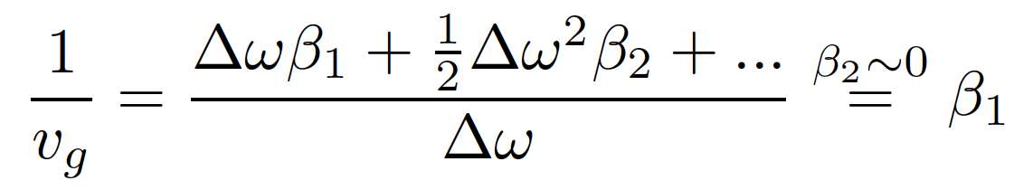
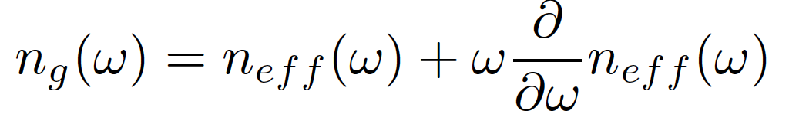
Dispersion in waveguides
Plug into the equation for the field
How does the envelope change?
Group velocity and group index

Slide 8
Example silicon slab waveguide

Slide 9
Other types of waveguides

Slide 10
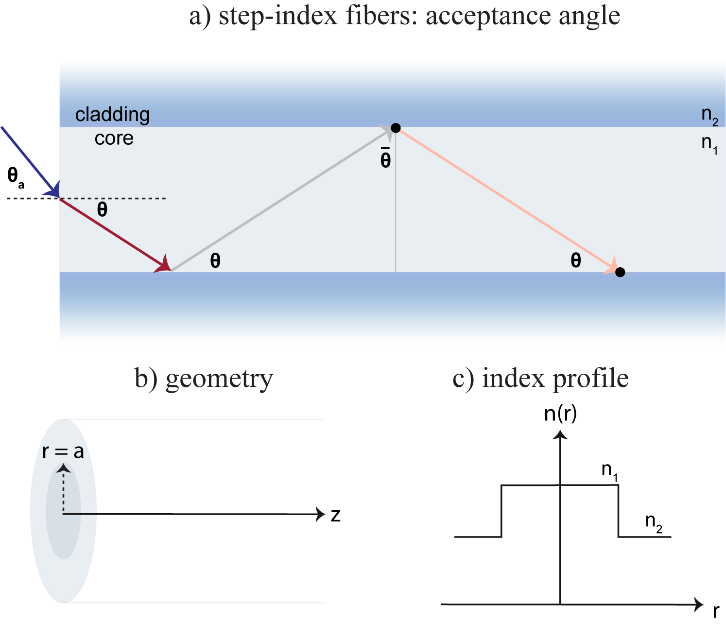
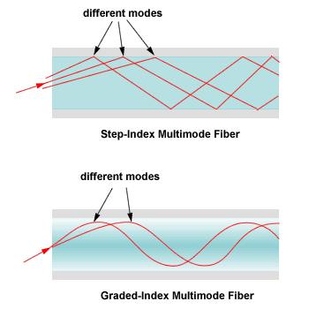

Fibers
Acceptance angle $θ_{a}$ and numerical aperture NA of a fiber:
$\sin{θ_{a}=\sqrt{n_{1}^{2}−n_{2}^{2}}}≈n_{1}\sqrt{2Δ}$ = NA -> large NA requires large index contrast

Slide 11
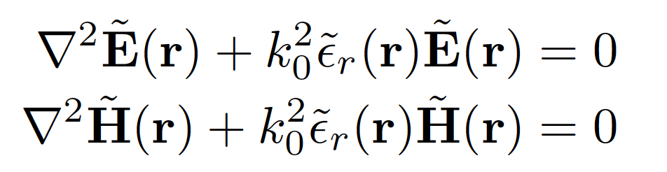
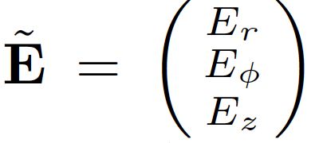
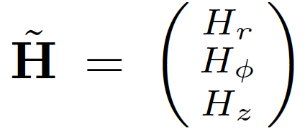
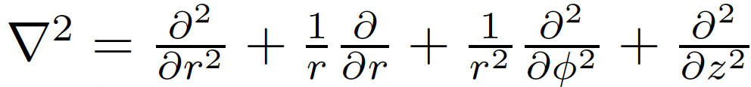
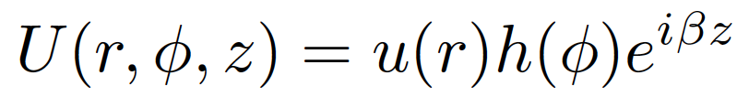
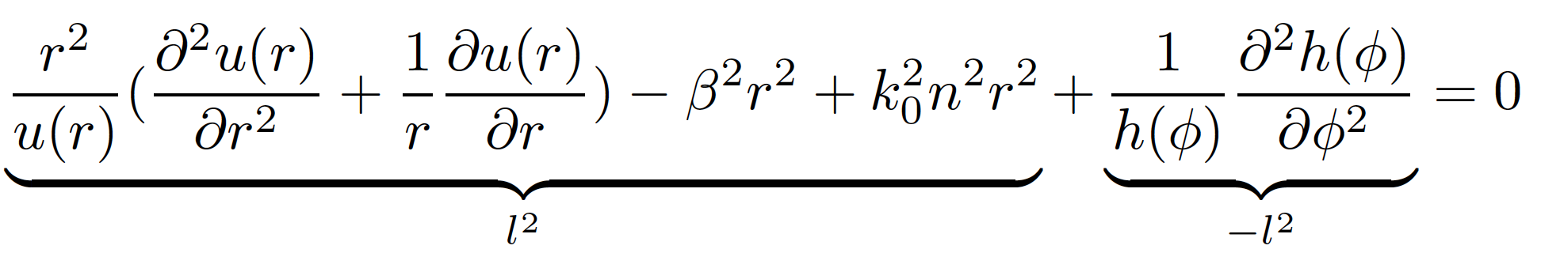
The math…
Helmholtz equation:
Cylindrical coordinates:
Ansatz:
To solve:

Slide 12

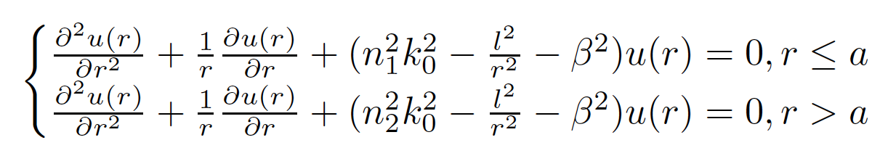
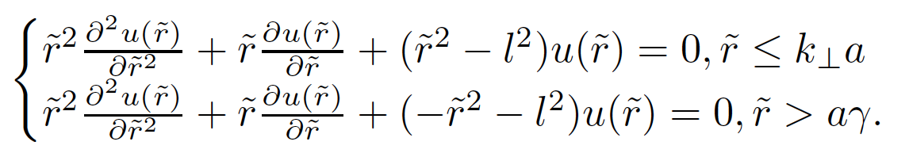

The math…continued
Angular dependence:
Radial dependence:
Substituting $γ^{2}=β^{2}−n_{2}^{2}k_{0}^{2}, k_{⊥}^{2}=n_{1}^{2}k_{0}^{2}−β^{2}, \tilde{r}=k_{⊥}r \left(r≤a\right)\tilde{ r}=γr (r>a)$

Slide 13
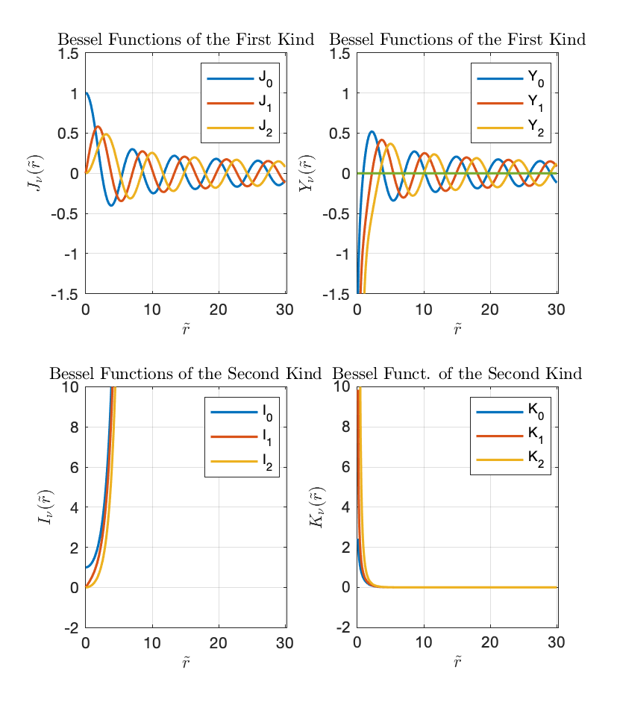
Bessel functions
What do you notice from the spatial field profile?
To which functions do these ressemble?
What is different?

Slide 14
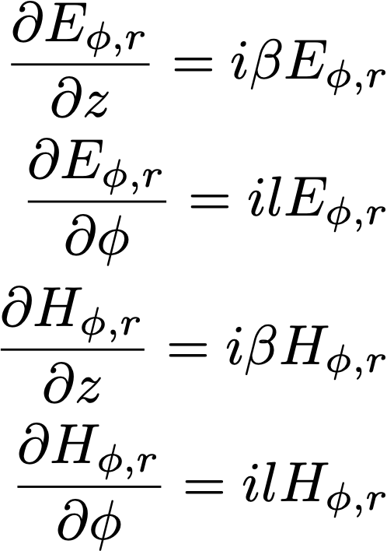
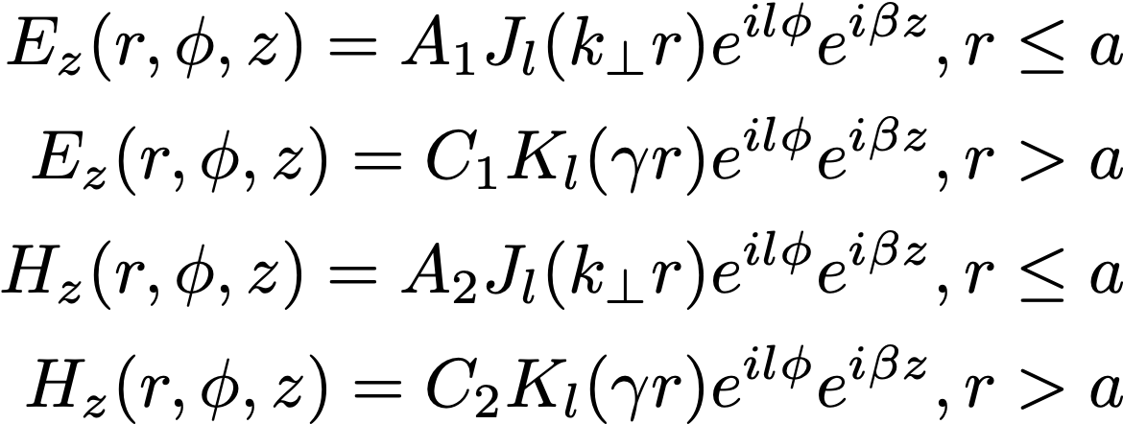
Next time: we start from….

