Slide 1
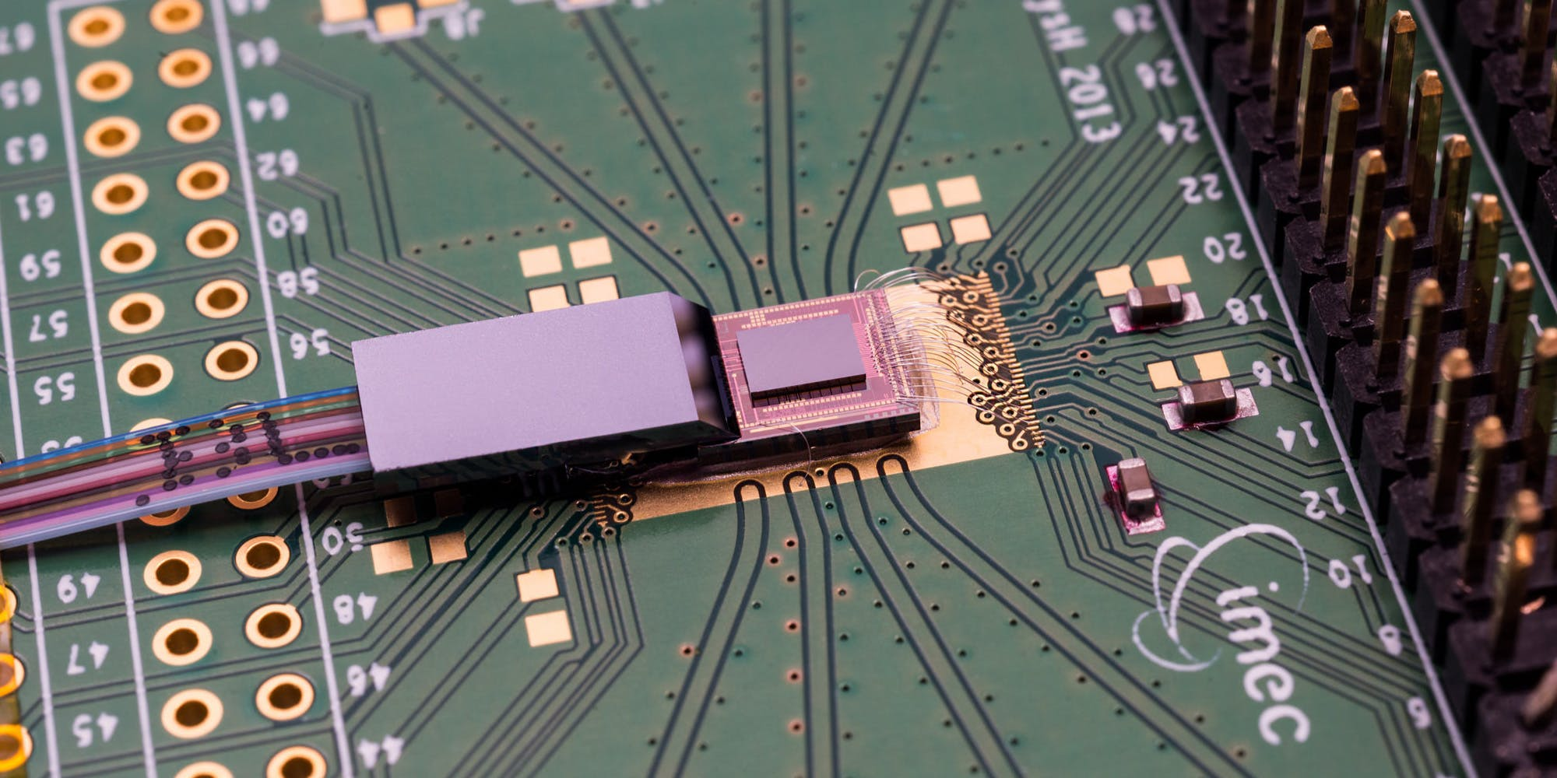
Introduction to photonic integrated circuits
https://www.imec-int.com/en/integrated-photonics

Slide 2
Today
Orga:
  Script online! All derivations there
  Assignments published Wednesdays 5 pm
Last week:
  Introduction and motivation of photonic chips
Today: Foundations
  Revision Maxwell equations
  Reflection at a dielectric boundary
  Start slab waveguide

Slide 3
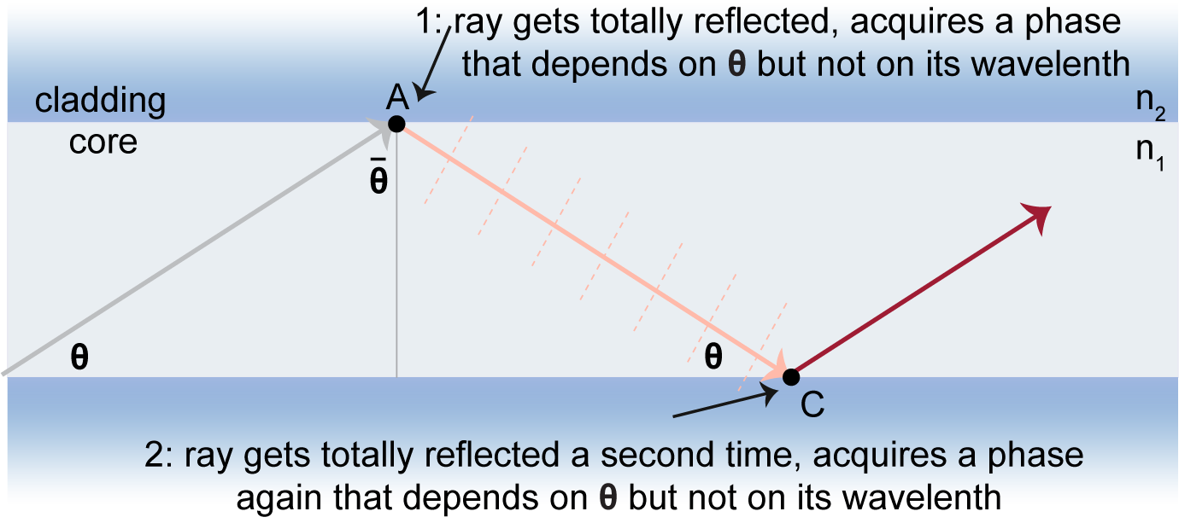
4.1. Introduction to wave propagation
Motivation
Need to know:
  Propagation of light in a medium
  What happens at interfaces

Slide 4
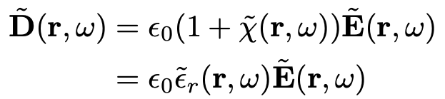
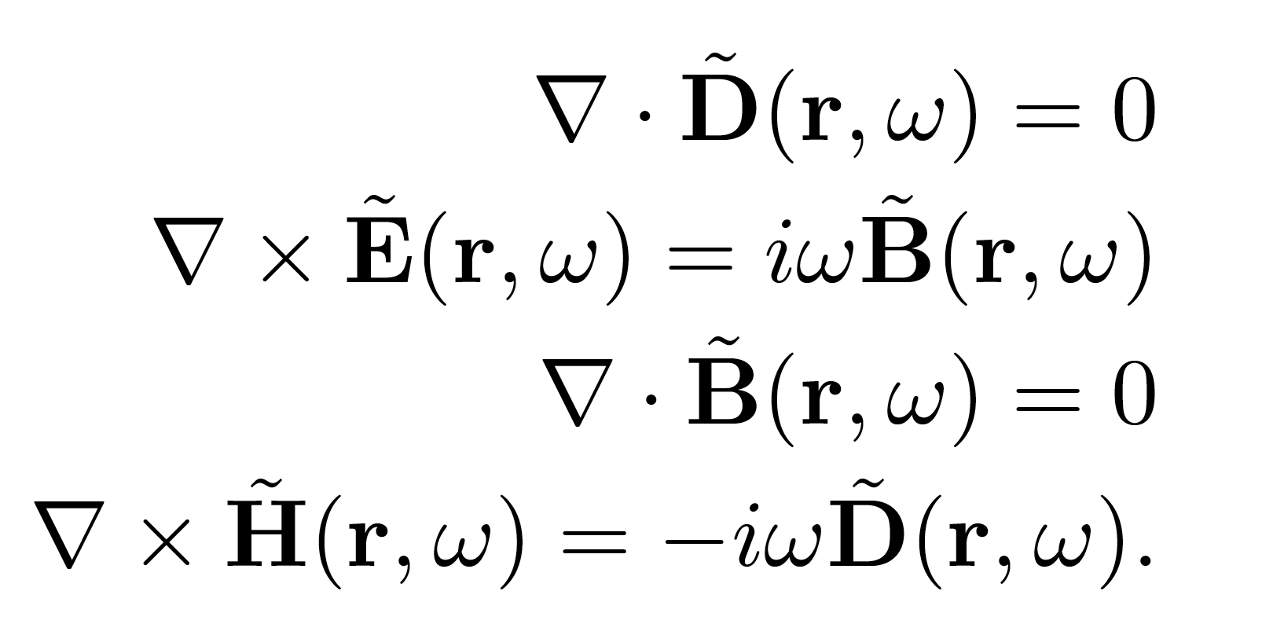

4.2. Plane waves in linear media
Starting from
+
+

Slide 5
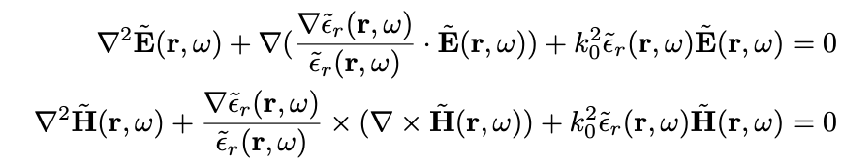
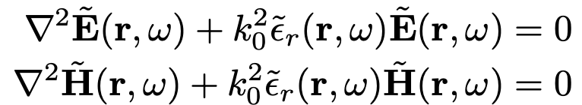

4.2. Plane waves in linear media
In weakly inhomogenous media, the dielectric function does not change significantly over length scales similar to an optical wavelength
Generalising we can write the famous Helmholtz equation
We will solve it for slab waveduide modes today!

Slide 6
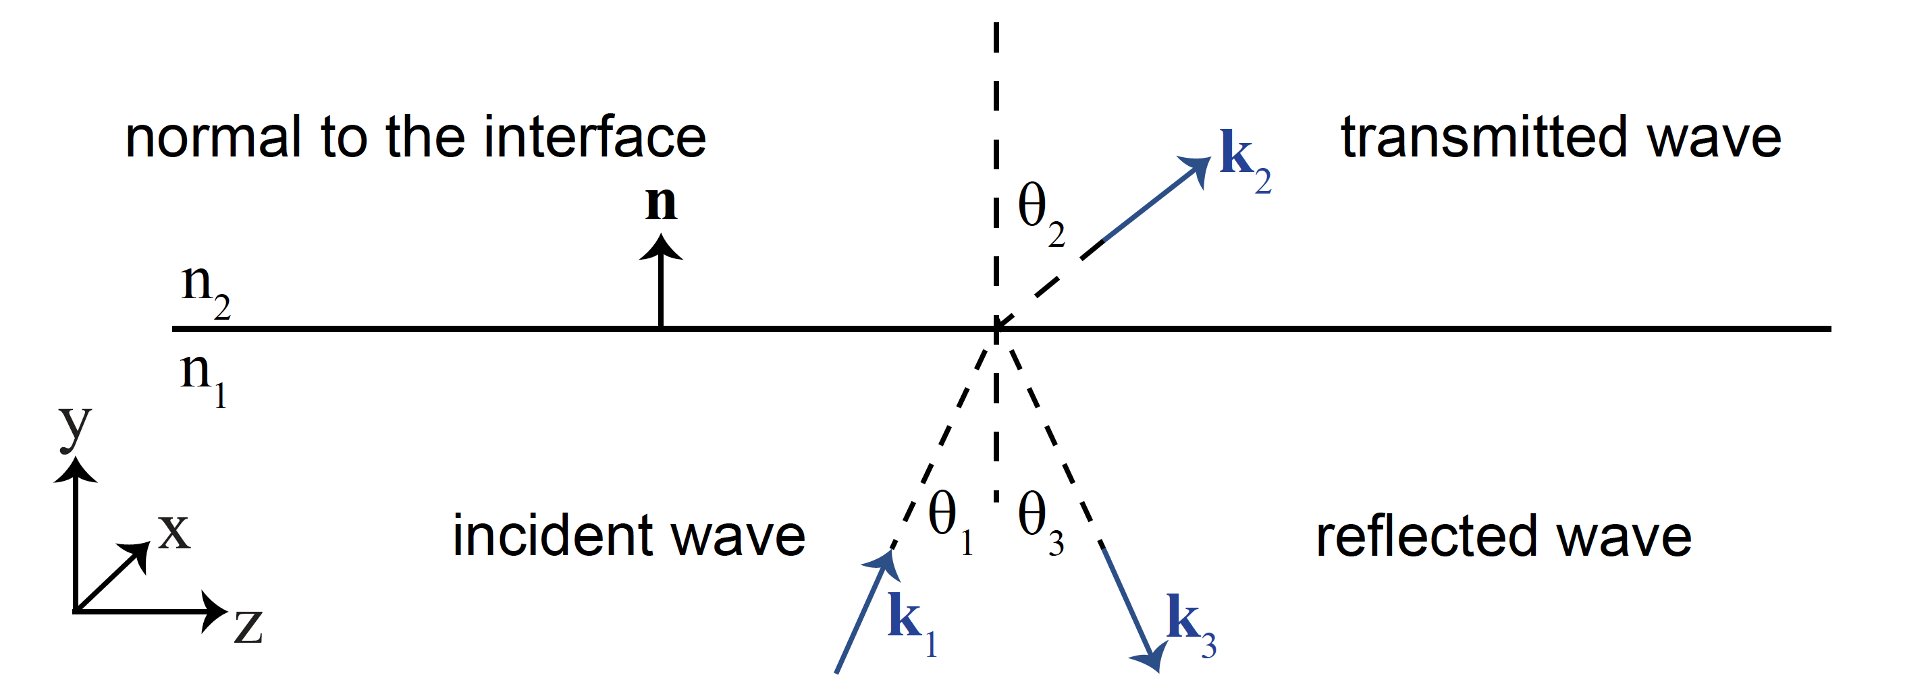
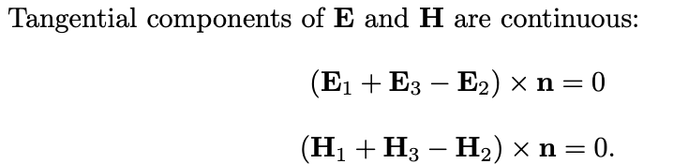
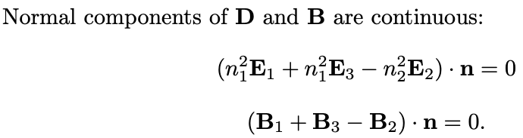
4.2. Laws of refraction and reflection at an interface

Slide 7
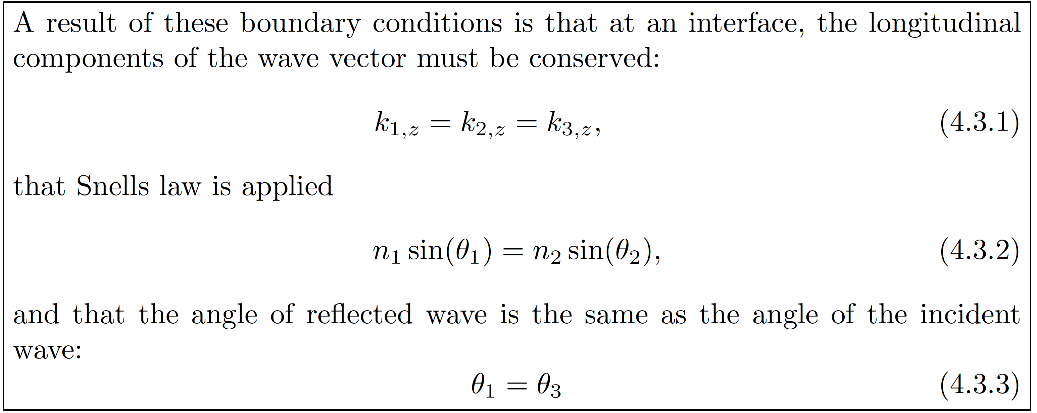
4.2. Laws of refraction and reflection at an interface
Math in the script….

Slide 8
TE and TM modes
Draw at blackboard (2 mins thinking)

Slide 9
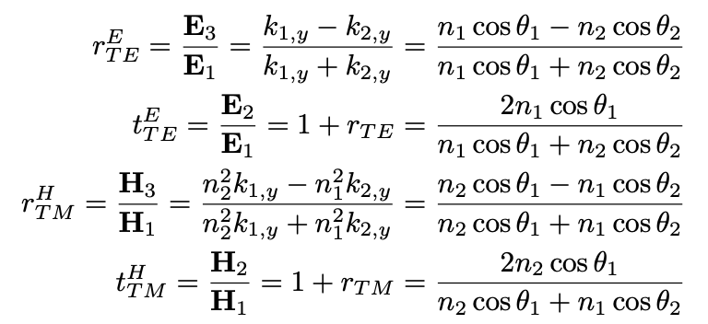
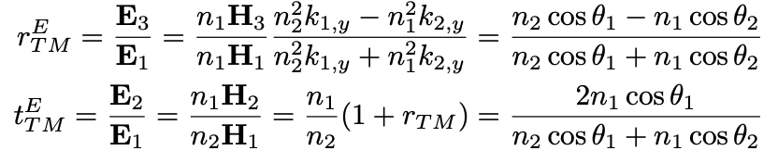
TE and TM modes
Math in exercise 1…
Total internal reflection?
If both numerator and denominator are real:
If $n_{1}cosθ_{1}>n_{2}cosθ_{2}$, then $r_{TE}^{}>0$, so $\arg\left(r\right)=0$
If $n_{1}cosθ_{1}<n_{2}cosθ_{2}$, then $r_{TE}^{}<0$, so $\arg\left(r\right)=π$
When $θ_{1}>θ_{c}$, denominator and numerator are complex, argument of $r_{TE}^{}$ becomes a function of $n_{1}$ $n_{2}$ and $θ_{1}$

Slide 10
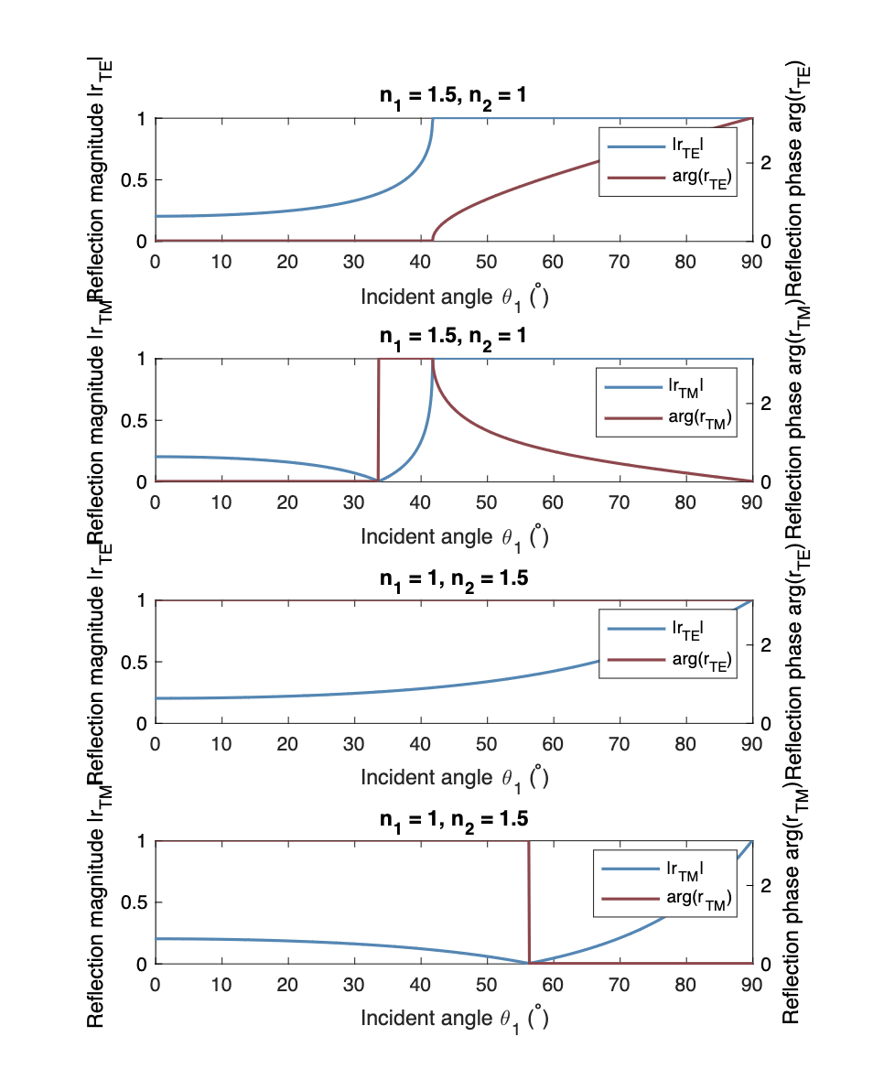
Reflection magnitude and phase
TE modes
TM modes
If both both numerator and denominator are real
If $n_{1}cosθ_{1}>n_{2}cosθ_{2}$, then $r_{TE}^{}>0$, so $\arg\left(r\right)=0$
If $n_{1}cosθ_{1}<n_{2}cosθ_{2}$, then $r_{TE}^{}<0$, so $\arg\left(r\right)=π$
When $θ_{1}>θ_{c}$, denominator and numerator are complex, argument of $r_{TE}^{}$ becomes a function of $n_{1}$ $n_{2}$ and $θ_{1}$

Slide 11
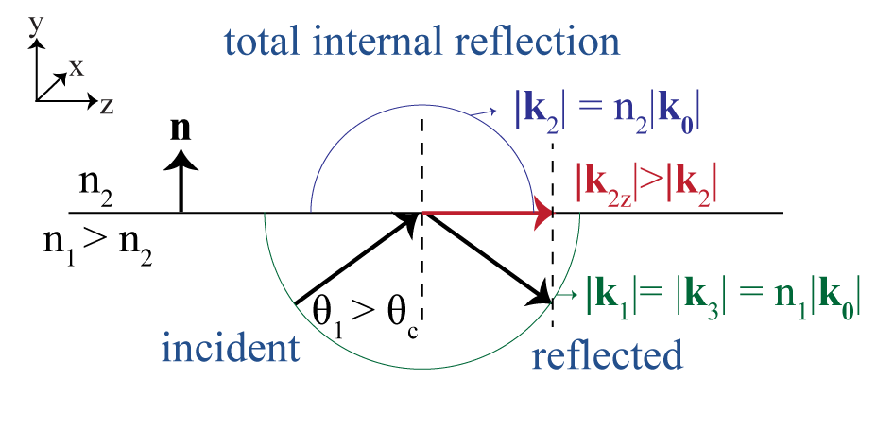


4.3.3. Total internal reflection at interface
$${\left|k_{2}\right|}^{2}={n_{2}}^{2}{k_{0}}^{2}=k_{2y}^{2}+k_{2z}^{2}=k_{2y}^{2}+k_{1z}^{2}=k_{2y}^{2}+{n_{1}}^{2}{k_{0}}^{2}{sinθ_{1}}^{2}$$
Since $θ_{1}>θ_{c}$, $sinθ_{1}>sinθ_{c}=\frac{n_{2}}{n_{1}}$
$k_{2y}^{2}+{n_{1}}^{2}{k_{0}}^{2}{sinθ_{1}}^{2}$> $k_{2y}^{2}+{n_{1}}^{2}{k_{0}}^{2}{sinθ_{c}}^{2}=k_{2y}^{2}+{n_{2}}^{2}{k_{0}}^{2}$
$$k_{2y}=i\left\lceil k_{2y}\right\rceil$$
We found that $k_{2y}$ is imaginary.
Total internal reflection is accompanied with a phase shift:

Slide 12
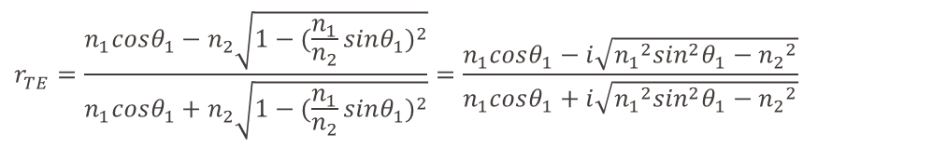

4.3.3. Total internal reflection at interface
$$r_{TE}^{}=\frac{n_{1}cosθ_{1}−n_{2}\sqrt{1−{(\frac{n_{1}}{n_{2}}sinθ_{1})}^{2}}}{n_{1}cosθ_{1}+n_{2}\sqrt{1−{(\frac{n_{1}}{n_{2}}sinθ_{1})}^{2}}}=\frac{n_{1}cosθ_{1}−i\sqrt{{n_{1}}^{2}\sin^{2}θ_{1}−{n_{2}}^{2}}}{n_{1}cosθ_{1}+i\sqrt{{n_{1}}^{2}\sin^{2}θ_{1}−{n_{2}}^{2}}}$$
(when $θ_{1}>θ_{c}$, $sinθ_{1}>sinθ_{c}=\frac{n_{2}}{n_{1}}$)
$$r_{TE}^{}=\left|r_{TE}\right|e^{−iφ_{r,TE}}$$
where $\left|r_{TE}\right|=1$, $φ_{r,TE}=2\arctan\left(\frac{\sqrt{{n_{1}}^{2}\sin^{2}θ_{1}−{n_{2}}^{2}}}{n_{1}cosθ_{1}}\right)=2\arctan\left(\sqrt{\frac{\cos^{2}θ_{c}}{\cos^{2}θ_{1}}−1}\right)$

Slide 13
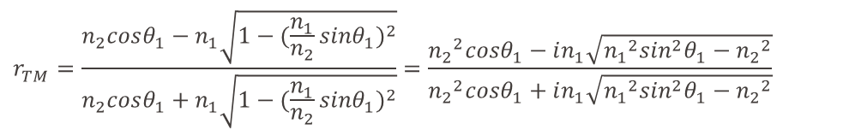

4.3.3. Total internal reflection at interface
$$r_{TM}^{}=\frac{n_{2}cosθ_{1}−n_{1}\sqrt{1−{(\frac{n_{1}}{n_{2}}sinθ_{1})}^{2}}}{n_{2}cosθ_{1}+n_{1}\sqrt{1−{(\frac{n_{1}}{n_{2}}sinθ_{1})}^{2}}}=\frac{{n_{2}}^{2}cosθ_{1}−in_{1}\sqrt{{n_{1}}^{2}\sin^{2}θ_{1}−{n_{2}}^{2}}}{{n_{2}}^{2}cosθ_{1}+in_{1}\sqrt{{n_{1}}^{2}\sin^{2}θ_{1}−{n_{2}}^{2}}}$$
(when $θ_{1}>θ_{c}$, $sinθ_{1}>sinθ_{c}=\frac{n_{2}}{n_{1}}$)
$$r_{TM}^{}=\left|r_{TM}\right|e^{−iφ_{r,TM}}$$
where $\left|r_{TM}\right|=1$, $φ_{r,TM}=2\arctan\left(\frac{n_{1}\sqrt{{n_{1}}^{2}\sin^{2}θ_{1}−{n_{2}}^{2}}}{{n_{2}}^{2}cosθ_{1}}\right)=2\arctan\left(\frac{1}{\sin^{2}θ_{c}}\sqrt{\frac{\cos^{2}θ_{c}}{\cos^{2}θ_{1}}}−1\right)$

Slide 14
Reflection magnitude and phase: a second look
TE modes
TM modes
If both both numerator and denominator are real
If $n_{1}cosθ_{1}>n_{2}cosθ_{2}$, then $r_{TE}^{}>0$, so $\arg\left(r\right)=0$
If $n_{1}cosθ_{1}<n_{2}cosθ_{2}$, then $r_{TE}^{}<0$, so $\arg\left(r\right)=π$
When $θ_{1}>θ_{c}$, denominator and numerator are complex, argument of $r_{TE}^{}$ becomes a function of $n_{1}$ $n_{2}$ and $θ_{1}$: important for waveguide design!

Slide 15
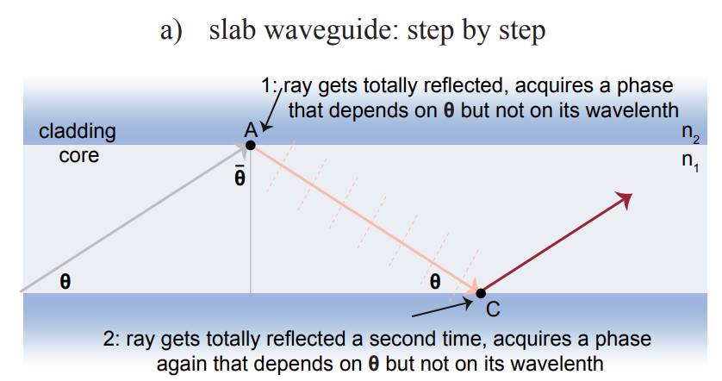
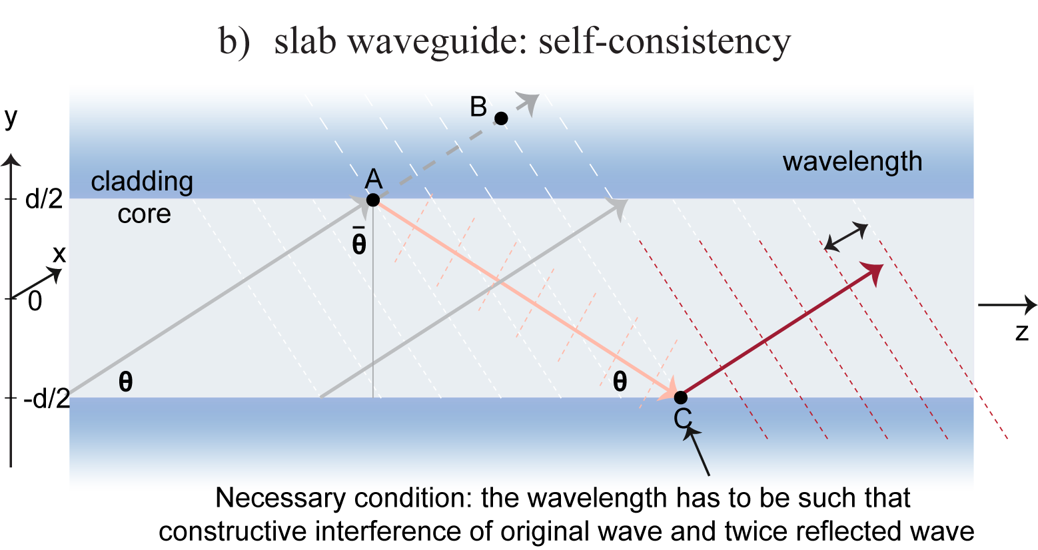
Chapter 5: Optical waveguides
Total internal reflection on both side: Slab waveguide!
Self-consistency condition: the wave that reflects twice on two boundaries needs to be in-phase with the original wave!

Slide 16


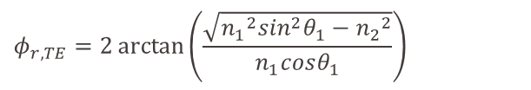



Chapter 5: Optical waveguides
Decompose the wavevector inside the core:
$$y$$
$$k_{1}= n_{1}k_{0}cosθe_{z}+n_{1}k_{0}sinθe_{y}$$
$$θ$$
$$z$$
Transverse component:
$$k_{y}= n_{1}sinθk_{0}$$
Phase accumulated on one round trip between the two core–cladding interfaces:
Propagation phase:
$$Δφ_{prop}=k_{y}∙2d=2n_{1}k_{0}dsinθ$$
$$φ_{r,TE}=2\arctan\left(\frac{\sqrt{{n_{1}}^{2}\sin^{2}θ_{1}−{n_{2}}^{2}}}{n_{1}cosθ_{1}}\right)$$
Reflection phase:
Total phase must equal an integer multiple of $2π$
$$2n_{1}k_{0}dsinθ−2φ_{r,TE}=2πm$$

Slide 17
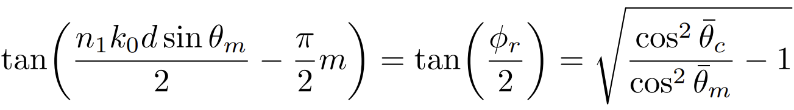
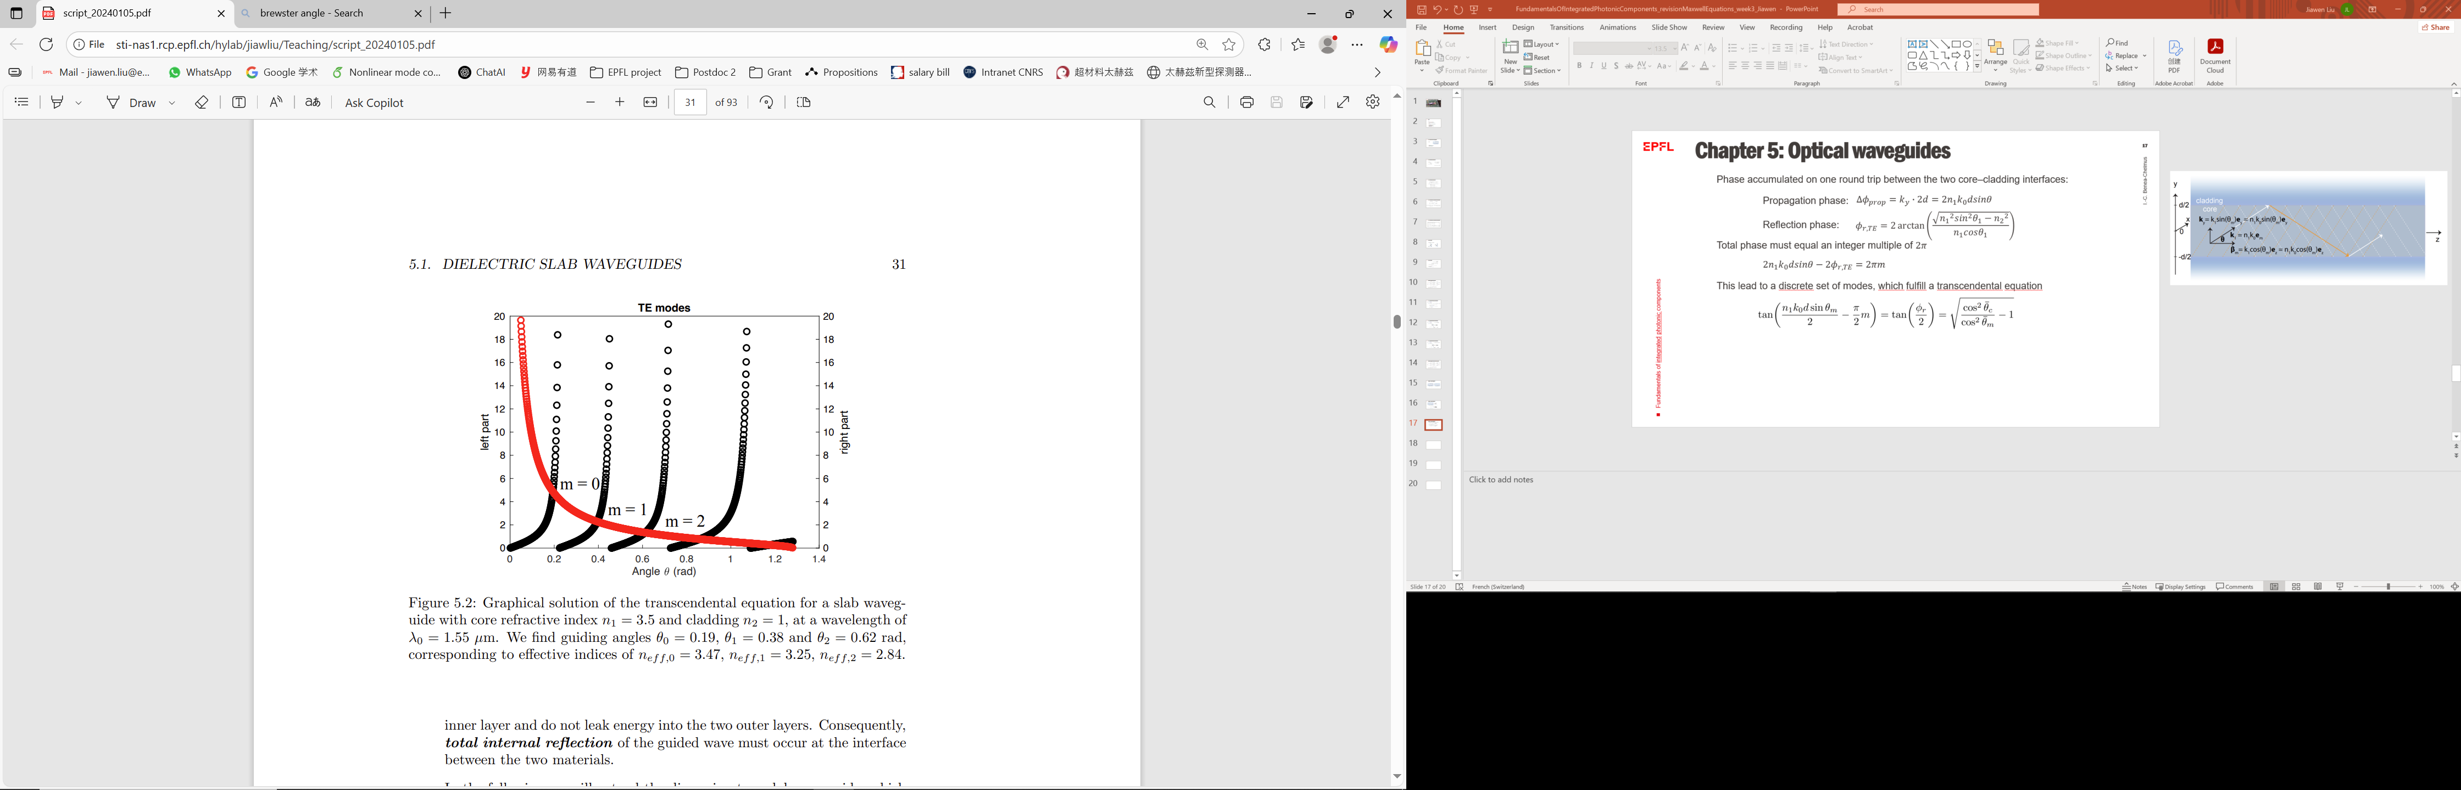
Chapter 5: Optical waveguides
Total phase must equal an integer multiple of $2π$
$$2n_{1}k_{0}dsinθ−2φ_{r,TE}=2πm$$
This lead to a discrete set of modes, which fulfill a transcendental equation

Slide 18
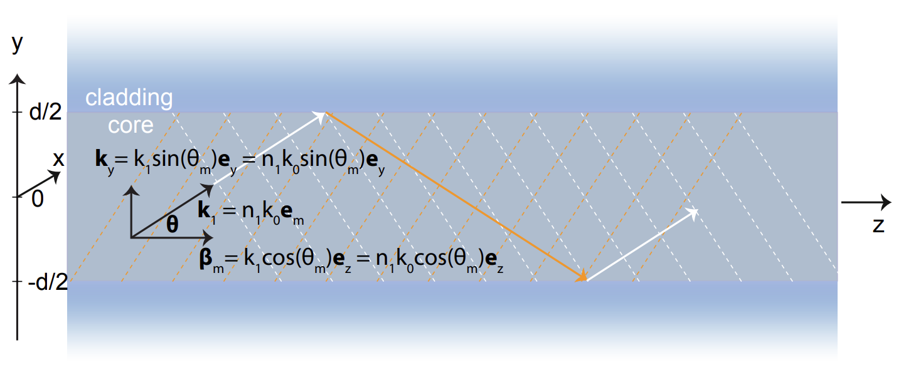
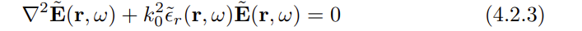

Chapter 5: Optical waveguides
Knowing the angle of the modes, we can define propagation constant $β_{m}=n_{1}k_{0}cosθ_{m}$
Then we solve the Helmholtz equation for the e field distribution inside the slab waveguide.
We make an Ansatz of separation of variables:

Slide 19
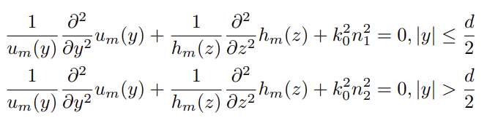
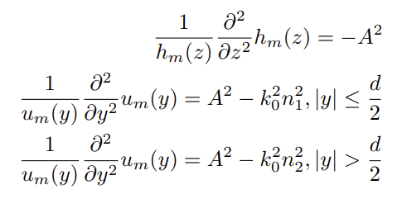
Chapter 5: Optical waveguides
The following equations must be satisfied simultaneously:
We assume:
We can find that $A=β_{m}$, and $h_{m}\left(z\right)=e^{iβ_{m}z}$ (with $β_{m}=n_{1}k_{0}cosθ_{m}$):

Slide 20
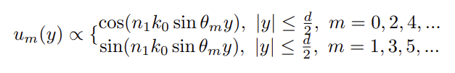



Chapter 5: Optical waveguides
Within the waveguide region ($\left|y\right|≤\frac{d}{2}$ ), the equation becomes
$$\frac{∂^{2}u_{m}\left(y\right)}{{∂y}^{2}}+(k_{0}^{2}n_{1}^{2}−k_{0}^{2}n_{1}^{2}\cos^{2}θ_{m})u_{m}\left(y\right)=0$$
$$k_{y}^{2}=k_{0}^{2}n_{1}^{2}\sin^{2}θ_{m}$$
General solution to this equation is a linear combination of exponentials :
$$u_{m}\left(y\right)=C_{1}e^{ik_{y}y}+C_{2}e^{−ik_{y}y}$$
Or can be written as a linear combination of $\cos\left(k_{y}y\right)$ and $sin(k_{y}y)$
$$u_{m}\left(y\right)=C_{1}′\cos\left(k_{y}y\right)+C_{2}′sin(k_{y}y)$$
The slab waveguide is symmetric about $y=0$, so the physical field $u_{m}\left(y\right)$ must be either even or odd:

Slide 21
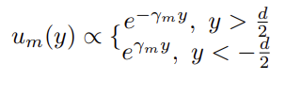

Chapter 5: Optical waveguides
Outside the waveguide region ($\left|y\right|>\frac{d}{2}$ ), we define $γ_{m}^{2}=β_{m}^{2}−k_{0}^{2}n_{2}^{2}$. the equation is
$$\frac{∂^{2}u_{m}\left(y\right)}{{∂y}^{2}}−γ_{m}^{2}u_{m}\left(y\right)=0$$
General solution:
$$u_{m}\left(y\right)=C_{1}e^{γ_{m}y}+C_{2}e^{−γ_{m}y}$$
For $y<−\frac{d}{2}$, the field must decay as $y→−∞$, so only the exponentially growing term is physical
$$u_{m}\left(y\right)=C_{1}e^{γ_{m}y}$$
For $y>\frac{d}{2}$, the field must decay as $y→+∞$, so only the exponentially decaying term is physical
$$u_{m}\left(y\right)=C_{2}e^{−γ_{m}y}$$
So the general solution is

Slide 22
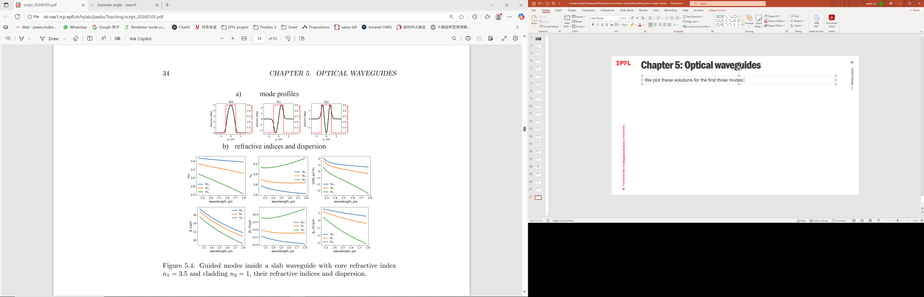
Chapter 5: Optical waveguides
We plot these solutions for the first three modes:
From the propagating term along z axis $h_{m}\left(z\right)=e^{iβ_{m}z}$ (with $β_{m}=n_{1}k_{0}cosθ_{m}$), we can get the so-called effective refractive index:
$$β_{m}(ω)=n_{eff,m}(ω)k_{0}$$
Guided modes inside a slab waveguide with core refractive index n1 = 3.5 and cladding n2 = 1

