Slide 1
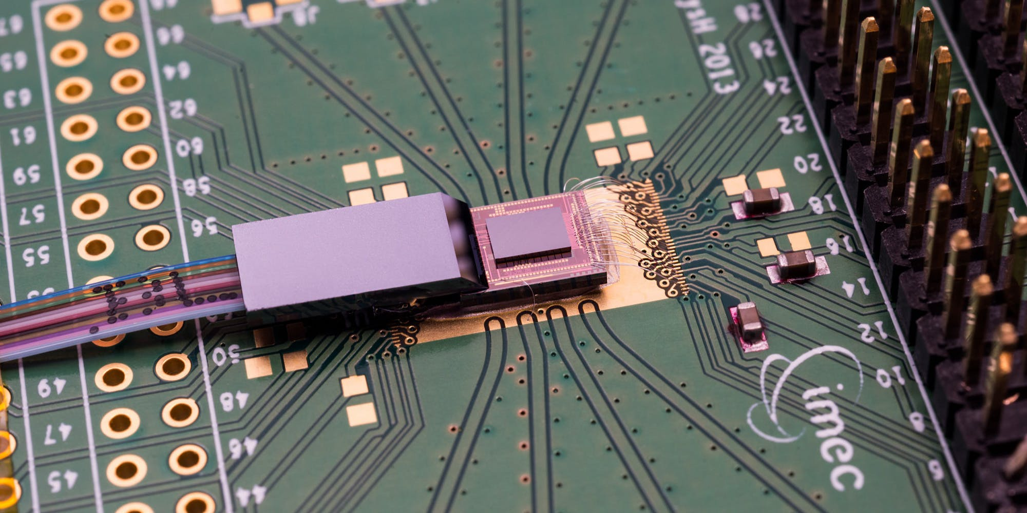
Introduction to photonic integrated circuits
https://www.imec-int.com/en/integrated-photonics

Slide 2
Today
Orga:
  Script online! All derivations there
  Assignments published Wednesdays 5 pm
Last week:
  Introduction and motivation of photonic chips
Today: Foundations
  Revision Maxwell equations
  Reflection at a dielectric boundary
  Start slab waveguide

Slide 3
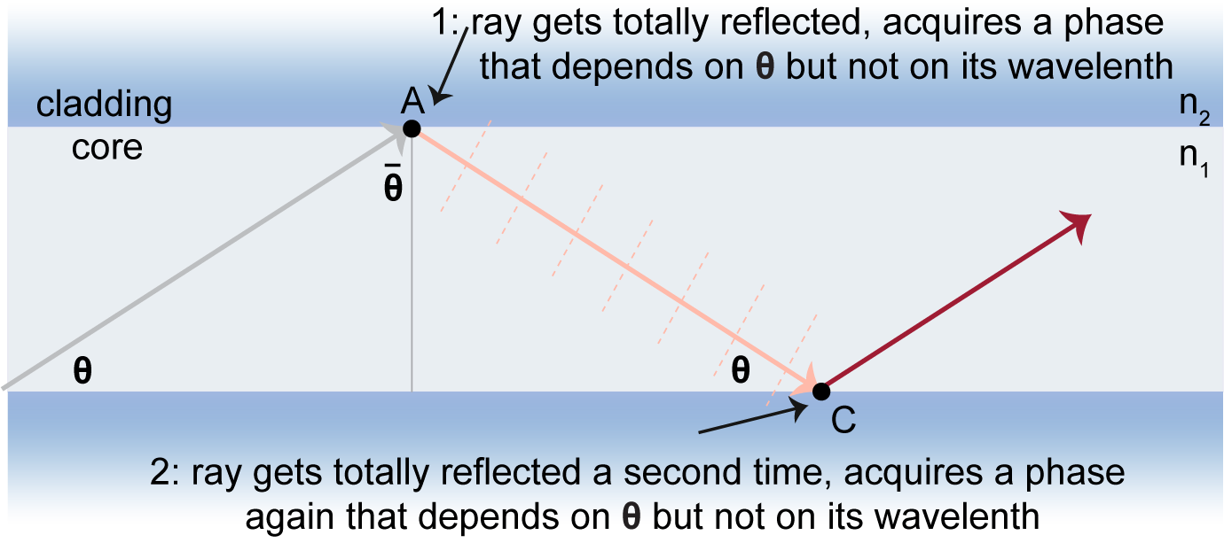
4.1. Introduction to wave propagation
Motivation
Need to know:
  Propagation of light in a medium
  What happens at interfaces

Slide 4
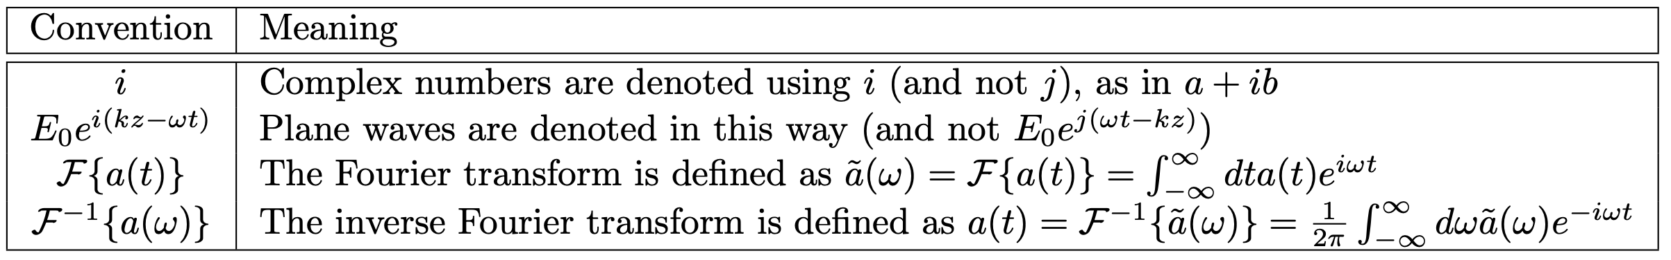
4.1. Conventions

Slide 5
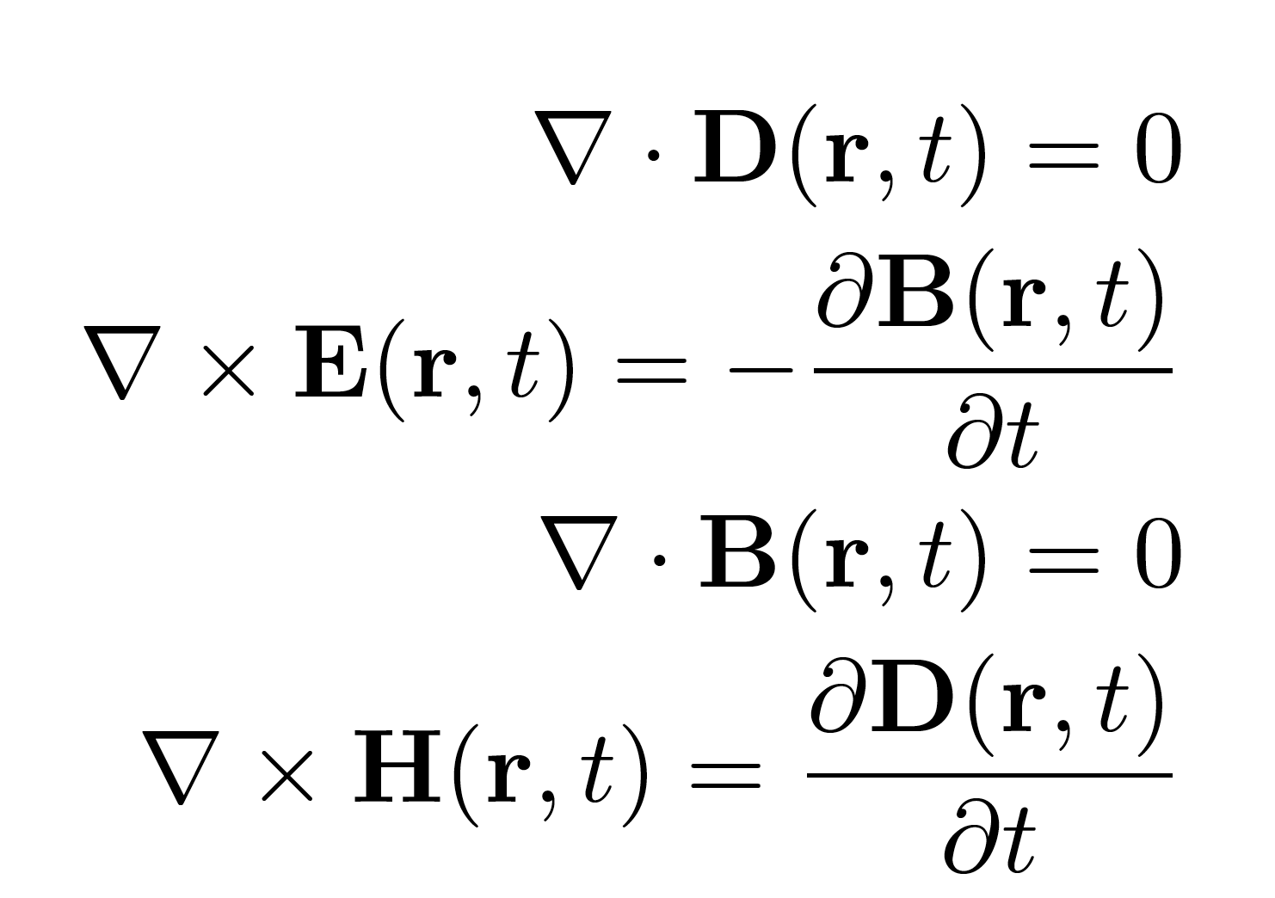
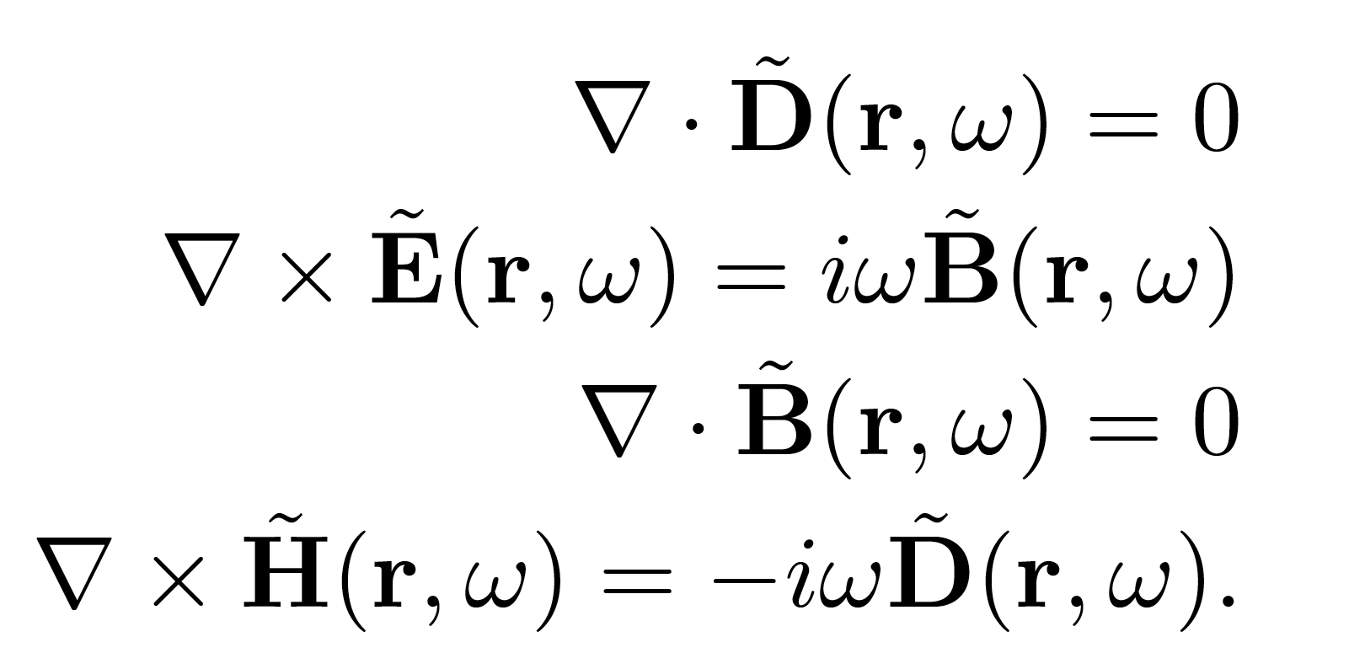

4.1. Revision Maxwell equations
This lecture: absence of free carriers ($ρ=0$) and currents ($J=0$):
With $r=\left(x,y,z\right)$ and using $ℑ\left\{\frac{∂}{∂t}f\left(t\right)\right\}=−iωℑ\left\{f\left(t\right)\right\}=−iω\tilde{F}(ω)$
Time domain (local)
Frequency domain

Slide 6
4.1. Dispersive media
(blackboard derivation)

Slide 7
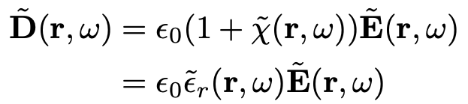

4.2. Plane waves in linear media
Starting from
+
+

Slide 8
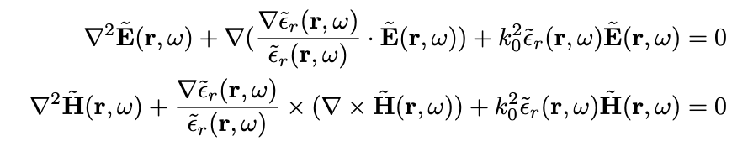
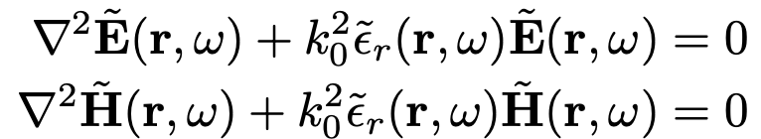

4.2. Plane waves in linear media
In weakly inhomogenous media, the dielectric function does not change significantly over length scales similar to an optical wavelength
Generalising we can write the famous Helmholtz equation

Slide 9
4.2. Plane waves in linear media
(discuss solutions at the blackboard)

Slide 10
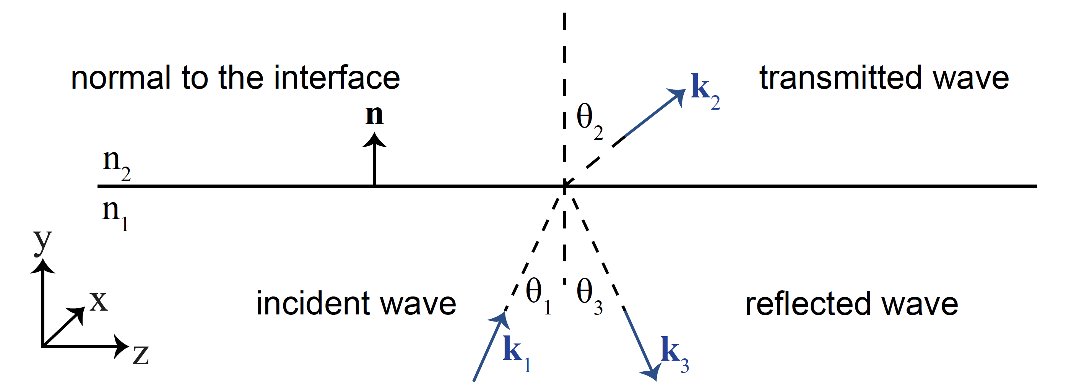
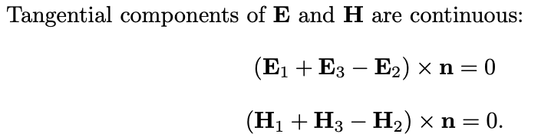
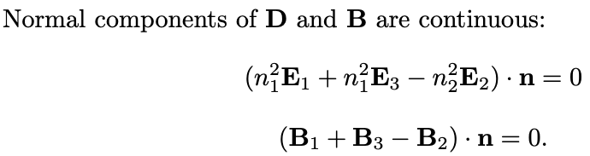
4.2. Laws of refraction and reflection at an interface

Slide 11
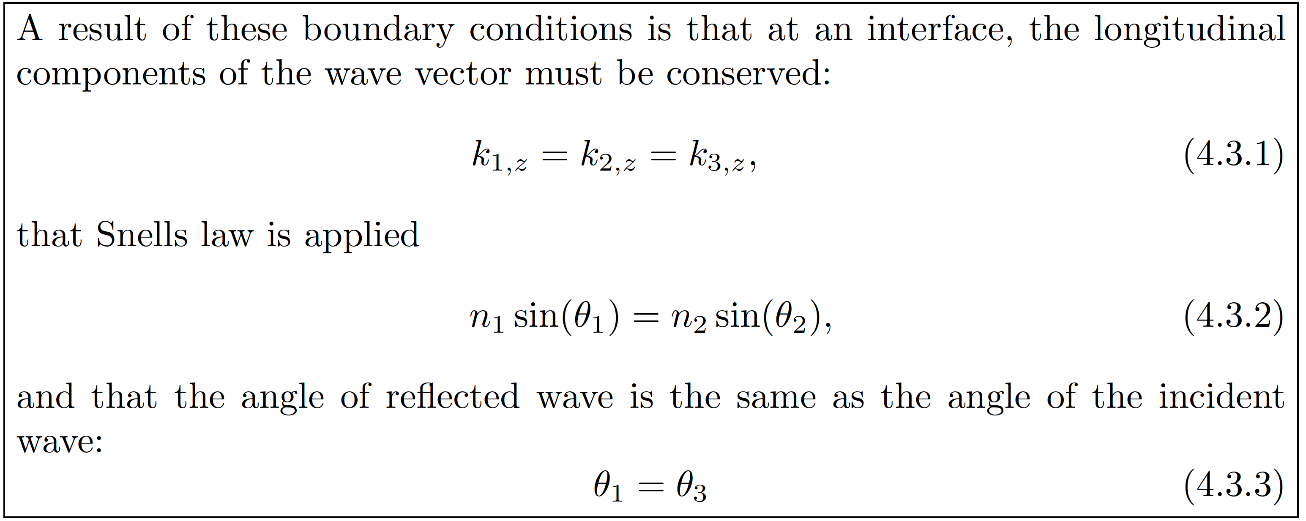
4.2. Laws of refraction and reflection at an interface
Math in the script….

Slide 12
TE and TM modes
Draw at blackboard (2 mins thinking)

Slide 13
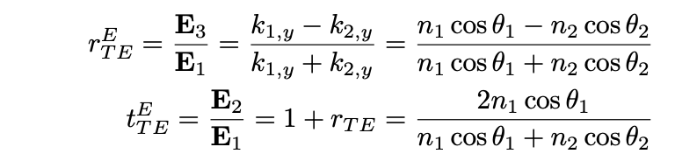
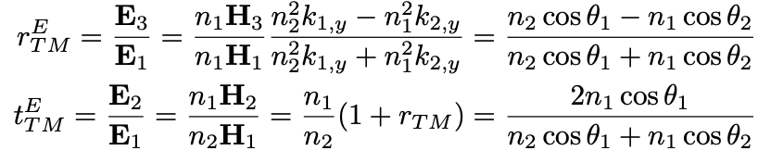
TE and TM modes
Math in exercise 1…
Total internal reflection?

Slide 14
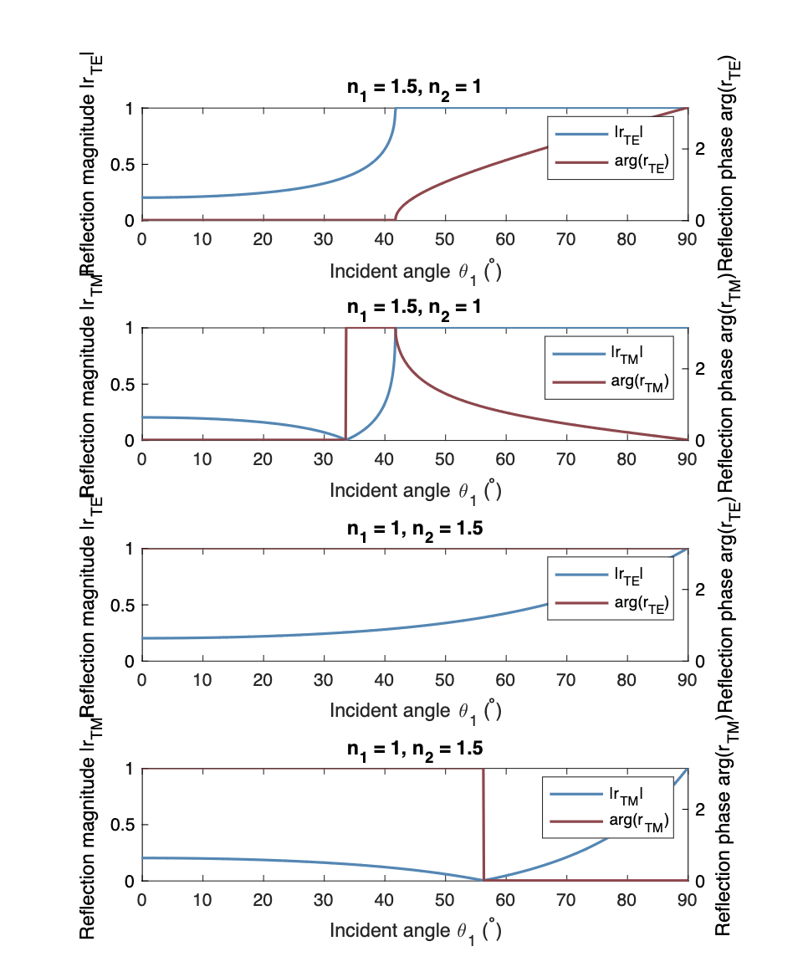
Reflection magnitude and phase
TE modes
TM modes

Slide 15
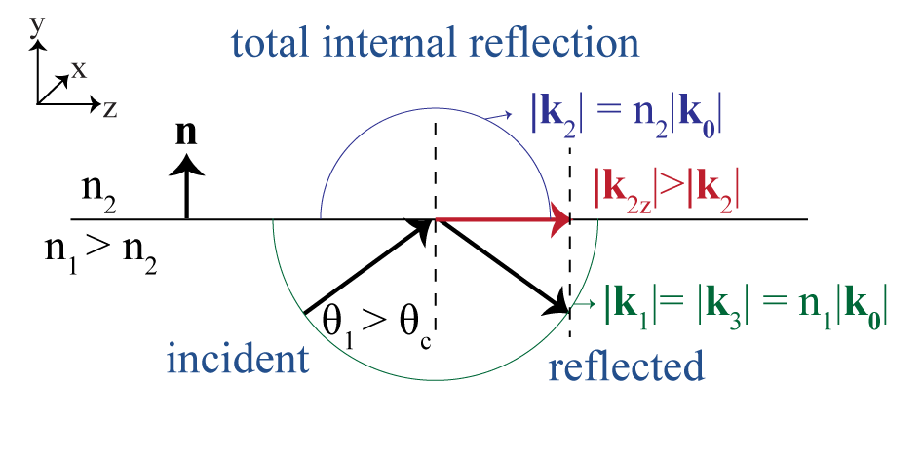
4.3.3. Total internal reflection at interface
Additional phase upon reflection for incidence at angles $θ_{1}>θ_{c}$

Slide 16
4.3.3. Total internal reflection at interface
(blackboard discussion)

Slide 17
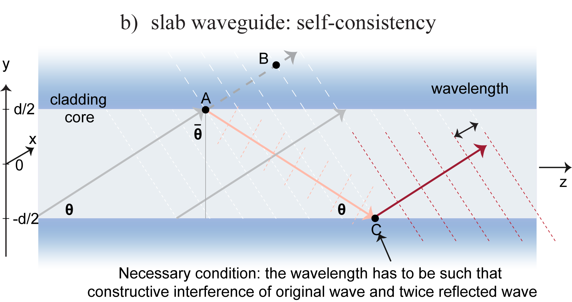
Ch 5: Optical waveguides
Slab waveguide

